Slide 1
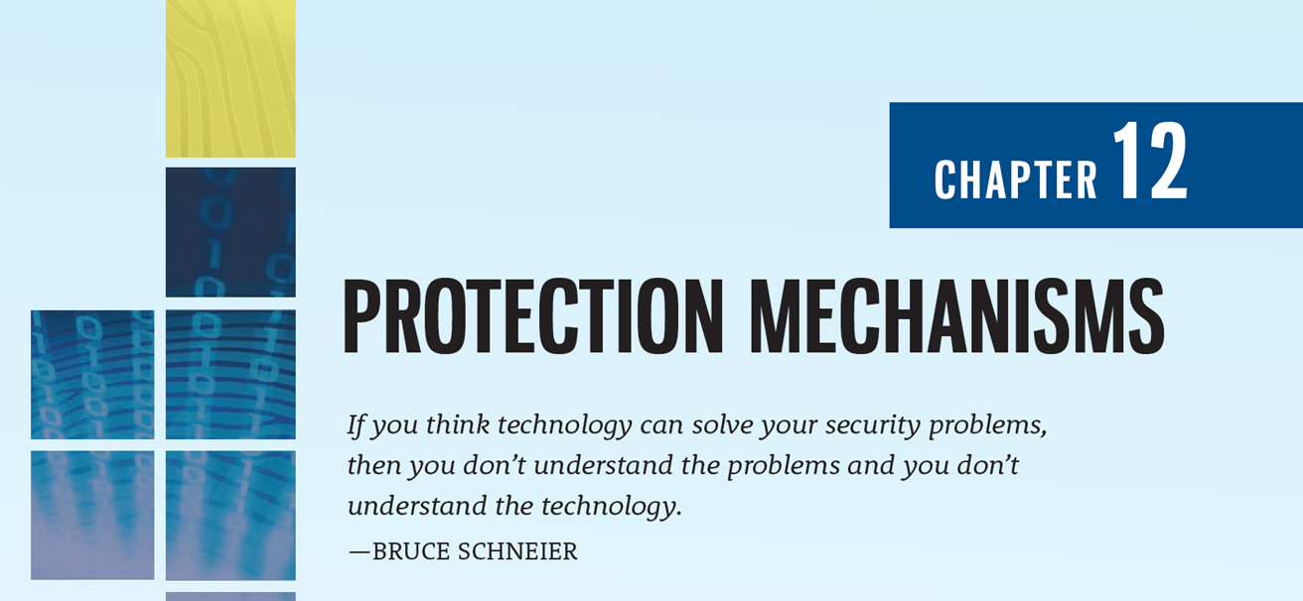

Slide 2
Learning Objectives
Upon completion of this chapter, you should be able to:
Describe the various access control approaches, including authentication, authorization, and biometric access controls
List and discuss the various types of firewalls and the common approaches to firewall implementation
Define and describe the types of intrusion detection and prevention systems and the strategies on which they are based
Explain the unique challenges associated with physical security and discuss how physical security can supersede computer security
Explain cryptography and the encryption process, and compare and contrast symmetric and asymmetric encryption
Notes:
process, and compare and contrast symmetric and asymmetric encryption

Slide 3
Introduction to Protection Mechanisms
Chapter 12: Protection Mechanisms

Slide 4
Introduction to Protection Mechanisms
Technical controls alone cannot secure an IT environment, but they are an essential part of the InfoSec program
Technical controls can enable policy enforcement where human behavior is difficult to regulate
Because individuals inside an organization often have direct access to the information, they can circumvent many of the most potent technical controls

Slide 5
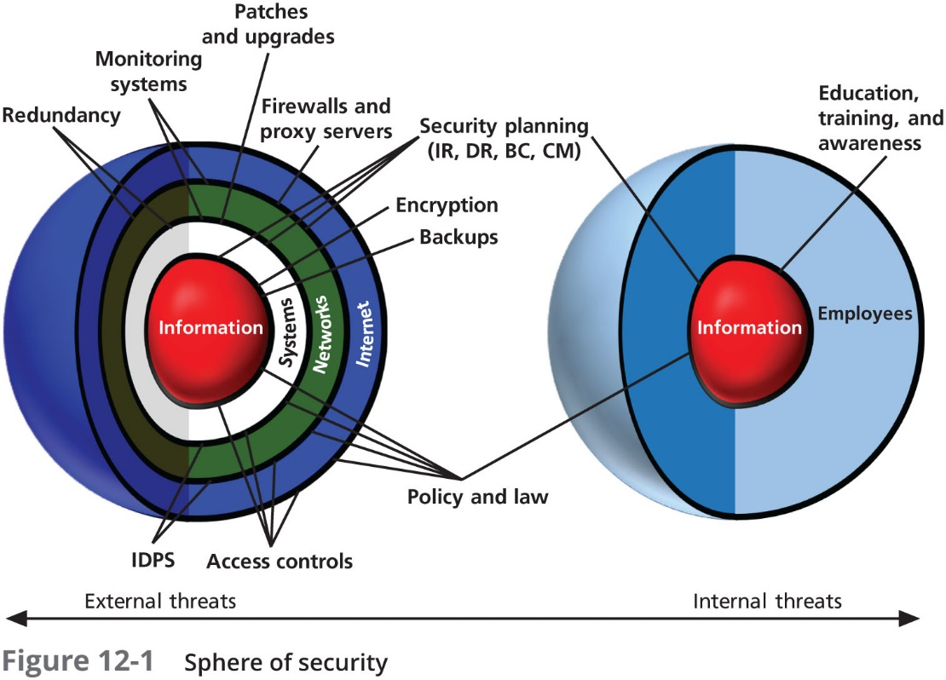

Slide 6
Access Controls and Biometrics
Access controls regulate the admission of users into trusted areas of the organization—both logical access to information systems and physical access to the organization’s facilities
Access control encompasses four processes:
Identification
Authentication
Authorization
Accountability
A successful access control approach always incorporates all four of these elements (IAAA)

Slide 7
Authentication
There are three types of authentication mechanisms:
Something a person knows
Something a person has
Something a person can produce
These characteristics can be assessed through the use of biometrics, which can then validate who the person claims to be

Slide 8
Something a Person Knows
This authentication mechanism verifies the user’s identity by means of a password, passphrase, or other unique code, such as a PIN
The current industry best practice is for all passwords to have a minimum length of 10 characters and contain at least one uppercase letter, one lowercase letter, one number, and one system-acceptable special character, which of course requires systems to be case-sensitive
The passphrase and corresponding virtual password are an improvement over the standard password, as they are based on an easily memorable phrase

Slide 9
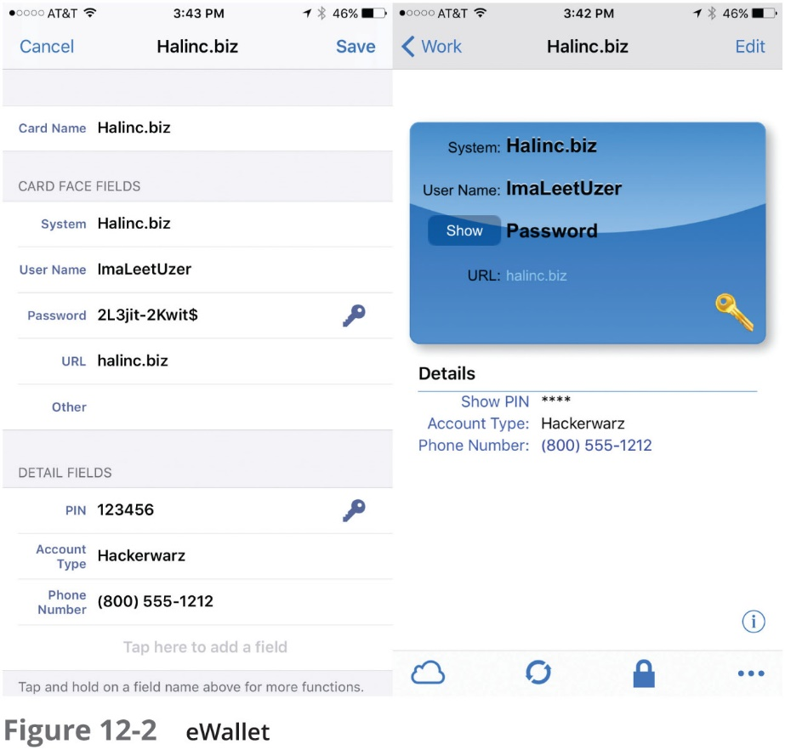

Slide 10
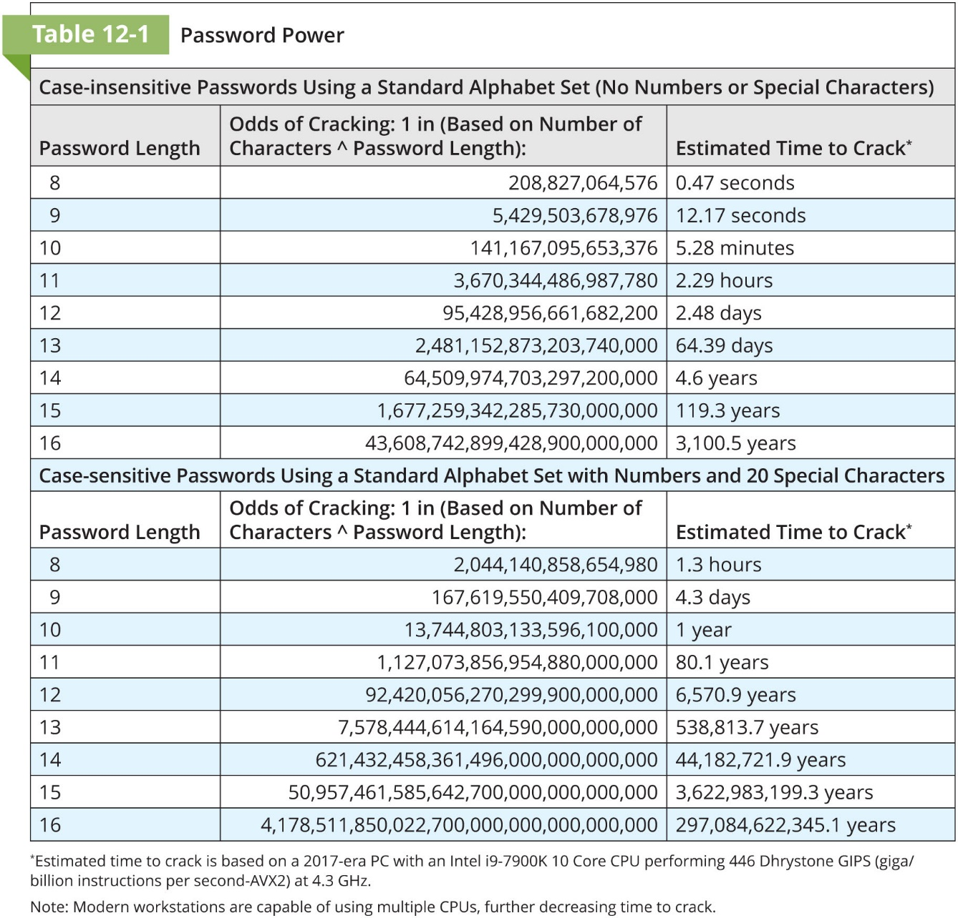

Slide 11
Something a Person Has
This authentication mechanism makes use of something that the user or the system possesses
Dumb card with magnetic strips
Smart card with embedded computer chip
Cryptographic token with a processor in a card that has a display
Tokens may be either synchronous or asynchronous
The rise of smartphones has led to the increasing use of communication of authentication code using out-of-band transmission
This is often combined with something a person knows to create a multifactor authentication

Slide 12
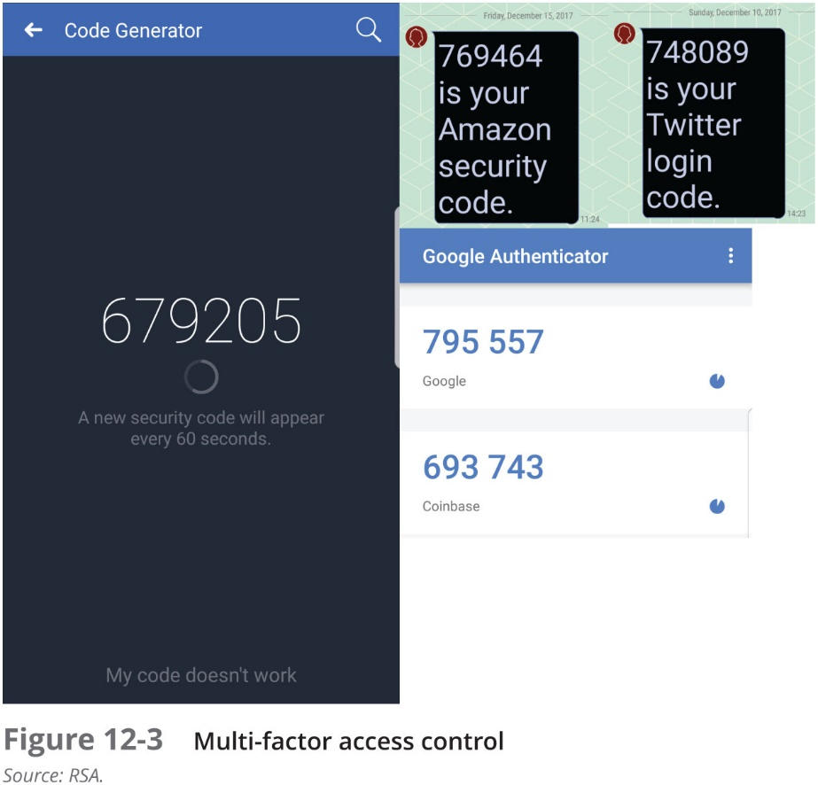

Slide 13
Something a Person Can Produce
This authentication mechanism takes advantage of something inherent about the user that is evaluated using biometrics
Fingerprint
Palm print
Hand geometry
Facial recognition—photographic ID card
Facial recognition—digital camera
Retinal print
Iris pattern
Most of the technologies that scan human characteristics convert these images to obtain some form of minutiae

Slide 14
Something a Person Can Produce (Continued)
Among all possible biometrics, only three human characteristics are usually considered truly unique:
Fingerprints
Retina of the eye
Iris of the eye
DNA or genetic authentication will be included in this category if it ever becomes a cost-effective and socially accepted technology
For items a person can produce, signature recognition is commonplace

Slide 15
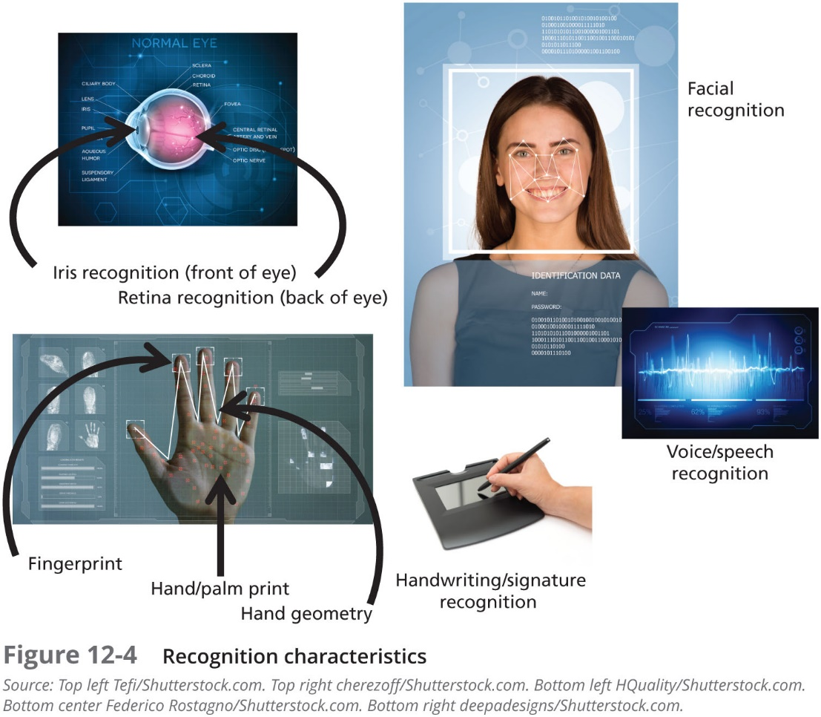

Slide 16
Evaluating Biometrics
Biometric technologies are generally evaluated according to three basic criteria:
The false reject rate or Type I Error
The false accept rate or Type II Error
The crossover error rate (CER)
A balance must be struck between the acceptability of a system to its users and the effectiveness of the same system
Many of the reliable, effective biometric systems are perceived as being somewhat intrusive by users

Slide 17
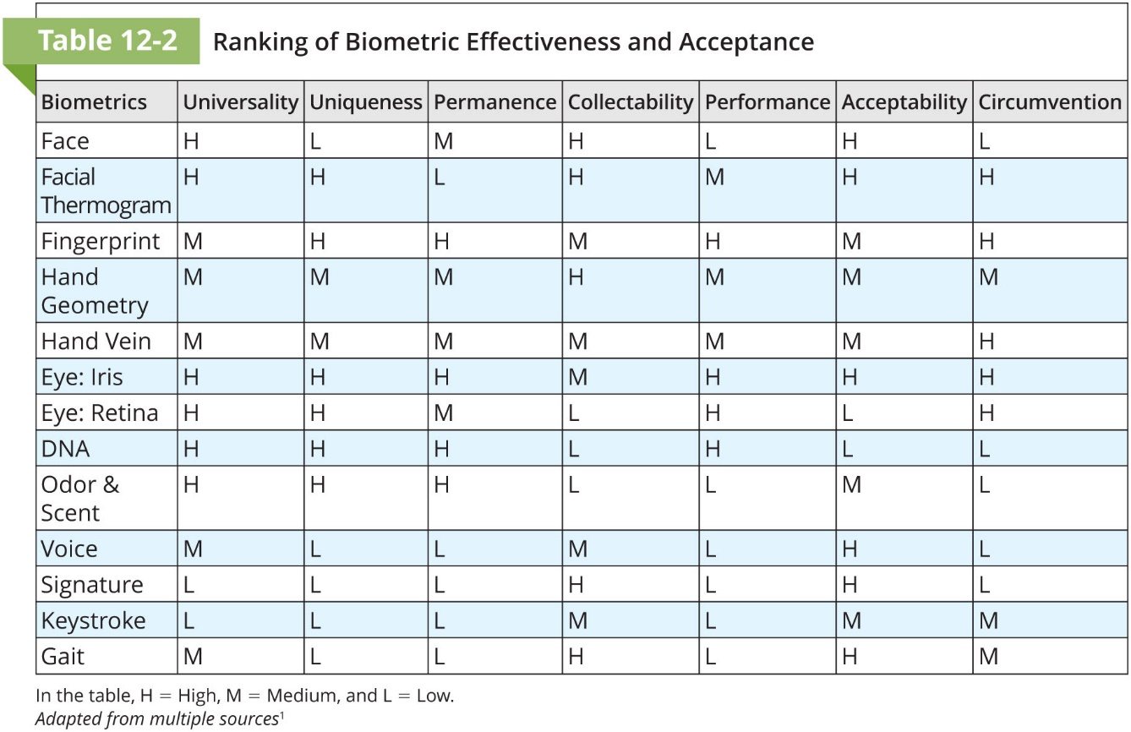

Slide 18
Managing Network Security
Chapter 12: Protection Mechanisms

Slide 19
Firewalls
In InfoSec, a firewall is any device that prevents a specific type of information from moving between the outside world, known as the untrusted network (e.g., the Internet), and the inside world, known as the trusted network
The firewall may be a separate computer system, a service running on an existing router or server, or a separate network containing a number of supporting devices

Slide 20
Categories of Firewalls
While most firewalls are an amalgamation of various options, services, and capabilities, most are associated with one of the basic categories or types of firewalls
The most common types of firewalls are:
Packet filtering firewalls
Application layer proxy firewalls
Stateful packet inspection firewalls
Unified Threat Management (UTM) devices

Slide 21
Packet Filtering Firewalls
Packet filtering firewalls are simple networking devices that filter packets by examining every incoming and outgoing packet header
They can selectively filter packets based on values in the packet header, accepting or rejecting packets as needed
These devices can be configured to filter based on IP address, type of packet, port request, and/or other elements present in the packet

Slide 22
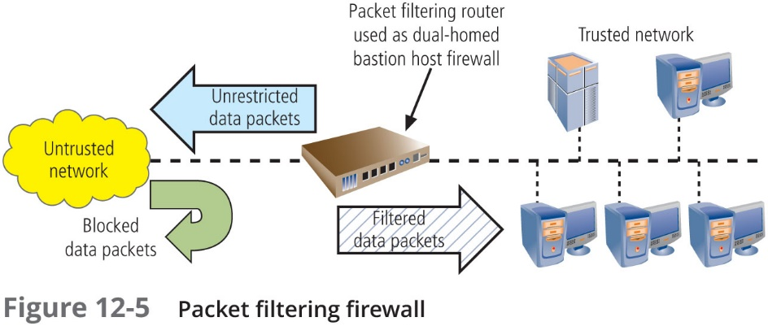

Slide 23
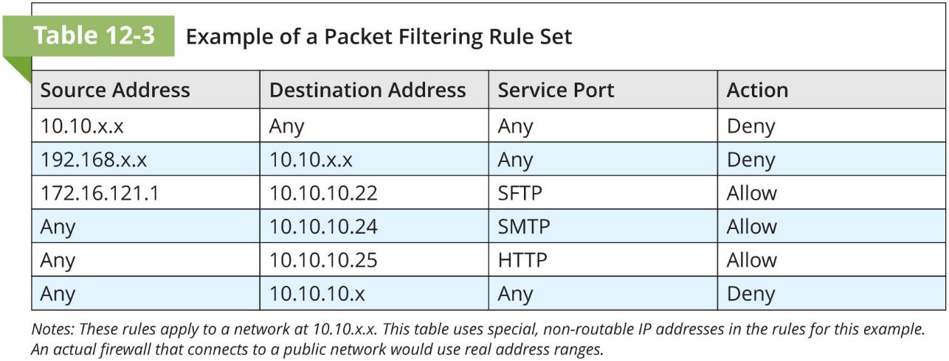

Slide 24
Application Layer Proxy Firewall
In the strictest sense, an application layer firewall (or application-level firewall) works like a packet filtering firewall, but at the application layer
A proxy server works as an intermediary between the requestor of information and the server that provides it, adding a layer of separation and thus security
If such a server stores the most recently accessed information in its internal cache to provide content to others accessing the same information, it may also be called a cache server
A proxy firewall, on the other hand, provides both proxy and firewall services

Slide 25
Application Layer Proxy Firewall (Continued)
When the firewall rather than an internal server is exposed to the outside world from within a network segment, it is considered deployed within a demilitarized zone (DMZ)
Using this model, additional filtering devices are placed between the proxy server and internal systems, thereby restricting access to internal systems to the proxy server alone

Slide 26
Stateful Packet Inspection Firewalls
Stateful packet inspection (SPI) firewalls keep track of each network connection established between internal and external systems using a state table, which tracks the state and context of each packet exchanged by recording which station sent which packet and when
A SPI firewall can restrict incoming packets by allowing access only to packets that constitute responses to internal requests
If the SPI firewall receives an incoming packet that it cannot match to its state table, then it defaults to traditional packet filtering against its rule base, and if the packet is allowed, it updates its state table

Slide 27
Unified Threat Management Devices
Unified Threat Management (UTM) devices are categorized by their ability to perform the work of a SPI firewall, network intrusion detection and prevention system, content filter, and spam filter as well as a malware scanner and filter
With the proper configuration, these devices are even able to “drill down” into the protocol layers and examine application-specific data, encrypted, compressed, and/or encoded data—commonly referred to as deep packet inspection (DPI)

Slide 28
Next-Generation (NextGen) Firewalls
Similar to UTM devices, next-generation firewalls (NextGen or NGFW) combine traditional firewall functions with other network security functions such as deep packet inspection, IDPSs, and the ability to decrypt encrypted traffic
The functions are so similar to those of UTM devices that the difference may lie only in the vendor’s description
According to Kevin Beaver of Principle Logic, LLC, the difference may only be one of scope. “Unified threat management (UTM) systems do a good job at a lot of things, while next-generation firewalls (NGFWs) do an excellent job at just a handful of things”

Slide 29
Firewall Implementation Architectures
Each of the firewall generations can be implemented in a number of architectural configurations
Three architectural implementations of firewalls are especially common:
Single Bastion Host Architecture
Screened-host firewalls
Screened-subnet firewalls

Slide 30
Single Bastion Host Architecture
Most organizations with an Internet connection use some form of device between their internal networks and the external service provider
In the single bastion host architecture, a single device configured to filter packets serves as the sole security point between the two networks and unfortunately represents a rich target for external attacks
The bastion host is usually implemented as a dual-homed host, as it contains two network interfaces: one that is connected to the external network and one that is connected to the internal network

Slide 31
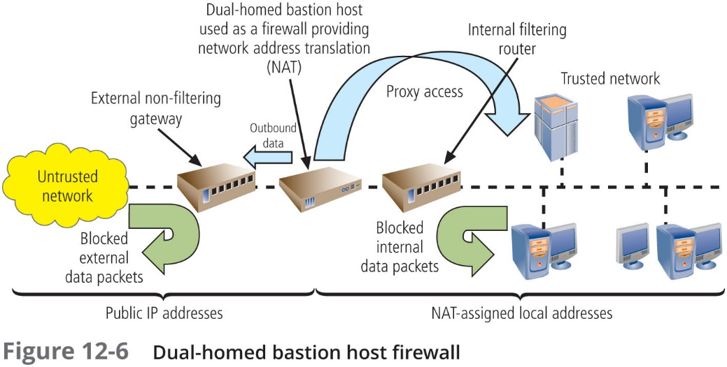

Slide 32
Single Bastion Host Architecture (Continued)
A technology known as network-address translation (NAT) is often implemented with this architecture
NAT is a method of converting multiple real, routable external IP addresses to special ranges of internal IP addresses, usually on a one-to-one basis
A related approach, called port-address translation (PAT), converts a single real, valid, external IP address to special ranges of internal IP address, adding a unique port number to the single external address when traffic leaves the private network and is placed on the public network

Slide 33
Single Bastion Host Architecture (Continued)
NAT and PAT use special, nonroutable addresses and consist of three different ranges:
Organizations that need very large numbers of local addresses can use the 10.x.x.x range, which has more than 16.5 million usable addresses
Organizations that need a moderate number of addresses can use the 192.168.x.x range, which has more than 65,500 addresses
Organizations with smaller needs can use the 172.16.0.0–172.16.15.0 range, which has approximately 4000 usable addresses

Slide 34
Screened-Host Architecture
Screened-host firewall systems combine the packet filtering router with a separate, dedicated firewall such as an application proxy server or proxy firewall
This approach allows the router to screen packets to minimize the network traffic and load on the internal proxy, while the proxy examines an application layer protocol, such as HTTP, and performs the proxy services

Slide 35
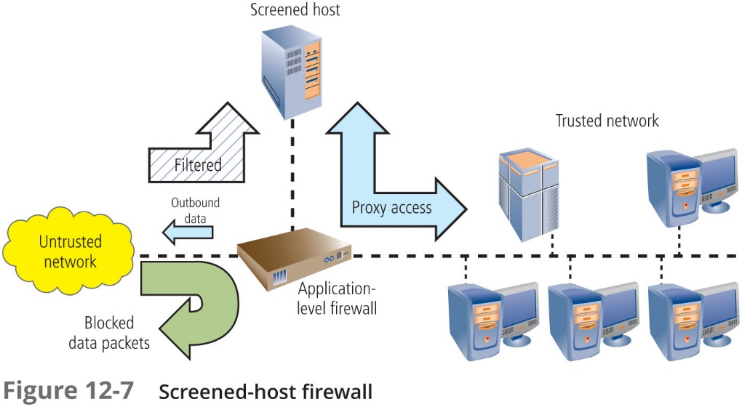

Slide 36
Screened-Subnet Architecture
The screened-subnet architecture consists of a special network segment with one or more internal hosts located behind a packet filtering router each host performs a role in protecting the trusted network
Functionally, the difference between the screened-host architecture and the screened-subnet architecture is the addition of packet filtering behind the bastion host or hosts, which provides more security and restricts access to internal hosts only to traffic approved in the interior firewall device’s rule set

Slide 37
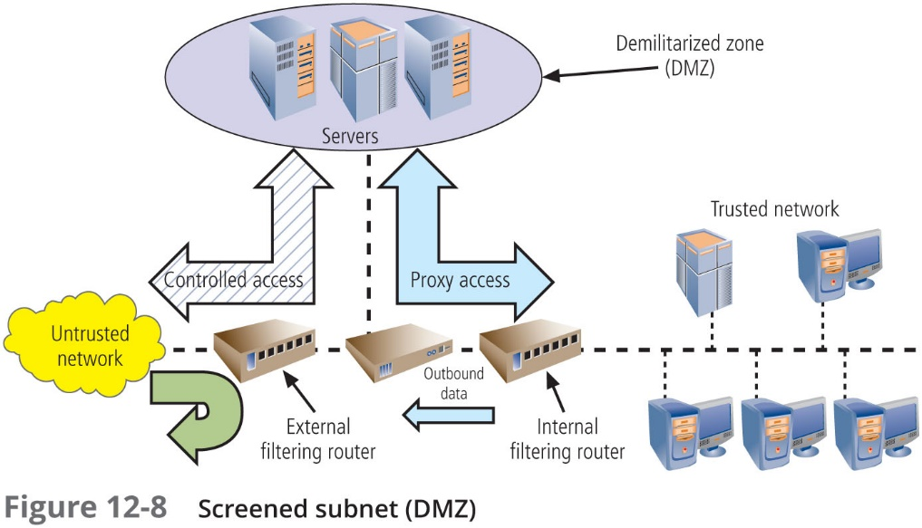

Slide 38
Screened-Subnet Architecture (Continued)
The first general model uses two filtering routers, with one or more dual-homed bastion hosts between them
The second general model shows connections are routed as follows:
Connections from the outside or untrusted network are routed through an external filtering router
Connections from the outside or untrusted network are routed into—and then out of—a routing firewall to the separate network segment known as the DMZ
Connections into the trusted internal network are allowed only from the DMZ bastion host servers

Slide 39
Selecting the Right Firewall
When evaluating a firewall, ask the following questions:
What type of firewall technology offers the right balance between protection and cost for the needs of the organization?
What features are included in the base price? What features are available at extra cost? Are all cost factors known?
How easy is it to set up and configure the firewall? How accessible are the staff technicians who can competently configure the firewall?
Can the candidate firewall adapt to the growing network in the target organization?

Slide 40
Content Filters
Another type of tool that effectively protects the organization’s systems from misuse and unintentional DoS conditions across networks is the content filter
Although technically not a firewall, a content filter (or Internet filter) allows administrators to restrict content that comes into a network
The most common application of a content filter is the restriction of access to Web sites with material that is not business-related
Content filters ensure that employees are not using network resources inappropriately

Slide 41
Managing Firewalls
Any firewall device—whether a packet filtering router, bastion host, or other firewall implementation—must have its own configuration rules that regulate its actions
A policy regarding the use of a firewall should be articulated before it is made operable
In practice, configuring firewall rule sets can be something of a nightmare; each firewall rule must be carefully crafted, placed into the list in the proper sequence, debugged, and tested

Slide 42
Managing Firewalls (Continued)
Firewalls are limited by the constraints of their programming and rule sets in the following ways:
Firewalls are not creative and cannot make sense of human actions outside the range of their programmed responses
Firewalls deal strictly with defined patterns of measured observation, which are known to possible attackers and can be used in an attack
Firewalls are computers and thus prone to programming errors, flaws in rule sets, and inherent vulnerabilities
Firewalls are designed to function within limits of hardware capacity and thus can only respond to patterns of events that happen in an expected and reasonably simultaneous sequence
Firewalls are designed, implemented, configured, and operated by people and are subject to human error

Slide 43
Managing Firewalls (Continued)
There are also a number of administrative challenges to the operation of firewalls:
1. Training—Most managers think of a firewall as just another device, more or less similar to the computers already humming in the rack
2. Uniqueness—Each brand of firewall is different, and the new e-commerce project just brought you a new firewall running on a different OS
3. Responsibility—Since you are the firewall guy, suddenly everyone assumes that anything to do with computer security is your responsibility
4. Administration—Being a firewall administrator for a medium or large organization should be a full-time job; however, that’s hardly ever the case

Slide 44
Managing Firewalls (Continued)
Some of the best practices for firewall use are:
All traffic from the trusted network is allowed out
The firewall device is never accessible directly from the public network
Simple Mail Transport Protocol (SMTP) data is allowed to pass through the firewall, but should be routed to a well-configured SMTP gateway (proxy server)
All Internet Control Message Protocol (ICMP) data should be denied
Telnet/terminal emulation access to all internal servers from the public networks should be blocked
When Web services are offered outside the firewall, HTTP traffic should be handled by some form of proxy access or DMZ architecture

Slide 45
Intrusion Detection and Prevention Systems
Chapter 12: Protection Mechanisms

Slide 46
Intrusion Detection and Prevention Systems
IDPSs work like burglar alarms and combine tried-and-true detection methods from intrusion detection systems (IDSs) with the capability to react to changes in the environment, which is available in intrusion prevention technology
As most modern technology in this category has the capability both to detect and prevent, the term IDPS is generally used to describe the devices or applications

Slide 47
Intrusion Detection and Prevention Systems (Continued)
Systems that include IPS technology attempt to prevent the attack from succeeding by:
Stopping the attack by terminating the network connection or the attacker’s user session
Changing the security environment by reconfiguring network devices (firewalls, routers, and switches) to block access to the targeted system
Changing the attack’s content to make it benign—for example, by removing an infected file attachment from an e-mail before the e-mail reaches the recipient

Slide 48
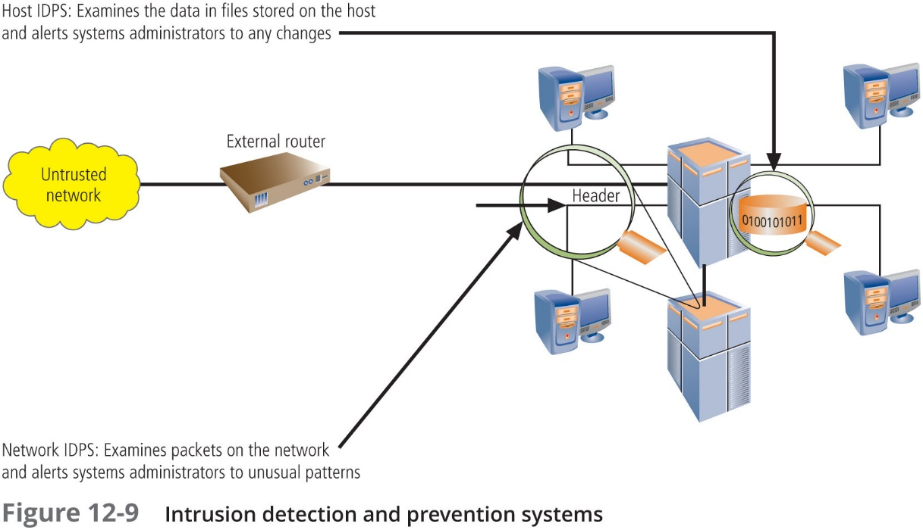

Slide 49
Host-Based IDPS
A host-based IDPS works by configuring and classifying various categories of systems and data files
Unless the IDPS is very precisely configured, benign actions can generate a large volume of false alarms
Host-based IDPSs can monitor multiple computers simultaneously by storing a client file on each monitored host and then making that host report back to the master console, which is usually located on the system administrator’s computer

Slide 50
Network-Based IDPS
Network-based IDPSs monitor network traffic and, when a predefined condition occurs, notify the appropriate administrator
The network-based IDPS looks for patterns of network traffic and must match known and unknown attack strategies against their knowledge base to determine whether an attack has occurred
These systems yield many more false-positive readings than do host-based IDPSs, because they are attempting to read the network activity pattern to determine what is normal and what is not

Slide 51
Signature-Based IDPS
A signature-based IDPS or knowledge-based IDPS examines data traffic for something that matches the signatures—predetermined attack patterns
The problem with this approach is that the signatures must be continually updated
If attackers are slow and methodical, they may slip undetected through the IDPS, as their actions may not match a signature that includes factors based on duration of the events

Slide 52
Anomaly-Based IDPS
The anomaly-based IDPS or behavior-based IDPS first collects data from normal traffic and establishes a baseline; it then periodically samples network activity and compares the samples to the baseline
When the activity falls outside the baseline parameters (or clipping level), the IDPS notifies the administrator
The anomaly-based IDPS is able to detect new types of attacks, as it looks for any type of abnormal activity
Unfortunately, these IDPSs require significant processing capacity as they constantly attempt to match activity to the baseline, and may generate many false-positive warnings

Slide 53
Managing IDPSs
Just as with any alarm system, if there is no response to an alert, then an alarm does no good
IDPSs must be configured using technical knowledge and adequate business and security knowledge to differentiate between routine circumstances and low, moderate, or severe threats
A properly configured IDPS can translate a security alert into different types of notification
A poorly configured IDPS may yield only noise

Slide 54
Managing IDPSs (Continued)
Most IDPSs monitor systems by means of agents—software that resides on a system and reports back to a management server
A valuable tool in managing an IDPS is the consolidated enterprise management service—which allows the security professional to collect data from multiple host- and network-based IDPSs and look for patterns across systems and subnetworks

Slide 55
Wireless Networking Protection
Most organizations that make use of wireless networks use an implementation based on IEEE 802.11
The size of a wireless network’s footprint depends on the amount of power the wireless access points (WAPs) emit
The most common encryption protocol used in wireless networking is the Wi-Fi Protected Access (WPA) family of protocols
The predecessor of WPA, unfortunately still in use, is Wired Equivalent Privacy (WEP), considered by most to be insecure and easily breached

Slide 56
Wireless Networking Protection (Continued)
Bluetooth is a de facto industry standard for short range (approximately 30 feet) wireless communications between devices
The Bluetooth wireless communications link can be exploited by anyone within range, unless suitable security controls are implemented
In discoverable mode, devices can easily be accessed, but even in non-discoverable mode, the device is susceptible to access by other devices that have connected with it in the past

Slide 57
Wireless Networking Protection (Continued)
By default Bluetooth does not authenticate connections, but it does implement some degree of security when devices access certain services like dial-up accounts and local area file transfers
The only way to secure Bluetooth-enabled devices is to:
1. turn off Bluetooth when you do not intend to use it and
2. do not accept an incoming communications pairing request unless you know who the requestor is

Slide 58
Managing Wireless Connections
It is possible to restrict access to the network to a preapproved set of wireless network card MAC addresses
One of the first management requirements is to regulate the size of the wireless network footprint by adjusting the placement and strength of the WAPs
Select WPA or WPA2 over WEP
Protect pre-shared keys

Slide 59
Scanning and Analysis Tools
Scanning and analysis tools can find vulnerabilities in systems, holes in security components, and other unsecured aspects of the network
Conscientious administrators will have several informational Web sites bookmarked, and they frequently browse for new vulnerabilities, recent conquests, and favorite assault techniques
There is nothing wrong with security administrators using the tools used by attackers to examine their own defenses and search out areas of vulnerability

Slide 60
Scanning and Analysis Tools (Continued)
Scanning tools collect the information that an attacker needs to succeed
Footprinting is the organized research of the Internet addresses owned or controlled by a target organization
Fingerprinting entails the systematic examination of all of the organization’s network addresses, and yields a detailed network analysis that reveals useful information about the targets of the planned attack

Slide 61
Port Scanners
Port scanners are a group of utility software applications that can identify active computers on a network; the active ports and services on those computers; the computers’ functions and roles, and other useful info
A port is a network channel or connection point in a data communications system
Well-known ports are those from 0 through 1023;
Registered ports are those from 1024 through 49151;
Dynamic and private ports are those from 49152 through 65535
Open ports can be used to send commands to a computer, gain access to a server, and exert control over a networking device

Slide 62
Vulnerability Scanners
Vulnerability scanners, which are variants of port scanners, are capable of scanning networks for very detailed information
They identify exposed user names and groups, show open network shares, and expose configuration problems and other server vulnerabilities

Slide 63
Packet Sniffers
A packet sniffer is a network tool that collects and analyzes packets on a network
It can be used to eavesdrop on network traffic
A packet sniffer must be connected directly to a local network from an internal location
To use a packet sniffer legally, you must:
Be on a network that the organization owns, not leases
Be under the direct authorization of the network owners
Have the knowledge and consent of the users
Have a justifiable business reason for doing so

Slide 64
Trap and Trace
Trap and trace applications are another set of technologies used to deploy IDPS technology that detects individuals who are intruding into network areas or investigating systems without authorization
Trap function software, like honey pots or honey nets, entice individuals who are illegally perusing the internal areas of a network, and distract the attacker while the software notifies the administrator of the intrusion
The trace is a process by which the organization attempts to determine the identity of someone discovered in unauthorized areas of the network or systems, but can be a violation of the ECPA

Slide 65
Managing Scanning and Analysis Tools
It is vitally important that the security manager be able to see the organization’s systems and networks from the viewpoint of potential attackers
The security manager should develop a program using in-house resources, contractors, or an outsourced service provider to periodically scan his or her own systems and networks for vulnerabilities with the same tools that a typical hacker might use

Slide 66
Managing Scanning and Analysis Tools (Continued)
Drawbacks to using scanners and analysis tools, content filters, and trap and trace tools:
These tools are not human and thus cannot simulate the more creative behavior of a human attacker
Most tools function by pattern recognition, so only previously known issues can be detected
Most of these tools are computer-based software or hardware and so are prone to errors, flaws, and vulnerabilities of their own
All of these tools are designed, configured, and operated by humans and are subject to human errors
You get what you pay for. Use of hackerware may actually infect a system with a virus or open the system to outside attacks or other unintended consequences
Specifically for content filters, some organizations have established policies or laws that protect the individual user’s right to access content, especially if it is necessary for the conduct of his or her job
Tool usage and configuration must comply with an explicitly articulated policy, and the policy must provide for valid exceptions

Slide 67
Managing Server-Based Systems with Logging
Some systems are configured to record a common set of data by default; other systems must be configured to be activated
This data, referred to generally as log files or logs, is commonly used to audit the systems performance and usage both by authorized and unauthorized users
To protect the log data, you must ensure that the servers that create and store the logs are secure
According to NIST, log management infrastructure involves two tiers, each with its own subtasks:
log generation
log analysis and storage

Slide 68
Log Generation
Log generation involves the configuration of systems to create logs as well as configuration changes needed to consolidate logs if this is desired
This typically requires activating logging on the various servers, and defining where to store logging data, locally or otherwise
Issues in log generation include:
Multiple log sources
Inconsistent log content
Inconsistent timestamps
Inconsistent log format

Slide 69
Log Analysis and Storage
Log analysis and storage is the transference of the log data to an analysis system, which may or may not be separate from the system that collects the log data, for the purpose of interpreting, filtering, correlating, analyzing, storing, and reporting the data
Collectively, systems of this type are known as “security event information management” (SEIM) systems
Important management functions within log storage:
Log rotation
Log archival
Log compression
Log reduction
Log conversion
Log normalization
Log file integrity

Slide 70
Log Analysis and Storage (Continued)
Important management functions within log analysis include:
Event correlation
Log viewing
Log reporting
General suggestions for managing logs:
Make sure that data stores can handle the amount of data generated by the configured logging activities
Rotate logs when unlimited data storage is not possible
Archive logs
Secure logs
Destroy logs

Slide 71
Managing Security for Emerging Technologies
Information security professionals are expected to understand innovations in the field and take the actions necessary to implement new technologies in secure ways
When an information security team is faced with a new technology, whether it is an advance in information technology, cybernetics, or security-related controls, they should adopt a supportive approach that asks one fundamental question: do the benefits of the proposed technology justify the expected costs of implementing that technology?

Slide 72
BYOD Using Network Access Control
Recent trends have led companies to open their networks to third parties and employees
To manage access to these networks, many organizations have turned to Network Access Control (NAC)
A properly deployed NAC will enable administrators to define and control how devices and users access resources from the organization’s network
To be effective, a NAC must offer scalable capacity, be vendor-neutral, support wired and wireless networking, and offer multiple deployment options, including physical and virtual appliances as well as cloud services

Slide 73
Embedded Systems and the Internet of Things
Embedded systems are now found in a far-ranging variety of devices, creating concerns for security
Organizations are struggling to manage an infrastructure where IT systems, sensors, actuators, and appliances interconnect—known as the Internet of Things (IOT)
When managing IoT, keep in mind the following points:
Some IoT devices are brought to the market with insufficient security and are themselves at risk of compromise
Once compromised, IoT devices can be used by an attacker as a launching point for attacks against other internal assets
Compromised IoT devices can also be used as zombies or bots to launch distributed denial-of-service attacks

Slide 74
Block Chains and the New World of Distributed Ledgers
A block chain is a decentralized method of storing data in a network of computers in which a continuously growing linked list of records is stored using cryptographic techniques
Blocks are batches of validated transactions, hashed, including a pointer to the previous block forming a chain
Block chains makes use of public key cryptography to secure the transactions’ contents; data stored on a block chain is generally considered incorruptible
Block chain infrastructure can be used to create distributed ledgers that enable higher-performance, distributed record keeping for transactions

Slide 75
Cryptography
Chapter 12: Protection Mechanisms

Slide 76
Cryptography
Encryption is the process of converting an original message into a form that cannot be understood by unauthorized individuals
Cryptology, the science of encryption, encompasses two disciplines: cryptography and cryptanalysis
Cryptography—from the Greek words kryptos, meaning “hidden,” and graphein, meaning “to write”—describes the processes involved in encoding and decoding messages so that others cannot understand them
Cryptanalysis—from analyein, meaning “to break up”—is the process of deciphering the original message (or plaintext) from an encrypted message (or ciphertext), without knowing the algorithms and keys used to perform the encryption

Slide 77
Cryptography (Continued)
The use of the proper cryptographic tools can ensure confidentiality by keeping private information concealed from those who do not need to see it
Other cryptographic methods can provide increased information integrity via a mechanism to guarantee that a message in transit has not been altered
In e-commerce situations, some cryptographic tools can be used to assure that parties to the transaction are authentic, so that they cannot later deny having participated in a transaction—called nonrepudiation

Slide 78
Common Ciphers
In encryption, the most commonly used algorithms include three functions: substitution, transposition, and XOR
In a substitution cipher, you substitute one value for another
A monoalphabetic substitution uses only one alphabet
A polyalphabetic substitution uses two or more alphabets
The transposition cipher (or permutation cipher) simply rearranges the values within a block to create the ciphertext, and can be done at the bit level or at the byte (character) level

Slide 79
Common Ciphers (Continued)
In the XOR cipher conversion, the bit stream is subjected to a Boolean XOR function against some other data stream, typically a key stream
XOR works simply, if the two values are the same, you get “0”; if not, you get “1”
This process is reversible; that is, if you XOR the ciphertext with the key stream, you get the plaintext

Slide 80
Symmetric Encryption
Each of the methods of encryption and decryption described requires that the same algorithm and key are used to both encipher and decipher the message, known as private key encryption, or symmetric encryption
Symmetric encryption methods are usually extremely efficient, requiring easily accomplished processing to encrypt or decrypt the message
One challenge in symmetric key encryption is getting a copy of the key to the receiver, a process that must be conducted out-of-band to avoid interception

Slide 81
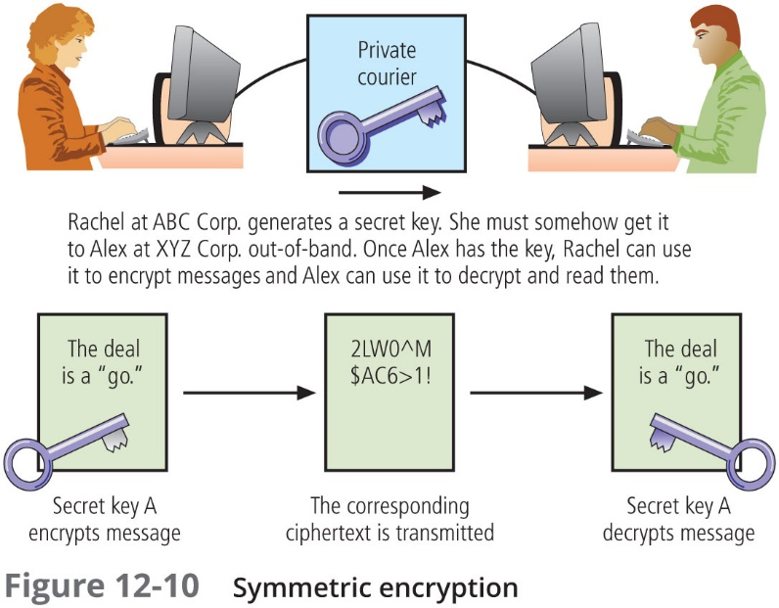

Slide 82
Symmetric Encryption (Continued)
One of the most familiar symmetric cryptosystems is Data Encryption Standard (DES), developed in 1977 by IBM and based on the Data Encryption Algorithm (DEA), which uses a 64-bit block size and a 56-bit key
Triple DES (3DES) was developed as an improvement to DES after DES was publicly cracked. 3DES used three keys instead of one and performs three encryption operations
The current industry and government standard in symmetric encryption is the Advanced Encryption Standard (AES), based on the Rijndael Block Cipher, which features a variable block length and a key length of 128, 192, or 256 bits

Slide 83
Asymmetric Encryption
Asymmetric encryption, or public key encryption, uses two different but related keys, either of which can be used to encrypt or decrypt the message
However, if Key A is used to encrypt the message, then only Key B can decrypt it; and vice versa
This technique is most valuable when one of the keys is private and the other is public
The problem with asymmetric encryption is that it requires four keys to hold a single conversation between two parties, and the number of keys grows geometrically as parties are added

Slide 84
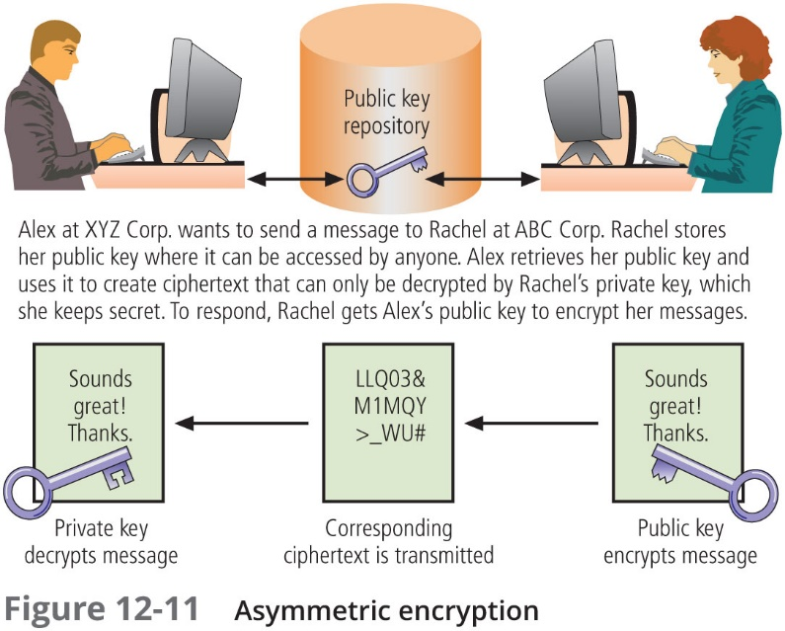

Slide 85
Digital Signature
When the asymmetric process is reversed—the private key encrypts a message, and the public key decrypts it—the fact that the message was sent by the organization that owns the private key cannot be refuted
This nonrepudiation is the foundation of digital signatures
Digital signatures are encrypted messages that are independently verified by a central facility (Registry) as authentic

Slide 86
Digital Certificate
A digital certificate is an electronic document, similar to a digital signature, attached to a file certifying that the file is from the organization it claims to be from and has not been modified from the original format
A certificate authority (CA) is an agency that manages the issuance of certificates and serves as the electronic notary public to verify their origin and integrity

Slide 87
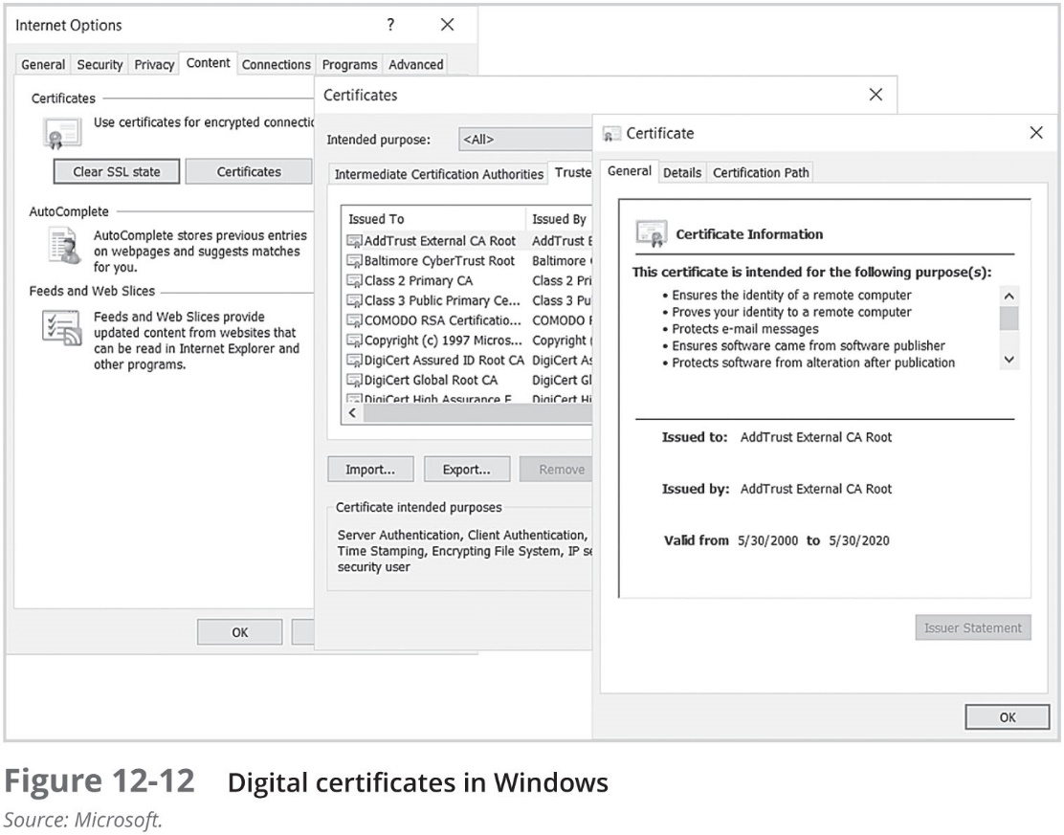

Slide 88
Public Key Infrastructure
Public key infrastructure (PKI) is the entire set of hardware, software, and cryptosystems necessary to implement public key encryption
Common implementations of PKI include:
Systems that issue digital certificates to users and servers
Systems with computer key values to be included in digital certificates
Tools for managing user enrollment, key generation, and certificate issuance
Verification and return of certificates
Key revocation services
Other services associated with PKI that vendors bundle into their products

Slide 89
Public Key Infrastructure (Continued)
PKI can increase the capabilities of an organization to protect its information assets by providing:
Authentication: Digital certificates in a PKI system permit individuals, organizations, and Web servers to authenticate the identity of each of the parties in an Internet transaction
Integrity: A digital certificate demonstrates that the content signed by the certificate has not been altered while in transit
Confidentiality: PKI keeps information confidential by ensuring that it is not intercepted during transmission over the Internet
Authorization: Digital certificates issued in a PKI environment can replace user IDs and passwords, enhance security, and reduce some of the overhead required for authorization processes and controlling access privileges for specific transactions
Nonrepudiation: Digital certificates can validate actions, making it less likely that customers or partners can later repudiate a digitally signed transaction, such as an online purchase

Slide 90
Hybrid Systems
Pure asymmetric key encryption is not widely used except in the area of certificates; instead, it is typically employed in conjunction with symmetric key encryption, creating a hybrid system
One hybrid process in widespread use is based on the Diffie-Hellman key exchange method, which provides a way to exchange private keys using public key encryption without exposure to any third parties
In this method, asymmetric encryption is used to exchange symmetric keys so that two organizations can conduct quick, efficient, and secure communications based on symmetric encryption

Slide 91
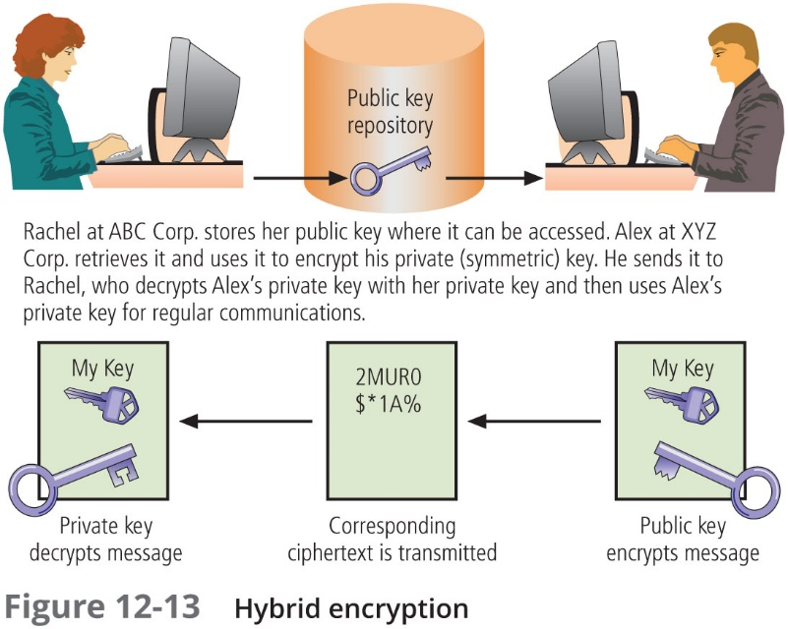

Slide 92
Using Cryptographic Controls
While modem cryptosystems can certainly generate unbreakable ciphertext, that is possible only when the proper key management infrastructure has been constructed and when the cryptosystems are operated and managed correctly
For those organizations with the need and the capability to use cryptographic controls, they can be used to support several aspects of the business:
Confidentiality and integrity of e-mail and its attachments
Authentication, confidentiality, integrity, and nonrepudiation of e-commerce transactions
Authentication and confidentiality of remote access through VPN connections
A higher standard of authentication when used to supplement access control systems

Slide 93
E-Mail Security
Secure Multipurpose Internet Mail Extensions (S/MIME) builds on the Multipurpose Internet Mail Extensions (MIME) encoding format by adding encryption and authentication via digital signatures based on public key cryptosystems
Pretty Good Privacy (PGP) was developed by Phil Zimmerman and uses the International Data Encryption Algorithm (IDEA) cipher, a 128-bit symmetric key block encryption algorithm with 64-bit blocks for message encoding

Slide 94
Securing the Web
Secure Sockets Layer (SSL) was developed in 1994 to provide security for e-commerce transactions and relies on RSA for key transfer and on IDEA, DES, or 3DES for encrypted symmetric key-based data transfer
Secure Hypertext Transfer Protocol (SHTTP) provides secure e-commerce transactions as well as encrypted Web pages for secure data transfer over the Web
Secure Shell (SSH) provides security for remote access connections over public networks by using tunneling, authentication services between a client and a server; it is commonly used for terminal emulation, remote management, and file transfer applications

Slide 95
Securing the Web (Continued)
IP Security (IPSec) is the dominant cryptographic authentication and encryption product for the Internet
IPSec combines several different cryptosystems:
Diffie-Hellman key exchange for deriving key material
Public key cryptography for signing the Diffie-Hellman exchanges to guarantee the identity of the two parties
Bulk encryption algorithms, such as DES, for encrypting the data
Digital certificates signed by a CA to act as digital ID cards
IPSec has two components:
The IP Security protocol itself, which specifies the information to be added to an IP packet and how to encrypt packet data
The Internet Key Exchange, which uses asymmetric key exchange and negotiates the security associations

Slide 96
Securing the Web (Continued)
IPSec works in two modes of operation: transport and tunnel
In transport mode, only the IP data is encrypted—not the IP headers themselves; this allows intermediate nodes to read the source and destination addresses
In tunnel mode, the entire IP packet is encrypted and inserted as the payload in another IP packet
IPSec and other cryptographic extensions to TCP/IP are often used to support a virtual private network (VPN), a private, secure network operated over a public and insecure network

Slide 97
Securing Authentication
A final use of cryptosystems is to provide enhanced and secure authentication
One approach to this issue is provided by Kerberos, which uses symmetric key encryption to validate an individual user’s access to various network resources
It keeps a database containing the private keys of clients and servers that are in the authentication domain that it supervises

Slide 98
Kerberos
Kerberos system knows these private keys and can authenticate one network node (client or server) to another
Kerberos also generates temporary session keys—that is, private keys given to the two parties in a conversation
Kerberos consists of three interacting services, all of which rely on a database library:
Authentication Server (AS)
Key Distribution Center (KDC)
Kerberos Ticket Granting Service (TGS)

Slide 99
Managing Cryptographic Controls
Don’t lose your keys
Know who you are communicating with
It may be illegal to use a specific encryption technique when communicating to some nations
Every cryptosystem has weaknesses
Give access only to those with a business need
When placing trust into a certificate authority, ask “Who watches the watchers?”
There is no security in obscurity
Security protocols and the cryptosystems they use are subject to the same limitations as firewalls and IDPSs
Make sure that your organization’s use of cryptography is based on well-constructed policy and supported with sound management procedures

Slide 100
Summary
Identification is a mechanism that provides basic information about an unknown entity to the known entity that it wants to communicate with
Authentication is the validation of a user’s identity. Authentication devices can depend on one or more of three factors: what you know, what you have, and what you can produce
Authorization is the process of determining which actions an authenticated person can perform in a particular physical or logical area
Accountability is the documentation of actions on a system and the tracing of those actions to a user, who can then be held responsible for those actions. Accountability is performed using system logs and auditing

Slide 101
Summary (Continued)
To obtain strong authentication, a system must use two or more authentication methods
Biometric technologies are evaluated on three criteria: false reject rate, false accept rate, and crossover error rate
A firewall in an InfoSec program is any device that prevents a specific type of information from moving between the outside world (the untrusted network) and the inside world (the trusted network)
Types of firewalls include packet filtering firewalls, application layer proxy firewalls, stateful packet inspection firewalls, and Unified Threat Management devices. There are three common architectural implementations of firewalls: single bastion hosts, screened-host firewalls, and screened-subnet firewalls

Slide 102
Summary (Continued)
A host-based IDPS resides on a particular computer or server and monitors activity on that system. A network-based IDPS monitors network traffic; when a predefined condition occurs, it responds and notifies the appropriate administrator
A signature-based IDPS, also known as a knowledge-based IDPS, examines data traffic for activity that matches signatures, which are preconfigured, predetermined attack patterns
A statistical anomaly-based IDPS (also known as a behavior-based IDPS) collects data from normal traffic and establishes a baseline. When the activity is outside the baseline parameters (called the clipping level), the IDPS notifies the administrator

Slide 103
Summary (Continued)
The science of encryption, known as cryptology, encompasses cryptography and cryptanalysis. Cryptanalysis is the process of obtaining the original message from an encrypted code without the use of the original algorithms and keys
In encryption, the most commonly used algorithms employ either substitution or transposition. A substitution cipher substitutes one value for another. A transposition cipher (or permutation cipher) rearranges the values within a block to create the ciphertext
Symmetric encryption uses the same key, also known as a secret key, both to encrypt and decrypt a message. Asymmetric encryption (public key encryption) uses two different keys for these purposes

Slide 104
Summary (Continued)
A public key infrastructure (PKI) encompasses the entire set of hardware, software, and cryptosystems necessary to implement public key encryption
A digital certificate is a block of data, similar to a digital signature, that is attached to a file to certify it is from the organization it claims to be from and has not been modified
A number of cryptosystems have been developed to make e-mail more secure. Examples include Pretty Good Privacy (PGP) and Secure Multipurpose Internet Mail Extensions (S/MIME)
A number of cryptosystems work to secure Web browsers, including Secure Sockets Layer (SSL), Secure Hypertext Transfer Protocol (SHTTP), Secure Shell (SSH), and IP Security (IPSec)

