Slide 1
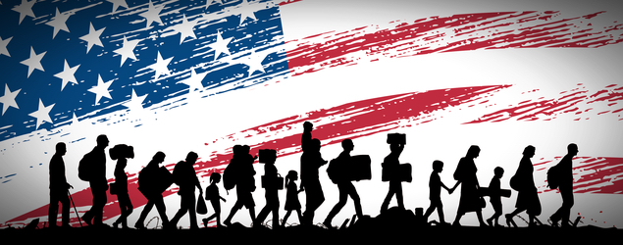
Image Credit: Ayn Rand Institute/ Seita via Shutterstock.com
How does America feel about immigration?
A DATA ANALYSIS ABOUT THE IMPACT OF IMMIGRATION IN THE AMERICAN SENTIMENTS.
BY M. HASHER, J. MENDIOLA & R. ORR

Slide 2


Questions to be asked
Is there a correlation between Twitter sentiment and immigration stock and/or flows?
How other demographic indicators are correlated with immigration?
Are sanctuary cities safer than other cities in terms of hate crime?
How America feels about immigration?

Slide 3
Approach
Matching the Twitter accounts of local NPR news stations along with Twitter accounts of local television stations with counties.
Use the data obtained along with US Census data to evaluate the relationship between the sentiment of these news Tweets and their replies with foreign-born share of the population.
How America feels about immigration?

Slide 4





Data Sources
CENSUS DATA
CSV files:
FIPS Code List
Demographics
Sanctuary cities
Immigration Rates
CRIME DATA
MEDIA DATA
CSV files:
Hate Crime Data (2012-2016)
PDF files:
NPR Stations List
Media Data- CSV files: NPR Twitter handles and local television Twitter handles
APIs
Twitter API was used to search local NPR affiliates and TV station tweets by the following filters: “Immigration, immigrant, immigrants, foreigner, non-citizen, undocumented, non-citizen, ’permanent resident”. The API also allowed us to geo-locate the tweet.
Google Geolocation API was used to geo-locate the agencies included in the UCR Hate Crime Data Reports to be able to assign each agency name to their respective FIPS code.
How America feels about immigration?

Slide 5


Data Exploration & Cleanup
NOTEBOOKS
Hate Crime by County
Ban Tweets
Census
Scatter Plots
Project Repository
How America feels about immigration?

Slide 6
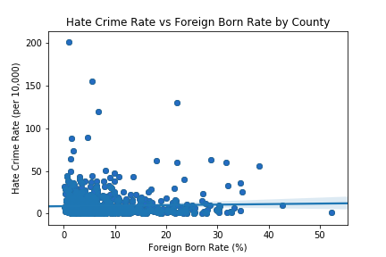
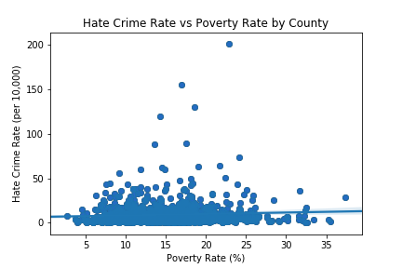
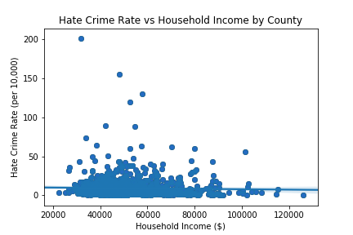
Data Analysis
3. Is there a correlation between hate crime rate and foreign born population rate?
Scatter plots were created to compare Hate Crime Rate with the following key demographic indicators:
Foreign Born Rate
Poverty Rate
Household Income
No significant correlation found.
How America feels about immigration?

Slide 7
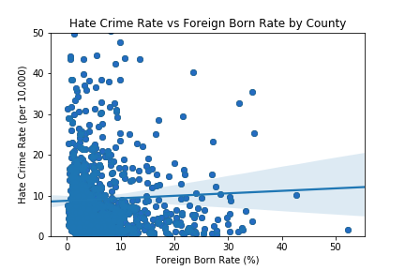
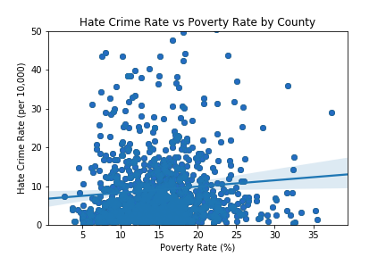
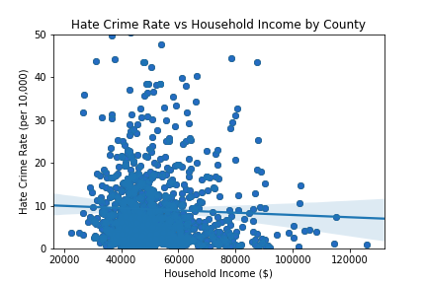
Data Analysis
3. Is there a correlation between hate crime rate and foreign born population rate?
Outliers were removed and plot zoomed to look for correlation among the indicators.
How America feels about immigration?

Slide 8
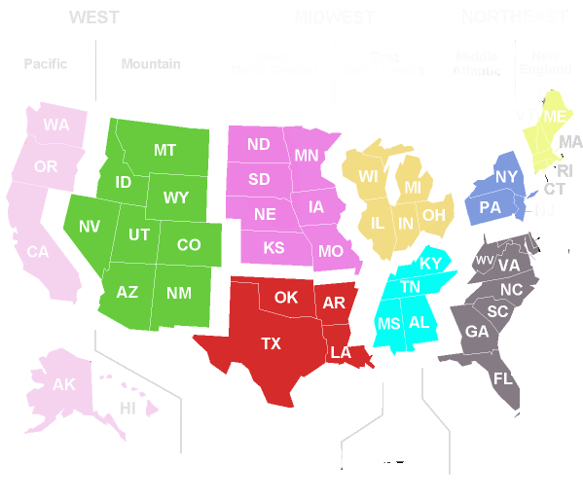
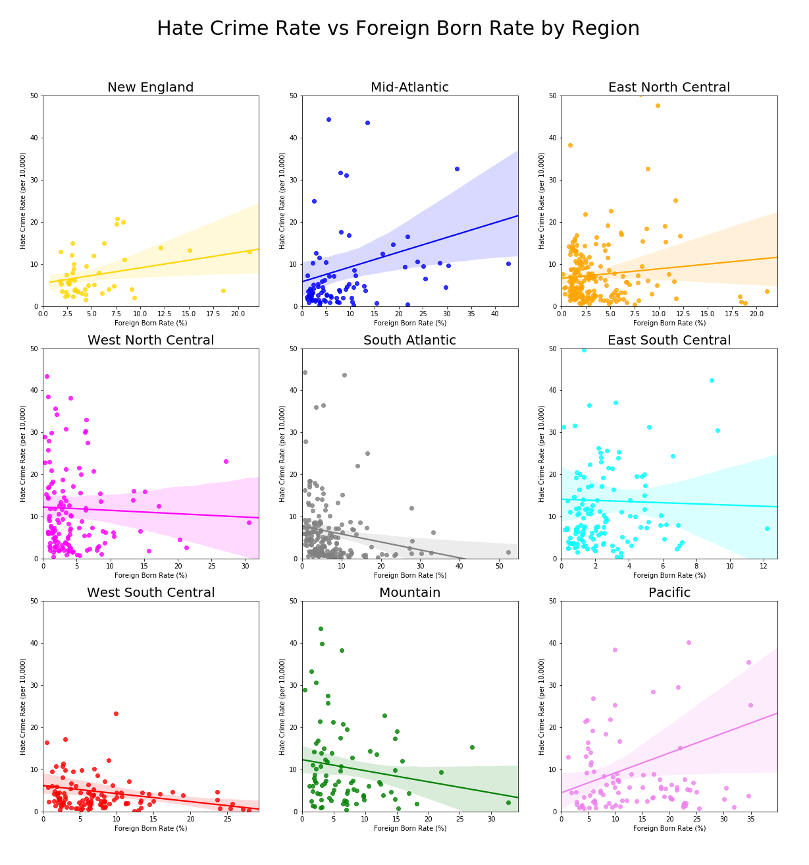
Data Analysis
3. Is there a correlation between hate crime rate and foreign born population rate?
Scatter plots were created to analyze if there were different behavior among US regions.
HATE CRIME vs FOREIGN BORN RATE
How America feels about immigration?

Slide 9
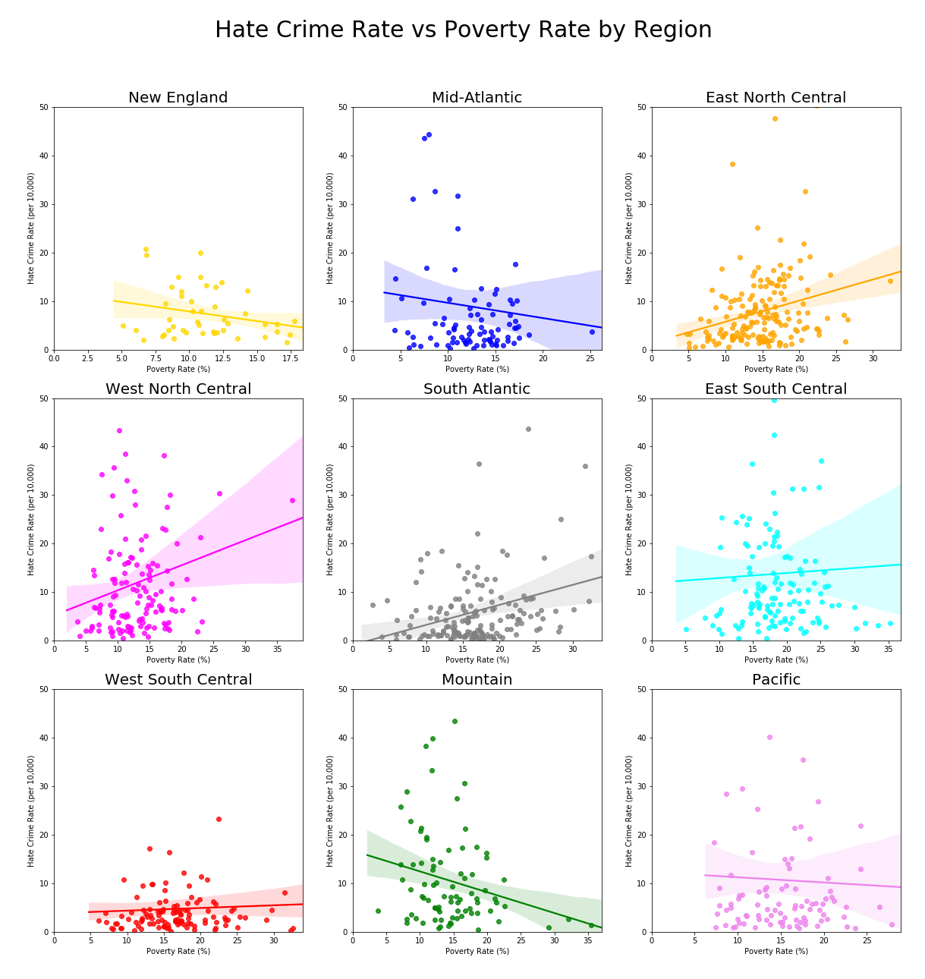
Data Analysis
3. Is there a correlation between hate crime rate and foreign born population rate?
Scatter plots were created to analyze if there were different behavior among US regions.
HATE CRIME vs POVERTY RATE
How America feels about immigration?

Slide 10
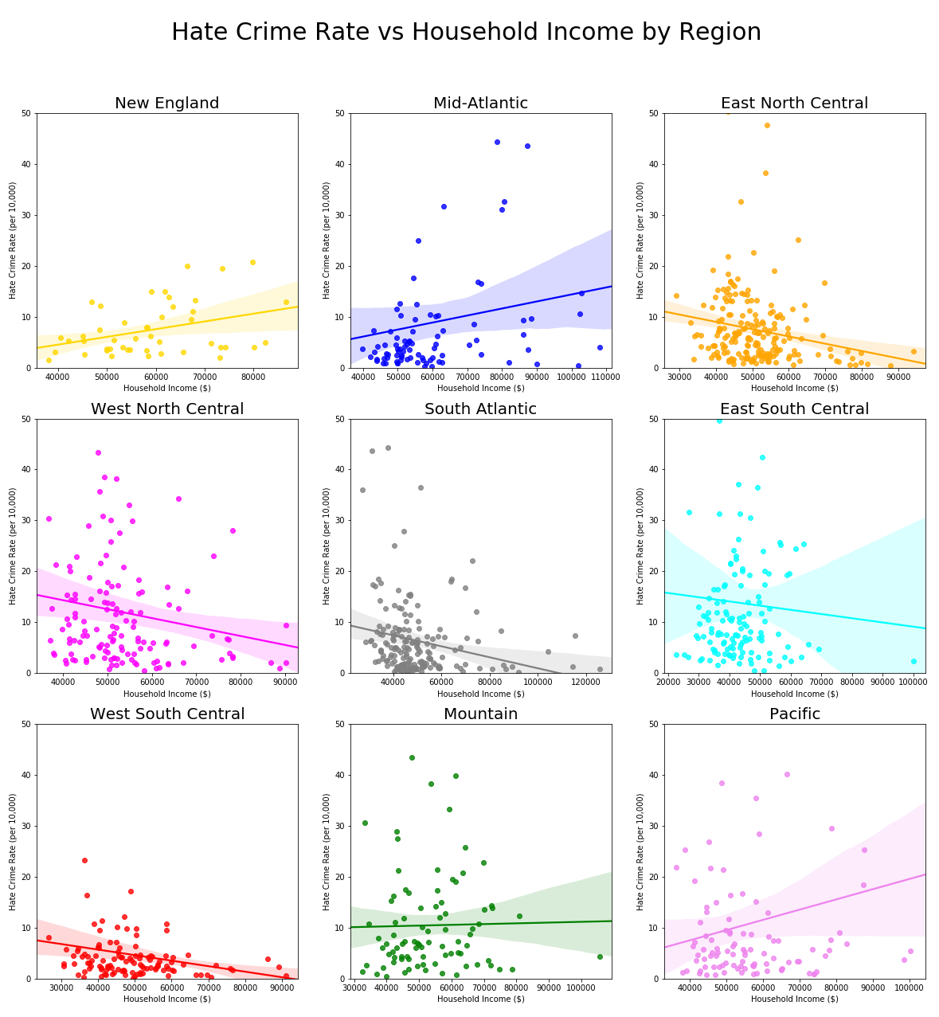
Data Analysis
3. Is there a correlation between hate crime rate and foreign born population rate?
Scatter plots were created to analyze if there were different behavior among US regions.
HATE CRIME vs HOUSEHOLD INCOME
How America feels about immigration?

Slide 11
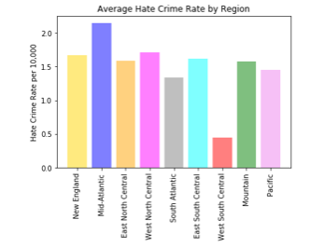
3. Is there a correlation between hate crime rate and foreign born population rate?
Bar plot to measure the Average Hate Crime Rate by Region from 2012 to 2016.
Data Analysis
How America feels about immigration?

Slide 12
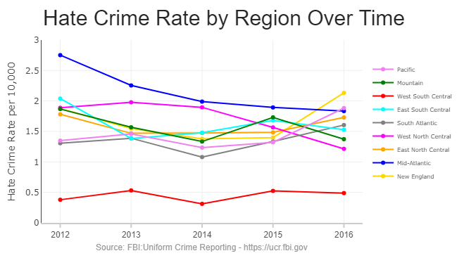
Data Analysis
3. Is there a correlation between hate crime rate and foreign born population rate?
Line plot to measure Hate Crime Rate over time by Region from 2012 to 2016.
New England, Pacific, South Atlantic and regions had a significant increase on the elections year (2016).
How America feels about immigration?

Slide 13
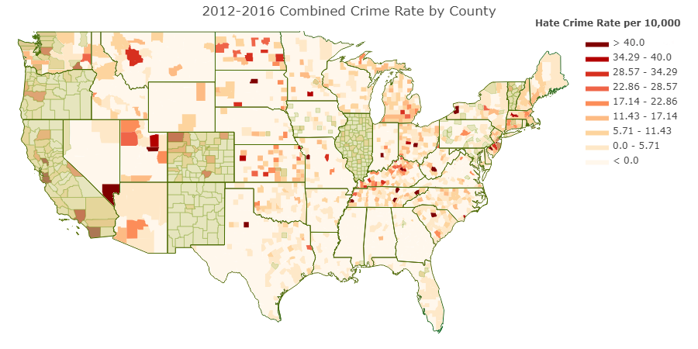
Data Analysis
4. Are sanctuary cities safer in terms of hate crime than other cities?
Choropleth Map to measure combined Hate Crime Rate by County (2012-2016) with sanctuary cities overlapped in green.
It doesn’t seem to be a significant trend that relates sanctuary cities with a higher or lower hate crime rate in comparison with non-sanctuary cities.
How America feels about immigration?

Slide 14
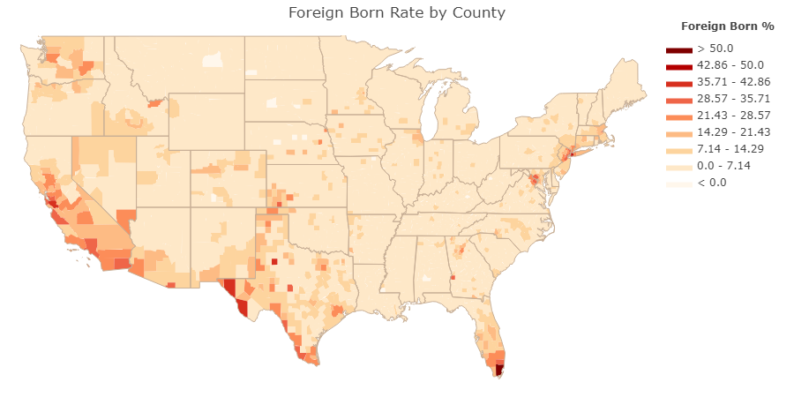
Data Analysis
4. Are sanctuary cities safer in terms of hate crime than other cities?
Choropleth Map to measure Foreign Born Rate by County in 2016.
It doesn’t seem to be a significant trend that relates sanctuary cities with a higher or lower foreign born population in comparison with non-sanctuary cities.
How America feels about immigration?

Slide 15
Conclusions
4. Are sanctuary cities safer in terms of hate crime than other cities?
4. Are sanctuary cities safer in terms of hate crime than other cities?
3 out of 4
Choropleth Map to measure Foreign Born Rate by County in 2016.
It doesn’t seem to be a significant trend that relates sanctuary cities with a higher or lower foreign born population in comparison with non-sanctuary cities.
How America feels about immigration?

Slide 16
Data Limitations
CLEANUP PROCESS
During the cleanup process, some valid data was excluded from the dataframes due to incorrect/invalid information in one or more of its columns or because registered location was not found during the geo-location process.
For the tweets analysis, we must consider that even with geo-location, we can not asure that the persons tweeting in that location are locals or actual residents of the city analyzed.
For the hate crime analysis, there are some points to take in consideration for the obtained results:
- Sanctuary cities are more likely to get reports about potential hate crimes by foreign born people (including illegal immigrants) due to the protection provided by the law about not being asked about their migration status.
- Sanctuary cities are more likely to get crimes classified as hate crime report due to the awareness among population and police agencies about the subject.
“The FBI reports that the numbers of hate crimes have decreased over several years, with the exception of 2015. Regardless of the year, however, the hate crime count is underreported to the FBI, explained Stacy. Some state, city and local police agencies simply don't collect or disclose the data.”
Middlebrook, H, 2017. The fascinating, if unreliable, history of hate crime tracking in the US. CNN, [Online]. Available at: https://www.cnn.com/2017/01/05/health/hate-crimes-tracking-history-fbi/index.html [Accessed 23 April 2018].
How America feels about immigration?

Slide 17
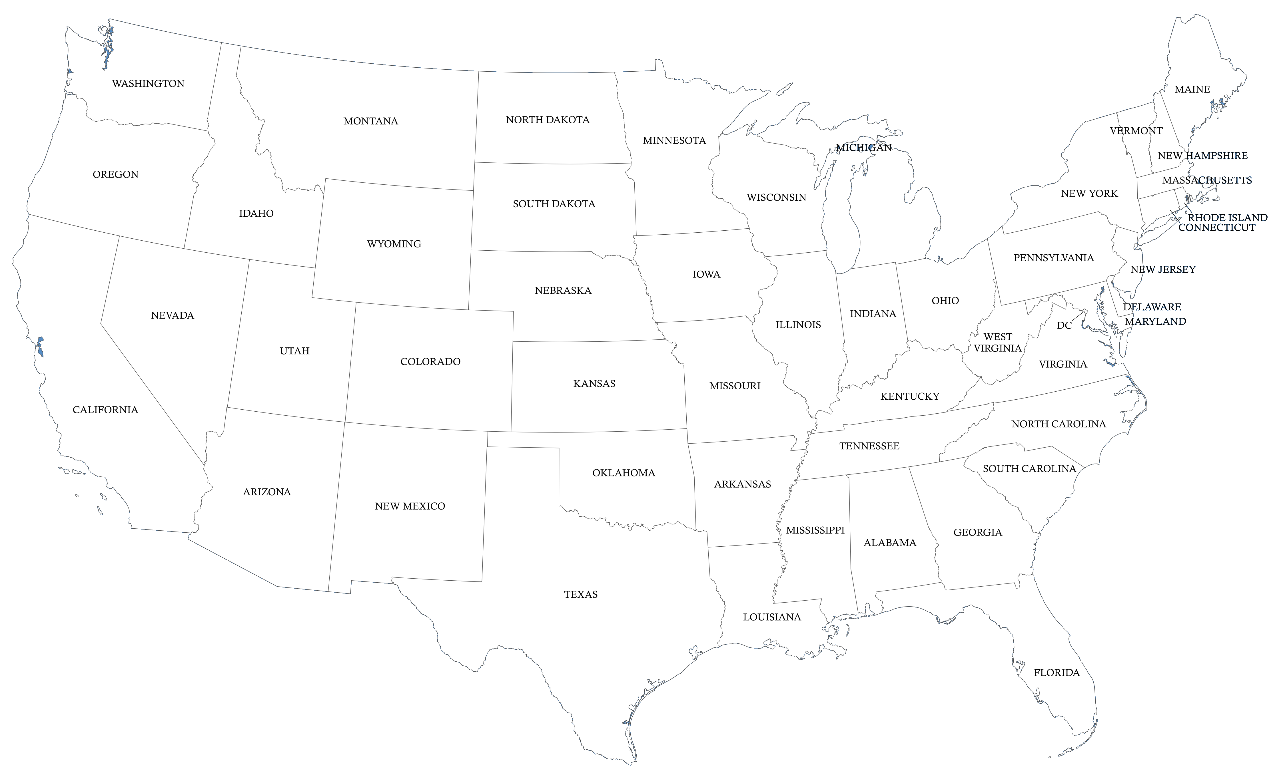
Thank you

