Slide 1
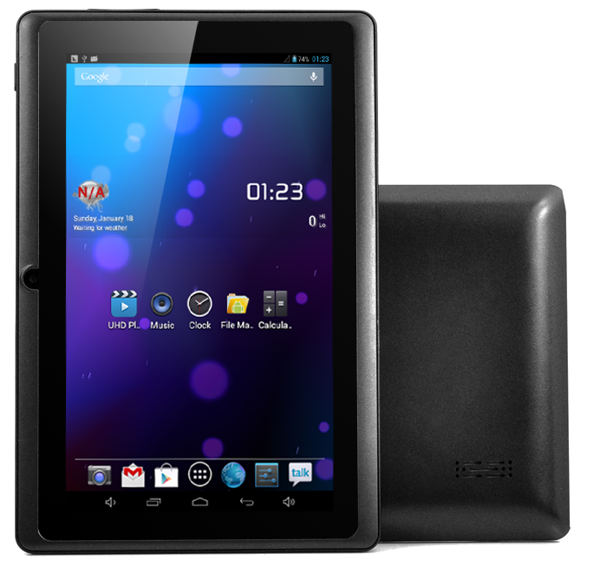





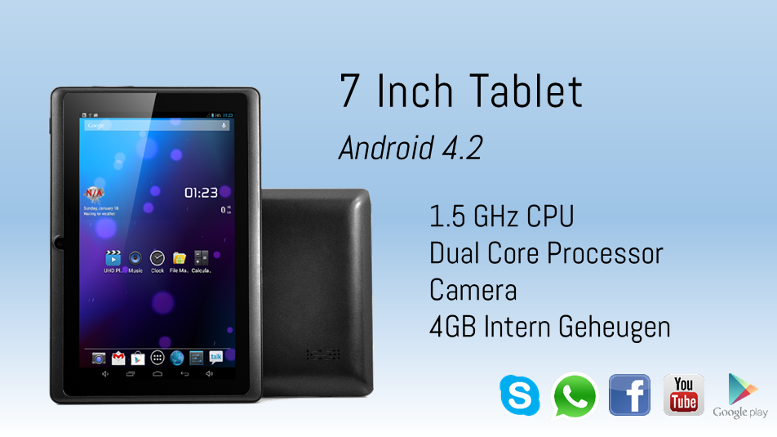
7 Inch Tablet
Android 4.2
1.5 GHz CPU
Dual Core Processor
Camera
4GB Intern Geheugen

