Slide 1
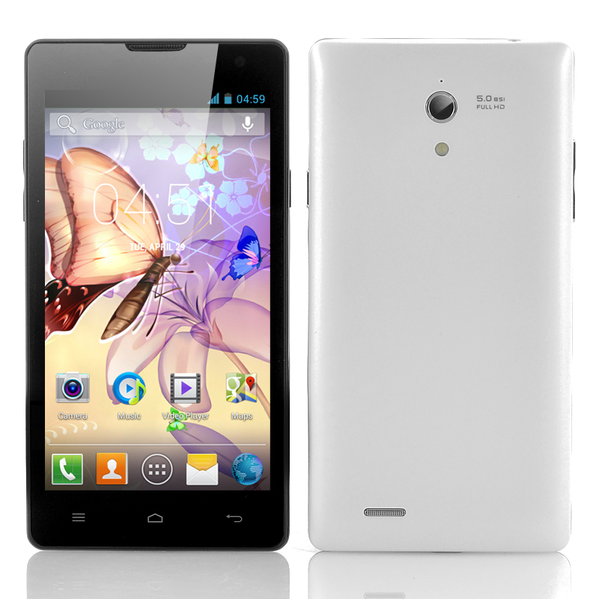
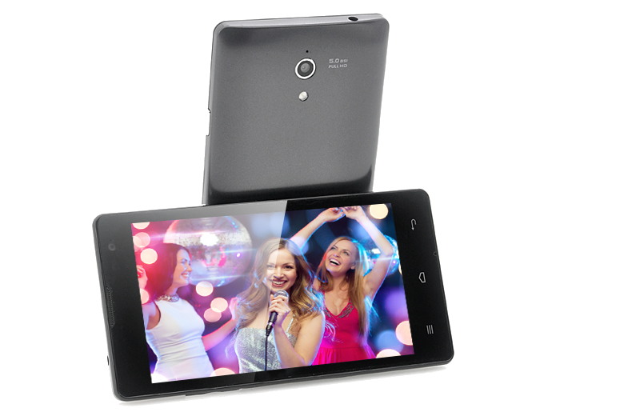
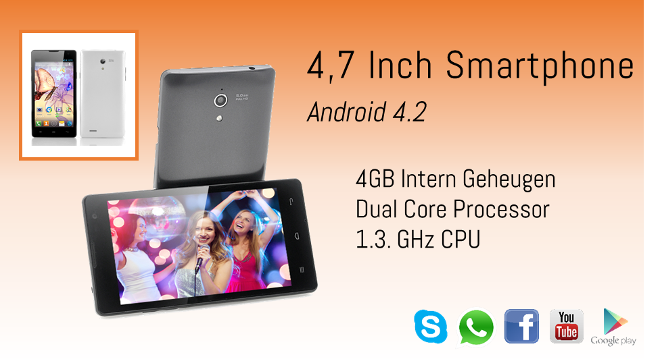





4,7 Inch Smartphone
Android 4.2
4GB Intern Geheugen
Dual Core Processor
1.3. GHz CPU

