Slide 1
Allegro Library Manager:
Demo
January 2012

Slide 2

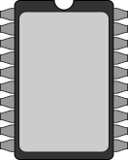


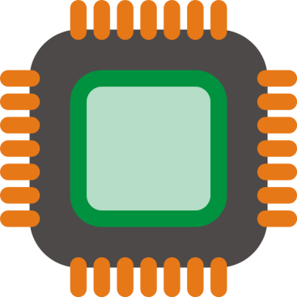
Problem
Layout
footprints
Other files
(pads, shapes, etc)
Schematic
symbols
?
Part information

Slide 3

More problems
Is this footprint verified?
Where can I get it?
Are there (pin-compatible) alternatives?
Have other projects used it?

Slide 4

Solution
Database application
containing all this and more

Slide 5




Allegro Library Managment tool
( )

Slide 6
What’s inside now...
Parts
Categories
Footprints
Symbols
Libraries

Slide 7
..and in the future.
Parts
Footprints
Manufacturer
Pads
Categories
Symbols
Distributors
Flash
Shapes
Projects
Libraries
For a complete overview of tables and information contained therein, see the redmine wiki

Slide 8
Where?
Redmine Project
http://172.31.25.85/redmine/projects/allegro/
wiki, bugtracking
Google Code
TBD
source code, database, footprints and symbols (?)

Slide 9
Demo time!

