Slide 1

Git Branching and Workflows
by Jason Meridth

Slide 2
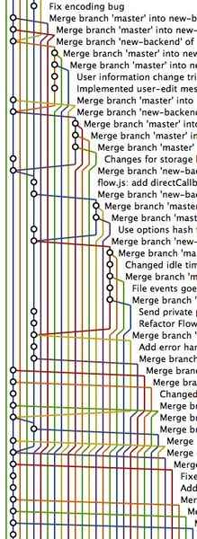
Branching
Notes:
branching
- parallel development
- topic branches
gitk

Slide 3

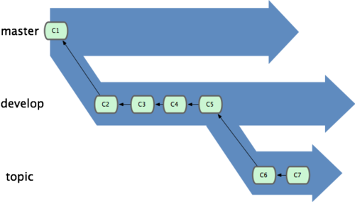
Local Branching and It's Power
Notes:
local branching
- it's power
- topic branches
keep master clean
a topic branch could equal a story, feature, bug

Slide 4
Remote Branches
"Remote branches are references to the state of branches on your remote repositories. They’re local branches that you can’t move; they’re moved automatically whenever you do any network communication. Remote branches act as bookmarks to remind you where the branches on your remote repositories were the last time you connected to them...They take the form (remote)/(branch)" Chapter 3 sect. 5 Pro Git Book

Slide 5
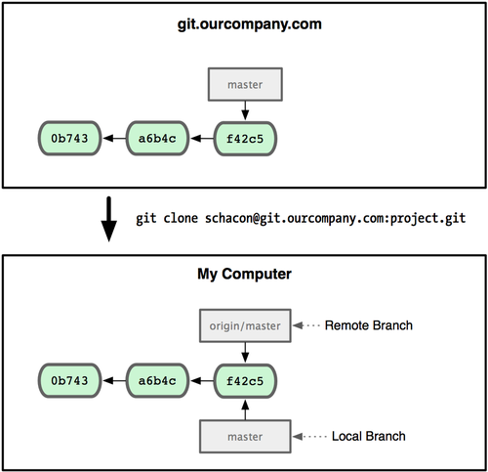

Slide 6
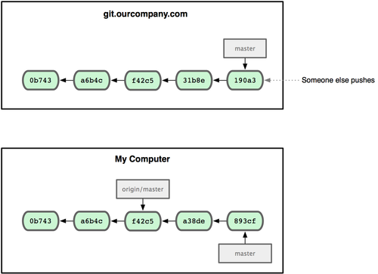
Notes:
someone else pushes changes to the remote repository

Slide 7
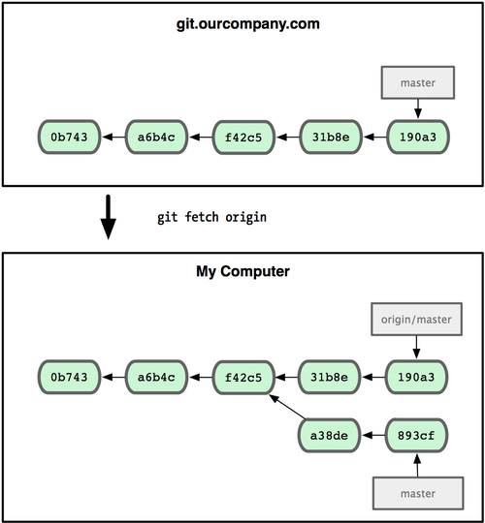
Notes:
get the remote repo and local reference in-sync

Slide 8
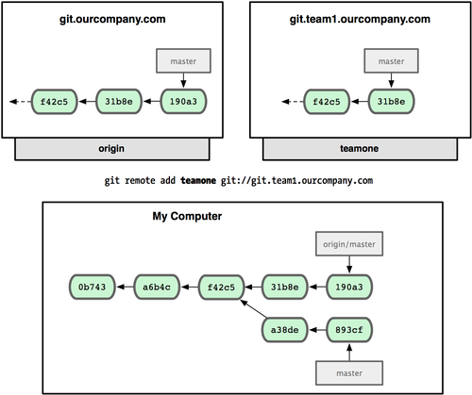
Notes:
adding the teamone remote

Slide 9
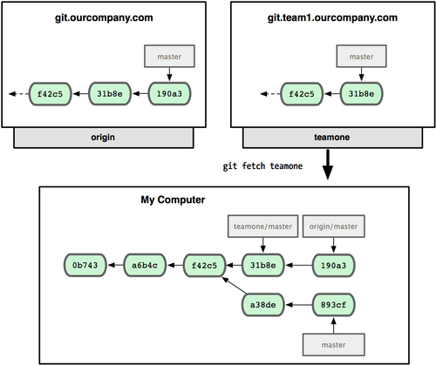
Notes:
fetch from the new remote, new reference exits

Slide 10
"Tracking" Branches
allows you to type git push or git pull without the remote or branch name.
$ git checkout -b serverfix origin/serverfix Branch serverfix set up to track remote branch refs/remotes/origin/serverfix. Switched to a new branch "serverfix"$ git checkout -b sf origin/serverfix Branch serverfix set up to track remote branch refs/remotes/origin/serverfix Switched to a new branch "sf"
$ git checkout --track origin/serverfix Branch serverfix set up to track remote branch refs/remotes/origin/serverfix. Switched to a new branch "serverfix"

Slide 11
Branch by Feature

Slide 12

Notes:
3 common workflows
- centralized
- integration manager
- dictator & lieutenant

Slide 13
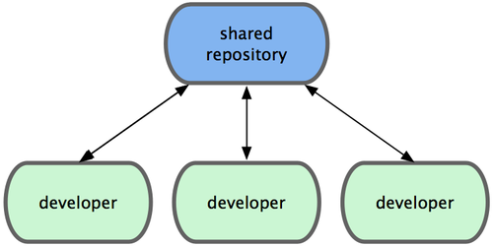
centralized

Slide 14


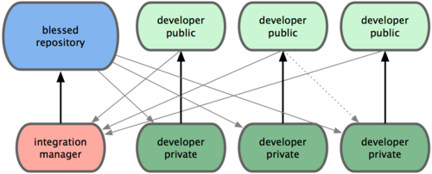
integration manager
Notes:
The project maintainer pushes to their public repository.
A contributor clones that repository and makes changes.
The contributor pushes to their own public copy.
The contributor sends the maintainer an e-mail asking them to pull changes.
The maintainer adds the contributor’s repo as a remote and merges locally.
The maintainer pushes merged changes to the main repository.
The Github workflow

Slide 15
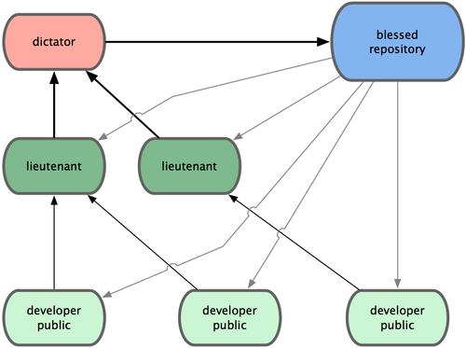
dictator & lieutenant
Notes:
Regular developers work on their topic branch and rebase their work on top of master. The master branch is that of the dictator.
Lieutenants merge the developers’ topic branches into their master branch.
The dictator merges the lieutenants’ master branches into the dictator’s master branch.
The dictator pushes their master to the reference repository so the other developers can rebase on it.

Slide 16
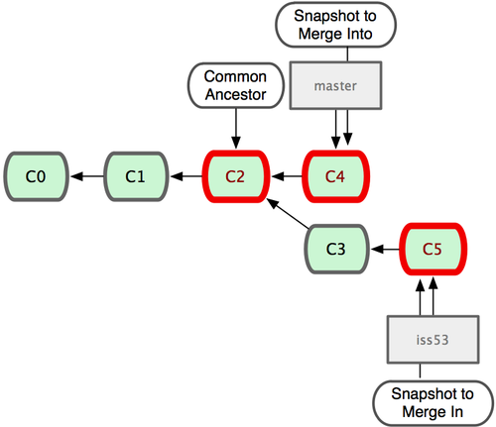
Merging Workflows

Slide 17
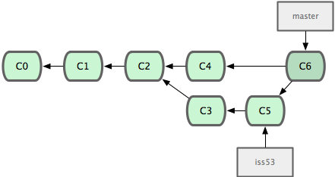

Slide 18
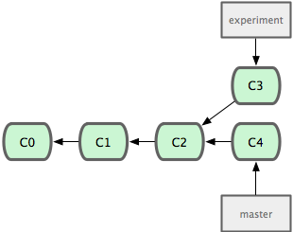
Rebasing Workflows

Slide 19
$ git checkout experiment $ git rebase master First, rewinding head to replay your work on top of it... Applying: added staged command

Slide 20
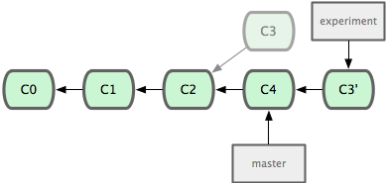
Notes:
rebase

Slide 21
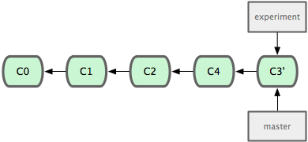
Notes:
merge fast-forward

Slide 22
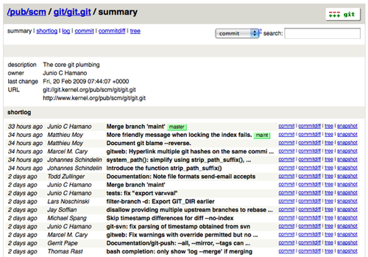
Gitosis + Gitweb

Slide 23

Gitorious

Slide 24
Credits
IMAGES
http://andyjeffries.co.uk/uploads/articles/33/view_git-logo.png
http://blog.nodeta.fi/wp-content/uploads/2009/07/git-branching.jpg
http://www.francescofrancavilla.com/gallery/images/3_musketeers_low.jpg
http://progit.org/figures/ch5/18333fig0501-tn.png
http://progit.org/figures/ch5/18333fig0502-tn.png
http://progit.org/figures/ch5/18333fig0503-tn.png
http://progit.org/figures/ch3/18333fig0318-tn.png
http://progit.org/figures/ch3/18333fig0319-tn.png
http://progit.org/figures/ch3/18333fig0322-tn.png
http://progit.org/figures/ch3/18333fig0323-tn.png
http://progit.org/figures/ch3/18333fig0324-tn.png
http://progit.org/figures/ch3/18333fig0325-tn.png
http://progit.org/figures/ch3/18333fig0326-tn.png
http://commune.s3.amazonaws.com/uploaded/cusp/site/github.png
http://antonlindstrom.com/public/graphic/octocat_stroked.png
http://progit.org/figures/ch4/18333fig0401-tn.png
http://upload.wikimedia.org/wikipedia/en/9/93/Gitorious.png
BOOKS
Pro Git by Scott Chacon - http://progit.org/book/
Git Community Book by Scott Chacon - http://book.git-scm.com
Pragmatic Version Control Using Git by Travis Swicegood - http://www.pragprog.com/titles/tsgit/pragmatic-version-control-using-git

