Slide 1

Rake
Jason Meridth
AlamoCoders May 2009
Notes:
- Pablo, LT pitch

Slide 2
Manual Builds
Compile + X-Copy
Zip file
Notes:
- how many of you have had to do either of these?
- were your builds consistent?

Slide 3
Why Automate?
Once done, rarely need to touch it again
Immediate feedback
Can work on other stuff besides the build
Remove human interaction (decrease errors)
Reproducible
Notes:
- Automation - let’s help Skynet take over faster
- once complete, you only really need to touch it to handle new features
- SOX compliance - be able to have another human handle the process with a single command

Slide 4
Current Solutions
NAnt
MSBuild
Notes:
- example using both on next slide
- query audience

Slide 5
Old School: NAnt
<?xml version="1.0" encoding="utf-8"?>
<project name="HelloUser" default="complete" xmlns="http://nant.sf.net/schemas/nant.xsd">
<property name="build.dir" value="build" />
<property name="dist.dir" value="dist" />
<property name="build.number" value="0.0.0.1" />
<property name="product" value="HelloUser" />
<property name="copyright" value="Copyright 2008-2009 Jason Meridth. All rights reserved" />
<property name="clr.version" value="v3.5" />
<property name="msbuild" value="${environment::get-variable('WINDIR')}/Microsoft.NET/Framework/${clr.version}/MSBuild.exe" />
<target name="complete" depends="prepare, compile, setup, unit_test, create_zip" description="Compile and Run Tests" />
<target name="prepare" description="Deletes all generated folders and files to start with clean folder structure">
<delete dir="${build.dir}" />
<delete dir="${dist.dir}" />
<mkdir dir="${build.dir}" if="${not directory::exists(build.dir)}"/>
<mkdir dir="${dist.dir}" if="${not directory::exists(dist.dir)}"/>
</target>
<target name="compile" description="Compiles debug solution">
<exec program="${msbuild}">
<arg value="HelloUser.sln" />
<arg value="/verbosity:minimal" />
<arg value="/p:Configuration=debug" />
<arg value="/p:WarningLevel=0" />
</exec>
<copy todir="${build.dir}" overwrite="true">
<fileset basedir="HelloUser\bin\Debug">
<include name="HelloUser.exe" />
<include name="HelloUser.pdb" />
<include name="HelloUserLibrary.dll" />
<include name="HelloUserLibrary.pdb" />
</fileset>
</copy>
</target>
<target name="setup" depends="compile">
</target>
<target name="unit_test">
<exec program="nunit-console.exe" basedir="lib\nunit">
<arg value="HelloUserLibraryTests\bin\Debug\HelloUserLibraryTests.dll" />
</exec>
</target>
<target name="create_zip">
<zip zipfile="${dist.dir}\HelloUser-bin-${build.number}.zip">
<fileset basedir="${build.dir}">
<include name="**" />
</fileset>
</zip>
</target>
</project>
Notes:
highlight:
project...default=”complete”
XML

Slide 6

What is Rake?
“...a simple Ruby build program with capabilities similar to make” ~ Jim Weirich (creator)
Notes:
Jim is the creator of Rake, FlexMock, etc

Slide 7
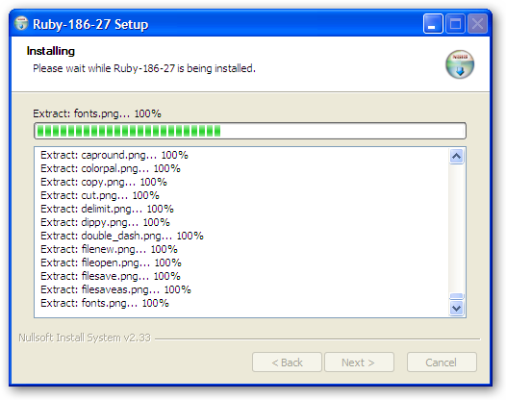
Install on Windows
One Click Installer
Cue VM...
http://rubyforge.org/projects/rubyinstaller/

Slide 8
Hello World
# Rakefile (or rakefile or rakefile.rb or Rakefile.rb)
require 'rake'
desc "Hello World!"
task :hello_world do
puts "Hello World!"
end
Notes:
- Hello world task
- 4 different ways to name rakefile
- require rake (One Click installer put the rake call into your environment variables PATH)
- description, task name (string or symbol) and block

Slide 9
rake -T (--tasks)
jasonmeridth@laptop ~/code/presentations/rake $ rake -T(in /Users/jasonmeridth/code/presentations/rake)rake hello_world # Hello World!
Notes:
- the rake command will walk upward (the file directory) until it finds it first Rakefile (or variant)

Slide 10
run rake
~/code/presentations/rake $ rake hello_world(in /Users/jasonmeridth/code/presentations/rake)Hello World!

Slide 11
A good Rakefile Example
JAGregregory’s Fluent-NHibernate Rakefile
(http://github.com/jagregory/fluent-nhibernate)

Slide 12

Gotchas
It is the RubyZip gem, _NOT_ ZipRuby.
(Go ahead Joe, laugh)

Slide 13
I can haz knowledge
One click install
Obeying Pragmatic Programmers - Learn a new language once a year
Easy to extend
Easy to read
Easy to learn

Slide 14
You can haz questions
???

Slide 15
Resources
http://rake.rubyforge.org
http://github.com/jimweirich/rake
http://martinfowler.com/articles/rake.html
http://derickbailey.lostechies.com/archive/2009/05/08/how-a-net-developer-learned-ruby-and-rake-to-build-net-apps-in-windows.aspx
http://railsenvy.com/2007/6/11/ruby-on-rails-rake-tutorial
http://github.com/jagregory/fluent-nhibernate/tree/master

