Slide 1
Implementation of Dijkstra’s Algorithm to Find the Shortest Path
COP 4530 Section: 002
Alessandro junior Parli U47375394
Jude Mersinger U21950507
Date: 04/21/2024

Slide 2

Content:
Introduction & Objectives
Problem Statement & Approach
Code implementation
Results

Slide 3
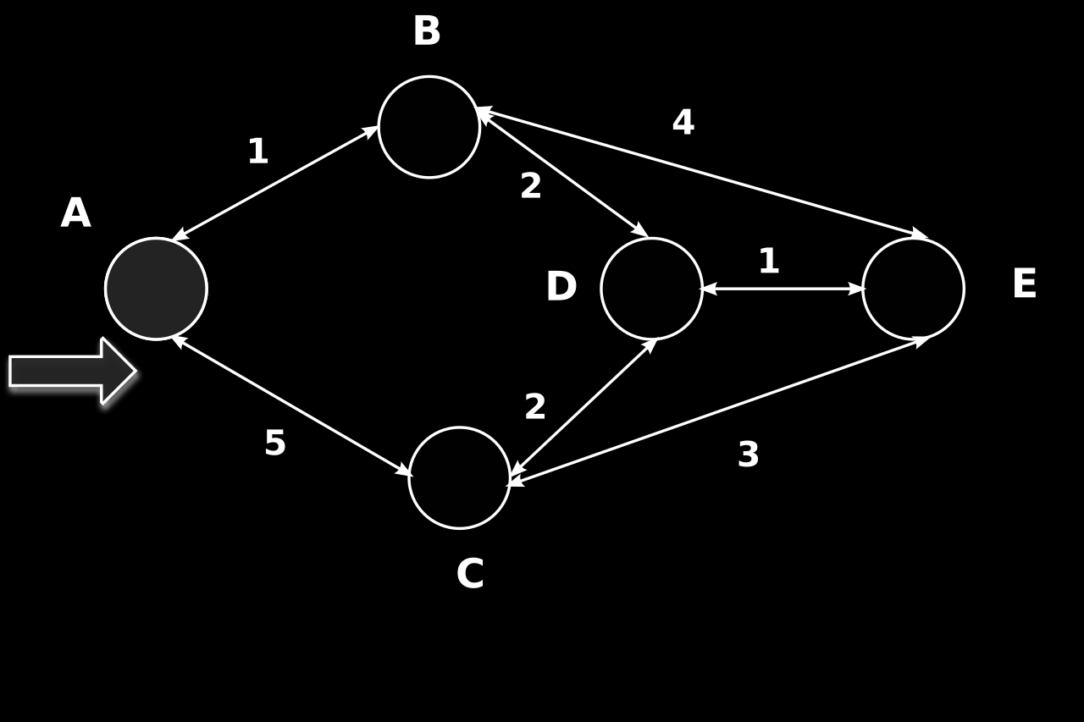
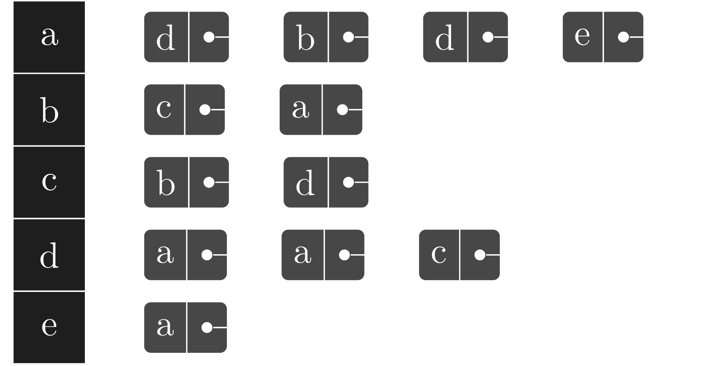
Introduction
For this project, Dijkstra's Algorithm will be researched, analyzed, and executed to find the shortest path between two vertices.
The creation of an undirected weighted Graph Abstract Data Type (ADT) will be necessary for this project work. Where will be able to choose between adjacency lists, adjacency matrices, or incidence matrices as graph implementation option.

Slide 4
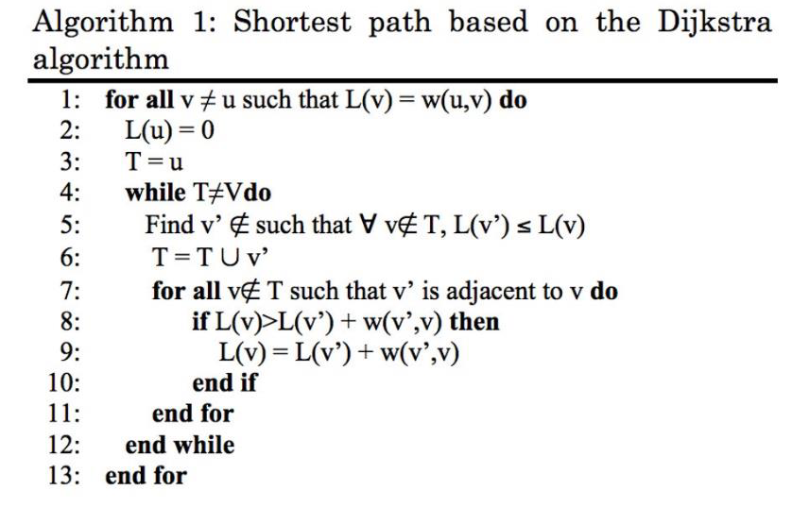
Objectives
Two Main Goals:
Implementation of Dijkstra's algorithm and the graph ADT.
Demonstration of functionality with examples and code.
To achieve these two objectives we must:
Deeper understanding of Dijkstra's shortest path-finding algorithm.
Hands-on experience with graph data structures and algorithms.
Fulfillment of requirements for COP 4530's Programming Project 4.

Slide 5

Problem Statement and Approach

Slide 6


Problem
We have to solve a graph theory problem based on Dijkstra’s Algorithm. Find the shortest path between two vertices in a network that is represented as a graph.
Dijkstra's algorithm is the main effective tool for quickly determining the weighted graph shortest path.
To accomplish this, we aim to integrate Dijkstra's algorithm with an undirected weighted graph ADT.

Slide 7
Approach
ADT Graph Design:
Fundamental component of our implementation on C++.
Includes commands to add and remove edges and vertices, ensuring each vertex has an identifiable label for easy identification.
Every vertex in the graph has a distinct label. Facilitates efficient retrieval and manipulation of specific graph elements.
For efficient management of vertices and edges, the Graph class internally utilizes two maps.

Slide 8
Implementation Details
Use of adjacency list to store data efficiently.
Advantage: space efficiency, quicker access to vertex neighbors compared to an adjacency matrix.
Example:
"A" is a user and "B" and "C" are the neighbors, then "A’ s " adjacency list entry would be a list listing "B" and "C"
Creation of distinct classes for edges and vertices to improve code organization and functionality.
Edge class will hold data regarding the connection between two vertices
Vertex class forms the basis for individual points within the graph.

Slide 9
Dijkstra’s Algorithm Integration
Dijkstra algorithm implementation in the Graph ADT is the project's essential component. The shortestPath function is a crucial feature for this class.
The role of this function is in storing the traversed vertex labels in a given vector, and in returning the total weight connected to the shortest path.
Algorithm main steps:
Assign a current distance of 0 to the source node and infinity to the remaining nodes.
Assign the current node to the non-visited node that is currently the closest.
The current node N adds the weight of the edge connecting 0 to 1 to the current distance of each neighboring node. Set it as the new current distance of N if it is less than the current distance of Node.
Designate node 1 as visited at this time.
In the event that nodes remain unvisited, proceed to step 2.

Slide 10
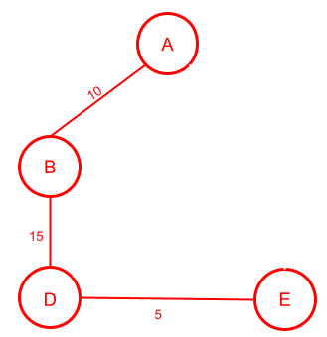
Example
Consider a road network where A, B, C, D, and E are locations. The distances between these locations are represented in the diagrams below.
To find the shortest path from A to E. Priority to vertices closest to A.
Then investigate routes from C and B by using the steps given before. Figuring out that the quickest path from A to E is A → B → D → E, which is a total of 30.

Slide 11

C++ Implementation

Slide 12
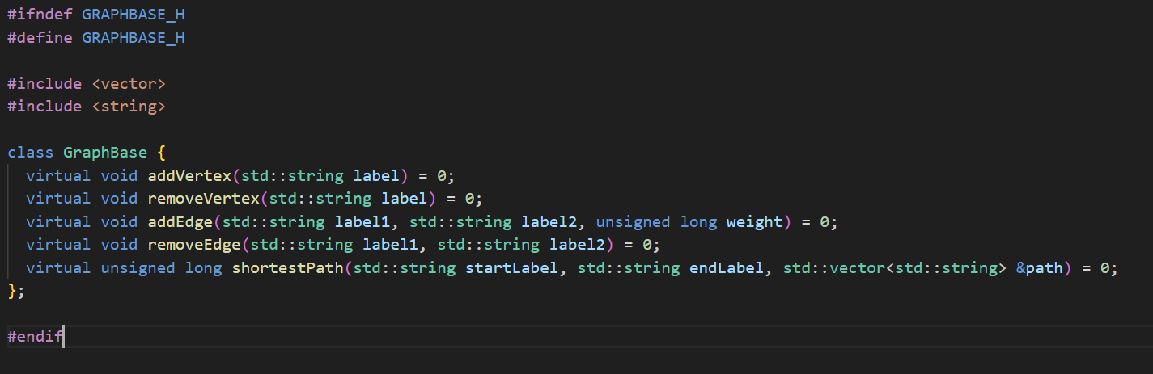
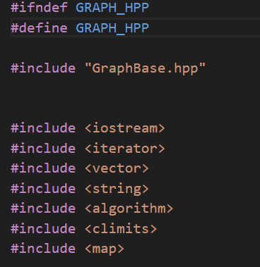
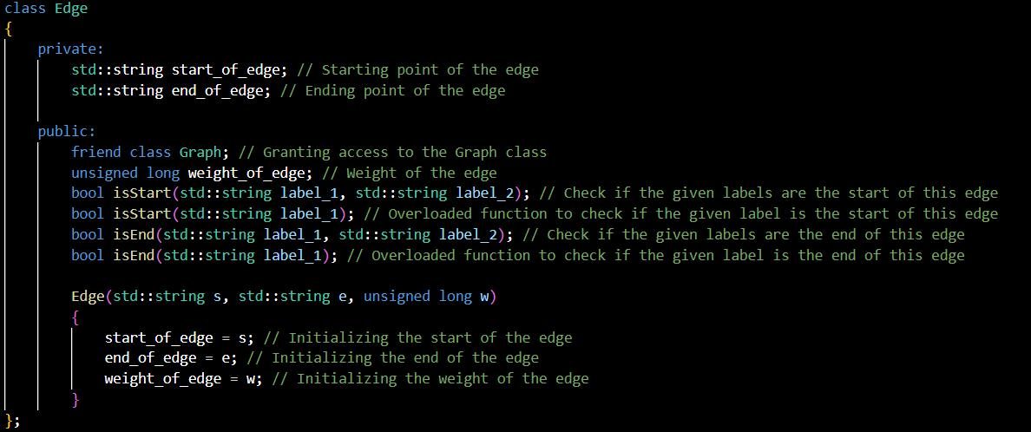
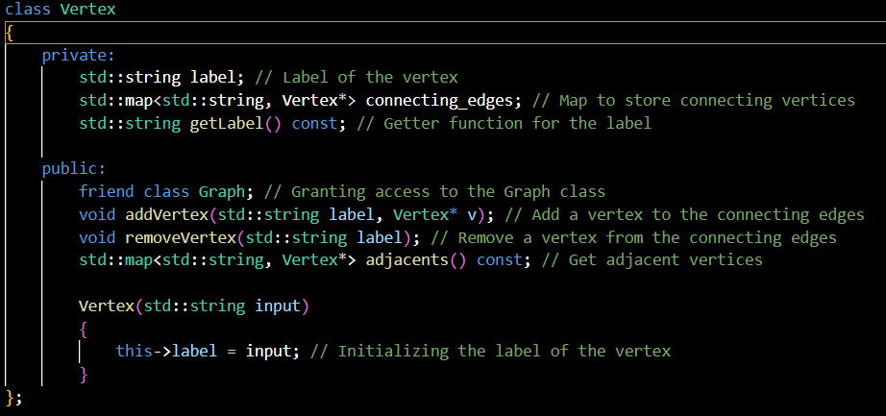
Edge Class:
Represents an edge (connection) between two vertices.
Private member variables: start_of_edge, end_of_edge, weight_of_edge.
Public member functions for edge manipulation.
Vertex Class:
Represents a vertex (node) in the graph.
Private member variables: label (distinct string identifier), connecting_edges (map storing pointers to connected vertices).
Public member functions for vertex manipulation.

Slide 13
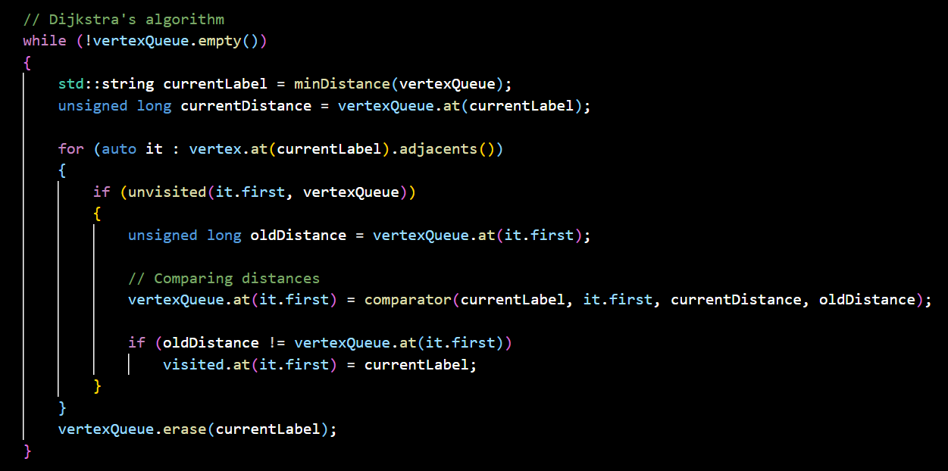
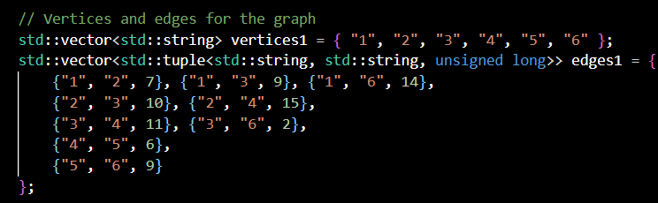
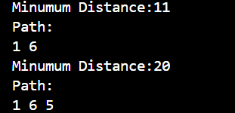
Results:
Dijkstra’s Implementation
Code output example

Slide 14
Conclusion
Dijkstra's algorithm was successfully applied in this project to an undirected weighted graph (ADT).
Correctly used adjacency lists for efficient edge storage and retrieval.
Improved understanding of graph data structures and algorithms.
Demonstrated the practical use of Dijkstra's algorithm for locating shortest paths.
Developed graph ADT is a valuable tool for examining graph structures.

Slide 15
REFERENCES
“What Is Dijkstra’s Algorithm?: Introduction to Dijkstra’s Shortest Path Algorithm.” GeeksforGeeks, GeeksforGeeks, 8 Mar. 2024, www.geeksforgeeks.org/introduction-to-dijkstras-shortest-path-algorithm/#dijkstras-algorithm.
Riley, Sean. “Dijkstra’s Algorithm - Computerphile.” YouTube, YouTube, 4 Jan. 2017, www.youtube.com/watch?v=GazC3A4OQTE
Devadas, Srini, director. Lecture 16: Dijkstra. Youtube Lecture 16: Dijkstra, MIT OpenCourseWare, 14 Jan. 2013, https://www.youtube.com/watch?v=2E7MmKv0Y24&t=1661s. Accessed 14 Apr. 2024.
Navone, Estefania Cassingena. “Dijkstra’s Shortest Path Algorithm - a Detailed and Visual Introduction.” freeCodeCamp.Org, freeCodeCamp, 3 Feb. 2022, www.freecodecamp.org/news/dijkstras-shortest-path-algorithm-visual-introduction/.

