Slide 1
Auxetic Structures:
Shock Absorption and Zero-Stiffness
MAE 263F
John Meshinsky and Beom Jun Kim

Slide 2


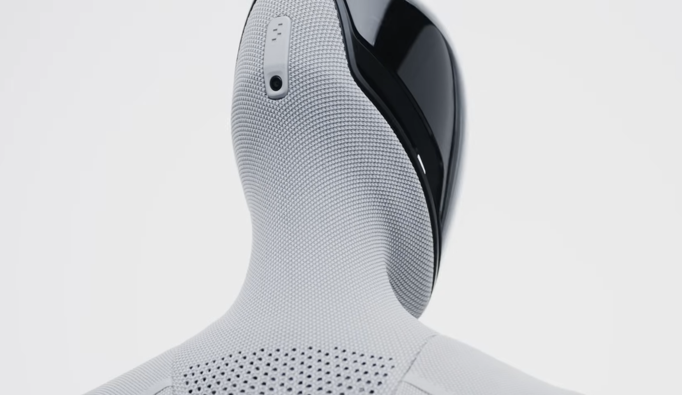
Motivation
Need for “robotic skin” to ensure environmental and human safety
Testing of “quasi zero-stiffness” robotic skin

Slide 3
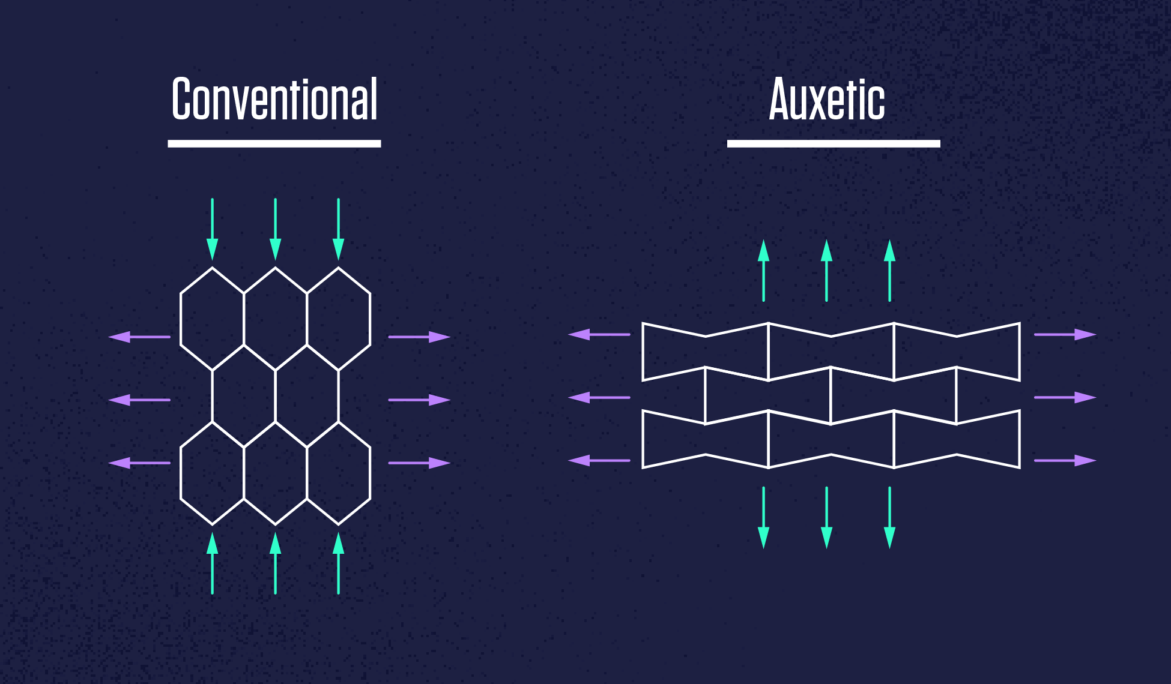
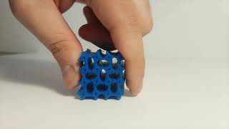
Goal
Testing different Auxetic lattices under uniform load to measure the Poisson ratio of the different lattices
Measurements to observe are compression/displacement, and energy absorption, stiffness(elasticity)
Tested using a lattice of elastic beams with the properties of TPU
Plan to expand to 3-dimensional structure lattice

Slide 4
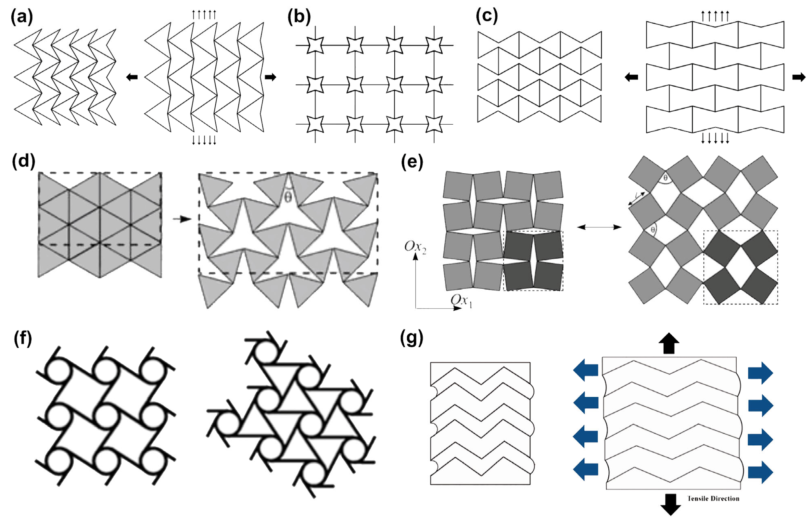
The Simulation
Design of a beam-spring network using the the tested lattices
Applying uniform loads/forces on the edges of the lattice to see deformation and testing passion’s ratio
Releasing forces to see the “zero-stiffness” quality of the lattice - returning to its original shape

Slide 5
