Slide 1
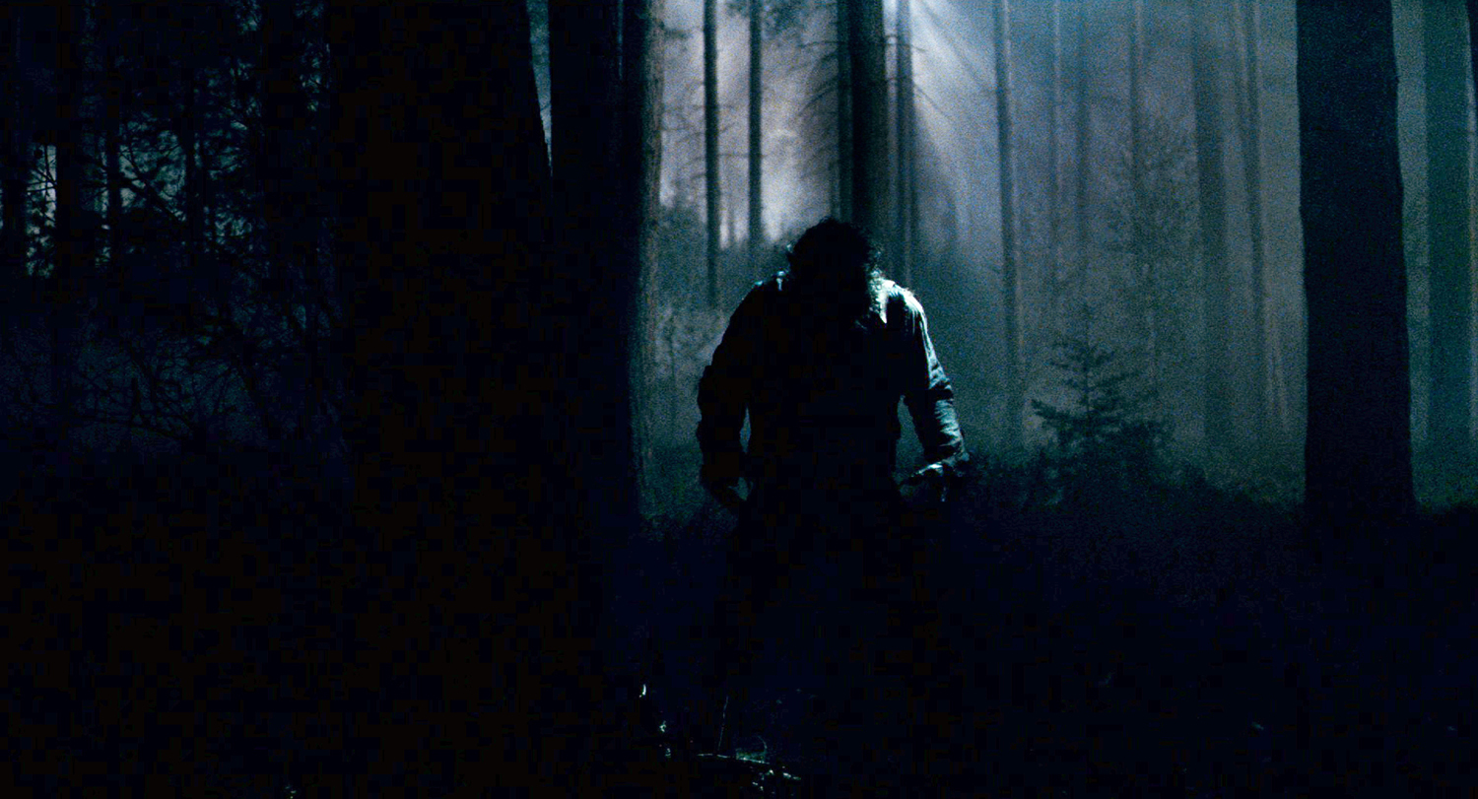

TO DISCOVER QUICK AND EFFECTIVE ROUTES AGAINST STREET ABUSE

Slide 2

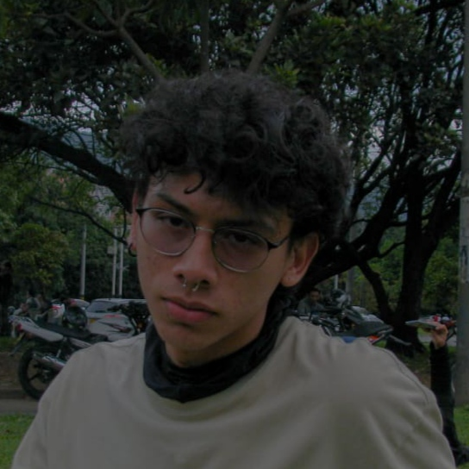
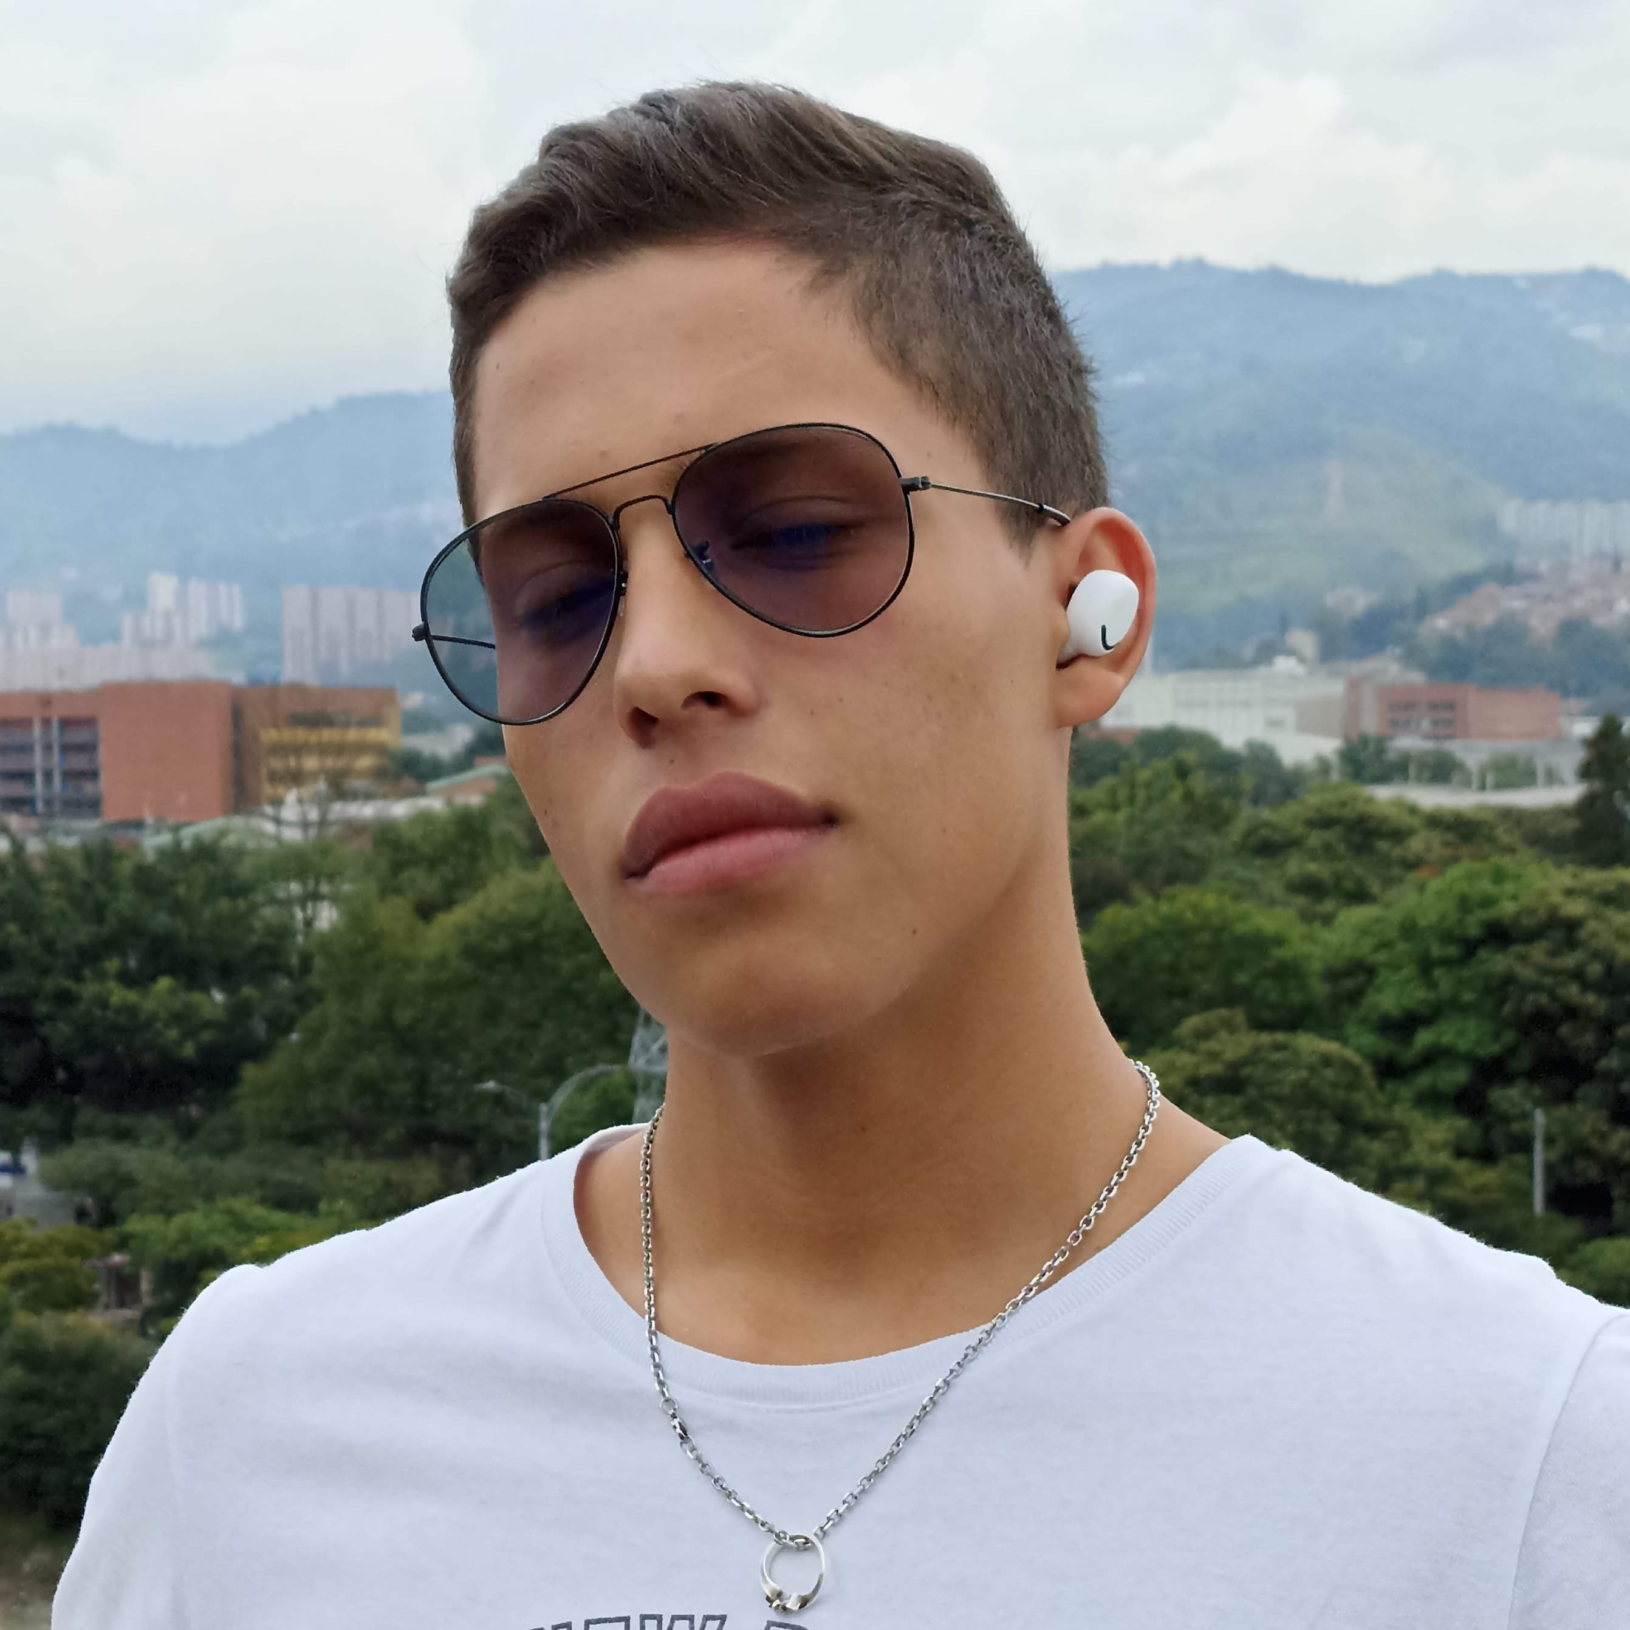
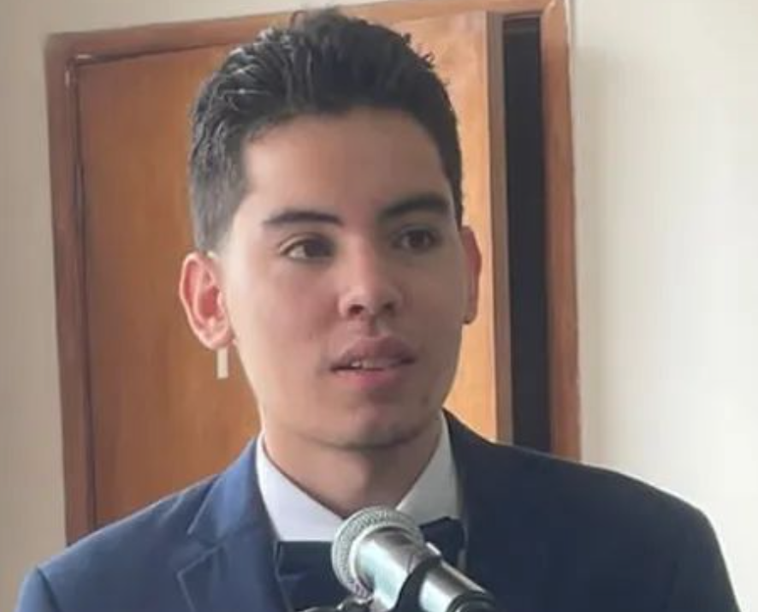
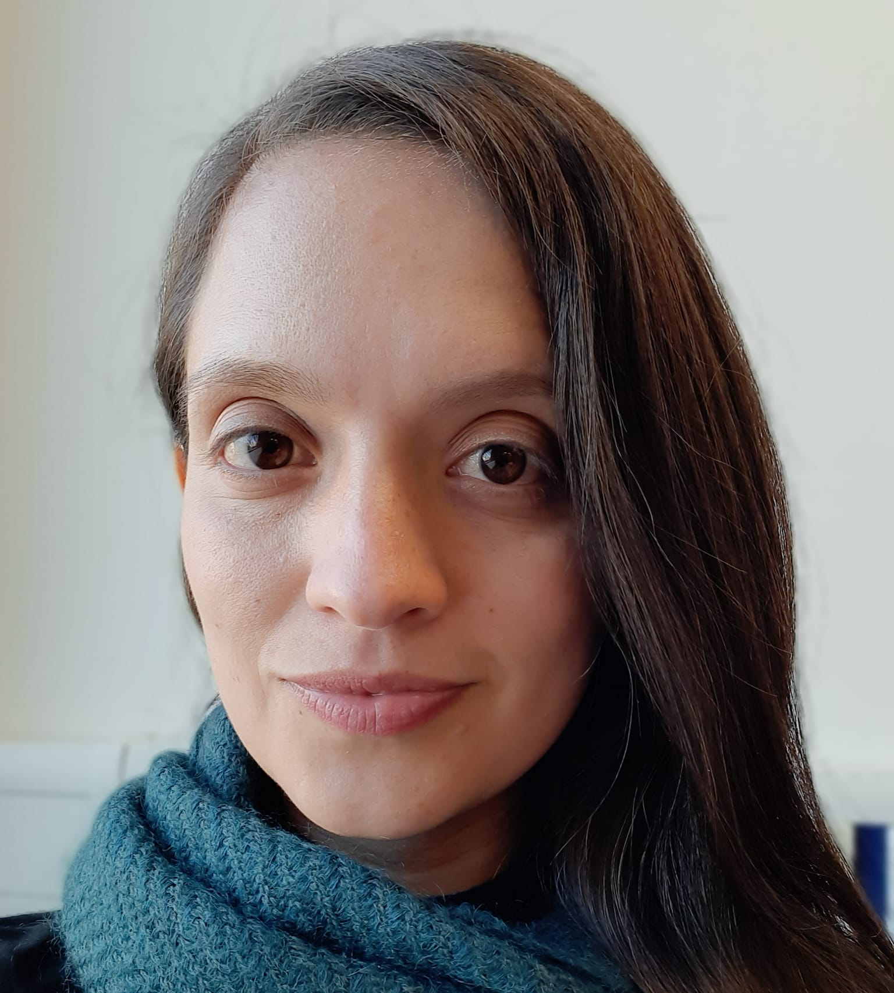

Presentation of the team
Juan Martín Espitia
Redactor and designer
David Alejandro Blandon
Data management
Daniel Betancur
Writer and Investigator
https://github.com/jmespitiag/Routes_against_street_harassment.git

