Slide 1
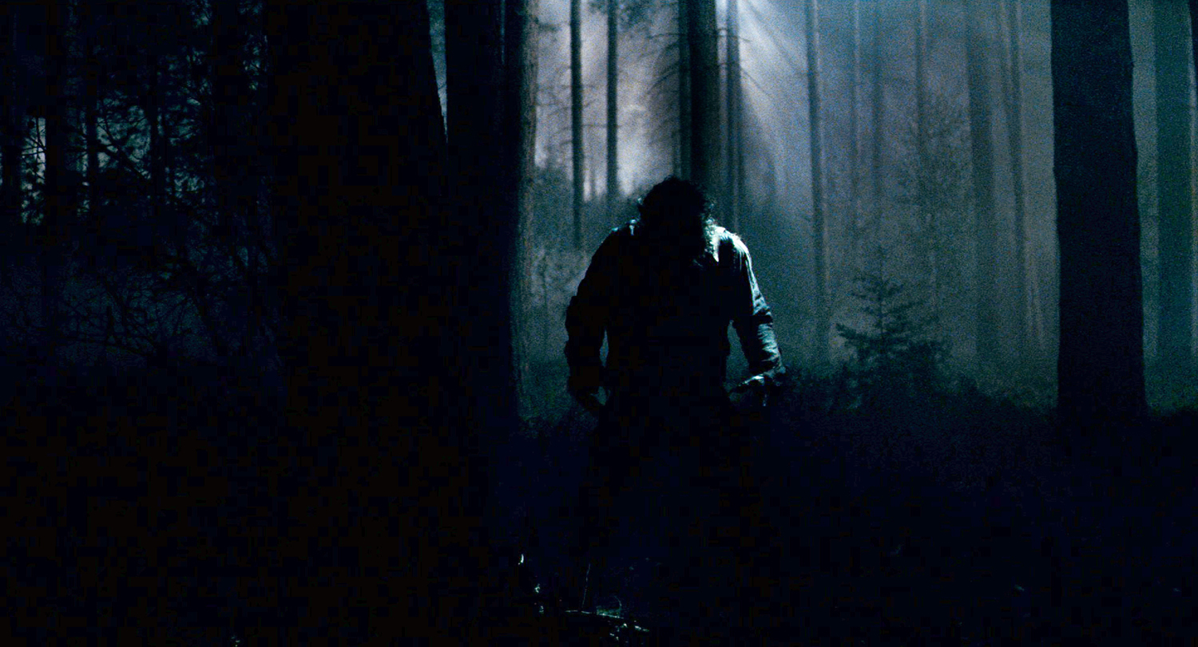

TO DISCOVER QUICK AND EFFECTIVE ROUTES AGAINST STREET ABUSE

Slide 2

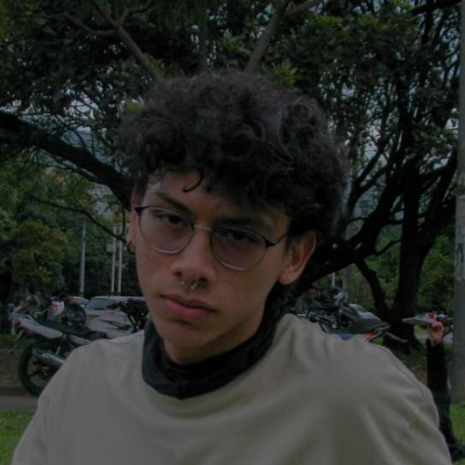

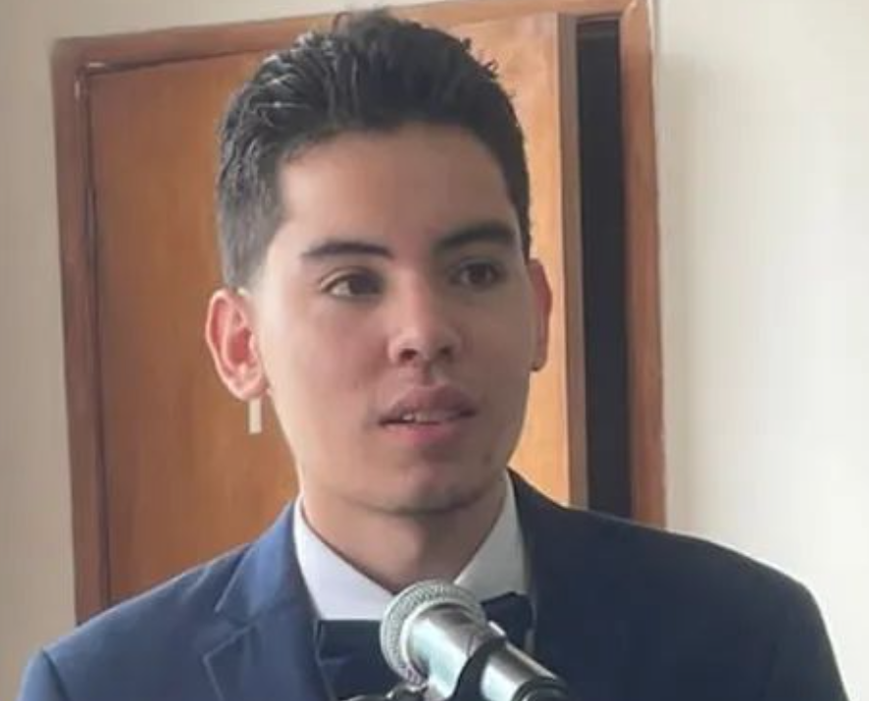


Team Presentation
Juan Martín Espitia
Redactor and designer
David Alejandro Blandon
Data management
Daniel Betancur
Writer and Investigator
https://github.com/jmespitiag/Routes_against_street_harassment.git

Slide 3
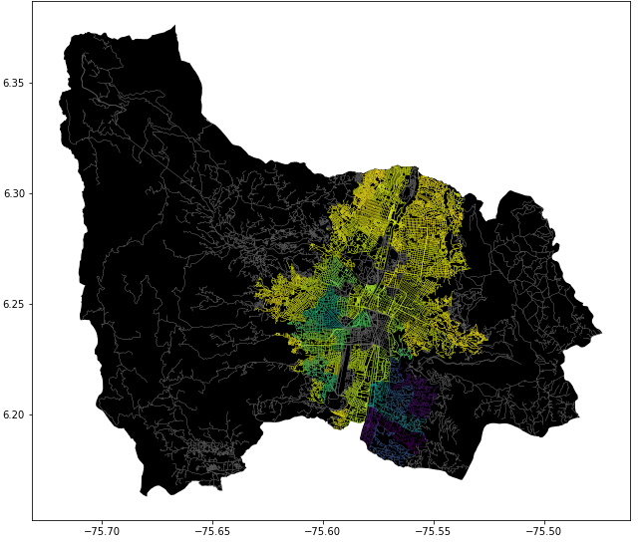
Problem statement
Algorithm for the shortest path
Streets of Medellin, Origin y Destination
Three paths that reduce both the risk of harassment and distance

Slide 4
Solution algorithm
Dijkstra’s algorithm
Streets of Medellin, Origin y Destination
a path that reduces both distance and harassment

Slide 5
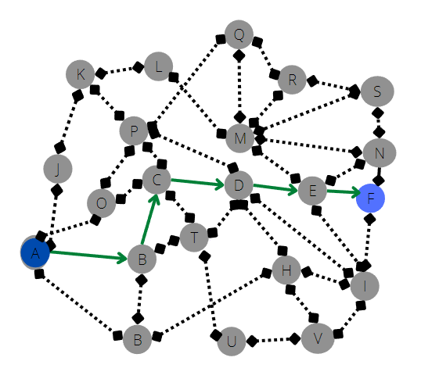
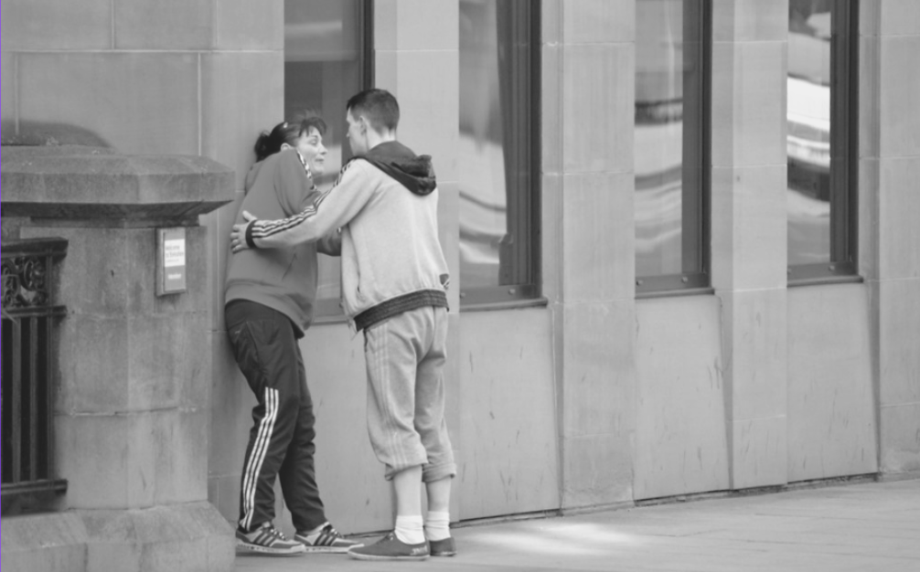
Explanation of the algorithm
Dijkstra’s Algorithm
Determine the shortest path to execute from a source vertex to the rest of the vertices located in a graph with weights on each edge

