Slide 1
Normalised
Least Mean-Square
Adaptive Filtering

Slide 2
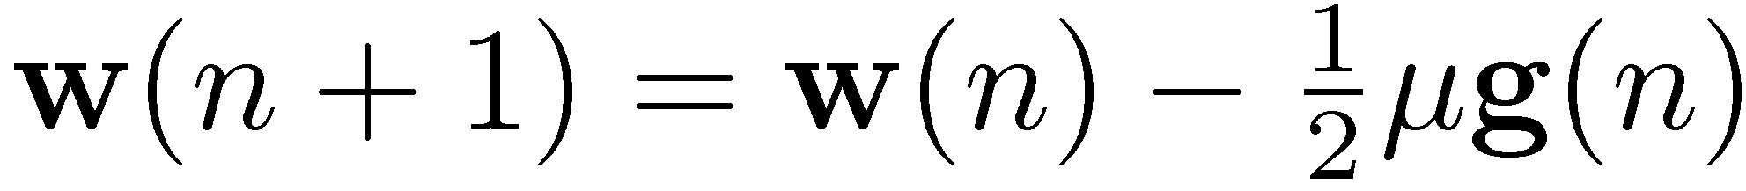
LMS Filtering
The update equation for the LMS algorithm is
which is derived from SD as an approximation
where the step size μ is originally considered for a deterministic gradient.
LMS suffers from gradient noise due to its random nature.
Above update is problematic due to this noise
  Gradient noise amplification when ||u(n)|| is large.
Step size
Error signal
Filter input
Step size

Slide 3
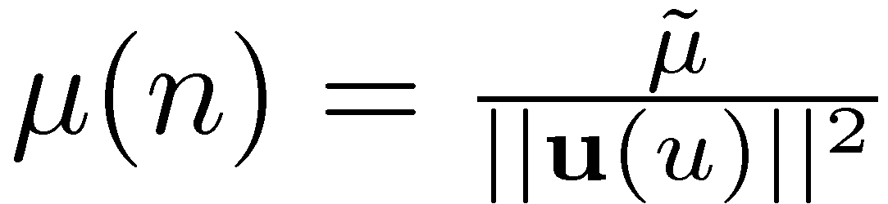
Normalised LMS
u(n) is random → instantaneous samples can assume any value for the norm ||u(n)|| which can be very large.
Solution: input samples can be forced to have constant norm
  Normalisation
  Update equation for the normalised LMS algorithm.
Note the similarity bw. NLMS and LMS update eqn.s
  NLMS can be considered same as LMS except time-varying step size.

Slide 4
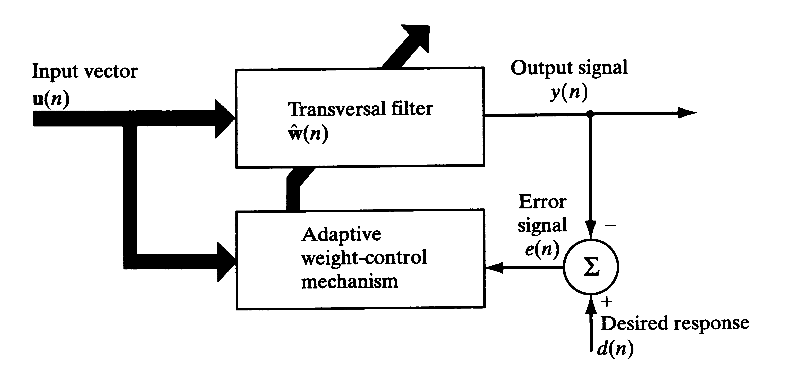
Normalised LMS
Block diagram very similar to that of LMS
The difference is in the Weight-Control Mechanism block.

Slide 5
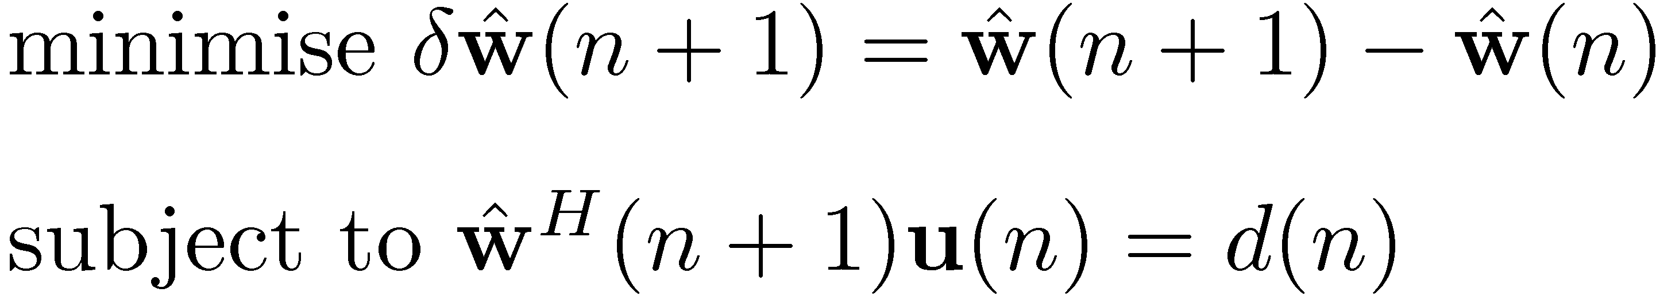
Normalised LMS
We have seen that LMS algorithm optimises the H∞ criterion instead of MSE.
Similarly, NLMS optimises another problem:
  From one iteration to the next, the weight vector of an adaptive filter should be changed in a minimal manner, subject to a constraint imposed on the updated filter’s output.
Mathematically,
which can be optimised by the method Lagrange multipliers

Slide 6
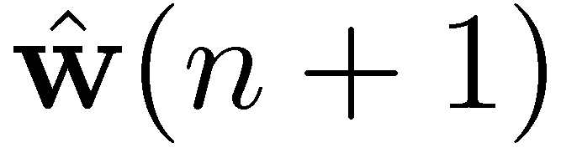
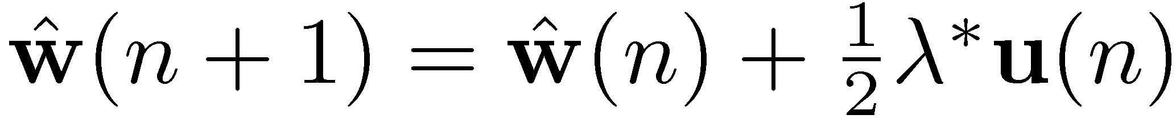
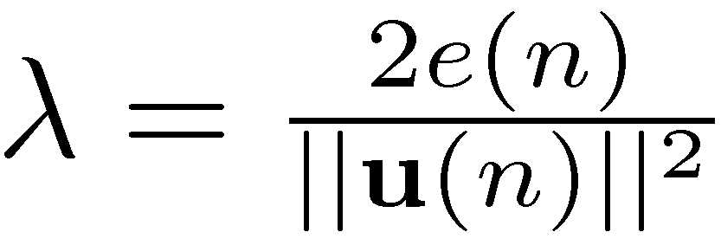
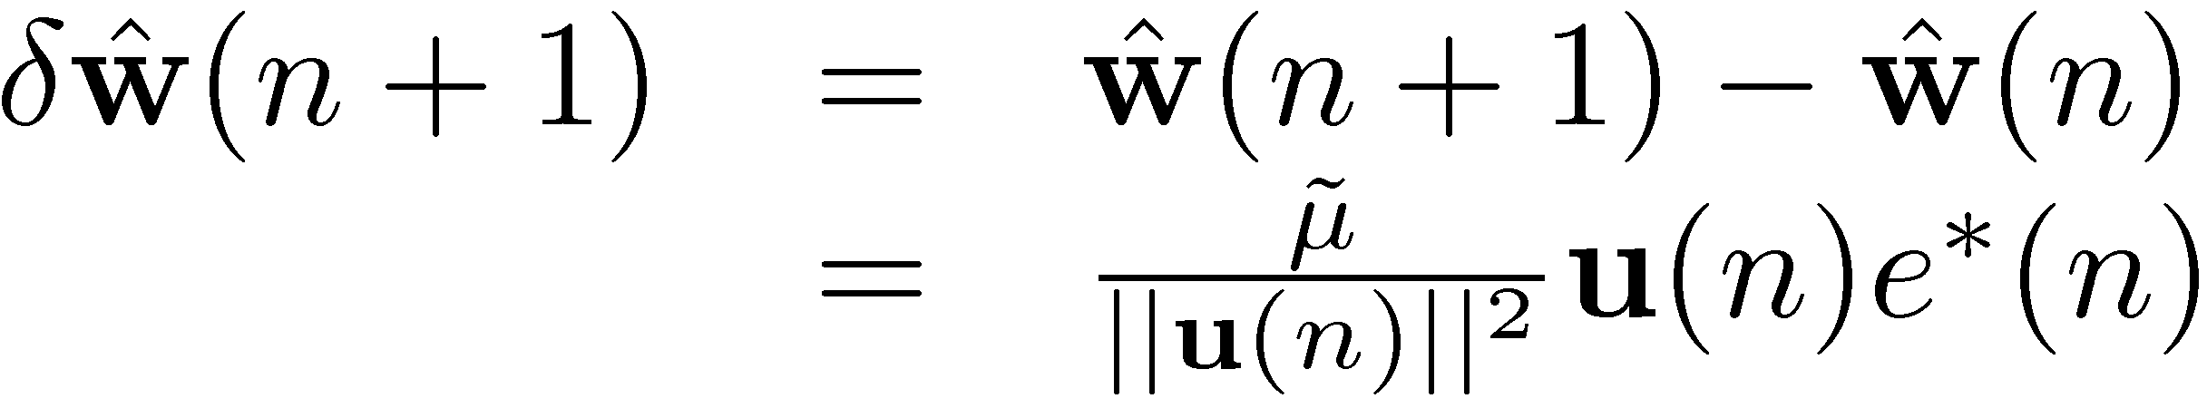
Normalised LMS
1. Take the first derivative of J(n) wrt and set to zero to find
2. Substitute this result into the constraint to solve for the multiplier
3. Combining these results and adding a step-size parameter to control the progress gives
4. Hence the update eqn. for NLMS becomes

Slide 7
Normalised LMS
Observations:
  We may view an NLMS filter as an LMS filter with a time-varying step-size parameter
  Rate of convergence of NLMS is faster than LMS
||u(n)|| can be very large, however, likewise it can also be very small
  Causes problem since it appears in the denominator
  Solution: include a small correction term to avoid stability problems.

Slide 8
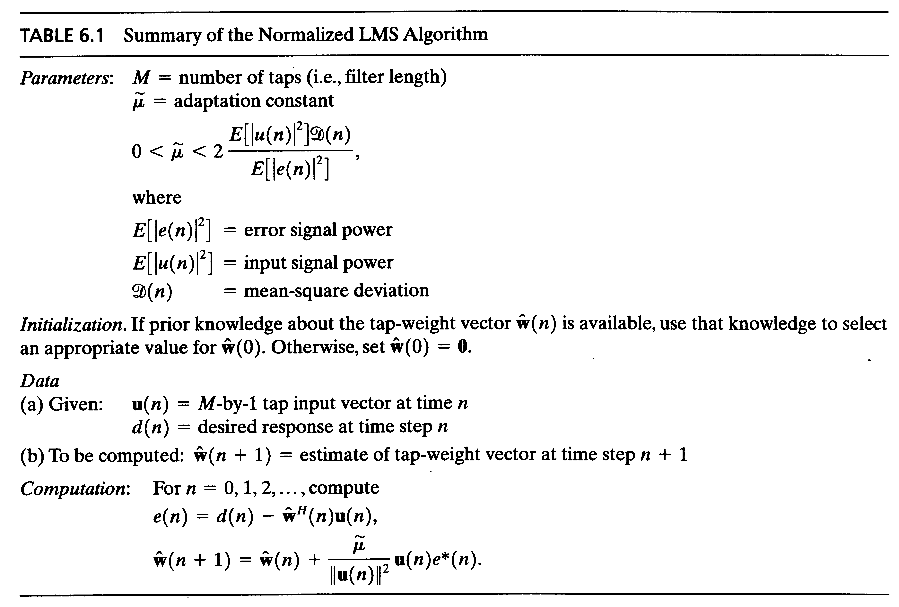
Normalised LMS

Slide 9
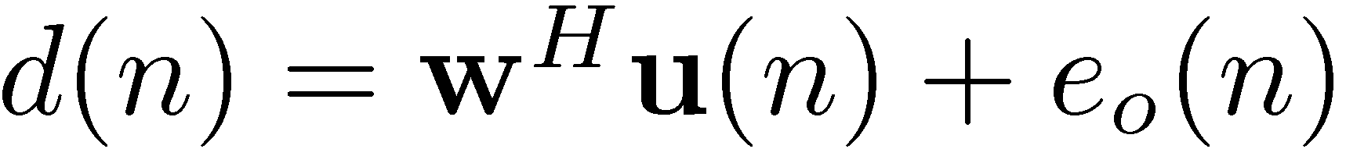
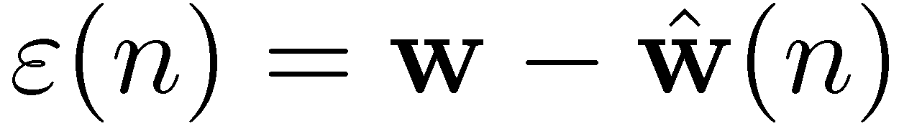
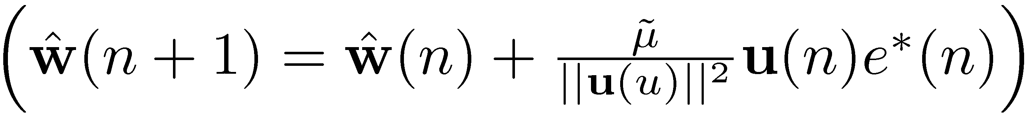
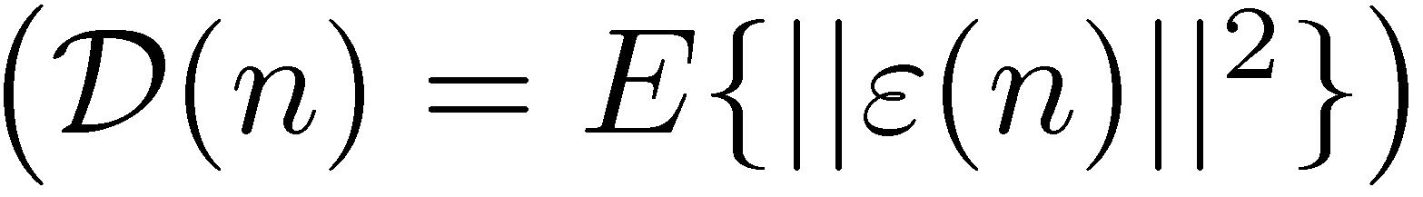
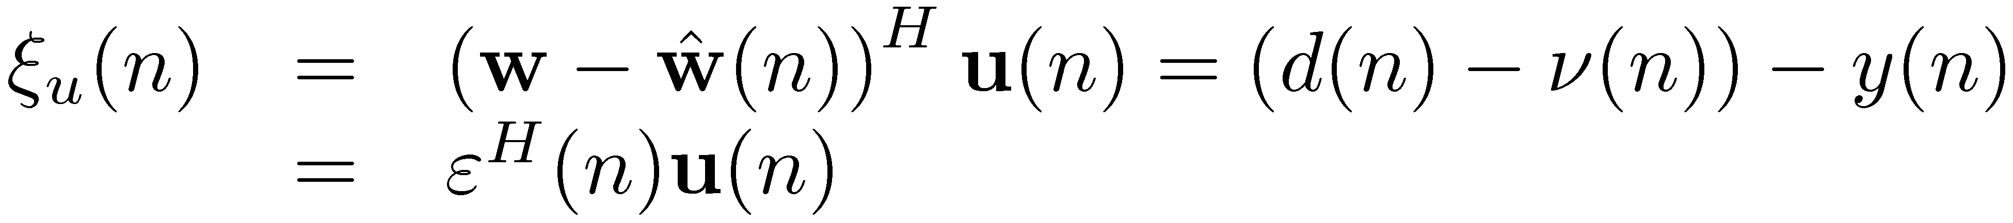
Stability of NLMS
What should be the value of step size μ for convergence?
Assume that the desired response is governed by
Substituting the weight-error vector
into the NLMS update equation we get
which provides the update for the mean-square deviation
Undisturbed error signal

Slide 10
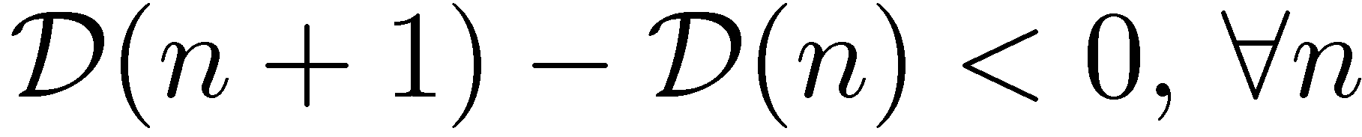
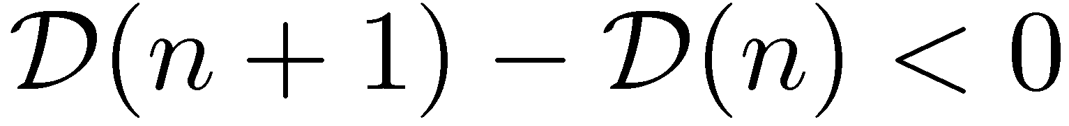
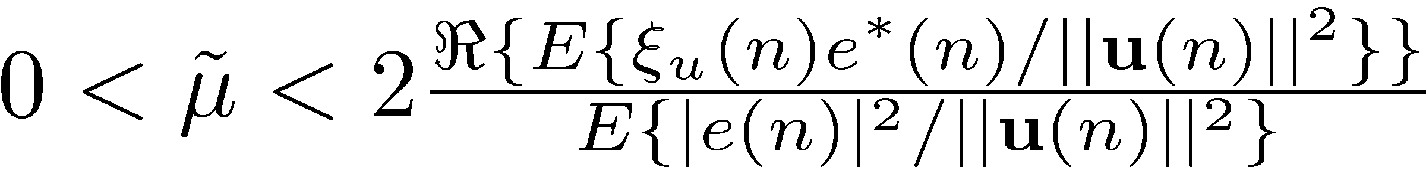
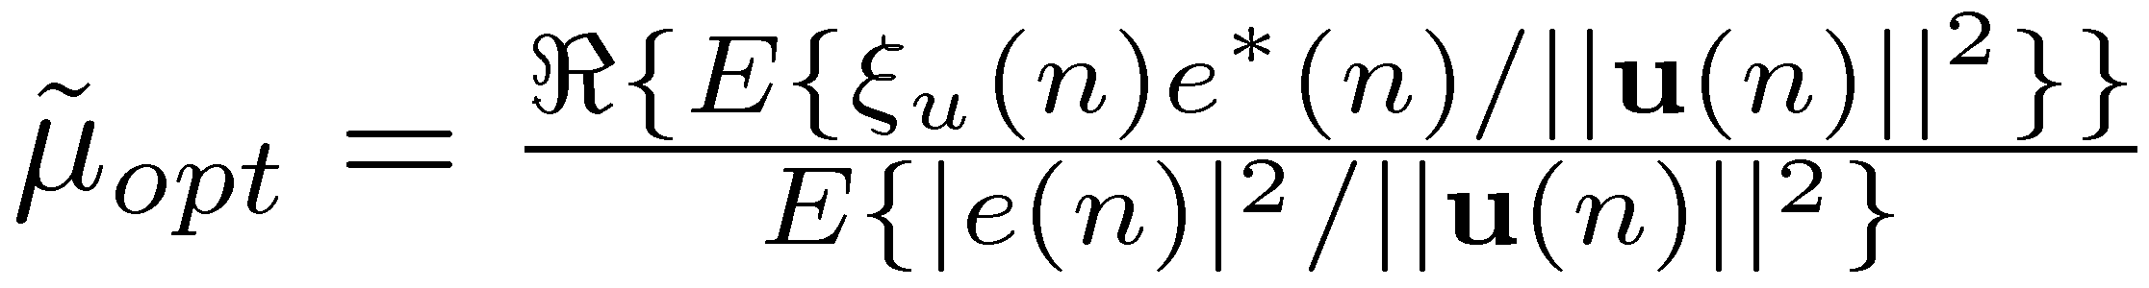
Stability of NLMS
Find the range for μ so that
Right hand side is a quadratic function of μ,
  is satisfied when
  Differentiate wrt and equate to 0 to find μ_{opt}
    This step size yields maximum drop in the MSD!
For clarity of notation assume real-valued signals

Slide 11
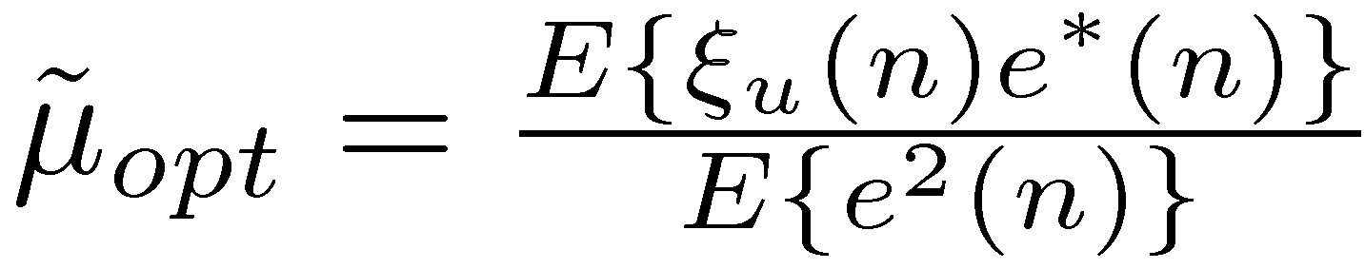
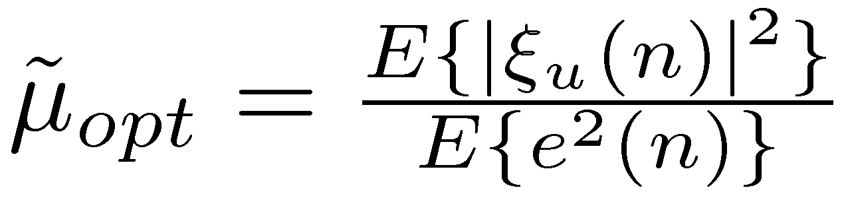
Stability of NLMS
Assumption I: The fluctuations in the input signal energy ||u(n)||² from one iteration to the next are small enough so that
Then
Assumption II: Undisturbed error signal ξ_{u}(n) is uncorrelated with the disturbance noise ν(n)
Then
e(n): observable, ξ_{u}(n): unobservable

Slide 12
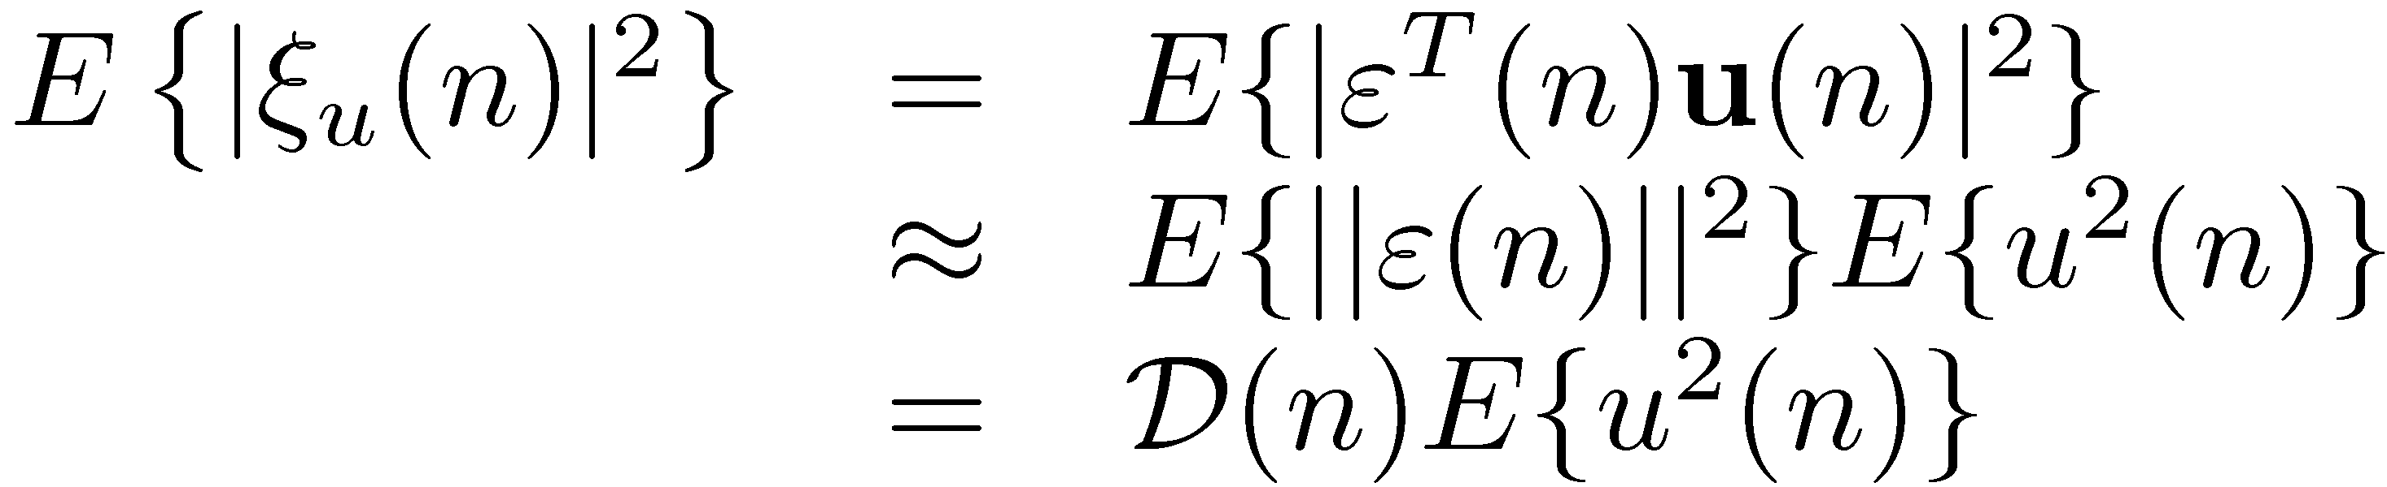
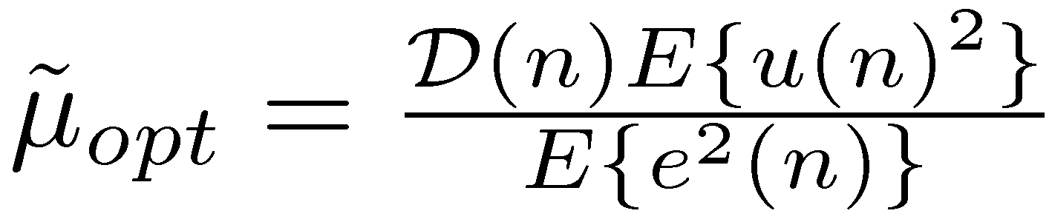
Stability of NLMS
Assumption III: The spectral content of the input signal u(n) is essentially flat over a frequency band larger than that occupied by each element of the weight-error vector ε(n) , hence
Then

Slide 13
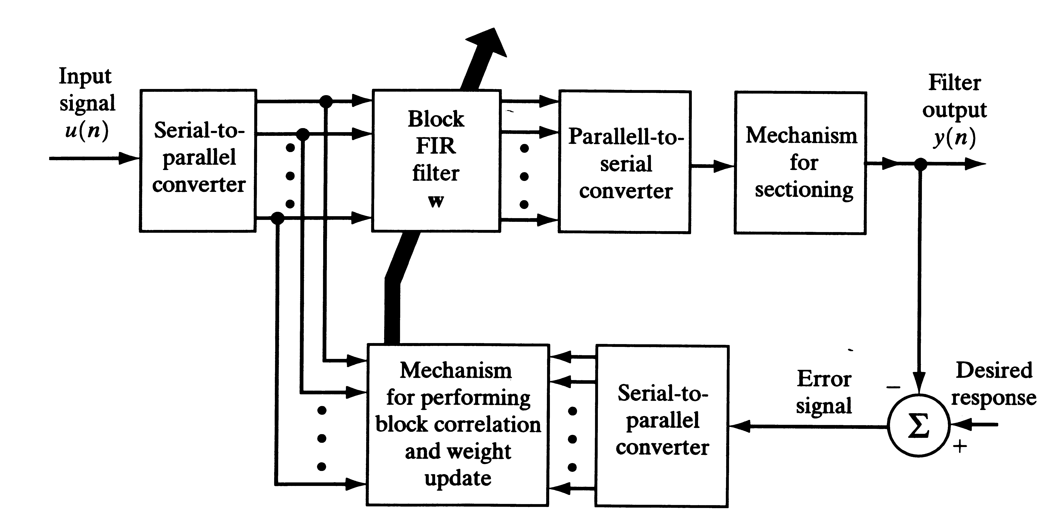
Block LMS
In conventional LMS, filter coefficients are updated for each sample
What happens if we update the filter in every L samples?

Slide 14
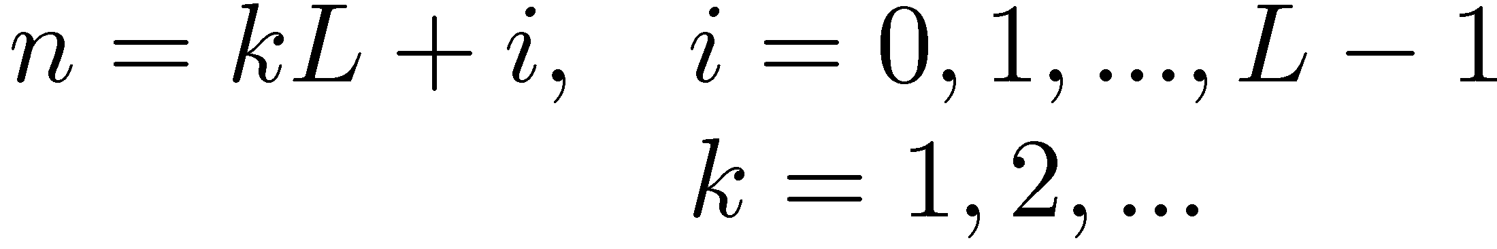
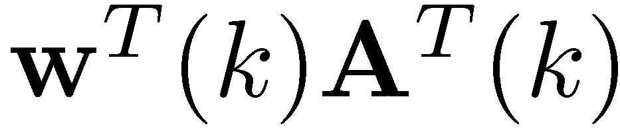
Block LMS
Express the sample time n in terms of the block index k
Stack the L consecutive samples of the input signal vector u(n)
into a matrix corresponding to the k-th block
where the whole k-th block will be processed by the filter
i=0
i=1
i=L-1
convolution

Slide 15
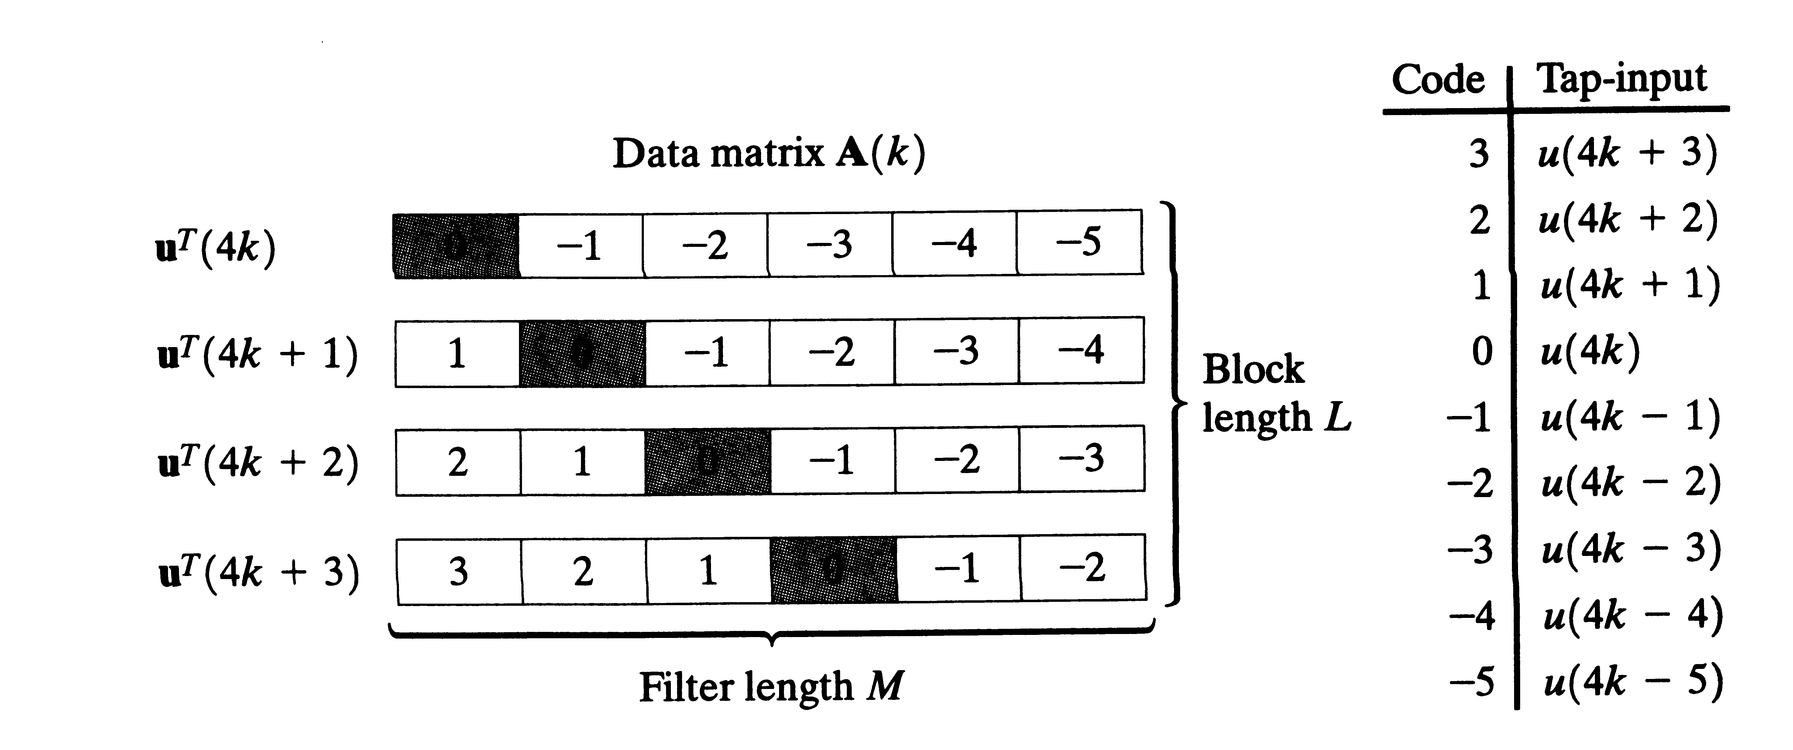
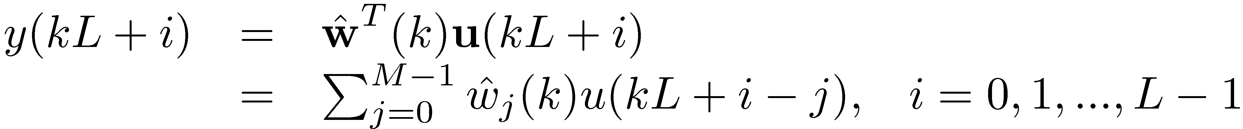
Block LMS
Filter length: M=6
Block size: L=4
The output of the filter is
And the error signal is
Error is generated for every sample in a block!

Slide 16
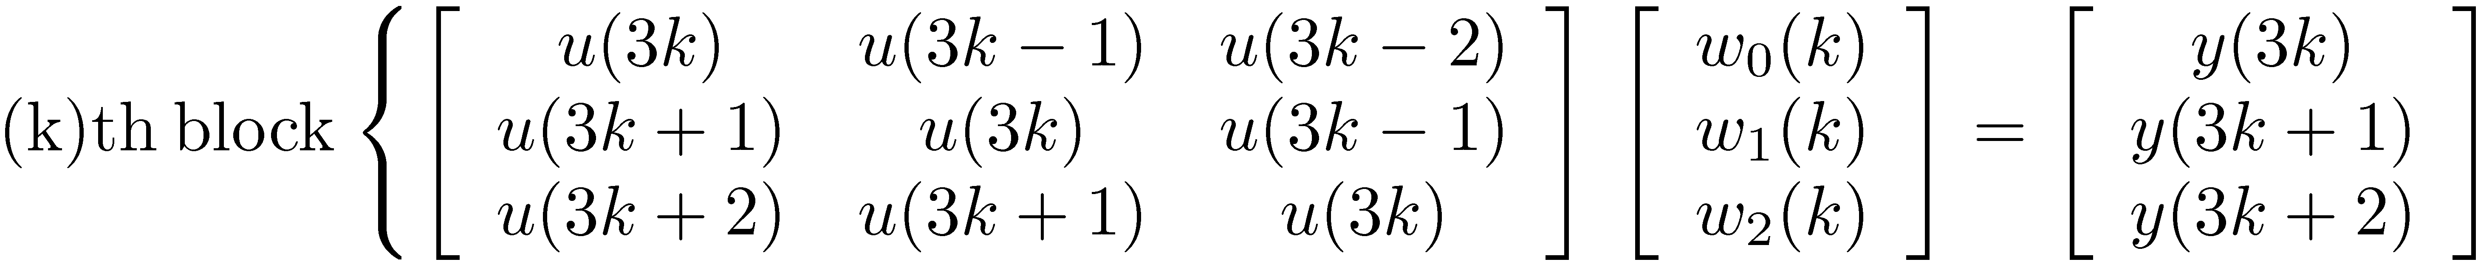
Block LMS
Example:
  M=L=3
  (k-1), k, (k+1)th block

Slide 17
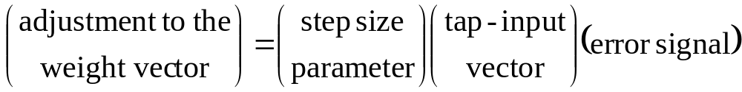
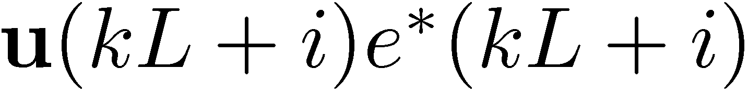
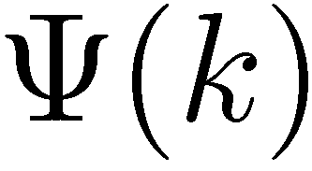
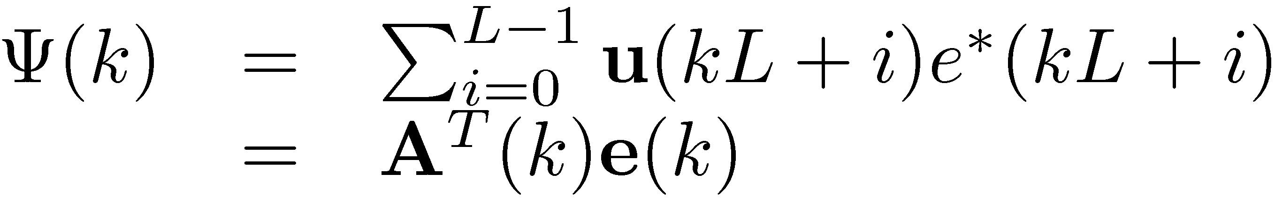
Block LMS Algorithm
Conventional LMS algorithm is
For a block of length L, w(k) is fixed, however, for every sample in a block we obtain separate error signals e(n).
How can we link these two?
Sum the product , i.e.
where

Slide 18
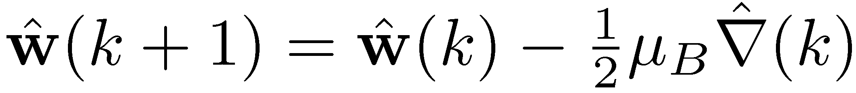

Block LMS Algorithm
Then the estimate of the gradient becomes
And the block LMS update eqn. İs
where
Block LMS
step-size
Block size
LMS step-size

Slide 19
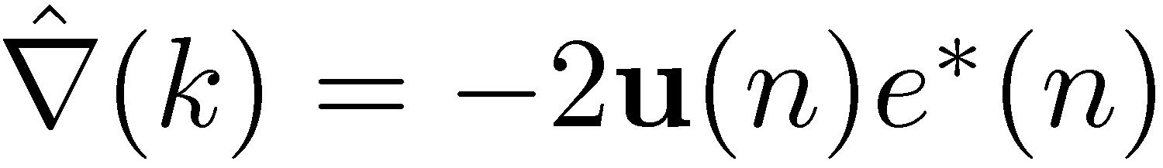
Convergence of Block LMS
  Conventional LMS Block LMS
Main difference is the sample averaging in Block LMS
  yields better estimate of the gradient vector.
Convergence rate is similiar to conventional LMS, not faster
  Block LMS requires more samples for the ‘better’ gradient estimate
Same analysis done for conventional LMS can also be applied here.
  Small-step size analysis

Slide 20
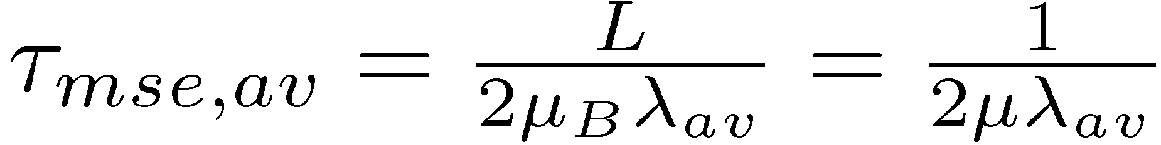

Convergence of Block LMS
Average time constant
if μ_{B}<1/λ_{max}
Misadjustment
same as
LMS
same as
LMS

Slide 21
Choice of Block Size?
Block LMS introduces processing delay
  Results are obtained at every L samples, L can be >>1
What should be length of a block?
  L=M: optimal choice from the viewpoint of computational complexity.
  L<M: reduces processing delay, although not optimal, better computational efficiency wrt conventional LMS
  L>M: redundant operations in the adaptation, estimation of the gradient uses more information than the filter itself.

Slide 22
Fast-Block LMS
Correlation is equivalent to convolution when one of the sequences is order reversed.
Linear convolution can be effectively computed using FFT
  Overlap-Add, Overlap-Save methods
A natural extension of Block LMS is to use FFT
  Let block size be equal to the filter length, L=M,
  Use Overlap-Save method with an FFT size of N=2M.

Slide 23
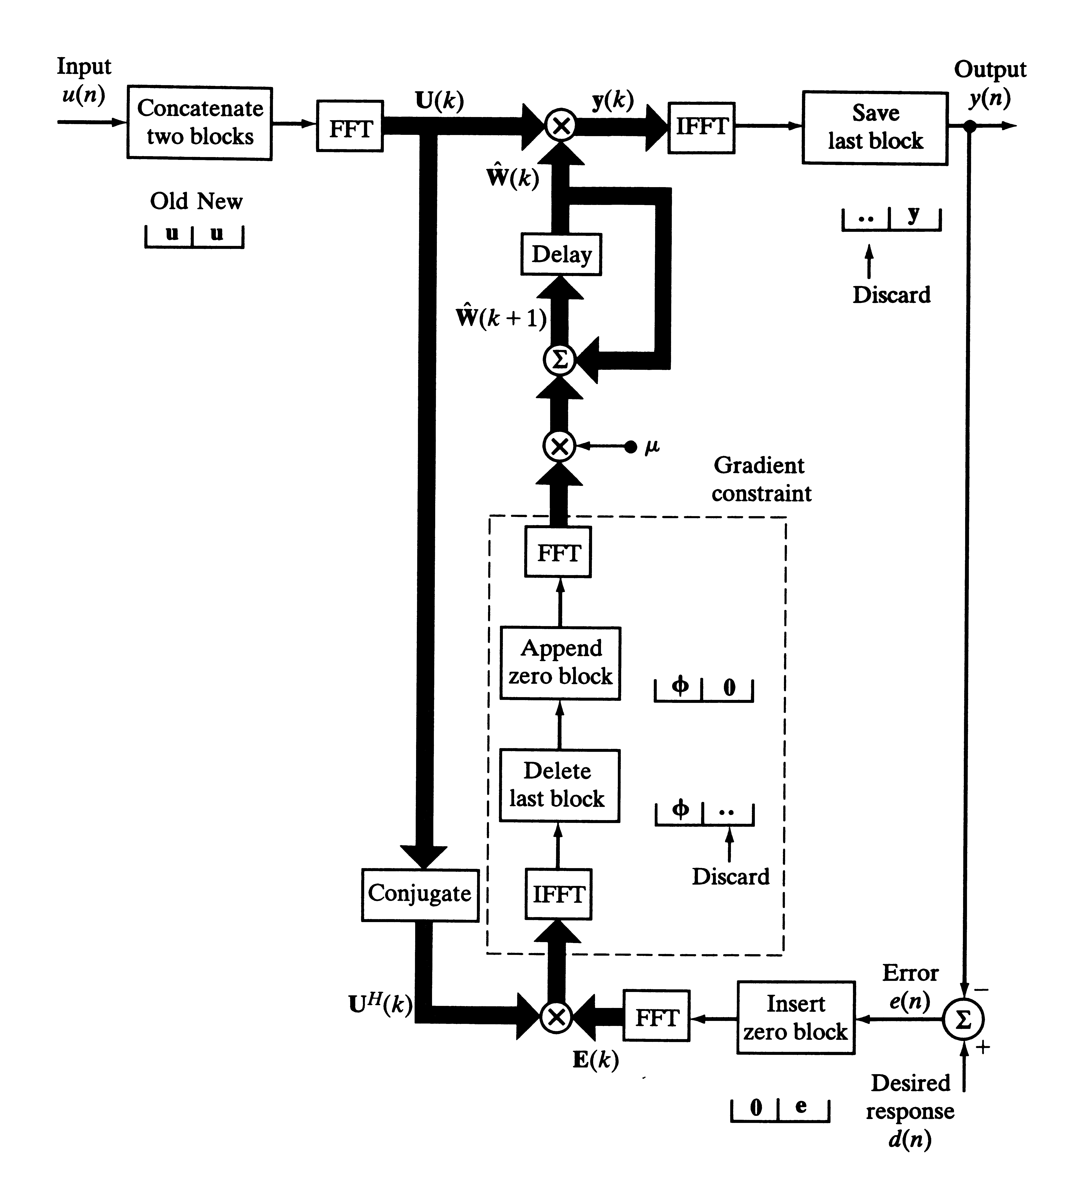

Slide 24
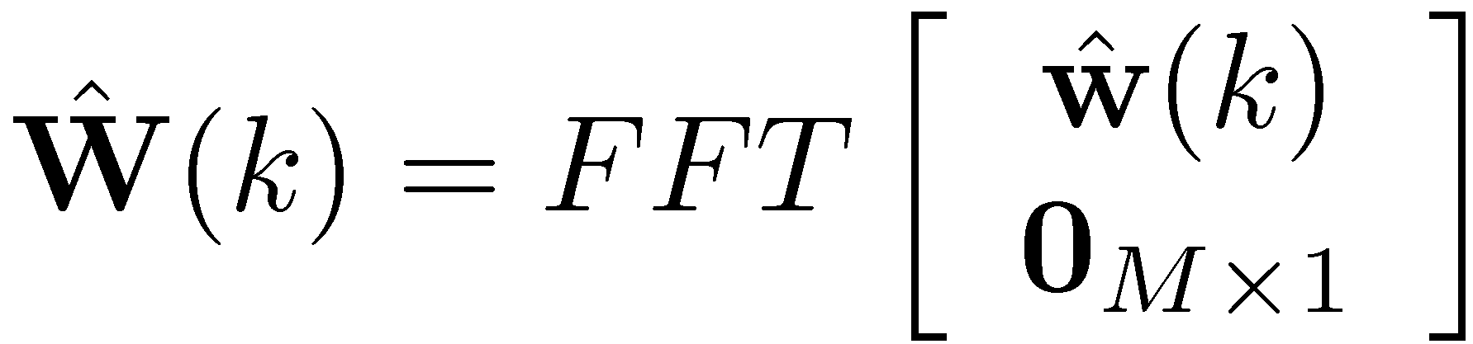
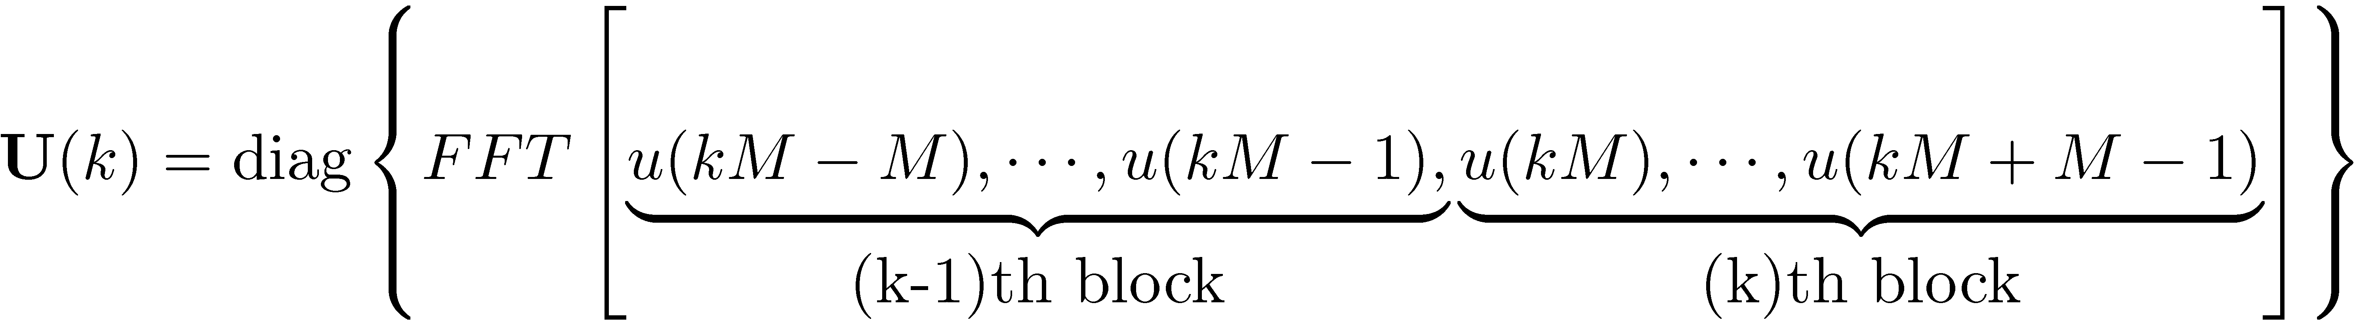
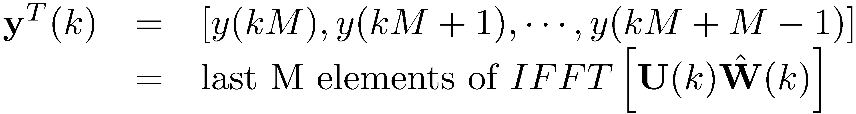
Fast-Block LMS
Using these two in the convolution, for the k-th block
The Mx1 desired response vector is
and the Mx1 error vector is

Slide 25
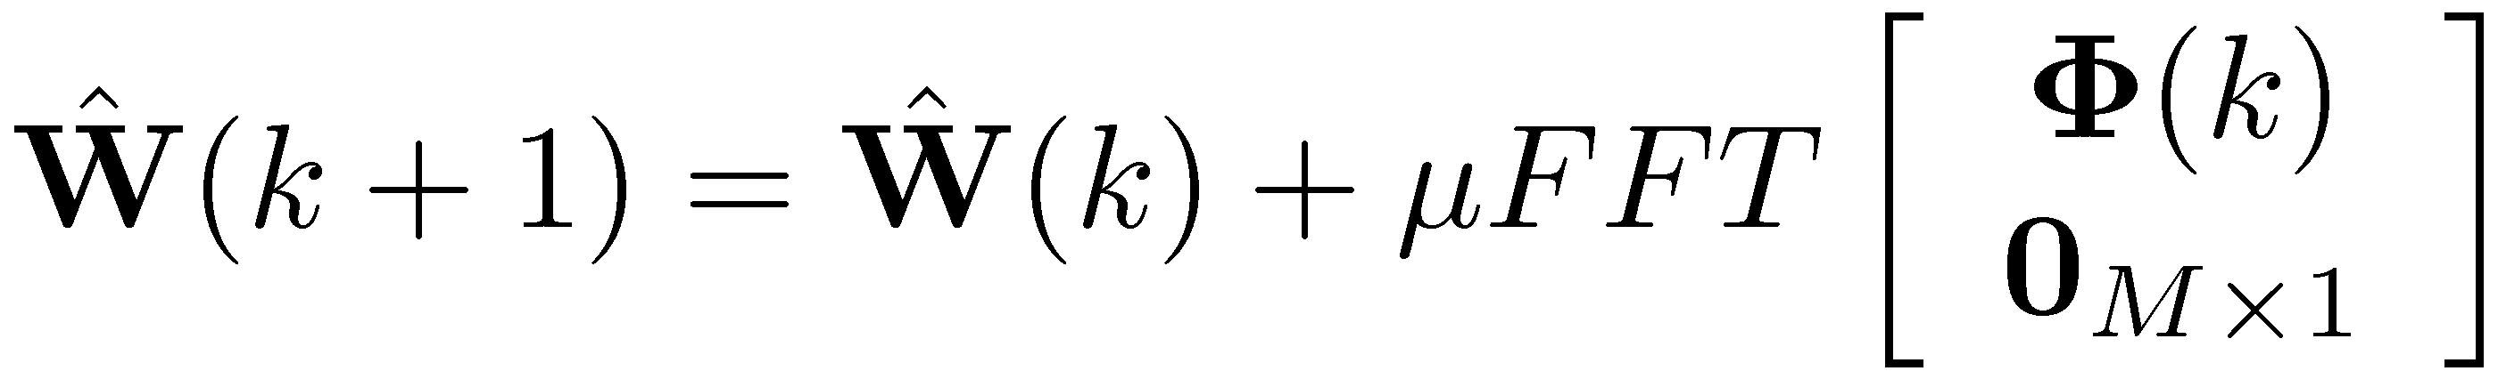
Fast-Block LMS
Correlation is convolution with one of the seq.s order reversed:
Then the update equation becomes (in the frequency domain)
Computational Complexity:
  Conventional LMS: requires 2M multiplications per sample
    2M² multiplications per block (of length M)
  Fast-Block LMS: 1 FFT = N log₂(N) real multiplications (N=2M)
    5 (I)FFTs, U^{H}(k)E(k): 4N multiplications → Total: 10Mlog2M+28M mult.s
  For M=1024, Fast Block LMS is 16 times faster than conventional LMS

Slide 26
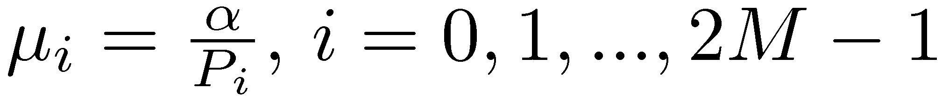
Fast-Block LMS
Same step size for all frequency bins (of FFT).
Rate of convergence can be improved by assigning separate step-size parameters to every bin
α: constant, P_{i}: estimate of the average power in the i-th freq. Bin
  Assumes wss. environment.
If not wss., use the recursion
i-th input of the Fast-LMS algorithm (freq. dom.)
for the k-th block

Slide 27
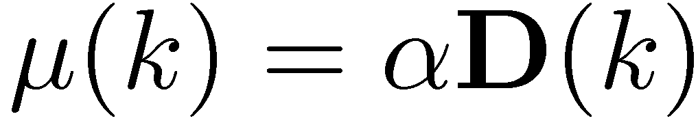

Fast-Block LMS
Run the iterations for all blocks to obtain
Then the step size parameter μ can be replace by the matrix μ
where
Update the Fast-LMS algorithm as follows:
  1.
  2. replace μ by α in the update eqn.

Slide 28




