Slide 1
BenchBot
EC 500 D1 Final Project
Presented by JoJo Meunier and Mike Ferguson

Slide 2
Motivation
To build a low cost robot with a user friendly interface that could assist biologist in performing tedious lab tasks such as PCR. Example: Colony PCR of dozens of colonies to submit for sequencing - increases chances of cloning success and saves money (don’t have to sequence all the colonies).
Automating steps in the cloning process would allow for repeatability in experimental results (save time and money) as well as save the biologist many hours of doing repeat tasks.

Slide 3
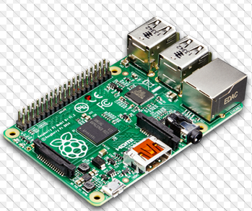
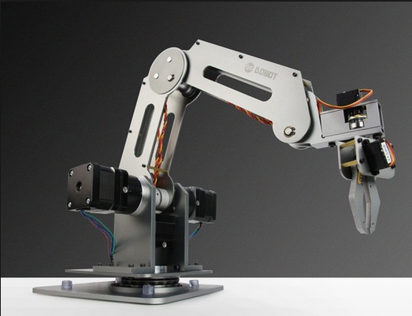
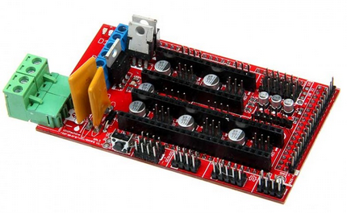
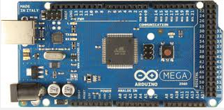
Hardware Functionality
Dobot - $500 (now $900) 4 axis robot, stepper motor driven with 10:1 planetary gear (increase resolution).
Arduino Mega 2560 - firmware to control stepper motors, 10$
RAMPS 1.4 - $10 board for stepper motor drivers, used in 3D printers, I2C
Electronic Pipettor - Uses a can stack linear actuator to move a teflon piston up and down a glass tube. 3D printed case and tip adapter (cost ~$100-$150).
Laptop or Raspberry Pi to run the software
Mike Ferguson

Slide 4
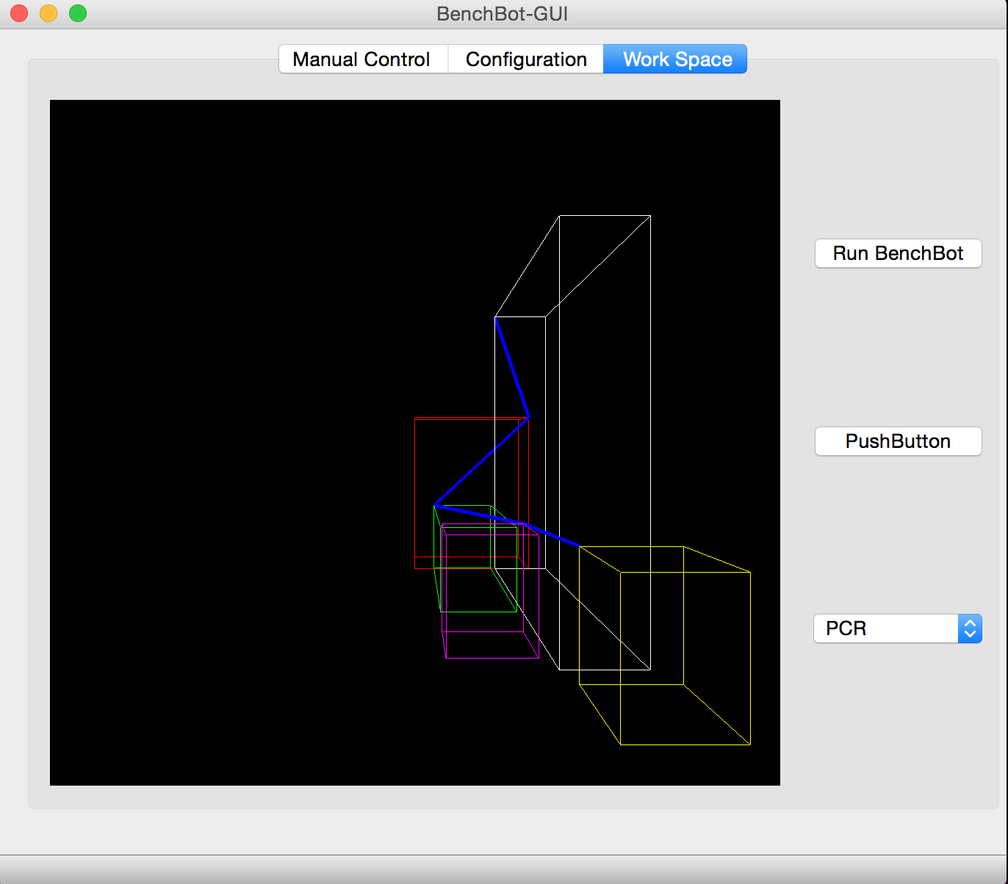
User Interface Functionality
User friendly GUI that allows someone to control the robot manually by sending it coordinates directly
Menu items allow the user to select from list of tasks they want to perform
Standard json file is provided to user that defines where each item in a workspace is
Objects are rendered in 3D scene on the workspace tab of the interface
Defined path can be run from interface by pressing a button
JoJo Meunier

Slide 5
Specification
BenchBot should allow the user to define their own workspace and instructions for each task by taking a standard json file that was provided and modifying it for their needs
Robot should be low in cost ~ $1000
It should move smoothly with no unpredicted movements
Speed should be on the order of seconds to move from A to B (reliability more important than speed)
Accuracy and resolution should be sufficient to pick up a pipette (few mm in diameter)
It should be able to determine best path to take and avoid obstacles in workspace
Small footprint, but large enough workspace
Be able to perform simple tasks for long periods of time ~ on the scale of several hours or even days (Feedback and Quality control)
Software should not be web based (could result in dropped commands)

Slide 6
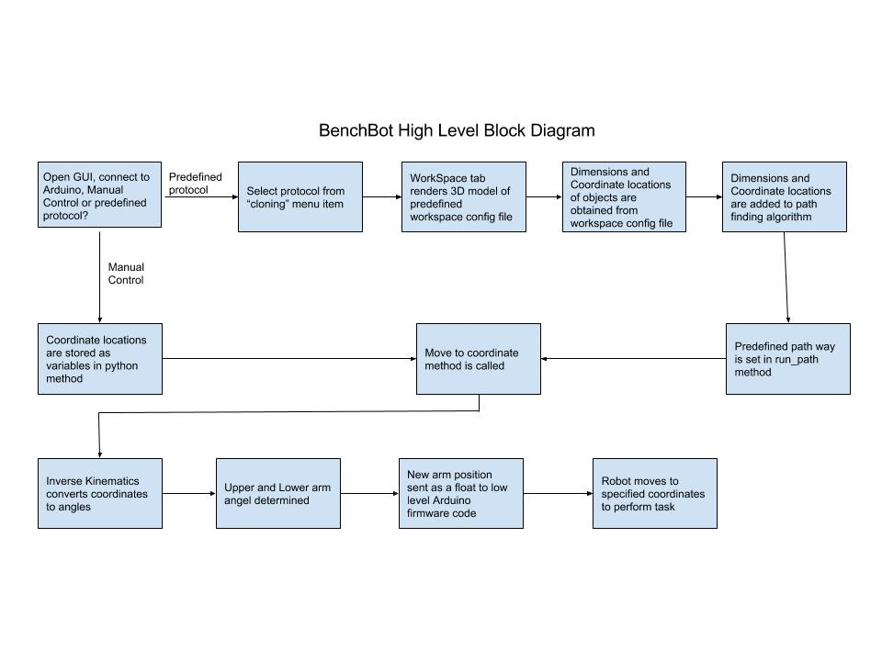

Slide 7
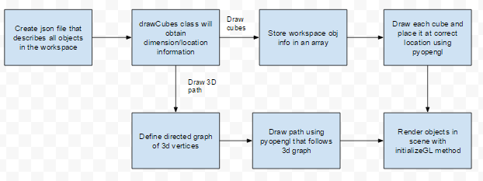
3D Model Rendering
Dimensions of all workspace objects are defined in python dictionaries
Dictionaries are used to create a json file
Coordinate locations and dimensions are used to define the location of 3D cube and size
Render cubes using pyopengl widget that is embedded into WorkSpace tab on GUI
Path way is defined and lines are drawn over cubes to demo the path the robot will travel
JoJo Meunier

Slide 8
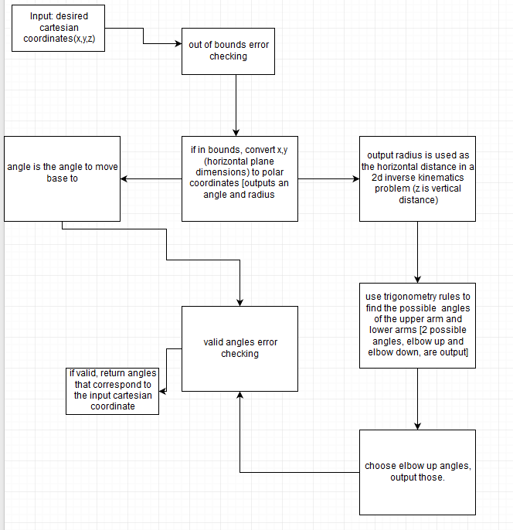
Inverse Kinematics
Translation algorithm
Converts cartesian coordinate position to polar coordinates
Polar coordinates are used as instructions for how the arm angle should change through a given path
Has an error check so that coordinates are not outside of the Dobot’s possible angle constraints
Mike Ferguson

Slide 9
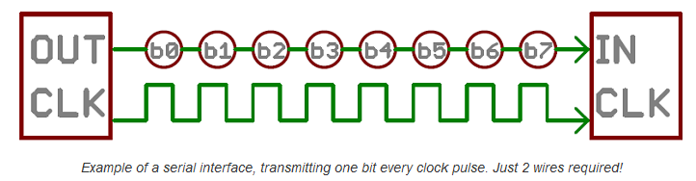
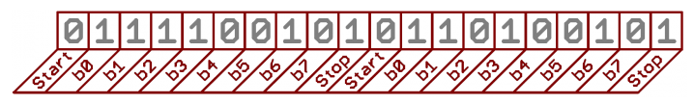
Serial Communication
Send data over Universal Serial Bus (USB)
Binary vs. Character based protocols
Arduino only has 8MB of RAM!
Serial Buffer is only 64 bytes!
Error checking can be incorporated (checksum)

Slide 10
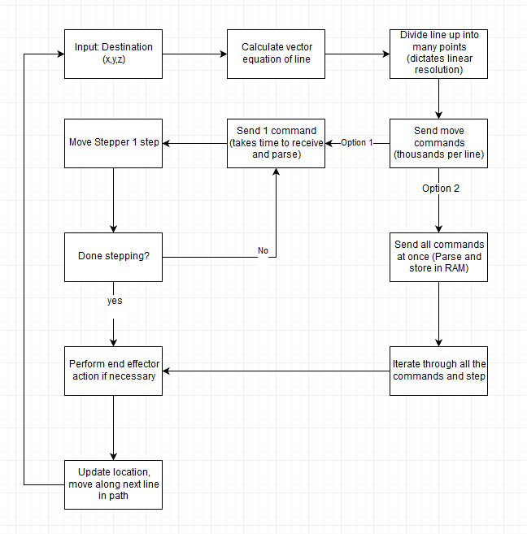
Moving in a straight line
Divide line into many points
Calculate step sequence
Send move commands
Various communication algorithms

Slide 11
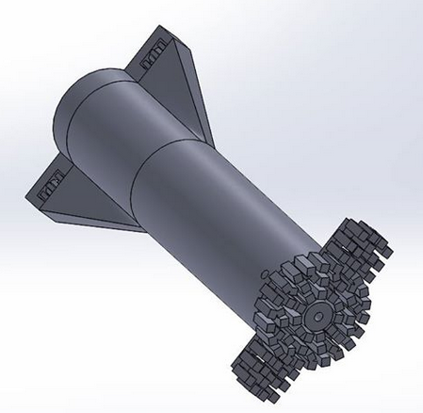
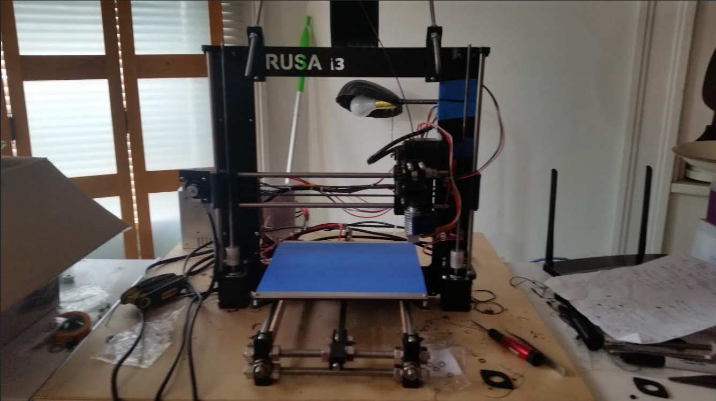
Electronic Pipettor
Can stack stepper motor linear actuator
3D printed case with a tip adapter
Teflon piston
Borosilicate glass barrel
Need to fix sealing mechanism

Slide 12
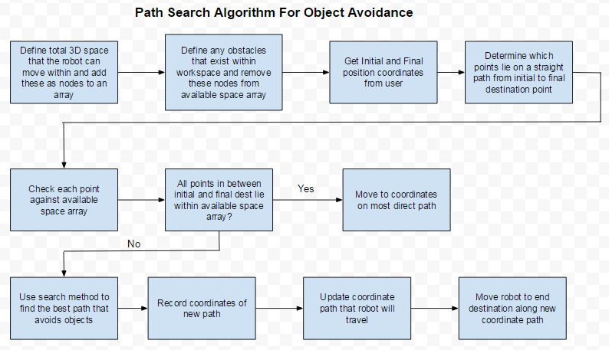
Path Finding Algorithm
JoJo Meunier

Slide 13
Successes
Implemented user interface that can be used by non-programmers to run lab tasks
Implemented algorithms that allow for the robot to move to specified coordinates along the most direct path
Implemented 3D model view in interface to allow user to visualize the path the robot will take as well as where objects should be placed in a workspace

Slide 14
Moving Forward
Better stepper motors for Dobot (More torque, higher resolution)
Bigger arm? Manufacture the arm from CAD files (~$250?)
Improve the serial protocol. Run everything from Raspberry Pi? (More RAM)
Add functionality to add custom menu items. Start developing useful tasks.
Calibration functionality
Finish the pipettor construction

