Slide 1


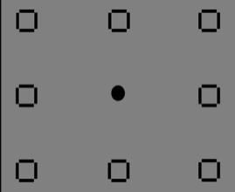
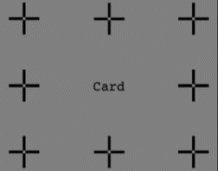
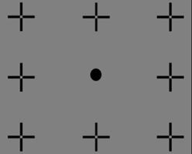
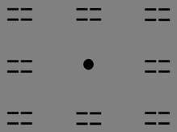
Experiment 1
+
card
250 ms
2000 ms
500 ms
Experiment 2
200 ms
1000 ms
Experiment 3
200 ms
2000 ms
3500 ms
1000 ms
200 ms
1000 ms
200 ms
500 ms
1500 ms
Experiment 4
200 ms
3500 ms
1000 ms
1000 ms
200 ms
500 ms
3500 ms
1500 ms
1000 ms

