Slide 1
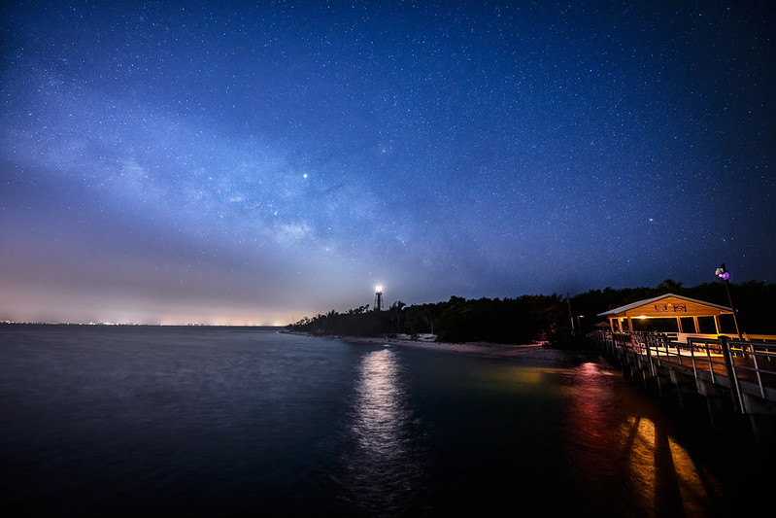
Sea Turtle Protection Policies & Light Pollution
Environmental Data Analytics Project by:
Grace Choi, Qiaotong Pang, & Jess Garcia

Slide 2
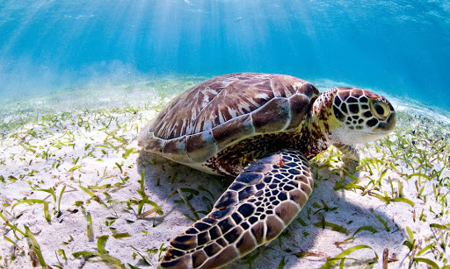
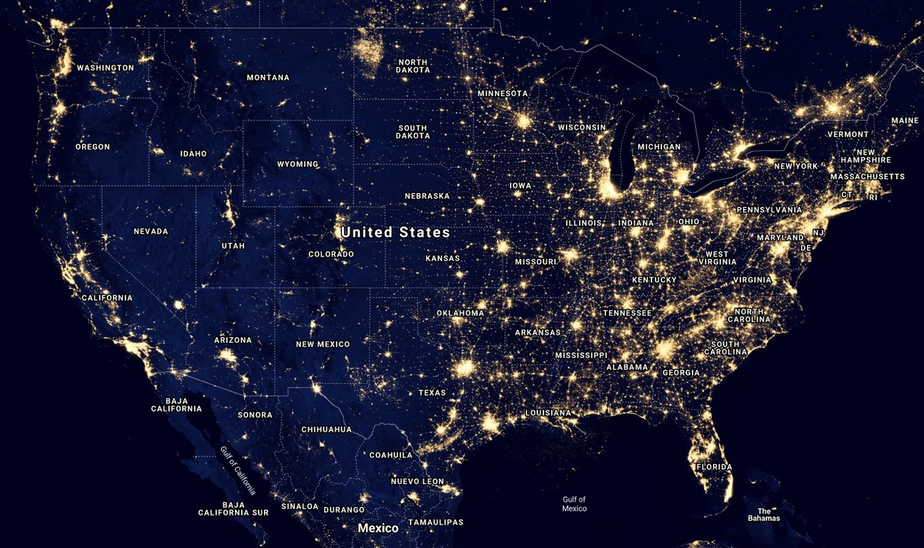
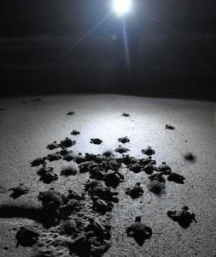
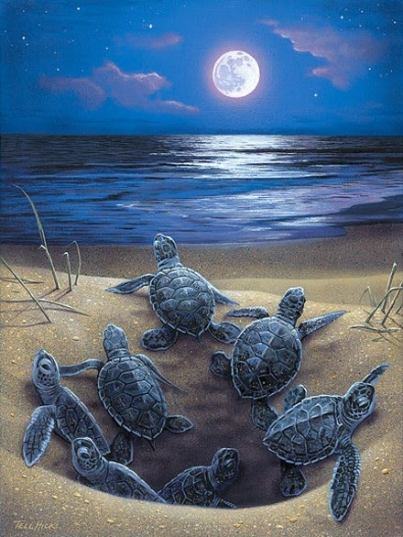
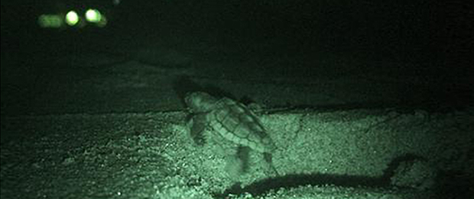
Notes:
Photo: https://elemental.medium.com/the-very-real-ways-that-light-pollution-affects-your-sleep-and-mood-9c423aebc16d,
https://www.worldwildlife.org/species/sea-turtle, https://www.worldwildlife.org/species/sea-turtle, https://www.worldwildlife.org/species/sea-turtle,
https://www.google.com/search?q=baby+sea+turtles+moon+light&tbm=isch&ved=2ahUKEwjhkcHw-5vwAhVD6JQKHRRPDKcQ2-cCegQIABAA&oq=baby+sea+turtles+moon+light&gs_lcp=CgNpbWcQAzoGCAAQBRAeOgYIABAIEB46BAgAEBNQ7hlY0zVgwDZoBXAAeACAAX6IAaMPkgEEMS4xN5gBAKABAaoBC2d3cy13aXotaW1nwAEB&sclient=img&ei=ormGYOG4IMPQ0wSUnrG4Cg&bih=719&biw=1486#imgrc=jck-nBYUwRxlXM

Slide 3
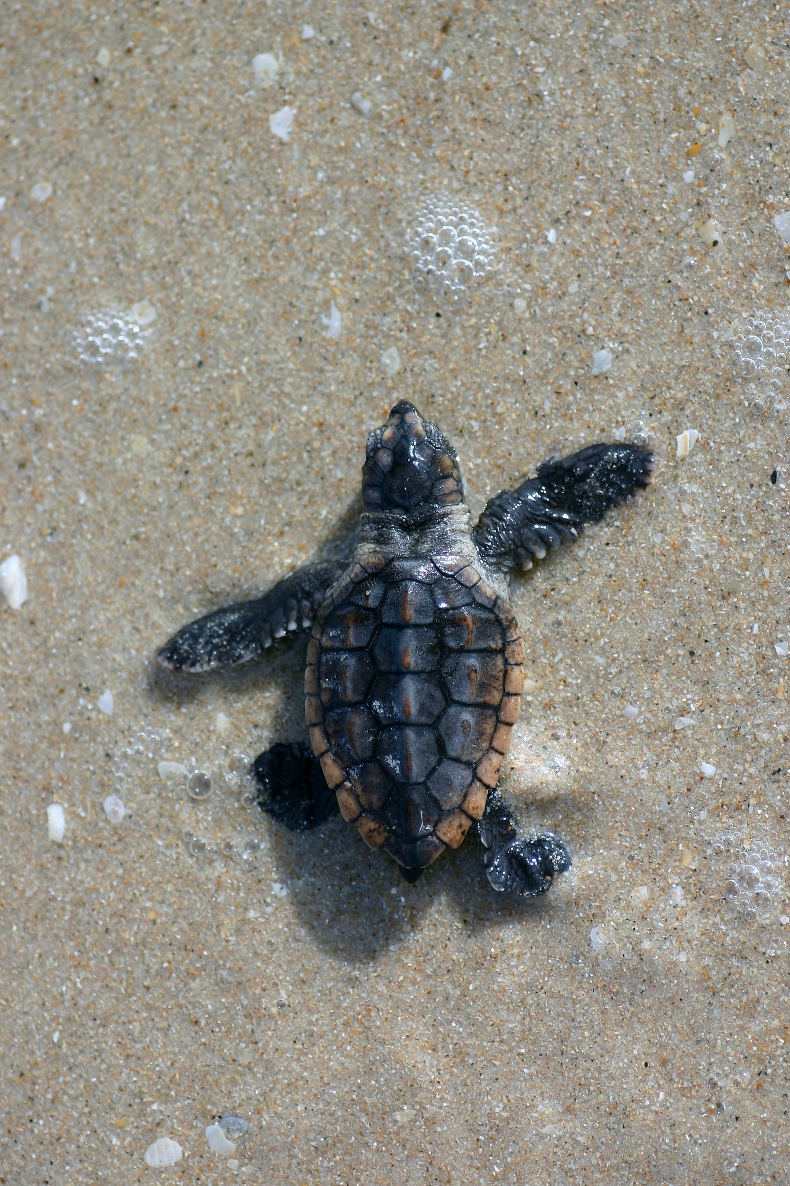
Research Questions
Primary research question: Is there a relationship between sea turtle protection ordinances (light pollution policies) in Florida cities/counties and the amount of radiance those cities/counties output?
How does radiance change before these light ordinances go into effect and after? I.e. how does radiance change with time?
How does average radiance over time vary across cities/counties?

Slide 4
Rationale
The state of Florida provided model lighting ordinance for local governments to develop their own light pollution policies largely to control beachfront lighting to protect hatching sea turtles.
Policy implementation is important, but the radiance data can show if the policy has affected the amount of radiance in these Florida counties/municipalities.
The amount or change in radiance, perhaps as a result of implementing the policy, is what will impact sea turtle protection.

Slide 5
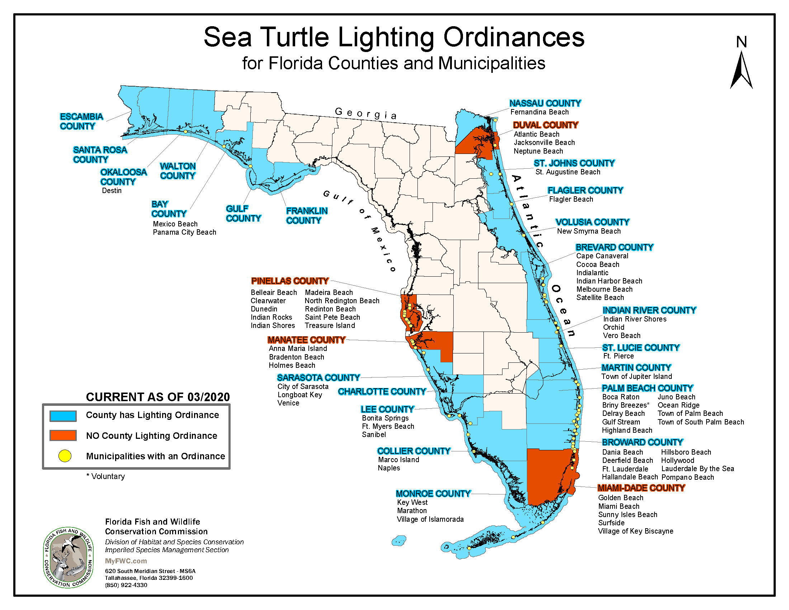
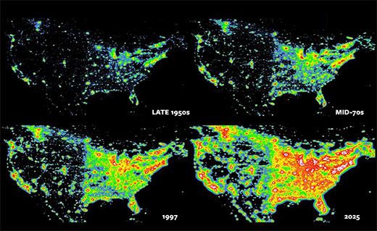
Notes:
https://myfwc.com/media/3150/seaturtle-lightordmap.pdf

Slide 6
Dataset Information
Data | Source | Time scales (used)
Nighttime ambient light DMP OLS: Nighttime Lights Time Series Version 4, Defense Meteorological Program Operational Linescan System | GoogleEarth Engine | 1992-2014
Sea Turtle Protection Ordinances Section 161.163, Florida Statutes | Florida Fish and WildlifeConservation Commission from Florida Department of Environmental Protection | 2000-2005

Slide 7
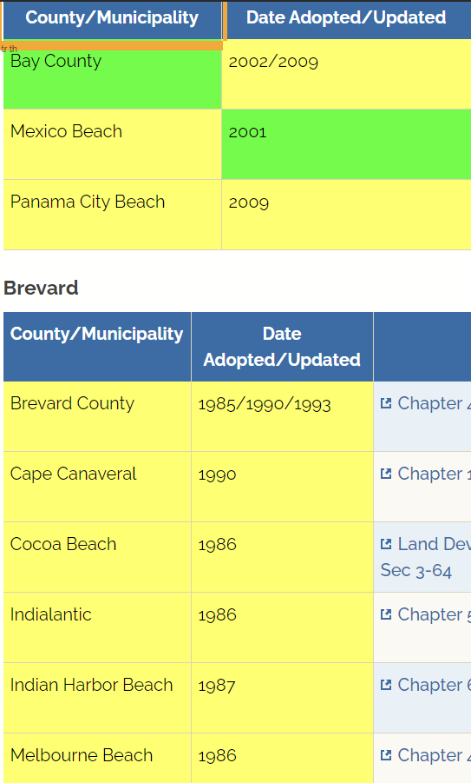
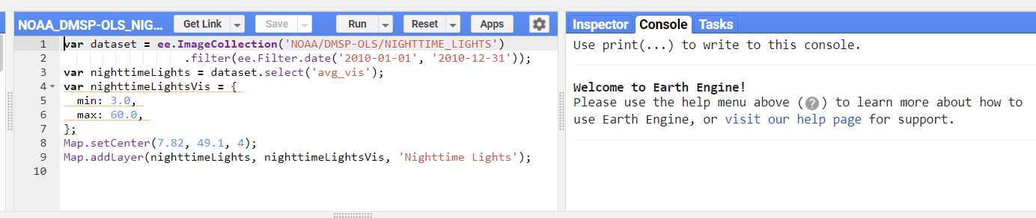
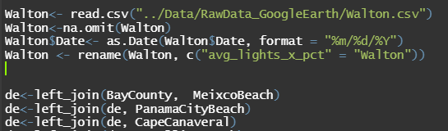
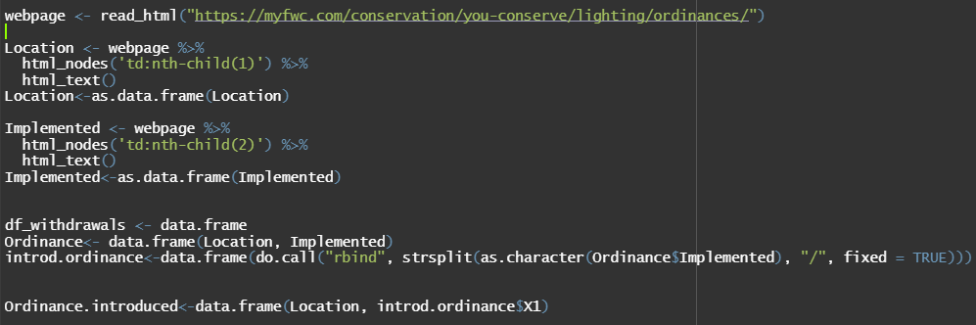
Data Preparation
Sea Turtle Protection Ordinances
Nighttime ambient light
Data

Slide 8
Data Analysis
Our data analysis covers:
Time series
Spatial analysis

Slide 9
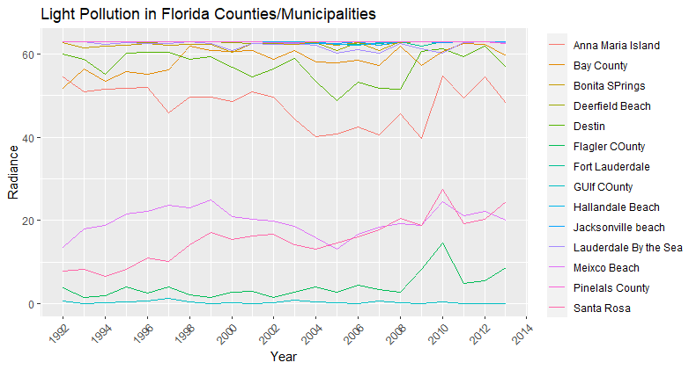

Slide 10
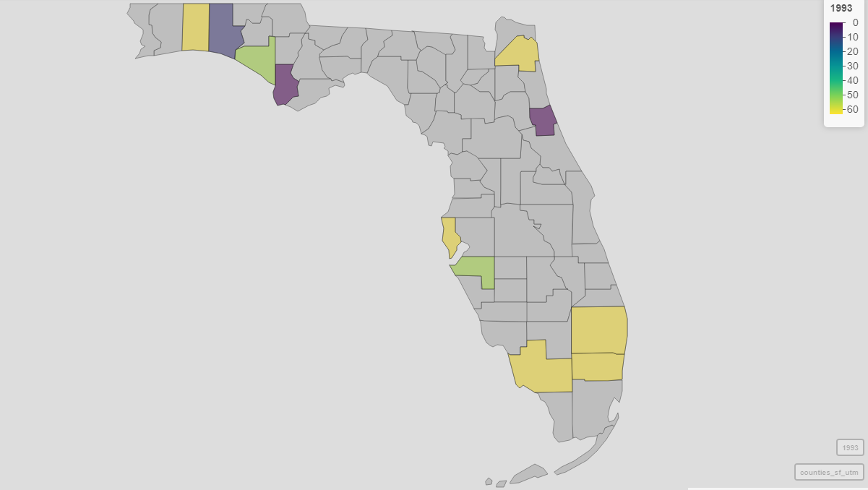
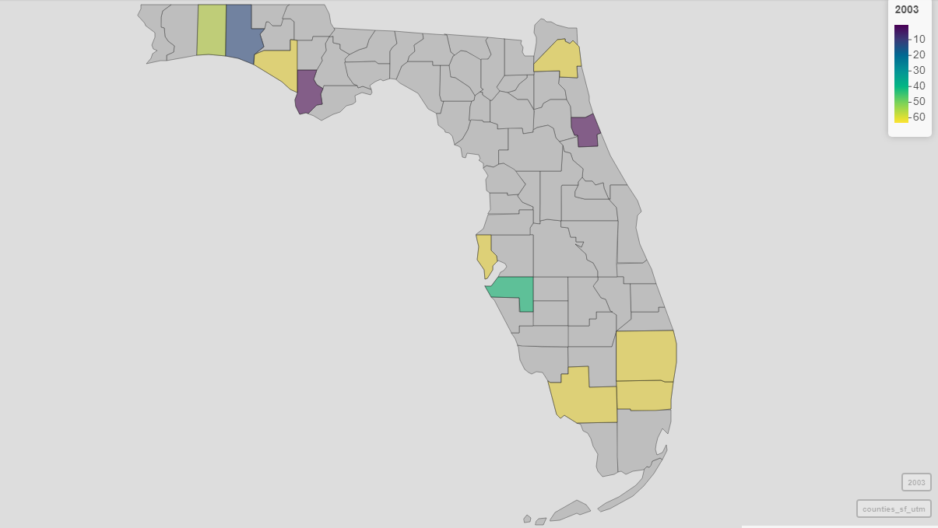
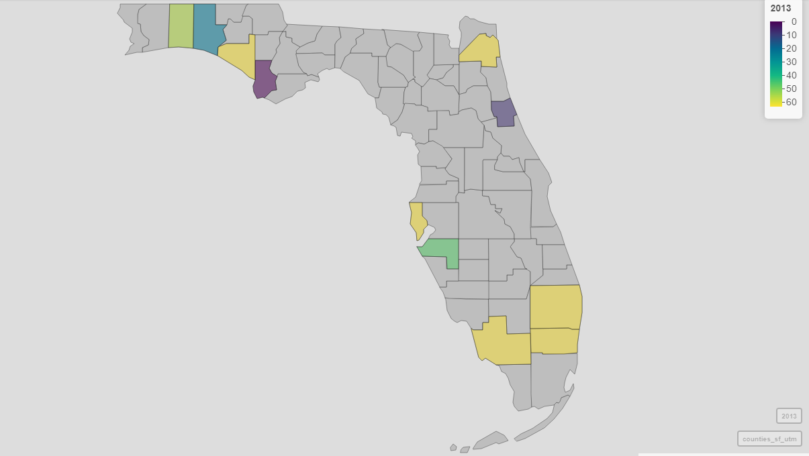
1993
2003
Mapview and ggplot
The value of Light radiance for Florida’ counties (1993, 2003, 2013)
Decreased e.g., Destin & Anna Maria Island
Increased e.g., Bay County & Walton
Almost unchanged e.g., Gulf County & Jacksonville beach
2013
Notes:
Data wrangling before we conducting spatial analysis

Slide 11
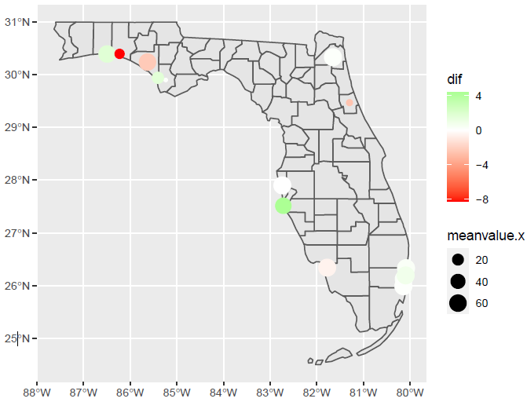
dif
Mean value of light radiance (before
After) implementing the ordinance
Only in three counties/locations, light radiation decreased after the implementation of ordinance
Sea Turtle Lighting Ordinance only works for a few counties
Meanvalue.x : the mean value of light radiance before implementing the ordinance (baseline)
High meanvalue.x small dif
Further research (socioeconomic metrics vs.. light radiation) needed e.g., Large population leads to high meavalue.x , then impedes the Sea Turtle Lighting Ordinance

Slide 12
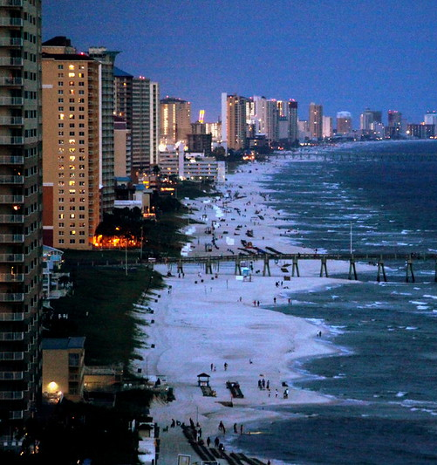


Slide 13
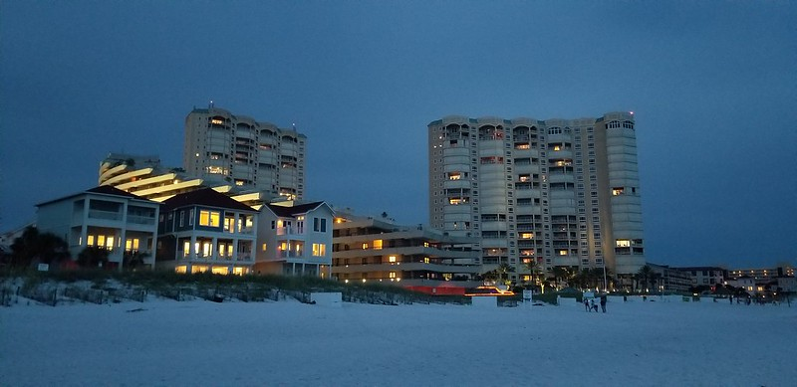

Slide 14
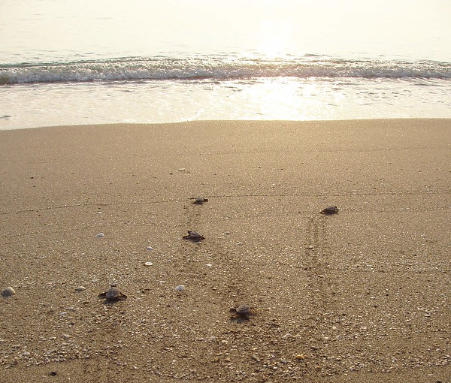

Slide 15
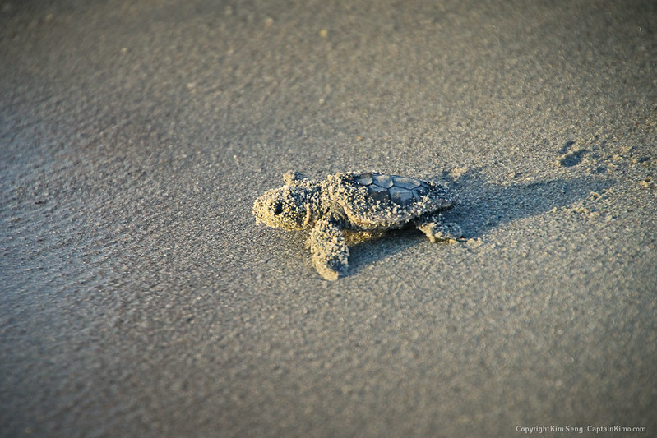

Slide 16
Analysis & Conclusions
There is not a strong connection between the sea turtle protection ordinances in Florida and the amount of radiance emitted.
Further Data Analysis Opportunities
Longer time periods of data, since we only had radiance data from 1992-2013
Higher resolution data
Compare to other locations around the U.S. or globally
Evaluate data on turtle nestling impacts over time

Slide 17
Thank you
The Milky Way over the Sanibel Lighthouse as seen from the Sanibel Fishing Pier, Sanibel Island, Florida
©Diana Robinson, Flickr

