Slide 1
Midnight in paris
Coursera “Battle of Neighborhoods” Capstone
Juan Manuel Gelos – August 2020

Slide 2
The business
Midnight Company is a (Fantastic) tematic restaurant looking to open a branch in Paris. They are interested in finding the neighborhood that best suits their charisma: love for antiques.
The restaurant prepares cuisine from all countries, offering a thematic setting and dishes based on different golden periods of each country
Its main concern is to find a place where people and tourists usually enjoy existing restaurants, in areas surrounded with antiques shop

Slide 3
The business problem
What is the best neighborhood in Paris for the new branch? fitting:
In first place, has enough antiques shops that assure attraction on target customers
In second, has an important presence of restaurants that assure the flow of customers on streets
In third place, the selected Neighborhood is better than others with similar cuisines

Slide 4
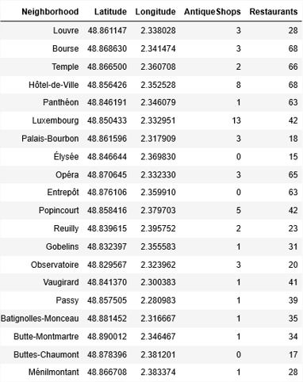
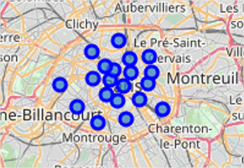
THE CANDIDATES: NEIGHBORHOOD IN PARIS

Slide 5
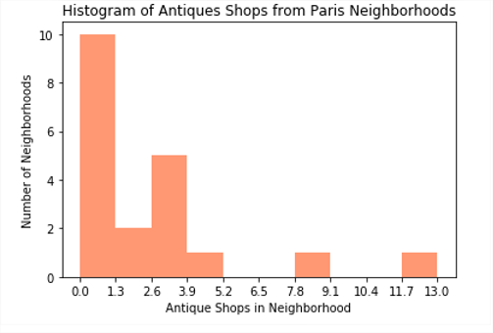
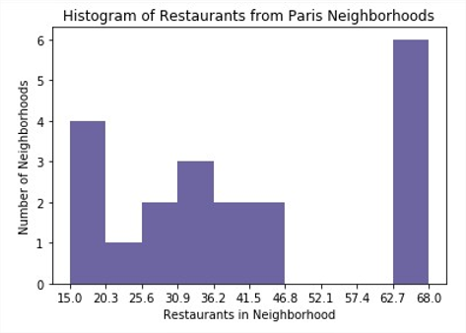
COUNTING # Venues by neighborhood
Antiques Shops
Restaurants

Slide 6
Found two Neighborhoods with a good density of antiques shops (8 and 13 shops respectively)
Antiques Shops
Restaurants

Slide 7
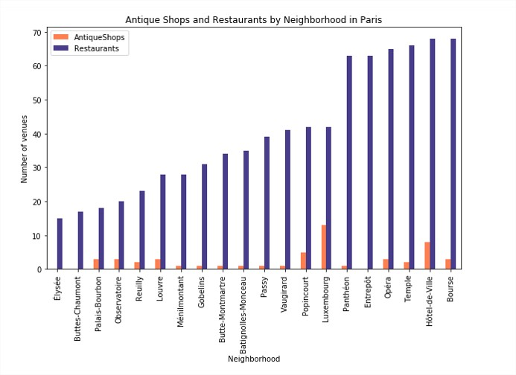
Antique shops & restaurants
Looking for a balance

Slide 8
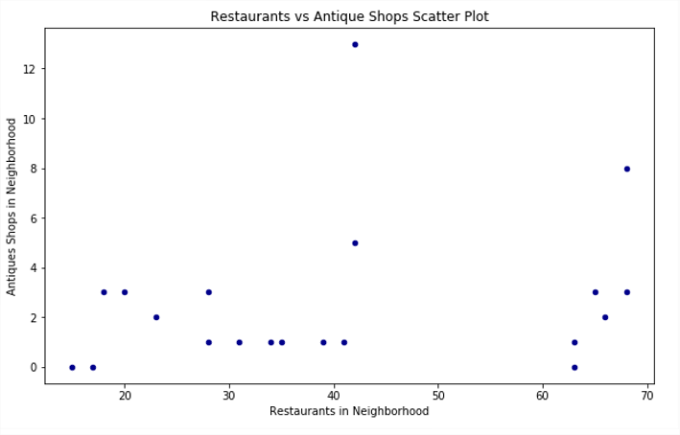
Restaurants vs antique shops no correlation

Slide 9
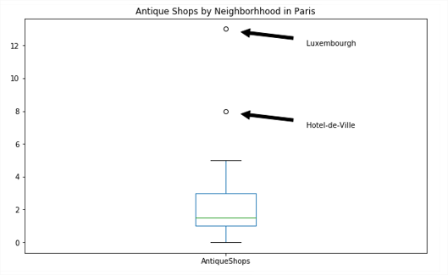
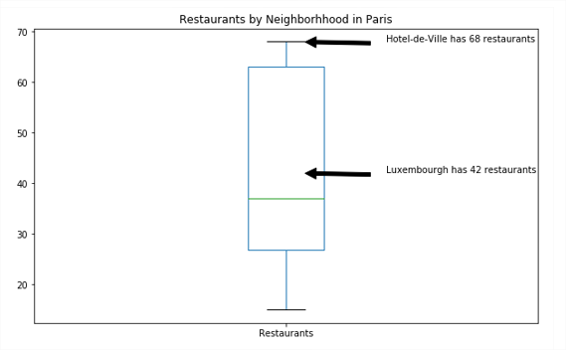
Luxembourg and hotel-de-ville vs all the rest in paris

Slide 10
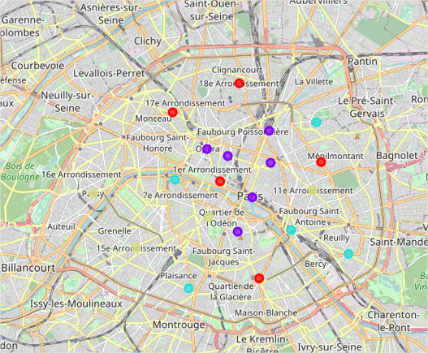
Food clusters clustering neighborhoods by restaurant categories
Food Cluster is important for the company because it defines the overall kind of food his competitors offer in each Neighborhood. Clustering Neighborhoods by this data bring us the capacity to compare the cuisine offer in wich the company prefer to set his branch
For this purpouse, where going to apply Machine Learning to calculate Clustering in four Clusters of similar restaurant categories offer as seen on left map

Slide 11
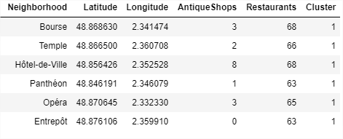
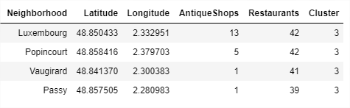
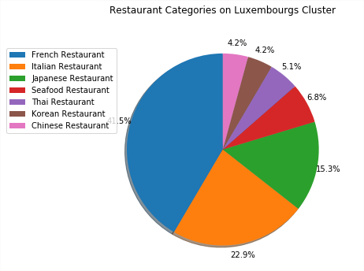
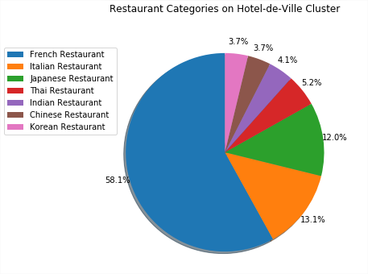
Luxemburg’s Cluster
Hôtel-de-Ville's Cluster

Slide 12
Luxemburgo wins the battle why?
The Antiques Shop’s principal Neiborhood in Paris by far
High presence of restaurants, above the average of Paris.
Balanced cuisines offer on competitors (French,Italian,Oriental)
Best Neighborhood in his own Food Cluster

