Slide 1

AVEIRO UNIVERSITY
GEANY IDE
Jodionísio Muachifi, 97147
João Felisberto, 98003
Diogo Santos, 98393
Human-Computer Interaction
Class P4
Professor: Beatriz Sousa Santos
31-03-2022

Slide 2
What is Geany?
Is powerful, stable and lightweight programmer’s text editor that provides tons of useful features. Is free and open source.
2
Notes:
Geany is being developed by Nick Treleaven, Colomban Wendling, Enrico Troeger, Matthew Brush and Frank Lanitz, using mainly the C/C++ language.(GPL licence)
Why have we chosen Geany?
Very usable (examplo : UA)
Supports more than 50 programming languages
It is translated into 40 different languages
Lightweight IDE | Cross-Plataform
It’s to mush unproductive IDE(here is the key we have explored to evaluate HE/CW)

Slide 3
Method used
01
To perform the Heuristic Evaluation (HE) we used the 10 Heuristics proposed by Nielsen
02
Severity Scale
0 - Not a problem at all
1 - Cosmetic problem
2 - Minor usability problem
3 - Major usability problem
4 - Usability catastrophe
03
To perform the Cognitive Walkthrough (CW) we followed the Streamlined Cognitive Walkthrough proposed by Rick H. Spencer
Q1 - Will the user know what to do at this step?
Q2 - If the user does the right thing, will they know that they did the right thing, and are making progress towards their goal?
3
Notes:
Methodology followed
HE - Each member tried to find issues with the system based on the 10 Heuristics by Nielsen. Then a table was made with all the issues found
and its respective severity.
CW – Only one main task was defined, and each member agreed to it
->>>Around 43 issues (errors) we found, we did choose only 6 most import issues to evaluate HE/CW

Slide 4
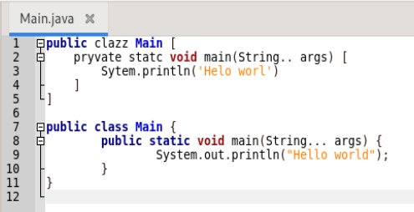
Results Obtained - HE
Syntactic erros are not detected
Heuristic: Error prevention
Severity: 4
4
Notes:
Erros sintáticos no código são permitidos (Quando há erros de sintaxe, não se consegue observar algum feedback inteligente por parte do editor)
Não há qualquer verificação de inputs nas preferências com input livre. (A maioria tem um conjunto de valores permitidos)
Solução: seria ter pelo menos uma extensão que faça isso.

Slide 5
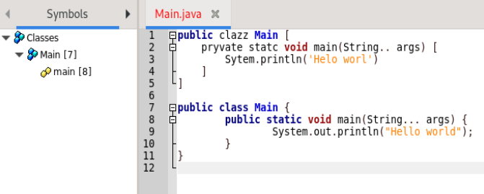
Results Obtained - HE
Symbols tab is the default
Heuristic: Consistency and standards
Severity: 3
5
Notes:
Aba de Símbolos é a principal (há outros que seguem a mesma flosofia, cf. Eclipse e NetBeans)

Slide 6
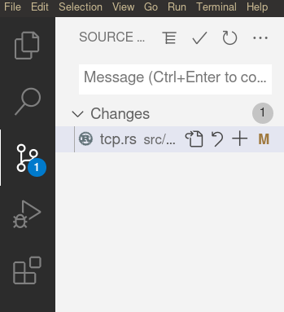
Results Obtained - HE
No VCS integration
Heuristic: Flexibility and efficiency of use
Severity: 3
6
Notes:
VCS – Version Control System

Slide 7
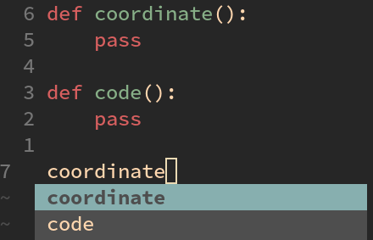
Results Obtained - HE
Lack of code completion by default
Heuristic: Flexibility and efficiency of use
Severity: 2
7

Slide 8
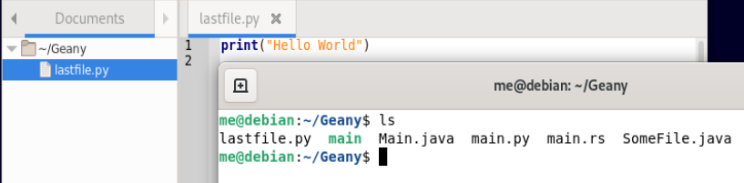
Results Obtained - HE
In the documents tab not all files under the open folders are shown
Heuristic: Visibility of system status
Severity: 3
8

Slide 9
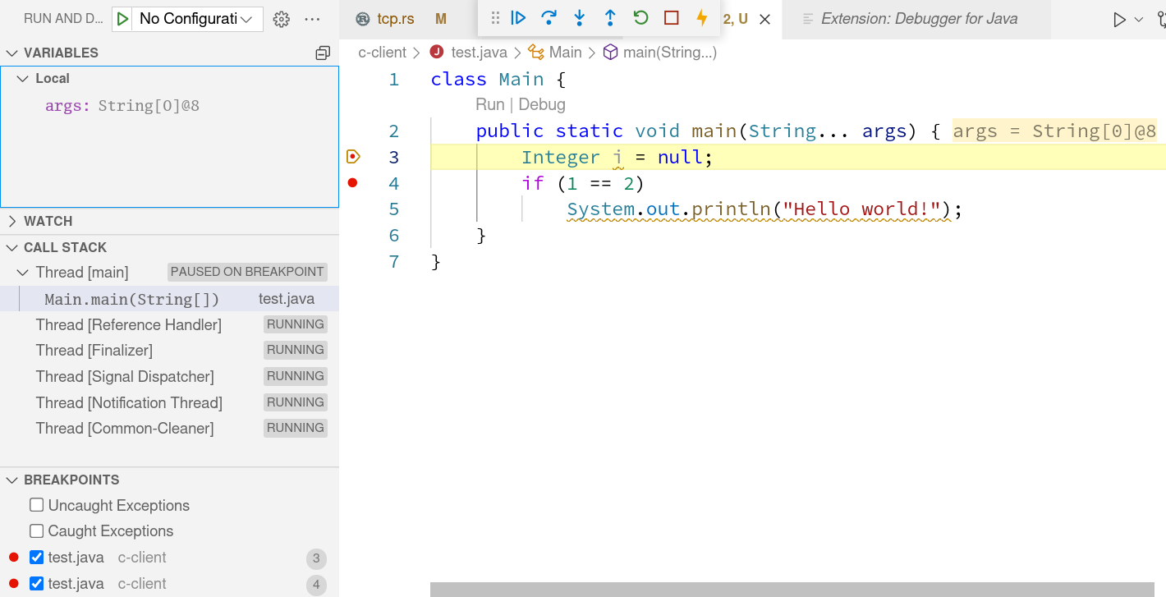
Results Obtained - HE
Does not include an Integrated Debugger
Heuristic: Visibility of system status
Severity: 2
9

Slide 10
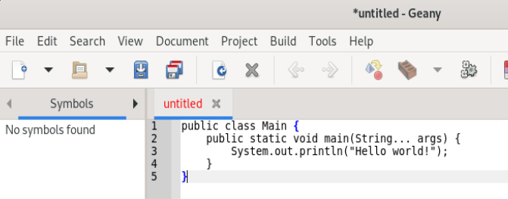
Cognitive Walkthrough
Write code
The text editing area is well placed and visible
The code will appear immediately, but syntax highlight will only take effect on the first save.
10

Slide 11
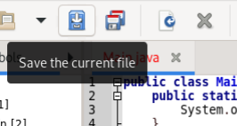
Cognitive Walkthrough
Save the file
The user might expect auto-save, but this is a feature not present in many text editors. The act of saving is obvious and the save icons will be gray while it is saved.
The file's name will not be red anymore, obvious and immediate feedback.
11

Slide 12
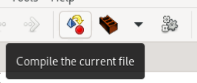

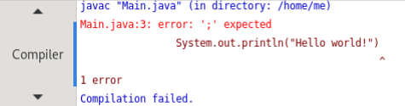
Cognitive Walkthrough
Compile the code
Assuming the user knows Java, and seeing the compile button, they will most likely assume that the run button will not compile. Those who don't know will learn it quite quickly.
When the compilation finishes there is feedback on the status window.
12

Slide 13
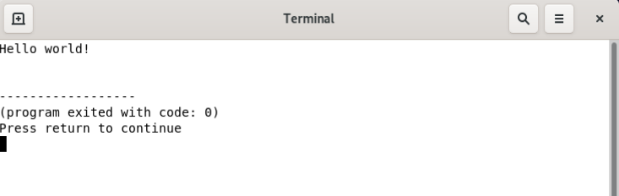
Cognitive Walkthrough
Run the code
Run button visible near compile and build.
When pressed, code will run and give feedback.
13

Slide 14
Our appreciation
In general it serves its purpose
Is a great editor text for beginners
However,…
There are a lot of improvements to be made
14
Notes:
What is the purpose?
Lightweight IDE for beginners
It is translated into 40 different languages
Supports more than 50 programming languages
Cross-Plataform
Is compatible with multiple envirenment like Linux, Windows, MacOs, BSD, Solaris

Slide 15
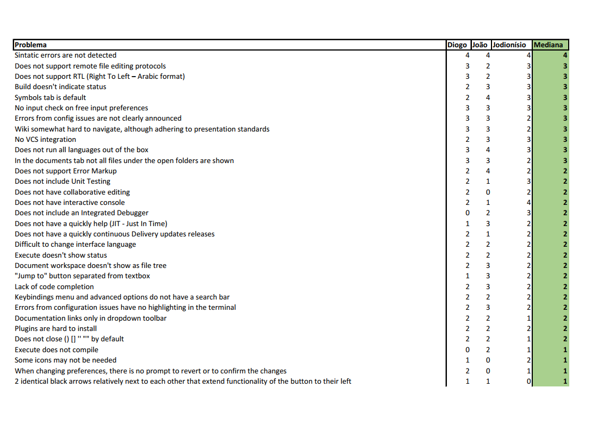
Table of all Results - HE
43 problems
found
To conclude the results of HE, we
include a table summarizing the
findings of all the analysts
15

Slide 16
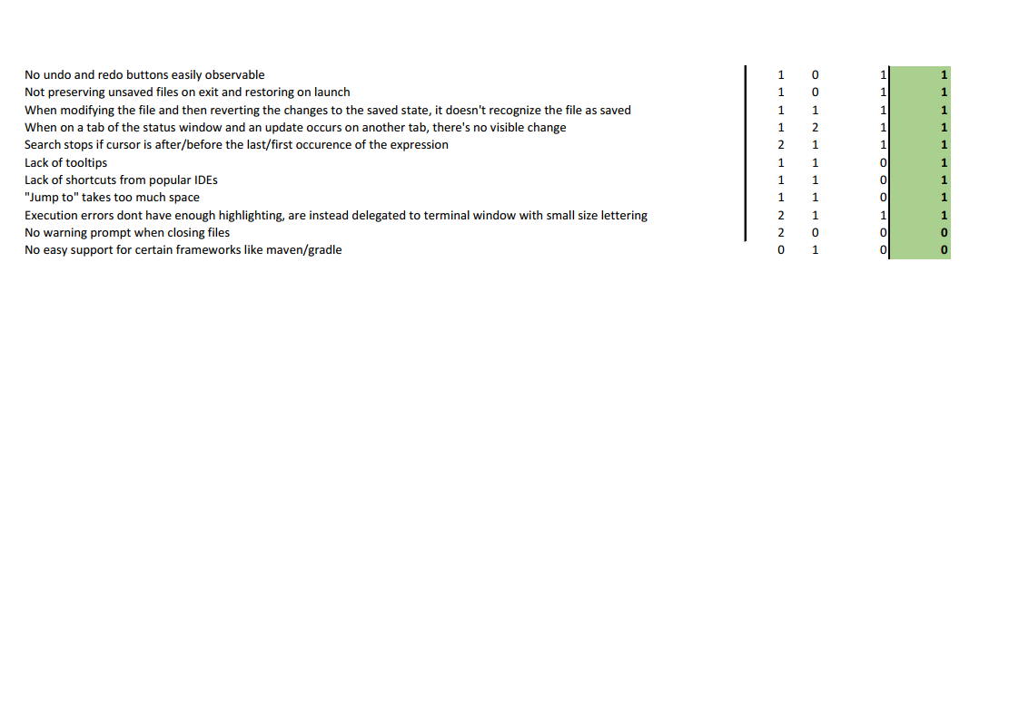
Table of general Results - HE
16

Slide 17
Aveiro University
HCI
Thank you for your attention
LECI – 2021/2022

