Slide 1
Aveiro University
Meraj Khan and Arnab Nandi | The Ohio State University
LECI
DreamStore: A Data Platform for Enabling Shared Augmented Reality
Human-Computer Interaction
2021 IEEE Virtual Reality and 3D User Interfaces (VR)
Jodionísio Muachifi, 97147
João Felisberto, 98003
Date of Conference: 27 March-1 April 2021
30-03-2022
Professor: Beatriz Sousa Santos

Slide 2
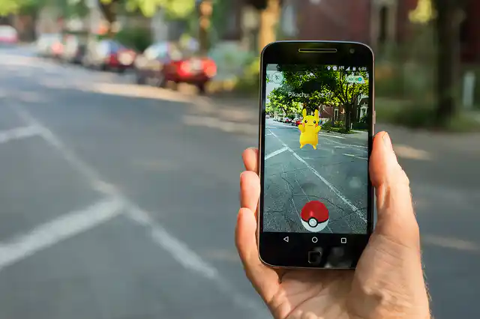

1
Introduction
2
Related Work
CONTENT
3
Querying AR
4
Prefetching for Interactivity
5
Evaluation
6
Conclusion

Slide 3


Introduction
Context
There are very few tools supporting shared AR experiences
These have high requirements for database performance
In some AR applications, the amount of augmented objects is too much for a great UX

Slide 4
Introduction
Motivation
DreamStore fixes both these issues
It provides a caching system that
Greatly reduces queries to the shared database
Reduces augmented objects in display by only querying the least amount of objects possible
Notes:
Some exemples of AR: Google Maps, Google Earth, instagram filters,etc

Slide 5
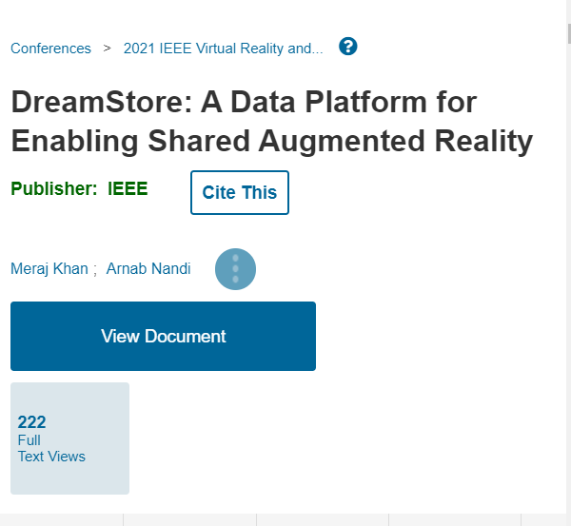
Introduction
Paper selection
Why did we choose this paper?
It is a little discussed topic about AR
Solves the problem about workload images (high-rate workload)
Can reduce effective query-rate through workload-reduction by about 5 times

Slide 6
Related Work
Data Platforms for Augmented Reality workloads
Written and discussed by Dieter Schmalstieg et al.,
They present a 3-tier data model for handling AR workloads
Add your title
Shared AR and Interactivity
Add your words here,according to your need to draw the text box size
Written and discussed by M. Singh et al.,
They present a study of Augmented Reality systems in which they describe a generic architecture for an AR application
Location-based Prefetching for Mobile Applications
01
Written and discussed by P. Geiger et al.,
They introduced ideas for developing a generic location-based mobile augmented reality

Slide 7
Querying in AR
Dreamstore data interface
The AR applications running on the DreamStore platform interact with the local client-side cache ARView through data management API calls
These API calls can trigger communication with the backend data stores
Query priority mapping
The user interface generates a READ query for each of the identified objects in the frame and passes it onto the Interaction Mapper module
The interaction mapper periodically aggregates all these READ requests
and calculates the density or the count for each object query
Notes:
All queries are mapped to DreamStore API calls, which do not distinguish between the query modality and only specify the level of details requested for any specific object

Slide 8
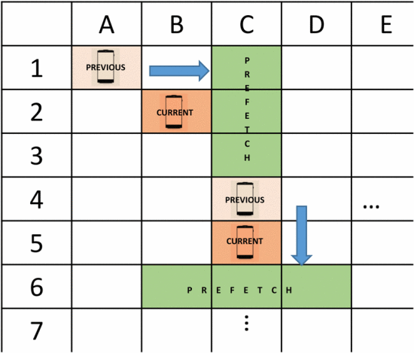
Prefetching for Interactivity
The interaction mapper predicts the set of AR objects to be prefetched from the backend data store to keep the DreamStore
The green regions indicate the regions to be prefetched based on the current and the previous location
Notes:
Directional prefetching strategy based on the four principal directions of movement.
The green regions indicate the regions to be prefetched based on the current and the previous location

Slide 9
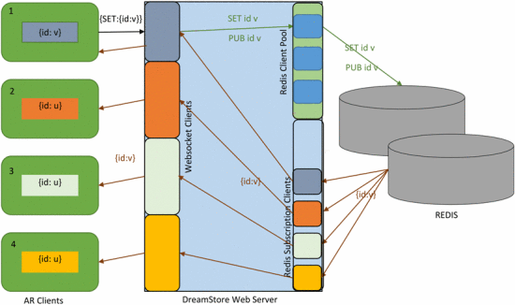
Prefetching for Interactivity
AR-View Maintenance
AR clients in the same shared physical space are required to acknowledge changes by each other while at the same time...
Decoupling the clients enforces
scalability at the abstraction level by allowing them to operate independently of each other
Notes:
AR clients in the same shared physical space are required to acknowledge changes by each other while at the same time, ensuring that they can function without explicitly tracking every other client in the system

Slide 10
Evalution | Results
Workload Generation
Because of a lack of open location-tagged AR workloads, Meraj Khan and Arnab Nandi used an indoor localization dataset to simulate AR application sessions.
Test Setup
Naive - each DreamStore API call translates to one server call, triggering a backend request for each implicit and explicit data interaction in the UI
Reduced - the query thresholding previously described is utilized (Query Priority Mapping) to reduce the generated READ calls to the backend
DreamStore - clients cache objects on top of query reduction
Notes:
User evaluations focused on human perception and cognition in AR, user-performance, and user-interaction is important for evaluating AR applications
Because of a lack of open location-tagged AR workloads, Meraj Khan and Arnab Nandi used an indoor localization dataset
(referred to as IPS in the text) published by Mohammadi et al. to simulate AR application sessions

Slide 11
Evalution | Results
Results
Generic Workload : Query Issue Rate, AverageLatency, and Interactive Constraint Violation
Generic-Mixed Workload: The Generic-MIXED workload shows performance characteristics similar to that of the Generic workload
IPS Workload : The IPS workload has a wide variation in the client-session running times ranging from 18 seconds to 2972 seconds or about 50 minutes
Performance Metrics
The principal metrics are:
Query Issue Rate, Latency/Response Time, Update Propagation Time, Cache Hit Ratio and Interactive Constraint Violation
Notes:
User evaluations focused on human perception and cognition in AR, user-performance, and user-interaction is important for evaluating AR applications
Indoor Positioning System(IPS)
Because of a lack of open location-tagged AR workloads, Meraj Khan and Arnab Nandi used an indoor localization dataset
(referred to as IPS in the text) published by Mohammadi et al. to simulate AR application sessions

Slide 12
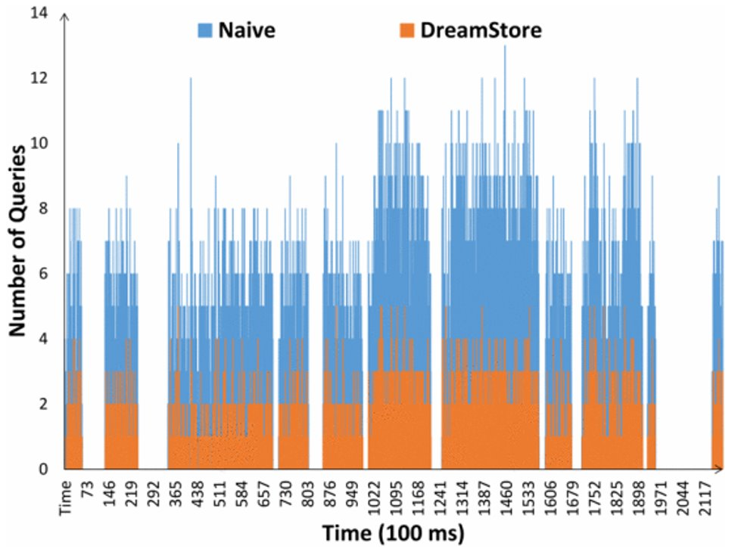
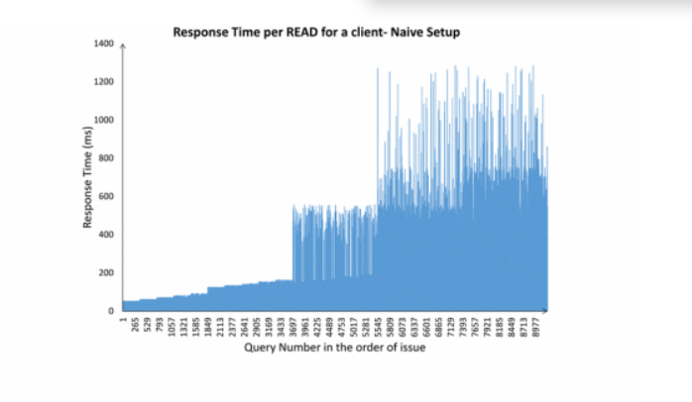
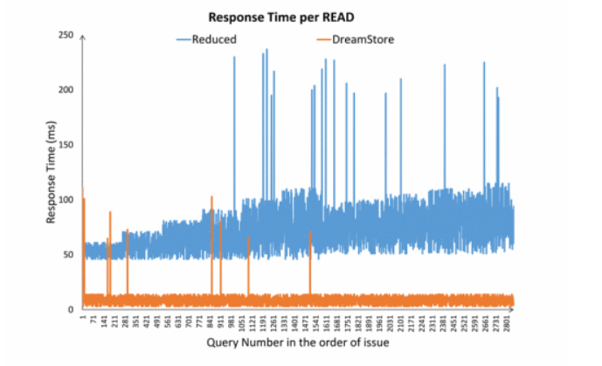
Evalution | Results
Notes:
Response time per query (plotted in the issue-order) for one of the simulated clients in the generic workload.

Slide 13
Evalution | Results
Discussion
Query Workload Reduction: Reducing the query workload generated by the clients through query prioritization and thresholding improves the average latency by about 4 times in the Generic and Generic-Mixed workloads.
Prefetching and Caching: The Generic and Generic-MIXED workloads access a small number of objects over the entire session that can all be cached on each client.
Limitations
Objects that are not frequently enough in sight can be ignored, despite interest
Due to the reduced queries, visualizing updates on objects will be much slower
Notes:
In contrast to the specialized data platforms for AR discussed in related work, DreamStore strips down the amount of
information it needs at the backend by having a dedicated store for virtual object properties and relying on a different
visual recognition database for marking the placement of these objects in space

Slide 14
Conclusion
They showed that DreamStore can reduce effective query-rate through workload-reduction by about 5 times, and along with client-side caching, can bring down the average response time by an order of magnitude compared to the baseline setup.
In the future, they intend to release client-environment specific view-management libraries for popular AR platforms.
They are also working on further refining the interaction module and defining the interaction mapper for a broader set of user actions for different interaction modalities.

Slide 15
Bibliography
R. Azuma, Y. Baillot, R. Behringer, S. Feiner, S. Julier and B. MacIn-tyre, "Recent advances in Augmented Reality", IEEE computer graphics and applications, vol. 21, no. 6, pp. 34-47, 2001.
R. T. Azuma, "A survey of Augmented Reality", Presence: Teleoperators and virtual environments, vol. 6, no. 4, pp. 355-385, 1997.
J. Bernardes, R. Tori, R. Nakamura, D. Calife and A. Tomoyose, "Augmented Reality games", Extending Experiences: Structure analysis and design of computer game player experience, vol. 1, pp. 228-246, 2008.
Other related names is enabled in this link: DreamStore: A Data Platform for Enabling Shared Augmented Reality | IEEE Conference Publication | IEEE Xplore

Slide 16
Aveiro University
LECI
THANKS
Human-Computer Interaction

