Slide 1


QUIC Protocol – (D)DoS Attack Anomaly Detection
06 Nov 2023
MECT | TPR
Jodionísio Muachifi «97147»
Rúben Castelhano «97688»
Professor:
Paulo Salvador

Slide 2
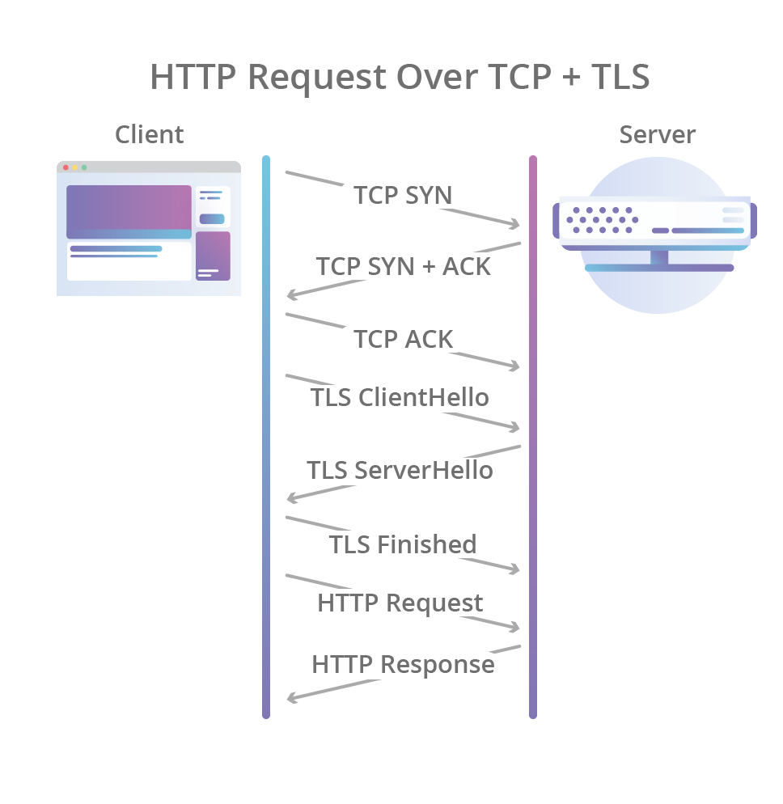
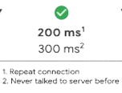
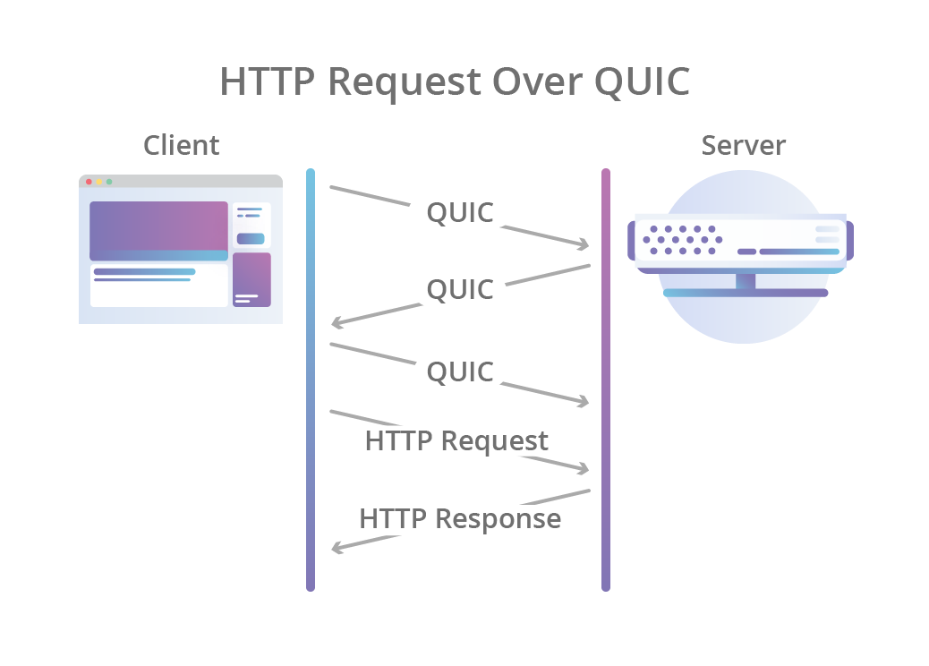
QUIC Overview
Modern transport protocol developed by Google
The first version appeared around 2012
It was later proposed as a new standard to IETF in 2013/2015
But it was presented as a standard in 2021 by RFC9000
200 ms¹
300 ms²
Repeat connection
Never talked to the server before
Purposes
More efficient
More secure
More adaptable
Faster (latency reduction)
Over UDP
0-RTT Feature
Encrypted packets
0 ms¹
100 ms²
Images from cloudflare Blog

Slide 3

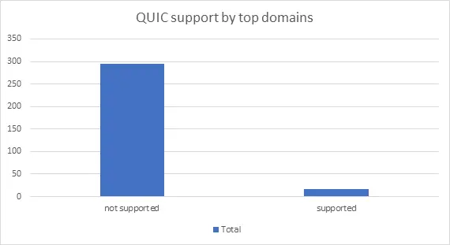

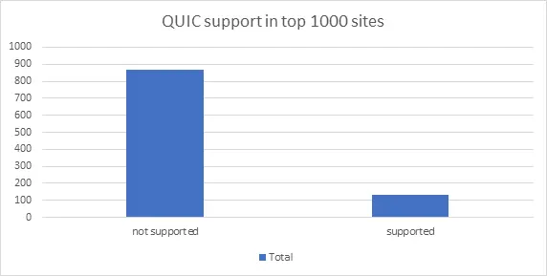
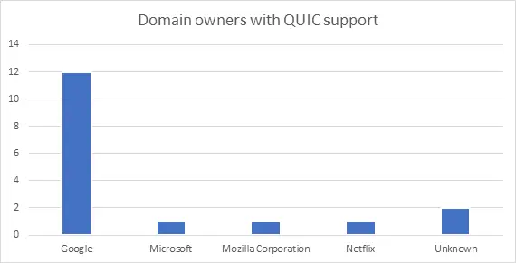

QUIC overview - Adoption
If we break it down by top-level domains, only 5.5% of domains support QUIC.
Taking the top 1000 sites from the list shows that 13.4% currently support some version of QUIC
If we look deeper, those 17 domains that support QUIC belong to only 4 known corporations, and ownership of 2 is not immediately obvious. The good news is that it’s not just Google—notably, some host names within windowsupdate.com and nflximg.com support it.
Info from keysight Blog

Slide 4
Security problem
DDOS attacks are a serious problem
Image from apnic Blog

Slide 5
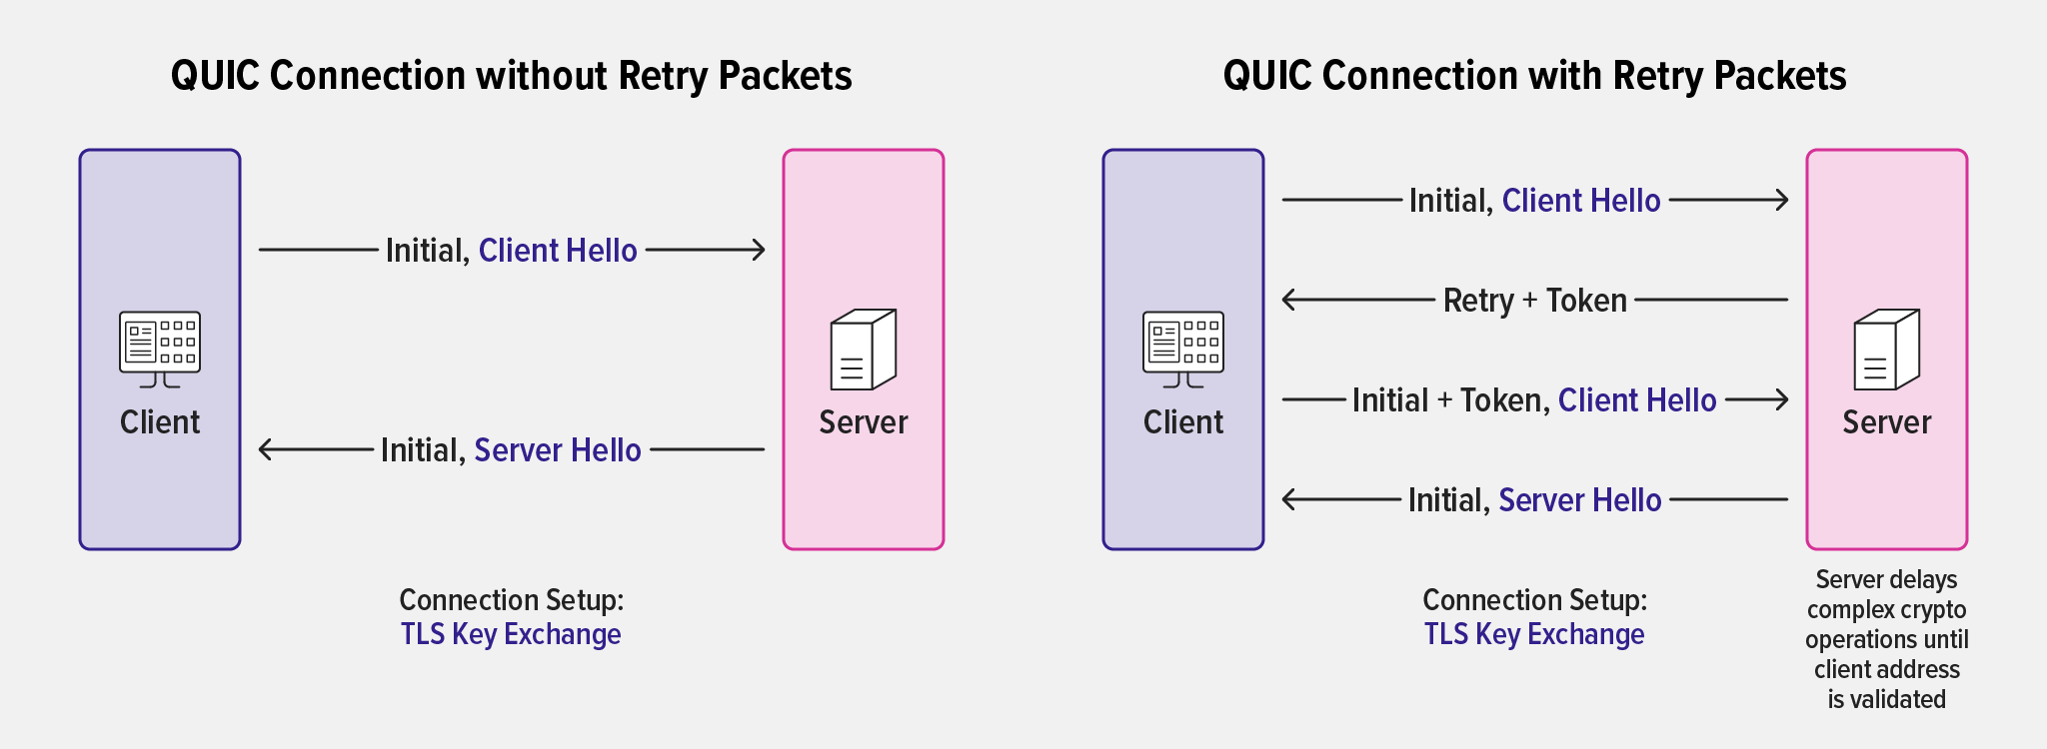
Security problem
Blah
Blah

Slide 6
Security problem - 2
Businesses targeted by DDOS attacks are in a difficult position
Service unavailability means lost revenue and decreased customer trust
Service unavailability is not permissible in critical services/fields (finance, health, military, etc.)
Brute-force defence is extremely expensive and can always be overwhelmed
Blocking legitimate users (accidentally or as a last resort) during an attack is essentially letting the attacker succeed in his goal

Slide 7
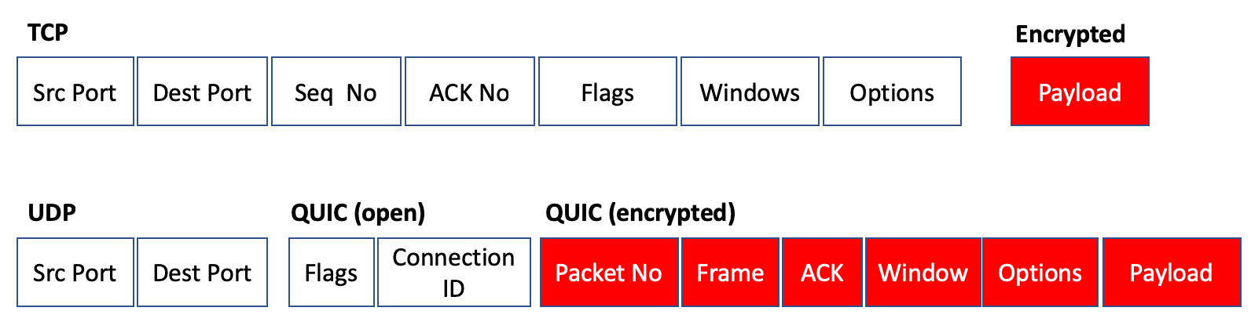
Security problem
QUIC (D)DoS attack
Overwhelming a targeted server (flood)
Reflection by spoofing the victim's IP address and requesting information from several servers
Difficult to manage (is a challenge)
UDP packets with little information
Encrypted packet analysis
Image from apnic Blog

Slide 8
Unavailability of services and possible solutions
Possible solutions
The unavailability of svc can affect
Increasing the reliability
Traffic filtering (ACL)
Load Balancing (LB)
Resource monitoring
Investor confidence
Customer dissatisfaction
Loss of revenue (e.g. e-commerce impact)
Reputation damage (e.g. frequent downtime)

Slide 9



Data sources
To check the QUIC supporters click here
Network Packets
Observation Window
Wireshark
1 minute and 30 seconds
30 secs of sliding
Public captures performed by supporters of QUIC
Geekflare
Text, browsing
Duration: 5 minutes
Spotify
Music, PodCasts, browsing
Duration: 15 minutes
Snapchat
Video, image, buttons, form
Duration: 15 minutes

Slide 10
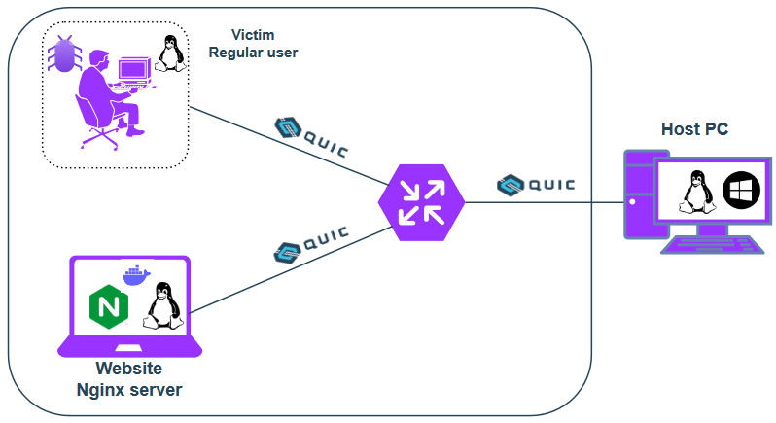
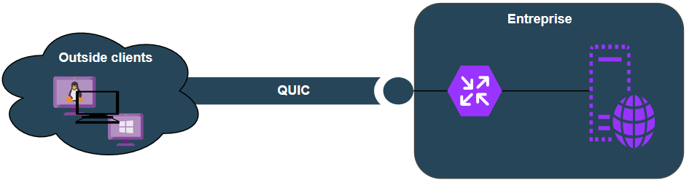
Solution setup and real-world scenario

Slide 11
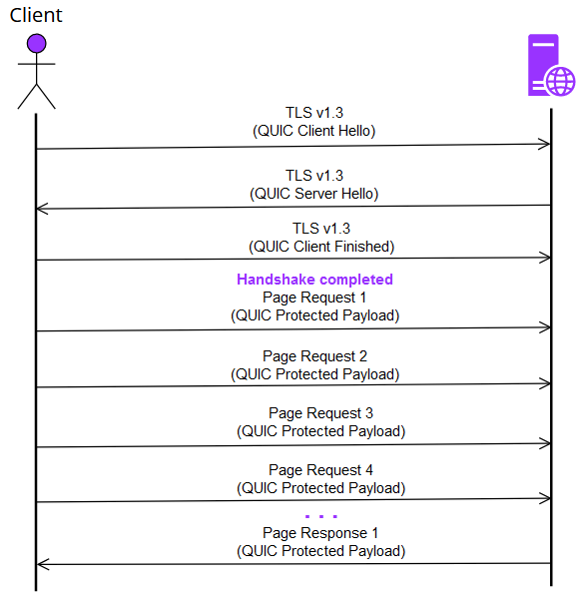
Test scenario 1
Requests Overload
The number of requests sent by the client is much higher than a regular client interaction

Slide 12
Test scenario 2

Slide 13
Data processing [metrics]

Slide 14
Features

Slide 15
References
https://www.cloudflare.com/learning/ddos/what-is-a-quic-flood/
https://blog.apnic.net/2019/03/04/a-quick-look-at-quic/
https://blog.cloudflare.com/the-road-to-quic/
https://www.keysight.com/blogs/tech/nwvs/2022/06/08/is-quic-on-its-way-to-becoming-the-transport-of-modern-internet
https://en.wikipedia.org/wiki/QUIC

Slide 16
Any Questions !? Comments !?
Thank you for your kind attention!

