Slide 1

QUIC Protocol: DoS attack
Anomaly Detection
Maria Inês Rocha
Pedro Abreu
93320
93240
TPR - November 2022

Slide 2
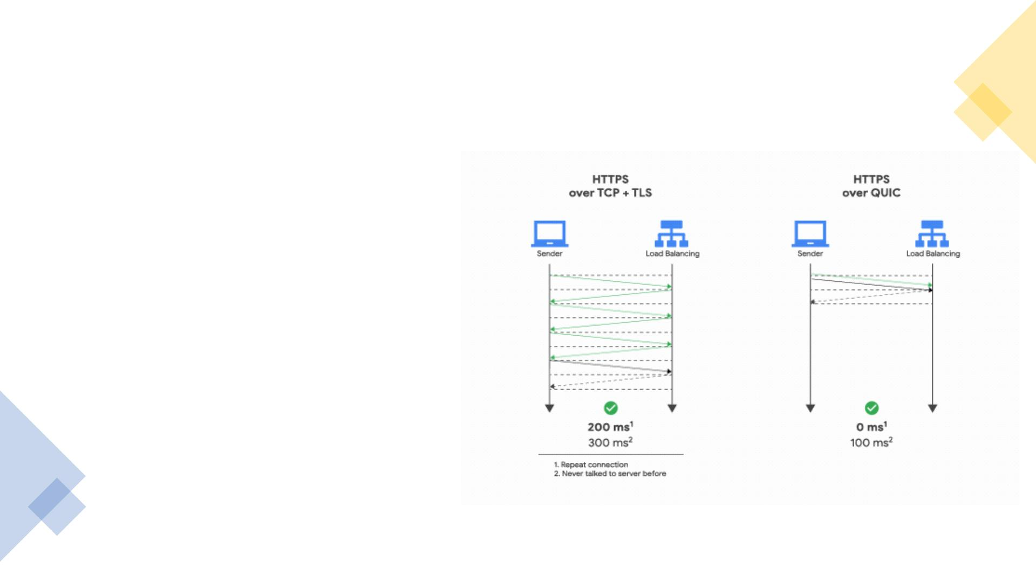
QUIC Overview
• New internet transport protocol
developed by Google
• Objectives:
• Faster (latency reduction)
• More efficient
• More secure
• Evolvable
• 0-RTT feature
• Encrypted packets
• Over UDP

Slide 3
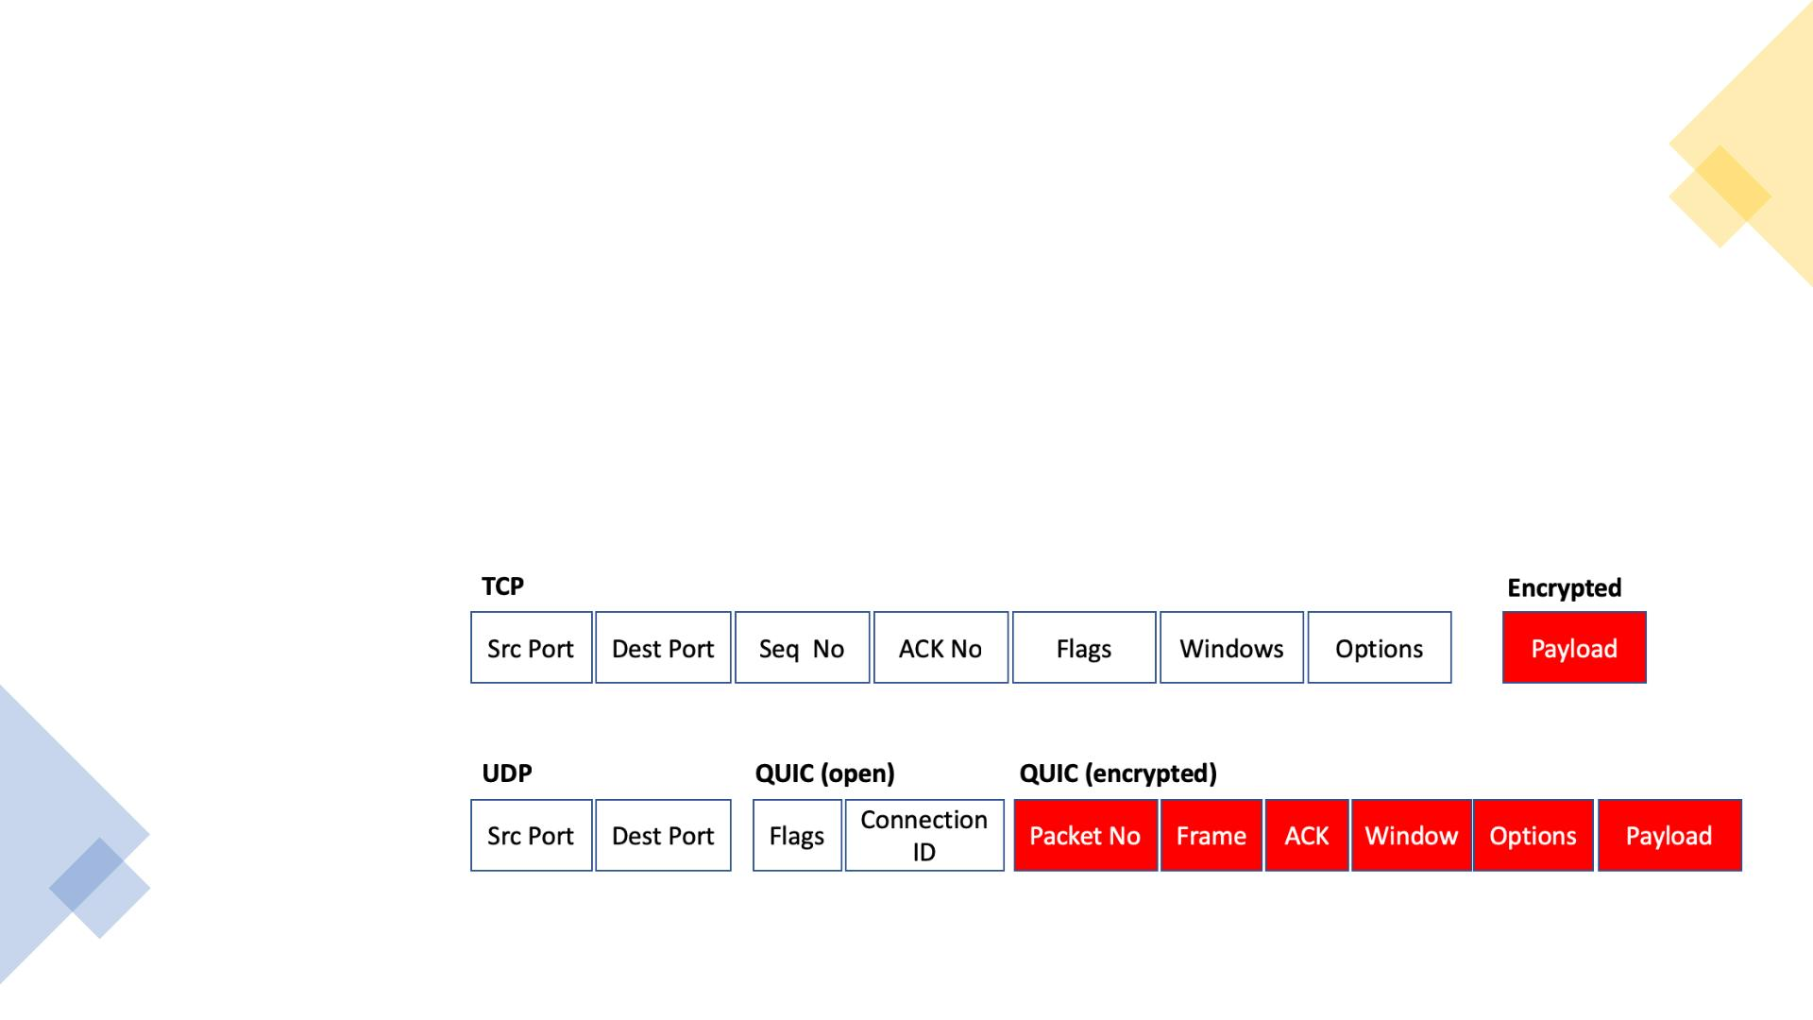
S e curity Problem
• QUIC DoS attack – service denial a tta ck
• Hard to handle:
• UDP packets with few information
• QUIC encrypted packets analysis

Slide 4

Solution Relevance
•Service downtime affects:
✓Distinguish regular from
malicious users
➢ The clients
✓Increasing the reliability
➢
The image
✓Protocol popularity is growing, so
➢ The business/profits
➢ Performance decreasing
will the attacks to it

Slide 5
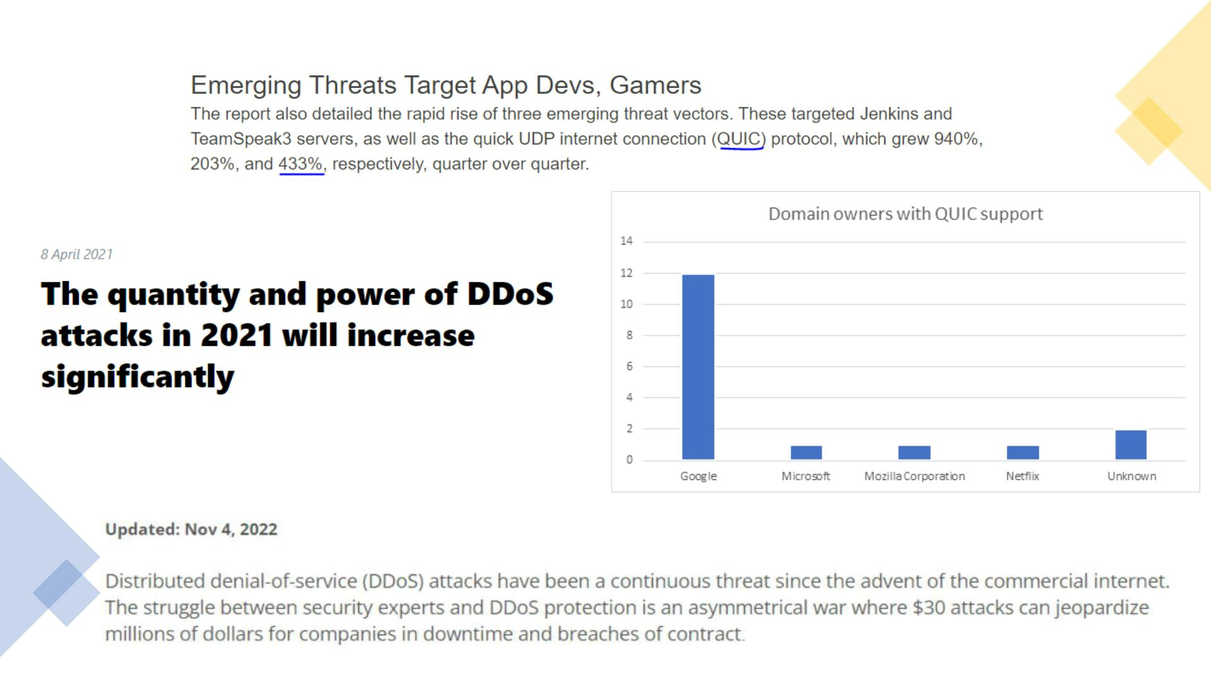
Solution Relevance
April 2021 Cloudflare Reports
StormWall Blog
KeySight Blog Jan 2022
By Stephen Condon, Kentik

Slide 6
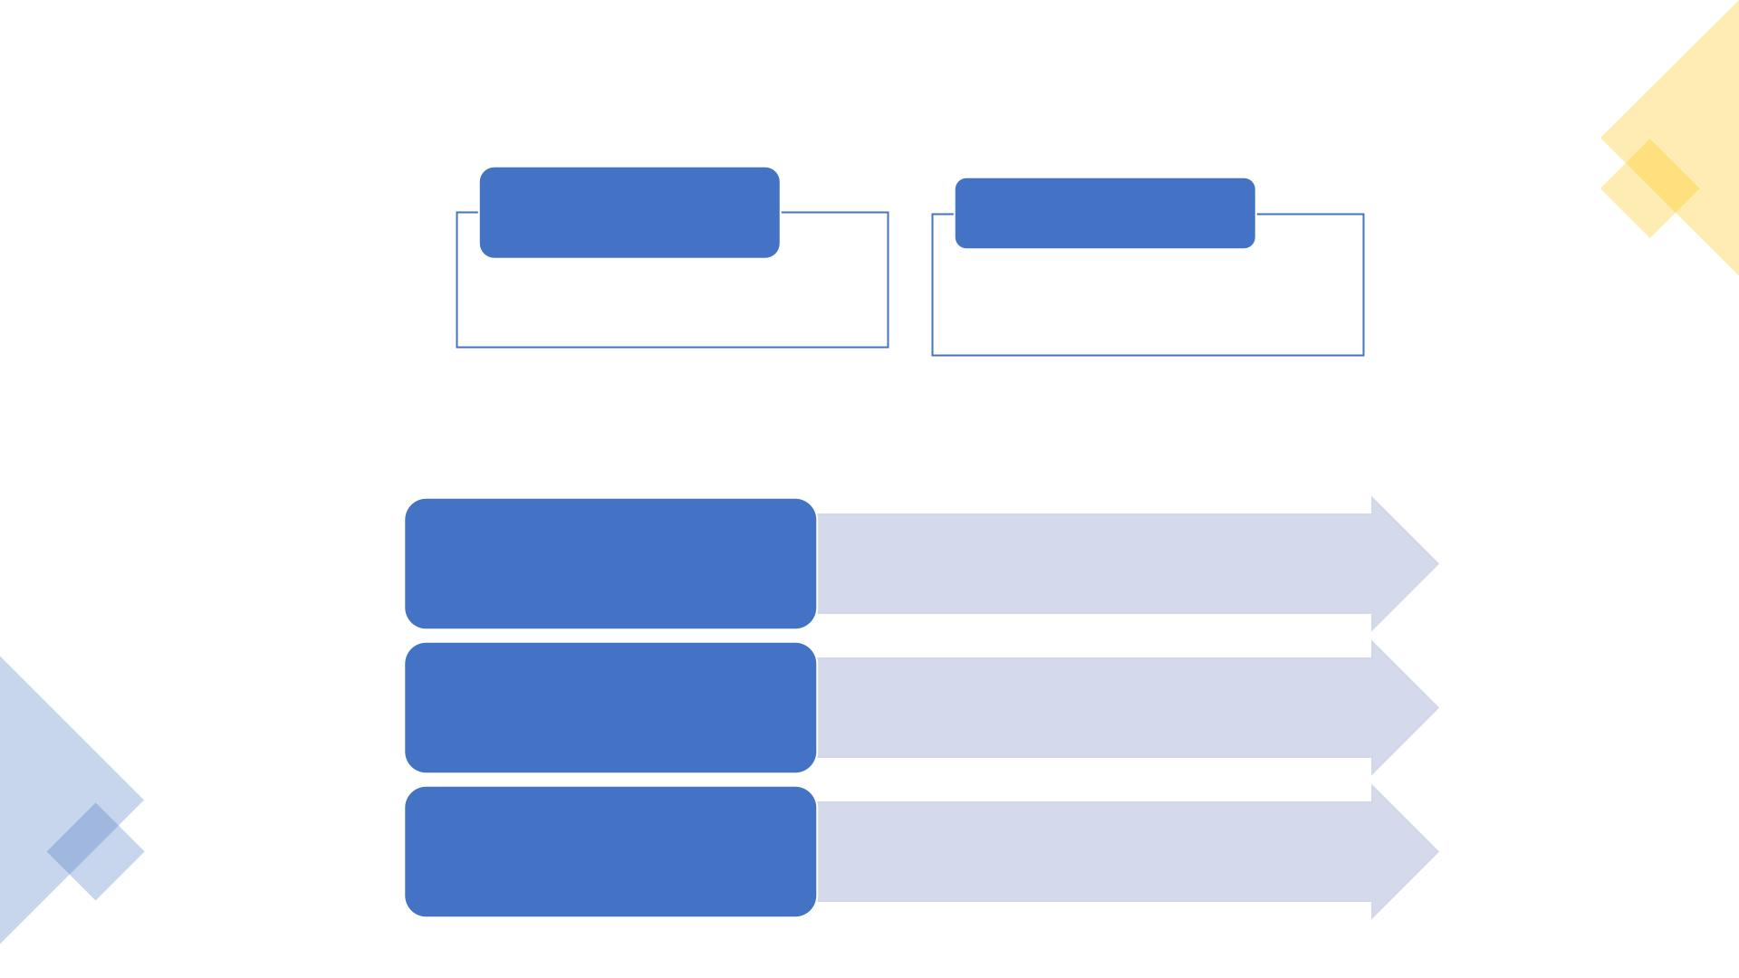
Data Sources
Network Packets
Observation Window
• Wireshark
• 1 minute and 30 seconds
• Sliding of 20 seconds
Captures performed in public QUIC supporters:
Snapchat
Instagram
• Video, image, buttons, forms
• Duration: 15mins
• Video, image, buttons
• Duration: 15 mins
unter.com.tr
• text, browsing
• Duration: 5 min

Slide 7
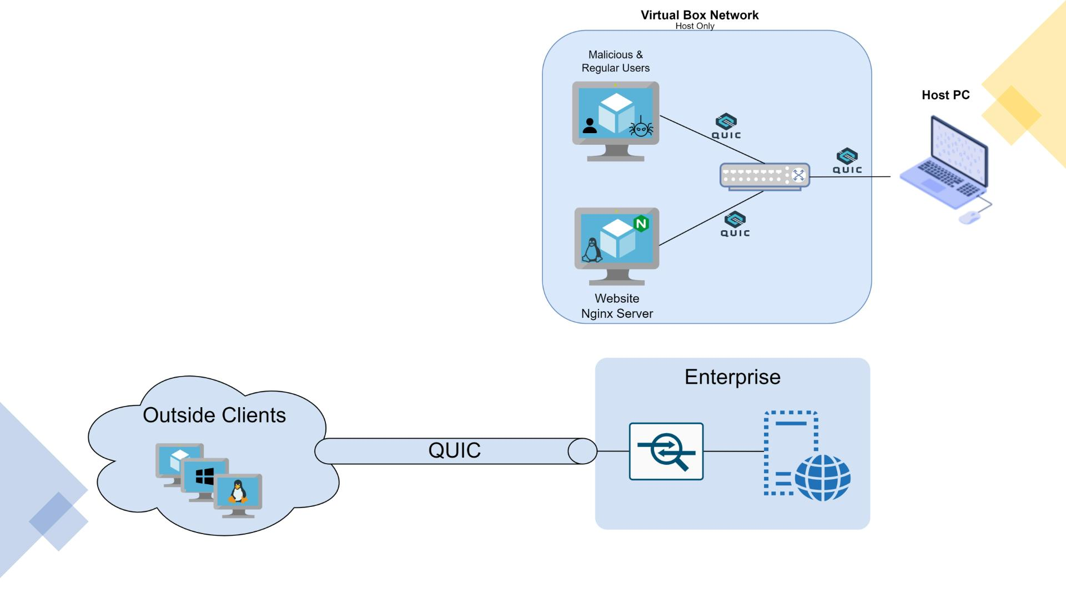
Solution Setup &
Real World Scenario

Slide 8
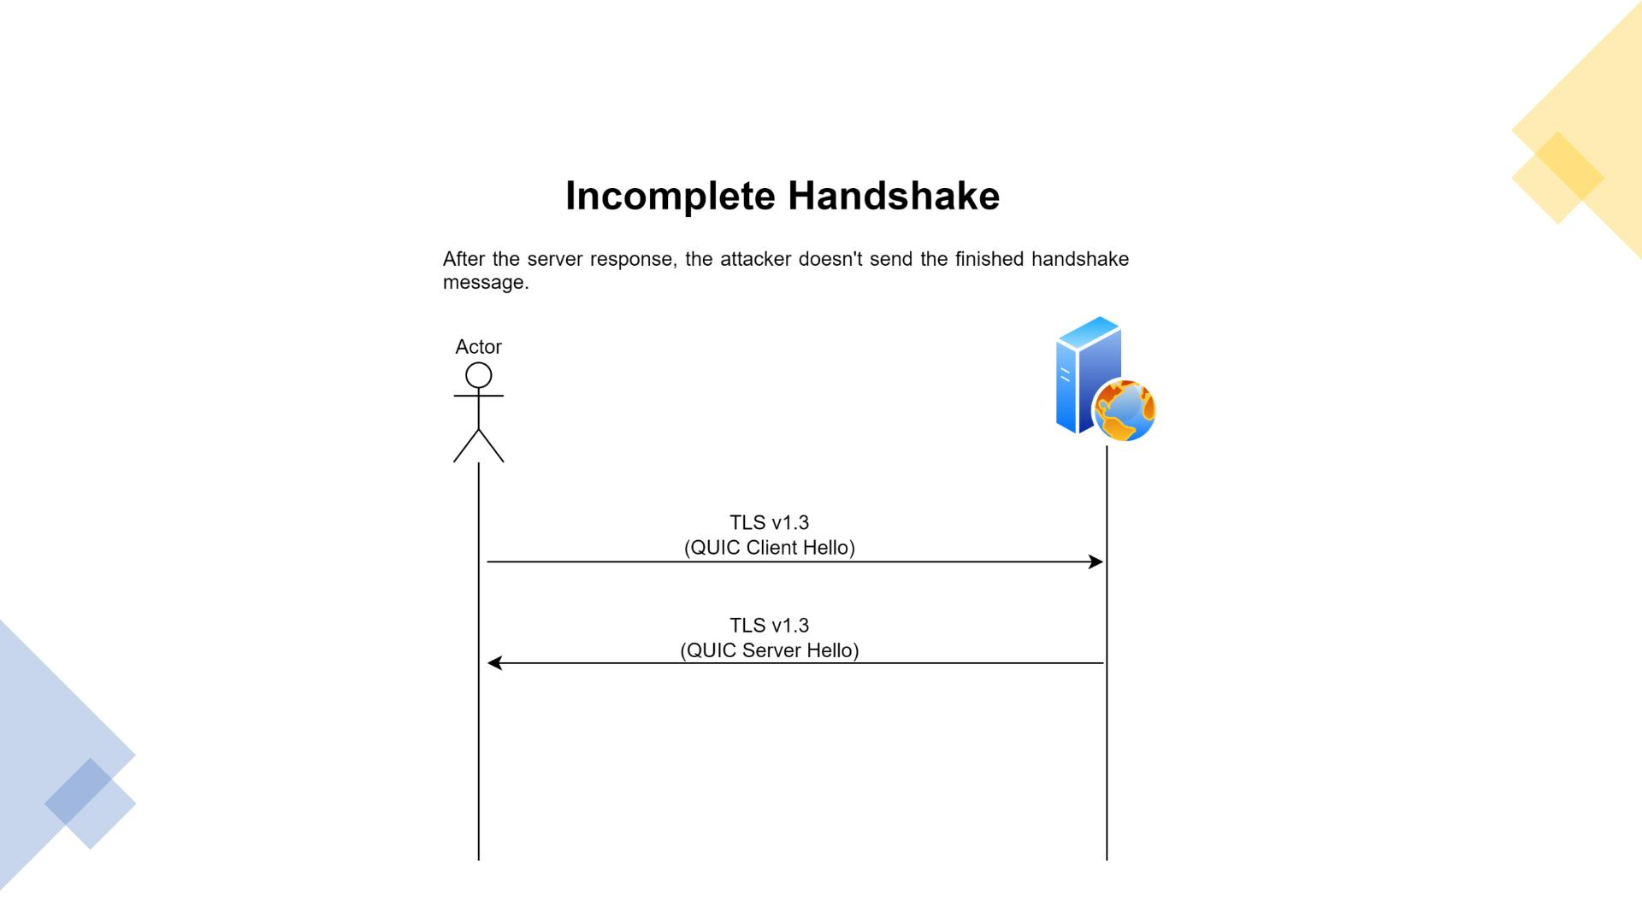
Test Scenario 1

Slide 9
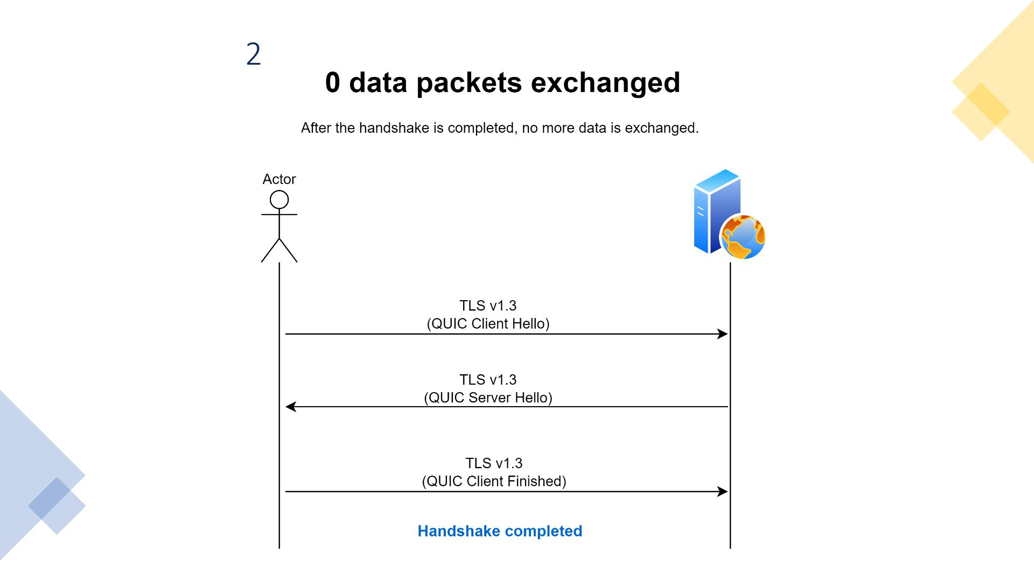
Test Scenario

Slide 10
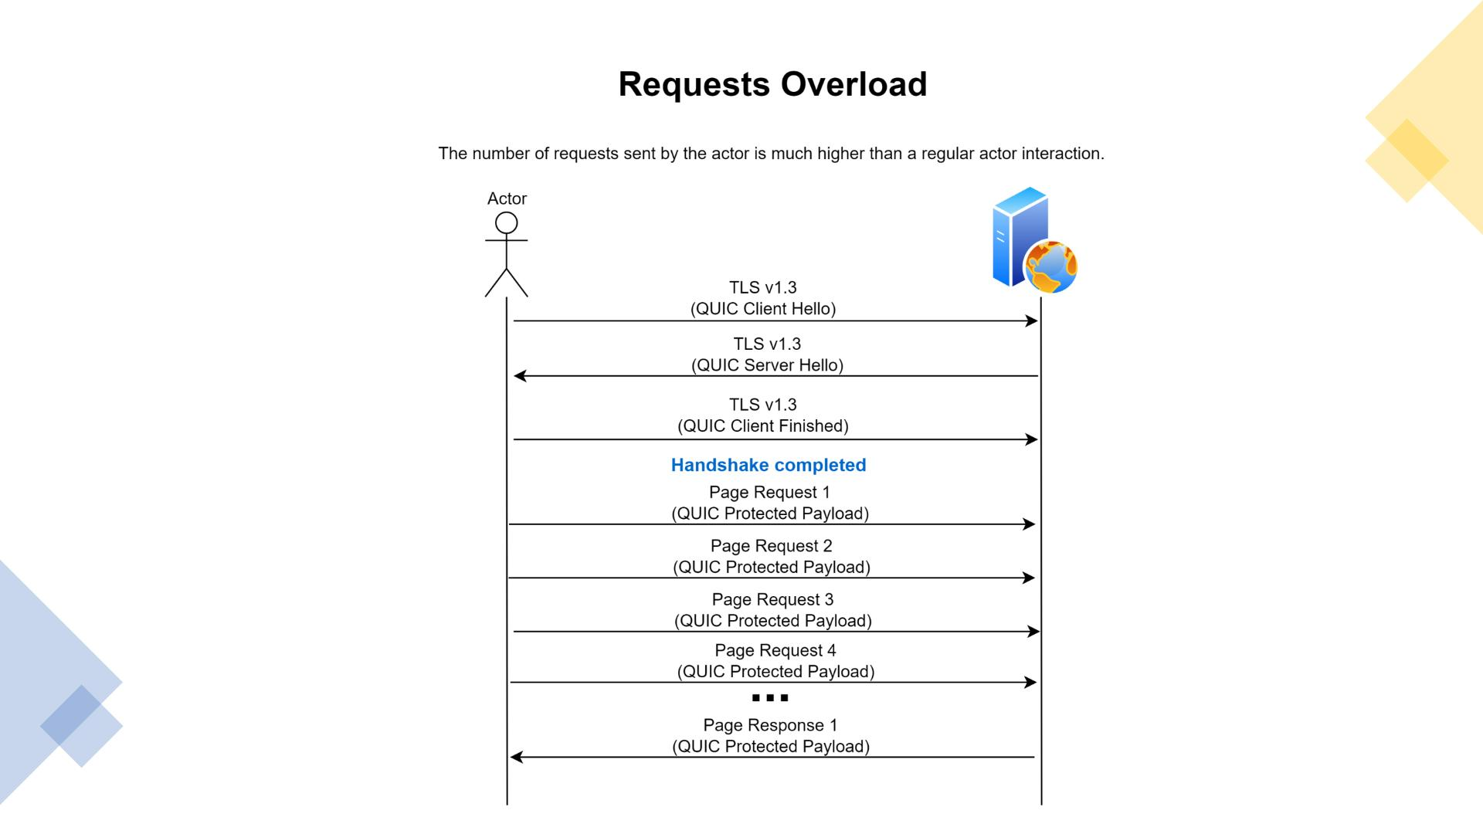
Test Scenario 3

Slide 11

Metrics
Source IP
Destination IP
Packet Size
Number of QUIC Initial Packets (TLSv1.3 Client Hello)
Number of QUIC Initial Packets (TLSv1.3 Server Hello)
Number of QUIC Initial Packets (TLSv1.3 Client Finished)
Number of QUIC Packets (Protected Payload)

Slide 12

Features
QUIC Initial (TLS1.3 Client Hello)
QUIC Client Finished
Activity periods:
Activity periods:
• number, average time, standard deviation
• number, average time, standard deviation
Silent periods:
Silent periods:
• number, average time, standard deviation
• number, average time, standard deviation

Slide 13
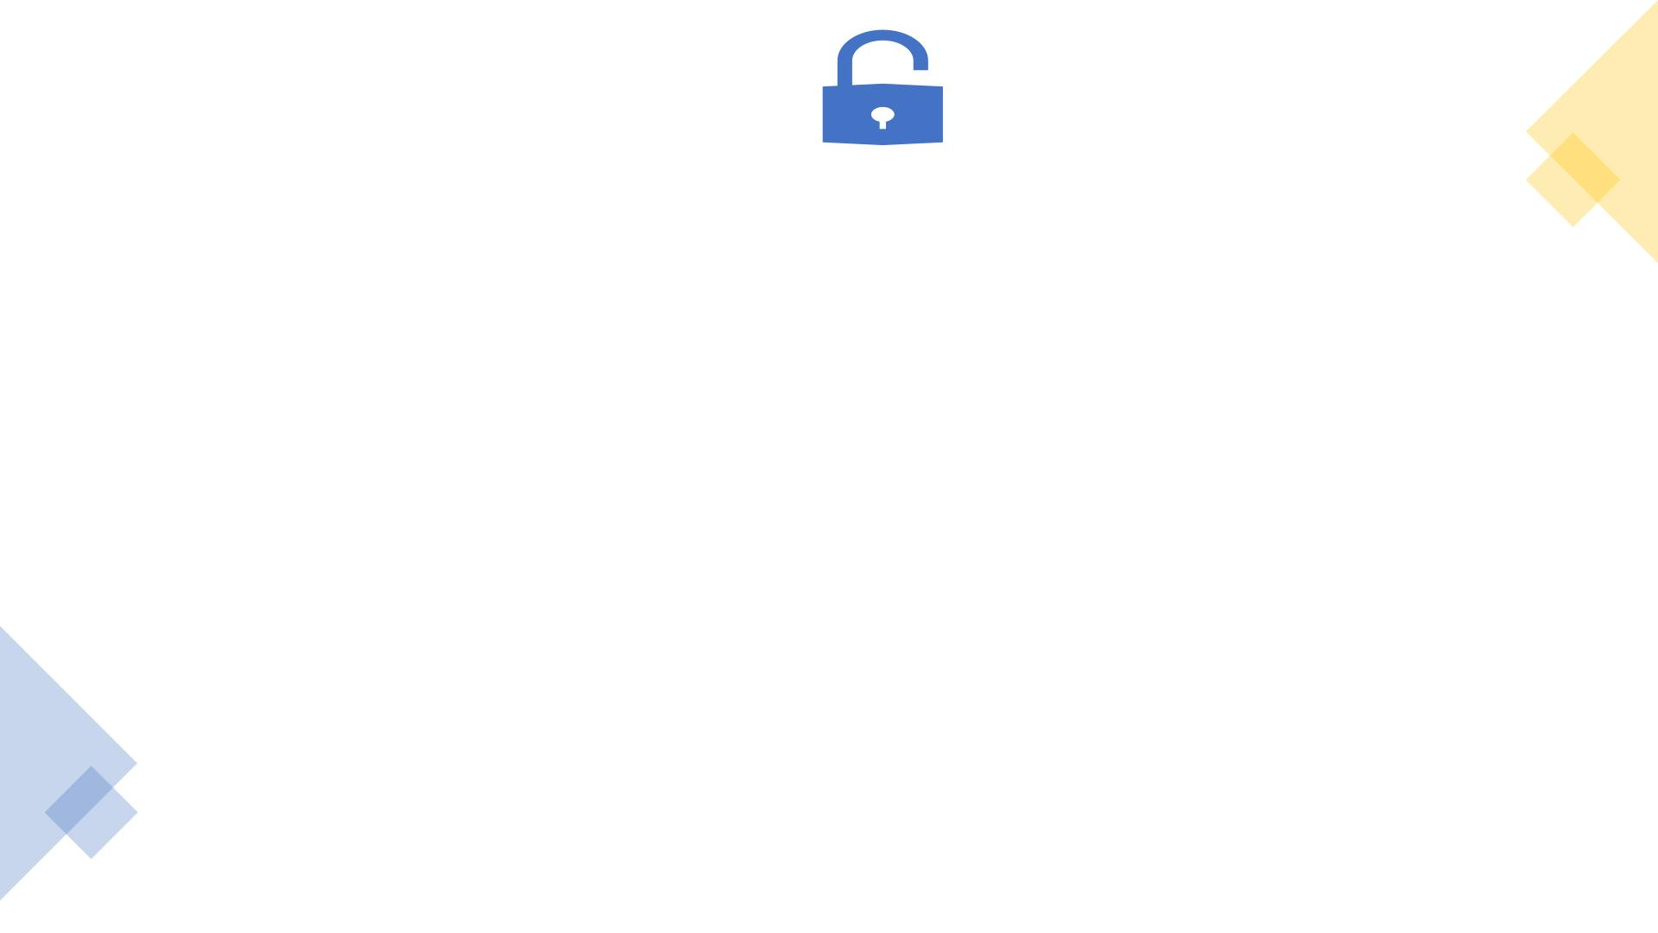
Features
QUIC Protected Payload
Number of packets pushed from server to client
Number of packets pushed from client to server
Total number of packets in a flow
Minimum packet length
Maximum packet length
Average packet length
Median packet length
Mode packet length
Standard deviation packet length
95th percentile packet length
Activity periods:
>> number, average time, standard deviation
Silent periods:
>> number, average time, standard deviation

Slide 14

QUESTIONS?
Thank you for your attention!
This Photo
.

