Slide 1

QUIC Protocol: DoS attack
Anomaly Detection
Maria Inês Rocha
Pedro Abreu
93320
93240
TPR - January 2023

Slide 2
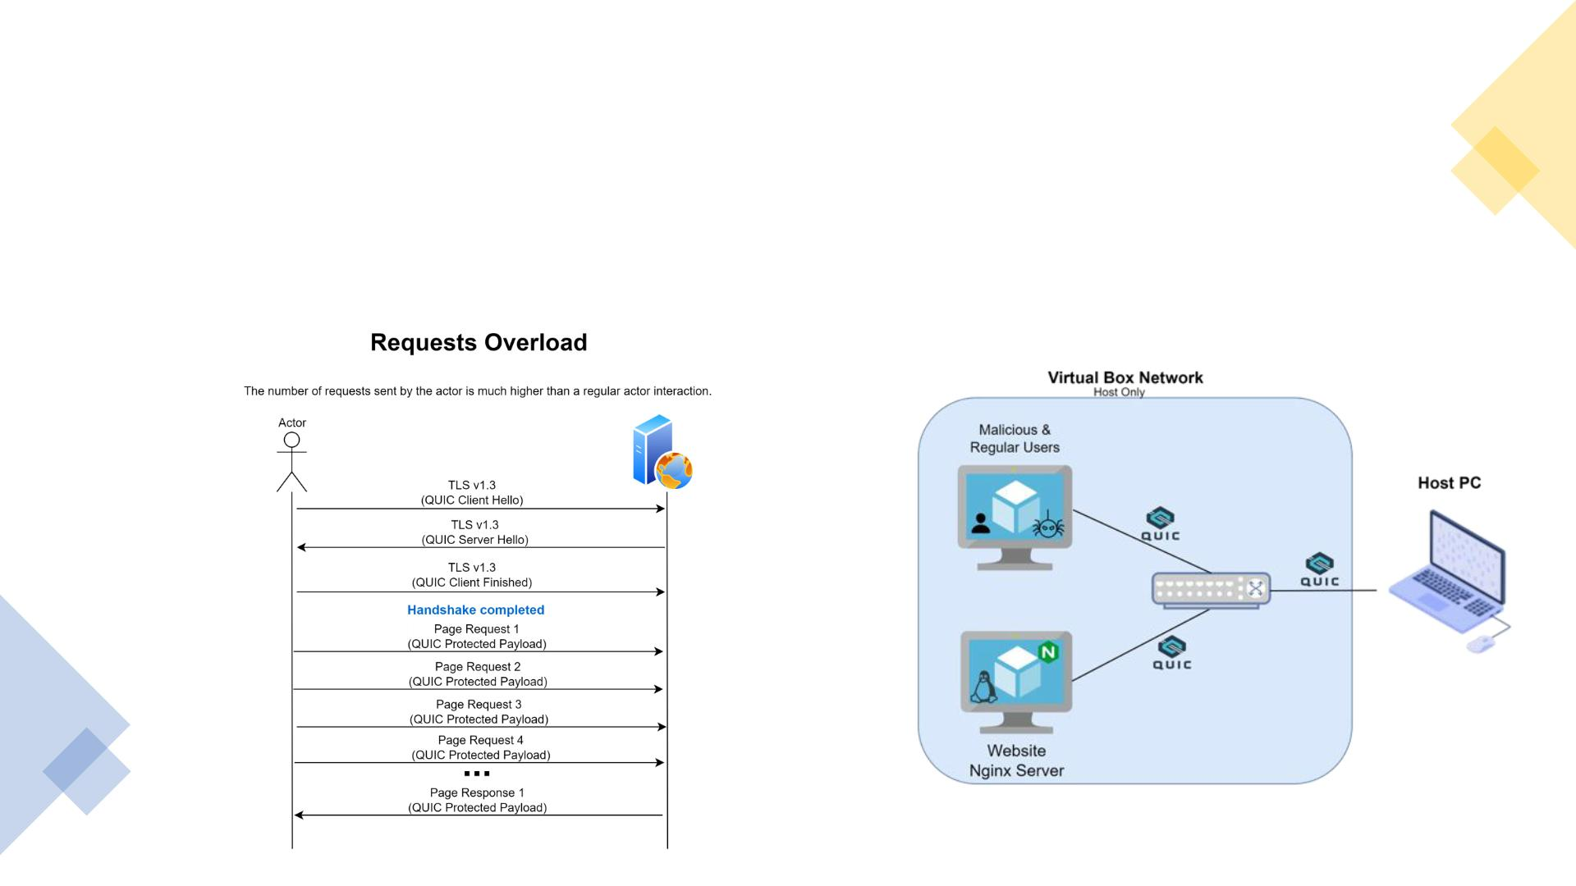
M ain Objective
• To detect a QUIC DoS attack – service denial a tta ck
• Proposed: 3 different scenarios
• Achieved: only 1 scenario evaluated
Test Scenario
Solution Setup

Slide 3
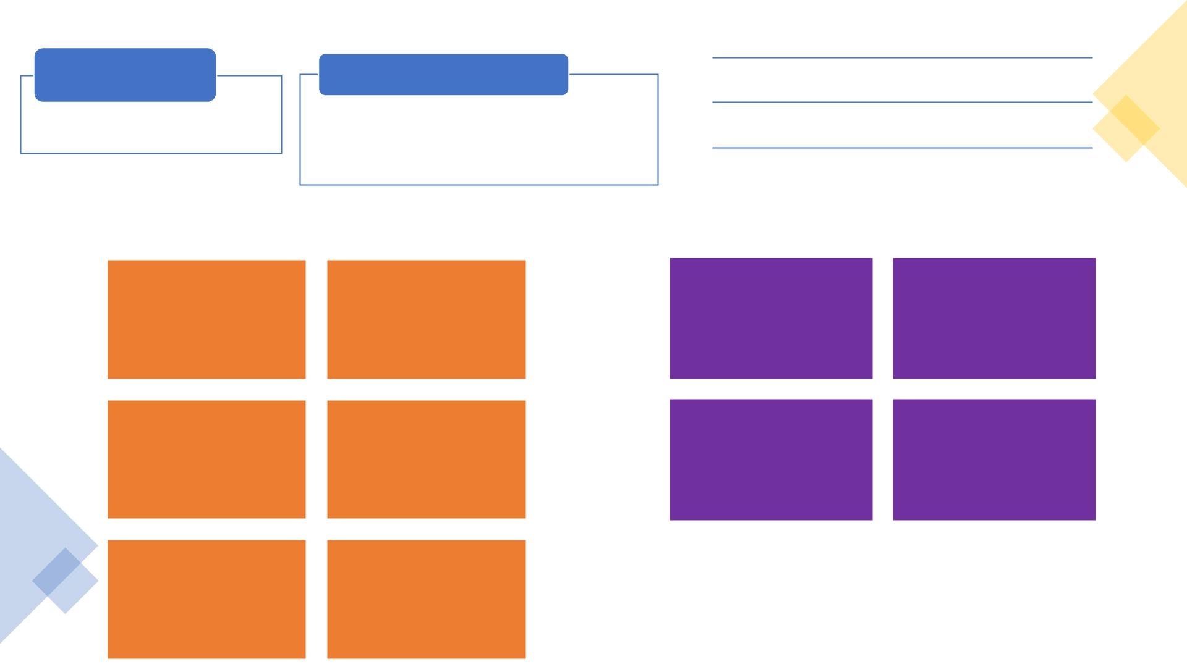
Data Sources
Metrics
Time between consecutive packets
Packet Size
Network Packets
Observation Windows Tested
• Wireshark
• 10 secs with sliding of 2 secs
• 20 secs with sliding of 5 secs
• 60 secs with sliding of 10 secs
Number of QUIC Packets
Time Independent Features
Time Dependent Features
Average packet length
Median packet length
Average of time
Median of time
Standard deviation packet
length
95th percentile packet
length
Standard deviation
Nº of upload
packets
of time
Two cases:
<1 sec
> 1 sec
Minimum packet length
Maximum packet length

Slide 4
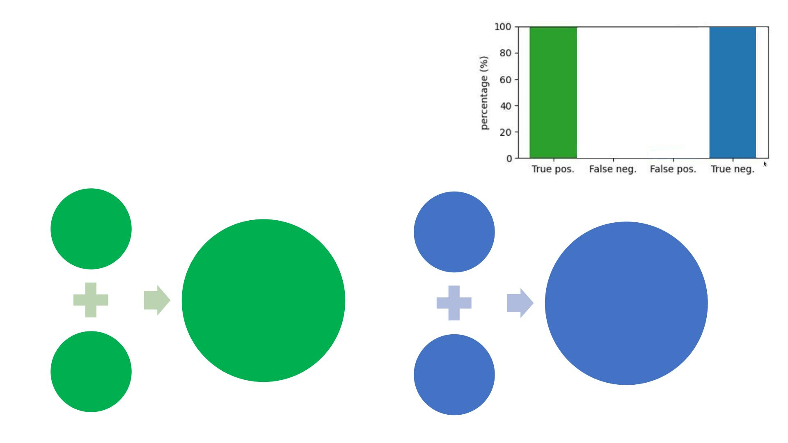
A nalysis C ontext
Pe rfect
Scenario
• Detecting anomalies:
=> Positive Class: Anomaly
=> Negative Class: Ok
Client
Train Set
Client
Train Set
Anomaly
predicted or
not: True
OK predicted
or not: True
Negative or
False Positive
Positive or
False Negative
Attacker
Test Set
Client
Test Set
(different)

Slide 5
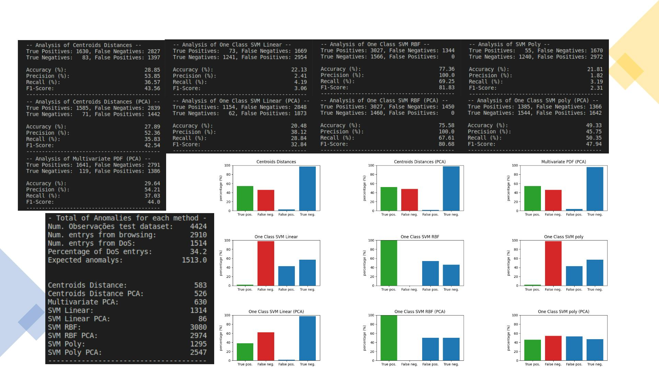
Results >> Wi ndow: 10 S lide: 2

Slide 6
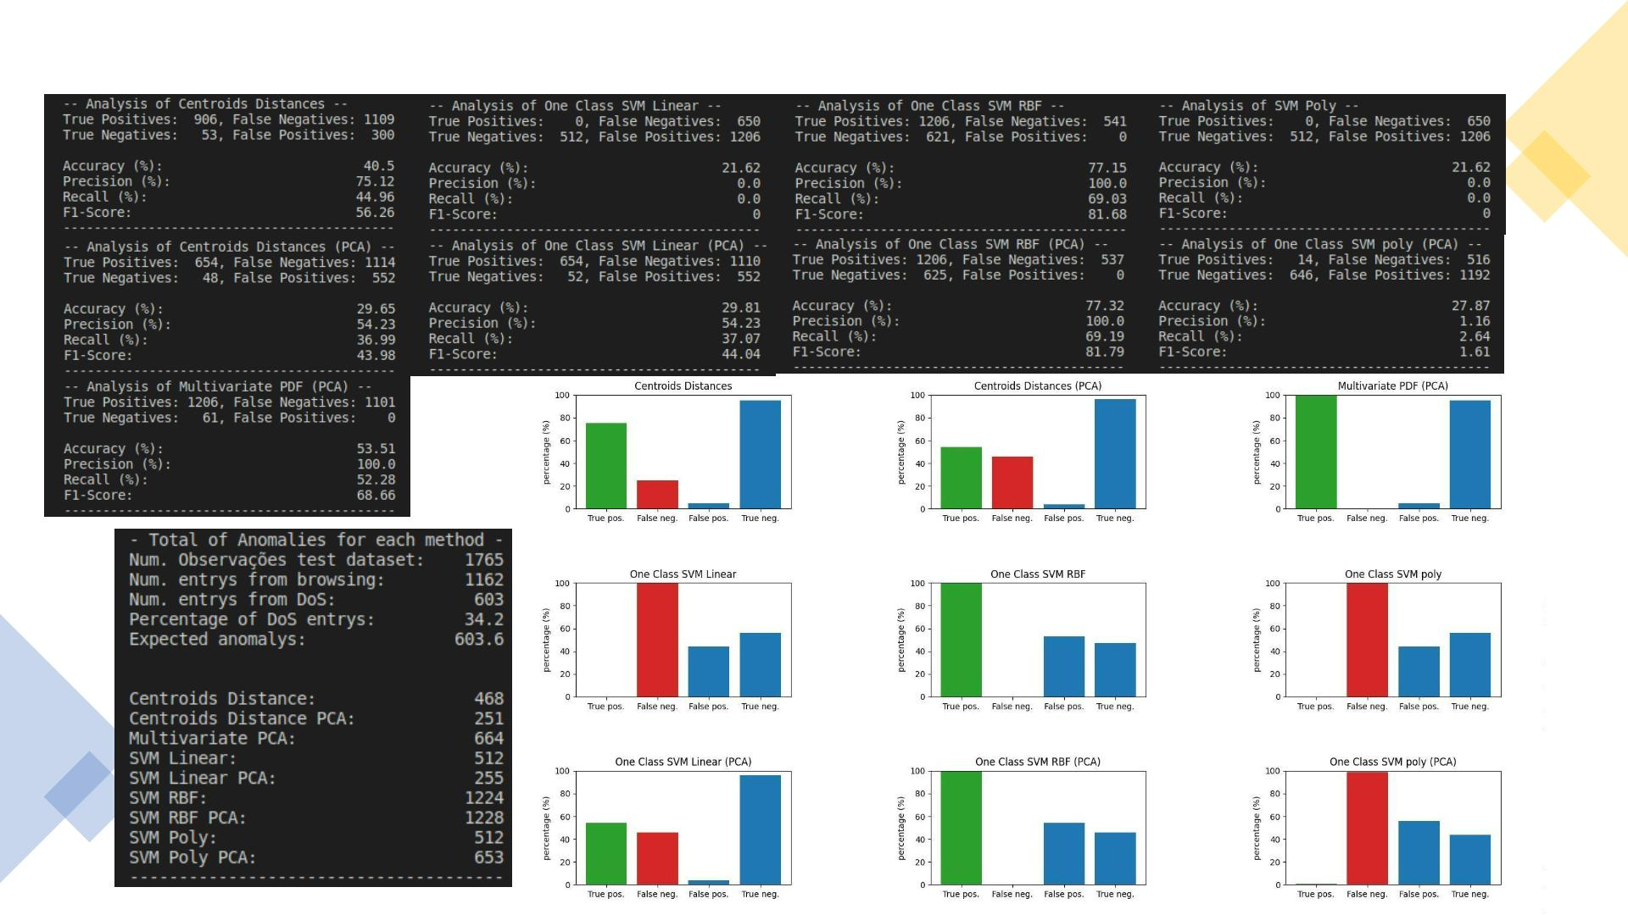
Results >> Wi ndow: 20 S lide: 5

Slide 7
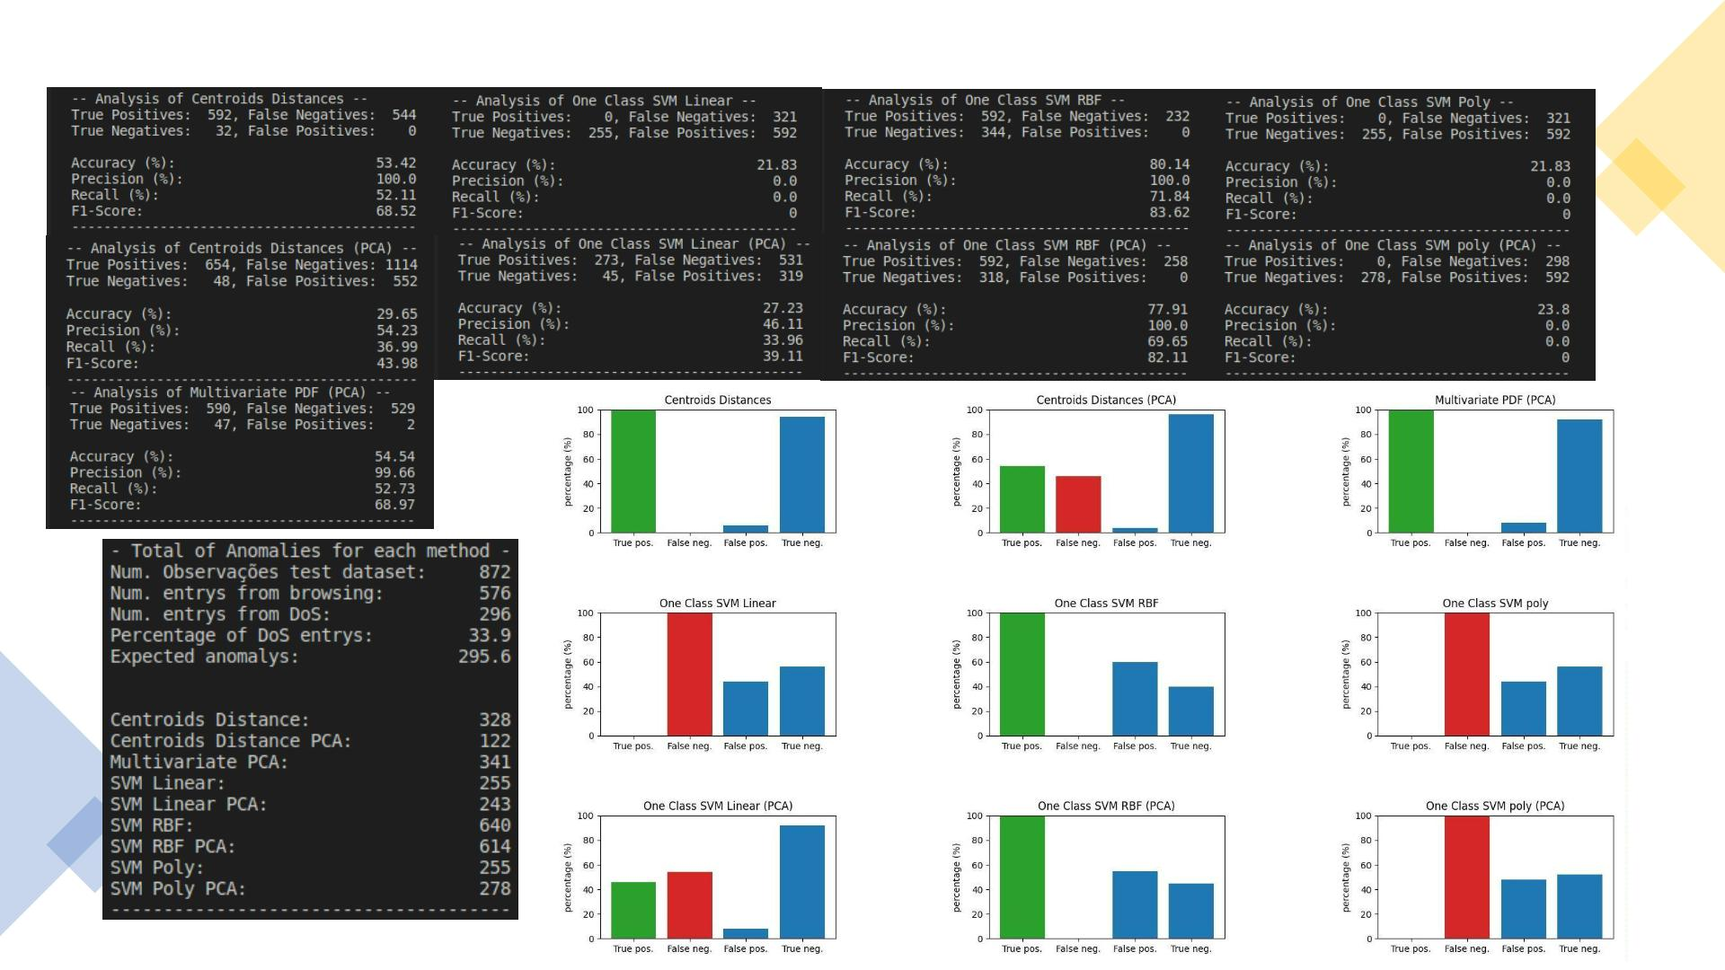
Results >> Wi ndow: 60 S lide: 10

Slide 8
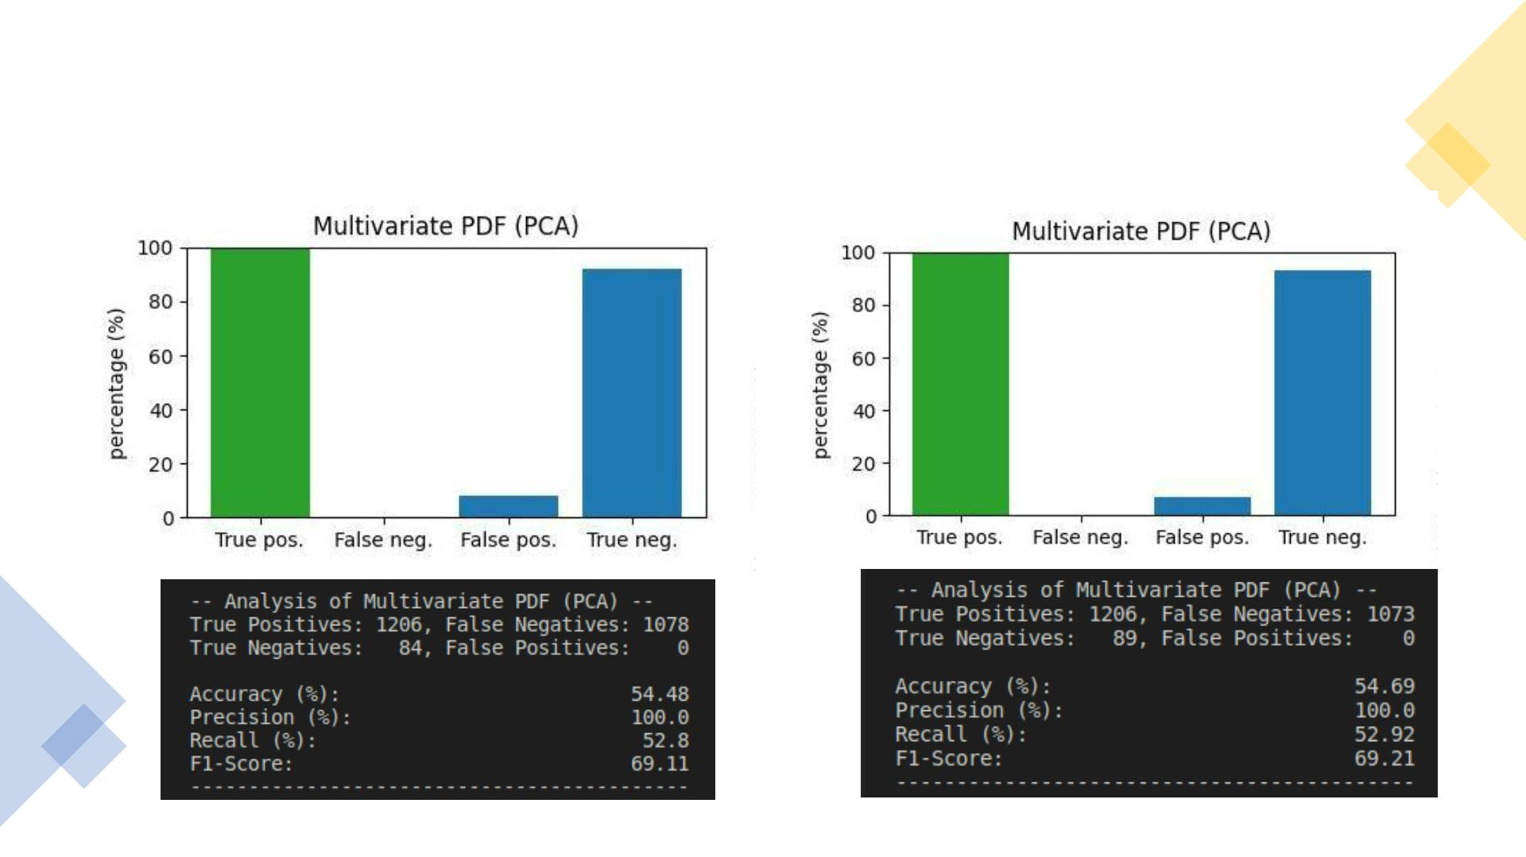
Results >> Wi ndow: 20 S lide: 5
PCA 4 components
PCA 5 components

Slide 9

Conclusions
• Limitation: the website service running in the server as only static
contents that are loaded at once
• There weren't detected significant changes when the number of PCA
components varied
• Statistics methods results were better than the machine learning ones
• From our perspective this happens due to the determinism of DoS
attacks
• OneClass SVM RBF [PCA] was most consistent method in
the detection of anomalies correctly (failed in legit traffic classification)
• The use of statistics approaches, namely, the Multivariate PDF with
PCA revealed to be the best choice

Slide 10

DEMO
https://github.com/Torrakanor611/QUIC_Anomaly_Detection

Slide 11

QUESTIONS?
Thank you for your attention!

