Slide 1
Iteration With purrr
JMG

Slide 2
Learning Objectives
In this lesson, we cover the basic usage and application of iteration following “tidy” principles by using the purrr package. After this lesson you should
Be familiar with common loop patterns.
Have a feel for the map family of purrr functions.
Be aware of some statistical applications of iteration using the purrr package.
References for this lesson are
R for Data Science
Advanced R
purrr Documentation

Slide 3
Prerequisites

Slide 4
Function Programming

Slide 5
R Markdown
This is an R Markdown presentation. Markdown is a simple formatting syntax for authoring HTML, PDF, and MS Word documents. For more details on using R Markdown see http://rmarkdown.rstudio.com.
When you click the Knit button a document will be generated that includes both content as well as the output of any embedded R code chunks within the document.

Slide 6
Slide with Bullets
Bullet 1
Bullet 2
Bullet 3

Slide 7
Slide with R Output
summary(cars)
## speed dist ## Min. : 4.0 Min. : 2.00 ## 1st Qu.:12.0 1st Qu.: 26.00 ## Median :15.0 Median : 36.00 ## Mean :15.4 Mean : 42.98 ## 3rd Qu.:19.0 3rd Qu.: 56.00 ## Max. :25.0 Max. :120.00

Slide 8
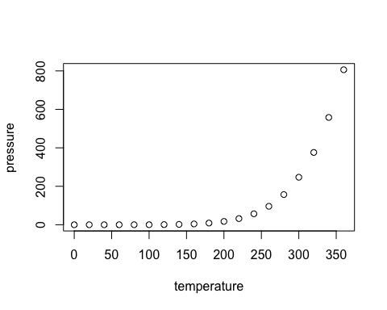
Slide with Plot

