Slide 1
Dates and Times in R
Jason M Graham

Slide 2
Goals
After this lesson, you should
be aware of some common challenges of working with data that include dates and times, and
know some introductory level techniques for handling date-time data in R using the lubridate package.

Slide 3
Background and Motivation
Data comes in a variety of types.
We measure quantities numerically with decimal numbers. In R, represented by numeric.
Count certain observations with whole numbers. In R, represented by numeric.
Record qualitative or categorical observations using text-based labeling. In R, represented by character.

Slide 4
R Data Examples
numeric_values <- c(1.2,6.5,8.1) class(numeric_values)
## [1] "numeric"
character_values <- c("dog","cat","bird") class(character_values)
## [1] "character"

Slide 5
Data Frames and Examples
Often, we store a data set as a data.frame or tibble in R.
Each column in a data frame can have a different type for the data it contains.
We will work with three data sets:
The restaurants and food service data from Data USA contained in the Monthly Employment.csv file, and
the R and R Packages download data from Tidy Tuesday.
The airline flights data from the nycflights13 package.

Slide 6
Looking at the Data
Let’s look at what is in the data frames for our working examples data.
We will show the first few rows for the food services and R package downloads data sets.

Slide 7
Food Services
What do you think are the data types for each column of the data?
Month of Year ID | Month of Year | Supersector ID | Supersector | NSA Employees | Date | NSA Employees Growth
2008-01 | January, 2008 | 70 | Leisure and Hospitality | 12,946,400 | 2008-01-01 | 1.662387
2008-02 | February, 2008 | 70 | Leisure and Hospitality | 13,057,000 | 2008-02-01 | 1.606941
2008-03 | March, 2008 | 70 | Leisure and Hospitality | 13,272,000 | 2008-03-01 | 1.179359
2008-04 | April, 2008 | 70 | Leisure and Hospitality | 13,556,600 | 2008-04-01 | 1.366852

Slide 8
R Package Downloads
What do you think are the data types for each column of the data?
date | time | size | version | os | country | ip_id
2018-10-23 | 18:20:45 | 82,877,758 | 3.5.1 | win | US | 1
2018-10-23 | 18:20:42 | 77,627,379 | 3.5.1 | osx | US | 2
2018-10-23 | 18:20:51 | 82,970,566 | 3.5.1 | win | US | 3
2018-10-23 | 18:20:51 | 1,394,694 | 3.5.1 | win | CA | 4

Slide 9
Date and Time Data
Some variables in the data sets have a date or time.
For example,
## [1] "Date"
## [1] "hms" "difftime"

Slide 10
Date and Time Challenges in a Spreadsheet
It can be very challenging to work with data or time data in a spreadsheet.

Slide 11
R Markdown
This is an R Markdown presentation. Markdown is a simple formatting syntax for authoring HTML, PDF, and MS Word documents. For more details on using R Markdown see http://rmarkdown.rstudio.com.
When you click the Knit button a document will be generated that includes both content as well as the output of any embedded R code chunks within the document.

Slide 12
Slide with Bullets
Bullet 1
Bullet 2
Bullet 3

Slide 13
Slide with R Output
summary(cars)
## speed dist ## Min. : 4.0 Min. : 2.00 ## 1st Qu.:12.0 1st Qu.: 26.00 ## Median :15.0 Median : 36.00 ## Mean :15.4 Mean : 42.98 ## 3rd Qu.:19.0 3rd Qu.: 56.00 ## Max. :25.0 Max. :120.00

Slide 14
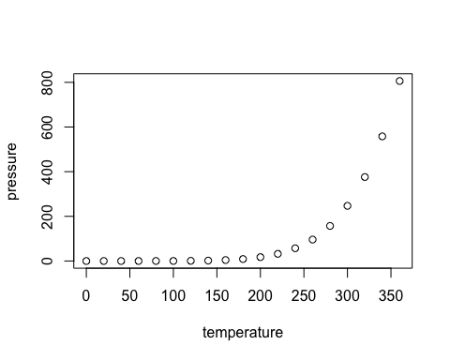
Slide with Plot

