Slide 1
Iteration With purrr
JMG

Slide 2
Learning Objectives
In this lesson, we cover the basic usage and application of “tidy” iteration using the purrr package. After this lesson you should:
Have a feel for the map family of purrr functions.
Have an understanding of how purr functions can be used in place of loops.
Be aware of some statistical applications of iteration using the purrr package.

Slide 3
References
References for this lesson are
R for Data Science
Advanced R
purrr Documentation
You can find code relevant to this lesson on my GitHub repo.

Slide 4
Prerequisites
This lesson assumes familiarity with
Vectors, lists, data frames, and functions in R.
The use of tidyverse packages such as tibble, ggplot2, and dplyr.
Knowledge of basic statistical concepts such as confidence intervals and linear models is helpful but not essential.

Slide 5
Iteration
In R for Data Science, good programming practices are stressed. For example, it is emphasized that one should never copy and paste code more than twice.
Loops provide one way to avoiding copying and pasting.
Functions provide another.
Let’s review the basic programming construct known as for loops.

Slide 6
Loops
Loops are examples of control flow statements in a program that result in iteration.
The basic idea of a for loop is that a specified action is repeated a predetermined number of times.
For example, if we have a container that holds three numbers and we want to multiply each of the three numbers by 2 then a for loop is an ideal method for doing this repetitive task.

Slide 7
Loops in R
A for loop in R has the general form
for (item in vector) perform_action
For example:
for (i in 1:3){ print(2*i) }

Slide 8
Output From Example Loop
The for loop in the previous slide will output
## [1] 2 ## [1] 4 ## [1] 6
Note that if we wanted to store the result of multiplying by 2 instead of printing it, we would need to initialize a vector of the appropriate size.

Slide 9
Functional Programming
Often, for loops are unnecessary in R because the language supports functional programming (FP).
FP is a paradigm that utilizes functions and function composition to develop code.
Use of FP can lead to clean, concise code.
The purrr package enhances FP in R.
FP code is convenient for multi-processing.

Slide 10
FP: Getting Started
A good way to get started with FP in R is via the map family of functions from purrr.
Here is a simple example:
map(1:3,function(x){2*x})
This creates a list object that contains 2, 4, and 6.

Slide 11
Output from Previous Slide
## [[1]] ## [1] 2 ## ## [[2]] ## [1] 4 ## ## [[3]] ## [1] 6

Slide 12
Explanation of map
The map function inputs an object such as a vector, list, or data frame together with a function, and applies the function to each component of the object.
map returns a list object.
There are similar functions, map_lgl, map_chr, map_dbl, map_int, etc. that return different data types. Examine documentation with ?map for details.

Slide 13
Example Output
For example,
map_dbl(1:3,function(x){2*x})
outputs
## [1] 2 4 6
This is a simple (atomic) vector instead of a list.
Let’s see some more interesting use cases.

Slide 14
Compute Multi-Column Medians
Suppose we have a data frame named sim_data with 4 numerical columns and we want to compute the median for each column.
map_dbl(sim_data,median)
## a b c d ## 0.02 0.39 0.00 1.96

Slide 15
Bootstrap Confidence Intervals
Bootstrapping approximates a sampling distribution by sampling with replacement many times the original sample.
We will see an application of using purrr to implement a bootstrap to approximate a confidence interval for a mean and confidence intervals for parameters in a linear model.

Slide 16
Bootstrapping a Mean
We start with some simulated data:
set.seed(42) x <- rnorm(35,10,6.7)
Then we define a function that will return a single sample with replacement of out data:
my_boot_samp <- function(i){ return(sample(x,replace=TRUE)) }

Slide 17
Applying map to Obtain Resamples
Next, we apply map to obtain a list of 500 resamples:
boot_samps <- map(1:500,my_boot_samp)
Finally, we use map_dbl to compute the mean for each of our bootstrap resamples:
boot_means <- map_dbl(boot_samps,mean)

Slide 18
Results
We compare the bootstrap CI with the usual formula:
Bootstrap CI
quantile(boot_means,probs = c(0.025,0.975))
## 2.5% 97.5% ## 8.17372 13.61412
Usual CI
mean(x) + 1.96*c(-1,1)*(sd(x)/sqrt(length(x)))
## [1] 8.164299 13.424184

Slide 19
Bootstrap Linear Model Parameters
Given a function boot_samp_leafburn that samples from the dataset, the following code obtains 500 bootstrap resamples of the leafburn data from the faraway package:
leafburn_boots <- map(1:500,boot_samp_leafburn)

Slide 20
Bootstrap Linear Model Parameters, Cont.
Now, given a function leafburn_boot_fit that returns the parameters from a linear fit, we obtain bootstrapped estimates:
boot_leafburn_df <- boot_leafburn_df %>% mutate(fits=map(boot_samps,leafburn_boot_fit))

Slide 21
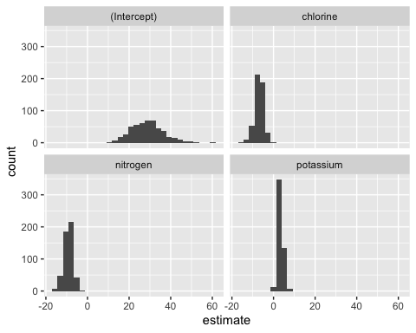
Results

Slide 22
Conclusion
We have introduced and demonstrated iteration in R using the map family of functions from the purrr package.
For more information, see R for Data Science, Advanced R, and purrr Documentation.
A purrr cheatsheet is available here.
The complete code for all examples is available here.

