Slide 1
Iteration With purrr
JMG

Slide 2
Learning Objectives
In this lesson, we cover the basic usage and application of iteration following “tidy” principles by using the purrr package. After this lesson you should
Be familiar with common loop patterns.
Have a feel for the map family of purrr functions.
Be aware of some statistical applications of iteration using the purrr package.

Slide 3
References
References for this lesson are
R for Data Science
Advanced R
purrr Documentation
You can find code relevant to this lesson on my GitHub repo.

Slide 4
Prerequisites
This lesson assumes familiarity with
The use of tidyverse packages such as tibble, ggplot2, and dplyr.
In particular, we will assume that the learner is comfortable with working with data frames or tibbles and is familiar with basic plotting using ggplot2.
We will refer to some basic statistical concepts such as confidence intervals and linear models. However, you can probably still get a fair amount out of this lesson even if your statistics background is minimal.

Slide 5
Iteration

Slide 6
Function Programming

Slide 7
R Markdown
This is an R Markdown presentation. Markdown is a simple formatting syntax for authoring HTML, PDF, and MS Word documents. For more details on using R Markdown see http://rmarkdown.rstudio.com.
When you click the Knit button a document will be generated that includes both content as well as the output of any embedded R code chunks within the document.

Slide 8
Slide with Bullets
Bullet 1
Bullet 2
Bullet 3

Slide 9
Slide with R Output
summary(cars)
## speed dist ## Min. : 4.0 Min. : 2.00 ## 1st Qu.:12.0 1st Qu.: 26.00 ## Median :15.0 Median : 36.00 ## Mean :15.4 Mean : 42.98 ## 3rd Qu.:19.0 3rd Qu.: 56.00 ## Max. :25.0 Max. :120.00

Slide 10
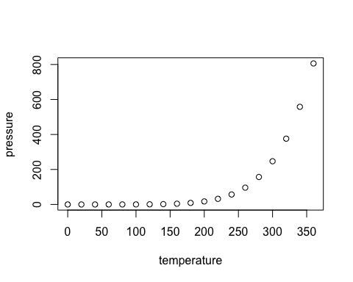
Slide with Plot

