Slide 1
Putt-Putt Golf
IVE Semester Project
Jared Gregor
Spring 2020

Slide 2
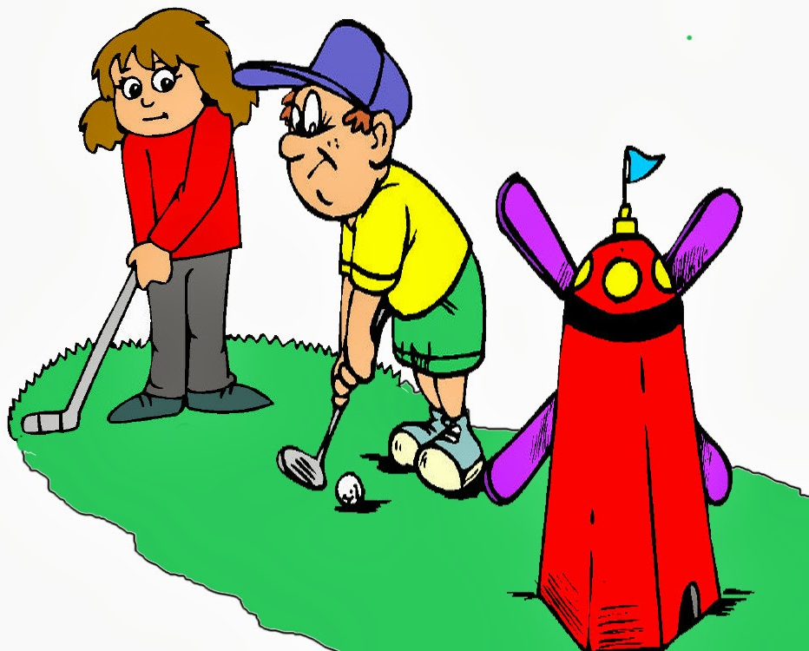
Why
Mini Golf?
Motivations
Game loved by many
Provokes understanding of geometry and physics to determine the best shot
Fun for people of all ages
http://clipart-library.com/clipart/1778609.htm

Slide 3
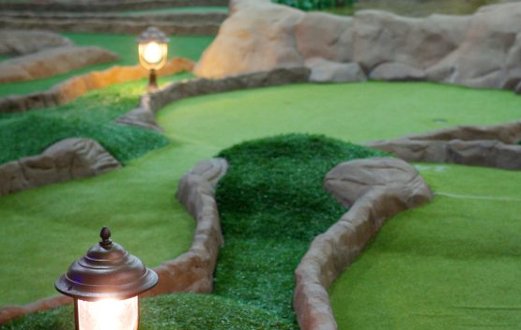
Why
Mini Golf?
Limitations
Walking around a small and usually rough terrain may be out of the question for some
People with disabilities
Older folks
Health concerns
Weather is a huge factor
https://www.minigolfcreations.com/how-to-build-mini-golf-course-business/

Slide 4
Virtual Putt-Putt Golf!

Slide 5
Equipment
Unity 2019.3.7f1
Generate Virtual Environment and Event System
Blender 2.82
Model the greens for 9 hole course
Head Mounted Display (Coming Soon…)
Play the game in Virtual Reality!

Slide 6
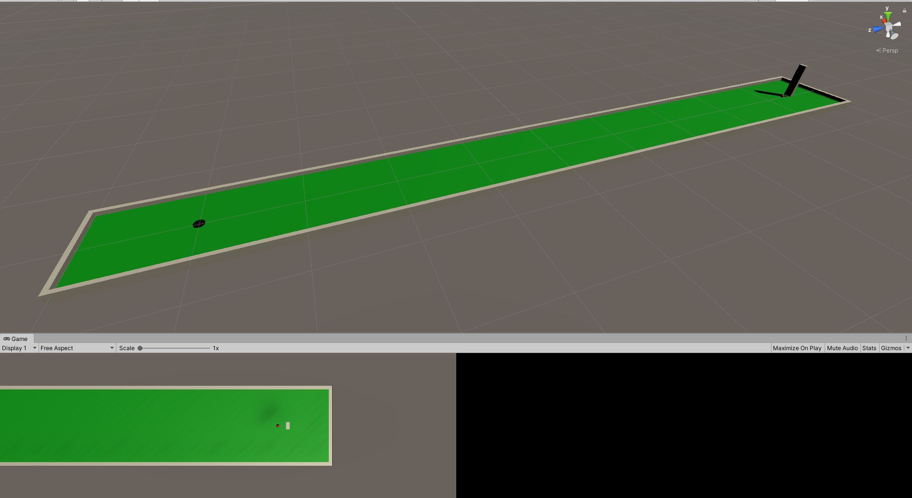
Start small and build up…
Get it working on a single hole course first!

Slide 7
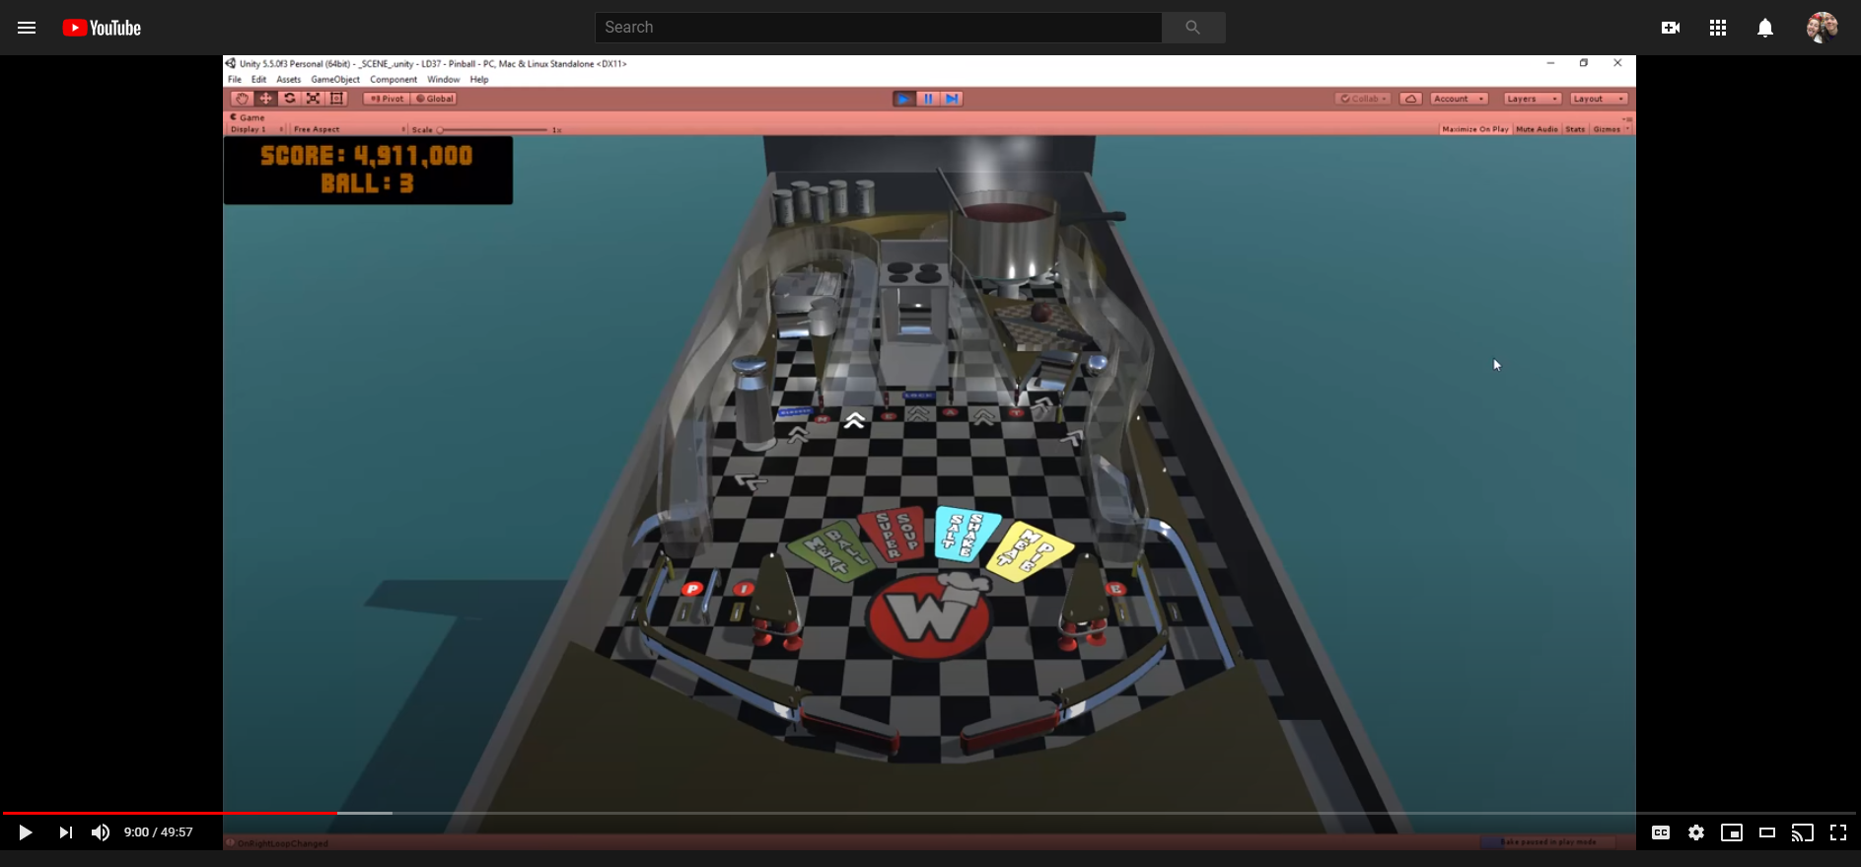
Ball interactions
Pinball Video!
Lot of similarities
Rolling ball
Objects moving to hit ball
Keeping score

Slide 8
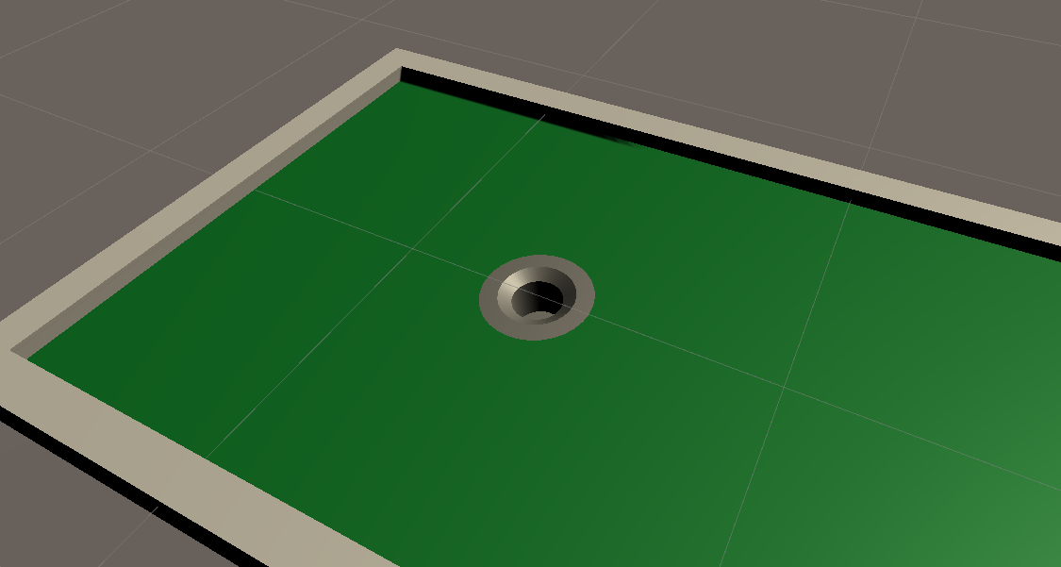
Better Hole
Fake hole tutorial in Unity without changing mesh

Slide 9
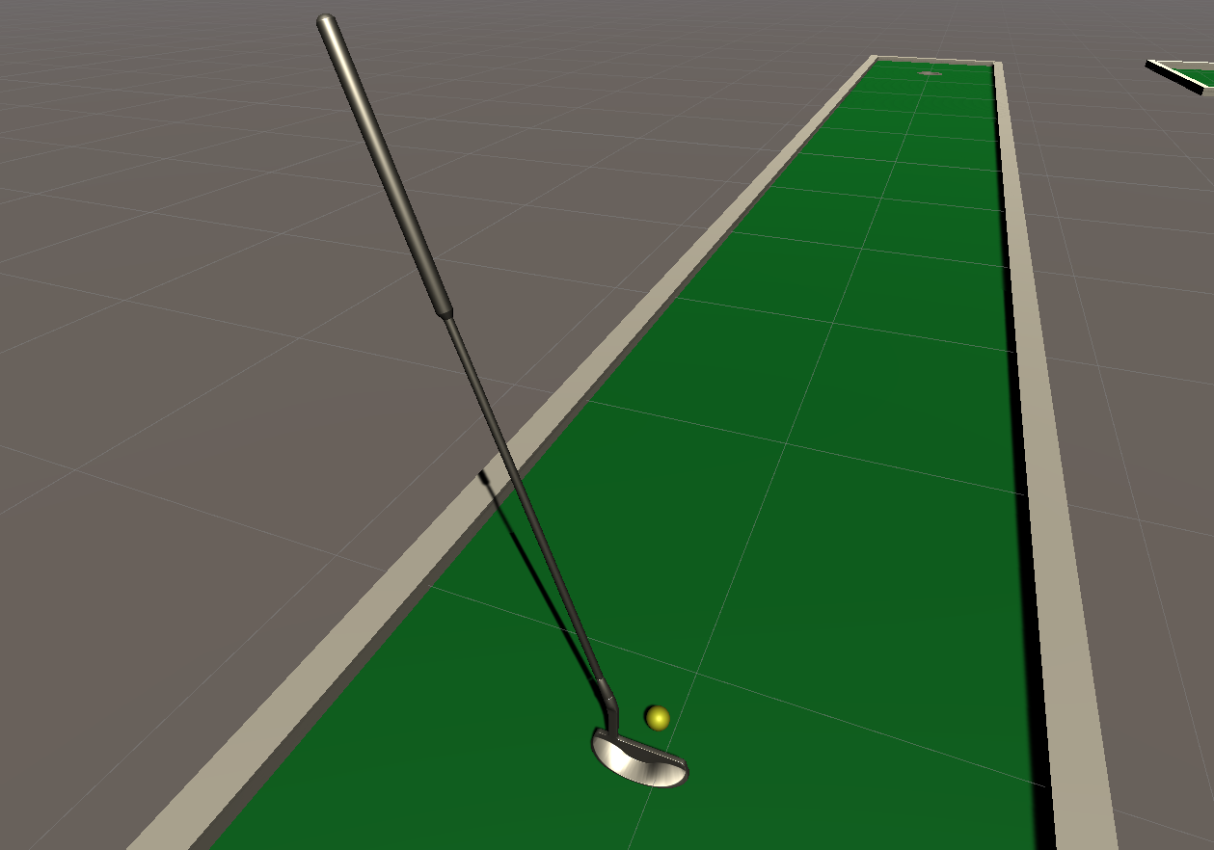
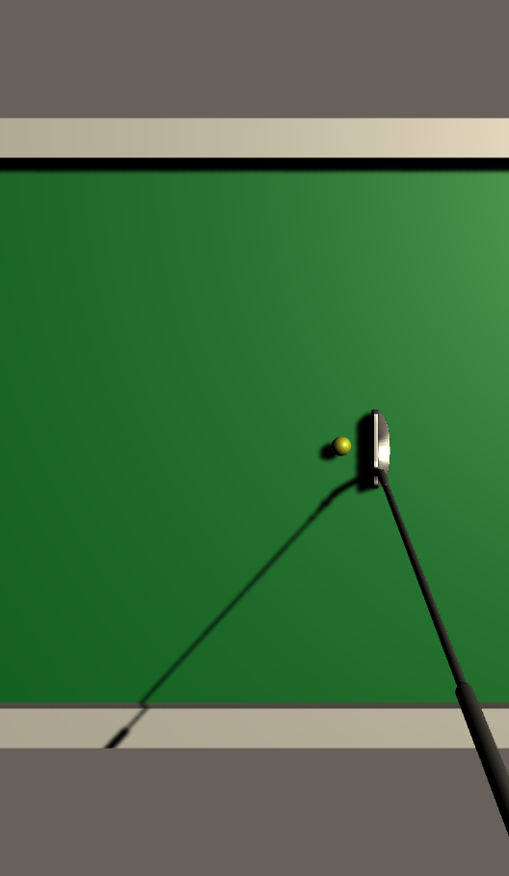
Better Club
Improved club model found online for free

Slide 13
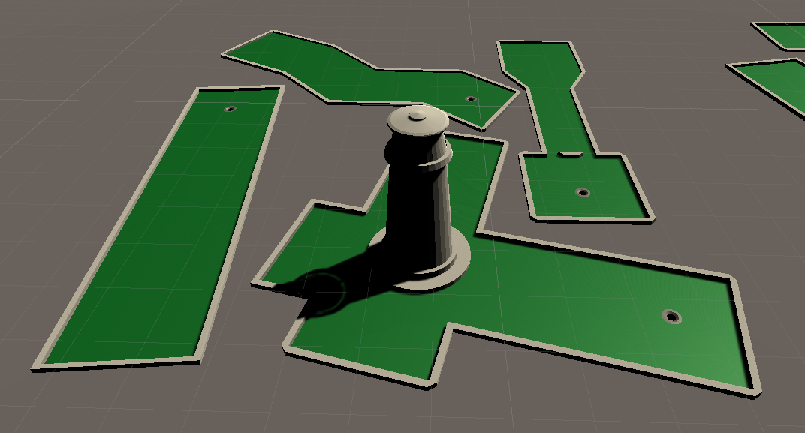
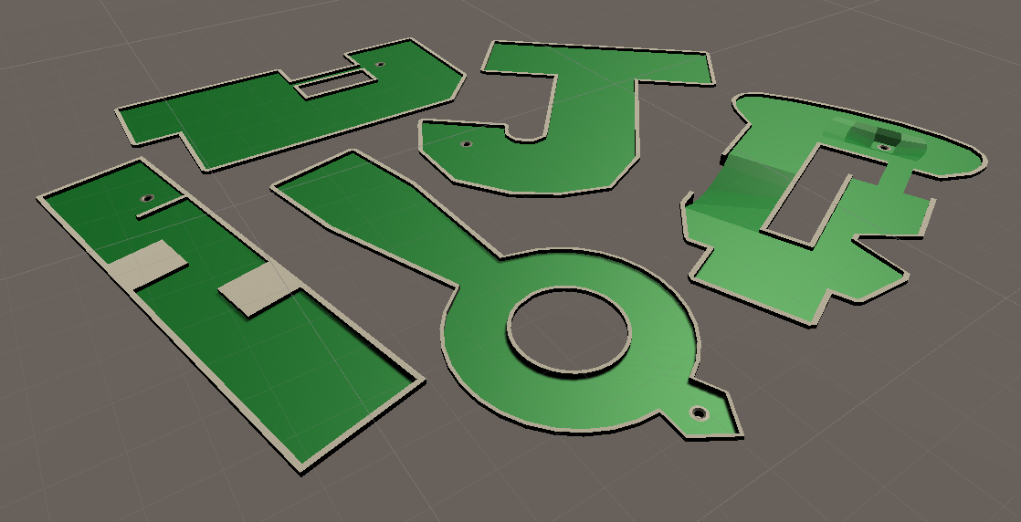
Expanding to 9 holes
Build the green in Blender
Import to unity and add materials

Slide 14
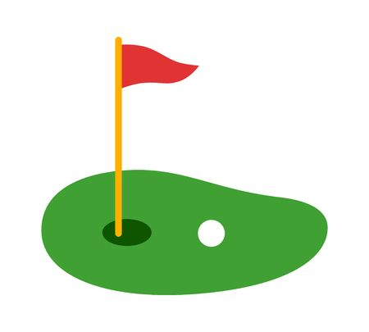
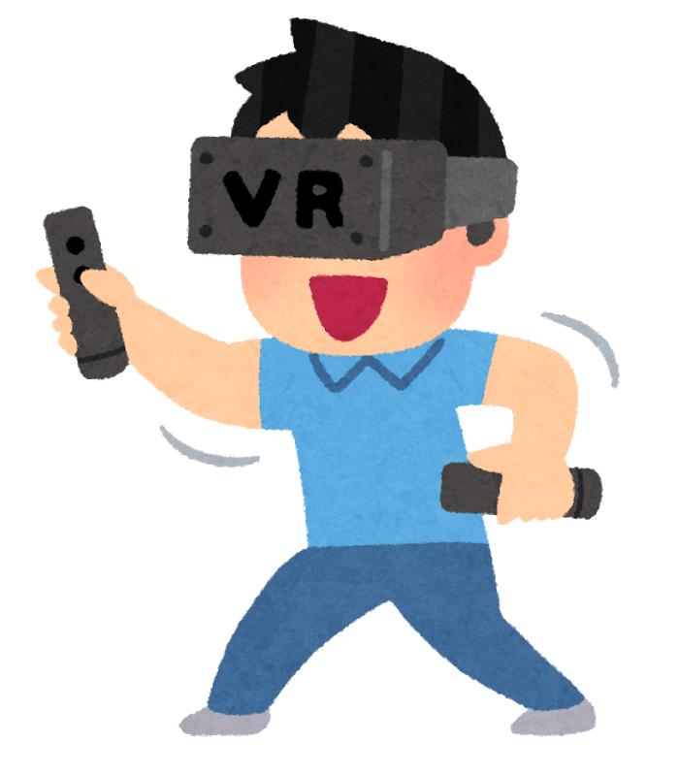
Future Work
Connect to head mounted display!
Possibly rescale for VR?
Add visuals such as a windmill or flowing water
https://www.clipart.email/clipart/mini-golf-clipart-images-244101.html
https://www.hiclipart.com/free-transparent-background-png-clipart-pnlpv

Slide 15
Questions?

