Slide 1
Putt-Putt Golf
IVE Semester Project
Jared Gregor
Spring 2020

Slide 2
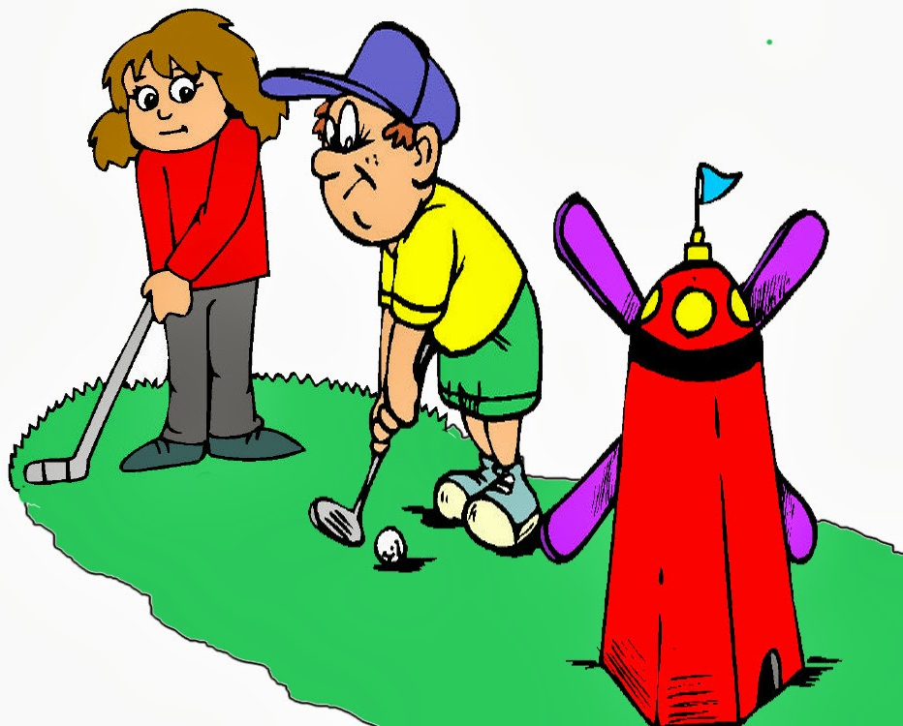
Why
Mini Golf?
Motivations
Game loved by many
Provokes understanding of geometry and physics to determine the best shot
Fun for people of all ages
http://clipart-library.com/clipart/1778609.htm

Slide 3
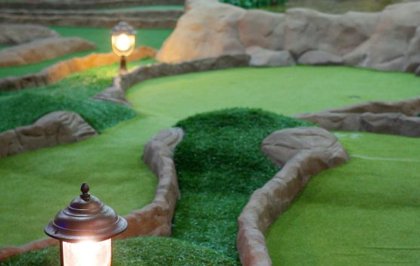
Why
Mini Golf?
Limitations
Walking around a small and usually rough terrain may be out of the question for some
People with disabilities
Older folks
Health concerns
Weather is a huge factor
https://www.minigolfcreations.com/how-to-build-mini-golf-course-business/

Slide 4
Virtual Putt-Putt Golf!

Slide 5
Equipment
Unity 2019.3.7f1
Generate Virtual Environment and Event System
Blender 2.82
Model the greens for 9 hole course
Head Mounted Display (Coming Soon…)
Play the game in Virtual Reality!

Slide 6
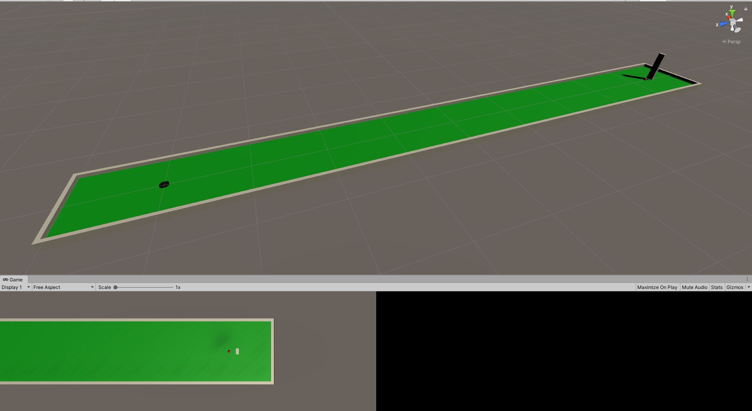
Start small and build up…
Get it working on a single hole course first!

Slide 7
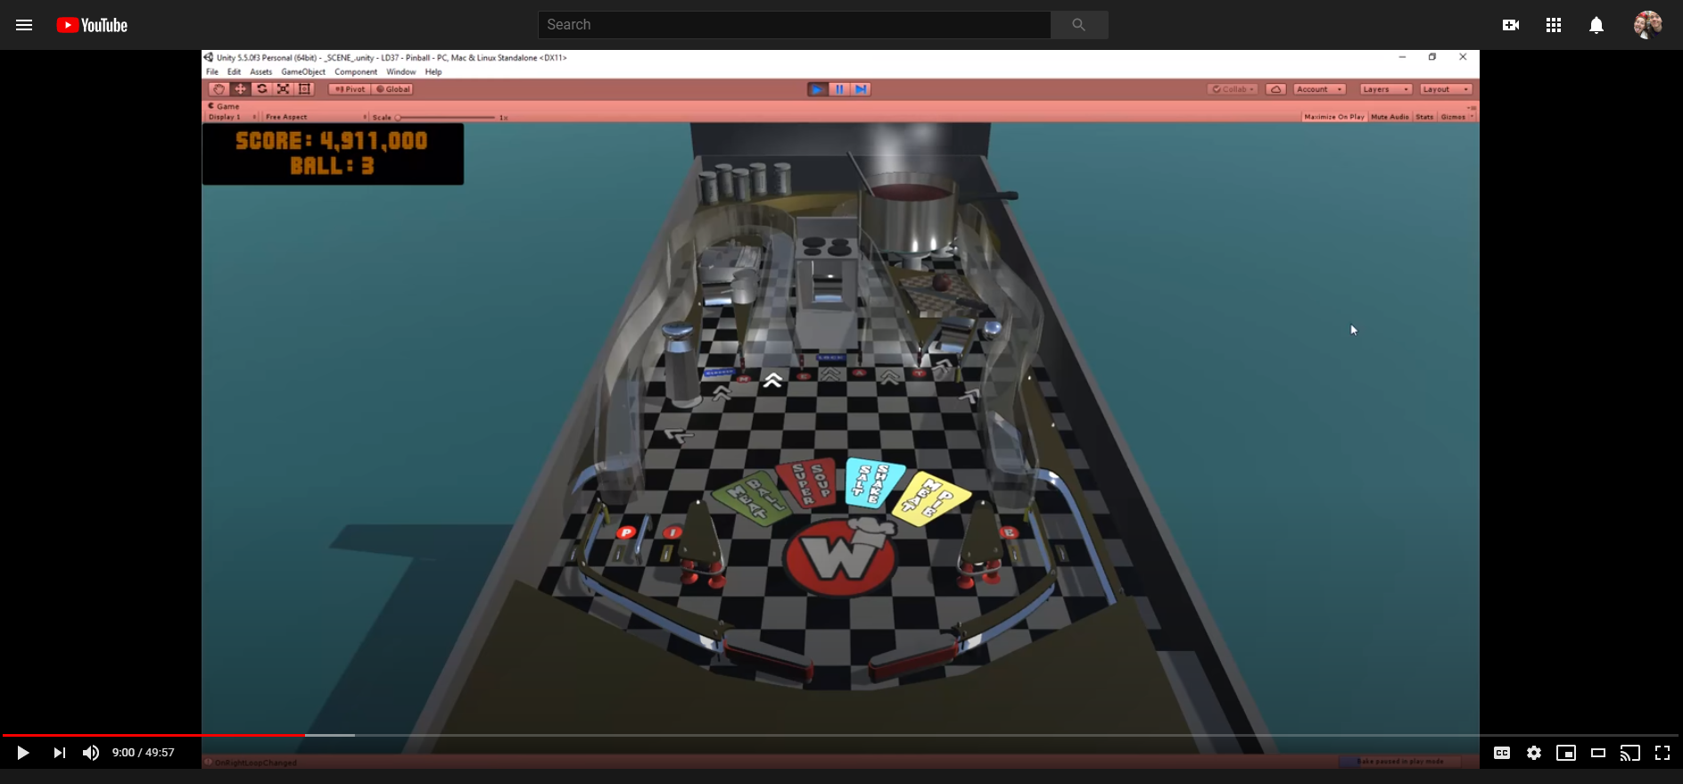
Ball interactions
Pinball Video!
Lot of similarities
Rolling ball
Objects moving to hit ball
Keeping score

Slide 8
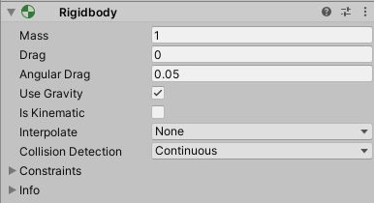
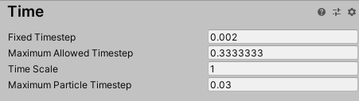
Ball interactions
Tick Rate (x10)
Continuous Collisions

Slide 9
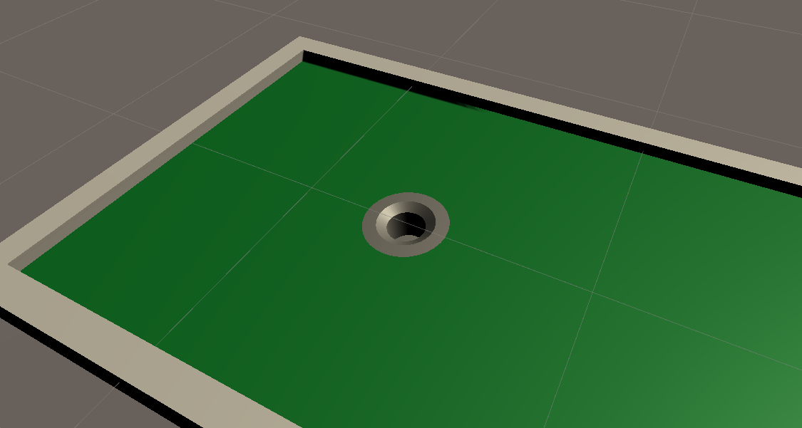
Better Hole
Fake hole tutorial in Unity without changing mesh

Slide 10
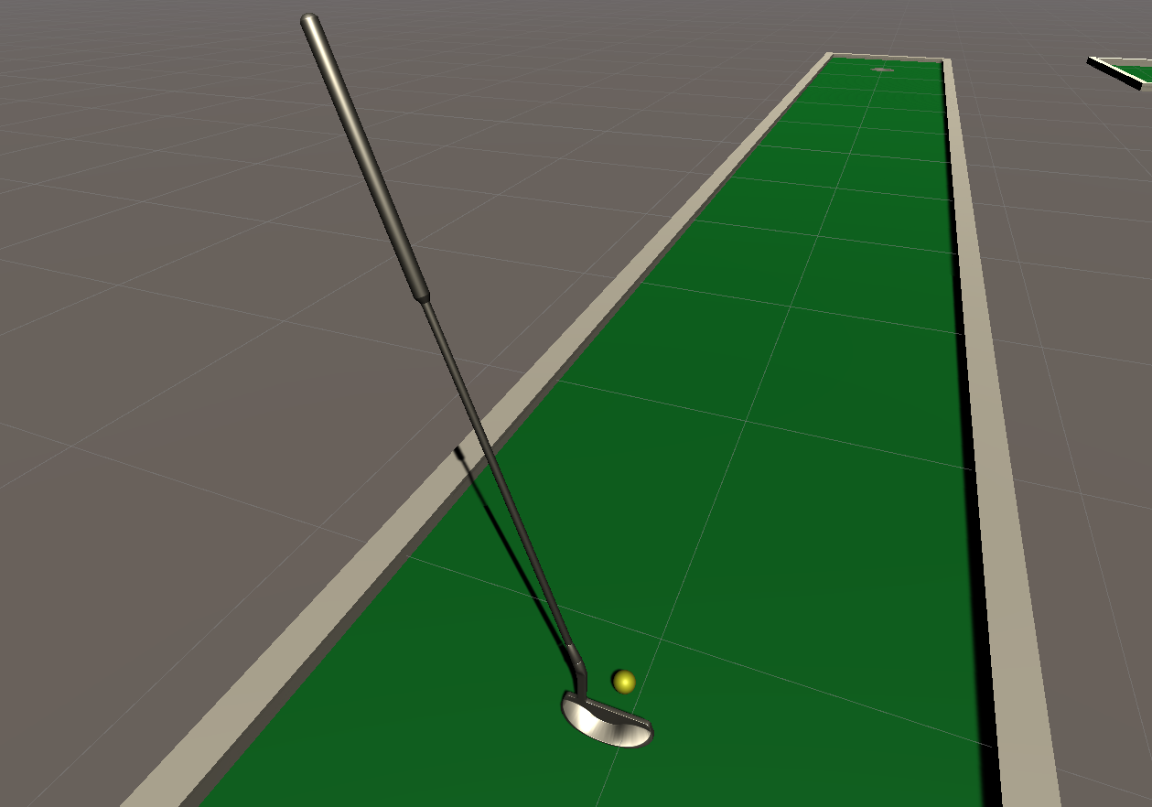
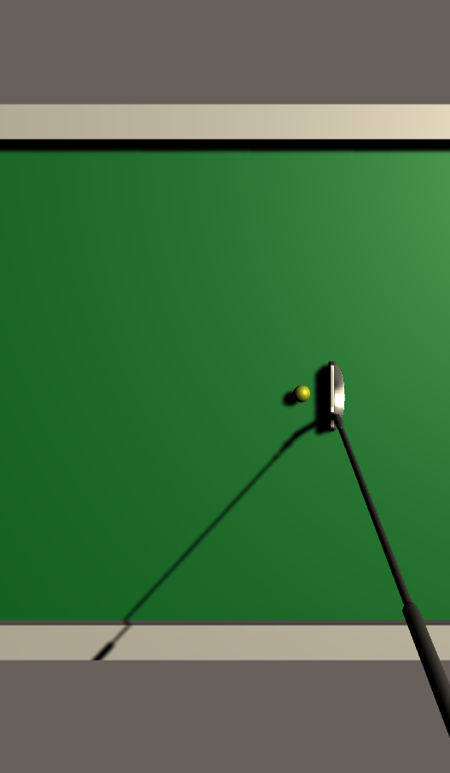
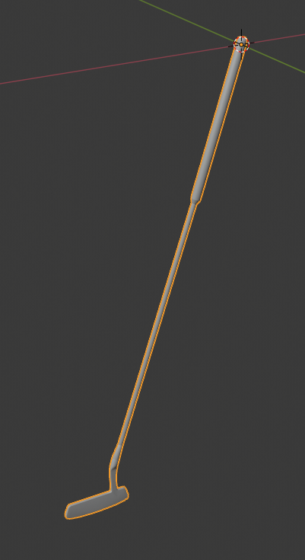
Better Club
Improved club model found online for free
Changed Origin to handle for realism

Slide 11
VRTK
Set up VRTK so we can use buttons

Slide 12
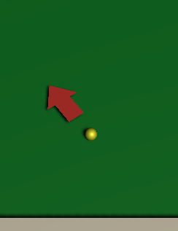
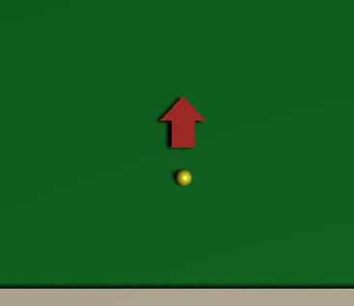
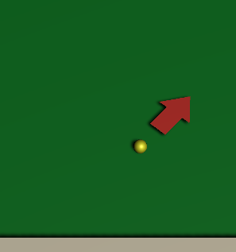
Game Mechanics
Choosing a putter angle
SPACE

Slide 13


Game Mechanics
Choosing a putter power
SPACE

Slide 14
Game Mechanics
Viewing the course

Slide 15

Game Mechanics
Keeping Score

Slide 16
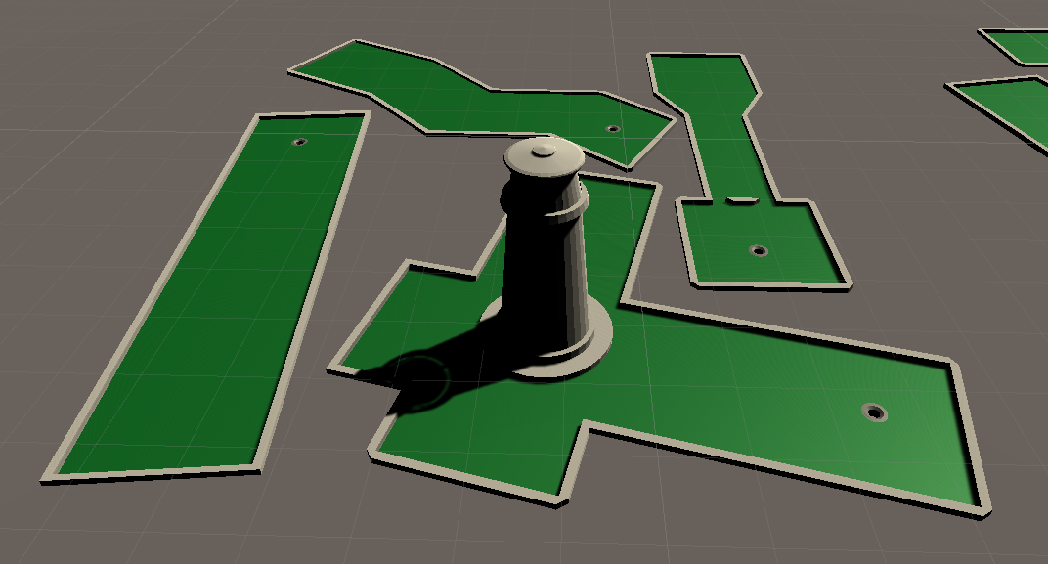
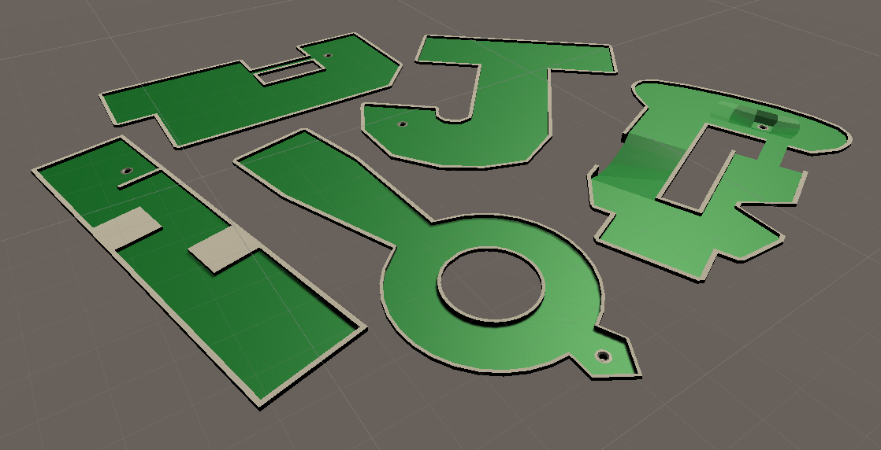
Expanding to 9 holes
Build the green in Blender
Import to unity and add materials

Slide 17
Growing Pains
Manually enter each starting position

Slide 18
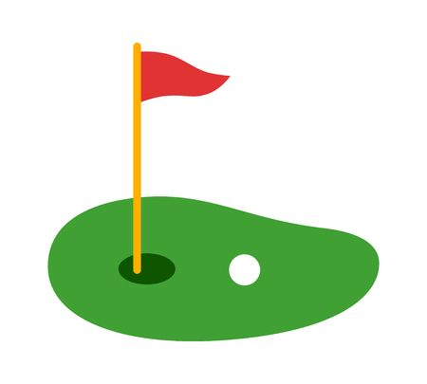
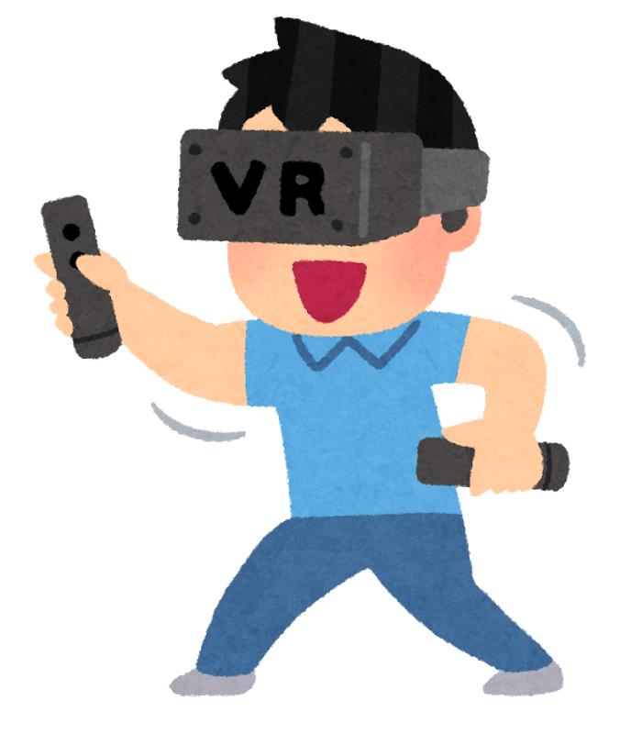
Future Work
Connect to head mounted display!
Possibly rescale for VR?
Add visuals such as a windmill or flowing water
https://www.clipart.email/clipart/mini-golf-clipart-images-244101.html
https://www.hiclipart.com/free-transparent-background-png-clipart-pnlpv

Slide 19
Questions?

