Slide 1


WEBSITE KOPEHOT
Guaño Julyam Mari M.
WBDV111 BSIT1-Y2-5
2026

Slide 2
PANIMULA

Slide 3
1.2 Objectives to be Achieved
Coffee lovers and avid drinkers
Students and working professionals Residents and visitors of the area
People looking for a place to relax or gather
They value comfort, clear communication, and warm hospitality

Slide 4
1.3 Project Objectives
Develop a functional and well-designed website that showcases Kapehot’s character and offerings
Provide easy access to important details: store history, services, menu, and contact information
Create a design that reflects the warm, classic, and inviting atmosphere of the coffee shop

Slide 5
Home Page Menu Page About Us Page Contact Us Page
GENERAL VIEW OF WEBSITE PAGES

Slide 6
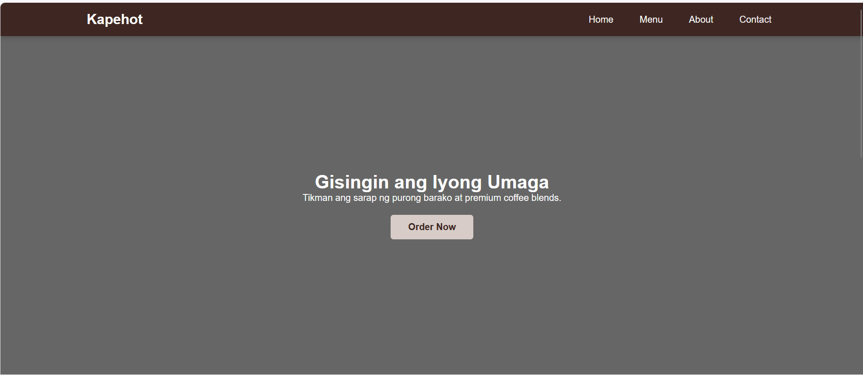
Shop name "Kapehot" displayed at the top left corner Navigation bar: Home | Menu | About | Contact Main headline: "Wake Up Your Morning " Short description: "Taste the richness of pure Barako and premium coffee blends. " Call‑to‑action button: "Order Now“ Color scheme: Dark brown for the header and grey for the main section — reflecting warmth and comfort

Slide 7
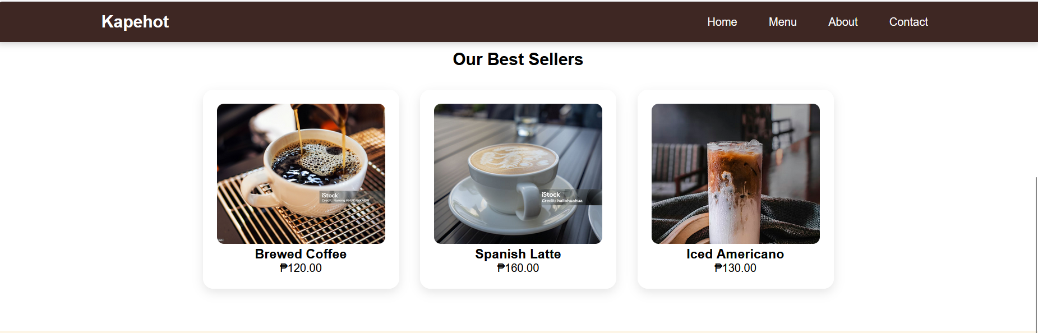
Our Most Popular Drinks Pictures, names, and prices of: Brewed Coffee – ₱120.00 Spanish Latte – ₱160.00 Iced Americano – ₱130.00

Slide 8
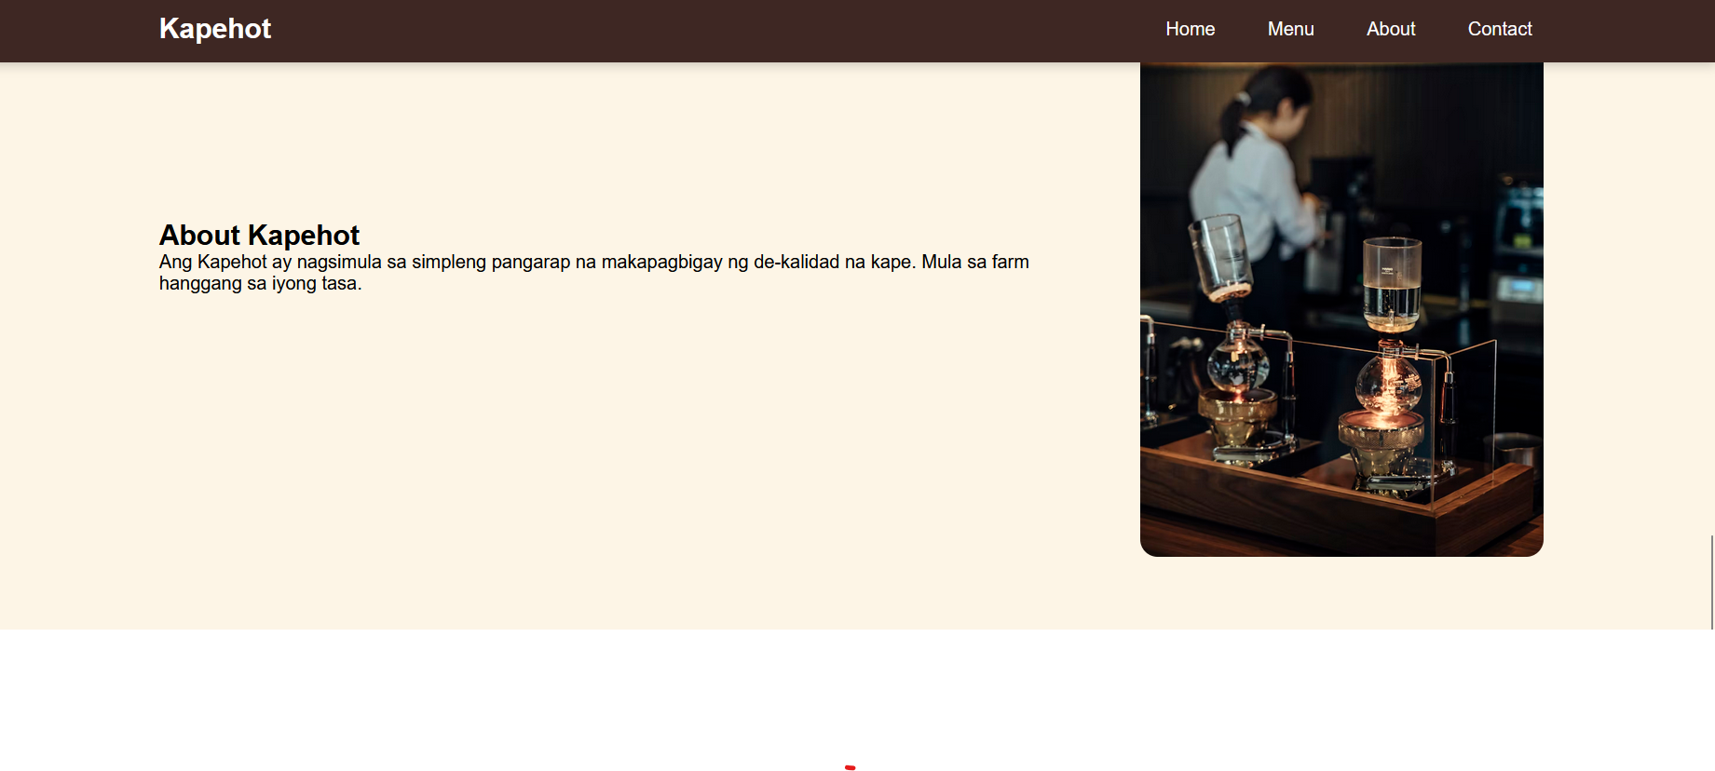
The Story of Kapehot: “It Started with a Simple Dream to Provide Quality Coffee” From the Farm to Your Cup

Slide 9
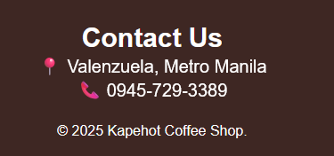
Page Title Contact Us" Physical Location: 📍 Valenzuela, Metro Manila Phone Number:📞 0945‑729‑3389 Footage: © 2025 Kapehot Coffee Shop

Slide 10
Horizontal bar at the top of each page Direct links: Home | Menu | About Us | Contact Us Remains visible as the page scrolls down Easy to understand and use for all visitors
DISENYO AND ESTILO

Slide 11
THANK YOU TO MY TEACHERS, PANELISTS, and EVERYONE WHO SUPPORTED THIS PROJECT Prof: Mr. Mark Anthony Ureta Prof: Ms. Mary Joyce Del Mundo
BY: Guaño | WBDV111 BSIT1-Y2-5

