Slide 1
World Builder
Arun Augustine
James Hall
Nithya Ningegowda
Kaushik Sivakumar
Matthew Stoltenberg

Slide 2
Introduction
CAD and architecture is difficult in 2D
Must translate 2D motion in to a 3D environment
Visualization
Requires expertise in software
World Builder solves these problems
Can move around an object to see it in 3D
Intuitive, easy to use interface
Construct3D is closest project
Intended for single object manipulation and viewer

Slide 3
Gaps in knowledge
Menu display (software interface)
Method of interaction with the system (Wii remotes)
Number of manipulation allowed on an object (low level correction and revision)
Scale the world
Bird-eye view

Slide 4
Design
Selection
Virtual Hand
Raycasting
PORT

Slide 5
Design
Simple Object Manipulation
Creation
Deletion
Translation
Rotation
Scaling

Slide 6
Design
Advanced Object Manipulations
Texturing
Boolean Operations
Union
Intersection
Subtraction
Group
Ungroup
Copy
Paste

Slide 7
Design
World Manipulation
Scale-the-World
Light
Sound

Slide 8
Design
Actual Interaction
A button is used to select or grab an object, and to bring up the menu
Menus available
Object menu for creation
Materials Menu for coloring and texturing
Tools menu for deleting, grouping, and boolean operations
File menu for saving/loading and exporting/importing
Haptic Feedback
Use the Wiimote’s rumble feature for user notification
i.e. Rumble when the user selects an object

Slide 9
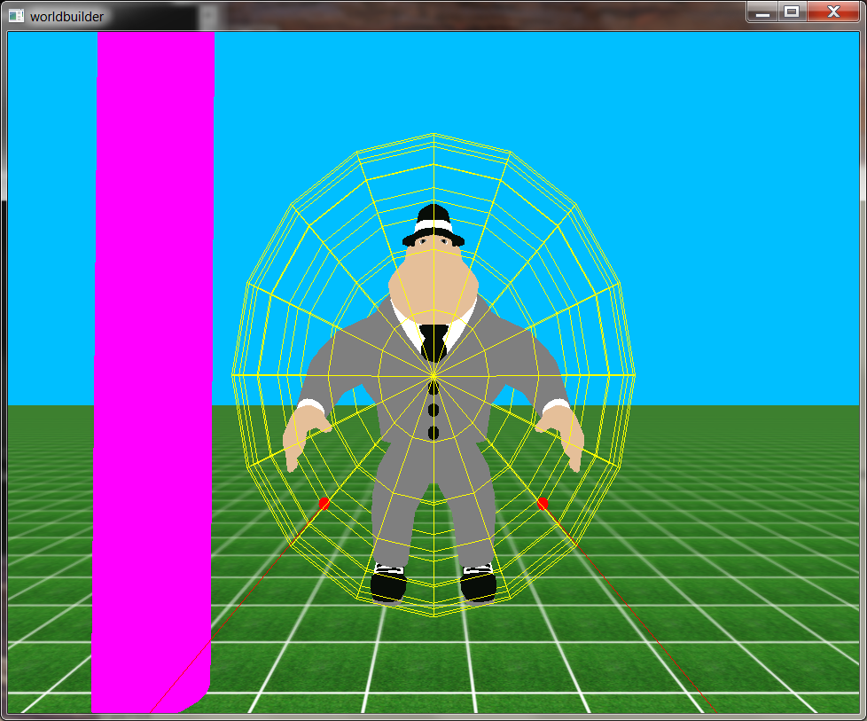
Prototype
Object Placement

Slide 10
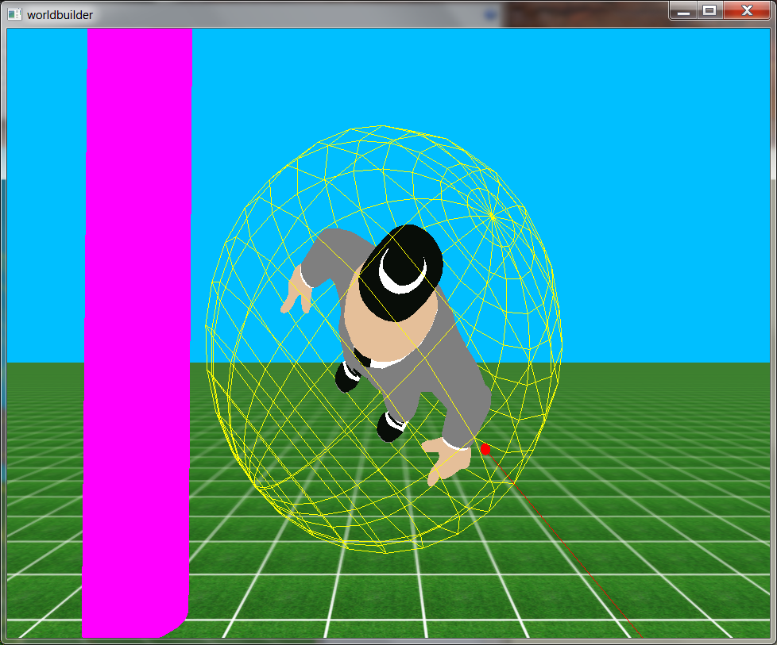
Prototype
Object Manipulation

Slide 11
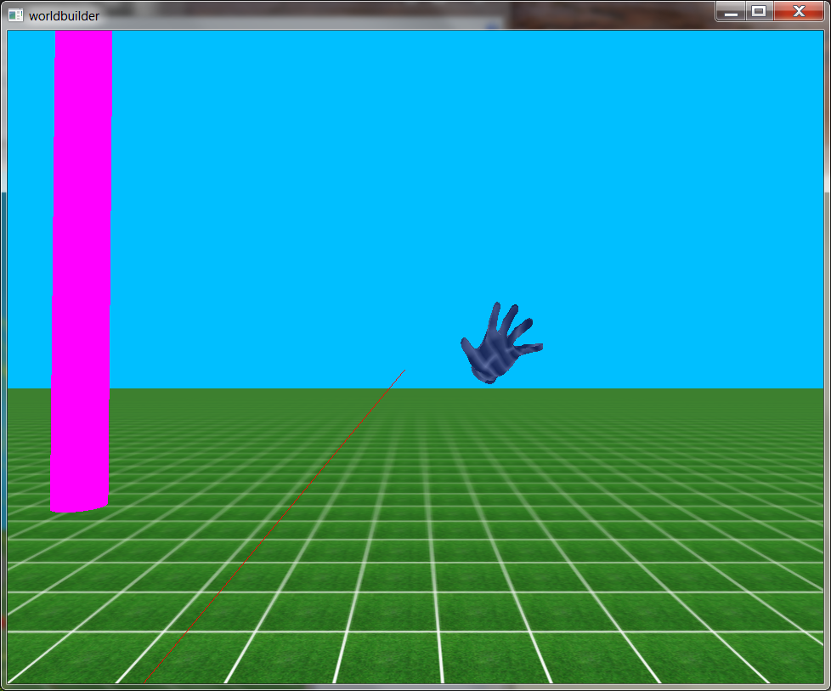
Prototype
Object Texturing

Slide 12
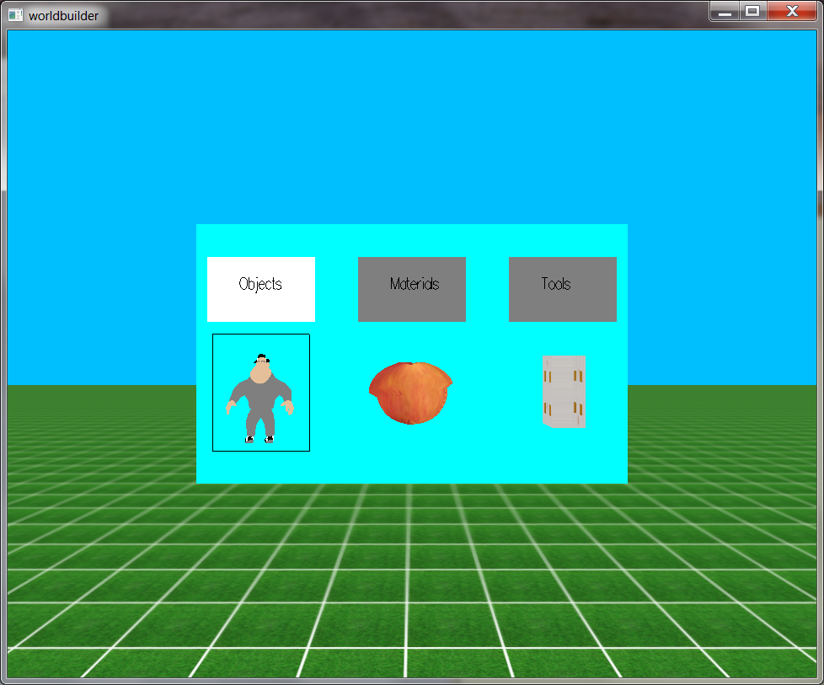
Prototype
System Interaction

Slide 13
Prototype
Other features implemented:
Grouping/Ungrouping
Copy/Paste
Scale-the-World
Object Manipulation
Raycasting
Easy integration with Kosmos
Copious use of github

Slide 14
Prototype
Future Work
Sound Creation and Manipulation
Light Creation and Manipulation
Haptic Feedback
Import/Export/Save/Load
Simulation Effects
Gravity, wind, water, electrical, friction, collision detection

Slide 15
Testing
Several hours in MoCap lab
Brought in three external users to test system
Used feedback from users to improve system

