Slide 1
第2讲 设备树 Device Tree
Jmiao1
2020-12-12

Slide 2
Device Tree
■ 目的
■ 历史与现在
■ 三位一体
■ 三大作用
■ debug方法

Slide 3
Device Tree
设备树的目的：
提供一种脚本语言 来描述 硬件配置信息
/Documentation/devicetree/usage-model.rst
The "Open Firmware Device Tree", or simply Device Tree (DT), is a data
structure and language for describing hardware. More specifically, it
is a description of hardware that is readable by an operating system
so that the operating system doesn't need to hard code details of the
machine.

Slide 4
Device Tree
最早：
Power PC linux
现在：
arm, mips, power pc , x86(intel 凌动系列)

Slide 5

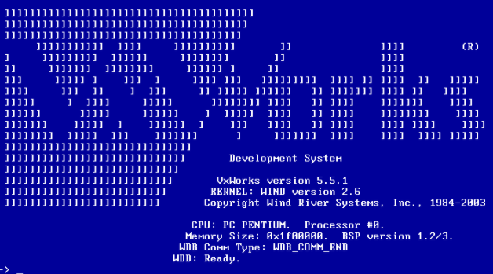




Device Tree
支持的OS
https://wiki.freebsd.org/FlattenedDeviceTree

Slide 6
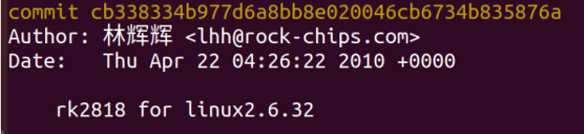

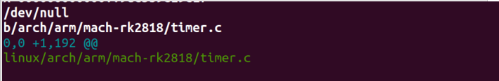
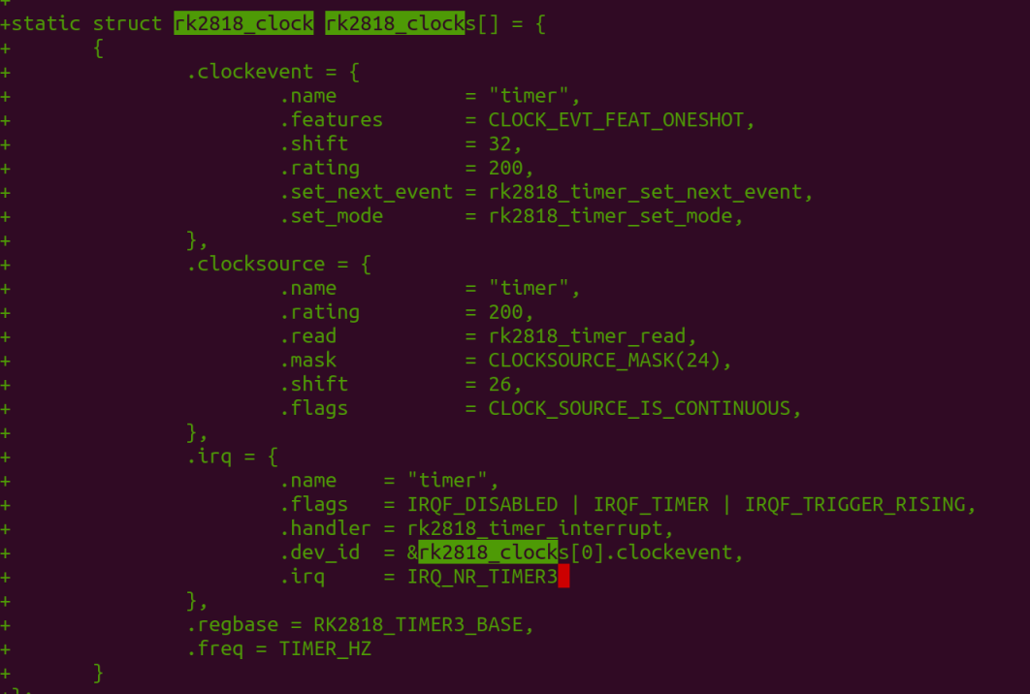
Device Tree
早期 描述方式：

Slide 7
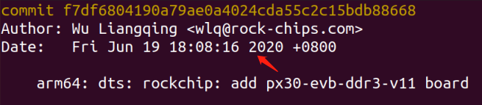
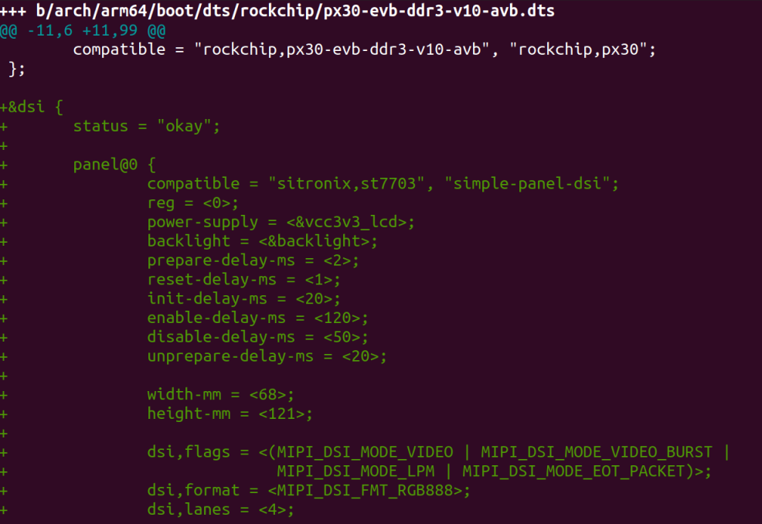
Device Tree
现在 表示方式：

Slide 8
Device Tree
ARM: F*king pain in the ass (2011)
“Gaah. Guys, this whole ARM thing is a f*cking pain in the ass”
https://lkml.org/lkml/2011/3/17/492
.

Slide 9
Device Tree
2011-07-25 arm/dt: Add dtb make rule Rob Herring2-0/+13
2011-07-25 arm/dt: Add skeleton dtsi file Grant Likely1-0/+13
2011-07-25 arm/dt: Add dt machine definition Grant Likely1-0/+7
2011-05-23 arm/dt: probe for platforms via the device tree Grant Likely6-4/+135
2011-05-23 arm/dt: consolidate atags setup into setup_machine_atags Grant Likely2-29/+47
2011-05-11 arm/dt: Allow CONFIG_OF on ARM Grant Likely7-1/+92
2011-05-11 arm/dt: Make __vet_atags also accept a dtb image Grant Likely2-10/+22

Slide 10
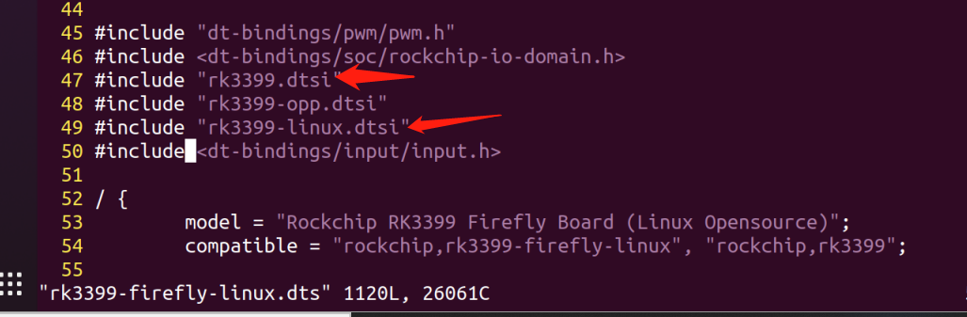
Device Tree
dtsi和dts

Slide 11
Device Tree
dtsi被dts引用
Soc.dtsi
include
Soc_2.dtsi
Soc_1.dtsi
include
include
include
Board-2.dts
Board-1.dts

Slide 12
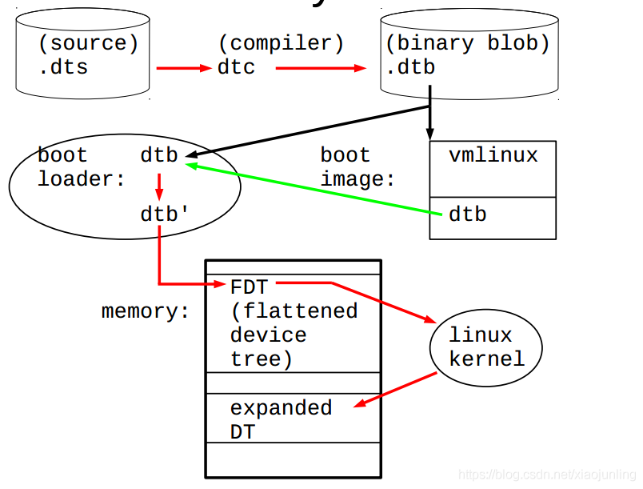
Device Tree
生命周期

Slide 13
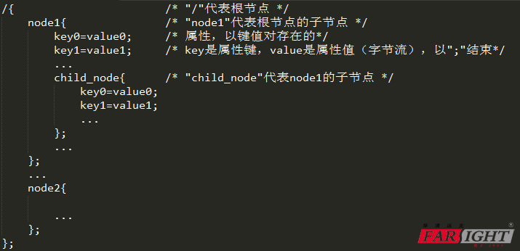
Device Tree
基本构成：

Slide 14

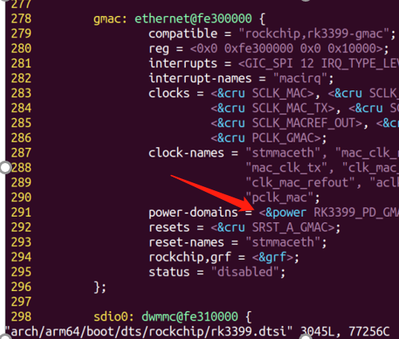
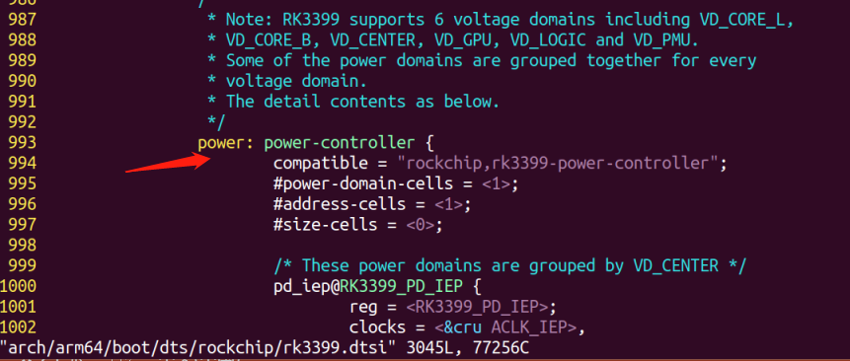
Device Tree
1. 节点名
语法：lab： <name>[@<unit-address>]
Rockchip-rk3399TRM-datasheet.pdf
2. 指向：&
3. 属性：compatible,interrupts,reg

Slide 15
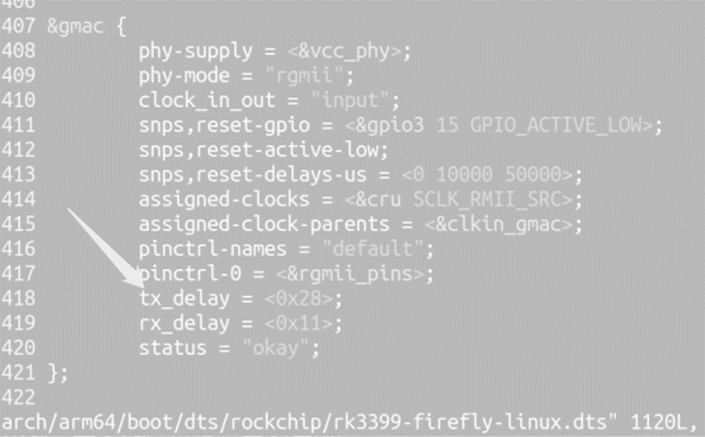
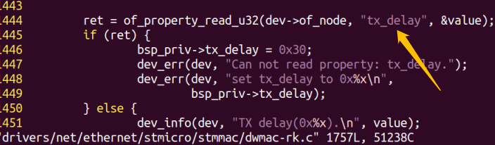
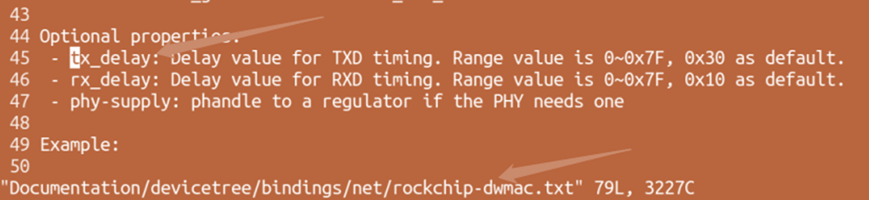
Device Tree
三位一体:
脚本
C 代码
驱动代码
文档

Slide 16
Device Tree
API: include/linux/of.h
int of_device_is_compatible(const struct device_node *device,const char *compat)
struct device_node *of_get_parent(struct device_node *nodes）
struct device_node *of_next_child(）
of_property_read_bool()
of_property_read_u32()
of_property_read_u32_array()
of_property_read_u64_array()还有u8,u16的
of_property_read_string()
of_property_read_string_index()
void __iomem *of_iomap(struct device_node *np, int index)
irq_of_parse_and_map

Slide 17
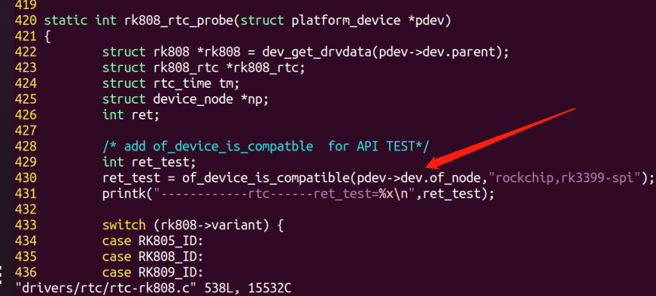
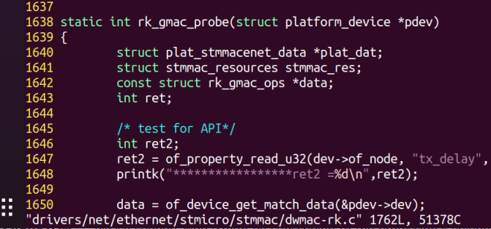
Device Tree

Slide 18
Device Tree
三大作用：
1. 平台标识 platform identification | 用DT来标识特定的machine； root节点的compatible字段，匹配machine_desc的dt_compat比如： compatible = “ti,omap3-beagleboard”, “ti,omap3450”, “ti,omap3”;
2. 运行时配置 runtime configuration bootargs | chosen节点的属性 chosen { bootargs = “console=ttyS0,115200 loglevel=8”; initrd-start = <0xc8000000>; initrd-end = <0xc8200000>; };
3. 设备信息集合 device population | serial@70006300 { // “厂家, 型号” 硬件的厂家 compatible = “nvidia,tegra20-uart”; reg = <0x70006300 0x100>; interrupts = <122>; };

Slide 19
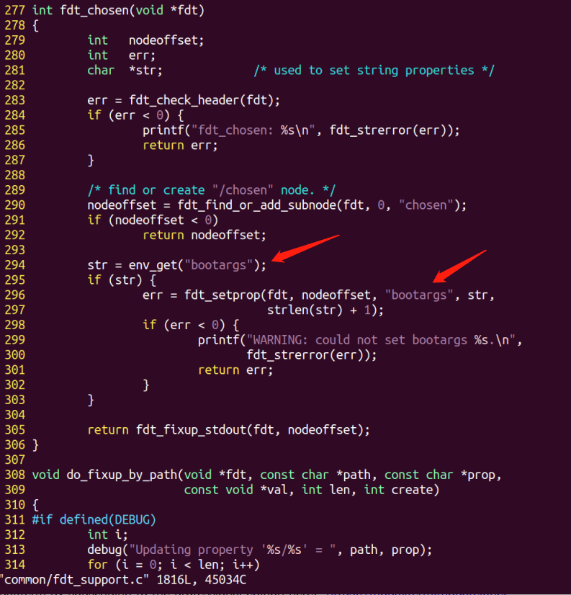
Device Tree

Slide 20
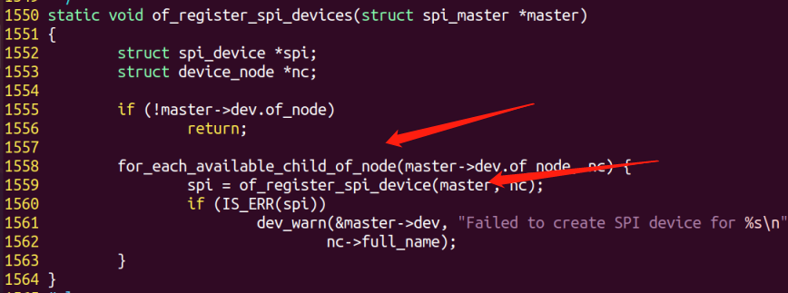
Device Tree
spi_register_master ->of_register_spi_devices

Slide 21
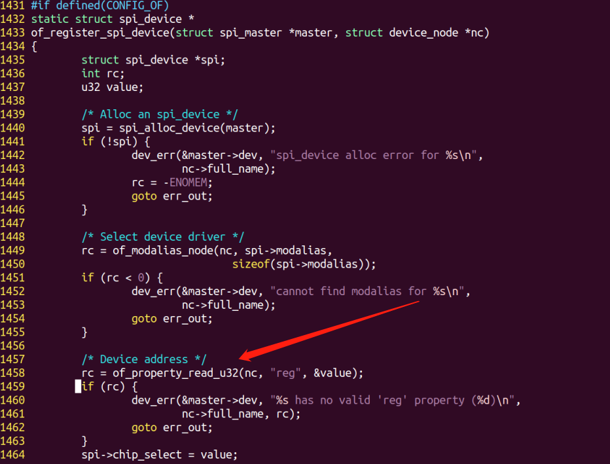
Device Tree
spi_register_master ->of_register_spi_devices

Slide 22
Device Tree
Debug1 : 编译后查看节点属性
kernel_dir/script/dtc/dtc -I dtb -O dts -o xxx.dts xxx.dtb
Debug2 : 加载中查看 uboot
~# fdt addr
~# fdt print

Slide 23
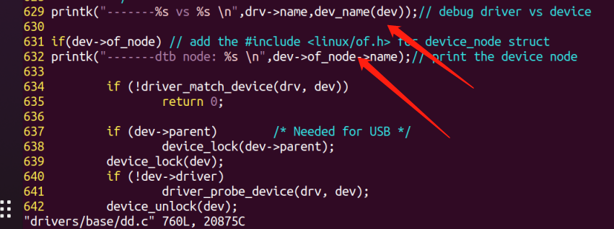
Device Tree
Debug3 :系统中查看 dev name, node name ?
module_platform_driver
->platform_driver_register
->platform_drv_probe
->__platform_driver_register ->
->__platform_driver_register
->bus_add_driver->driver_attach
->__driver_attach
->driver_match_device(drv, dev);
- driver_probe_device->really_probe

Slide 24
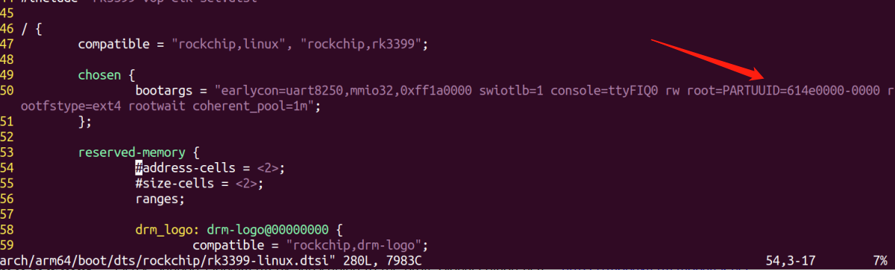
Device Tree
driver vs device debug:

Slide 25
Device Tree
Bootargs debug:
setenv ipaddr 128.224.162.220
setenv serverip 128.224.162.214
setenv kernel_file rk-image
setenv fdtfile rk3399-firefly-linux.dtb
setenv bootargs "earlycon=uart8250,mmio32,0xff1a0000 swiotlb=1 console=ttyFIQ0 rw root=/dev/nfs rootwait nfsroot=128.224.162.214:/home/jmiao1/project/IT/setup/cicd,vers=4,tcp,nolock,proto=tcp,nfsvers=3 ip=128.224.162.220::0.0.0.0:255.255.255.0::eth0:off"
setenv bootcmd "echo Booting from network ... ...; setenv autoload no; tftp ${kernel_addr_r} ${kernel_file}; tftp ${fdt_addr_r} ${fdtfile}; ”run bootargs;booti ${kernel_addr_r} - ${fdt_addr_r} "

Slide 26
Device Tree
作业:
1.具体细节自行分析：
设备树中常见的属性有compatible、地址address、中断interrupt、MAC地址、GPIO口、clock、power、regulator、等等
2. 体会API接口的作用
of_property_read_bool()
of_property_read_u32()
…

Slide 27
Device Tree
Thanks
注：课程思路借鉴：
https://blog.csdn.net/xiaojunling/article/details/88955278)

