Slide 1
Inharmonicity Regression against Pitch for Automatic Guitar Tablature Transcription
Thesis Defense – 06/01/17
Jonathan Michelson
Advisors: Dr. Richard Stern, Dr. Tom Sullivan

Slide 2
Agenda
Background & Previous Work
Guitar, Tablature, Inharmonicity
Missing Science
Proposed System
Evaluation

Slide 3
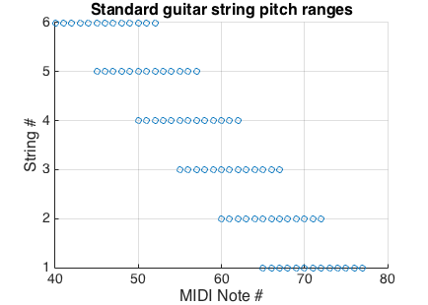
The Guitar, and Pitch Overlap

Slide 4
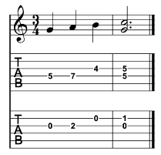
Tablature Specifies Fretboard Position

Slide 5
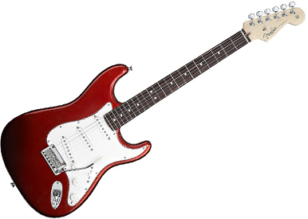




Automating the Transcription Process
Manual Transcription
Guitar Audio
Accurate Tabs

Slide 6
Automating the Transcription Process
Manual Transcription
Guitar Audio
Accurate Tabs

Slide 7
Applications
Music education
Virtuosi secrets

Slide 8
Solution paradigms
Optimal path search
Pitch → tabs via Viterbi search
Algorithmic
Do X with Y to obtain Z
Supervised learning
Learn model based on labeled data, predict on unseen data

Slide 9
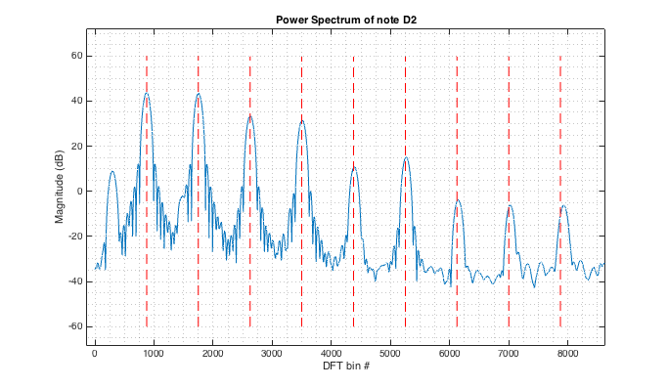
Inharmonicity is useful for TX

Slide 10
Defining Inharmonicity

Slide 11
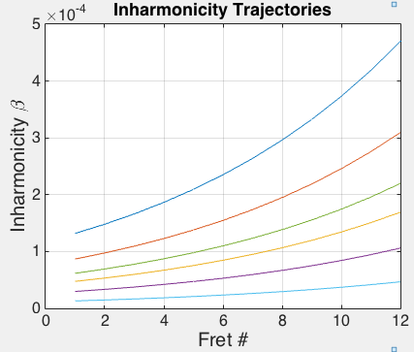
Inharmonicity is deterministic

Slide 12
Inharmonicity is deterministic
For any fret number n and integer r, ¹
1. I. Barbancho et al. Inharmonicity-based method for the automatic generation of guitar tablature. In Proceedings of the IEEE Transactions on Audio, Speech, and Language Processing, 2012

Slide 13
Motivation
Barbancho’s method:
Given open-strings, find tx
Inharmonicity alone is sufficient! But…
Requires prior info
Exploit deterministic inharmonicity trajectories W/O requisite prior info
1. I. Barbancho et al. Inharmonicity-based method for the automatic generation of guitar tablature. In Proceedings of the IEEE Transactions on Audio, Speech, and Language Processing, 2012
2. J. Abeßer. Automatic string detection for bass guitar and electric guitar. In From Sounds to Music and Emotions - 9th International Symposium, 2012

Slide 14
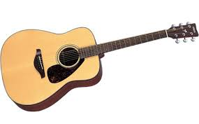
Proposed System
Inharmonicity estimation
Regression against pitch
Training Audio
Inharmonicity estimation
Classification
Testing Audio
Tablature conversion

Slide 15
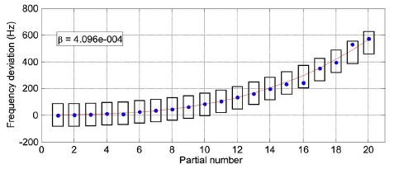
Step 1: Inharmonicity Estimation

Slide 16
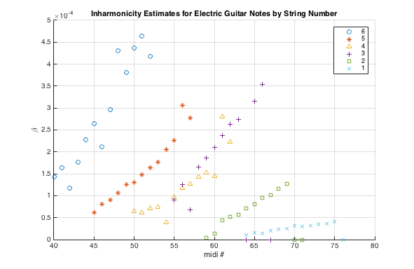
Step 2: Regression against Pitch

Slide 17
Step 2: Regression against Pitch

Slide 18
Step 2: Regression against Pitch

Slide 19
Step 2: Regression against Pitch

Slide 20
Step 2: Regression against Pitch

Slide 21
Step 2: Regression against Pitch

Slide 22
Step 2: Regression against Pitch

Slide 23
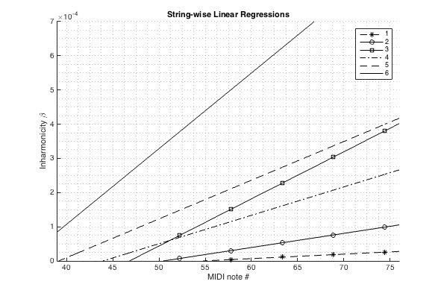
Step 2: Regression against Pitch

Slide 24

Step 2: Regression against Pitch

Slide 25
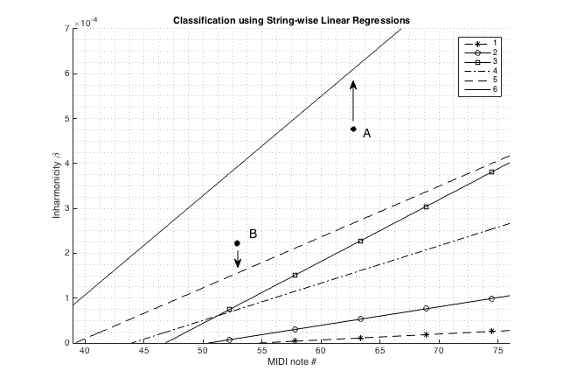
Step 3: Classification

Slide 26

Step 3: Classification

Slide 27
Step 4: Tablature conversion
Fret(note) = midi(note) – midi(string(note))

Slide 28

Step 4: Tablature conversion
F2
D4
Given tuning: E2, A2, D3, G3, b3, e4

Slide 29

Addition: Tuning-compensation
Different tuning simply scales inharmonicity curves
Proposed system easily accomodates this

Slide 30
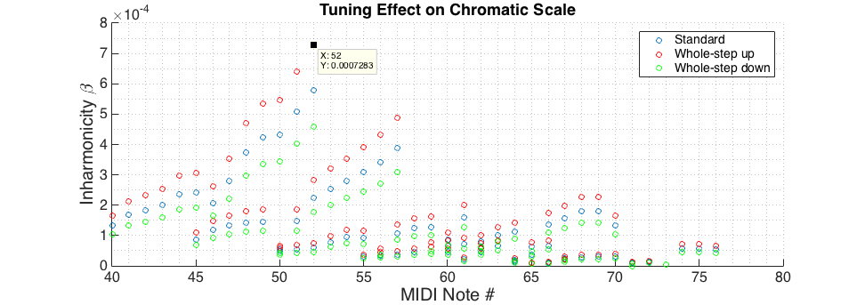
Addition: Tuning-compensation
Notes:
Which BTW means modifications to previous work to include “tuning correction factor” would be good things to test. This unsupervised method simply is an approach that doesn’t require prior seeds or training.

Slide 31
Transcription F1-scores
[table]

Slide 32
Tuning Compensation F1-scores
[table]

Slide 33
Thank you. Questions?

