Slide 1
Unsupervised Inharmonicity-Based Guitar String/Tab Transcription
Thesis Proposal – Music Tech seminar 04/03/17
Jonathan Michelson
Advisors: Prof. Richard Stern, Prof. Tom Sullivan

Slide 2
Agenda
Background & Previous Work
Missing Science
Proposed Solution
Pilot Results
Remaining Work
Evaluation Criteria

Slide 3
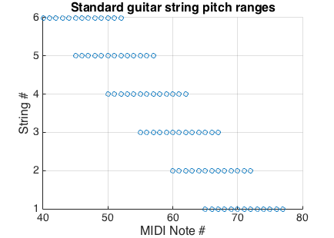
The Guitar, and Pitch Overlap

Slide 4
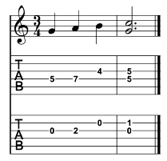
Tablature Specifies Fretboard Position

Slide 5
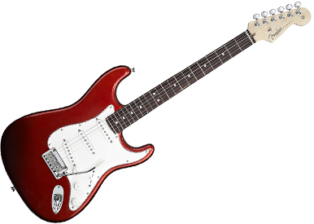




Automating the Transcription Process
Manual Transcription
Guitar Audio
Accurate Tabs

Slide 6
Automating the Transcription Process
Manual Transcription
Guitar Audio
Accurate Tabs

Slide 7
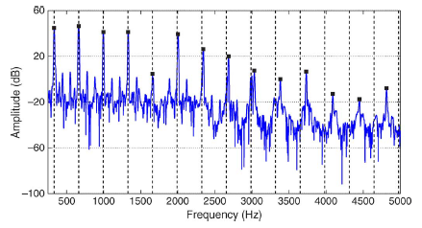
Inharmonicity is key to identification

Slide 8
Defining Inharmonicity

Slide 9
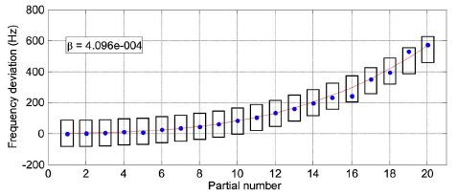
Estimating Inharmonicity

Slide 10
Inharmonicity along strings is deterministic
For any fret number n and integer r, ¹
1. I. Barbancho et al. Inharmonicity-based method for the automatic generation of guitar tablature. In Proceedings of the IEEE Transactions on Audio, Speech, and Language Processing, 2012

Slide 11
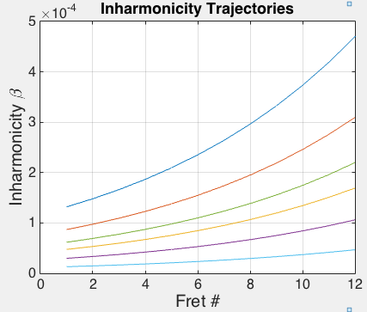
Inharmonicity along strings is deterministic

Slide 12
Missing Science
Tuning-invariant performance untested
Barbancho¹: “seed” open strings
Abesser²: classifier trained on standard tuning
Adapt previous work to incorporate this, or…
Unsupervised learning
No labels
Guitar audio + its tuning + prior knowledge → tablature
1. I. Barbancho et al. Inharmonicity-based method for the automatic generation of guitar tablature. In Proceedings of the IEEE Transactions on Audio, Speech, and Language Processing, 2012
2. J. Abeßer. Automatic string detection for bass guitar and electric guitar. In From Sounds to Music and Emotions - 9th International Symposium, 2012

Slide 13
Proposed Unsupervised Pipeline
Inharmonicity estimates
Linear regression mixtures
Get string clusters
Tablature conversion

Slide 14
Step 1: Inharmonicity estimates
f0

Slide 15
Step 1: Inharmonicity estimates
f0

Slide 16
Step 1: Inharmonicity estimates
f0

Slide 17
Step 2: EM for linear regression mixtures
f0

Slide 18
Step 2: EM for linear regression mixtures
f0

Slide 19
Step 2: EM for linear regression mixtures
f0

Slide 20
Step 3: Cluster
f0

Slide 21
Step 3: Cluster
f0

Slide 22
Step 3: Cluster
f0

Slide 23
Step 4: Tablature conversion
F2
D4
Given tuning: E2, A2, D3, G3, b3, e4

Slide 24

Step 4: Tablature conversion
F2
D4
Given tuning: E2, A2, D3, G3, b3, e4

Slide 25
Invariance to Tuning
Different tuning simply scales inharmonicity curves
This linear regression pipeline still seems reasonable

Slide 26
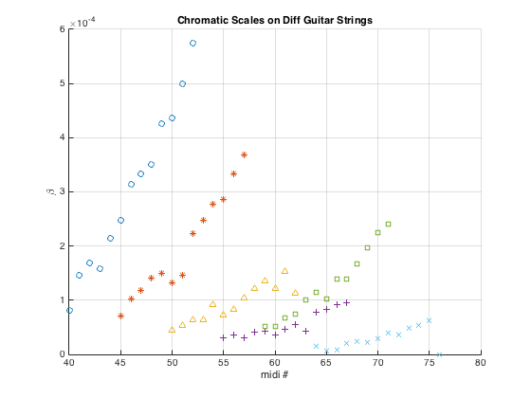
Pilot Results

Slide 27
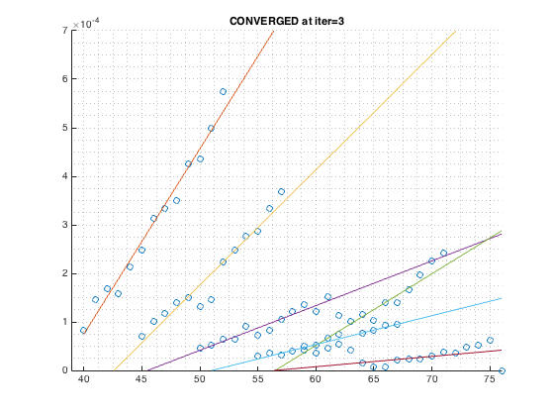
Pilot Results

Slide 28
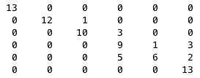
Pilot Results*
True string labels: 6 5 4 3 2 1
Classified labels
6
5
4
3
2
1
F-scores: 1.0, 0.96, 0.83, 0.60, 0.60, 0.84
Mean f-score: 0.80
Notes:
* For diff plot actually, didn’t have that other plot’s confusion matrix

Slide 29
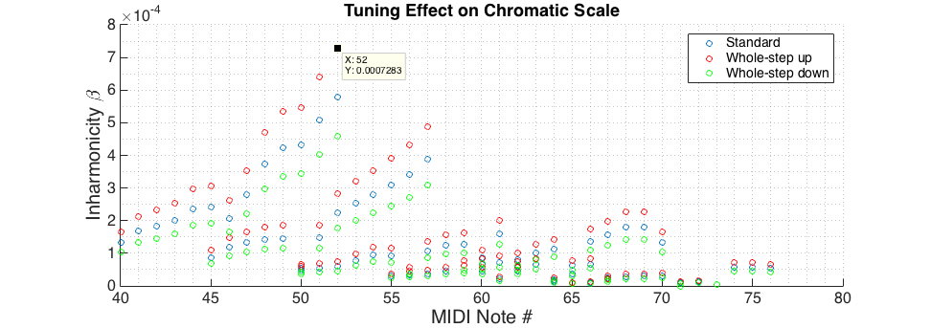
Pilot “Calculations”
Notes:
Which BTW means modifications to previous work to include “tuning correction factor” would be good things to test. This unsupervised method simply is an approach that doesn’t require prior seeds or training.

Slide 30
Remaining Work
Core system development
Inharmonicity Estimation Robustness
Try (1) TCIF reassignment before peak-picking, (2) Outlier removal
If no success soon (~1week), move on
EM needs to self-determine:
Initialization of line parameters
Number of line mixtures present
Output formatting
Transform notes’ cluster IDs and f0s into (string,fret) pairs

Slide 31
Remaining Work
Experiment Data
RWC Music Instruments
3EGs: Fender Strat, Aria PE, Ibanez Artcore (all std tuning)
Clean isolated monophonic notes
Frets 0-12, strings 1-6, 3dyn, 4techniques
IDMT-SMT-GUITAR*
4EGs: Fender Strat, Ibanez Strat, Gibson LP, Aristedes (all std tuning)
Clean isolated mono/polyphonic notes and short licks
Notes: frets 0-12, strings 1-6, 2pickups
Licks: frets [varying], strings [varying], various techniques
JM
1EG: Ibanez RG (std tuning, up/down two semitones[, other?])
Clean isolated monophonic notes[, and IDMT licks?]
Frets 0-12, strings 1-6

Slide 32
Remaining Work
Experiments
Vary (1) EM init method and (2) EM mixture determination method, observe effect on classification performance for test sets
Test set = homogeneous tuning/technique/dynamic/pickup group
~30 w/o IDMT-SMT-GUITAR data

Slide 33
Evaluation Criteria
Confusion matrices
True string classes vs. predicted string classes
F-scores
Harmonic mean of precision and recall
Hope: F-score > 0.16 (human transcriber)¹
Comparison to previous work difficult, don’t have their full systems implemented
1. J. Abeßer. Automatic string detection for bass guitar and electric guitar. In From Sounds to Music and Emotions - 9th International Symposium, 2012

Slide 34
Thanks. Questions?

