Slide 1
VENNUSIGN BACK OFFICE
Menus · Slice 6-A · second pass
Paste import, panel by panel
A venue operator copies their menu out of a document and ends up with a VennuSign menu they can trust. Screens are drawn from the live design, cropped where a detail is the point.
Paste
→
Read
→
Review
→
Confirm
→
Done
17 panels · 23 slides
Notes:
Second pass, after team review. Direction unchanged; the corrections are in matching safety, replacement recovery, the missing proof states, capacity, and legibility.

Slide 2
SINCE THE LAST PASS
Six corrections. The shape of the flow is unchanged.
Nothing is answered for you
The replaced draft is saved first
Only punctuation, spacing and capitals match automatically — a safe match — and each shows the rule. Tick all 30 and Untick all are gone.
A restorable version is written inside the transaction, every time — so a successful replace is recoverable too.
The proof states exist
Two limits, both stated early
Reading, answered-review with the counts settled, and a replacement completion of its own.
2,000 lines to read, 500 items to hold. A paste can pass one and fail the other, and hears so before answering anything.
Done is a stop, not a hop
Questions first, audit behind a door
Review draft in builder, Not live yet, and Done for now beside it.
Review counts decisions, not questions. The 47-item inventory has its own screen.
Notes:
Six corrections from the review. Nothing about the overall direction moved.

Slide 3
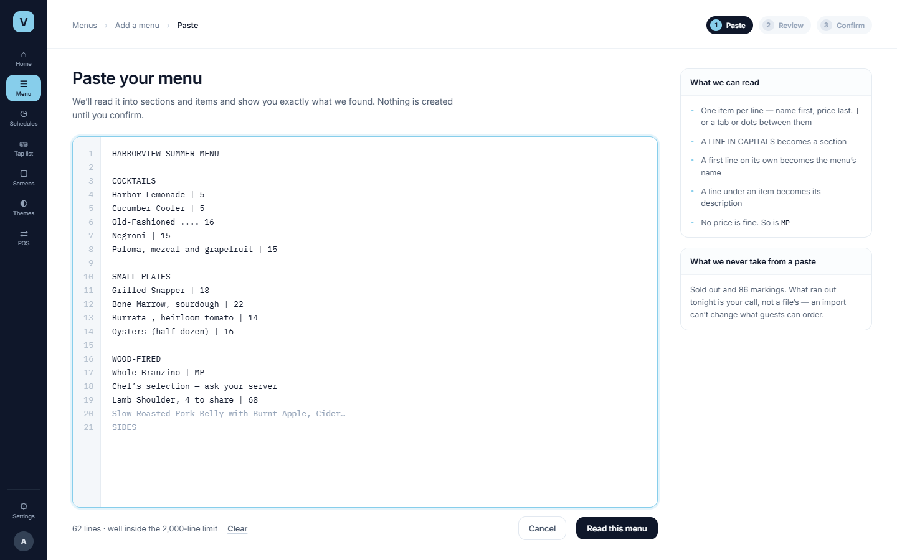
Paste the menu
PANEL 1
Frame P1b
WHAT HAPPENS
They paste. We count the lines and state the limit — the only claim we make before the server has read it.
WHY IT LOOKS LIKE THIS
The format is taught beside the box, not enforced by a template — people paste what they already have.
TELL US
Is “what we never take from a paste” worth its space, or only shown when a paste contains sold-out marks?
Notes:
The line count is the only claim before the server reads it.

Slide 4
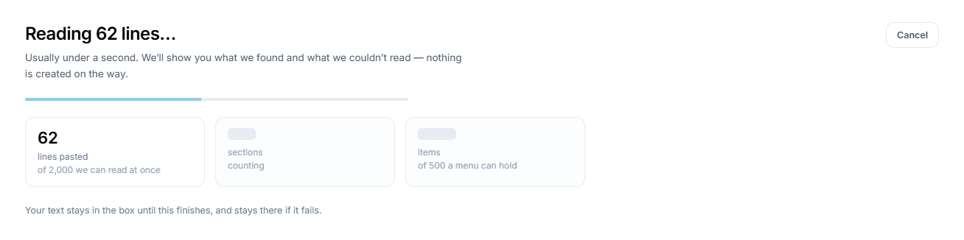
Reading it — new
PANEL 2
Frame P1c
THE STATE THAT WAS MISSING
Between pressing the button and seeing the review there was nothing drawn. It matters, because this is where the two ceilings first exist — and where a menu that can’t be created has to be refused, before anyone answers a single question about it.
TWO DIFFERENT LIMITS
2,000 lines is how much text we read at once. 500 items is how much one menu can hold, Imported items included. 1,880 lines can still make 612 items.
Notes:
New state. Both ceilings appear here as soon as they exist, because a paste can pass the line limit and fail the item limit.

Slide 5
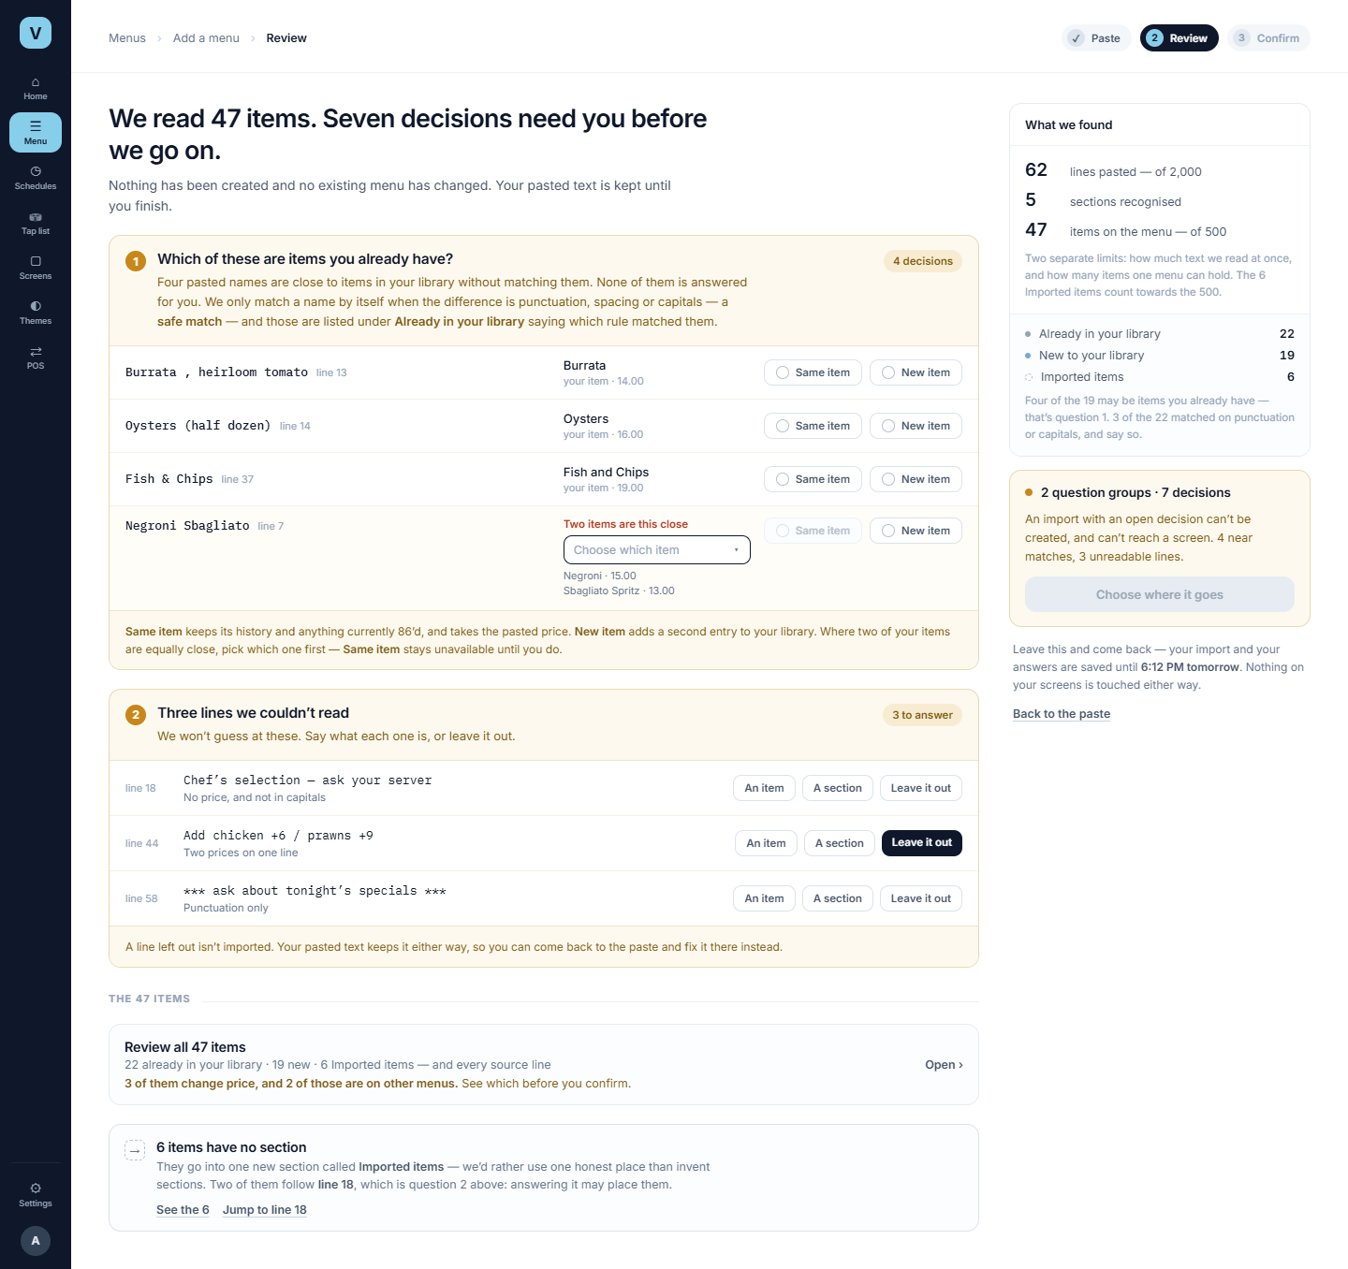
Review — the shape of it
PANEL 3
Frame P2 · scrolls
WHAT HAPPENS
47 items came back with two question groups and seven decisions inside them. None of them is answered in advance, and the way forward stays shut until all seven are.
WHAT MOVED
The full item inventory used to sit under the questions competing for attention. It now has its own screen behind Review all 47 items . What stays is the fallback, because it has a consequence: a section gets created.
TELL US
Is counting decisions rather than questions the right promise to make at the top?
Notes:
The argument of this screen is its shape: decisions on top, inventory behind a door. Next two slides show the questions at readable size.

Slide 6
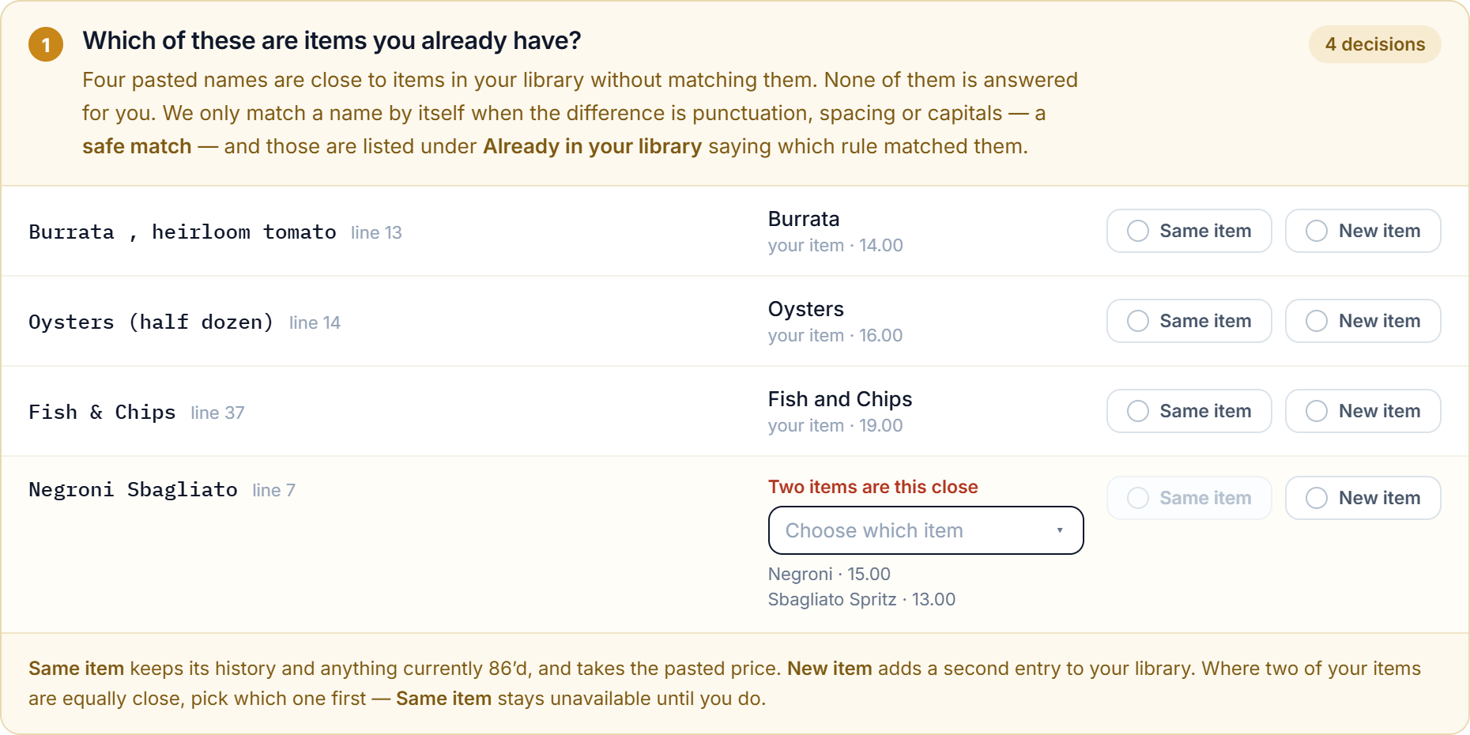
Which are items you already have?
PANEL 3A
Detail from P2
THE RULE NOW
TWO CANDIDATES
Automatic only for punctuation, spacing and capitals — and those are listed as matched, with the rule that did it. Anything semantic is a decision, and starts blank.
Where two of your items are equally close, Same item is unavailable until one is chosen. We never pick for them.
AT 30 ROWS
One action: Accept 28 safe matches . The two we’re unsure of can never be inside it, and stay unanswered for individual review.
Notes:
The correction that matters most. Nothing pre-ticked, the rule shown on automatic matches, and a candidate selector where two library items are equally close.

Slide 7
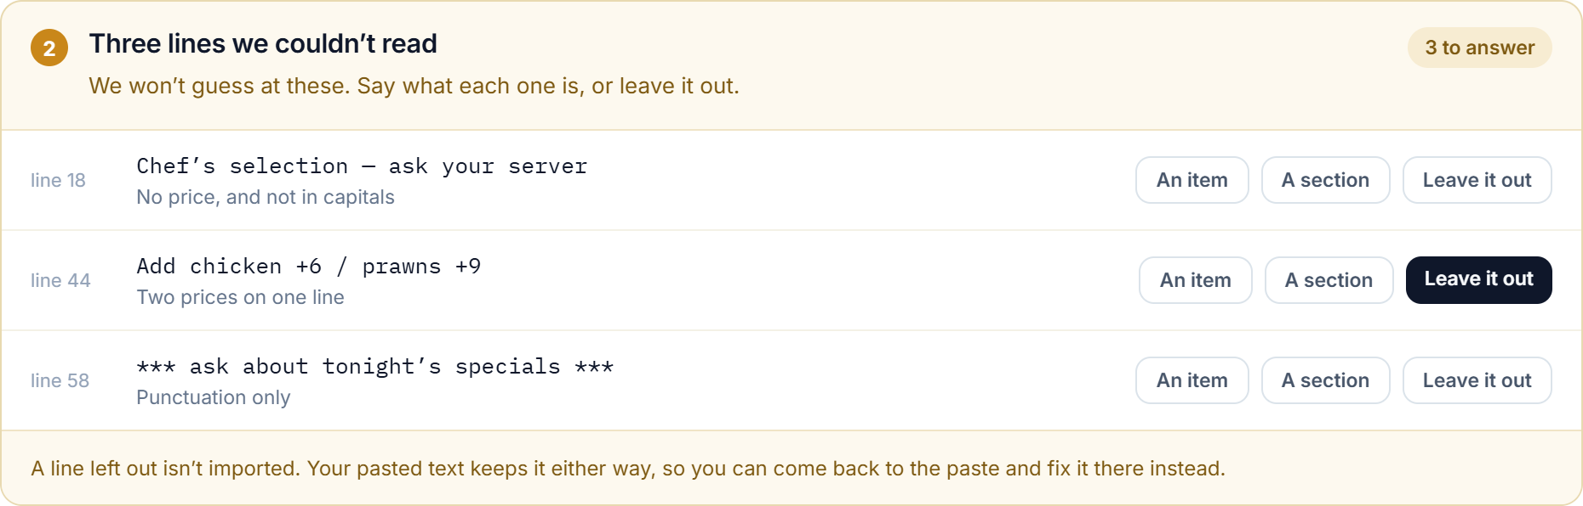
Three lines we couldn’t read
PANEL 3B
Detail from P2
THREE ANSWERS
An item, a section, or leave it out. Each row cites its line and says why we couldn’t read it. A line left out stays in the pasted text.
TELL US
Is promoting a line to a section in scope? It’s the difference between a 26-item fallback and none.
Notes:
Three lines the parser could not classify. Promoting one to a section is the cheapest fix for a large fallback.

Slide 8
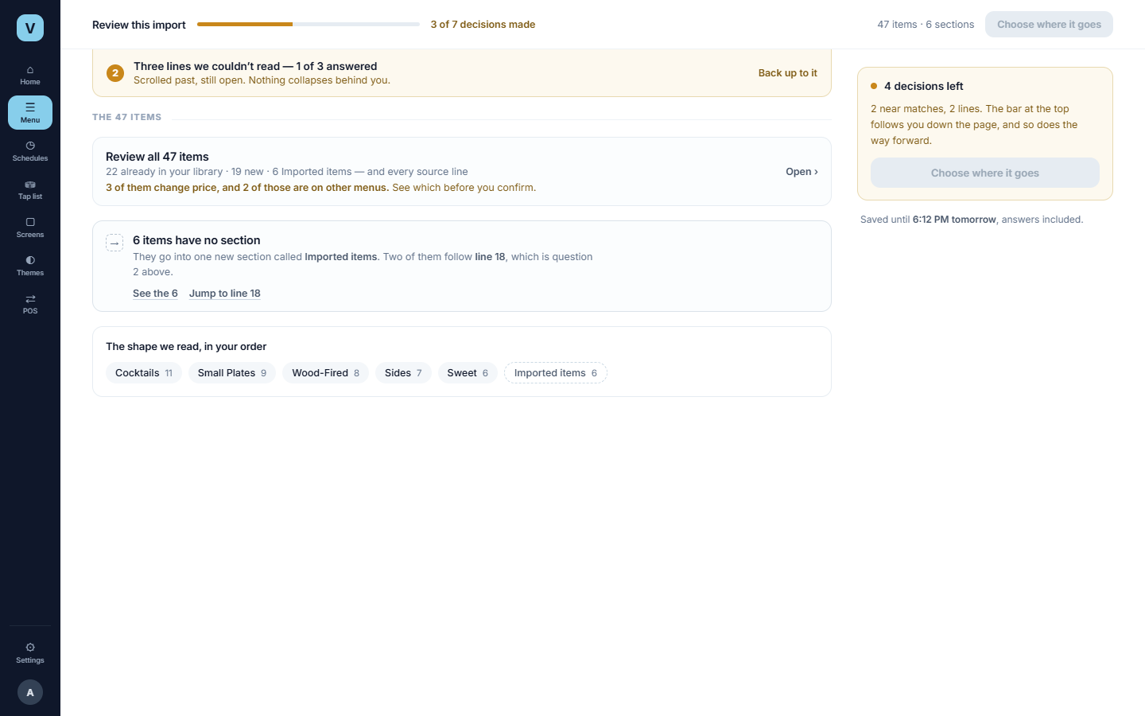
The same page, further down
PANEL 4
P2 → P2s
AT THE TOP
SCROLLED, 3 OF 7 ANSWERED
WHAT STICKS
A bar carrying the decisions left, the progress and the primary action — so the moment the count hits zero, the way forward is already on screen.
WHAT DOESN’T HIDE
An answered group shrinks to a line. An unanswered one stays open, with a route back to it.
Notes:
Before and after scrolling, since we claim the progress bar and primary action follow the operator down the page.

Slide 9
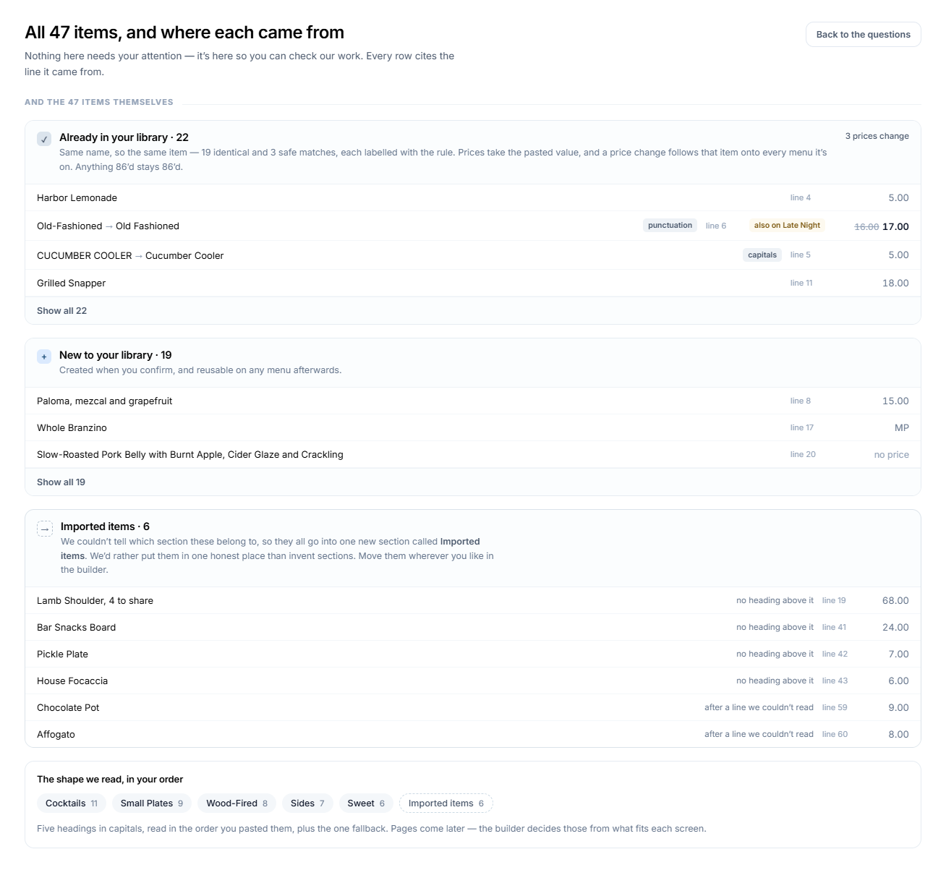
Review all 47 items
PANEL 5
Frame P2i
WHY IT’S SEPARATE
Nothing here needs attention — it’s here so the operator can check our work. Every row cites the line it came from, and the three automatic matches carry a punctuation or capitals label.
IMPORTED ITEMS
Listed in full at six. At 26 it summarises and names the cause instead: “22 of these follow the same unreadable line.”
Notes:
The audit, one step in. Automatic matches show the rule that produced them.

Slide 10
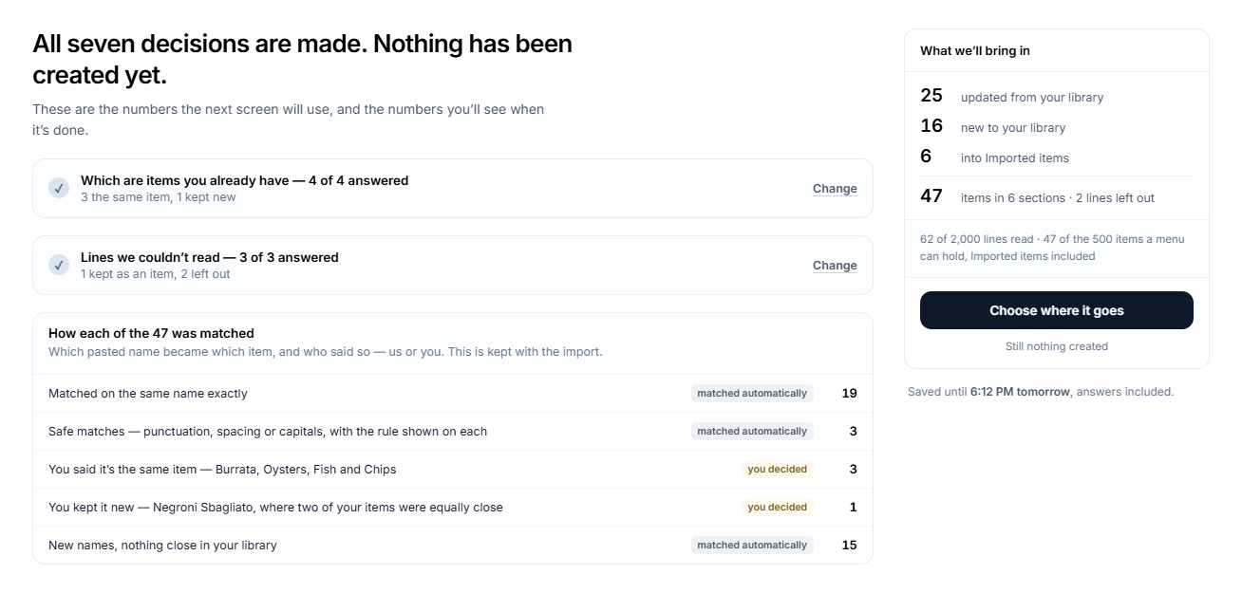
Answered — and the counts settle
PANEL 6
Frame P2r · new
WHY IT HAS TO EXIST
HOW EACH ITEM WAS MATCHED
Without it the story jumps from open questions to confirmation, and “the finish screen agrees with the review screen” has nothing to stand on. 25 updated, 16 new, 6 imported — the same numbers Done will report.
19 exact names, 3 safe matches, 3 the operator confirmed, 1 they kept new, 15 with nothing close. Each line says matched automatically or you decided , and it’s kept with the import.
Notes:
The frame the storyboard was missing. 22/19 becomes 25/16 in front of the operator, and the identity summary says which moves were ours and which were theirs.

Slide 11
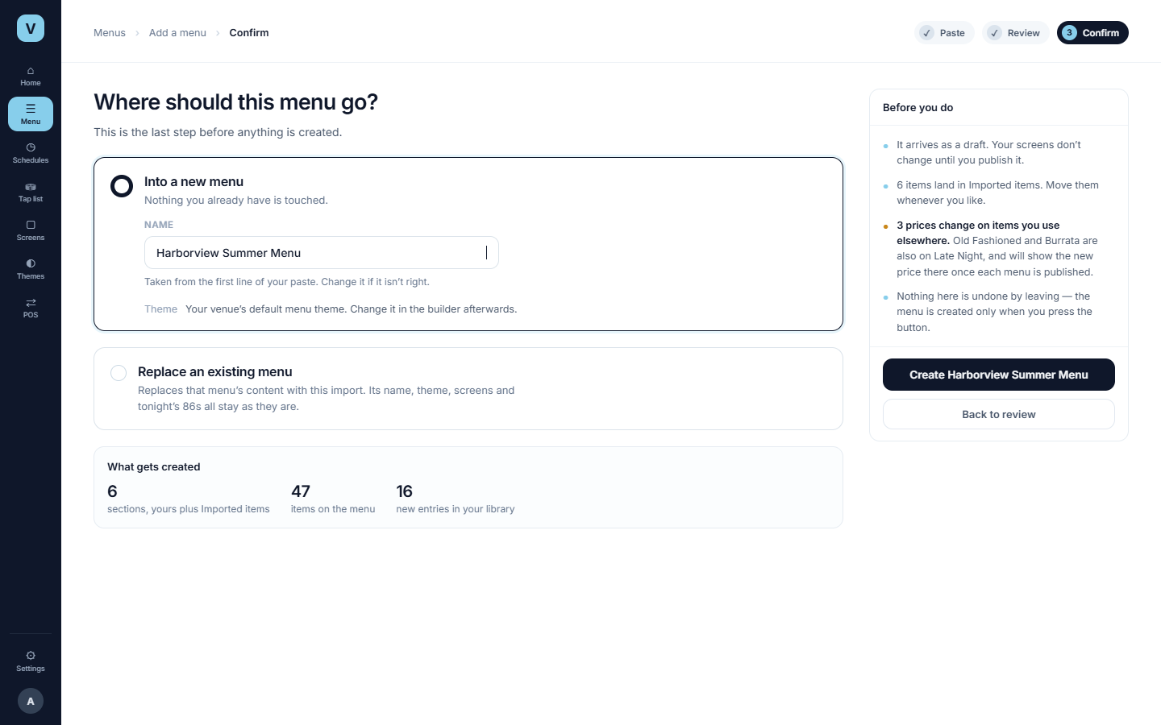
Confirm — into a new menu
PANEL 7
Frame P3a
WHAT HAPPENS
The name comes from the first line of the paste and says so. The button names the menu it creates.
SHARED, NOT BESPOKE
The same confirmation step a blank menu uses, and the other route is now called Replace an existing menu.
TELL US
Theme is the venue default and not choosable here. Right call?
Notes:
Same confirmation step blank creation uses. The button names the object it creates.

Slide 12
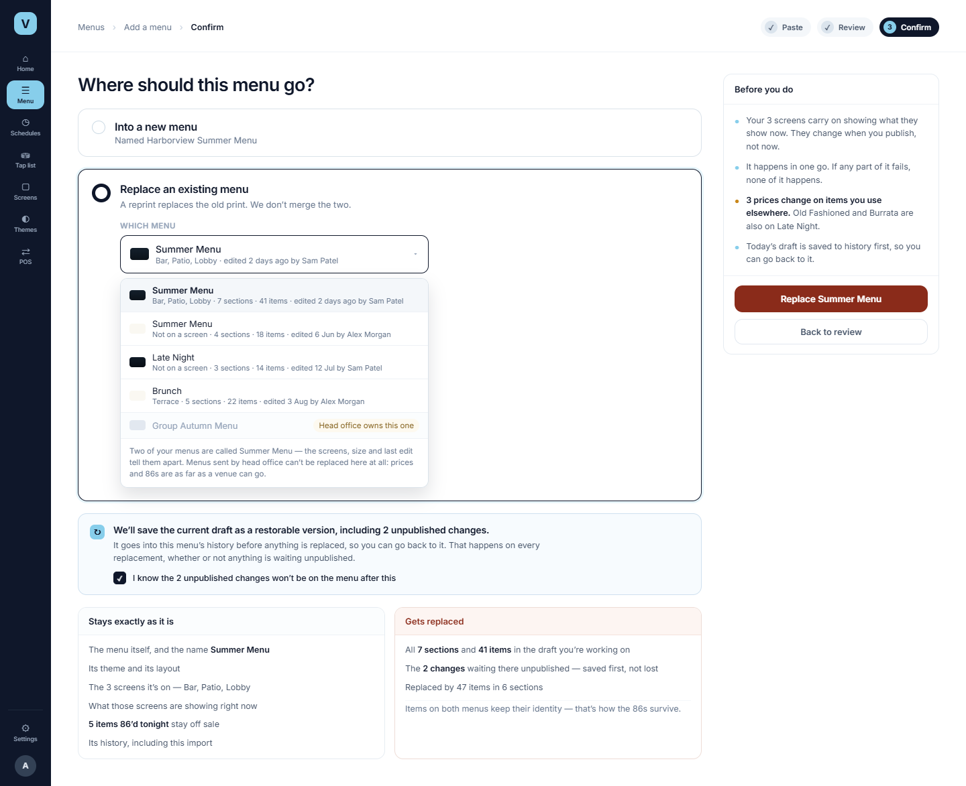
Confirm — replace an existing menu
PANEL 8
Frame P3b · scrolls
THE NEW PROMISE
“We’ll save the current draft as a restorable version, including 2 unpublished changes.”
Every replacement records the complete pre-import working state. All snapshots remain; tier configuration controls scope, retention and restore. The server supplies the unpublished-change total and breakdown.
IDENTITY, NOT JUST NAMES
Two menus are called Summer Menu. The picker distinguishes them by screens, size and last edit — head-office menus are listed with the reason they can’t be picked.
WHAT SURVIVES
Name, theme, the screens, what they’re showing now, and tonight’s 86s — matched items keep their identity, which is how the 86s survive.
Notes:
Two columns plus the new snapshot promise. The acknowledgment appears only because unpublished changes exist.

Slide 13
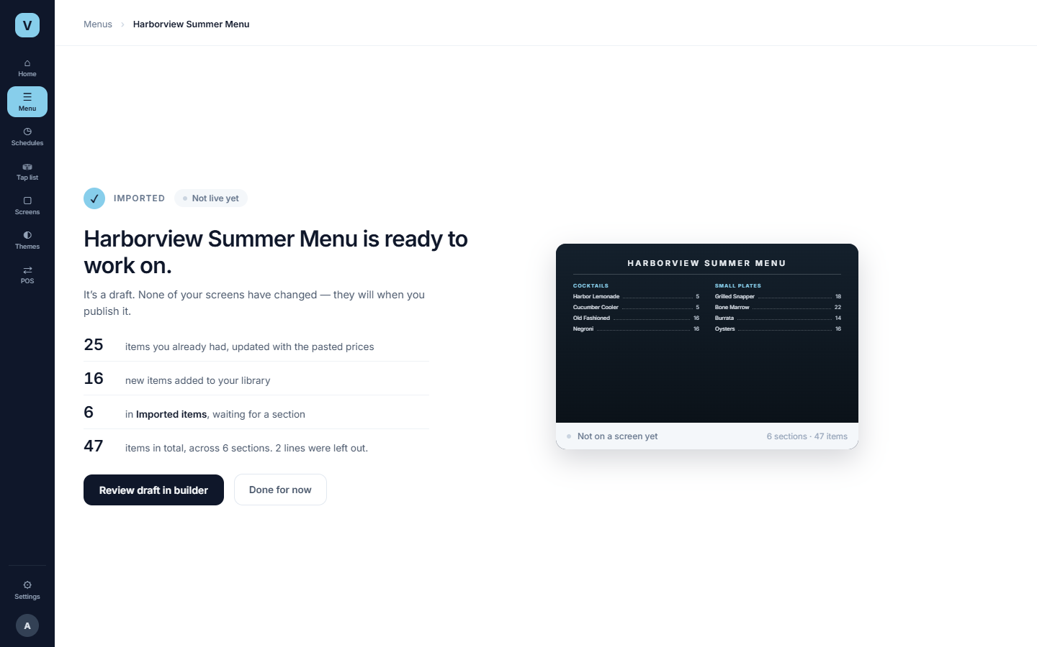
Done — a new menu
PANEL 9
Frame P4
WHAT CHANGED HERE
A Not live yet status, Review draft in builder as the primary action, and Done for now beside it. Confirmation returns a menu ID; nothing navigates on its own.
TRUTHFUL COUNTS
25 updated, 16 added, 6 in Imported items, 47 total, 2 lines left out — identical to the answered review.
Notes:
Done is a stop. Review draft in builder is the operator's own action; Not live yet is stated.

Slide 14
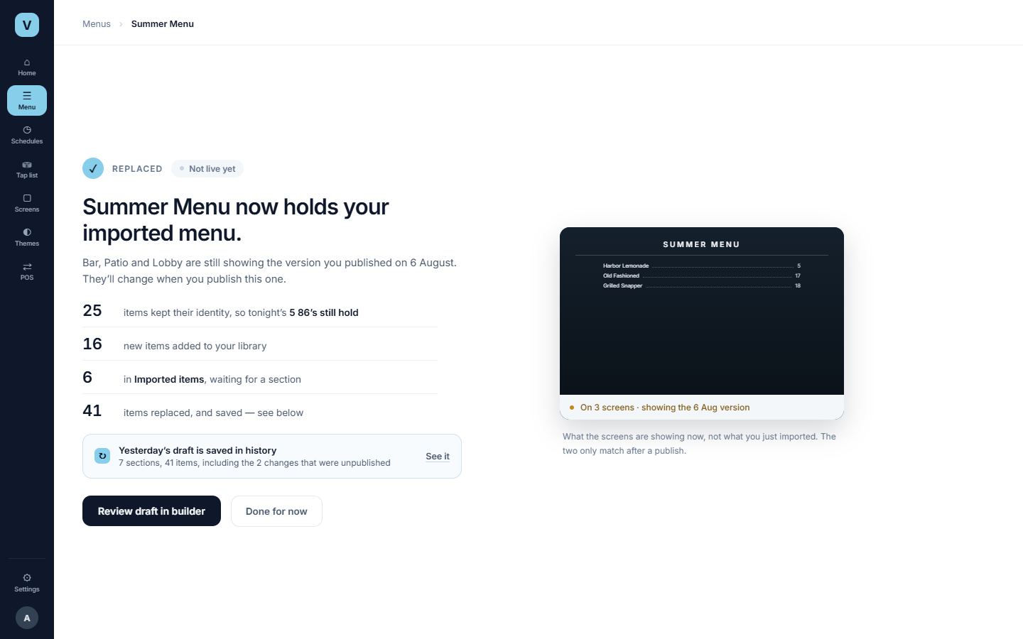
Done — a menu replaced
PANEL 10
Frame P4b · new
DIFFERENT FACTS
The 5 86s that survived, the 41 items replaced and saved , and three screens still showing the version published on 6 August.
THE PREVIEW IS DELIBERATE
It shows what the screens are showing now , not what was just imported. The two only match after a publish.
Notes:
Replacement ends on facts a new menu does not have: surviving 86s, the published version still on the screens, and the saved restore point.

Slide 15
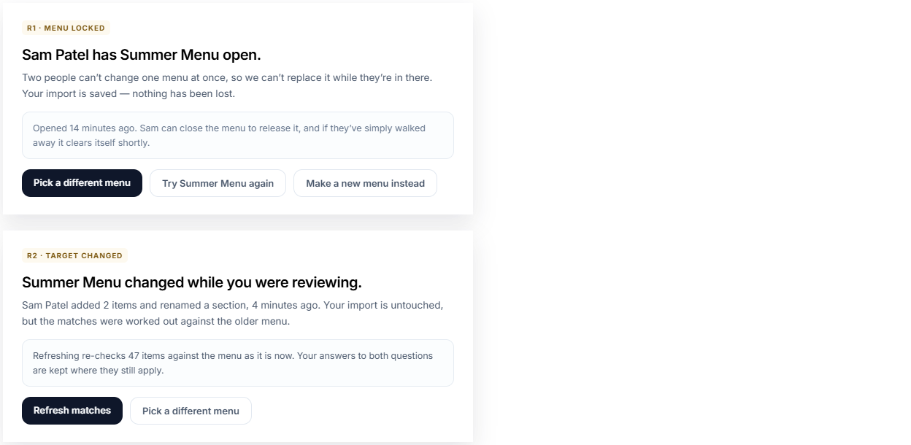
Someone else has it, or it moved
PANEL 11
R1, R2
LOCKED
Names Sam, how long they’ve had it, what Sam can do about it, and that it clears itself.
CHANGED UNDERNEATH
Who changed what, when. Refresh matches re-checks 47 items and keeps the answers that still apply.
ACCEPTED DECISION
Keep still-valid answers. Clear and explain only those affected by the changed target.
Notes:
Both name the person and keep the import. R1 mentions the self-clearing lease without the word lease.

Slide 16
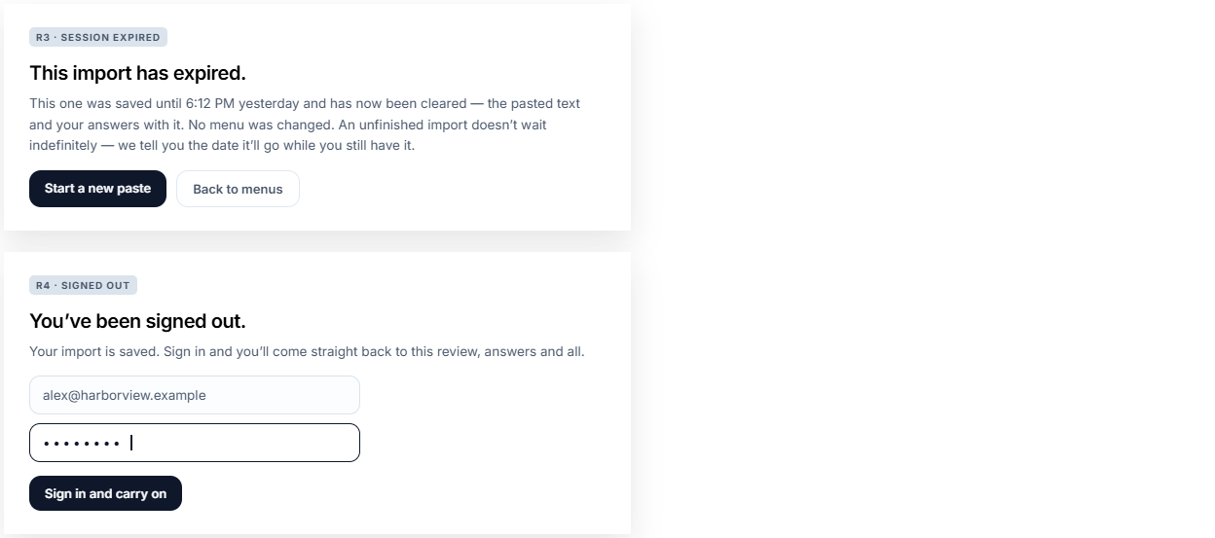
The session
PANEL 12
R3, R4
ABSOLUTE, NOT RELATIVE
Everywhere in the flow shows the resolved absolute expiry. Session lifetime comes from centralized tier configuration; successful user mutations may renew it, passive reads do not.
SIGNED OUT
The import is saved server-side, so signing in lands back on the same review with the same answers.
Notes:
Expiry is the only state that admits losing work, so it is specific about what and when.

Slide 17
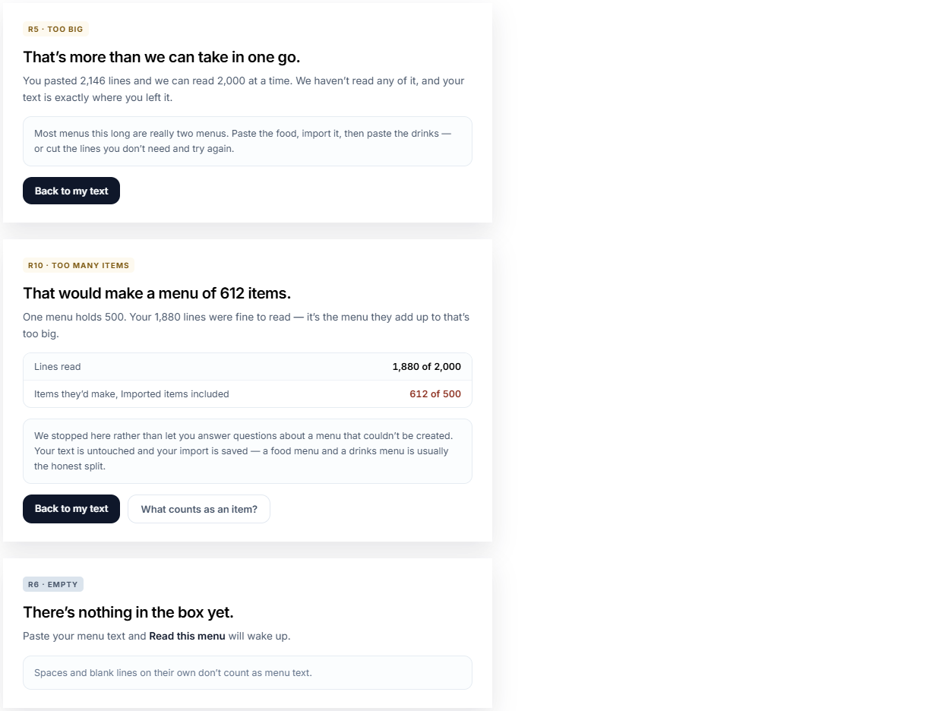
What was pasted
PANEL 13
R5, R10 new, R6
TWO CEILINGS, TWO REFUSALS
Too big is 2,146 lines against 2,000 — nothing was read. Too many items is new: 1,880 lines read fine, but they add up to 612 items against a 500 limit.
BEFORE, NOT AFTER
Both arrive before any matching is resolved, so nobody spends ten minutes answering questions about a menu that can’t be created. The pasted text is kept in every case.
Notes:
Two ceilings and an empty box. R10 is new: line count fine, item count not.

Slide 18
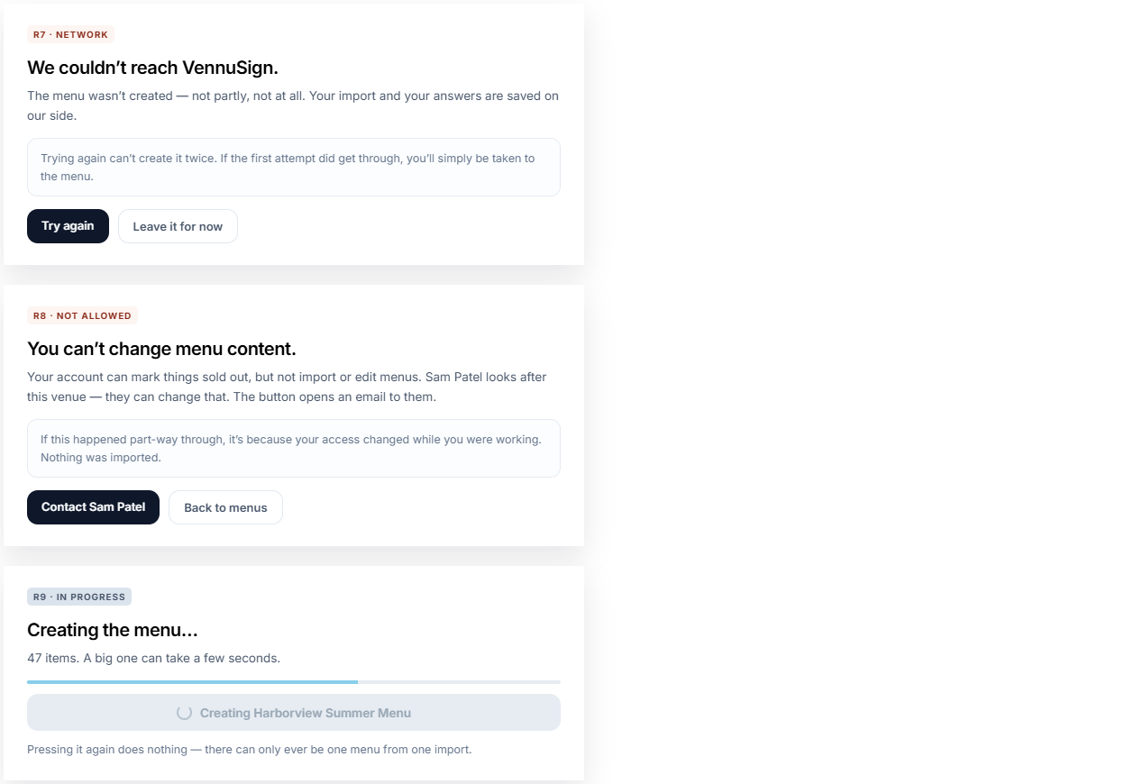
In flight
PANEL 14
R7, R8, R9
NO DUPLICATES, EVER
R7 and R9 both promise it. That’s the visible face of the idempotency key: retry after a timeout lands on the menu that was already made.
PERMISSION
Renamed to Contact Sam Patel , and the copy says the button opens an email — no request inbox is being implied.
Notes:
Nothing here can produce half a menu, and nothing here can produce two.

Slide 19
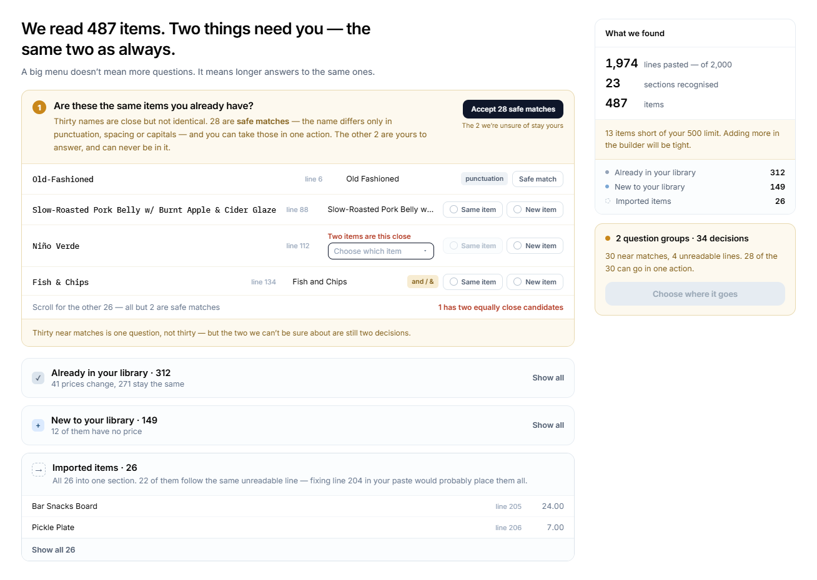
487 items, 30 near matches
PANEL 15
Frame B4
ONE SCOPED ACTION
Accept 28 safe matches — it says how many and why. The 2 we’re unsure of sit outside it and stay unanswered for individual review. There is no untick all.
THE FALLBACK IS DIAGNOSED
All 26 stay in one Imported items section. Per-line reason codes can group explanations and support one correction.
NEAR THE CEILING
“13 items short of your 500 limit” — said at review, while there’s still a choice to make about it.
Notes:
A bigger menu means longer answers to the same questions, plus one scoped bulk action.

Slide 20
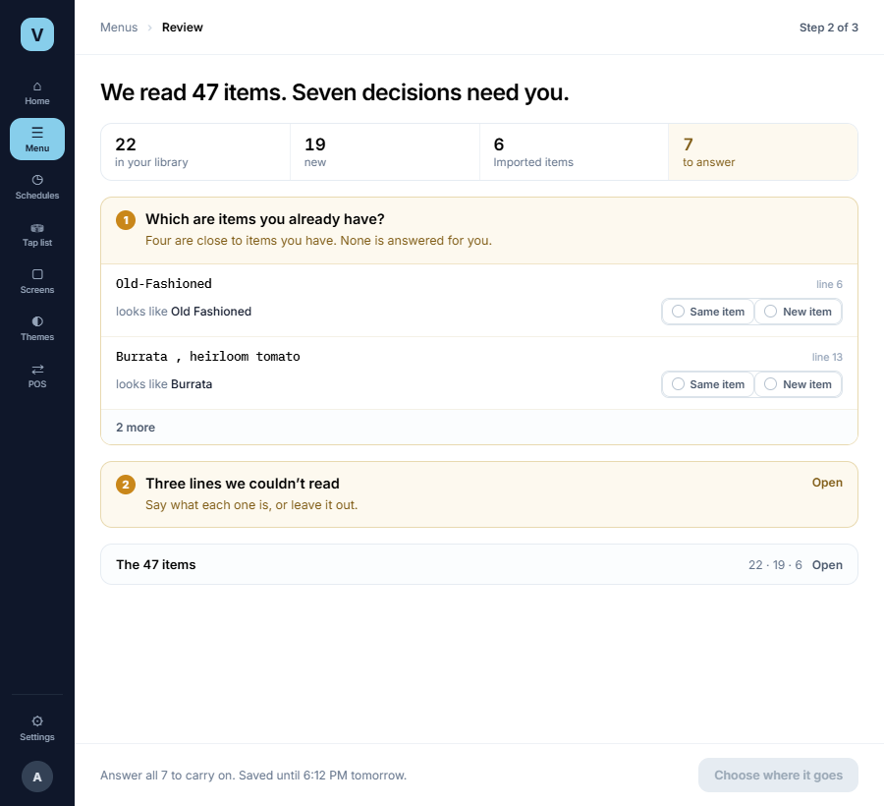
900px — the supported floor
PANEL 16
Frame D2
WHAT TIGHTENS
The summary rail becomes a four-cell bar, the item groups close to single rows, and the primary action moves into a footer that can’t be scrolled past. The questions still fill the first screenful.
WHAT DOESN’T SHRINK
Same item and New item keep their full words at every width. They are the choice, not a label — abbreviating them is how someone picks the wrong one.
Notes:
900px is the supported floor. The choice keeps its full words even when the layout tightens.

Slide 21
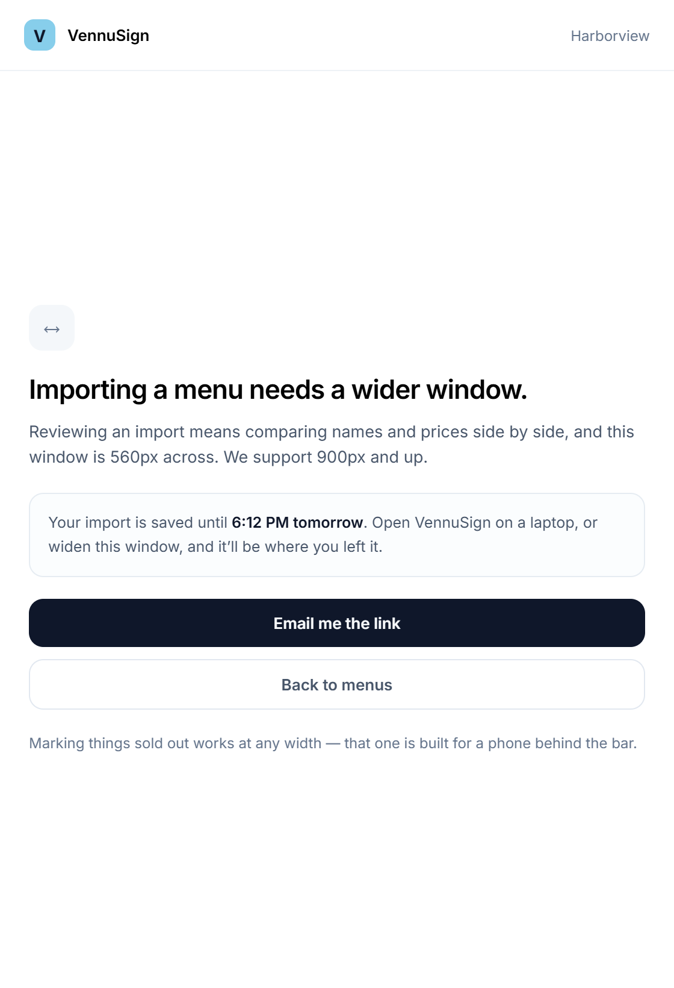
Narrower than 900px
PANEL 17
Frame D3 · new
NAMED, NOT BROKEN
It says what it needs, that this window is 560px, and where the work went. No half-usable review, no silent degradation.
THE WORK IS KEPT
The import is saved until 6:12 PM tomorrow, with a way to pick it up on a wider screen.
AND WHAT DOES WORK SMALL
Marking things sold out, at any width — that one is built for a phone behind the bar.
Notes:
Narrower than the floor: named, not broken, and the work is kept. One isolated frame so it can actually be read.

Slide 22
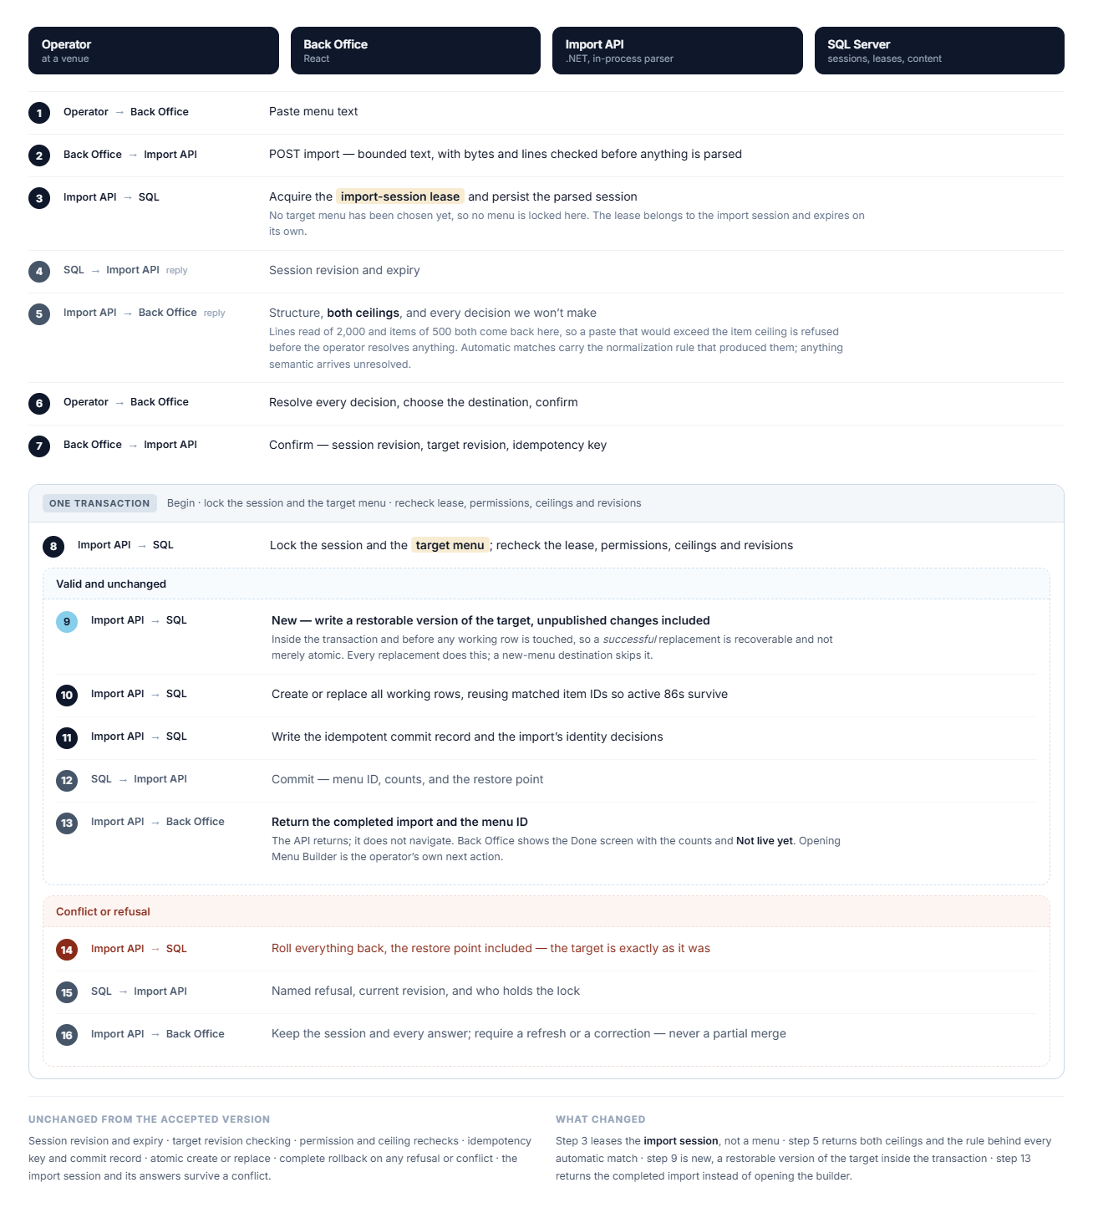
Confirm sequence, revised
SEQ-01
Replaces the accepted diagram when approved
3
Import-session lease , not an edit lease — no target menu has been chosen yet.
5
Returns both ceilings and the rule behind every automatic match.
8
The target menu lock stays here, at confirmation, where it already was.
9
New — write the restorable version inside the transaction, before any working row is replaced.
13
Return completed import and menu ID. Back Office shows Done; the operator opens the builder.
Unchanged: revisions, expiry, permission and ceiling rechecks, idempotency, atomic create or replace, full rollback, and a session that survives a conflict with its answers.
Notes:
Four corrections: import-session lease early, target lock at confirm, the new snapshot step inside the transaction, and a return instead of a navigation.

Slide 23
ACCEPTED — OWNER DECISIONS
Seven behaviours confirmed
These decisions now govern the storyboard, repository authority and implementation. Example expiry times remain illustrative until tier defaults are configured.
1
Refresh preserves answers whose source line and candidate identity remain valid; only dependency-affected answers are cleared and explained.
2
The server computes a structured delta against the published snapshot and returns a readable total and category breakdown at confirmation.
3
Fallback content stays in one Imported items section; per-line parser reasons support explanation, diagnostics and grouping.
4
An eligible unreadable line may become a section only through an explicit reversible review action.
5
Keep every pre-import snapshot. Tier configuration controls its scope, retention and restore eligibility.
6
Import-session lifetime comes from tier configuration. Successful user mutations may renew expiry; passive reads do not.
7
A pasted price change is menu-scoped and never silently changes another menu. Shared-price storage must create an override/copy or explicitly refuse.
Accessibility scope: only keyboard-specific interaction design and keyboard testing are out of this milestone. Semantic controls, accessible names and relationships, visible focus, and screen-reader-compatible status and error messaging remain required — they are specified with each screen, not deferred.
Notes:
Seven behaviours the design draws but nobody has signed off. They are pending, not settled. Plus the accessibility scope: only keyboard-specific design and testing are out; semantics, names, focus and status messaging are still required.

