Slide 1
Scheduling and Analysis of Limited-Preemptive Malleable Gang Taks
Joan Marcè i Igual
Geoffrey Nelissen
Mitra Nasri
Paris Panagiotou
24th of February, 2020

Slide 2
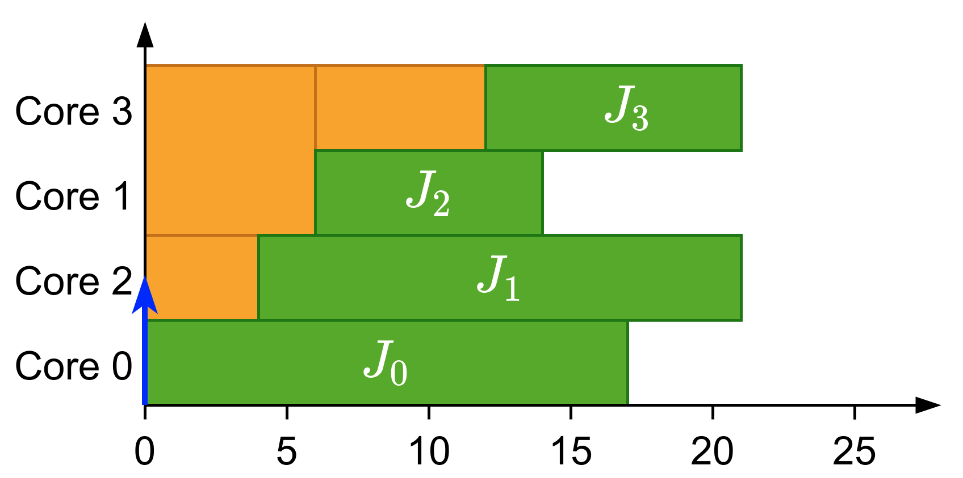
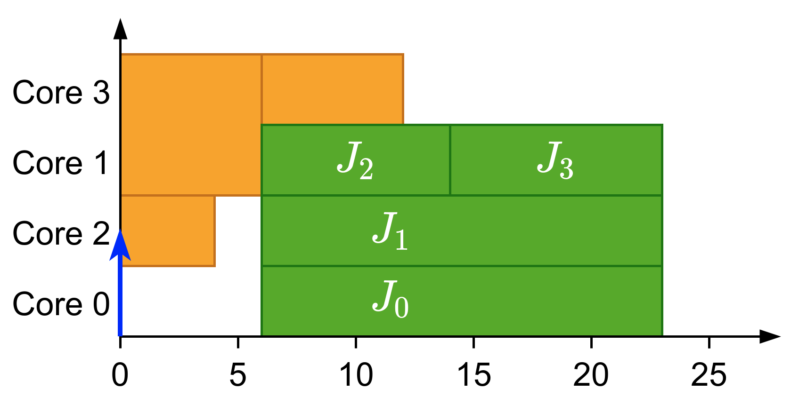
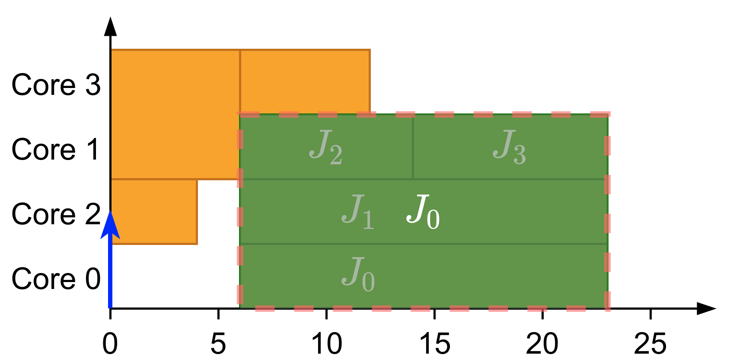
What is gang?
Parallel threads executed together as a “gang”
Execution does not start until there are enough free cores
Global scheduling
Gang Scheduling

Slide 3
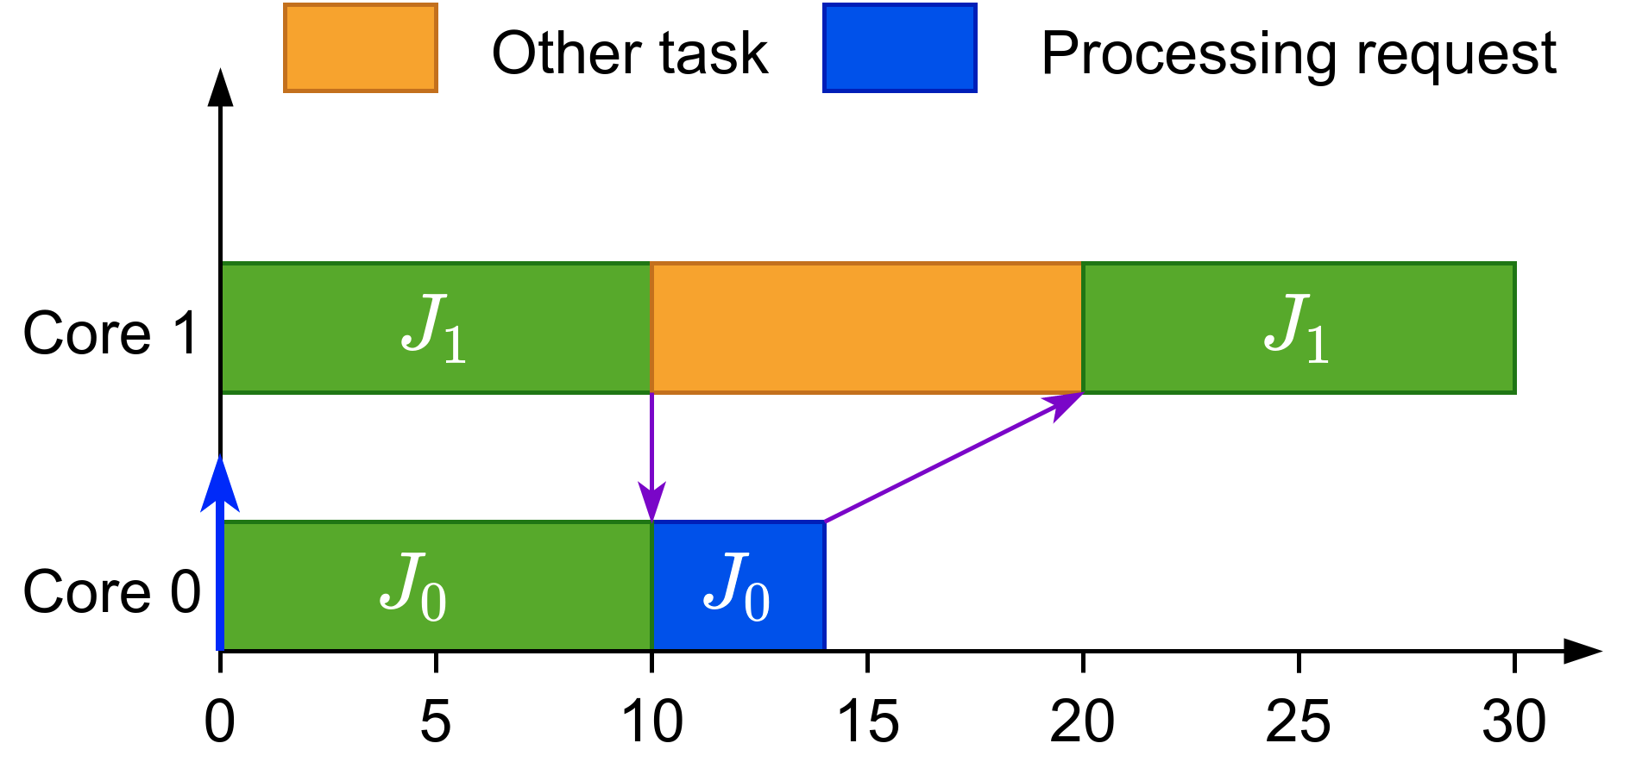
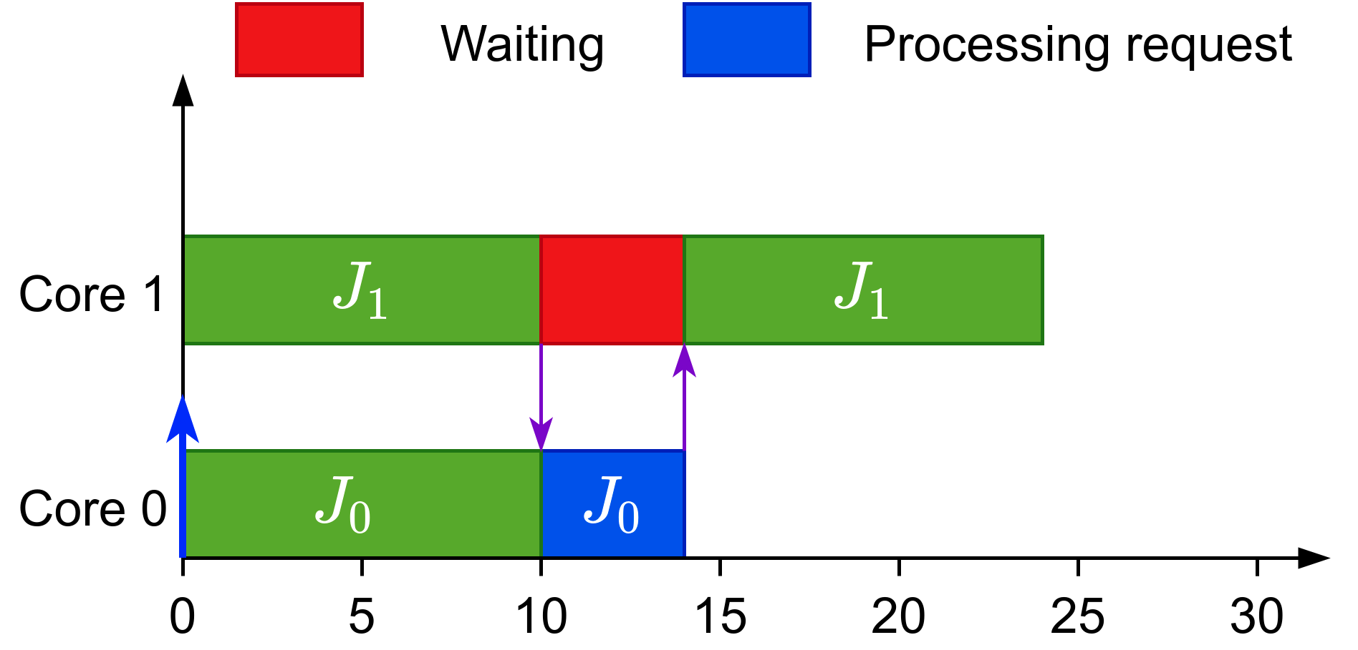
Why gang?
Efficient synchronization

Slide 4
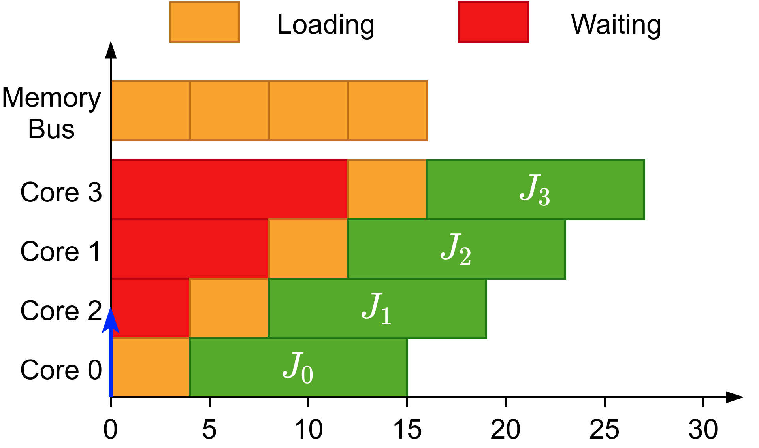
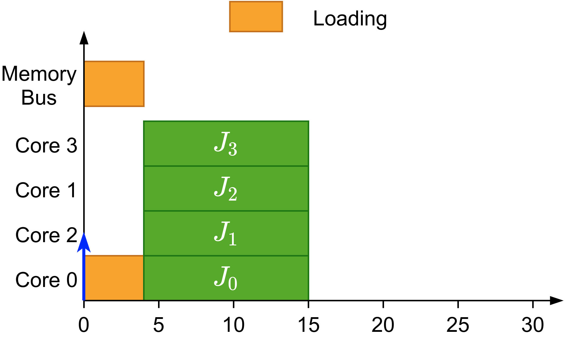
Why gang?
Efficient synchronization
Avoids overhead when loading initial data

Slide 5
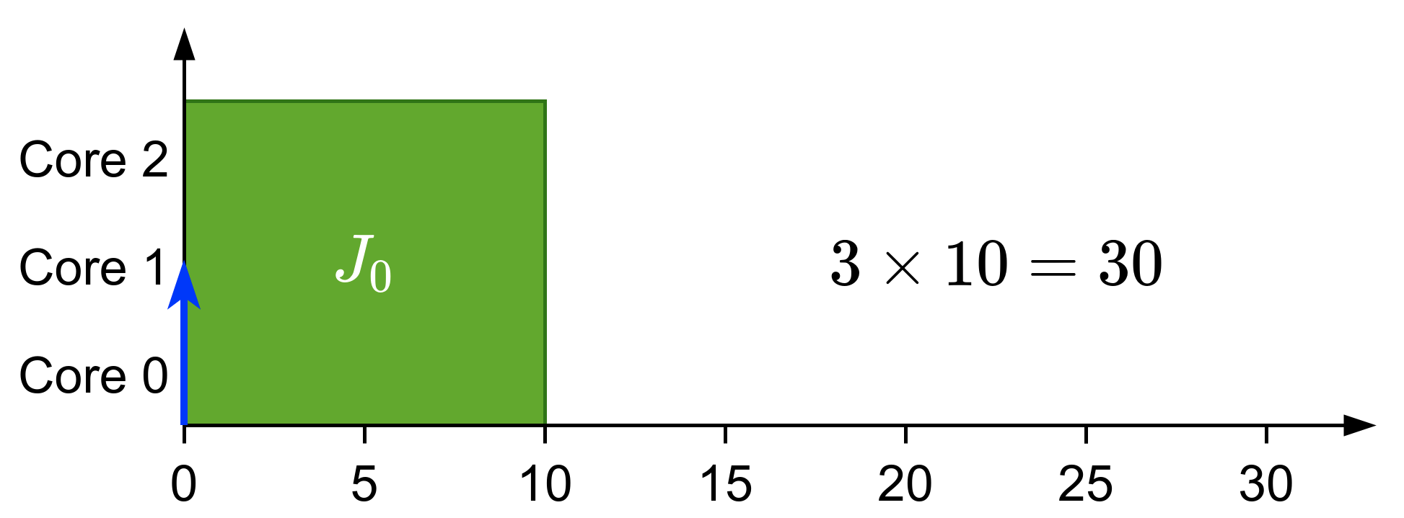
Types of gang
Rigid: number of cores set by programmer

Slide 6
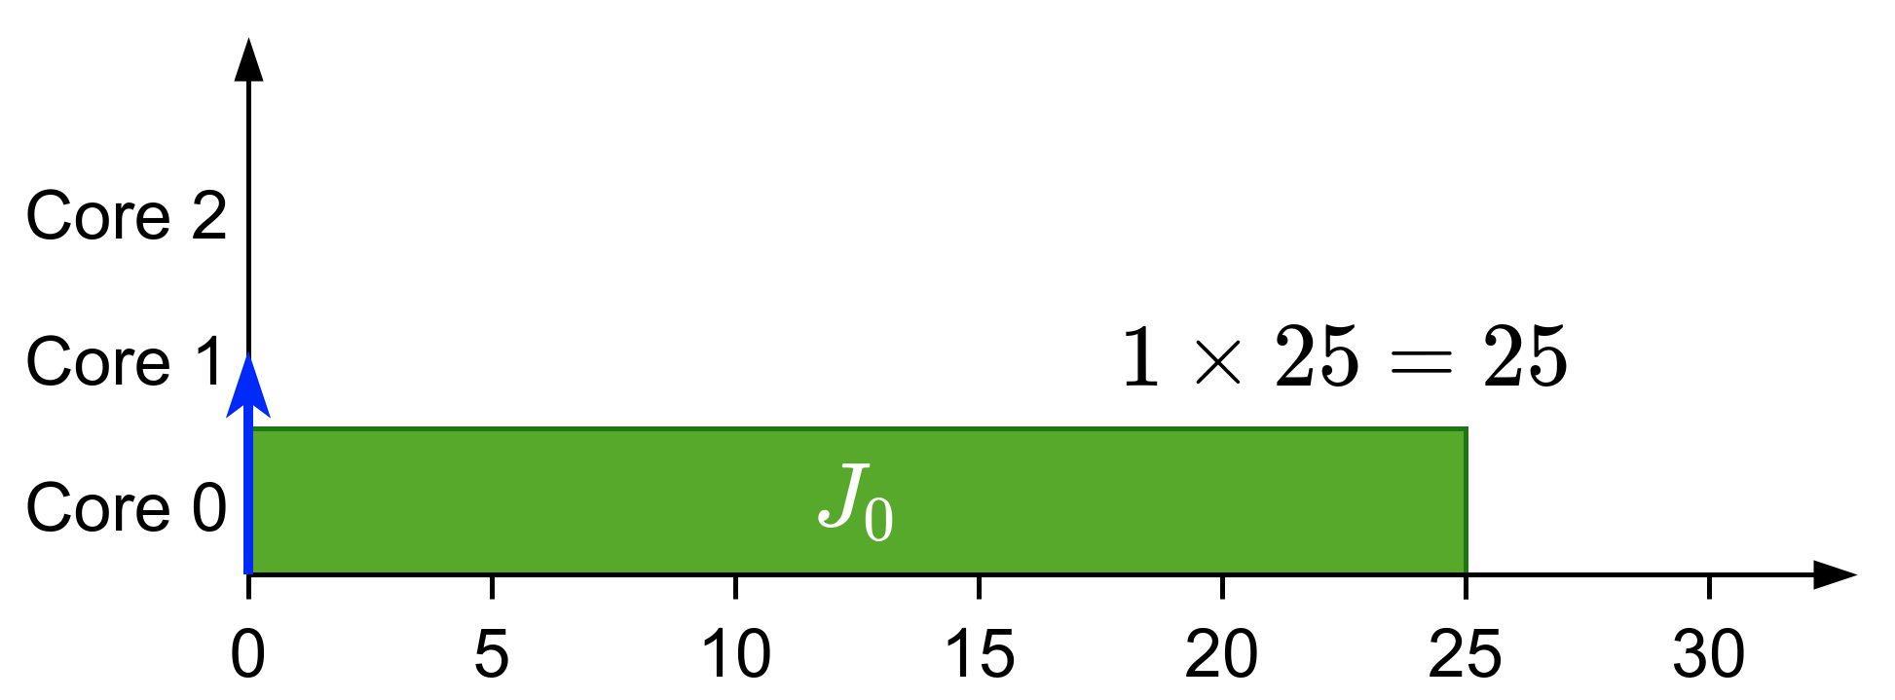
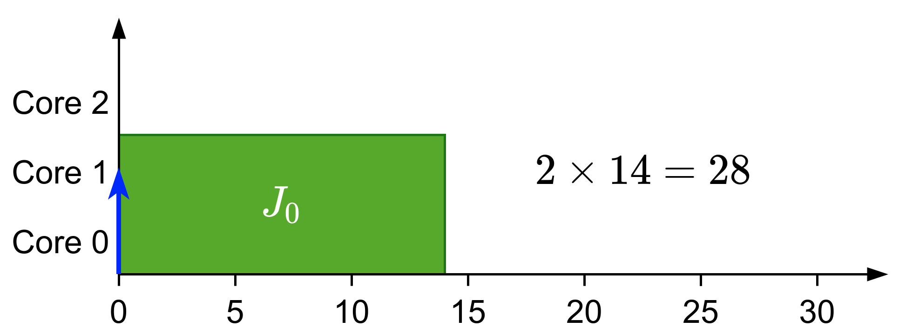
Types of gang
Rigid: number of cores set by programmer
Moldable: number of cores assigned during scheduling

