Slide 1


Scheduling Analysis of Limited-Preemptive Moldable Gang Tasks
Joan Marcè i Igual
Geoffrey Nelissen
Mitra Nasri
20th of May, 2020

Slide 2
Scheduling Analysis
Schedule Abstraction
Graph^{[1]}
Simulations
Scheduling tests
Exact
Slow
Pessimist
Fast
Accurate
Relatively fast
Explore space of possible schedules for a given job set
Models scheduler decisions
^{[1] Nasri et al., 2018}
Notes:
SAG is the bridge between tests and simulations
Accurate and relatively fast
Explore space of possible schedules
Model scheduler decisions

Slide 3
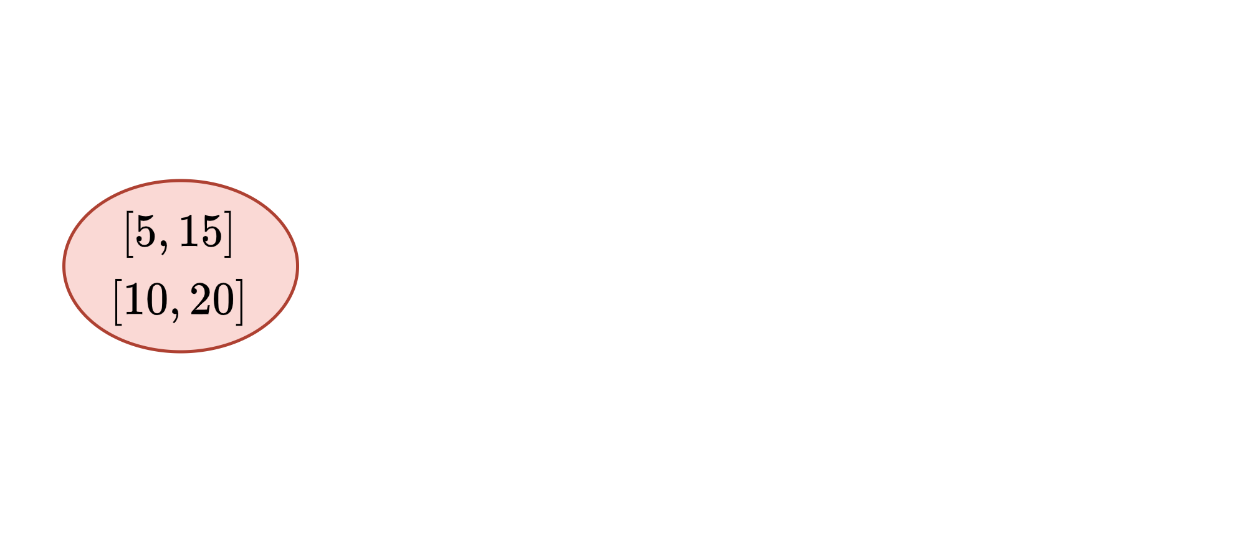
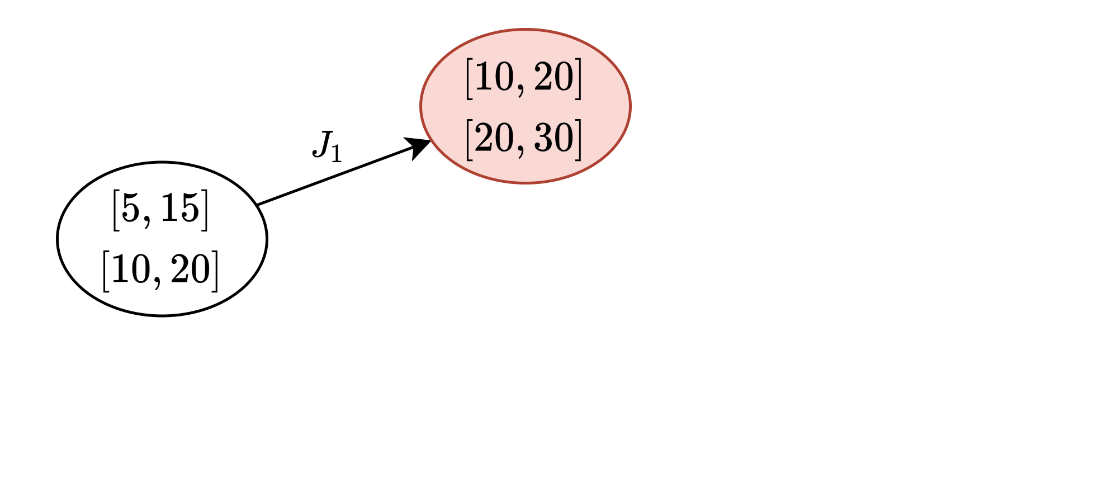
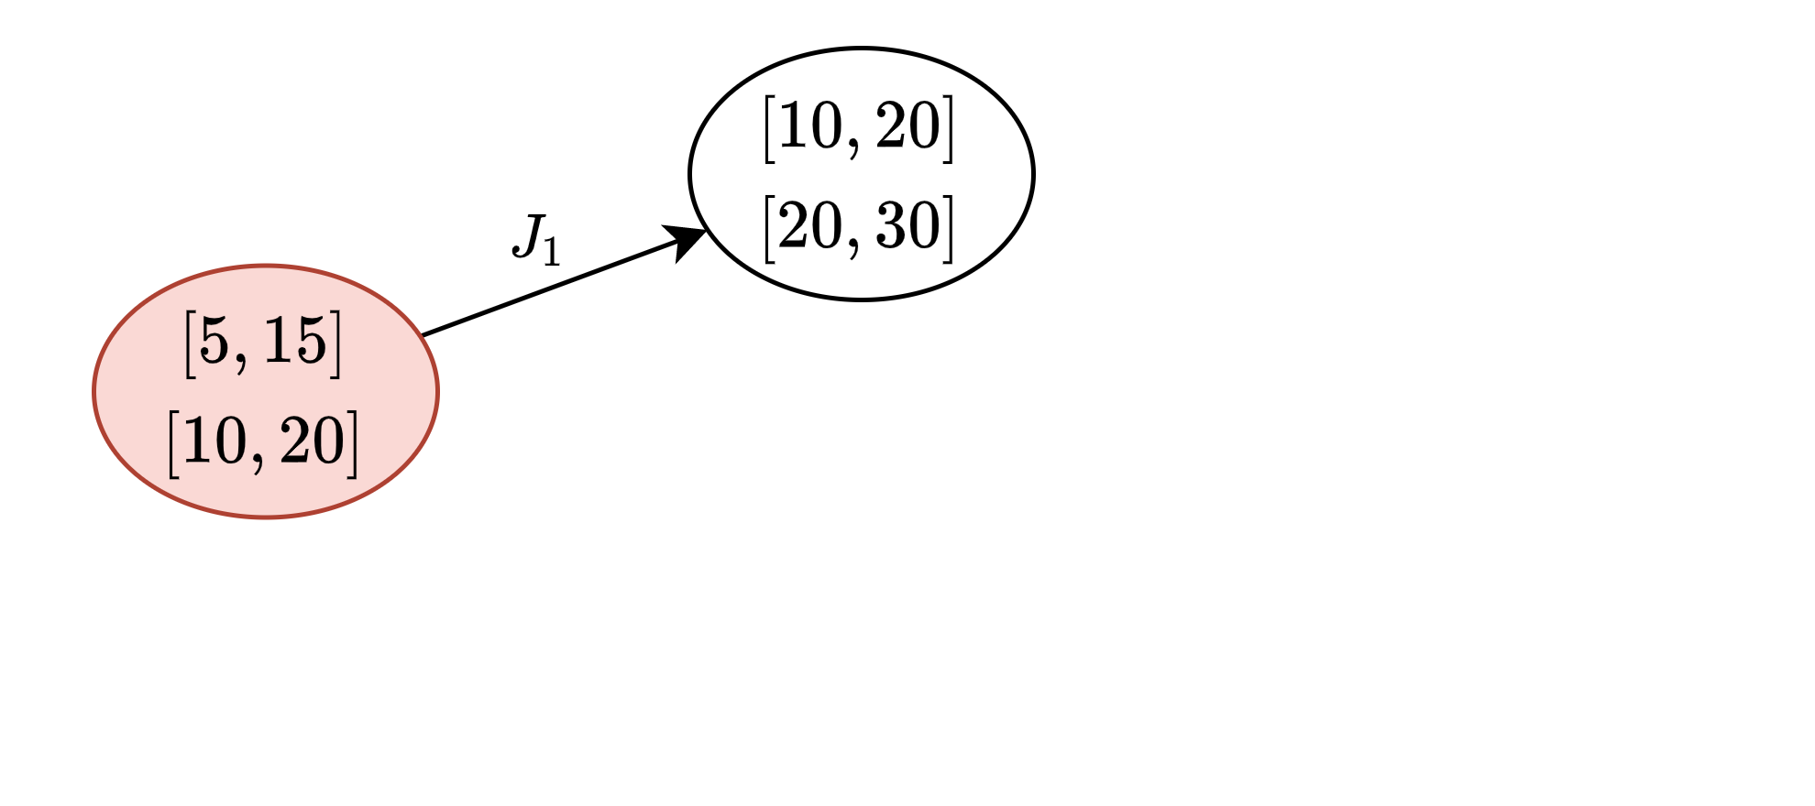
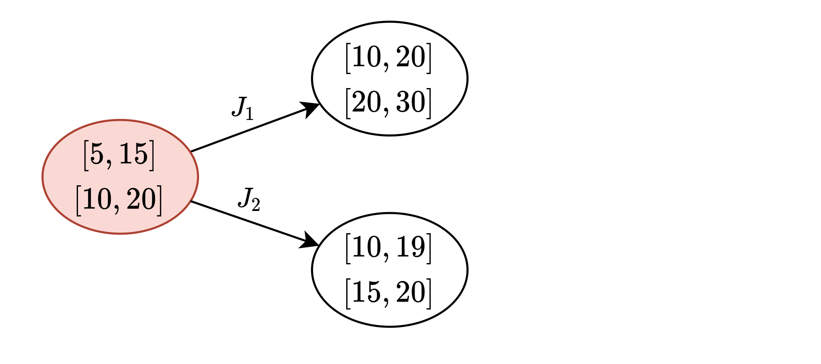
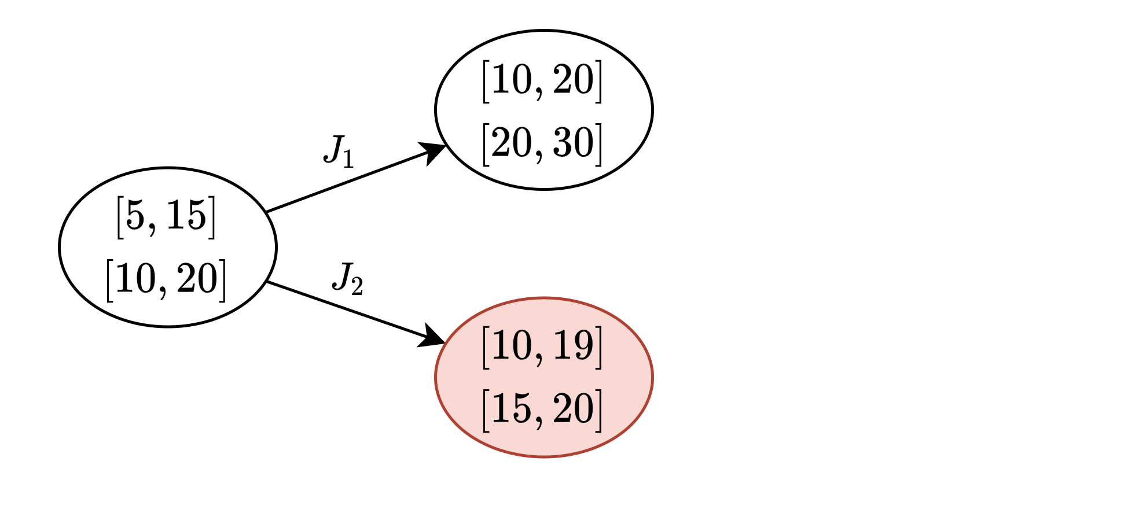
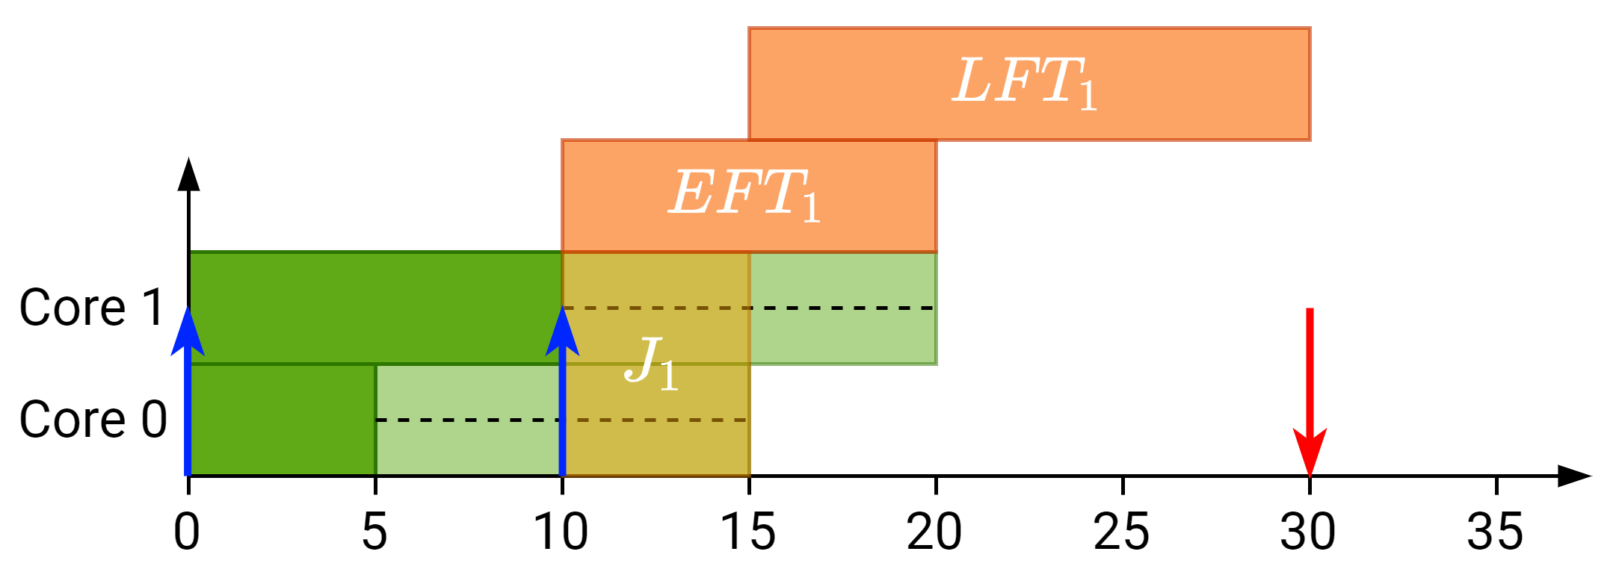
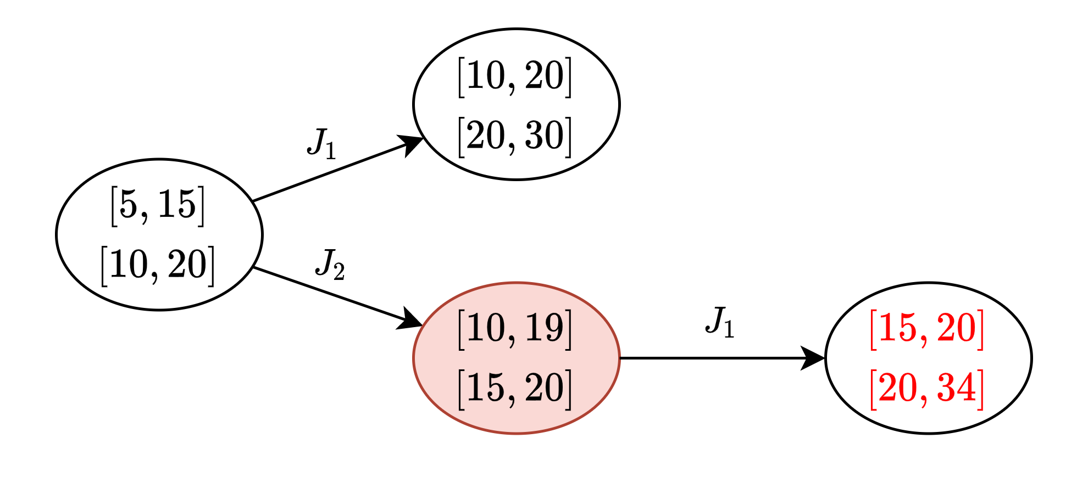
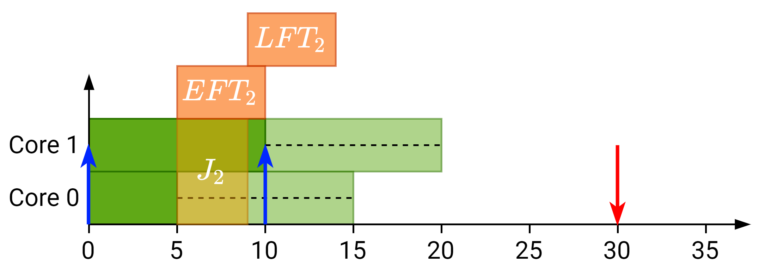
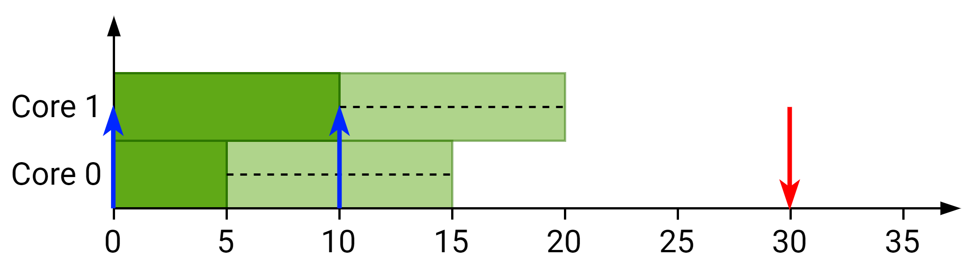
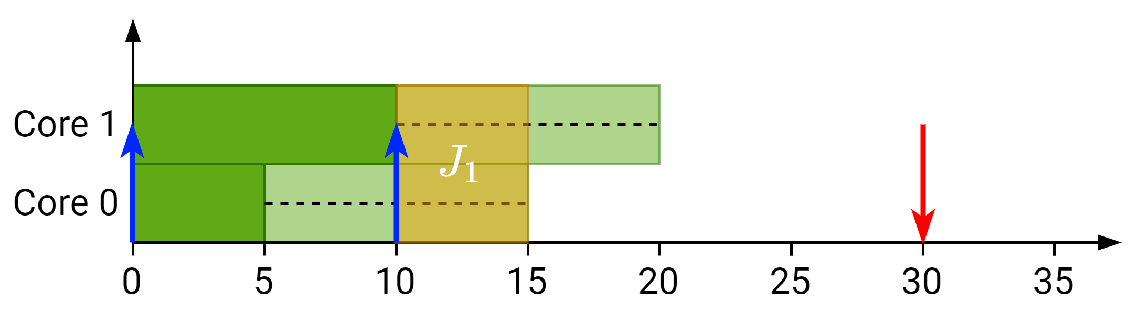
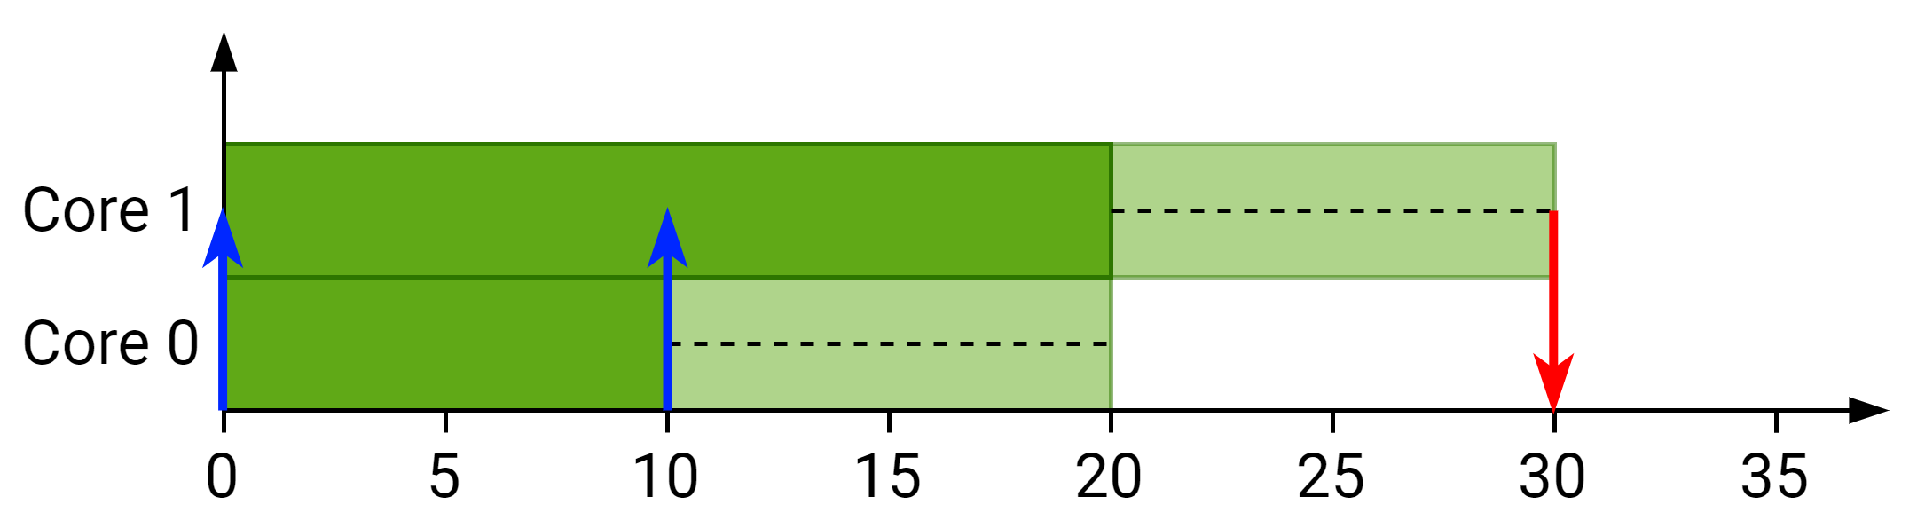
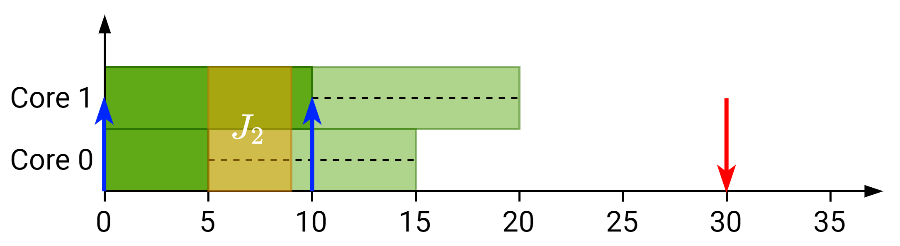
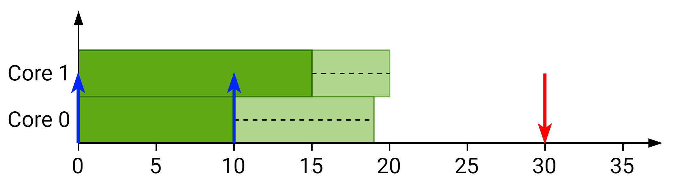
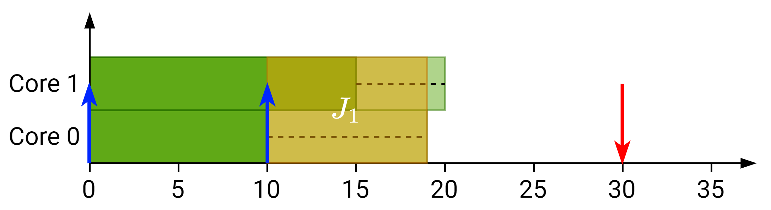
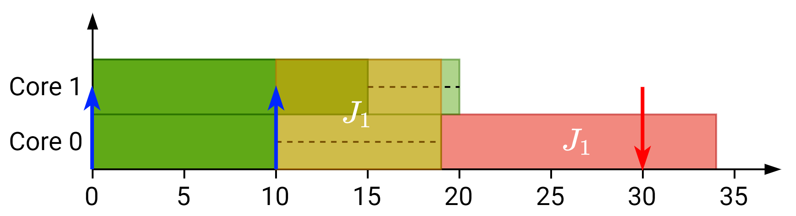
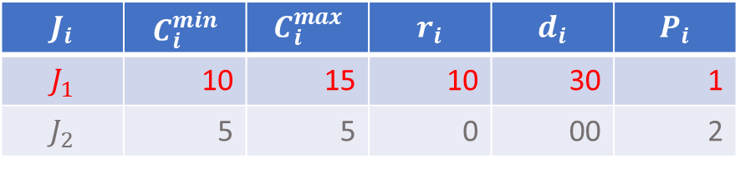
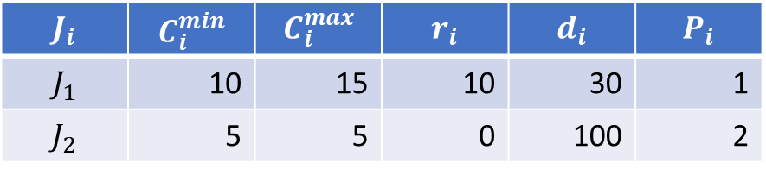
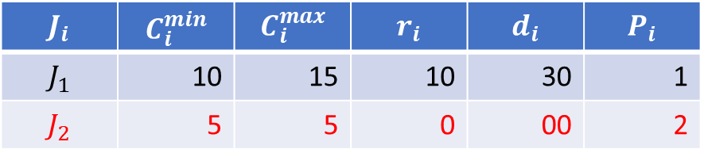
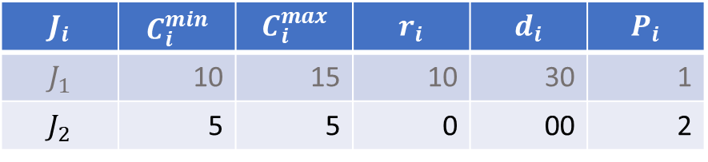
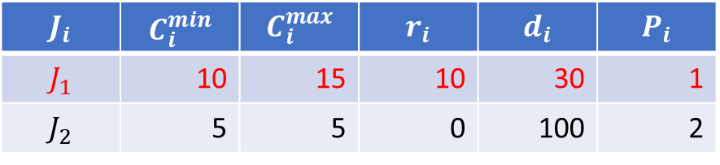
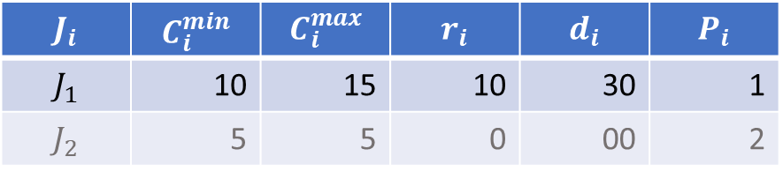
How does SAG work?
$$J_{i}$$ | $$C_{i}^{min}$$ | $$C_{i}^{max}$$ | $$r_{i}$$ | $$d_{i}$$ | $$P_{i}$$
$$J_{1}$$ | 10 | 15 | 10 | 30 | 1
$$J_{2}$$ | 5 | 5 | 0 | 100 | 2
$$J_{i}$$ | $$C_{i}^{min}$$ | $$C_{i}^{max}$$ | $$r_{i}$$ | $$d_{i}$$ | $$P_{i}$$
$$J_{1}$$ | 10 | 15 | 10 | 30 | 1
$$J_{2}$$ | 5 | 5 | 0 | 100 | 2
$$J_{i}$$ | $$C_{i}^{min}$$ | $$C_{i}^{max}$$ | $$r_{i}$$ | $$d_{i}$$ | $$P_{i}$$
$$J_{1}$$ | 10 | 15 | 10 | 30 | 1
$$J_{2}$$ | 5 | 5 | 0 | 00 | 2
$$J_{i}$$ | $$C_{i}^{min}$$ | $$C_{i}^{max}$$ | $$r_{i}$$ | $$d_{i}$$ | $$P_{i}$$
$$J_{1}$$ | 10 | 15 | 10 | 30 | 1
$$J_{2}$$ | 5 | 5 | 0 | 00 | 2
$$J_{i}$$ | $$C_{i}^{min}$$ | $$C_{i}^{max}$$ | $$r_{i}$$ | $$d_{i}$$ | $$P_{i}$$
$$J_{1}$$ | 10 | 15 | 10 | 30 | 1
$$J_{2}$$ | 5 | 5 | 0 | 00 | 2
$$J_{i}$$ | $$C_{i}^{min}$$ | $$C_{i}^{max}$$ | $$r_{i}$$ | $$d_{i}$$ | $$P_{i}$$
$$J_{1}$$ | 10 | 15 | 10 | 30 | 1
$$J_{2}$$ | 5 | 5 | 0 | 00 | 2
Notes:
Example of graph exploration:
If $J_{1}$ goes first no deadline miss
If $J_{2}$ goes first then $J_{1}$ has a deadline miss later

Slide 4
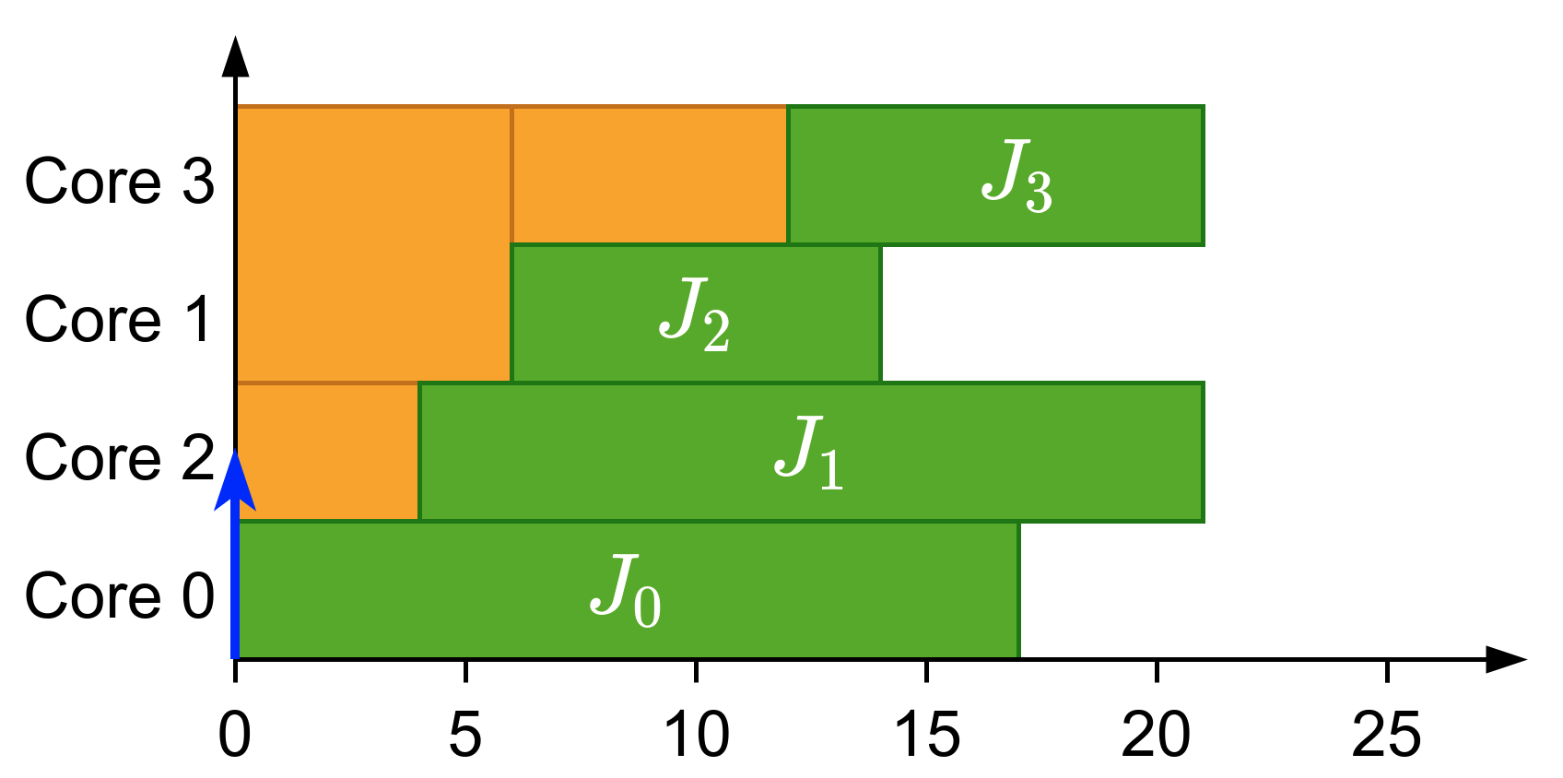
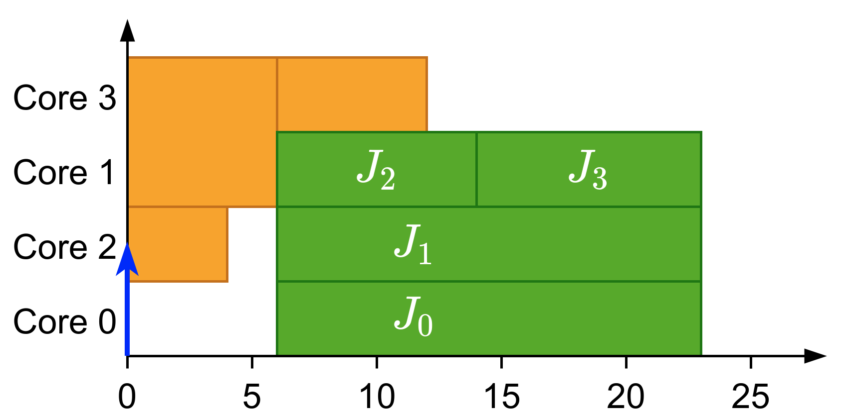
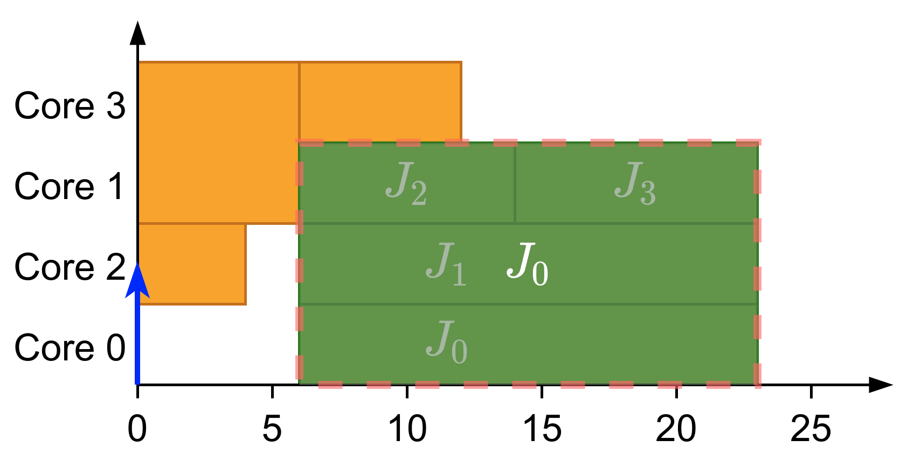
What is gang?
Parallel threads executed together as a “gang”
Execution does not start until there are enough free cores
Global scheduling
Gang Scheduling
Notes:
Multiple related threads
Execute them together as a “gang”
Form a single job

Slide 5
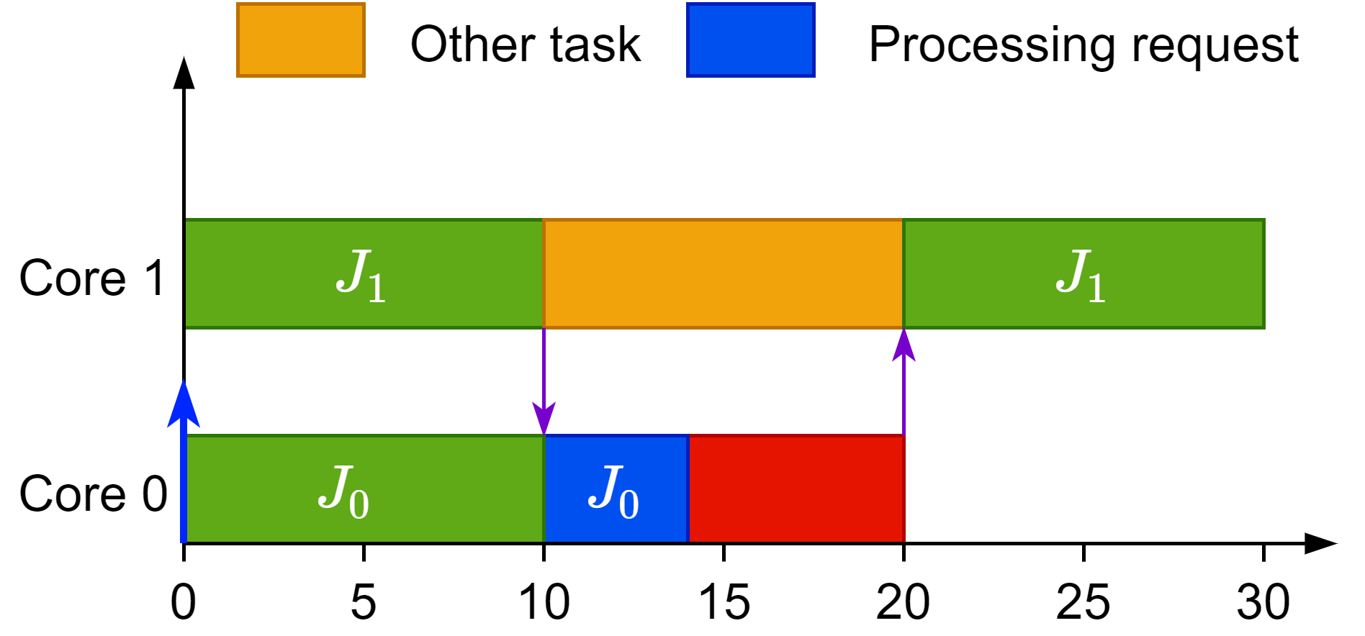
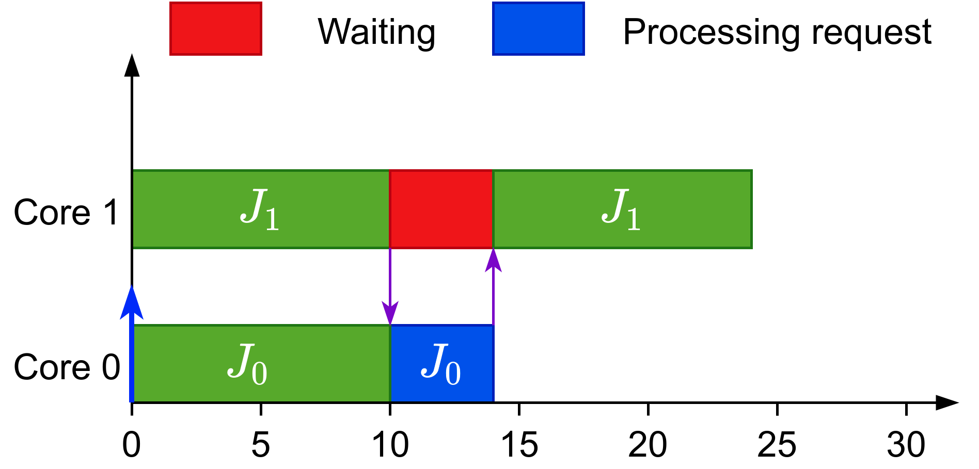
Why gang?
Efficient synchronization
Global scheduling
Gang Scheduling
Notes:
Gang looks worse but it actually has advantages:
Global scheduling would be pre-empted when waiting for synchronization
Gang scheduling would busy wait and for the reply

Slide 6
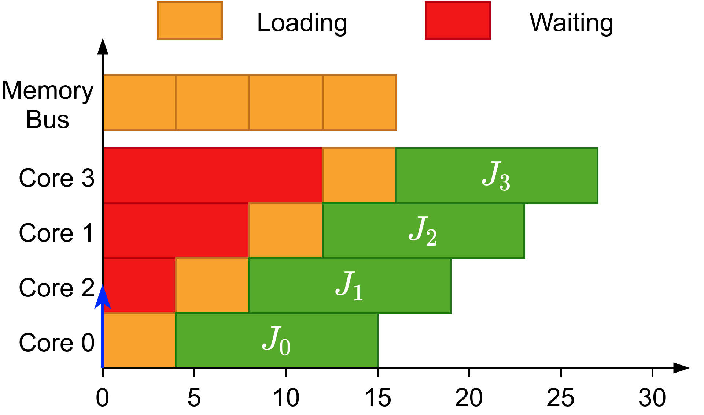
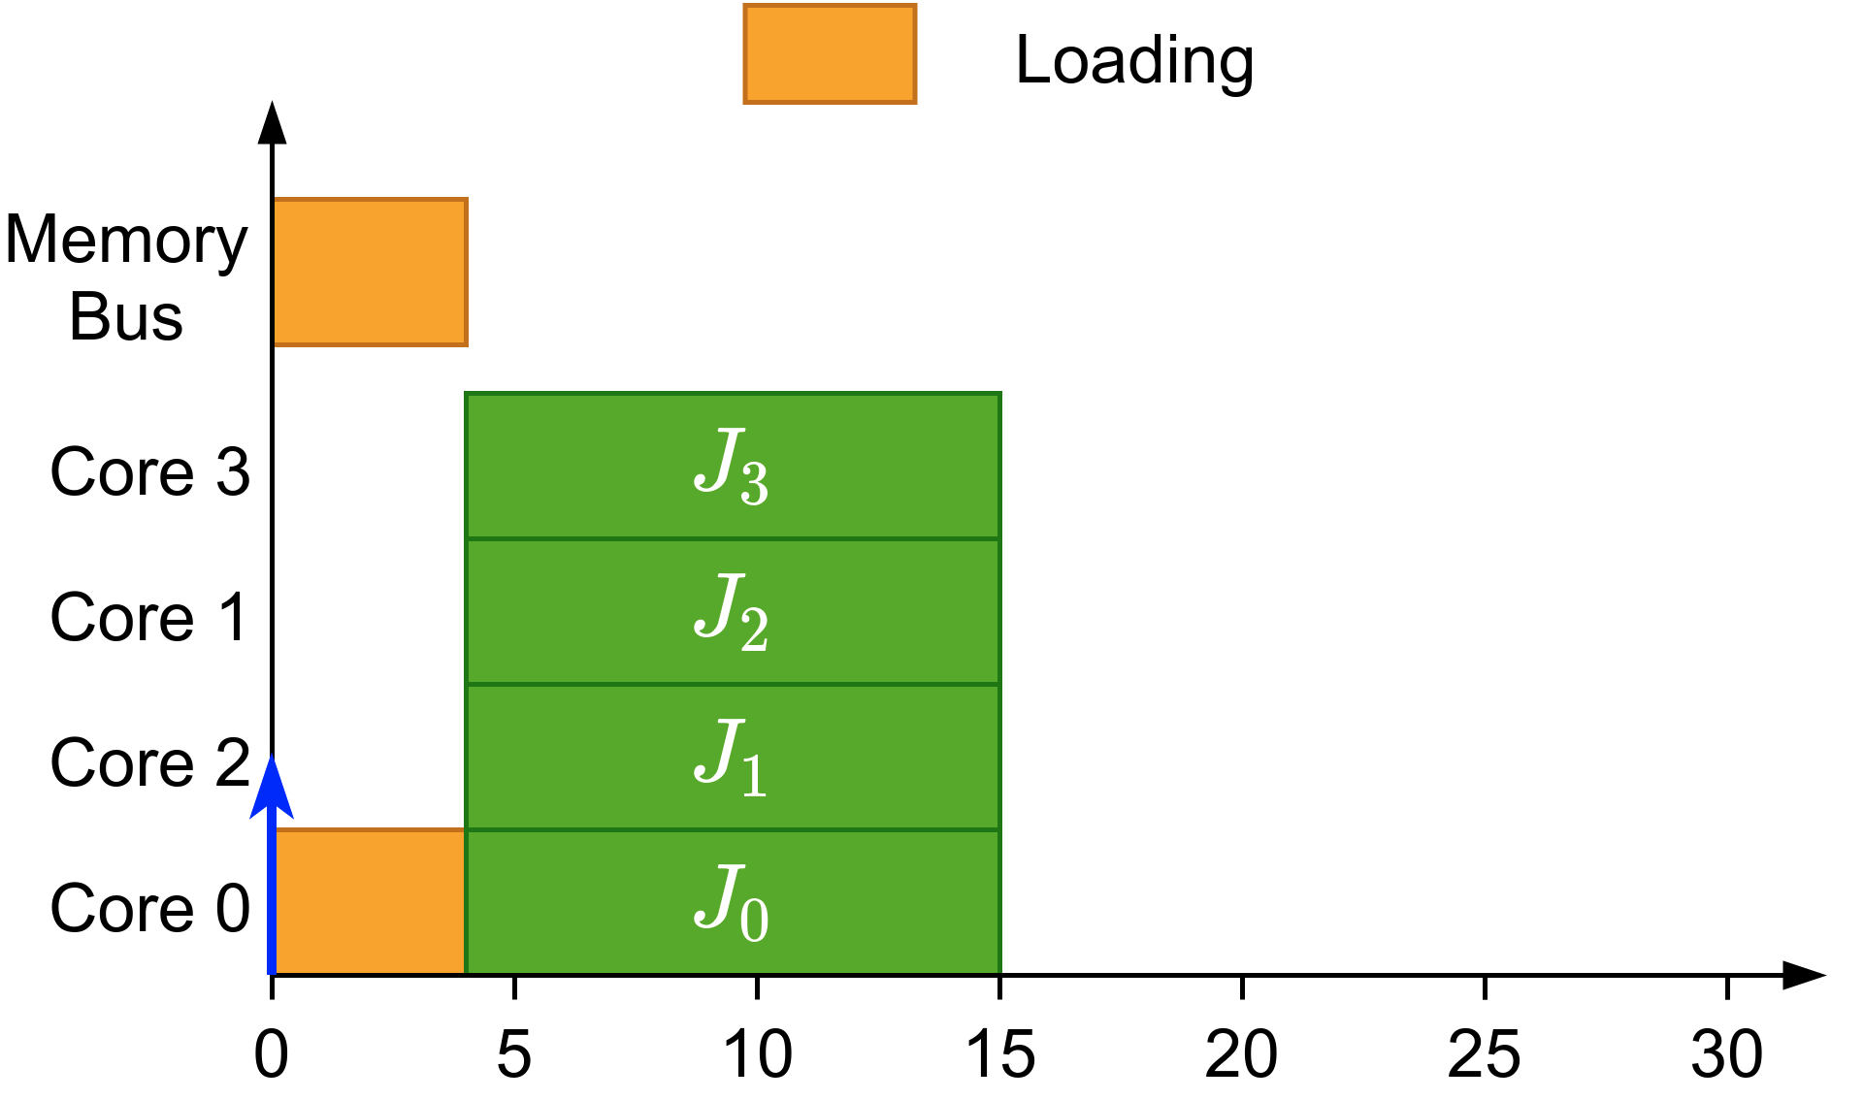
Why gang?
Efficient synchronization
Avoids overhead when loading initial data
Shows its full potential when executed non-preemptively
Global scheduling
Gang Scheduling
Notes:
Global scheduling would load the same data multiple times
Gang scheduling would load the data once for all the jobs

Slide 7
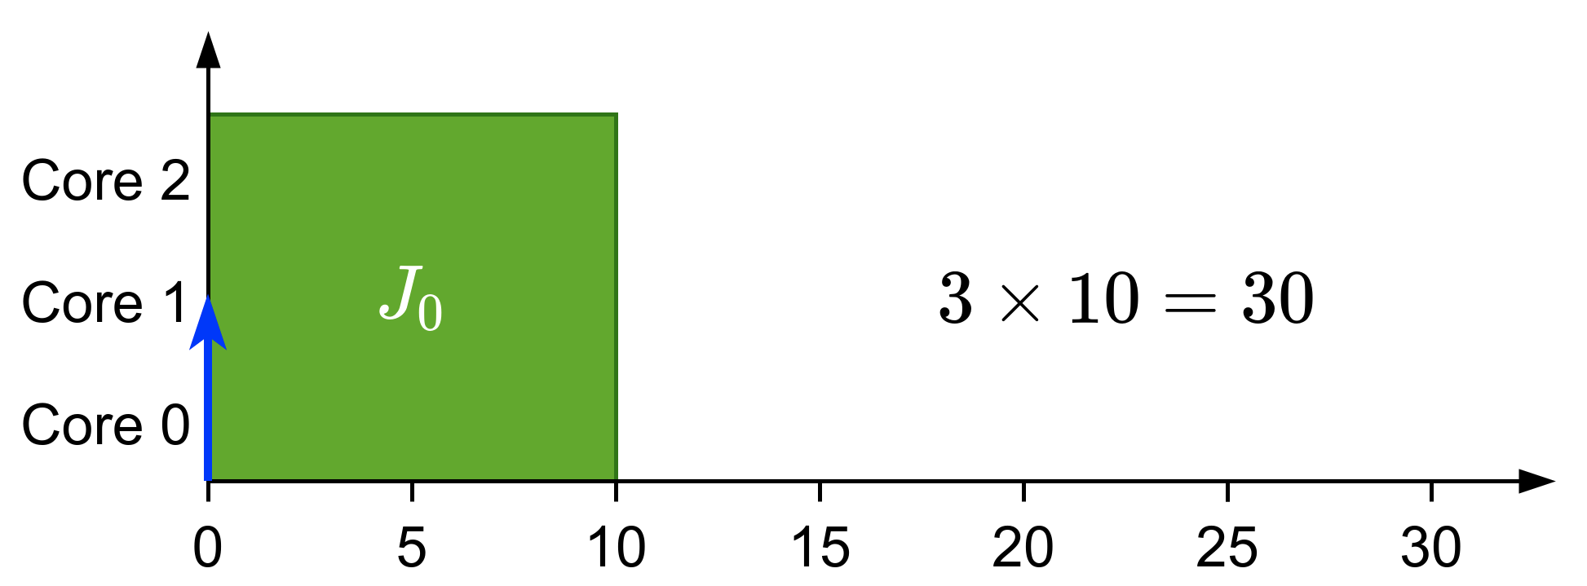
Types of gang
Rigid: number of cores set by programmer
Notes:
Three types:
Rigid gang: Number of cores fixed by programmer
Moldable gang: Number of cores between minimum and maximum. Scheduler chooses at scheduling time.
Malleable gang: Number of cores between minimum and maximum. Can vary during runtime

Slide 8
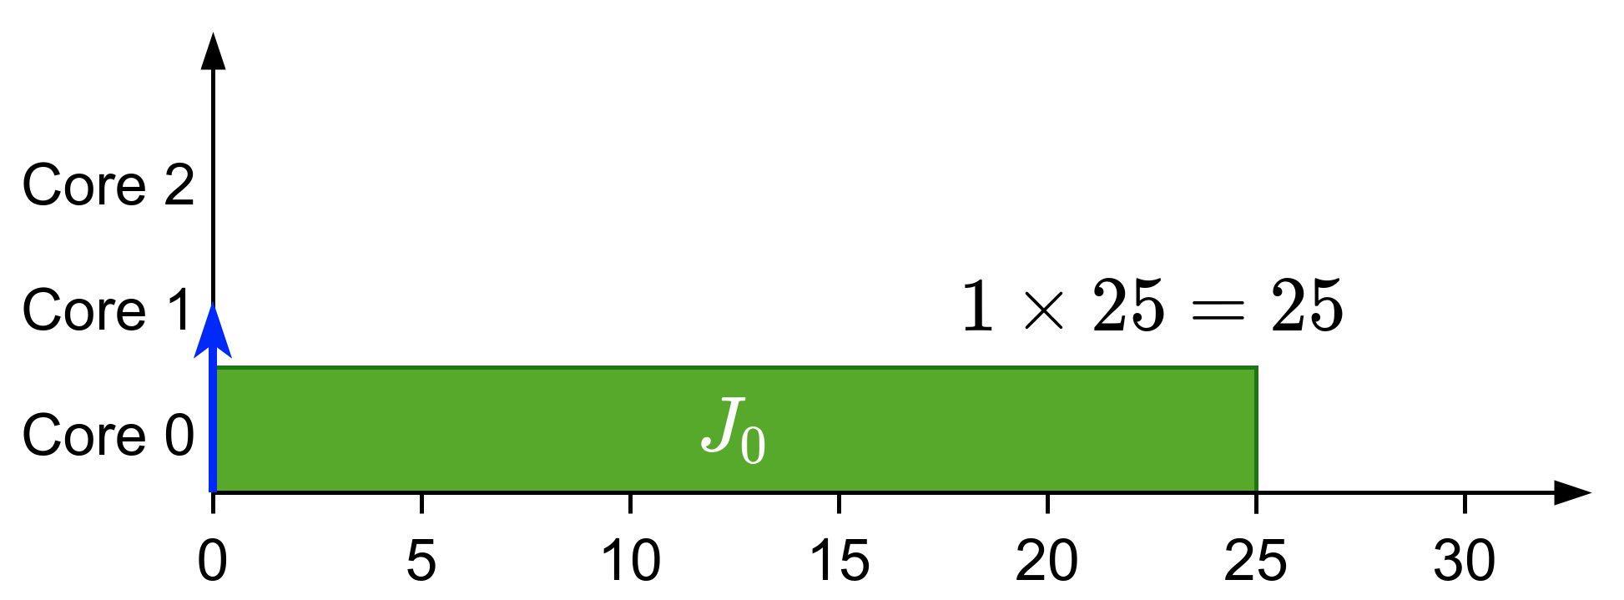
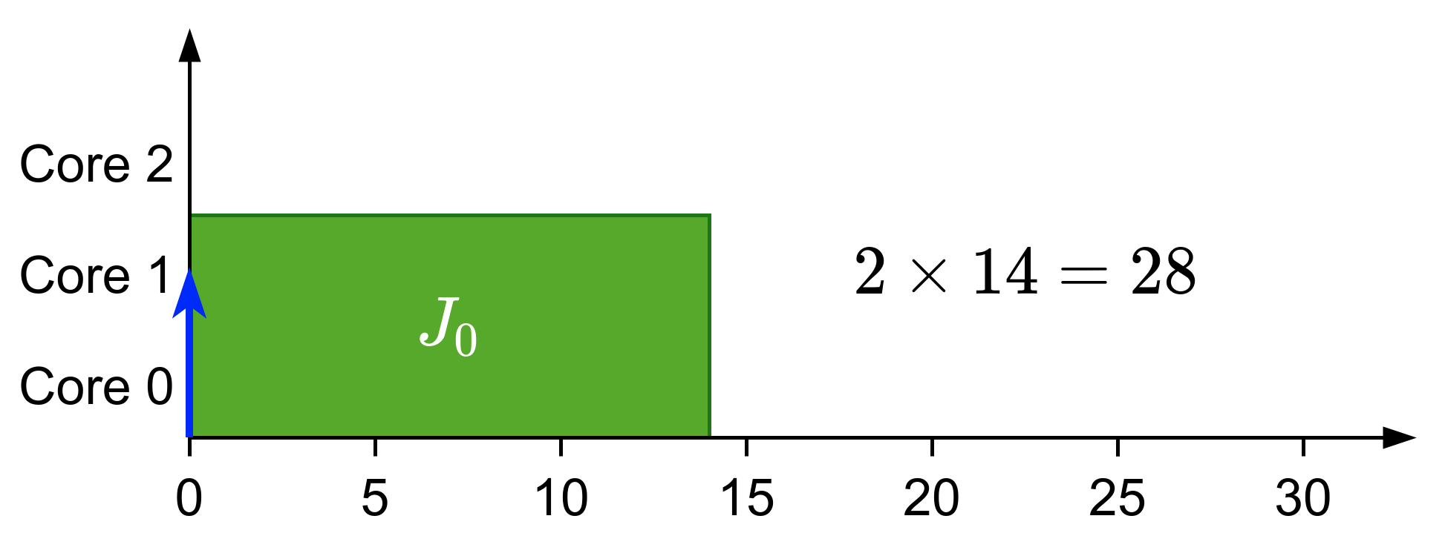
Types of gang
Rigid: number of cores set by programmer
Moldable: number of cores assigned during scheduling
Notes:
Three types:
Rigid gang: Number of cores fixed by programmer
Moldable gang: Number of cores between minimum and maximum. Scheduler chooses at scheduling time.
Malleable gang: Number of cores between minimum and maximum. Can vary during runtime

Slide 9
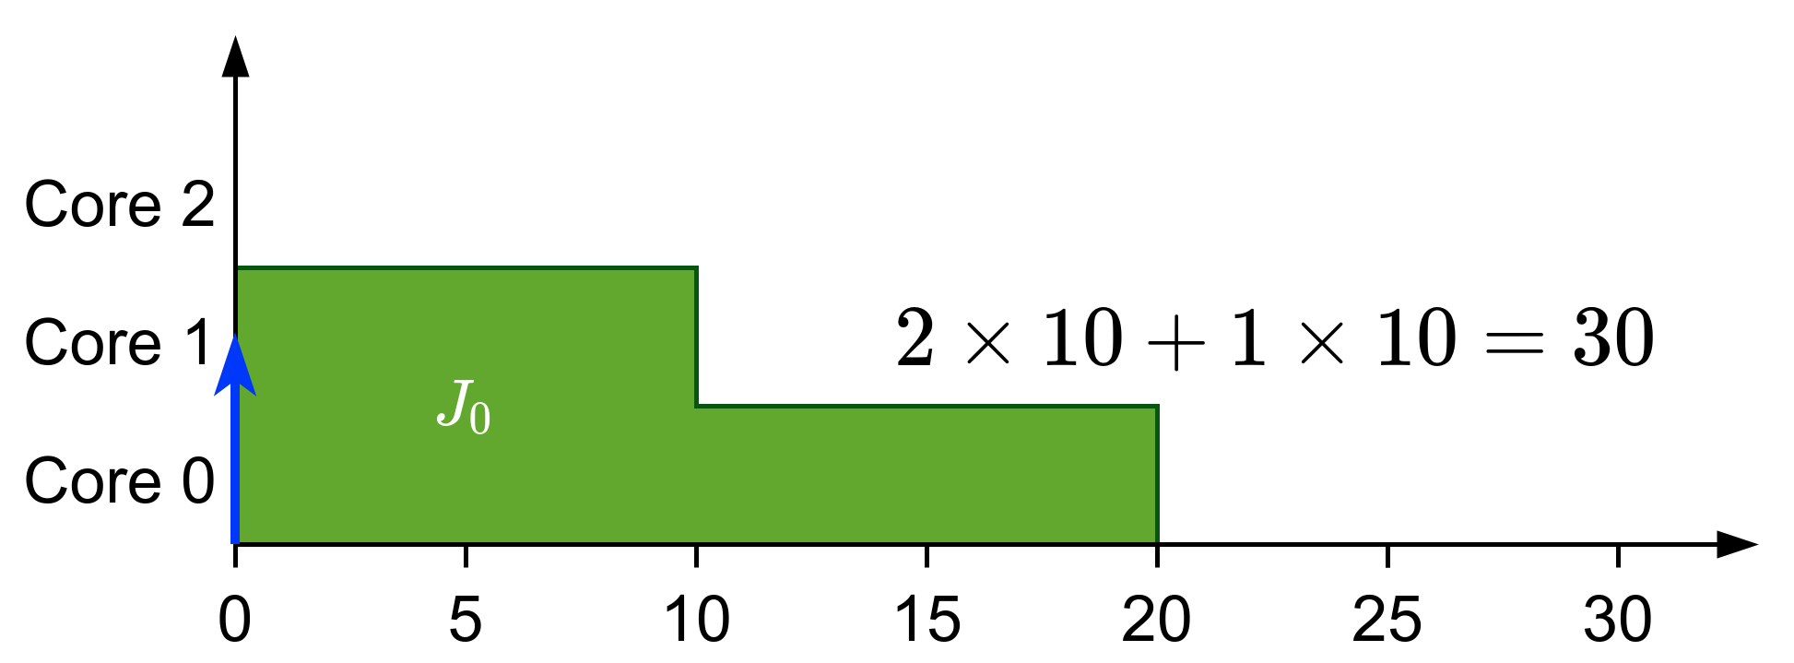
Types of gang
Rigid: number of cores set by programmer
Moldable: number of cores assigned during scheduling
Malleable: number of cores can change during runtime
Notes:
Three types:
Rigid gang: Number of cores fixed by programmer
Moldable gang: Number of cores between minimum and maximum. Scheduler chooses at scheduling time.
Malleable gang: Number of cores between minimum and maximum. Can vary during runtime

Slide 10
Previous work
Introduced in the context of high-performance computing^{[1]}
In real-time:
We know that JLFP scheduler is not predictable/sustainable^{[2]}
Most of the work is focused in fully-preemptive solutions:
Optimal scheduler for rigid gang (DP-Fair)^{[3]}
Moldable scheduler^{[4]}
Bundled scheduling^{[5]}
Tasks with precedence constraints modelled as a succession of bundles
Our limited-preemptive definition comes from here
^{[1]}Ousterhout, 1982
[3]Goossens et al., 2016
^{[4]}Wasly et al., 2017
^{[2]}Goossens et al., 2010
^{[4]}Berten et al., 2011
Notes:
Introduced in high-performance computing
Real-time:
Fixed-priority is not predictable
Fully-preemptive solutions:
Optimal scheduler for rigid gang but high number of preemptions
Moldable scheduler using moldable property to match deadlines
Bundled scheduling:
Precedence constraints modelled as a succession of bundles
LP definition comes from here

Slide 11
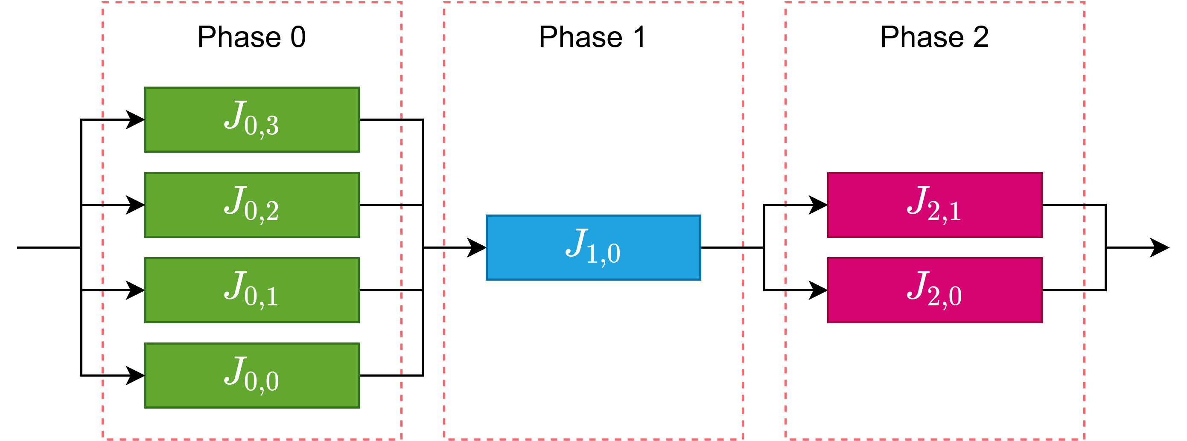
Summarizing
Notes:
Example, three bundles.

Slide 12
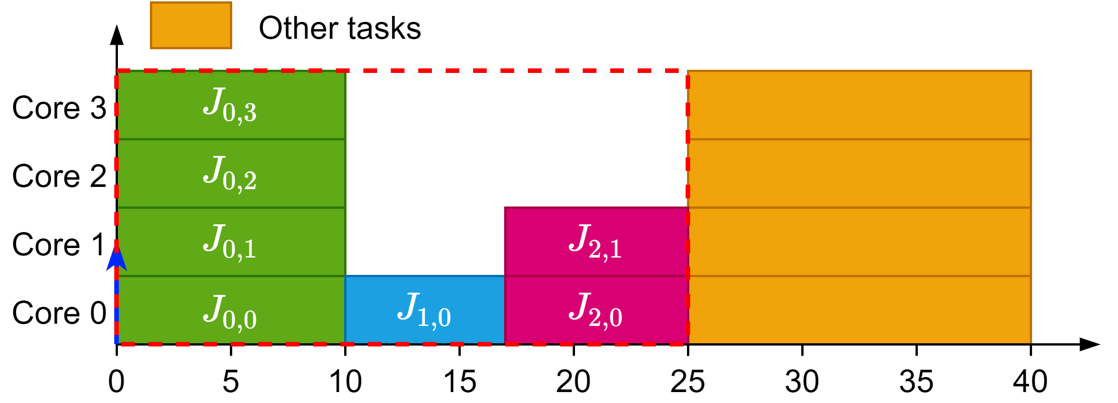
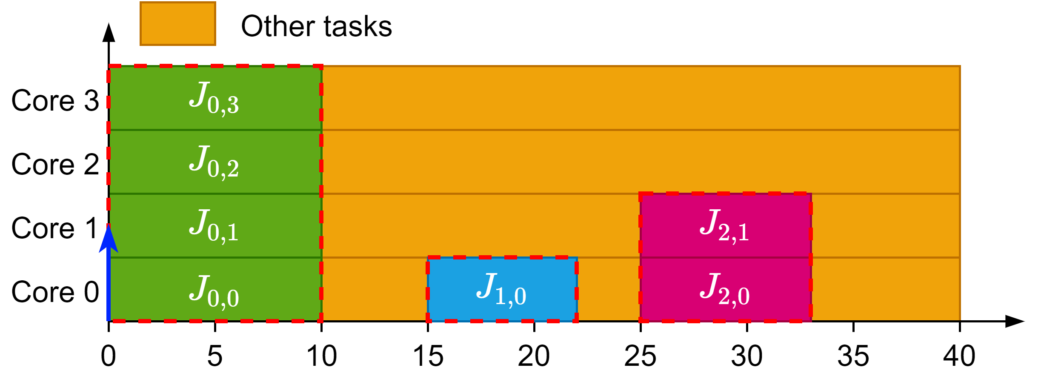
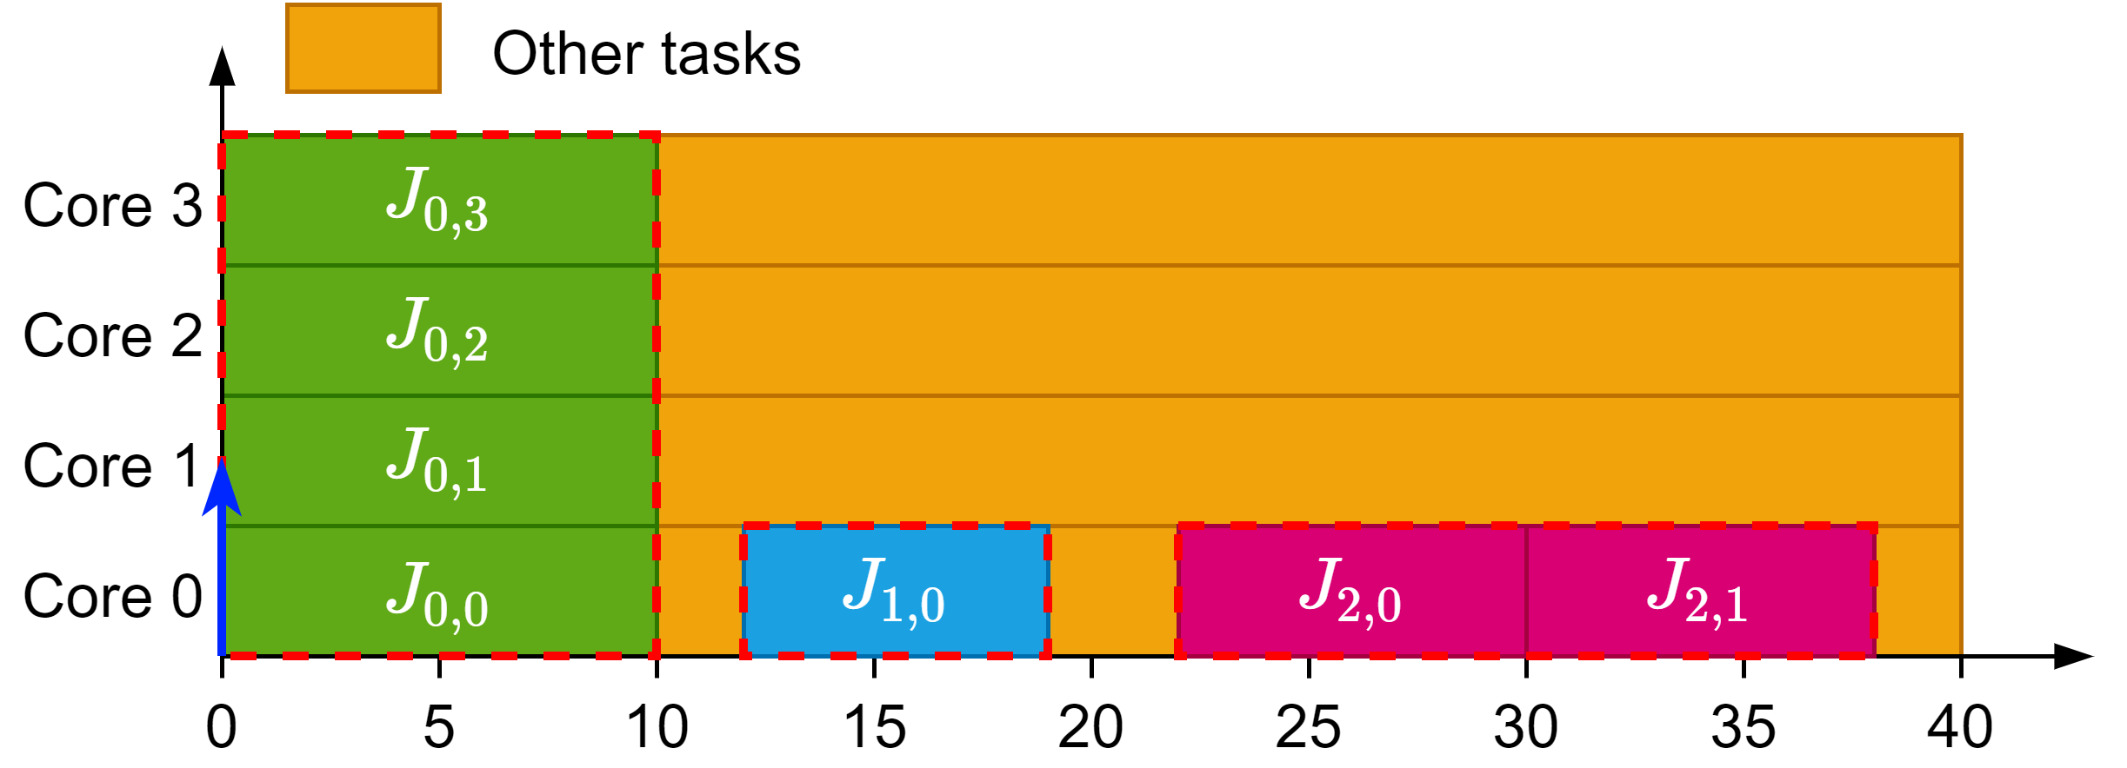
Summarizing
Rigid gang reserves the whole block
Bundled creates multiple rigid blocks with dependencies
Limited-Preemptive tries to schedule these blocks in a moldable way
Bundled model scheduling
Limited-Preemptive scheduling
Rigid gang scheduling
Notes:
Rigid gang reserves a whole block for the three bundles
Bundled scheduling creates three individual rigid bundles
Limited-Preemptive creates three individual moldable bundles

Slide 13
Our work

Slide 14
Project goals
Design an accurate schedulability analysis for limited-preemptive moldable gang tasks
Propose a new scheduling algorithm to improve the schedulability of limited-preemptive moldable gang tasks

Slide 15
Job-Level Fixed Priority Scheduler for Gang
Based on Global JLFP scheduler
Work conserving scheduler
Job with highest priority goes first
All the predecessors of a job must have finished before it can start
Assigns maximum cores available between $m_{i}^{\min{ }}$ and $m_{i}^{\max{ }}$

Slide 16
Difficulties related to SAG
We have to consider all scenarios.
The scheduler has to decide:
When to release a job
How many cores to assign to this job

Slide 17
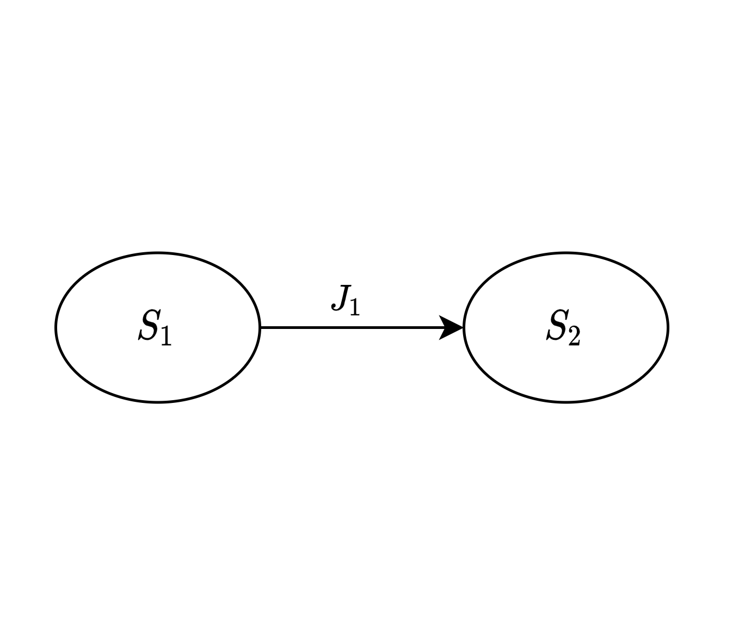
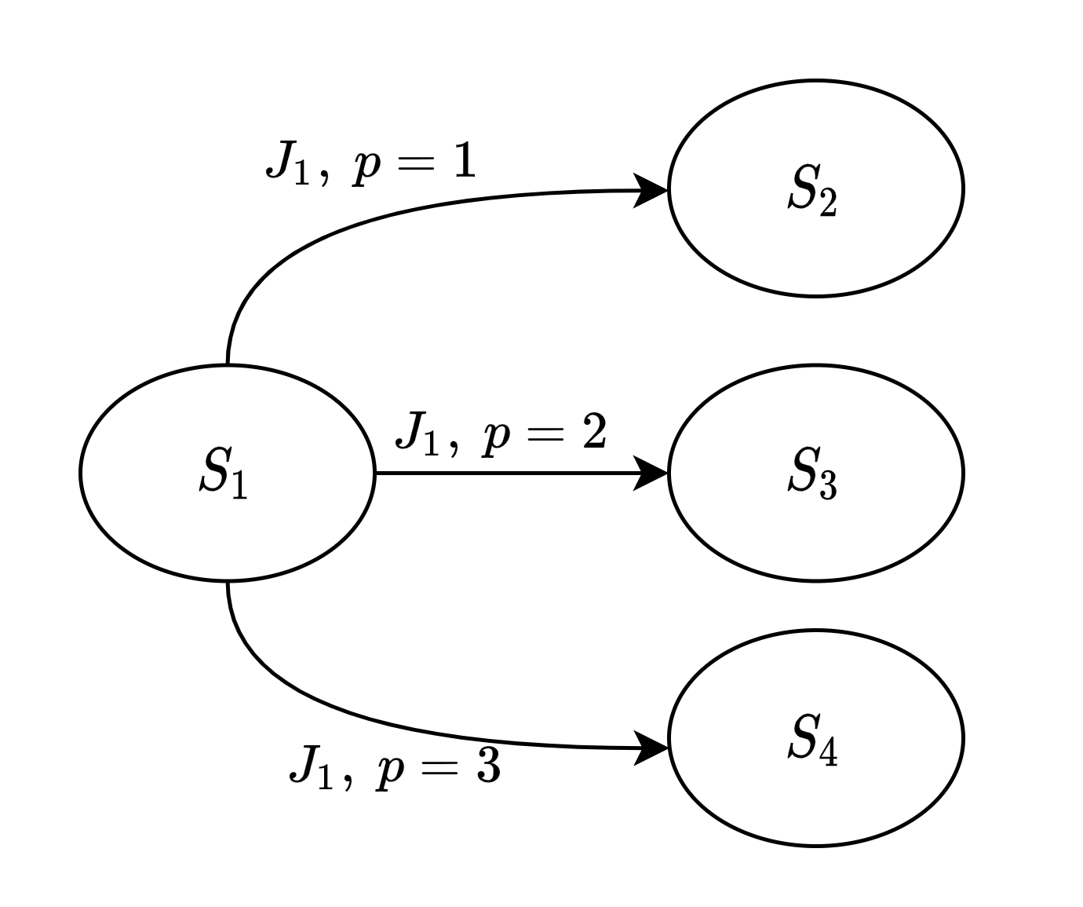
SAG analysis changes in gang
Previously a state was created for every schedulable job
Now a state is created for every job and possible number of cores

Slide 18
Temporary results

Slide 19
Pessimism identified

Slide 20
Cores released pessimism

Slide 21
Precedence constraints pessimism

Slide 22
New scheduler

Slide 23
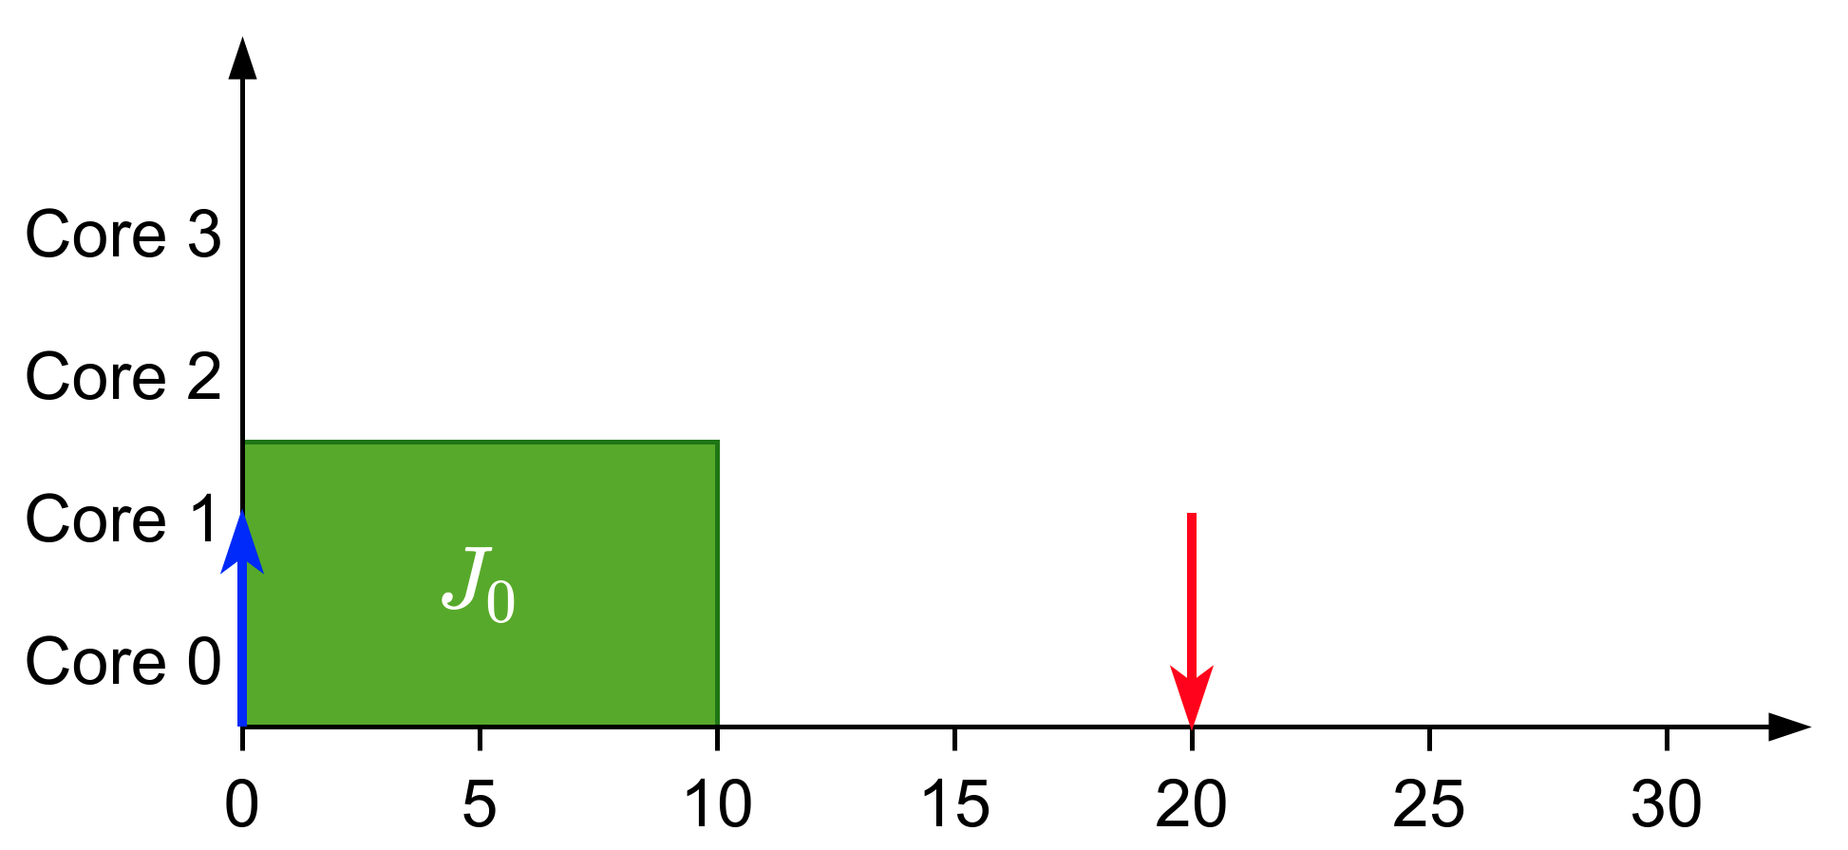
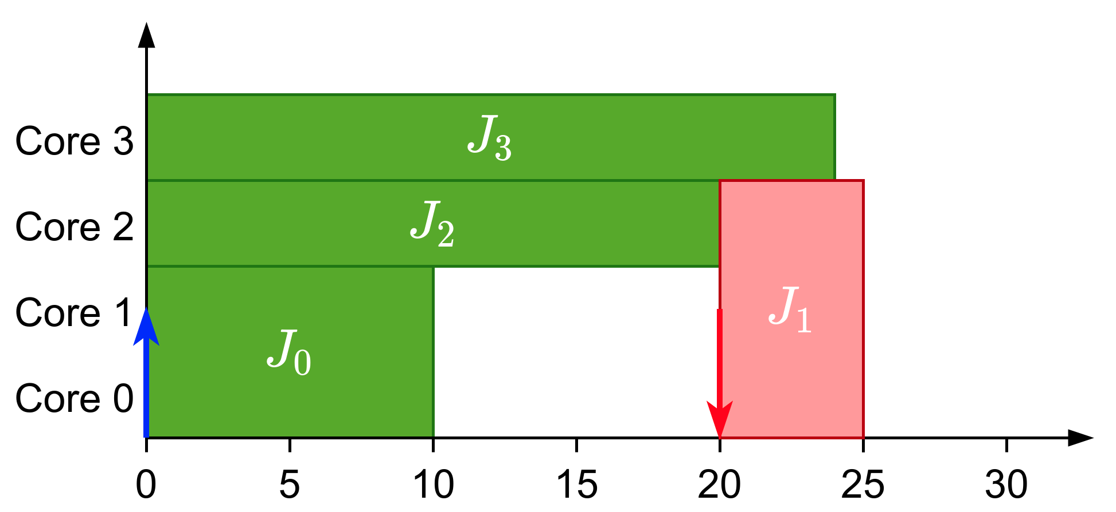
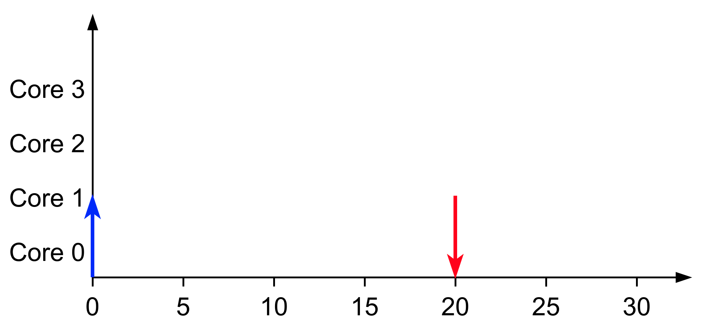
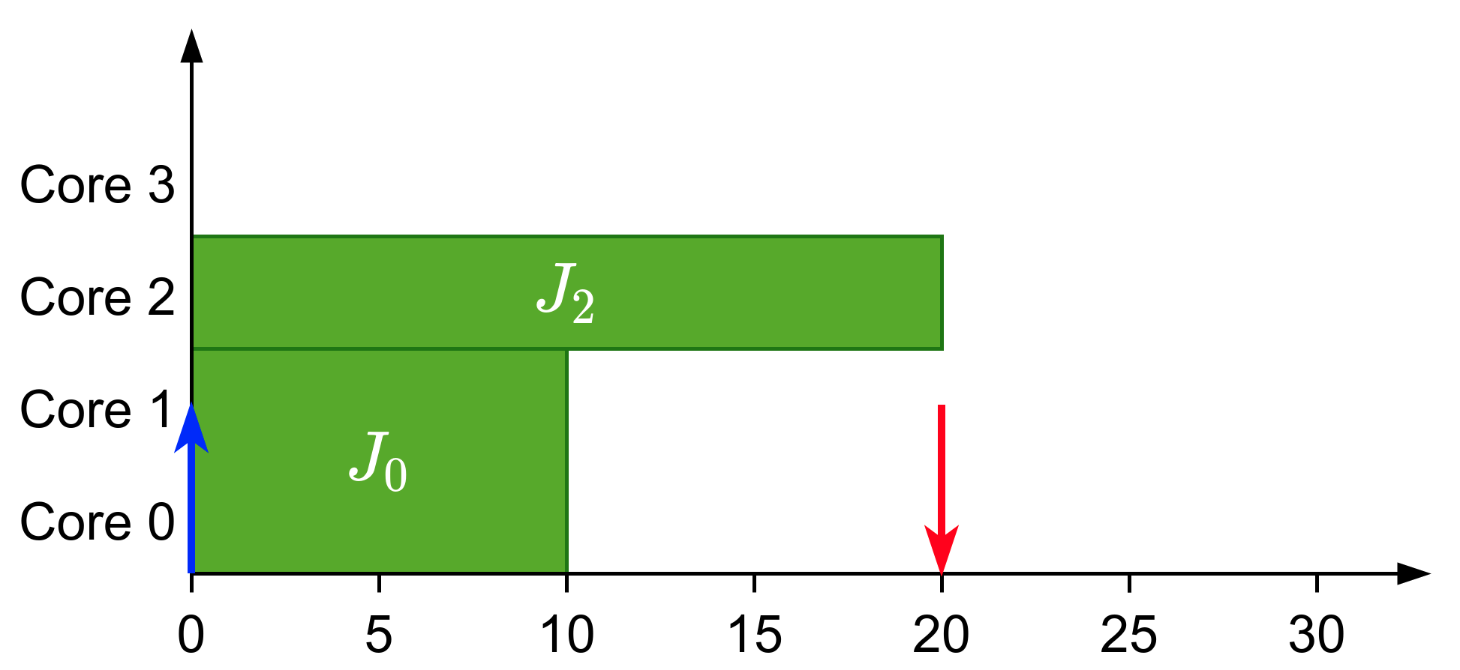
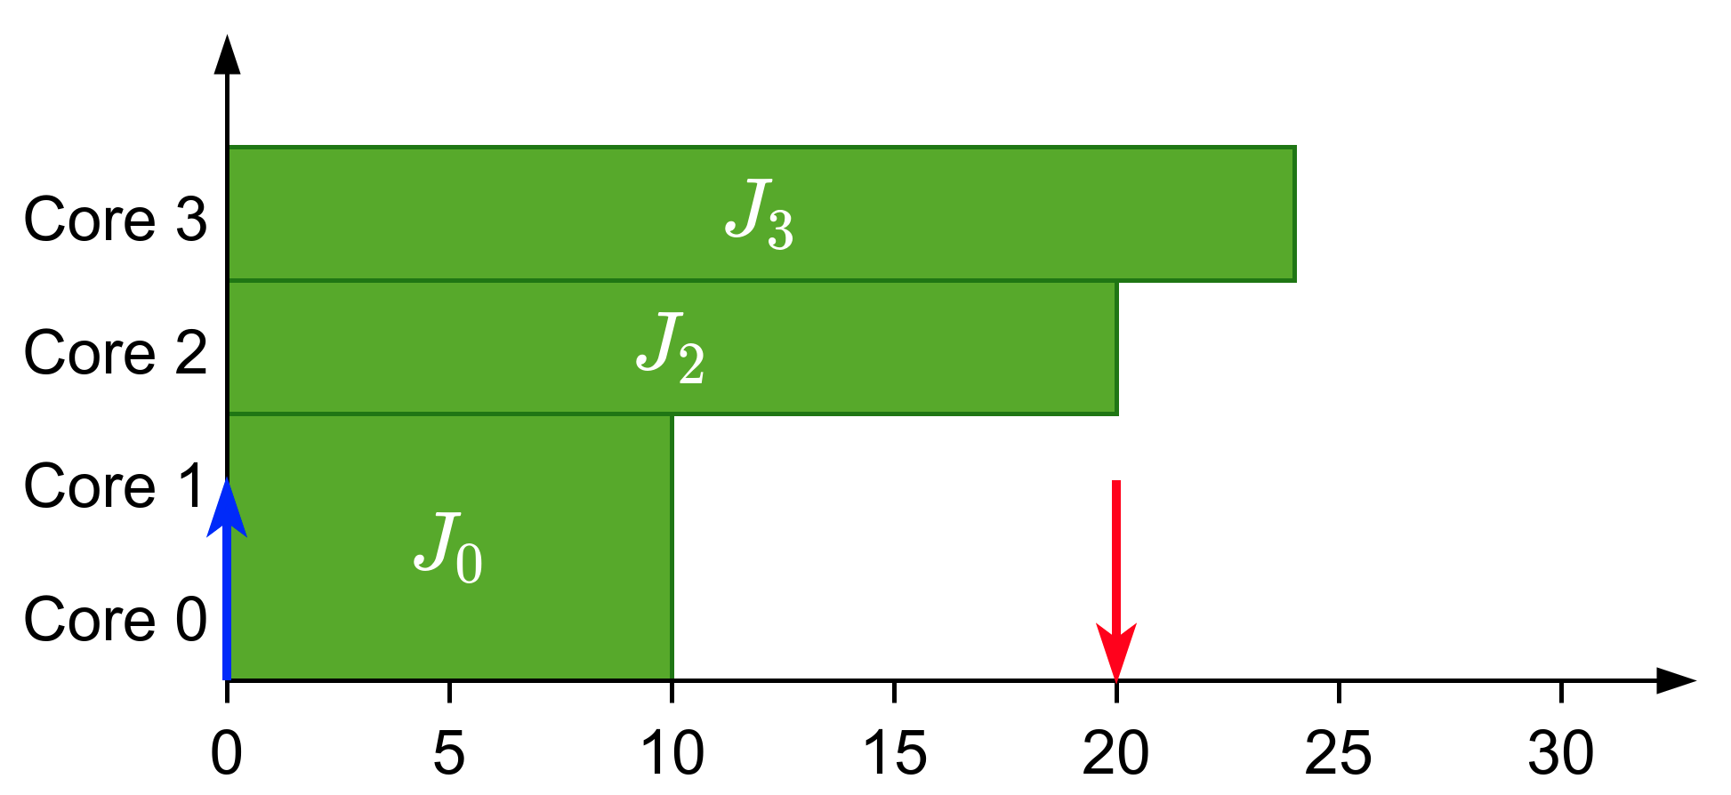
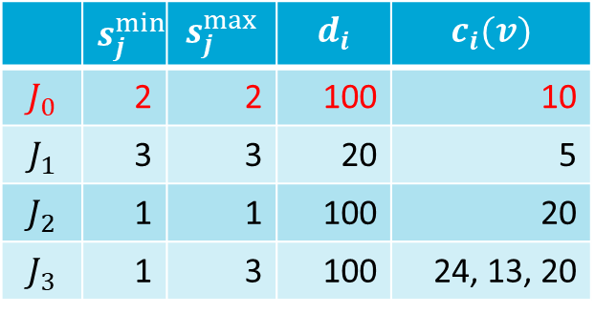
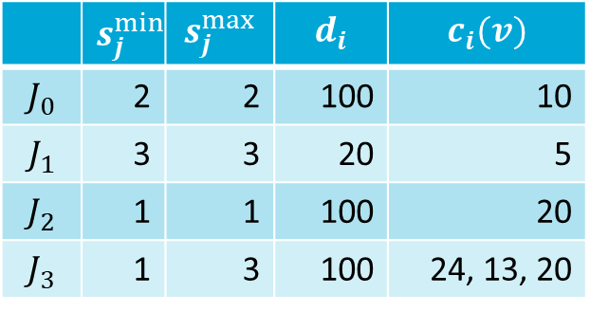

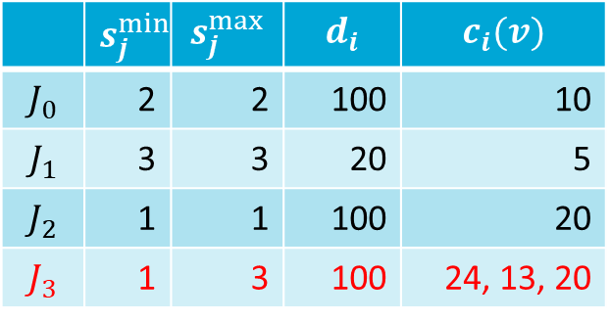

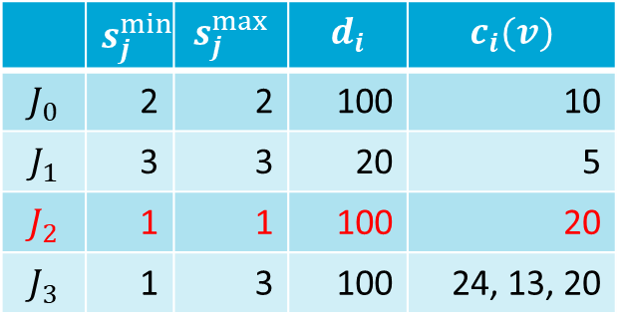


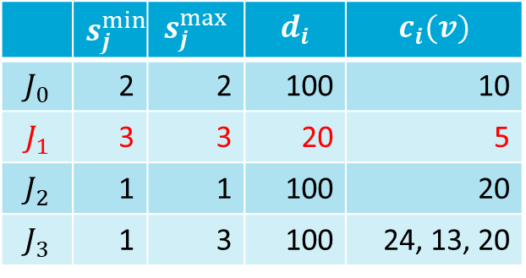
New Scheduler
Limited-Preemptive Moldable Reservation Gang Scheduler
Non-work conserving scheduler
Reserve cores of higher-priority tasks and distribute the remaining ones among lower priority tasks
JLFP scheduler
Scheduling: $J_{0}$
Scheduling: $J_{2}$
Scheduling: $J_{3}$
Scheduling: $J_{1}$
 | $$s_{j}^{min}$$ | $$s_{j}^{max}$$ | $$d_{i}$$ | $$c_{i}(v)$$
$$J_{0}$$ | 2 | 2 | 100 | 10
$$J_{1}$$ | 3 | 3 | 20 | 5
$$J_{2}$$ | 1 | 1 | 100 | 20
$$J_{3}$$ | 1 | 3 | 100 | 24, 13, 20
 | $$s_{j}^{min}$$ | $$s_{j}^{max}$$ | $$d_{i}$$ | $$c_{i}(v)$$
$$J_{0}$$ | 2 | 2 | 100 | 10
$$J_{1}$$ | 3 | 3 | 20 | 5
$$J_{2}$$ | 1 | 1 | 100 | 20
$$J_{3}$$ | 1 | 3 | 100 | 24, 13, 20
 | $$s_{j}^{min}$$ | $$s_{j}^{max}$$ | $$d_{i}$$ | $$c_{i}(v)$$
$$J_{0}$$ | 2 | 2 | 100 | 10
$$J_{1}$$ | 3 | 3 | 20 | 5
$$J_{2}$$ | 1 | 1 | 100 | 20
$$J_{3}$$ | 1 | 3 | 100 | 24, 13, 20
 | $$s_{j}^{min}$$ | $$s_{j}^{max}$$ | $$d_{i}$$ | $$c_{i}(v)$$
$$J_{0}$$ | 2 | 2 | 100 | 10
$$J_{1}$$ | 3 | 3 | 20 | 5
$$J_{2}$$ | 1 | 1 | 100 | 20
$$J_{3}$$ | 1 | 3 | 100 | 24, 13, 20
 | $$s_{j}^{min}$$ | $$s_{j}^{max}$$ | $$d_{i}$$ | $$c_{i}(v)$$
$$J_{0}$$ | 2 | 2 | 100 | 10
$$J_{1}$$ | 3 | 3 | 20 | 5
$$J_{2}$$ | 1 | 1 | 100 | 20
$$J_{3}$$ | 1 | 3 | 100 | 24, 13, 20

Slide 24

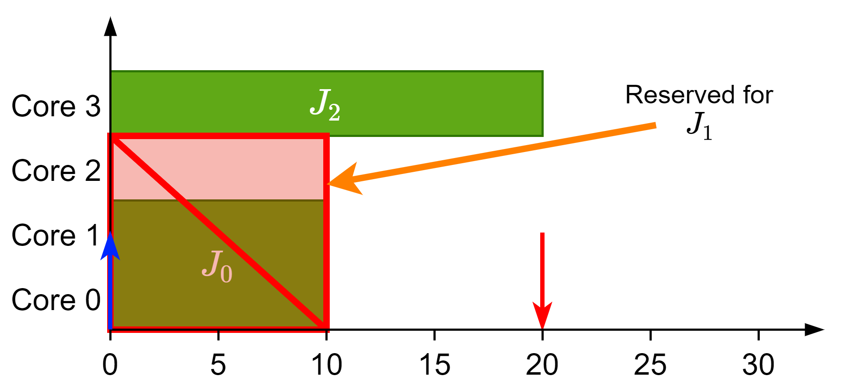
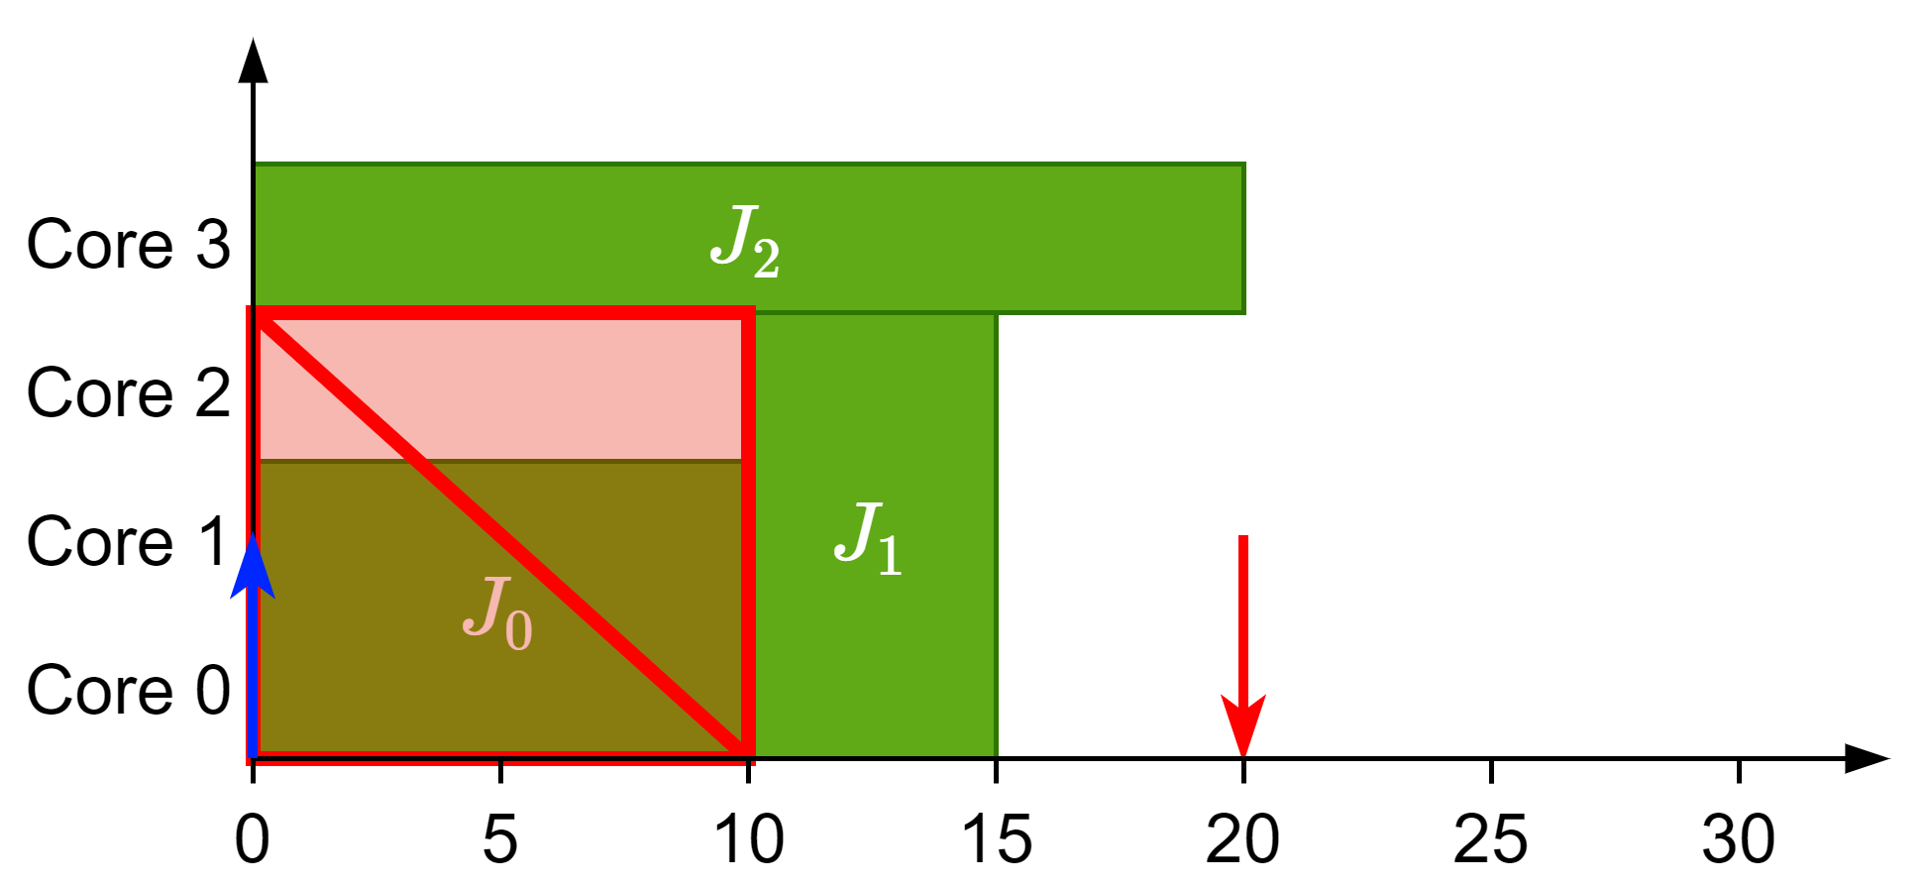






New Scheduler
Limited-Preemptive Moldable Reservation Gang Scheduler
Non-work conserving scheduler
Reserve cores of higher-priority tasks and distribute the remaining ones among lower priority tasks
LPMRGS scheduler
Scheduling: $J_{0}$
Scheduling: $J_{2}$
Scheduling: $J_{3}$
Scheduling: $J_{1}$
 | $$s_{j}^{min}$$ | $$s_{j}^{max}$$ | $$d_{i}$$ | $$c_{i}(v)$$
$$J_{0}$$ | 2 | 2 | 100 | 10
$$J_{1}$$ | 3 | 3 | 20 | 5
$$J_{2}$$ | 1 | 1 | 100 | 20
$$J_{3}$$ | 1 | 3 | 100 | 24, 13, 20
 | $$s_{j}^{min}$$ | $$s_{j}^{max}$$ | $$d_{i}$$ | $$c_{i}(v)$$
$$J_{0}$$ | 2 | 2 | 100 | 10
$$J_{1}$$ | 3 | 3 | 20 | 5
$$J_{2}$$ | 1 | 1 | 100 | 20
$$J_{3}$$ | 1 | 3 | 100 | 24, 13, 20
 | $$s_{j}^{min}$$ | $$s_{j}^{max}$$ | $$d_{i}$$ | $$c_{i}(v)$$
$$J_{0}$$ | 2 | 2 | 100 | 10
$$J_{1}$$ | 3 | 3 | 20 | 5
$$J_{2}$$ | 1 | 1 | 100 | 20
$$J_{3}$$ | 1 | 3 | 100 | 24, 13, 20
 | $$s_{j}^{min}$$ | $$s_{j}^{max}$$ | $$d_{i}$$ | $$c_{i}(v)$$
$$J_{0}$$ | 2 | 2 | 100 | 10
$$J_{1}$$ | 3 | 3 | 20 | 5
$$J_{2}$$ | 1 | 1 | 100 | 20
$$J_{3}$$ | 1 | 3 | 100 | 24, 13, 20
 | $$s_{j}^{min}$$ | $$s_{j}^{max}$$ | $$d_{i}$$ | $$c_{i}(v)$$
$$J_{0}$$ | 2 | 2 | 100 | 10
$$J_{1}$$ | 3 | 3 | 20 | 5
$$J_{2}$$ | 1 | 1 | 100 | 20
$$J_{3}$$ | 1 | 3 | 100 | 24, 13, 20

Slide 25
Conclusions
Gang scheduling is an interesting problem with a lot that can be done
A faster and more accurate analysis can be defined with SAG
Its moldable properties can be used with the proper scheduler
Questions?

