Slide 1



Scheduling and Analysis of Limited-Preemptive Moldable Gang Tasks Weekly Meeting
Joan Marcè i Igual
Geoffrey Nelissen
Mitra Nasri
Paris Panagiotou
1st of March, 2020

Slide 2
What has been done?
Work on results
Bugs found:
Priorities were not assigned properly
After solving JLFP was performing better than LPMGRS
Priorities were not used properly by LPMGRS
After solving LPMGRS performs better than JLFP
Core reservation by LPMGRS was not done properly in some cases where the cores were already busy
The reservation algorithm was changed slightly
Notes:
First of all, let’s explain what gang scheduling is.
<click>
Let’s say that we have multiple threads that we want to schedule. If we want to convert them to a gang task we would put them together as a “gang” <click> and then we would schedule as a single task<click> so the execution would not start until there are enough free cores.

Slide 3
Algorithm change

Slide 4
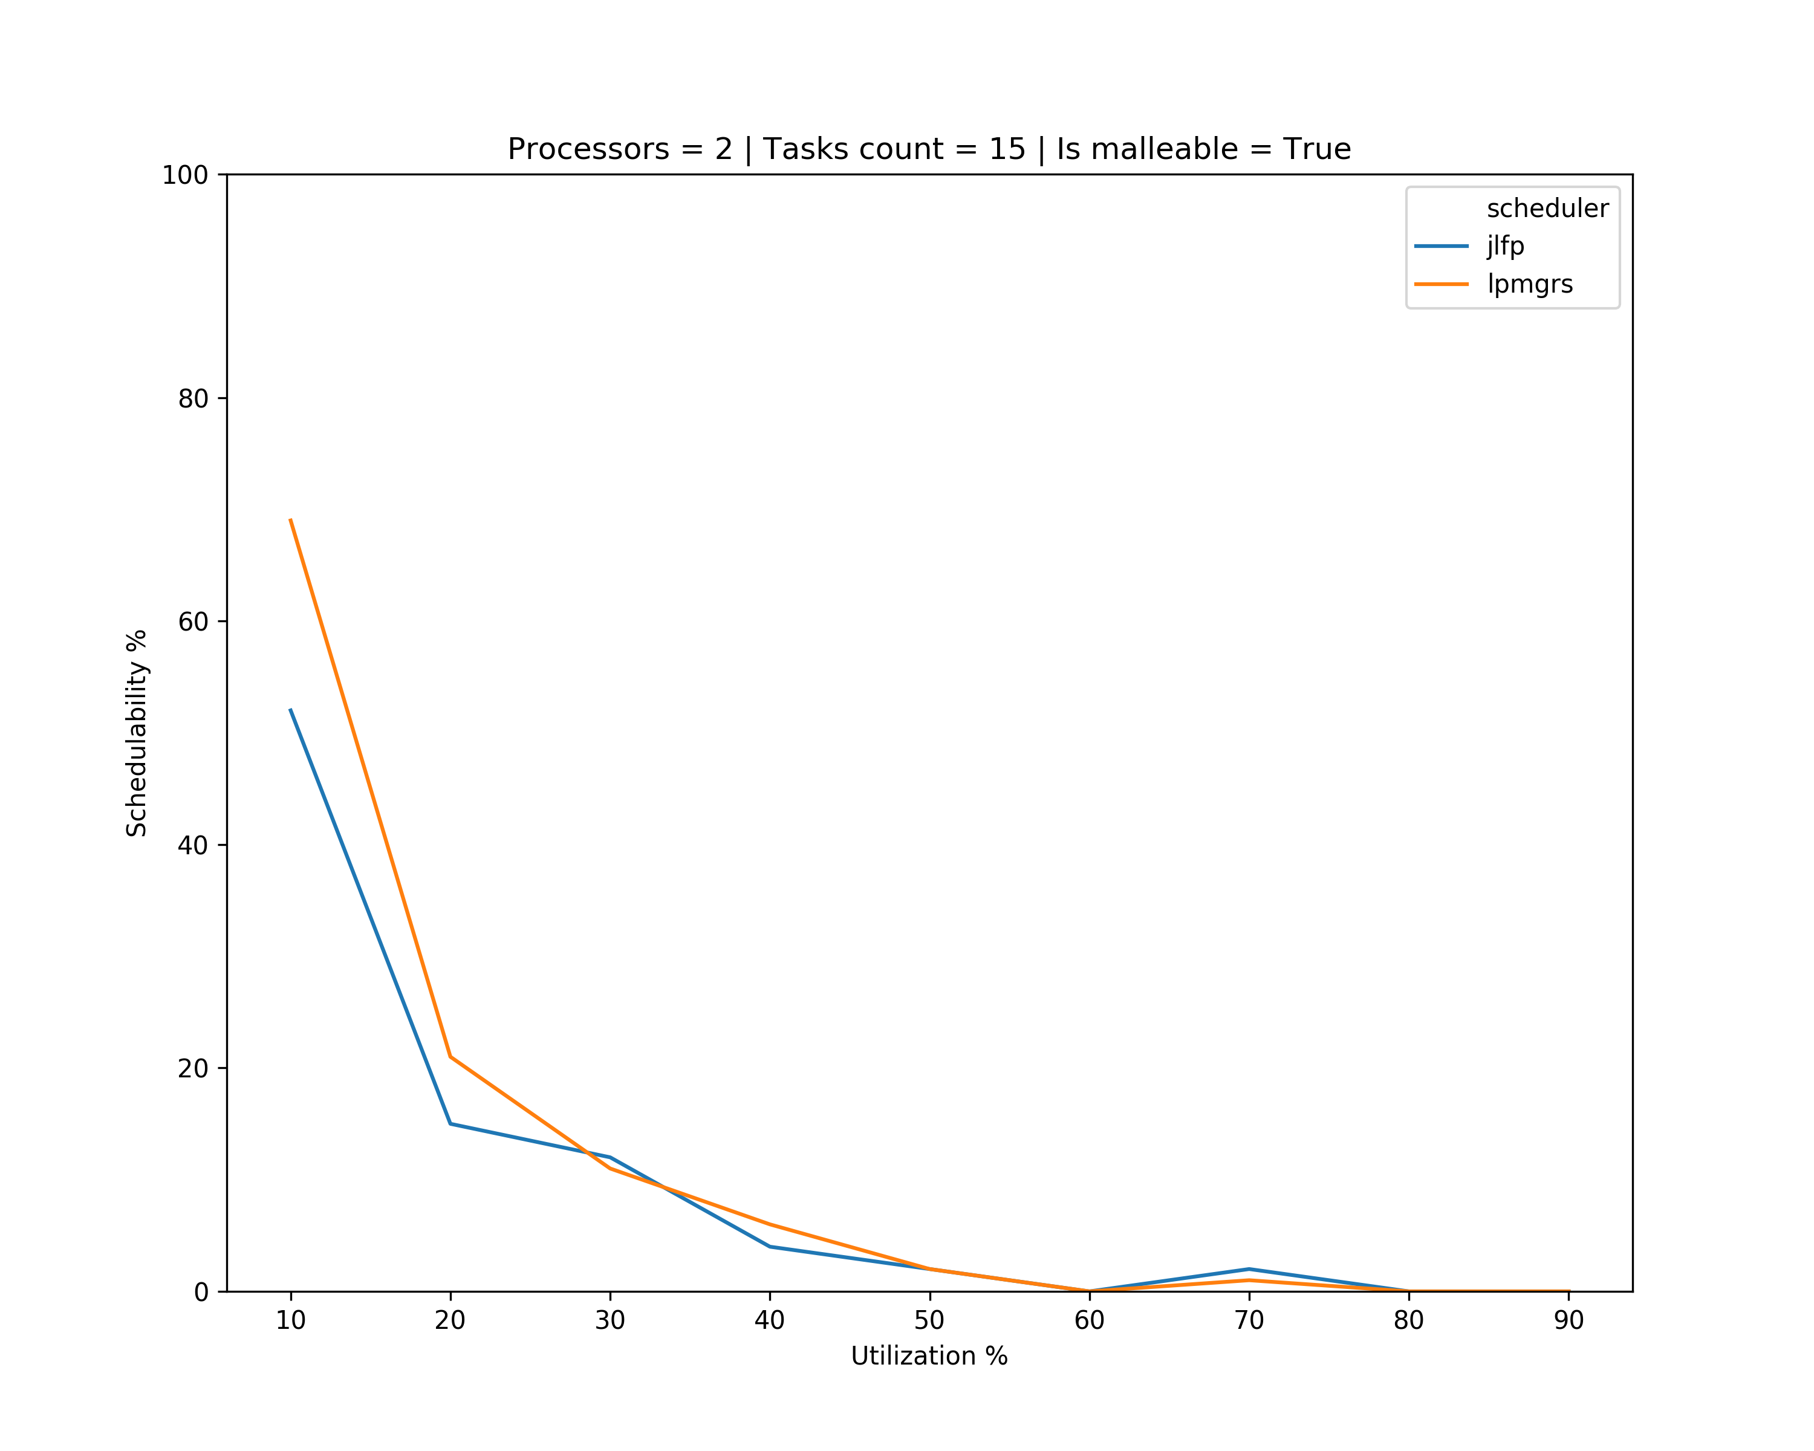
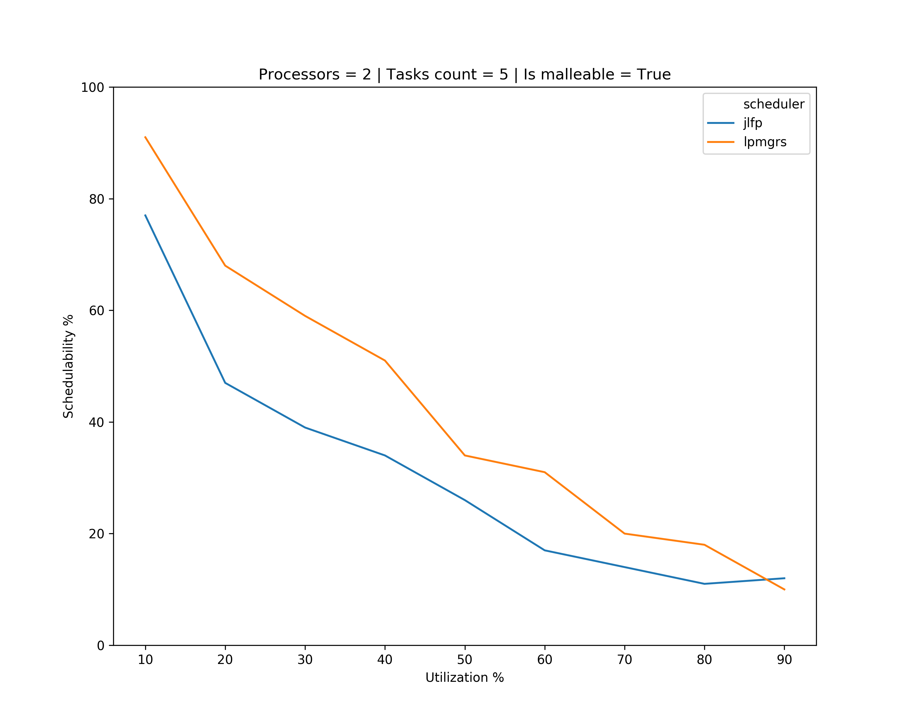
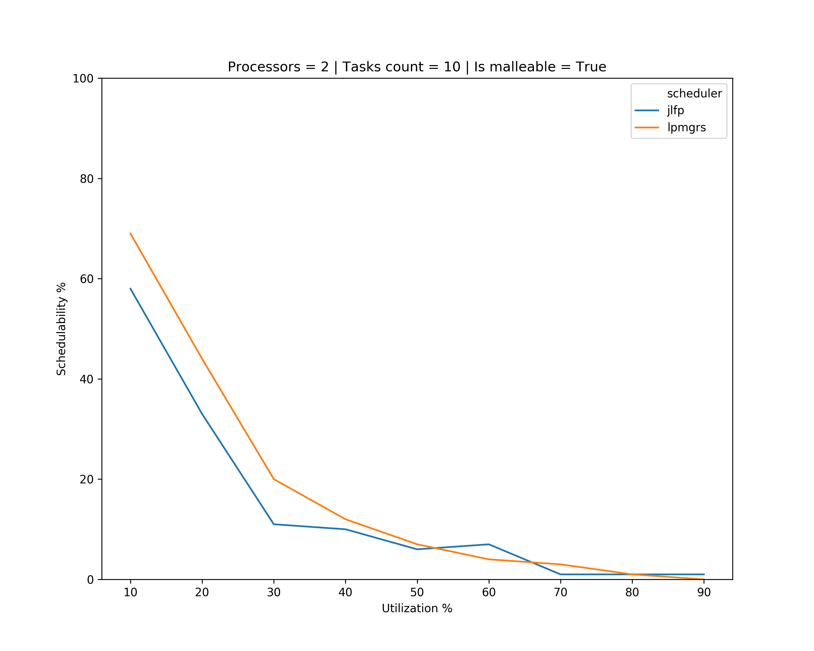
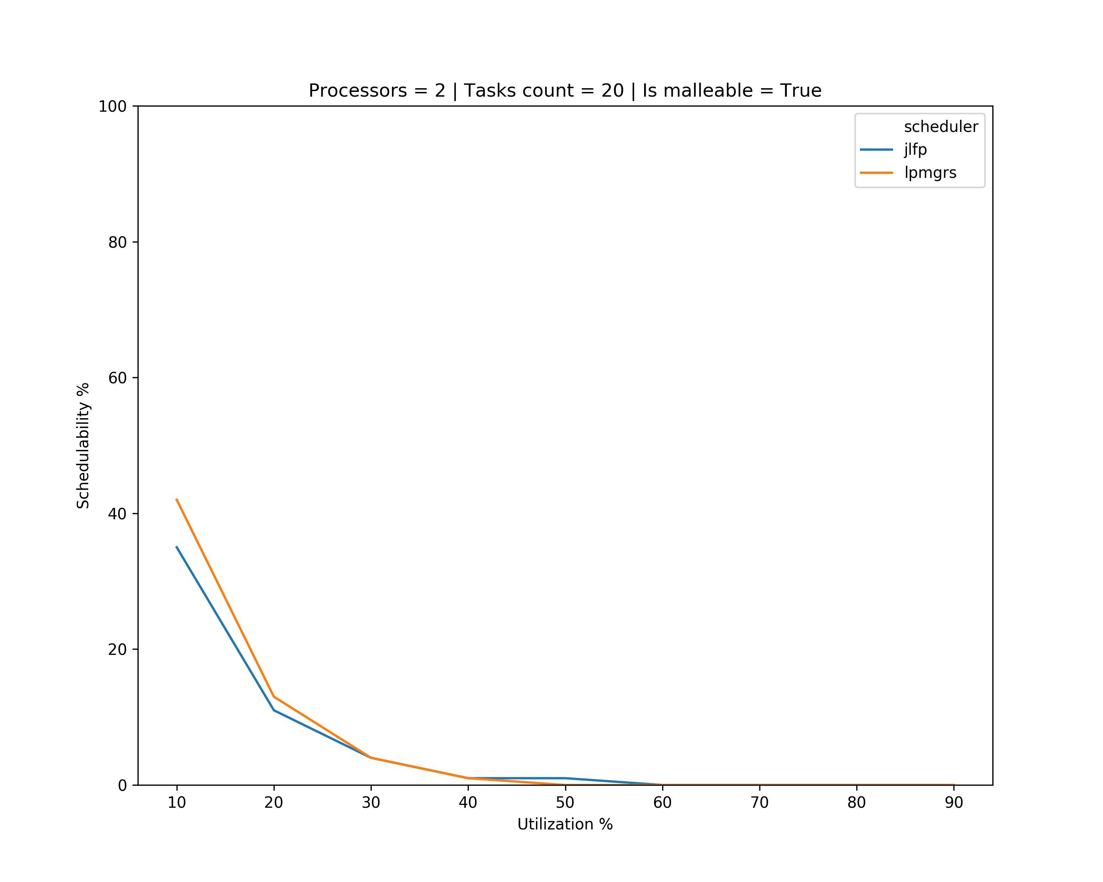
Results

Slide 5
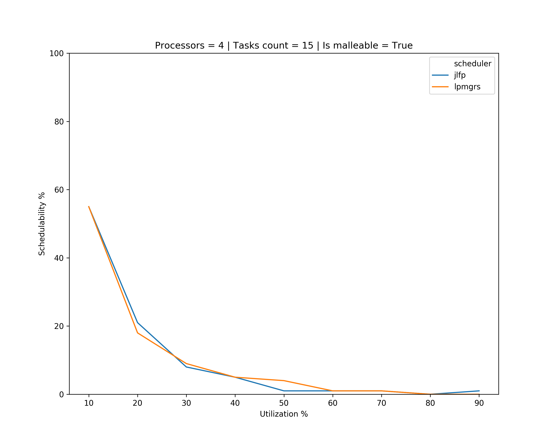
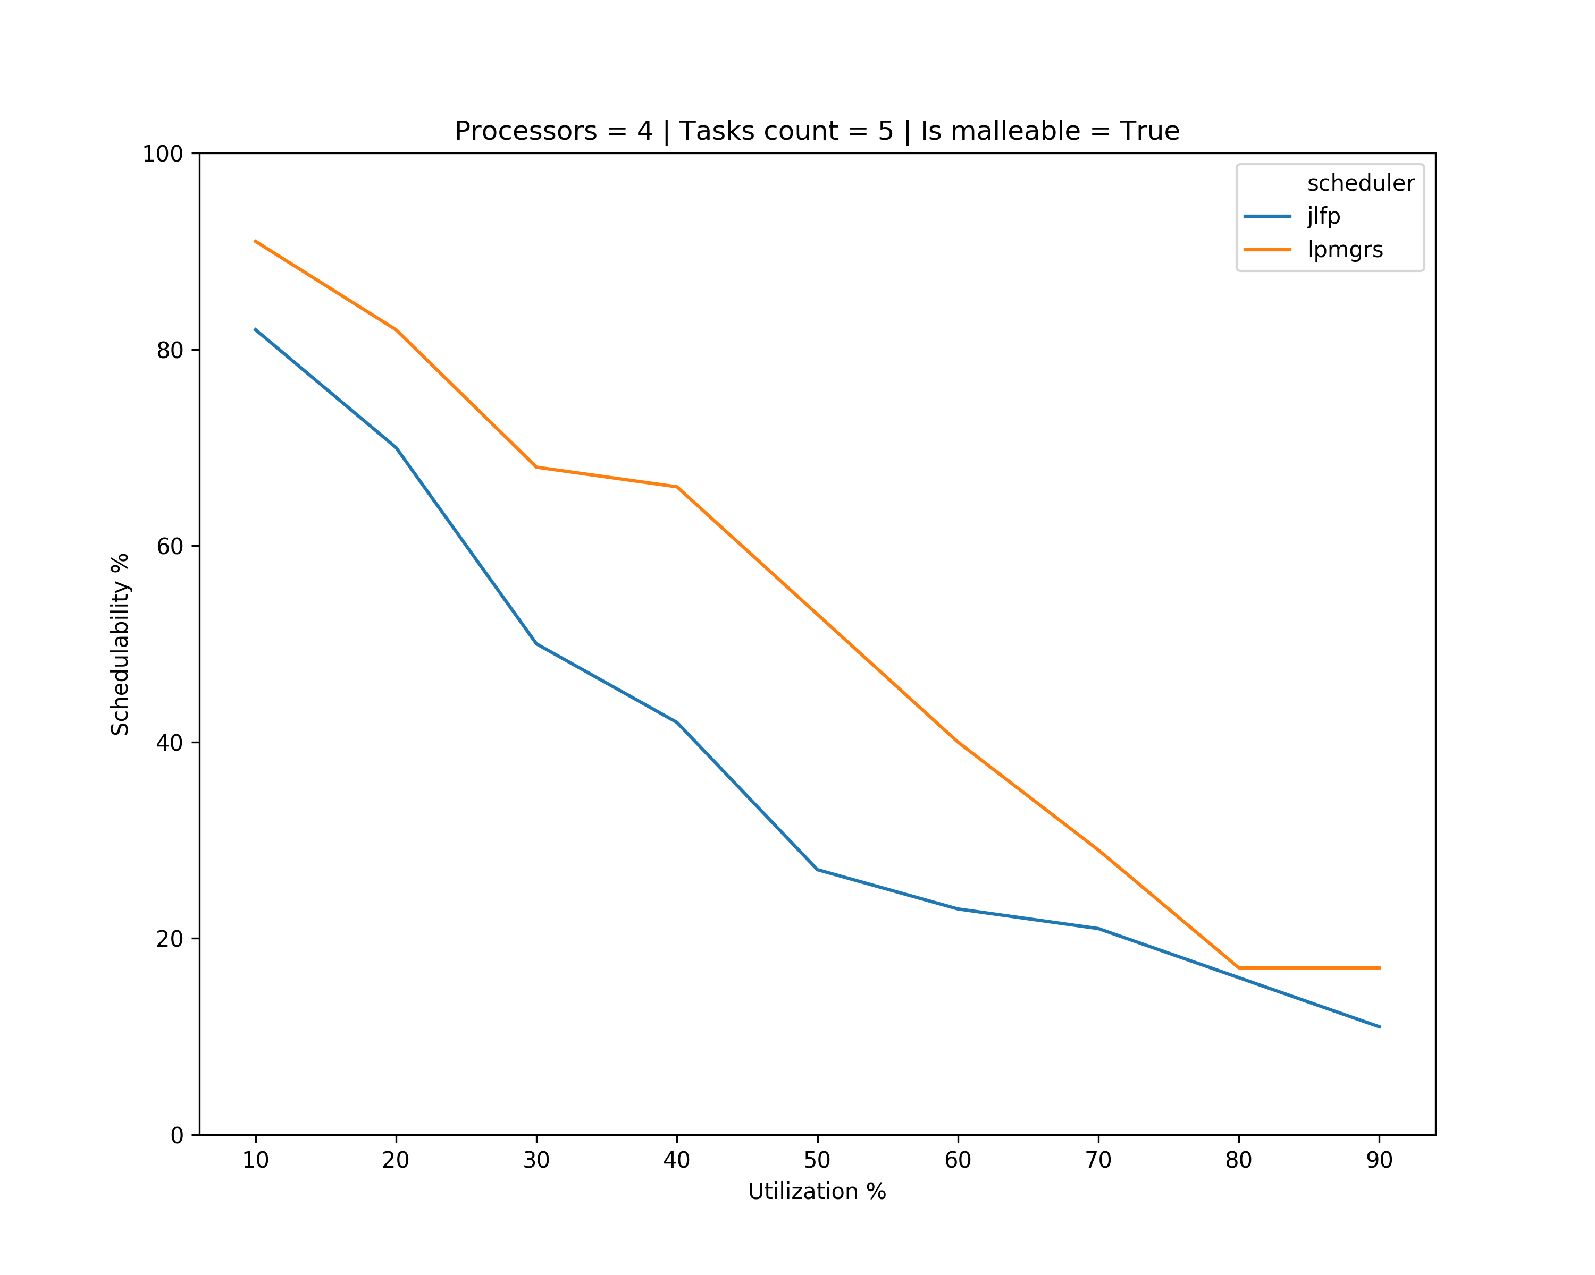
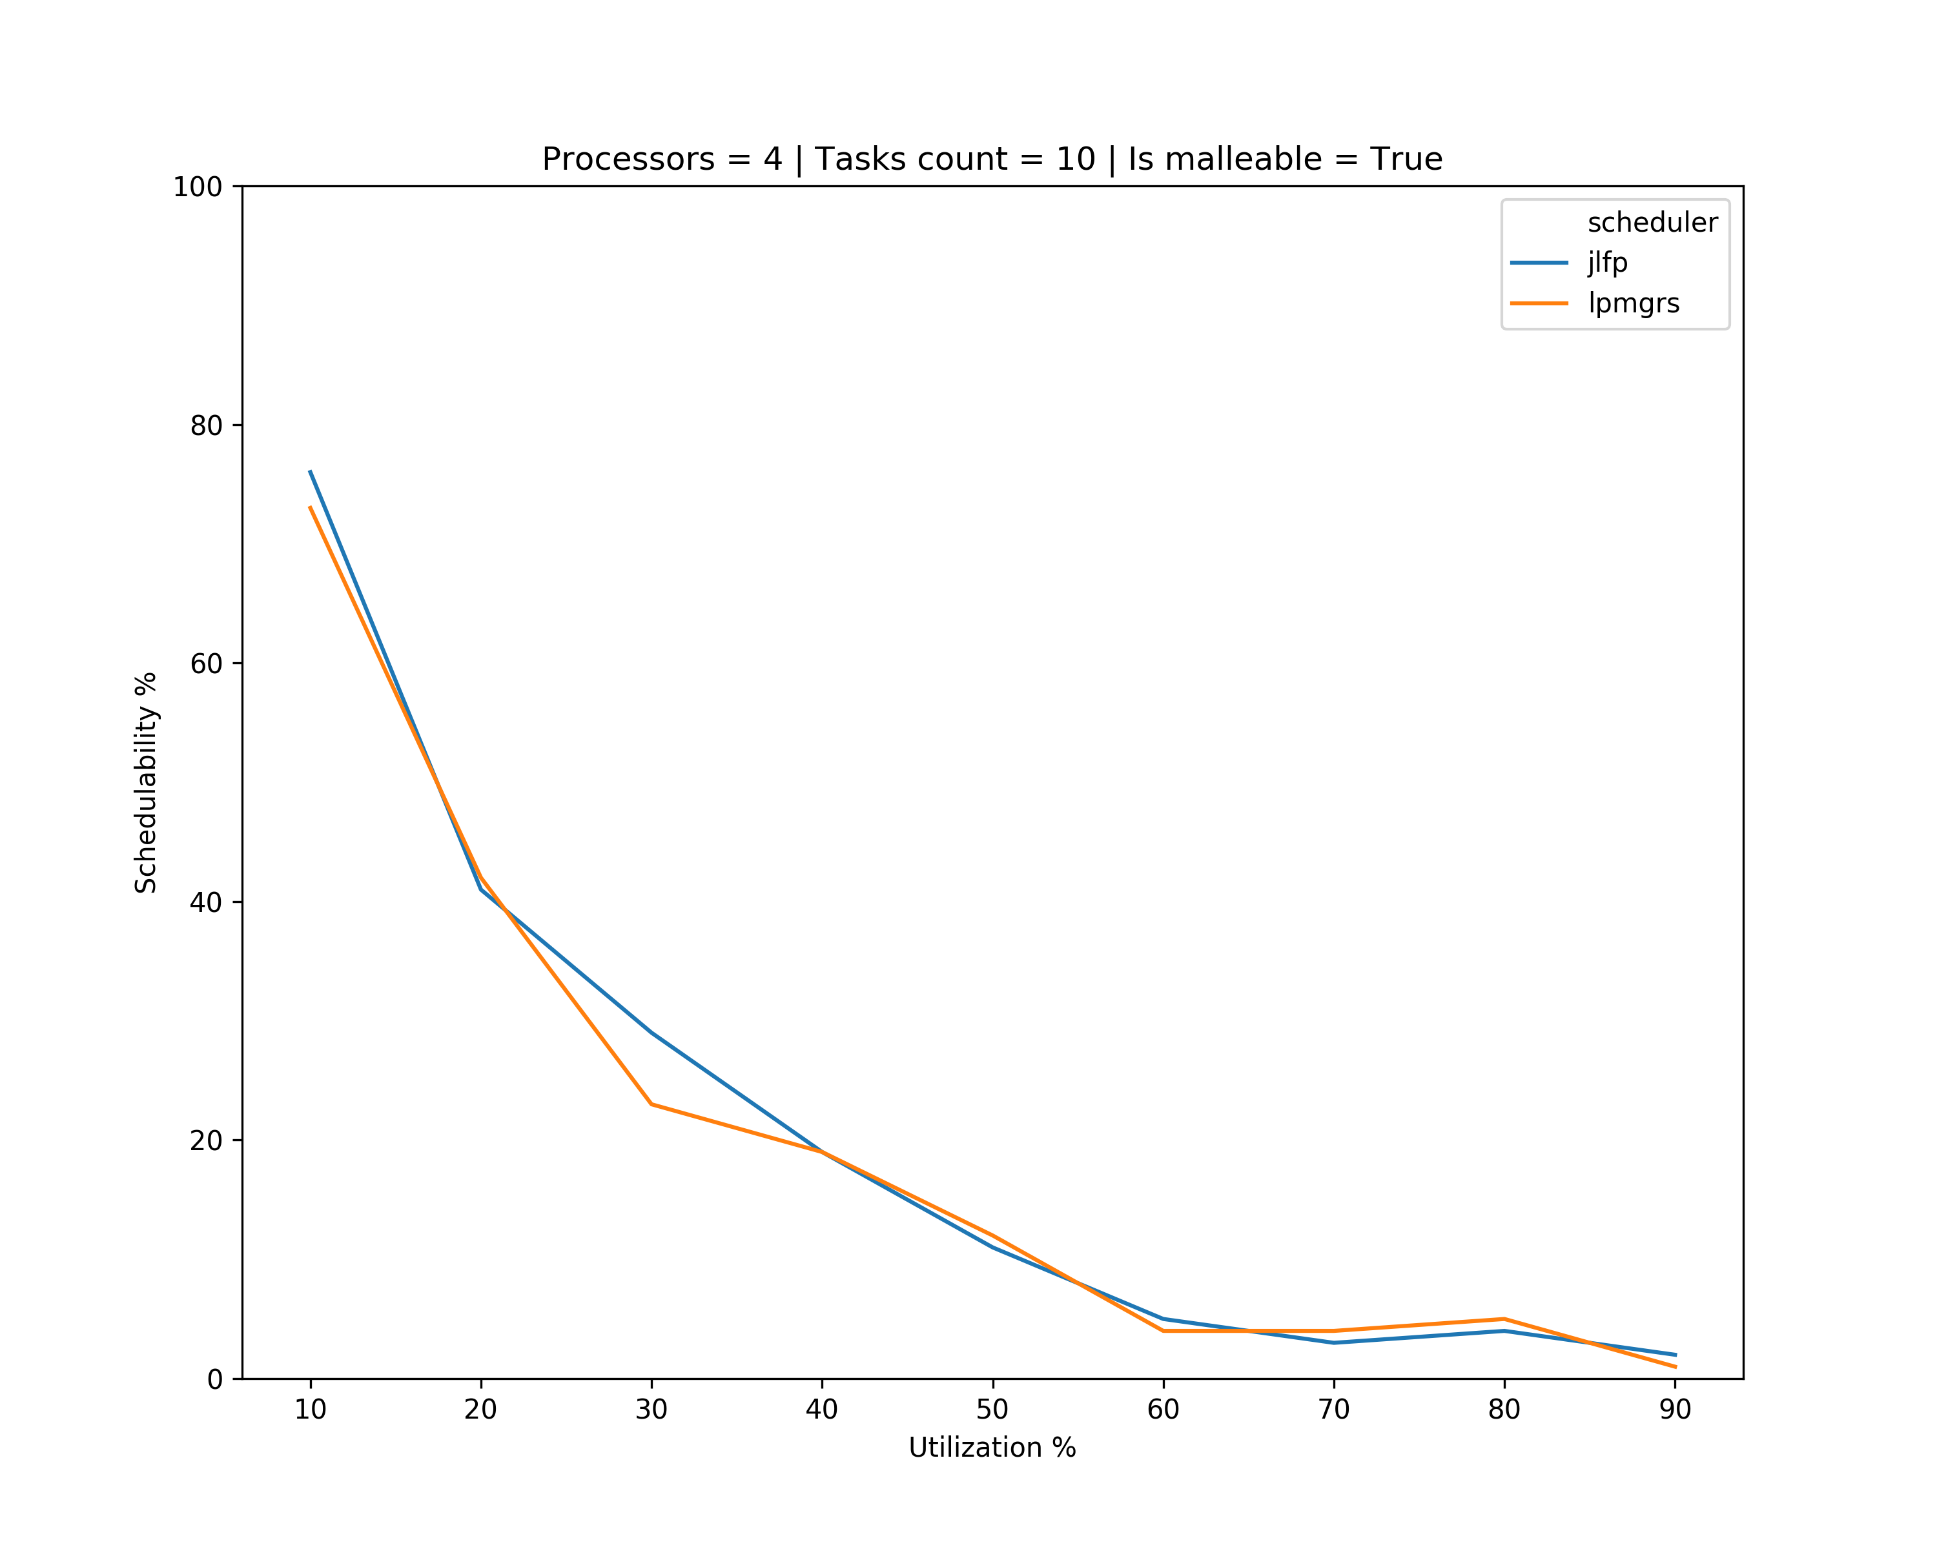
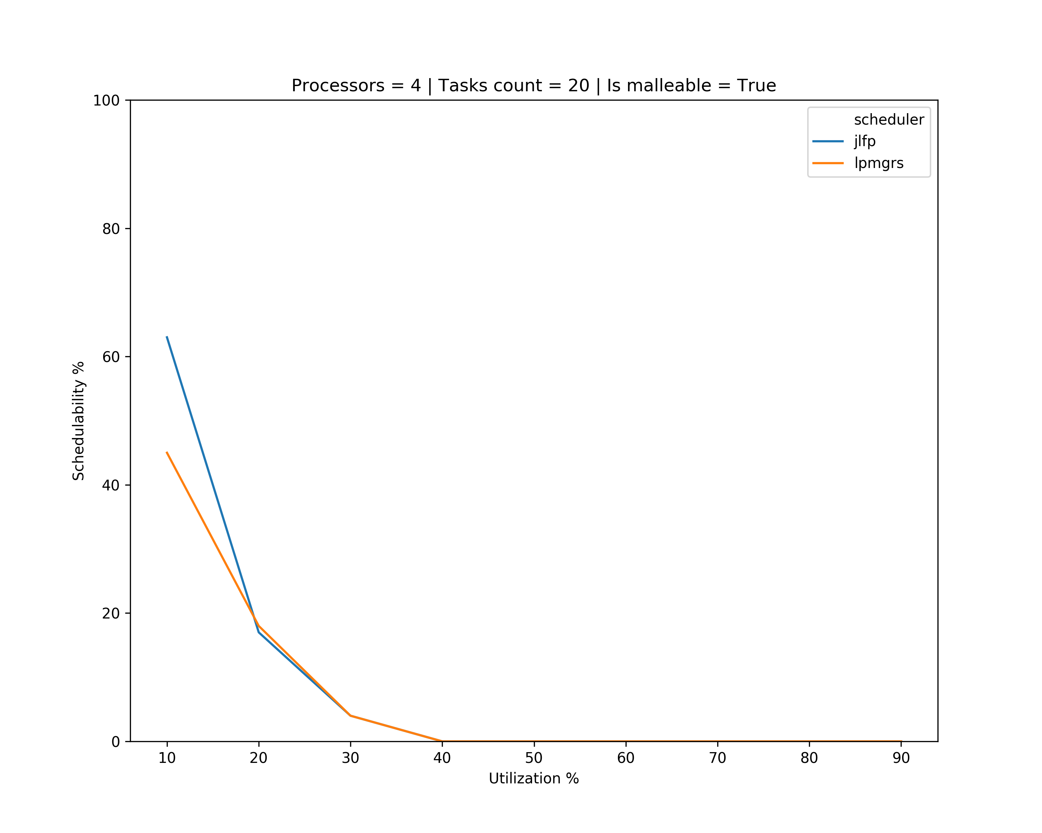
Results

Slide 6
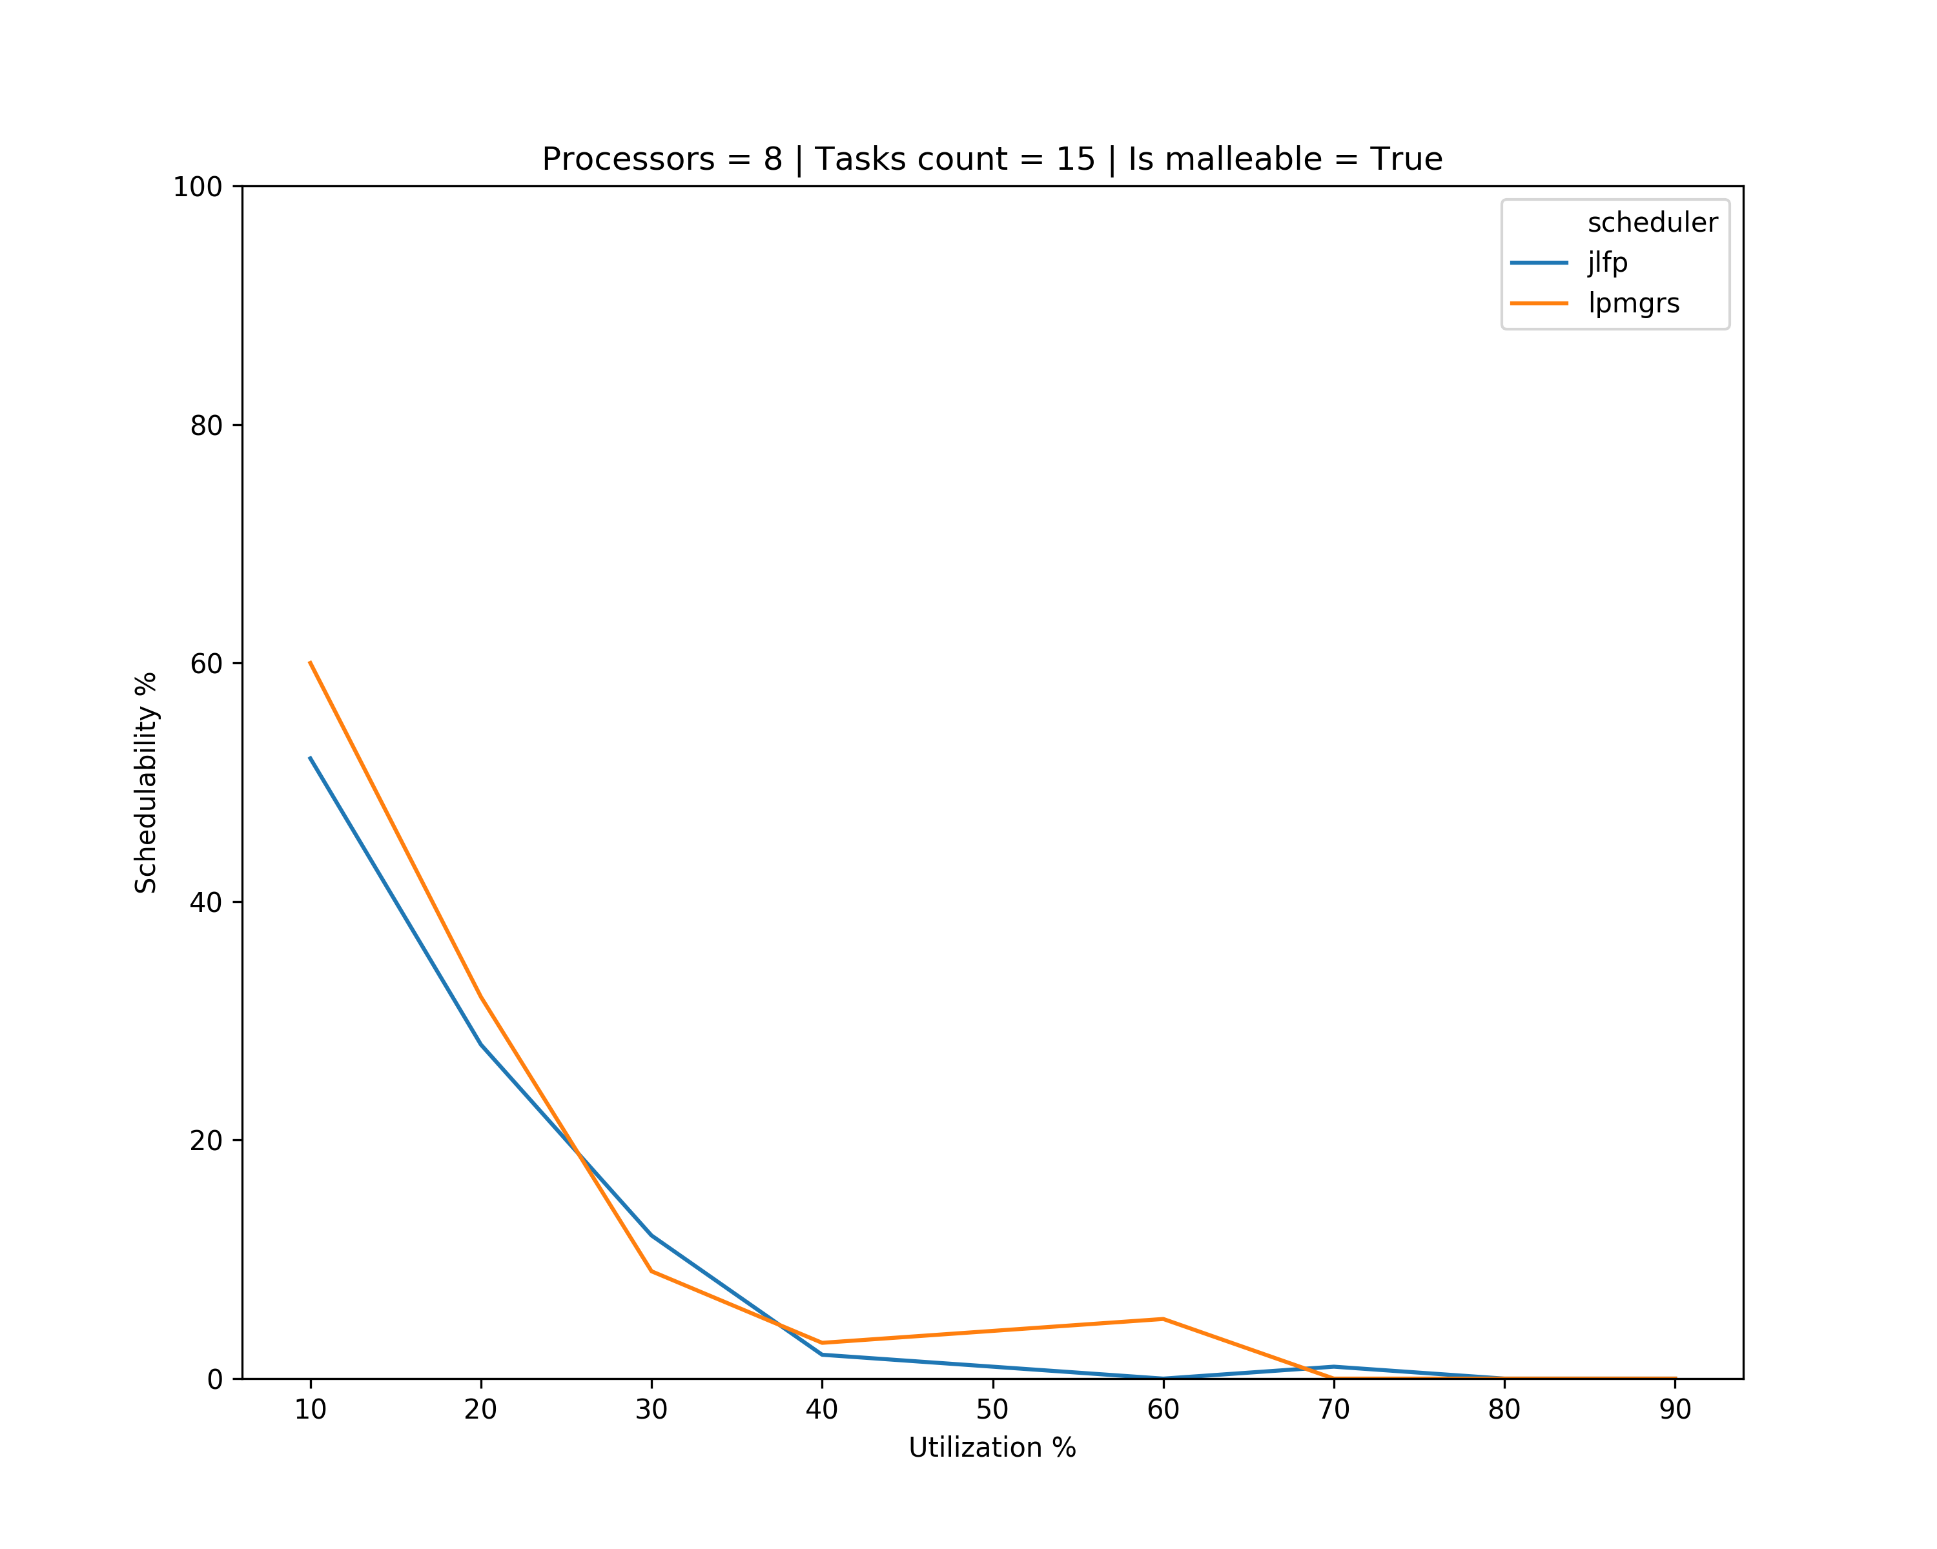
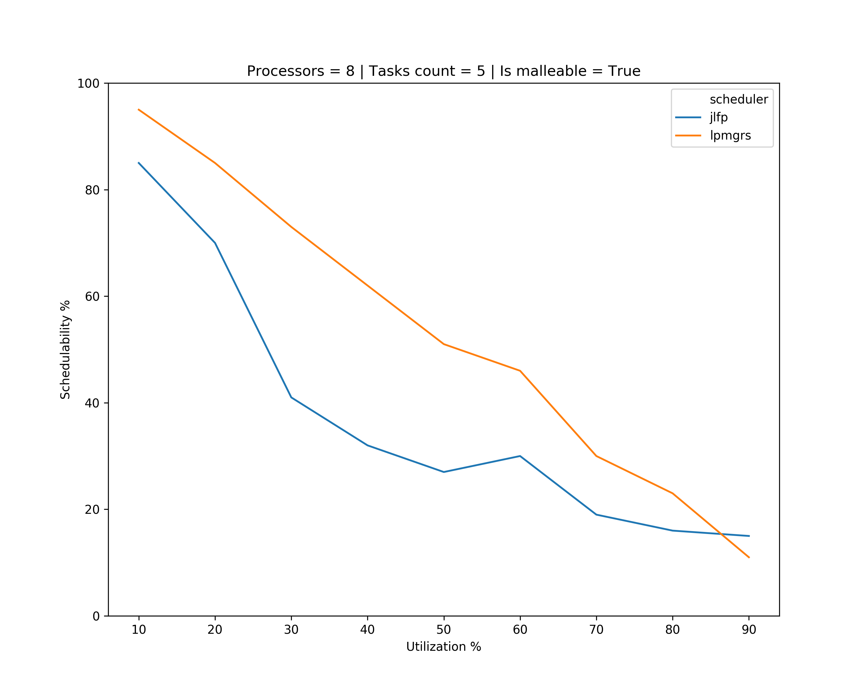
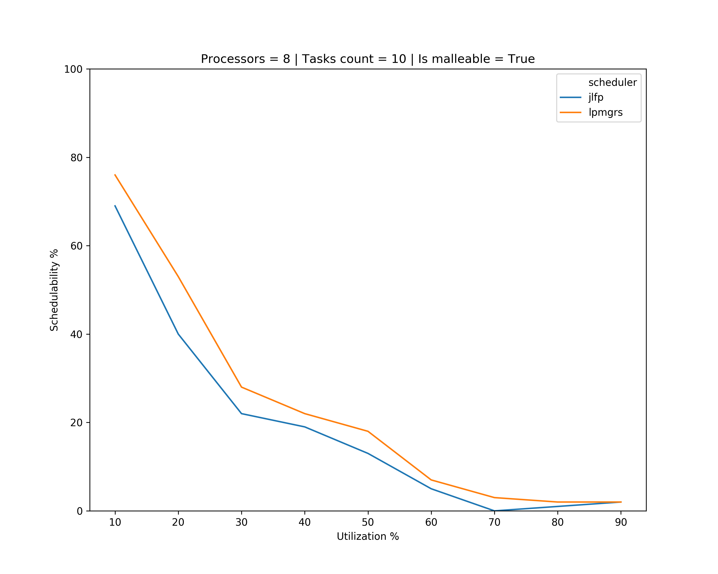
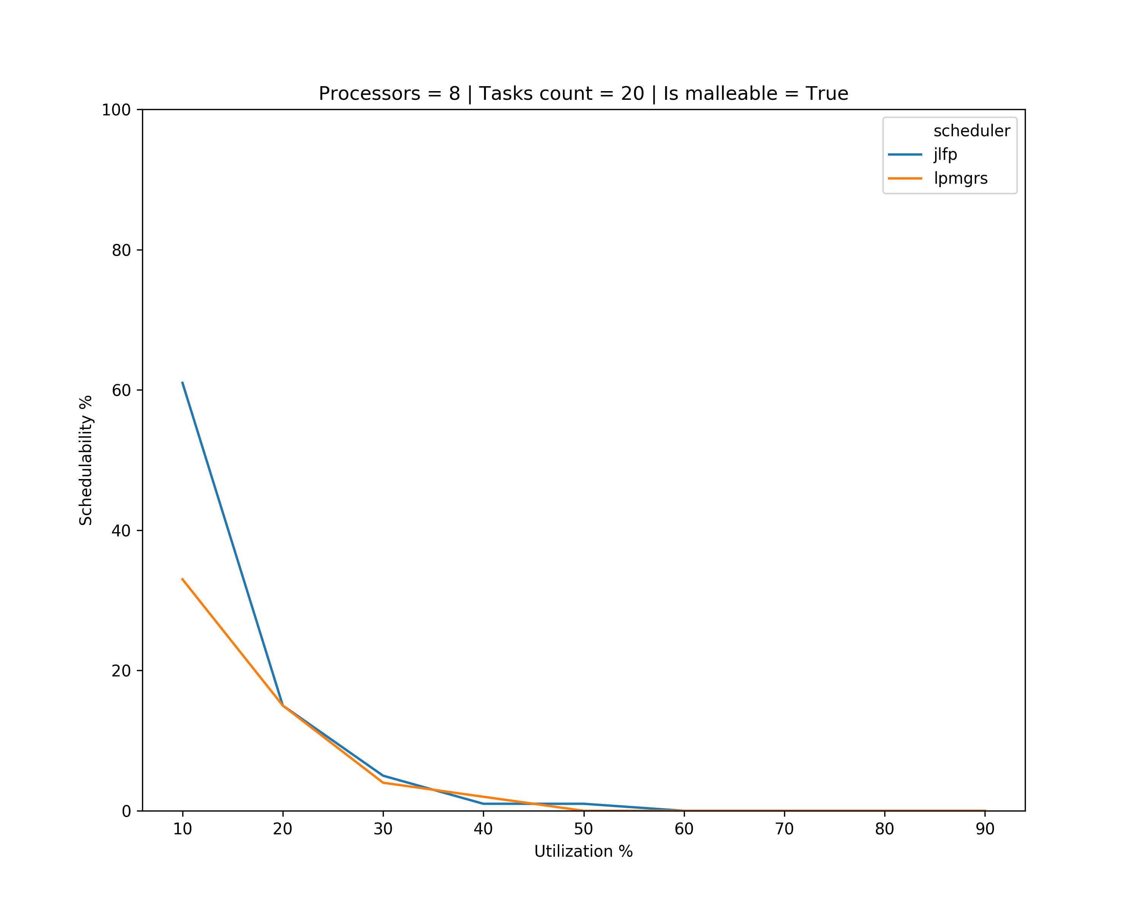
Results

Slide 7
What’s next?
Improve tasksets generation
The minimum number of cores should be determined by the utilization of the task
Find a way to increase schedulability
Find a way to analyse non-schedulable tasksets

