Slide 1

Scheduling and Analysis of Limited-Preemptive Moldable Gang Tasks Weekly Meeting
Joan Marcè i Igual
6th of May, 2020

Slide 2



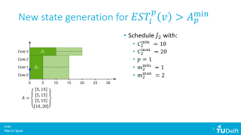



To discuss today
New state generation with $EST_{i}^{p}\left(v\right)>A_{p}^{\min{ }}$
Reduce pessimism with:
Precedence constraints $EST$ computation
Moldable gang $EST$ computation

Slide 3

Final solution
Joining the solutions for both methods we obtain:
$$EST_{i}^{p}\left(v\right)=\max{\{R_{i},t_{gang},t_{hs}\}}$$

Slide 4
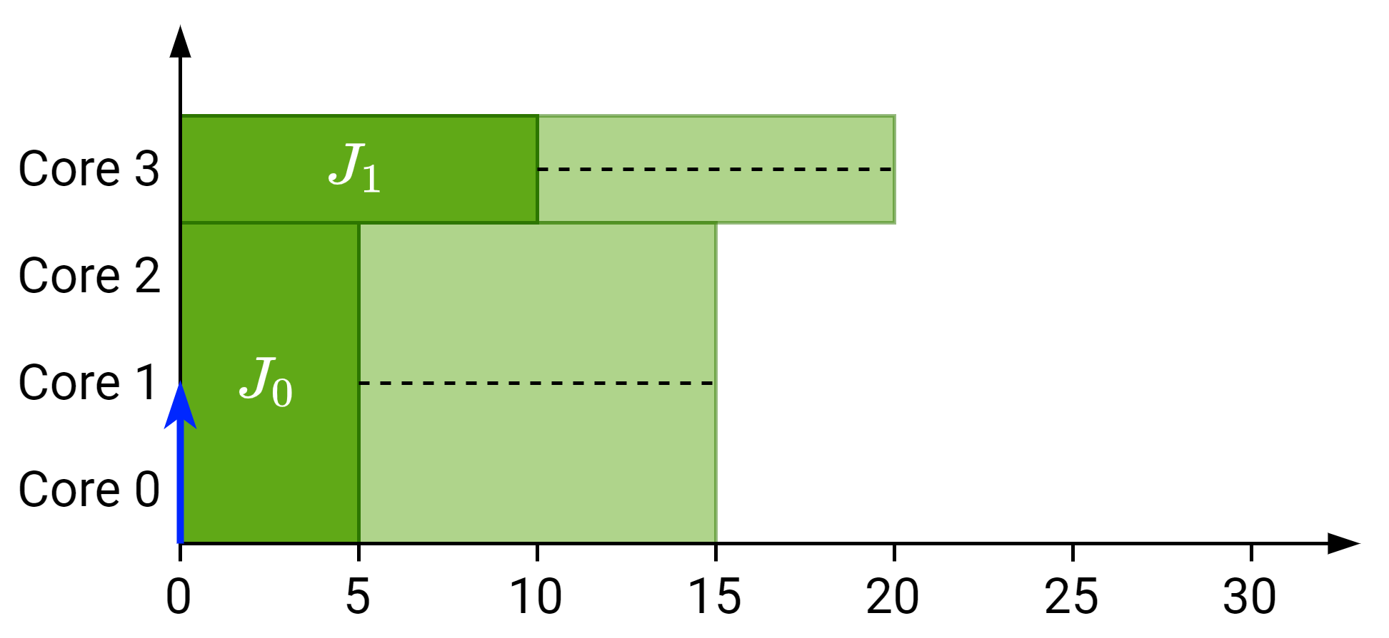

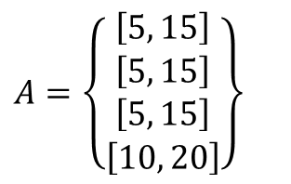

New state generation for $EST_{i}^{p}\left(v\right)>A_{p}^{\min{ }}$
Schedule $J_{2}$ with:
$C_{2}^{\min{ }}=10$
$C_{2}^{\max{ }}=20$
$p=1$
$m_{2}^{\min{ }}=1$
$m_{2}^{\max{ }}=2$
$$A=\left\{\begin{matrix}\left[5, 15\right] \\ \left[5, 15\right] \\ \left[5, 15\right] \\ \left[10, 20\right]\end{matrix}\right\}$$

Slide 5
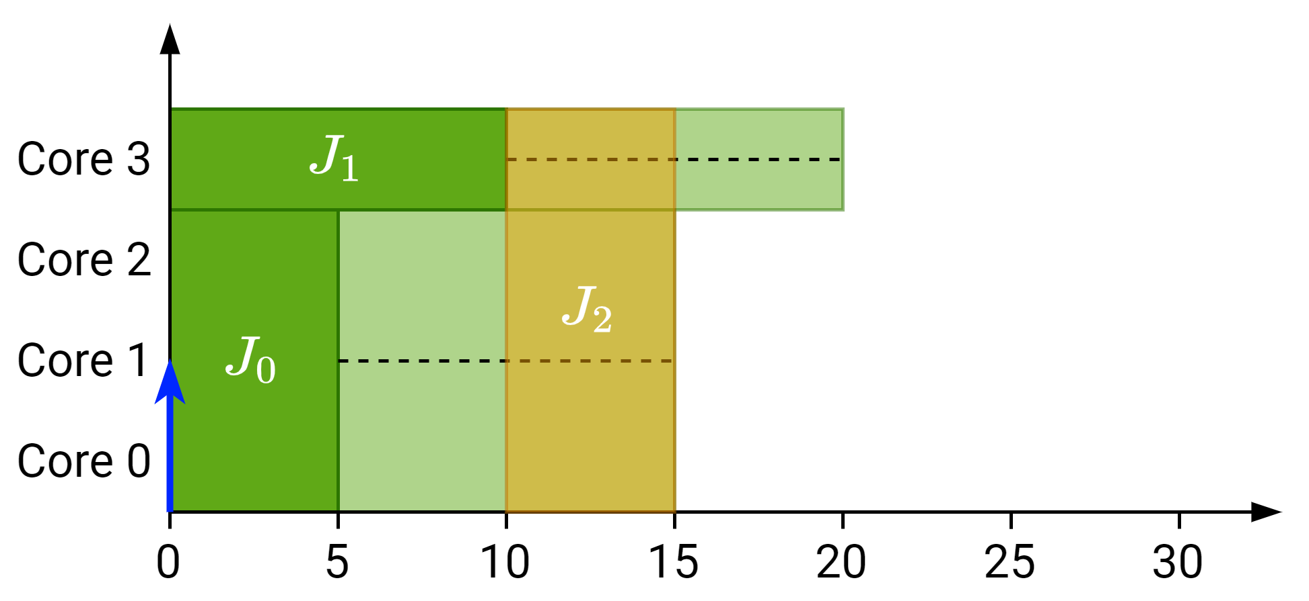

New state generation for $EST_{i}^{p}\left(v\right)>A_{p}^{\min{ }}$
Schedule $J_{2}$ with:
$C_{2}^{\min{ }}=10$
$C_{2}^{\max{ }}=20$
$p=1$
$m_{2}^{\min{ }}=1$
$m_{2}^{\max{ }}=2$
$EST_{2}^{1}=10$
$LST_{2}^{1}=15$
$$A=\left\{\begin{matrix}\left[5, 15\right] \\ \left[5, 15\right] \\ \left[5, 15\right] \\ \left[10, 20\right]\end{matrix}\right\}$$

Slide 6
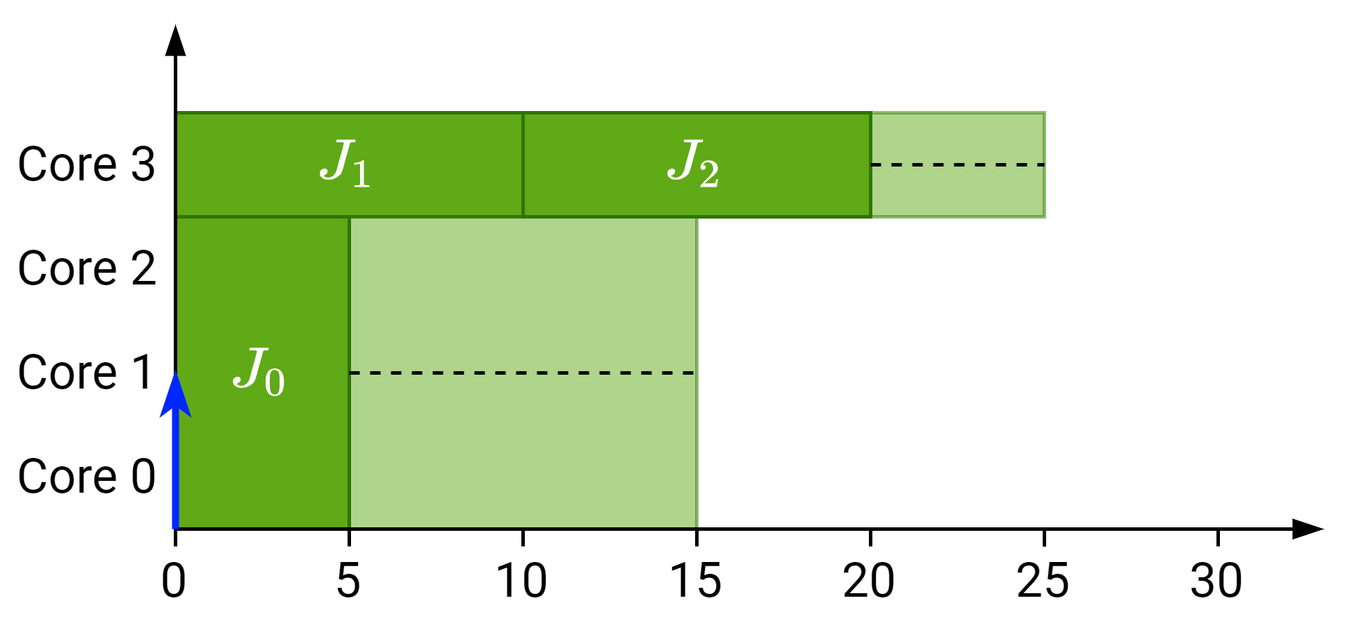
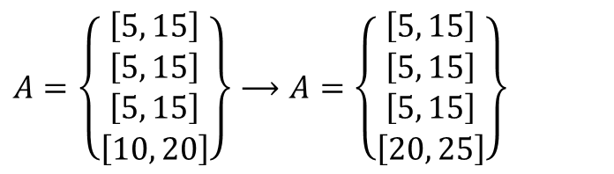
New state generation for $EST_{i}^{p}\left(v\right)>A_{p}^{\min{ }}$
Expected
Schedule $J_{2}$ with:
$C_{2}^{\min{ }}=10$
$C_{2}^{\max{ }}=20$
$p=1$
$m_{2}^{\min{ }}=1$
$m_{2}^{\max{ }}=2$
$EST_{2}^{1}=10$
$LST_{2}^{1}=15$
$$A=\left\{\begin{matrix}\left[5, 15\right] \\ \left[5, 15\right] \\ \left[5, 15\right] \\ \left[10, 20\right]\end{matrix}\right\}⟶A=\left\{\begin{matrix}\left[5, 15\right] \\ \left[5, 15\right] \\ \left[5, 15\right] \\ \left[20, 25\right]\end{matrix}\right\}$$

Slide 7
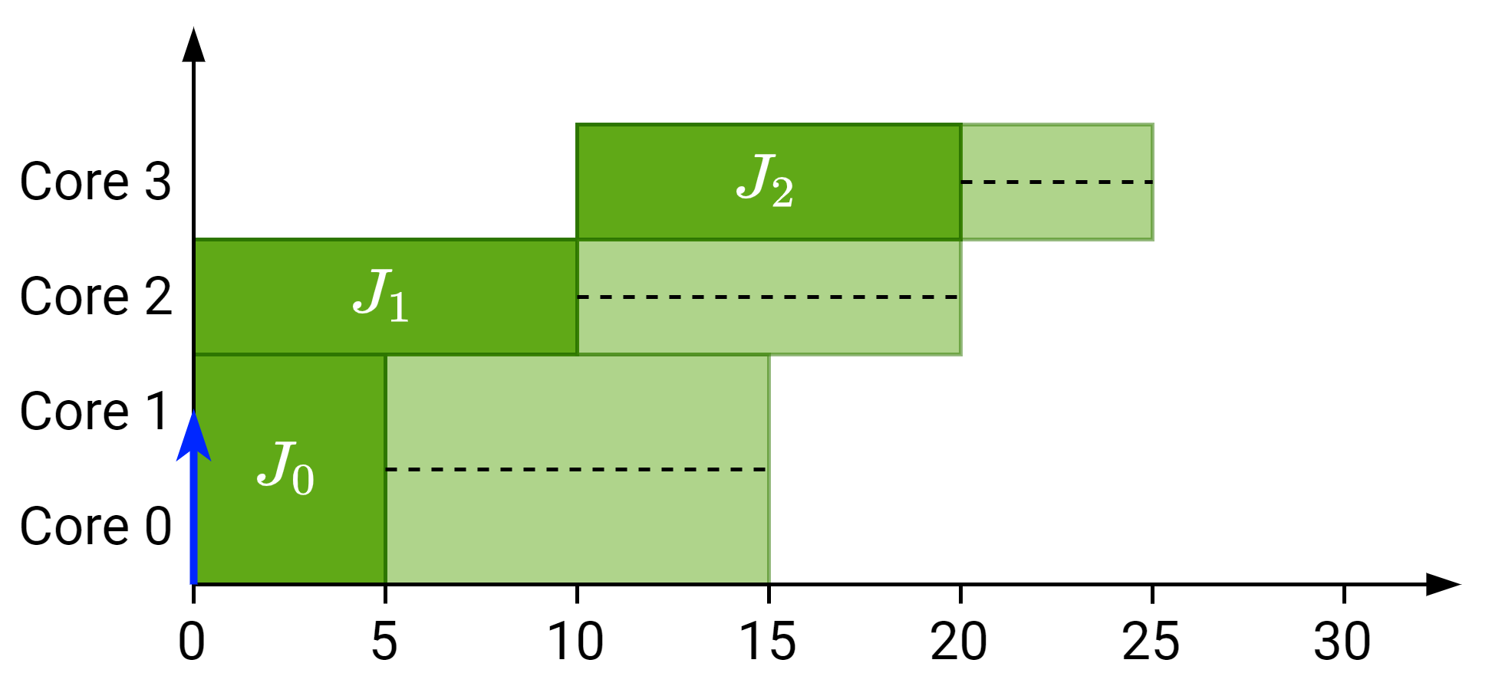
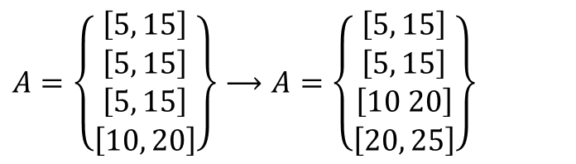
New state generation for $EST_{i}^{p}\left(v\right)>A_{p}^{\min{ }}$
Actual
Schedule $J_{2}$ with:
$C_{2}^{\min{ }}=10$
$C_{2}^{\max{ }}=20$
$p=1$
$m_{2}^{\min{ }}=1$
$m_{2}^{\max{ }}=2$
$EST_{2}^{1}=10$
$LST_{2}^{1}=15$
$$A=\left\{\begin{matrix}\left[5, 15\right] \\ \left[5, 15\right] \\ \left[5, 15\right] \\ \left[10, 20\right]\end{matrix}\right\}⟶A=\left\{\begin{matrix}\left[5, 15\right] \\ \left[5, 15\right] \\ \left[10 20\right] \\ \left[20, 25\right]\end{matrix}\right\}$$

Slide 8

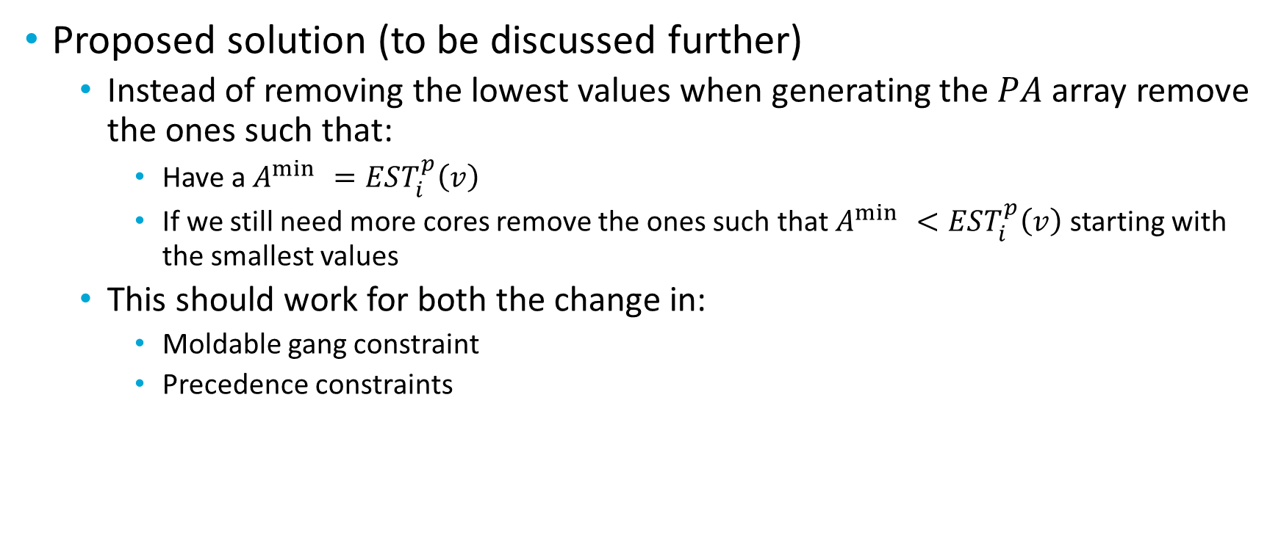
New state generation for $EST_{i}^{p}\left(v\right)>A_{p}^{\min{ }}$
Proposed solution (to be discussed further)
Instead of removing the lowest values when generating the $PA$ array remove the ones such that:
Have a $A^{\min{ }}=EST_{i}^{p}\left(v\right)$
If we still need more cores remove the ones such that $A^{\min{ }}<EST_{i}^{p}\left(v\right)$ starting with the smallest values
This should work for both the change in:
Moldable gang constraint
Precedence constraints

Slide 9


Precedence $EST$ computation
Find time at which it is not necessary to use all the cores currently used by higher-priority segments that have a successor ready.
So $EST_{i}^{p}\left(v\right)$ now is computed as follows:
$$EST_{i}^{p}\left(v\right)=\max\left\{R_{i}, A_{p}^{\min{ }}, t_{hs}\right\}$$

Slide 10
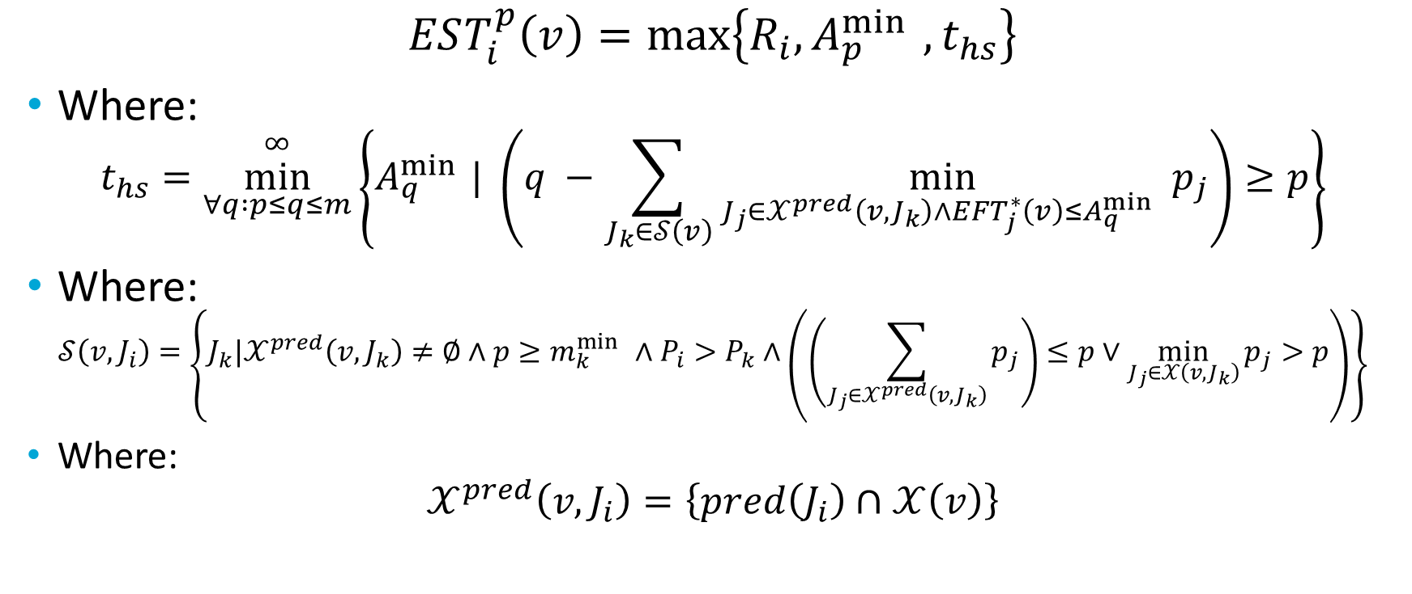
Precedence $EST$ computation
$$EST_{i}^{p}\left(v\right)=\max\left\{R_{i}, A_{p}^{\min{ }}, t_{hs}\right\}$$
Where:
$$t_{hs}=\underset{∀q :p≤q≤m}{\overset{∞}{min}}\left\{A_{q}^{\min{ }}| \left(q −\sum_{J_{k}∈𝒮\left(v\right)}{\min_{J_{j}∈𝒳^{pred}\left(v,J_{k}\right)∧EFT_{j}^{∗}\left(v\right)≤A_{q}^{\min{ }}}{p_{j}}}\right)≥p\right\}$$
Where:
$$𝒮\left(v, J_{i}\right)=\left\{J_{k}|𝒳^{pred}\left(v,J_{k}\right)≠∅∧p≥m_{k}^{\min{ }}∧P_{i}>P_{k}∧\left(\left(\sum_{J_{j}∈𝒳^{pred}\left(v, J_{k}\right)}{p_{j}}\right)≤p∨\min_{J_{j}∈𝒳\left(v, J_{k}\right)}{p_{j}}>p\right)\right\}$$
Where:
$$𝒳^{pred}\left(v, J_{i}\right)=\left\{pred\left(J_{i}\right)∩𝒳\left(v\right)\right\}$$

Slide 11
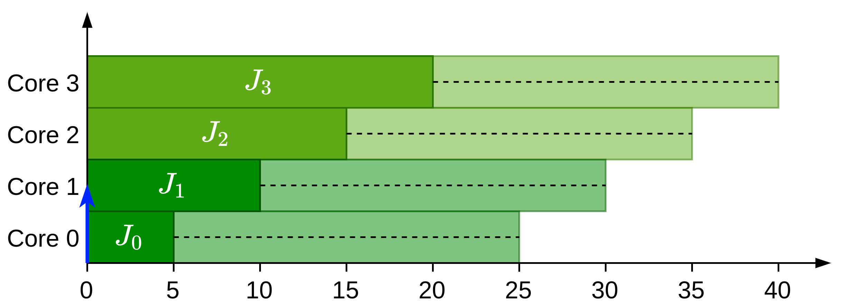



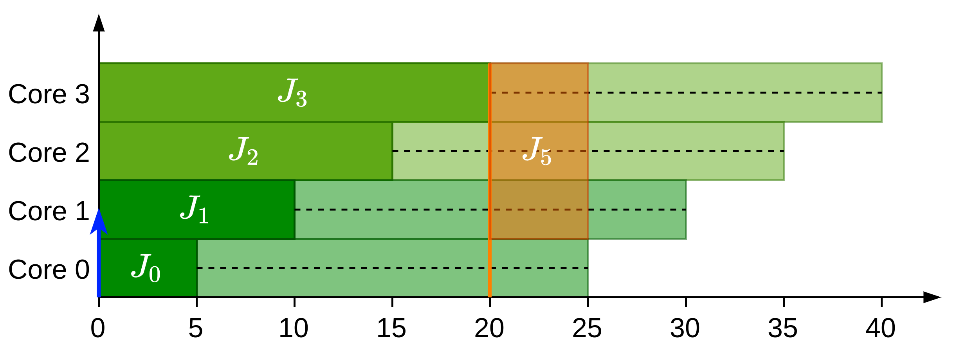

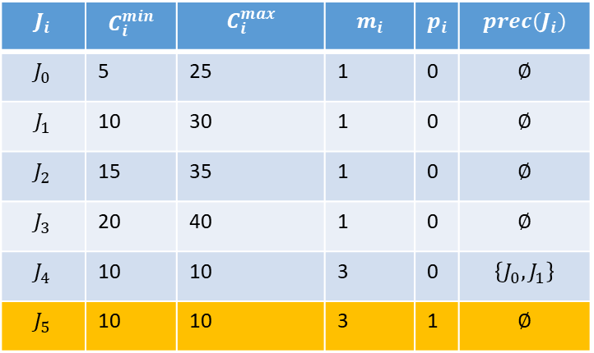
Precedence $EST$ computation
$$J_{i}$$ | $$C_{i}^{min}$$ | $$C_{i}^{max}$$ | $$m_{i}$$ | $$p_{i}$$ | $$prec\left(J_{i}\right)$$
$$J_{0}$$ | 5 | 25 | 1 | 0 | $$∅$$
$$J_{1}$$ | 10 | 30 | 1 | 0 | $$∅$$
$$J_{2}$$ | 15 | 35 | 1 | 0 | $$∅$$
$$J_{3}$$ | 20 | 40 | 1 | 0 | $$∅$$
$$J_{4}$$ | 10 | 10 | 3 | 0 | $$\left\{J_{0}, J_{1}\right\}$$
$$J_{5}$$ | 10 | 10 | 3 | 1 | $$∅$$

Slide 12
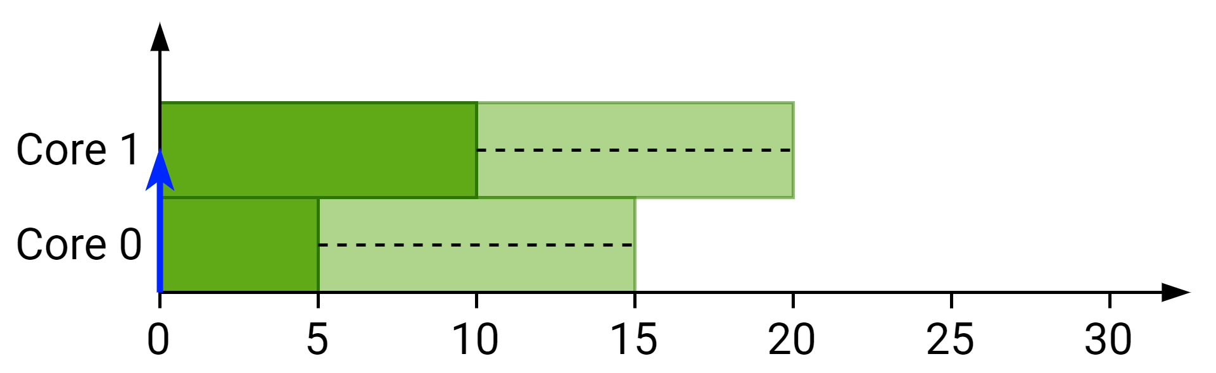
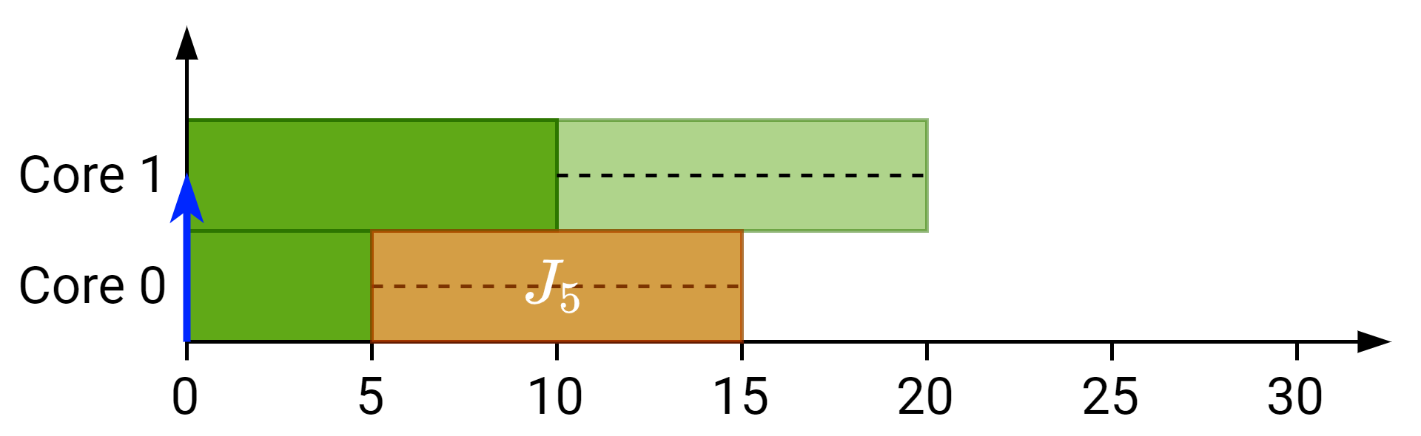
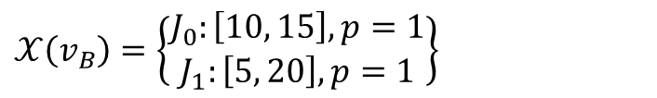
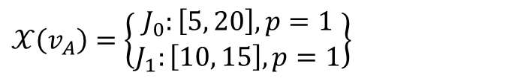
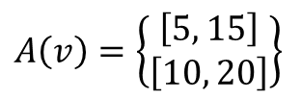
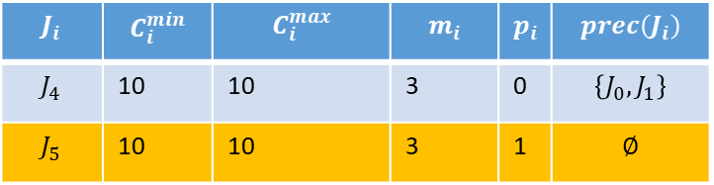
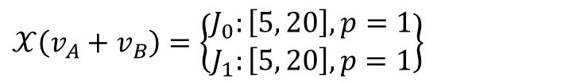
Precedence $EST$ computation
$$J_{i}$$ | $$C_{i}^{min}$$ | $$C_{i}^{max}$$ | $$m_{i}$$ | $$p_{i}$$ | $$prec\left(J_{i}\right)$$
$$J_{4}$$ | 10 | 10 | 3 | 0 | $$\left\{J_{0}, J_{1}\right\}$$
$$J_{5}$$ | 10 | 10 | 3 | 1 | $$∅$$
$$A\left(v\right)=\left\{\begin{matrix}\left[5, 15\right] \\ \left[10, 20\right]\end{matrix}\right\}$$
$$𝒳\left(v_{A}\right)=\left\{\begin{matrix}J_{0}:\left[5, 20\right], p=1 \\ J_{1}:\left[10, 15\right], p=1\end{matrix}\right\}$$
$$𝒳\left(v_{B}\right)=\left\{\begin{matrix}J_{0}:\left[10, 15\right], p=1 \\ J_{1}:\left[5, 20\right], p=1\end{matrix}\right\}$$
$$𝒳\left({v_{A}+v}_{B}\right)=\left\{\begin{matrix}J_{0}:\left[5, 20\right], p=1 \\ J_{1}:\left[5, 20\right], p=1\end{matrix}\right\}$$

Slide 13


Moldable gang $EST$ computation
Find availabilities corresponding to more than $p$ cores released at once and discard them
So $EST_{i}^{p}\left(v\right)$ now is computed as follows:
$$EST_{i}^{p}\left(v\right)=\max\left\{R_{i}, A_{p}^{\min{ }}, t_{gang}\right\}$$

Slide 14
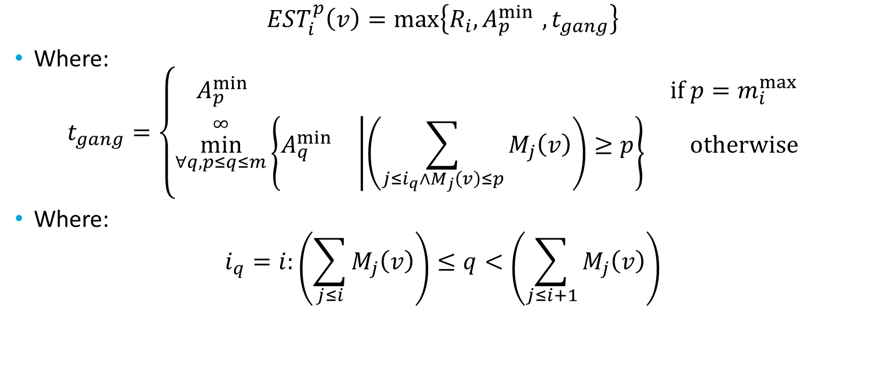
Moldable gang $EST$ computation
$$EST_{i}^{p}\left(v\right)=\max\left\{R_{i}, A_{p}^{\min{ }}, t_{gang}\right\}$$
Where:
$$t_{gang}=\left\{\begin{matrix}A_{p}^{\min{}} & \text{if} p=m_{i}^{\max{}} \\ \underset{∀q,p≤q≤m}{\overset{∞}{min}}\left\{A_{q}^{\min{}}\left|\left(\sum_{j≤i_{q}∧M_{j}\left(v\right)≤p}{M_{j}\left(v\right)}\right)≥p\right.\right\} & \text{otherwise}\end{matrix}\right.$$
Where:
$$i_{q}=i:\left(\sum_{j≤i}{M_{j}\left(v\right)}\right)≤q<\left(\sum_{j≤i+1}{M_{j}\left(v\right)}\right)$$

Slide 15
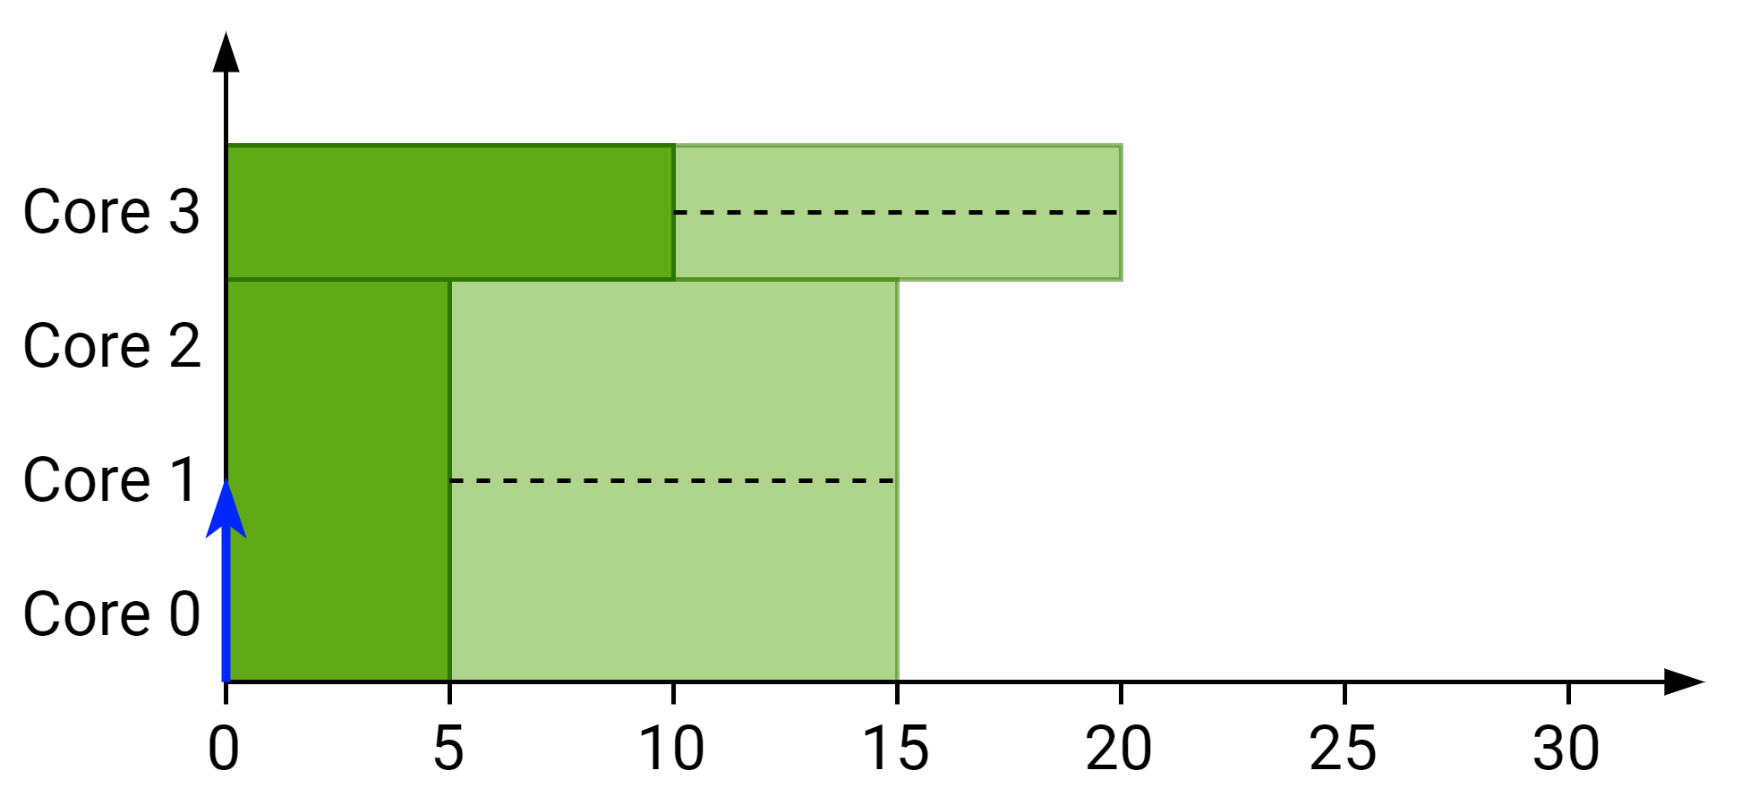
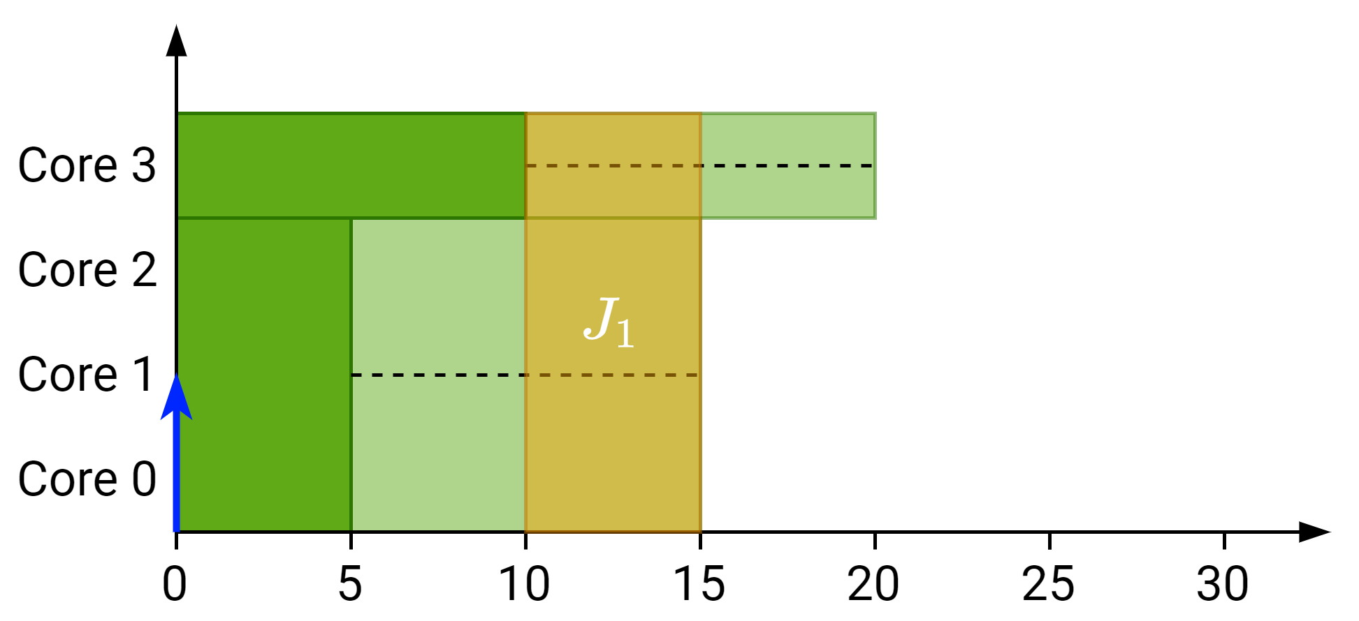


Moldable gang $EST$ computation
Scheduling $J_{i}$ with $p=1$:
$EST_{1}^{1}\left(v\right)=10$
$LST_{1}^{1}\left(v\right)=15$
$$M\left(v\right)=\{3, 1\}$$

Slide 16
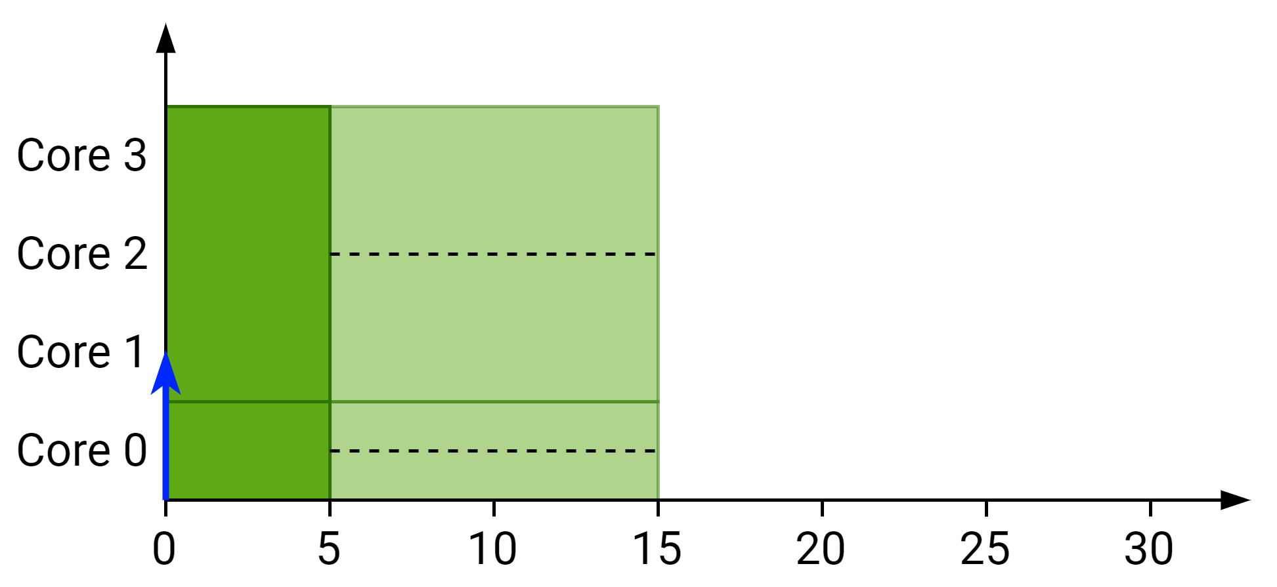
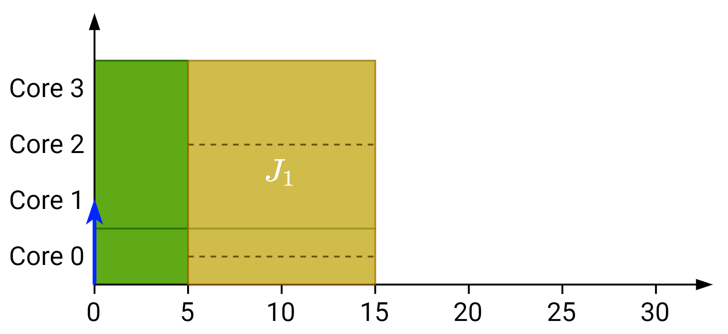


Moldable gang $EST$ computation
Scheduling $J_{i}$ with $p=1$:
$EST_{1}^{1}\left(v\right)=5$
$LST_{1}^{1}\left(v\right)=15$
$$M\left(v\right)=\{1, 3\}$$

Slide 17
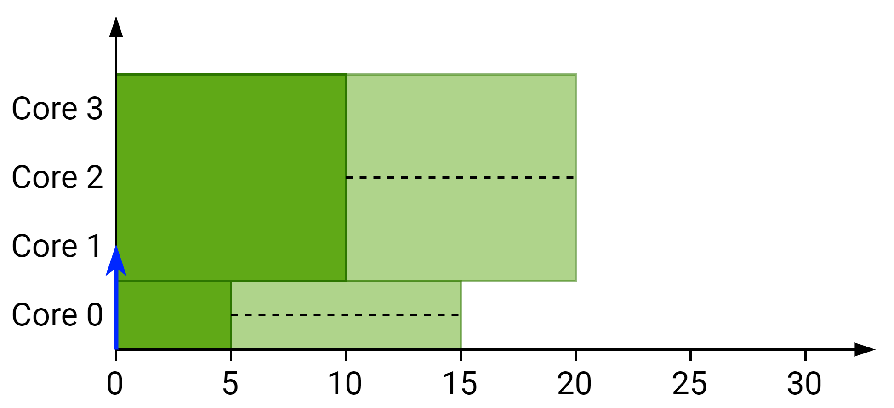
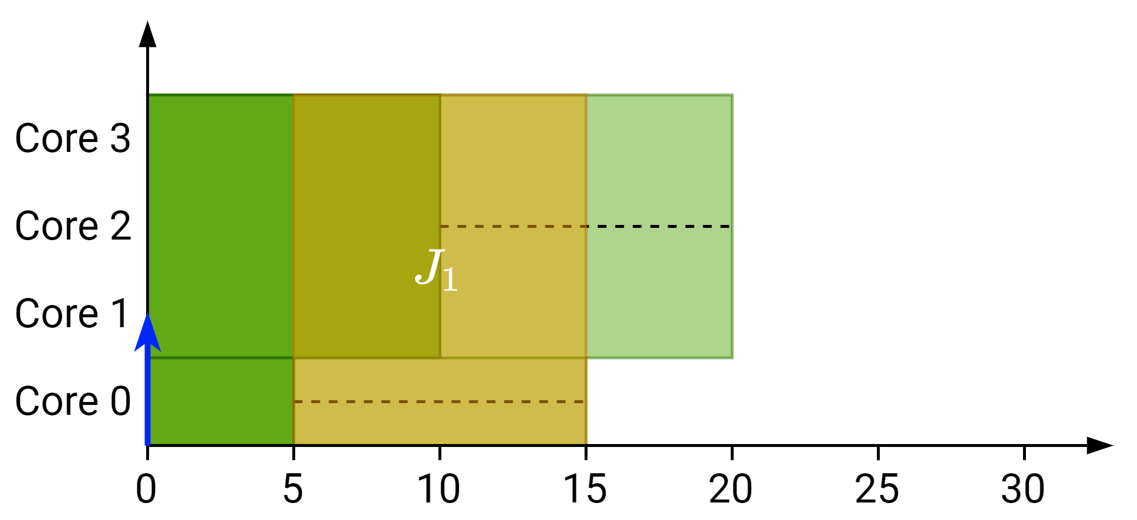
Moldable gang $EST$ computation
Scheduling $J_{i}$ with $p=1$:
$EST_{1}^{1}\left(v\right)=5$
$LST_{1}^{1}\left(v\right)=15$
$$M\left(v\right)=\{1, 3\}$$

Slide 18
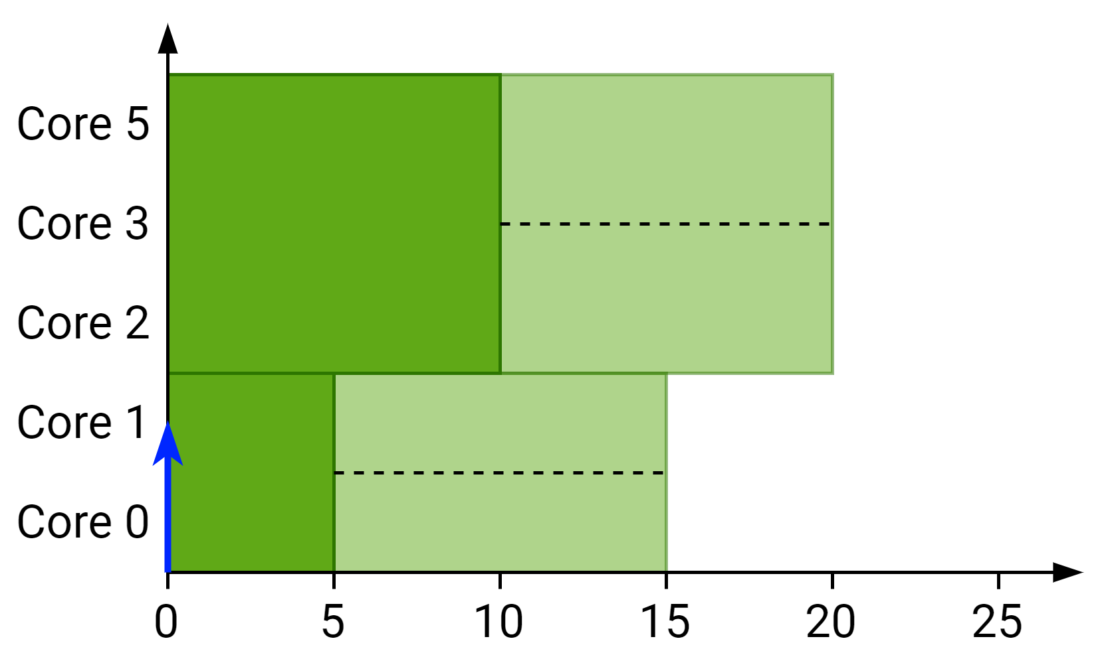
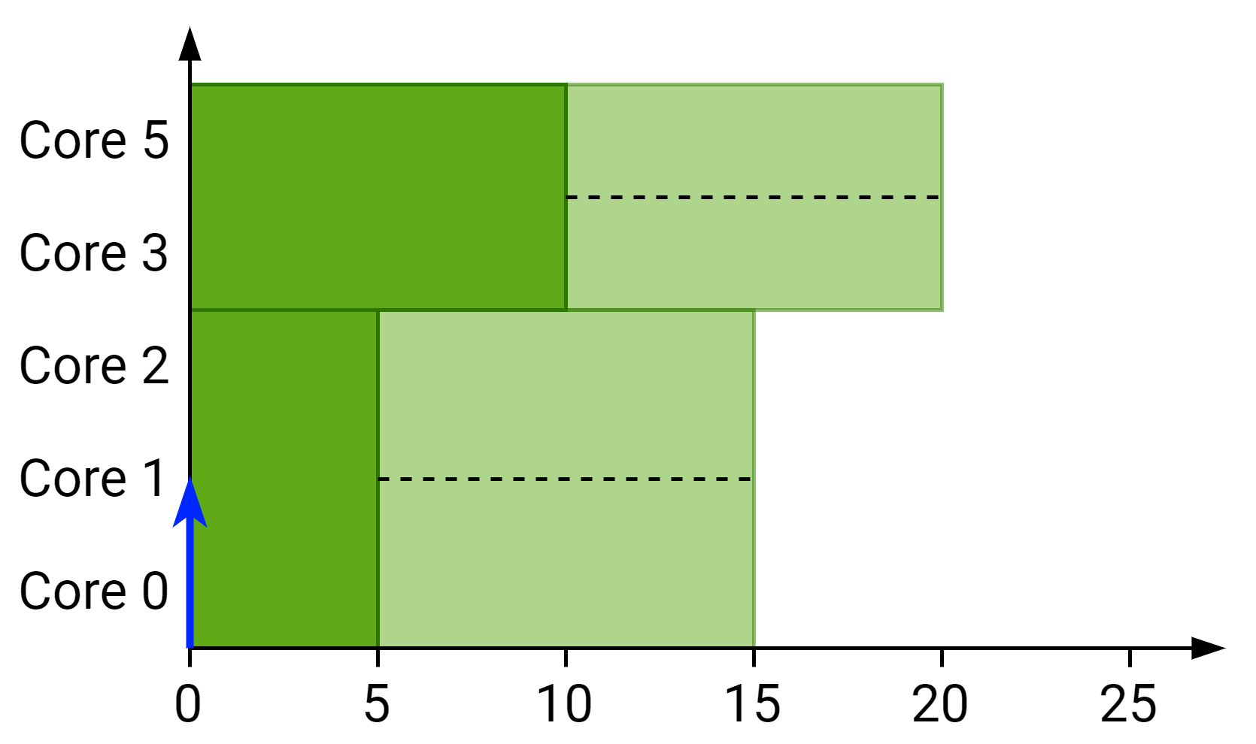
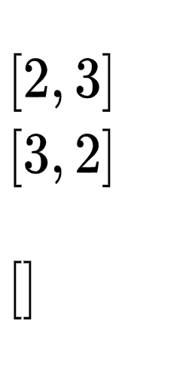
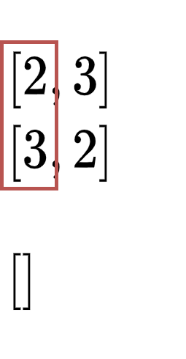
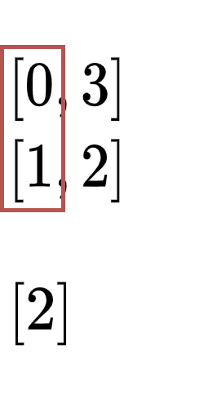
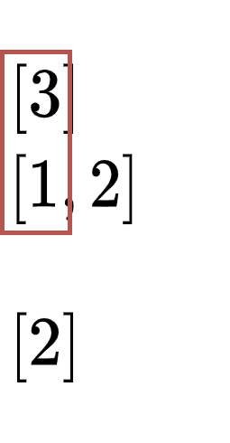
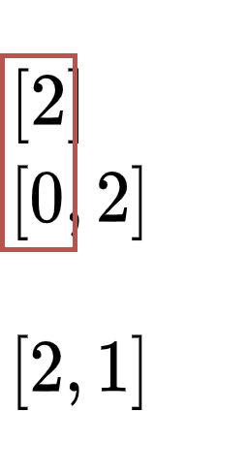
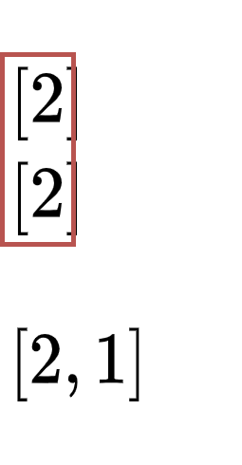
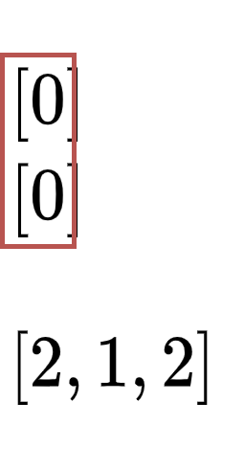
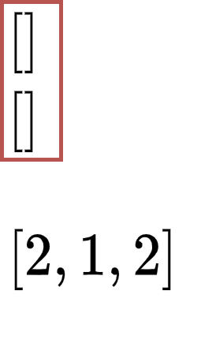
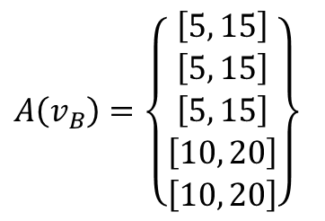
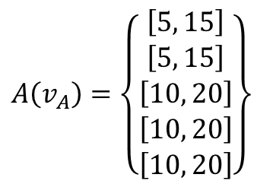


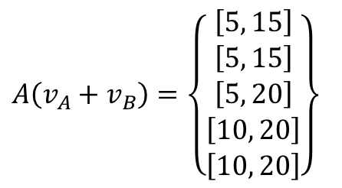
Merge phase
$$A\left(v_{A}\right)=\left\{\begin{matrix}\left[5, 15\right] \\ \left[5, 15\right] \\ \left[10, 20\right] \\ \left[10, 20\right] \\ \left[10, 20\right]\end{matrix}\right\}$$
$$A\left(v_{B}\right)=\left\{\begin{matrix}\left[5, 15\right] \\ \left[5, 15\right] \\ \left[5, 15\right] \\ \left[10, 20\right] \\ \left[10, 20\right]\end{matrix}\right\}$$
$$A\left(v_{A}+v_{B}\right)=\left\{\begin{matrix}\left[5, 15\right] \\ \left[5, 15\right] \\ \left[5, 20\right] \\ \left[10, 20\right] \\ \left[10, 20\right]\end{matrix}\right\}$$
$$M\left(v_{A}\right)=\left\{2, 3\right\}$$
$$M\left(v_{A}\right)=\left\{3, 2\right\}$$

Slide 19
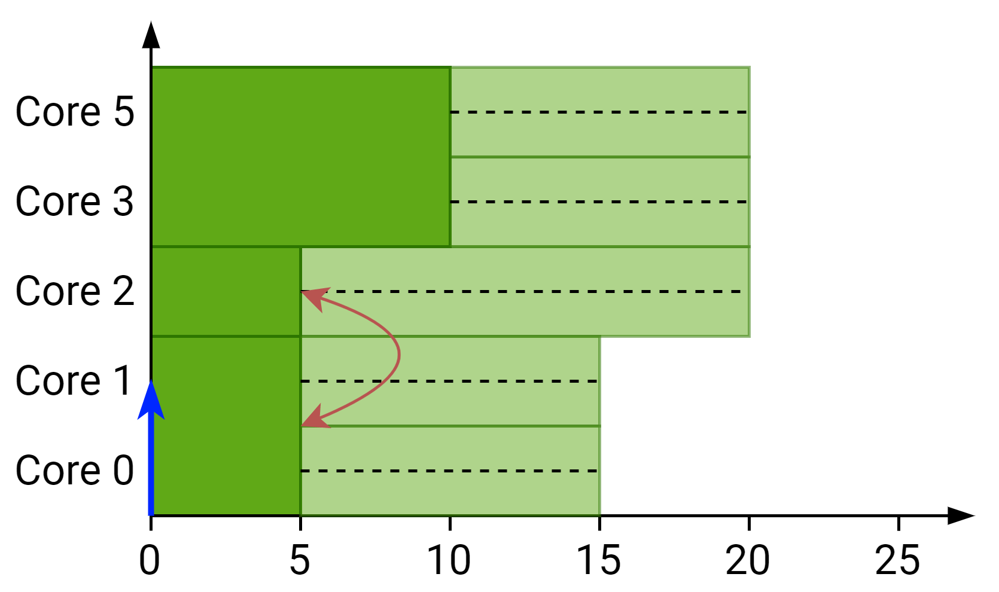
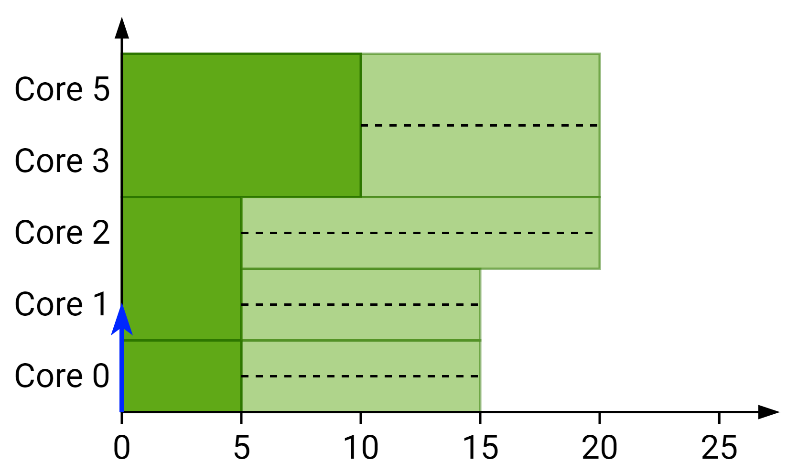

Merge phase
$$M\left(v_{A}+v_{B}\right)=\left\{1, 2, 2\right\}$$

