Slide 1
Scheduling and Analysis of Limited-Preemptive Malleable Gang Taks
Joan Marcè i Igual
Geoffrey Nelissen
Mitra Nasri
Paris Panagiotou
24th of February, 2020

Slide 2
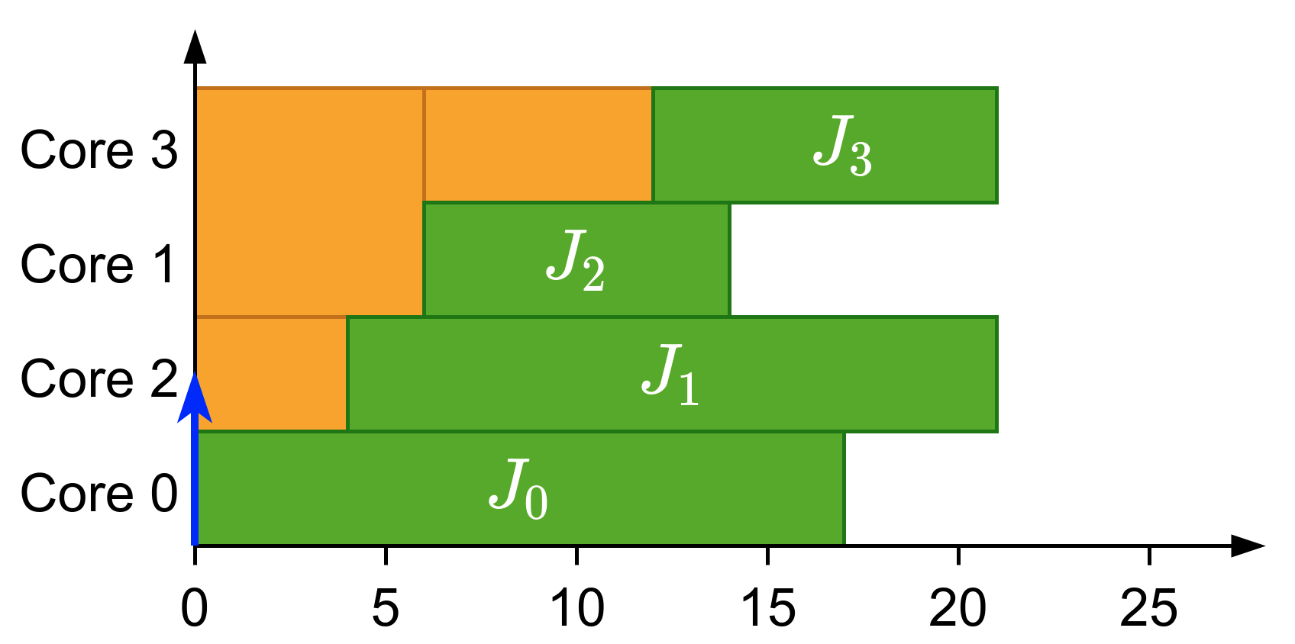
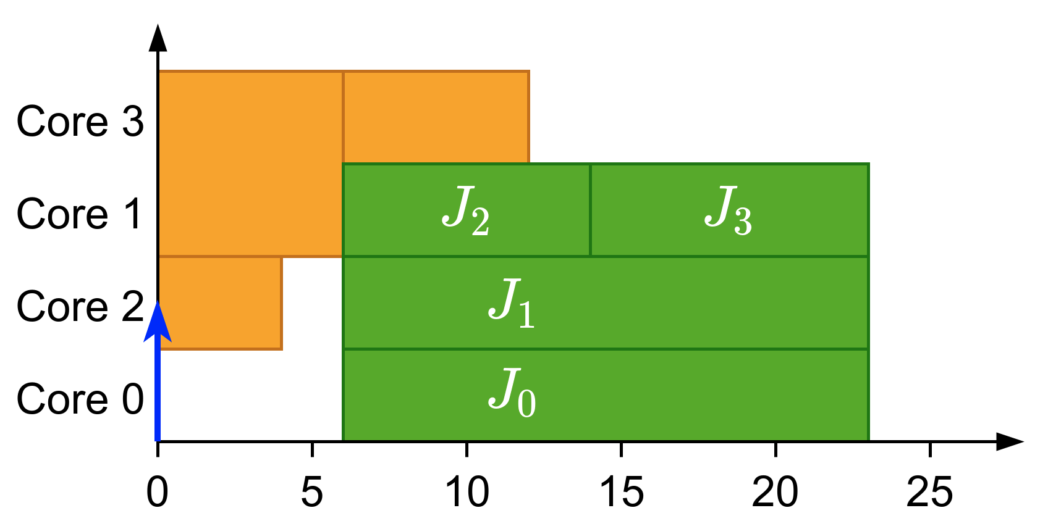
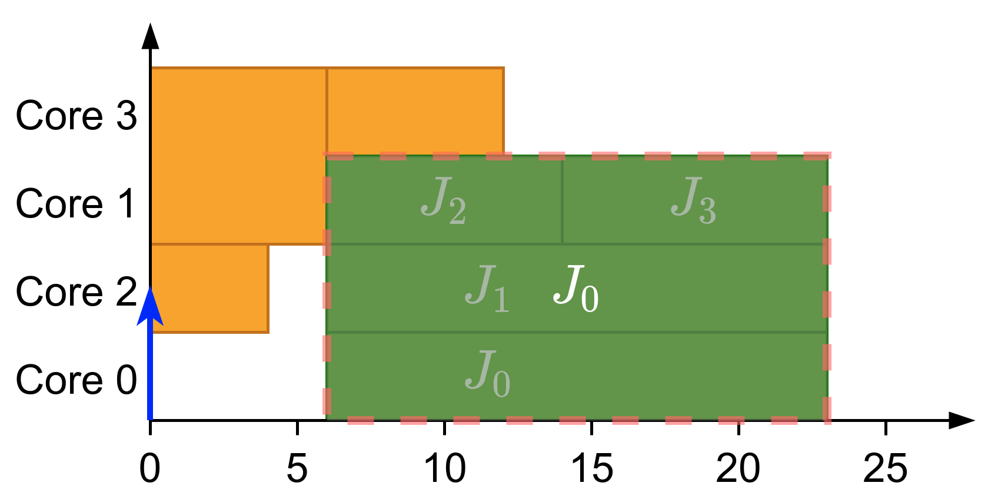
What is gang?
Parallel threads executed together as a “gang”
Execution does not start until there are enough free cores
Global scheduling
Gang Scheduling

Slide 3
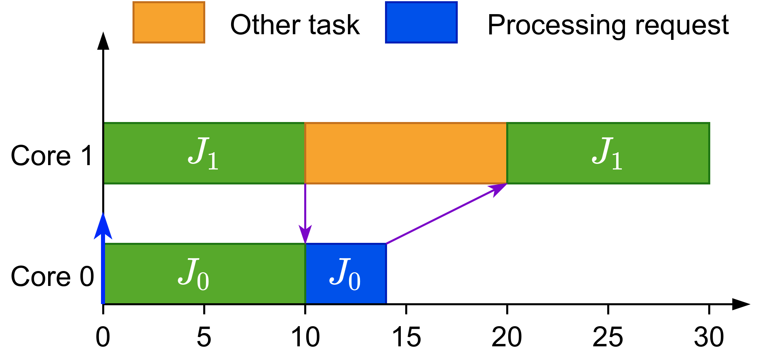
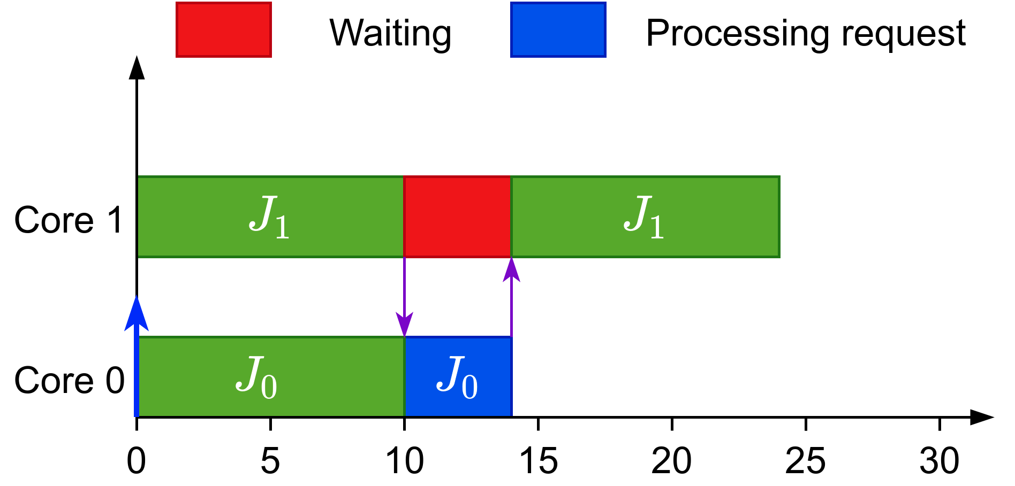
Why gang?
Efficient synchronization

Slide 4
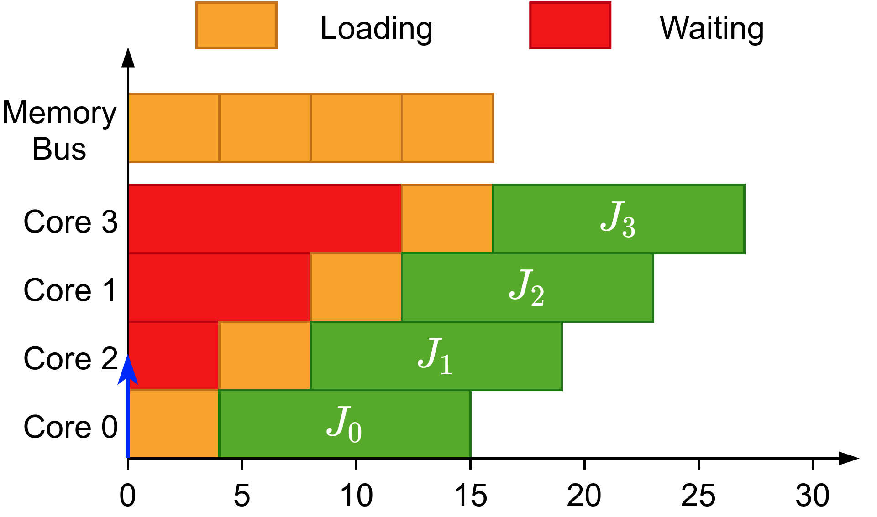
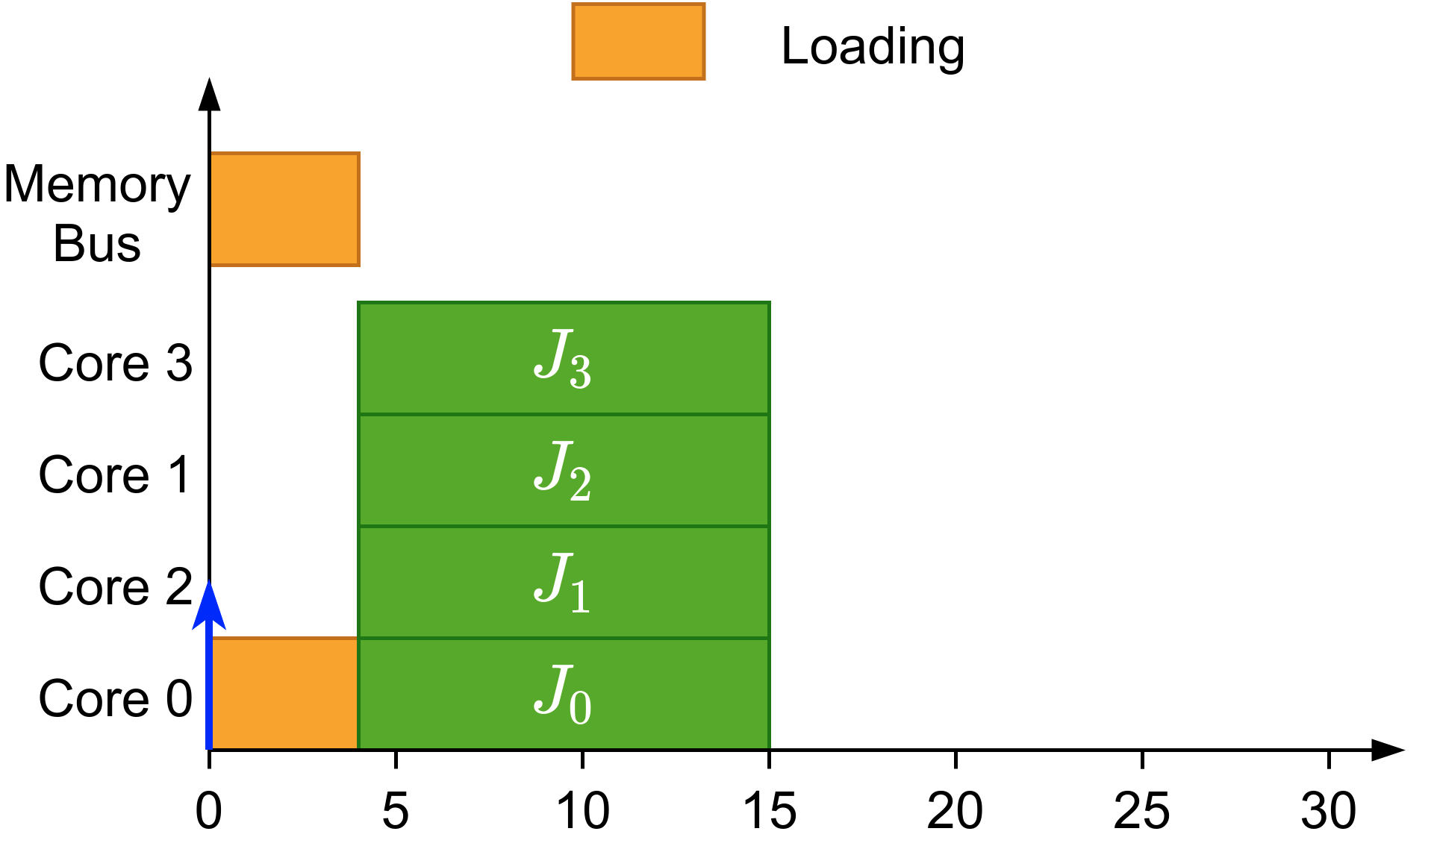
Why gang?
Efficient synchronization
Avoids overhead when loading initial data

Slide 5
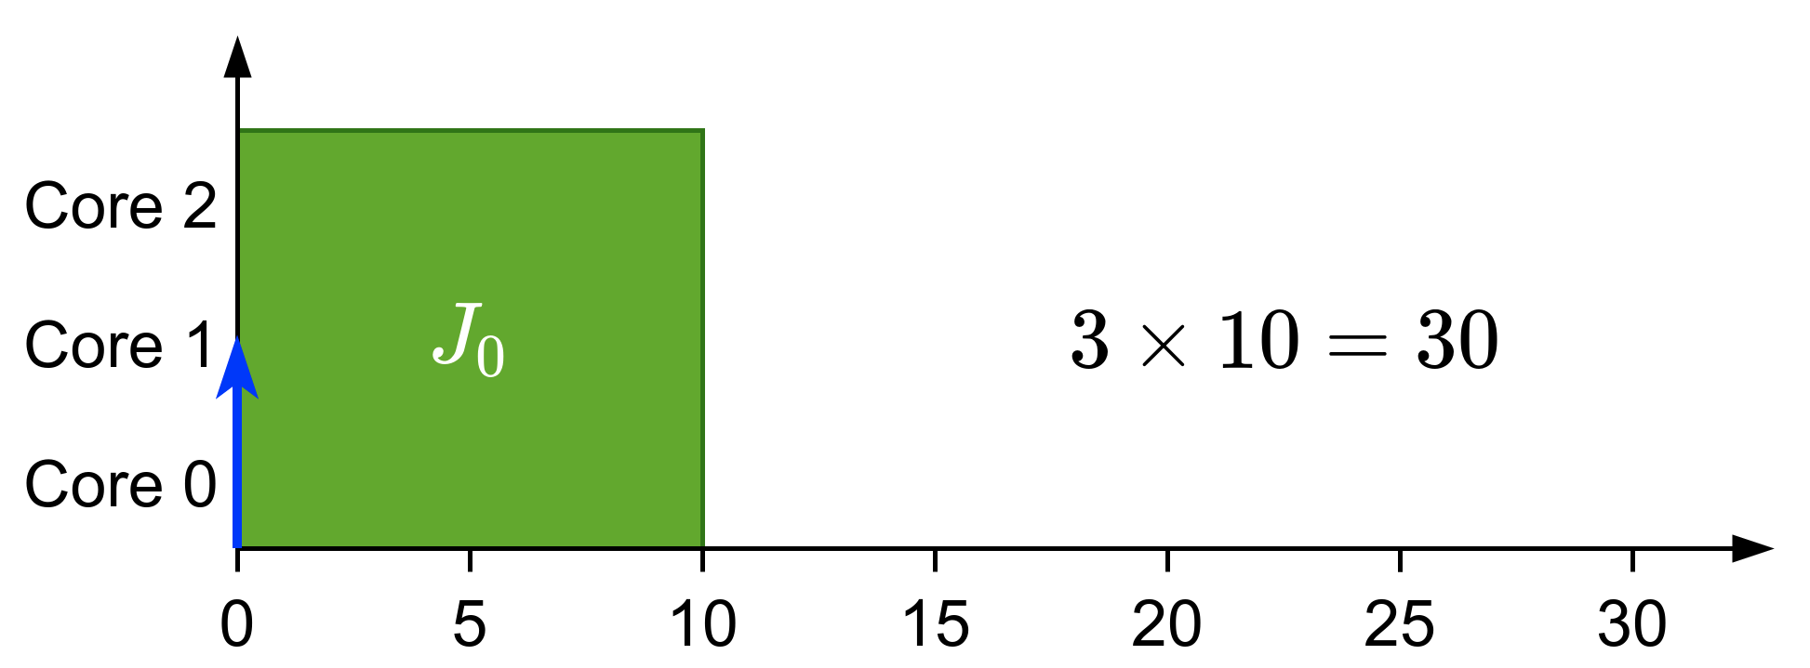
Types of gang
Rigid: number of cores set by programmer

Slide 6
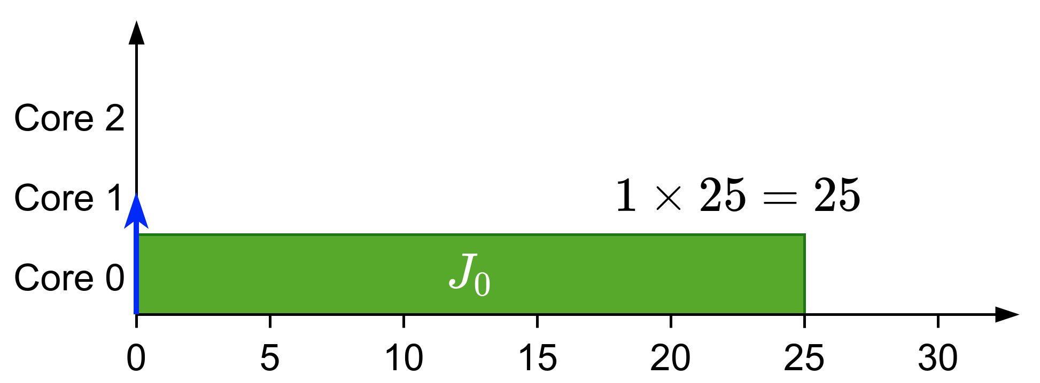
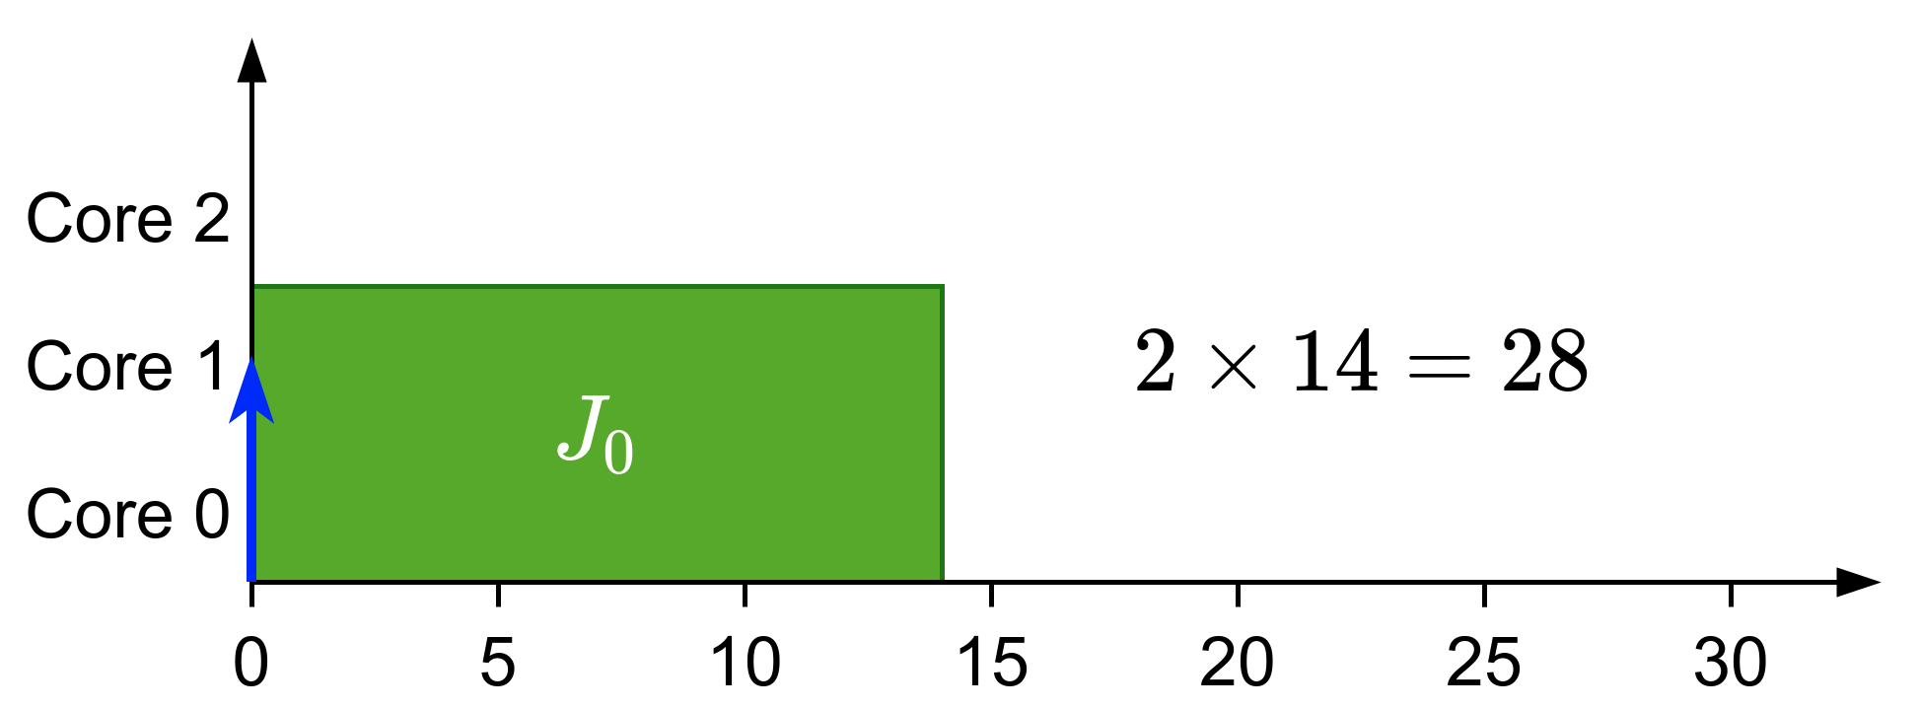
Types of gang
Rigid: number of cores set by programmer
Moldable: number of cores assigned during scheduling

Slide 7
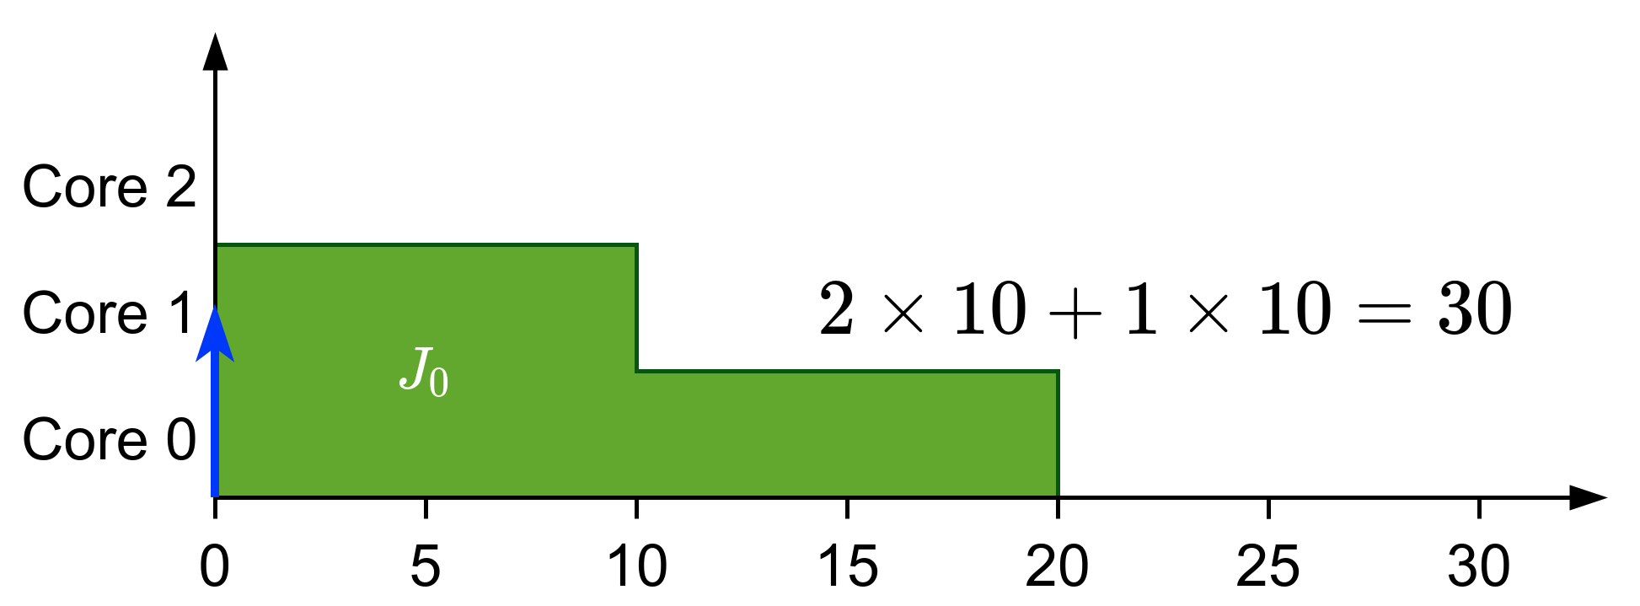
Types of gang
Rigid: number of cores set by programmer
Moldable: number of cores assigned during scheduling
Malleable: Number of cores can change during runtime

Slide 8
Previous work
Introduced in the context of high-performance computing^{[1]}
In real-time:
We know that JLFP scheduler is not predictable/sustainable^{[2]}
Most of the work is focused in fully-preemptive solutions:
Optimal scheduler for rigid gang (DP-Fair)^{[3]}
Moldable scheduler^{[4]}
Bundled scheduling^{[5]}
Tasks with precedence constraints modelled as a succession of bundles
Our limited-preemptive definition comes from here
^{[1]}Ousterhout, 1982
[3]Goossens et al., 2016
^{[4]}Wasly et al., 2017
^{[2]}Goossens et al., 2010
^{[4]}Berten et al., 2011

Slide 9
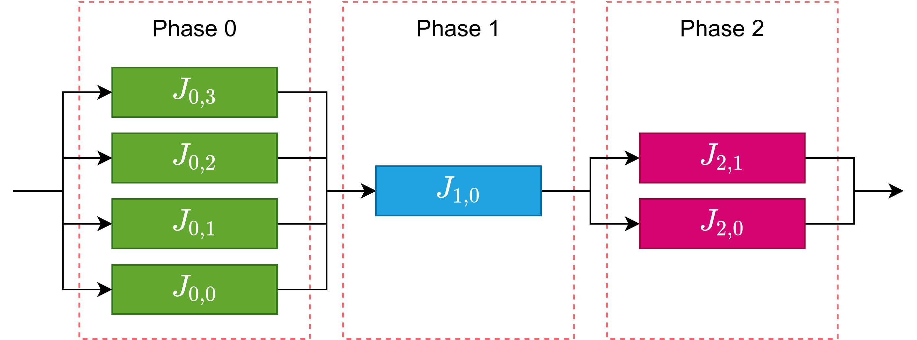
Summarizing

Slide 10
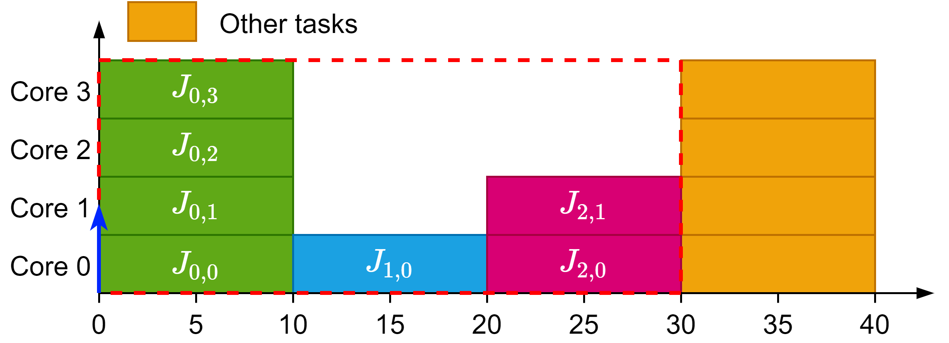
Summarizing
Rigid gang reserves the whole block
Bundled creates multiple rigid blocks with depencencies
Limited-Preemptive tries to schedule these blocks in a moldable way

