Slide 1

Scheduling and Analysis of Limited-Preemptive Moldable Gang Tasks Weekly Meeting
Joan Marcè i Igual
6th of May, 2020

Slide 2

To discuss today
New state generation with $EST_{i}^{p}\left(v\right)>A_{p}^{\min{ }}$
Precedence constraints $EST$ computation
Moldable gang $EST$ coputation
Notes:
First of all, let’s explain what gang scheduling is.
<click>
Let’s say that we have multiple threads that we want to schedule. If we want to convert them to a gang task we would put them together as a “gang” <click> and then we would schedule as a single task<click> so the execution would not start until there are enough free cores.

Slide 3
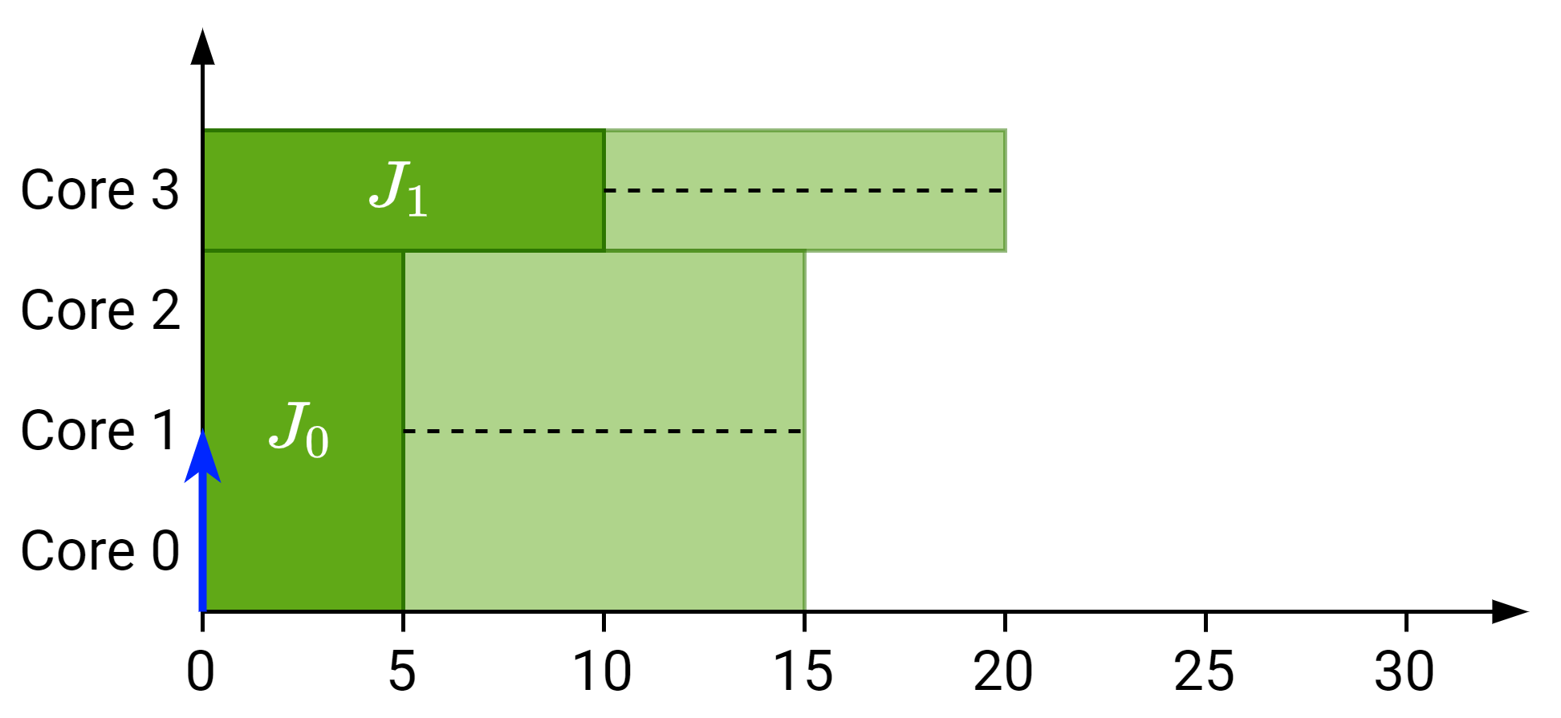

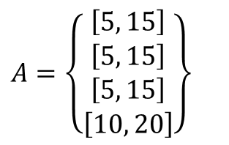

New state generation for $EST_{i}^{p}\left(v\right)>A_{p}^{\min{ }}$
Schedule $J_{2}$ with:
$C_{2}^{\min{ }}=10$
$C_{2}^{\max{ }}=20$
$p=1$
$m_{2}^{\min{ }}=1$
$m_{2}^{\max{ }}=2$
$$A=\left\{\begin{matrix}\left[5, 15\right] \\ \left[5, 15\right] \\ \left[5, 15\right] \\ \left[10, 20\right]\end{matrix}\right\}$$

Slide 4
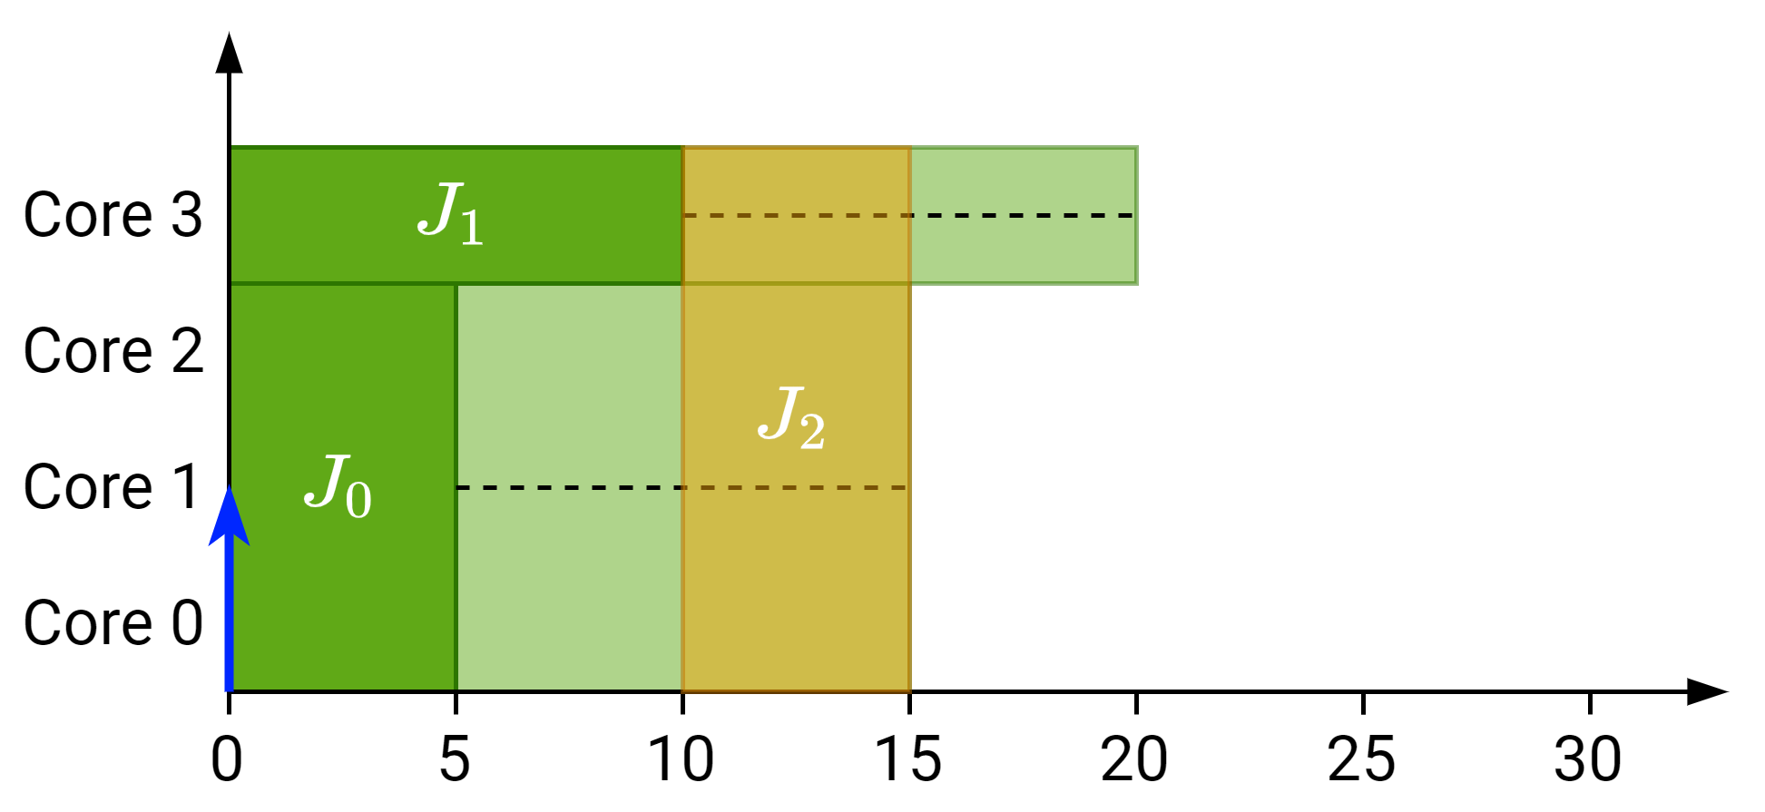

New state generation for $EST_{i}^{p}\left(v\right)>A_{p}^{\min{ }}$
Schedule $J_{2}$ with:
$C_{2}^{\min{ }}=10$
$C_{2}^{\max{ }}=20$
$p=1$
$m_{2}^{\min{ }}=1$
$m_{2}^{\max{ }}=2$
$EST_{2}^{1}=10$
$LST_{2}^{1}=15$
$$A=\left\{\begin{matrix}\left[5, 15\right] \\ \left[5, 15\right] \\ \left[5, 15\right] \\ \left[10, 20\right]\end{matrix}\right\}$$

Slide 5
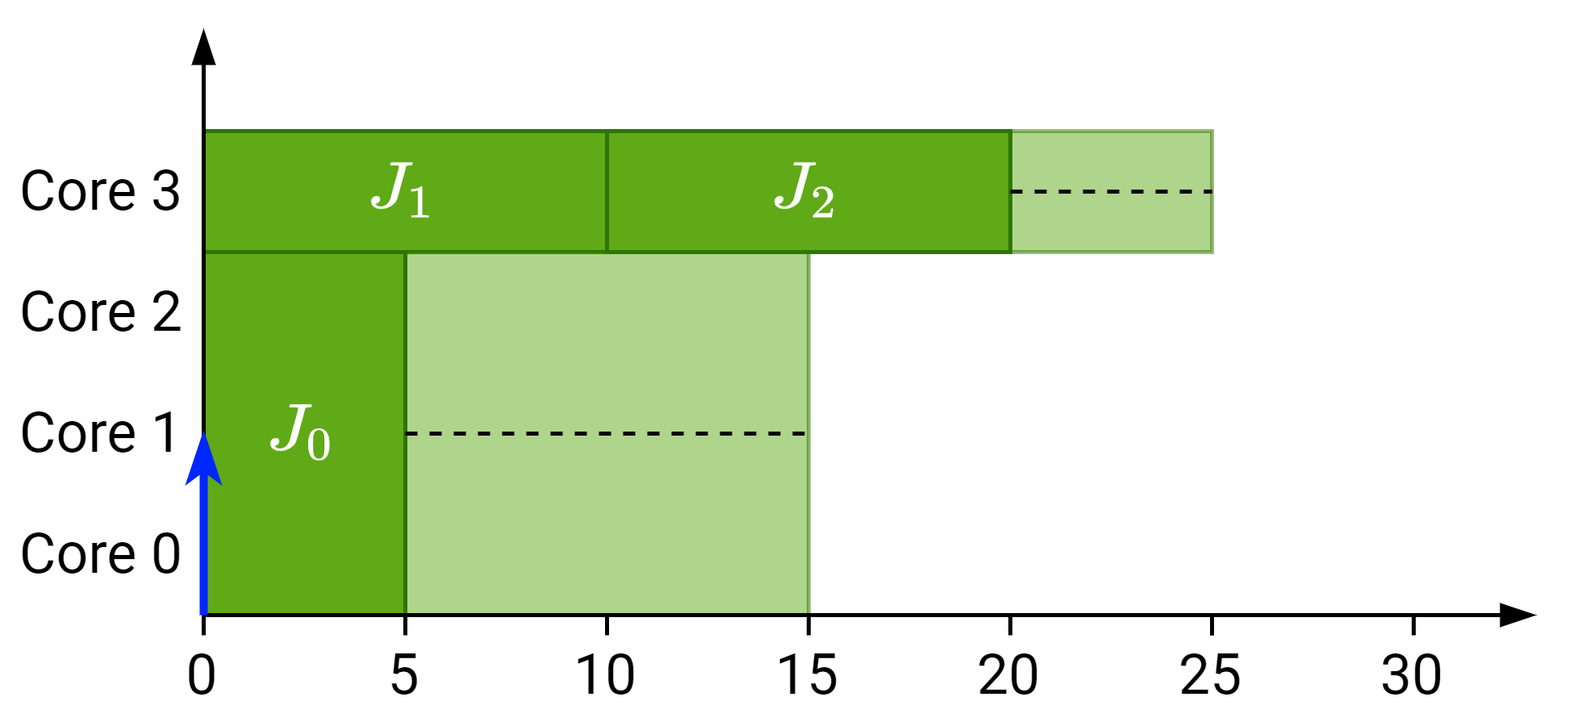
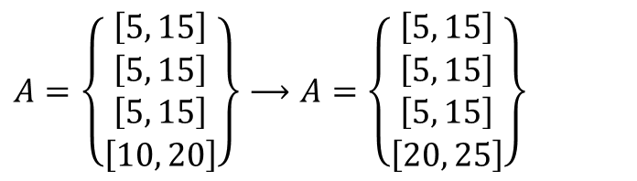
New state generation for $EST_{i}^{p}\left(v\right)>A_{p}^{\min{ }}$
Expected
Schedule $J_{2}$ with:
$C_{2}^{\min{ }}=10$
$C_{2}^{\max{ }}=20$
$p=1$
$m_{2}^{\min{ }}=1$
$m_{2}^{\max{ }}=2$
$EST_{2}^{1}=10$
$LST_{2}^{1}=15$
$$A=\left\{\begin{matrix}\left[5, 15\right] \\ \left[5, 15\right] \\ \left[5, 15\right] \\ \left[10, 20\right]\end{matrix}\right\}⟶A=\left\{\begin{matrix}\left[5, 15\right] \\ \left[5, 15\right] \\ \left[5, 15\right] \\ \left[20, 25\right]\end{matrix}\right\}$$

Slide 6
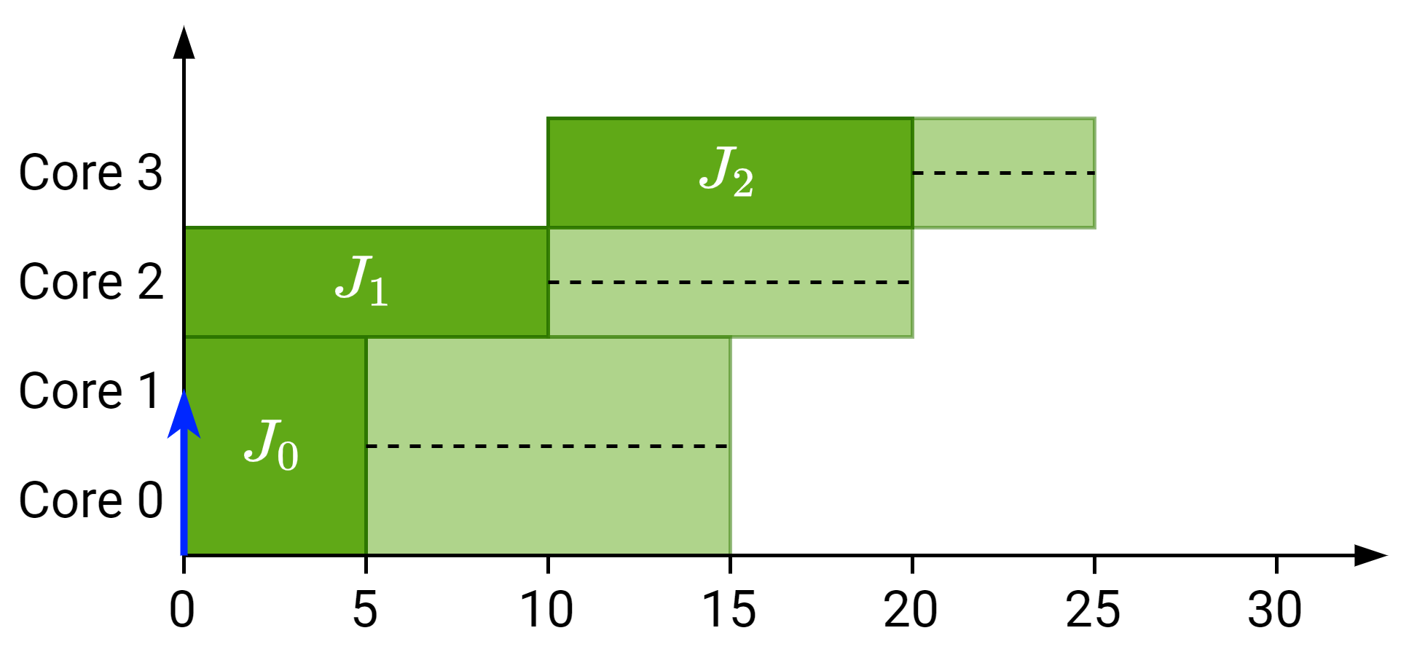
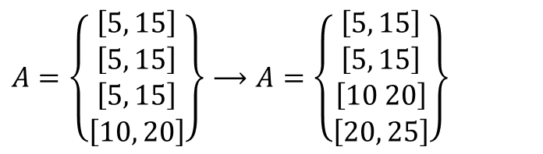
New state generation for $EST_{i}^{p}\left(v\right)>A_{p}^{\min{ }}$
Actual
Schedule $J_{2}$ with:
$C_{2}^{\min{ }}=10$
$C_{2}^{\max{ }}=20$
$p=1$
$m_{2}^{\min{ }}=1$
$m_{2}^{\max{ }}=2$
$EST_{2}^{1}=10$
$LST_{2}^{1}=15$
$$A=\left\{\begin{matrix}\left[5, 15\right] \\ \left[5, 15\right] \\ \left[5, 15\right] \\ \left[10, 20\right]\end{matrix}\right\}⟶A=\left\{\begin{matrix}\left[5, 15\right] \\ \left[5, 15\right] \\ \left[10 20\right] \\ \left[20, 25\right]\end{matrix}\right\}$$

Slide 7
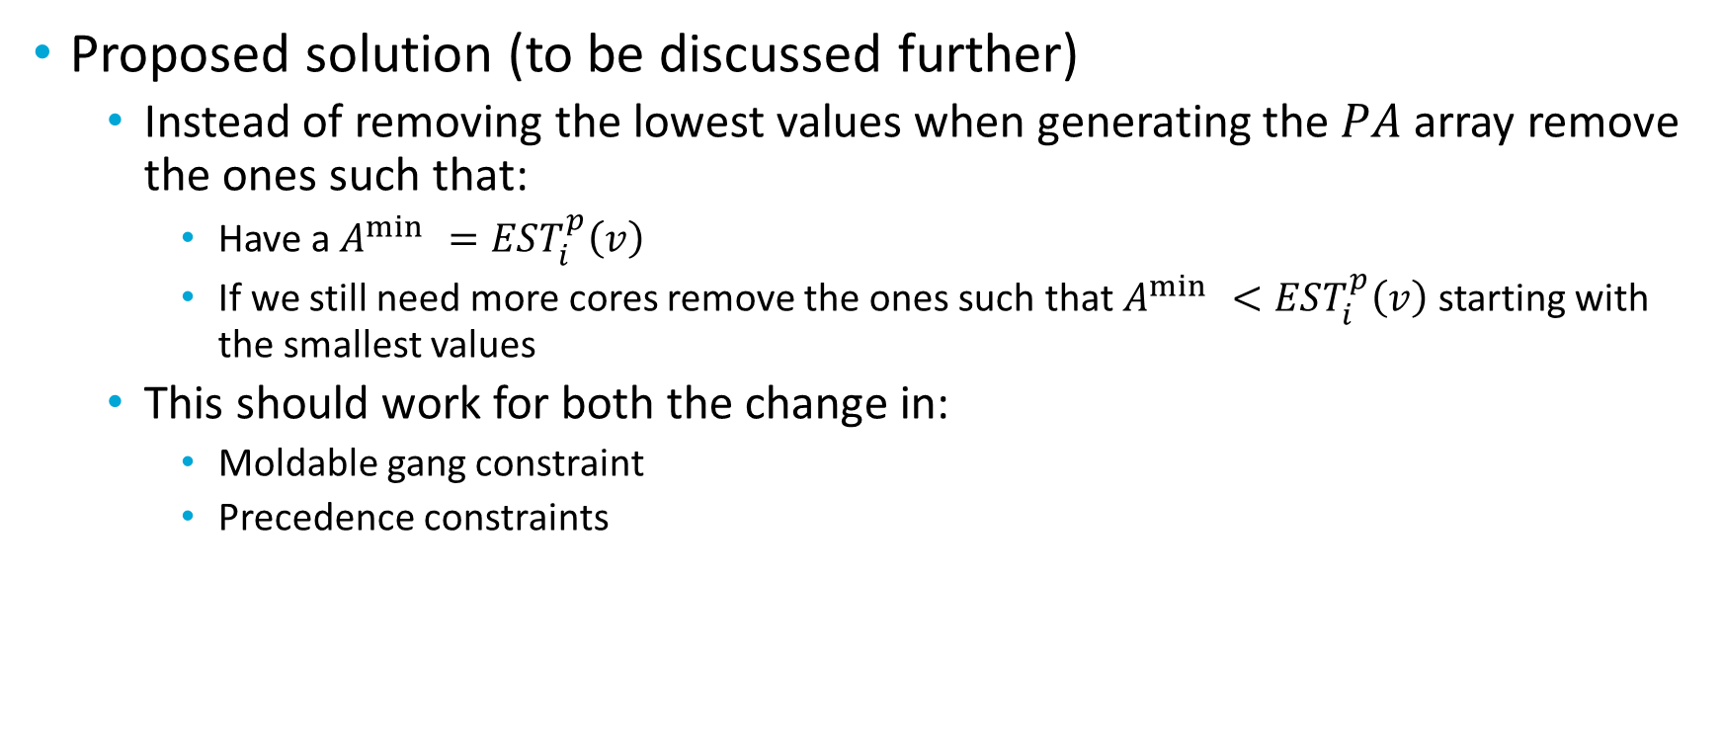

New state generation for $EST_{i}^{p}\left(v\right)>A_{p}^{\min{ }}$
Proposed solution (to be discussed further)
Instead of removing the lowest values when generating the $PA$ array remove the ones such that:
Have a $A^{\min{ }}=EST_{i}^{p}\left(v\right)$
If we still need more cores remove the ones such that $A^{\min{ }}<EST_{i}^{p}\left(v\right)$ starting with the smallest values
This should work for both the change in:
Moldable gang constraint
Precedence constraints

Slide 8

Precedence $EST$ computation
Basic idea
Find time at which it is not necessary to use all the cores currently used by higher-priority segments that have a successor ready.
Notes:
First of all, let’s explain what gang scheduling is.
<click>
Let’s say that we have multiple threads that we want to schedule. If we want to convert them to a gang task we would put them together as a “gang” <click> and then we would schedule as a single task<click> so the execution would not start until there are enough free cores.

Slide 9
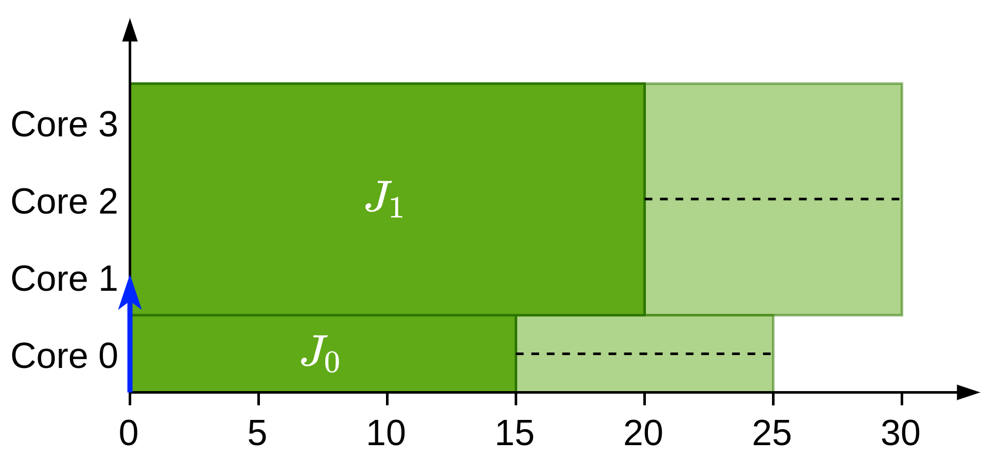
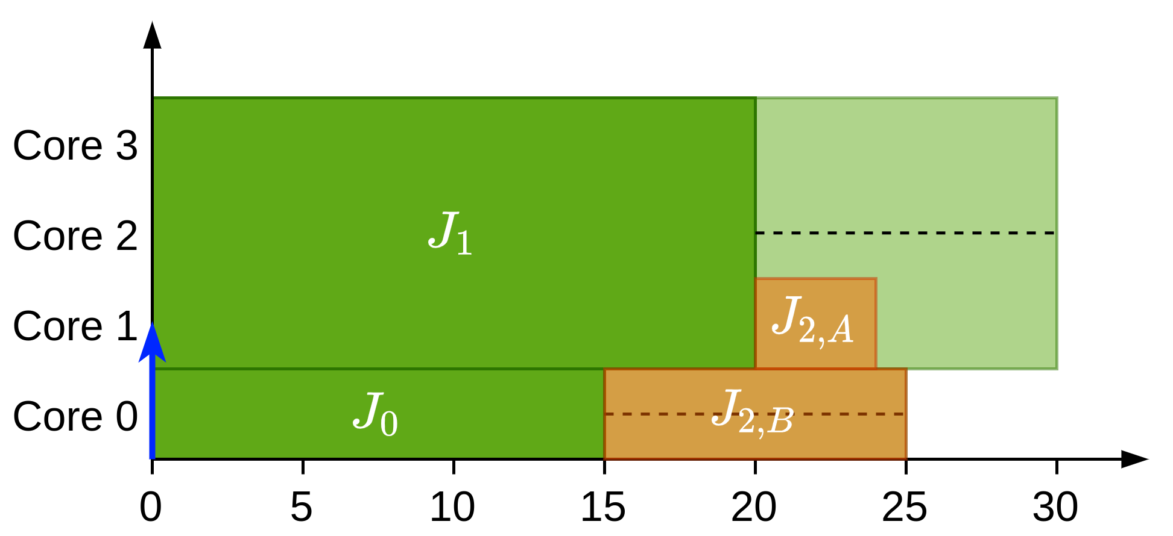
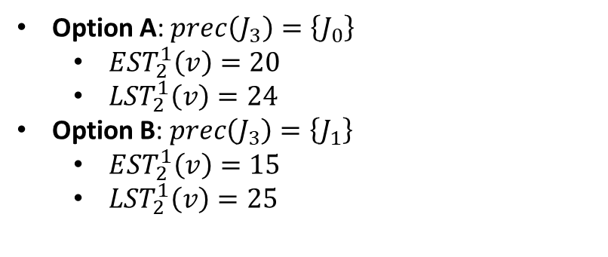
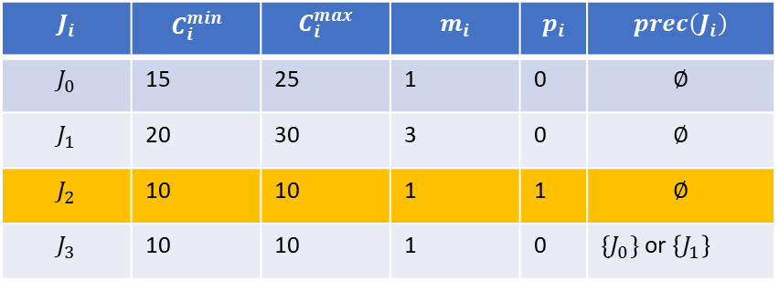
Illustration of the problem in global processing
$$J_{i}$$ | $$C_{i}^{min}$$ | $$C_{i}^{max}$$ | $$m_{i}$$ | $$p_{i}$$ | $$prec\left(J_{i}\right)$$
$$J_{0}$$ | 15 | 25 | 1 | 0 | $$∅$$
$$J_{1}$$ | 20 | 30 | 3 | 0 | $$∅$$
$$J_{2}$$ | 10 | 10 | 1 | 1 | $$∅$$
$$J_{3}$$ | 10 | 10 | 1 | 0 | $\{J_{0}\}$ or $\left\{J_{1}\right\}$
Option A: $prec\left(J_{3}\right)=\left\{J_{0}\right\}$
$EST_{2}^{1}\left(v\right)=20$
$LST_{2}^{1}\left(v\right)=24$
Option B: $prec\left(J_{3}\right)=\left\{J_{1}\right\}$
$EST_{2}^{1}\left(v\right)=15$
$LST_{2}^{1}\left(v\right)=25$

Slide 10
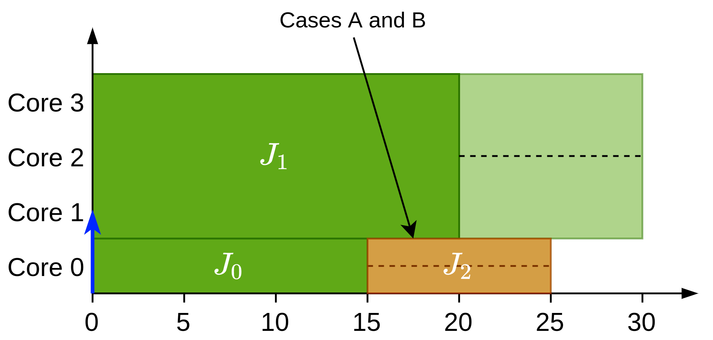
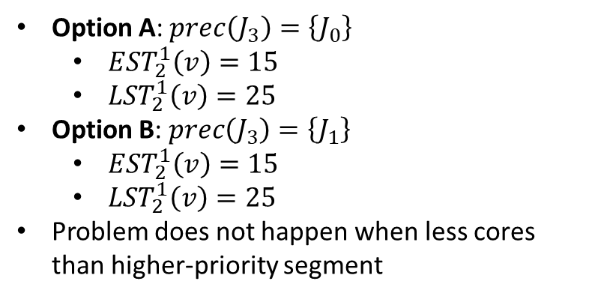
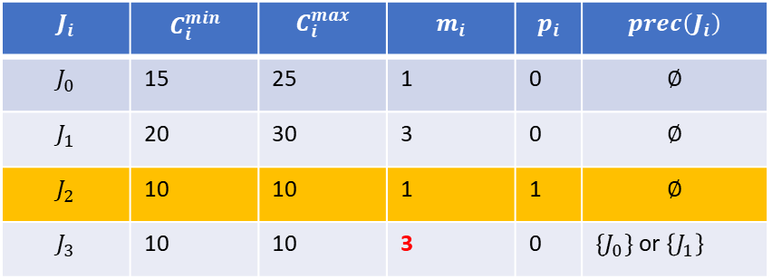
Illustration of the problem in gang
$$J_{i}$$ | $$C_{i}^{min}$$ | $$C_{i}^{max}$$ | $$m_{i}$$ | $$p_{i}$$ | $$prec\left(J_{i}\right)$$
$$J_{0}$$ | 15 | 25 | 1 | 0 | $$∅$$
$$J_{1}$$ | 20 | 30 | 3 | 0 | $$∅$$
$$J_{2}$$ | 10 | 10 | 1 | 1 | $$∅$$
$$J_{3}$$ | 10 | 10 | 3 | 0 | $\{J_{0}\}$ or $\left\{J_{1}\right\}$
Option A: $prec\left(J_{3}\right)=\left\{J_{0}\right\}$
$EST_{2}^{1}\left(v\right)=15$
$LST_{2}^{1}\left(v\right)=25$
Option B: $prec\left(J_{3}\right)=\left\{J_{1}\right\}$
$EST_{2}^{1}\left(v\right)=15$
$LST_{2}^{1}\left(v\right)=25$
Problem does not happen when less cores than higher-priority segment

Slide 11
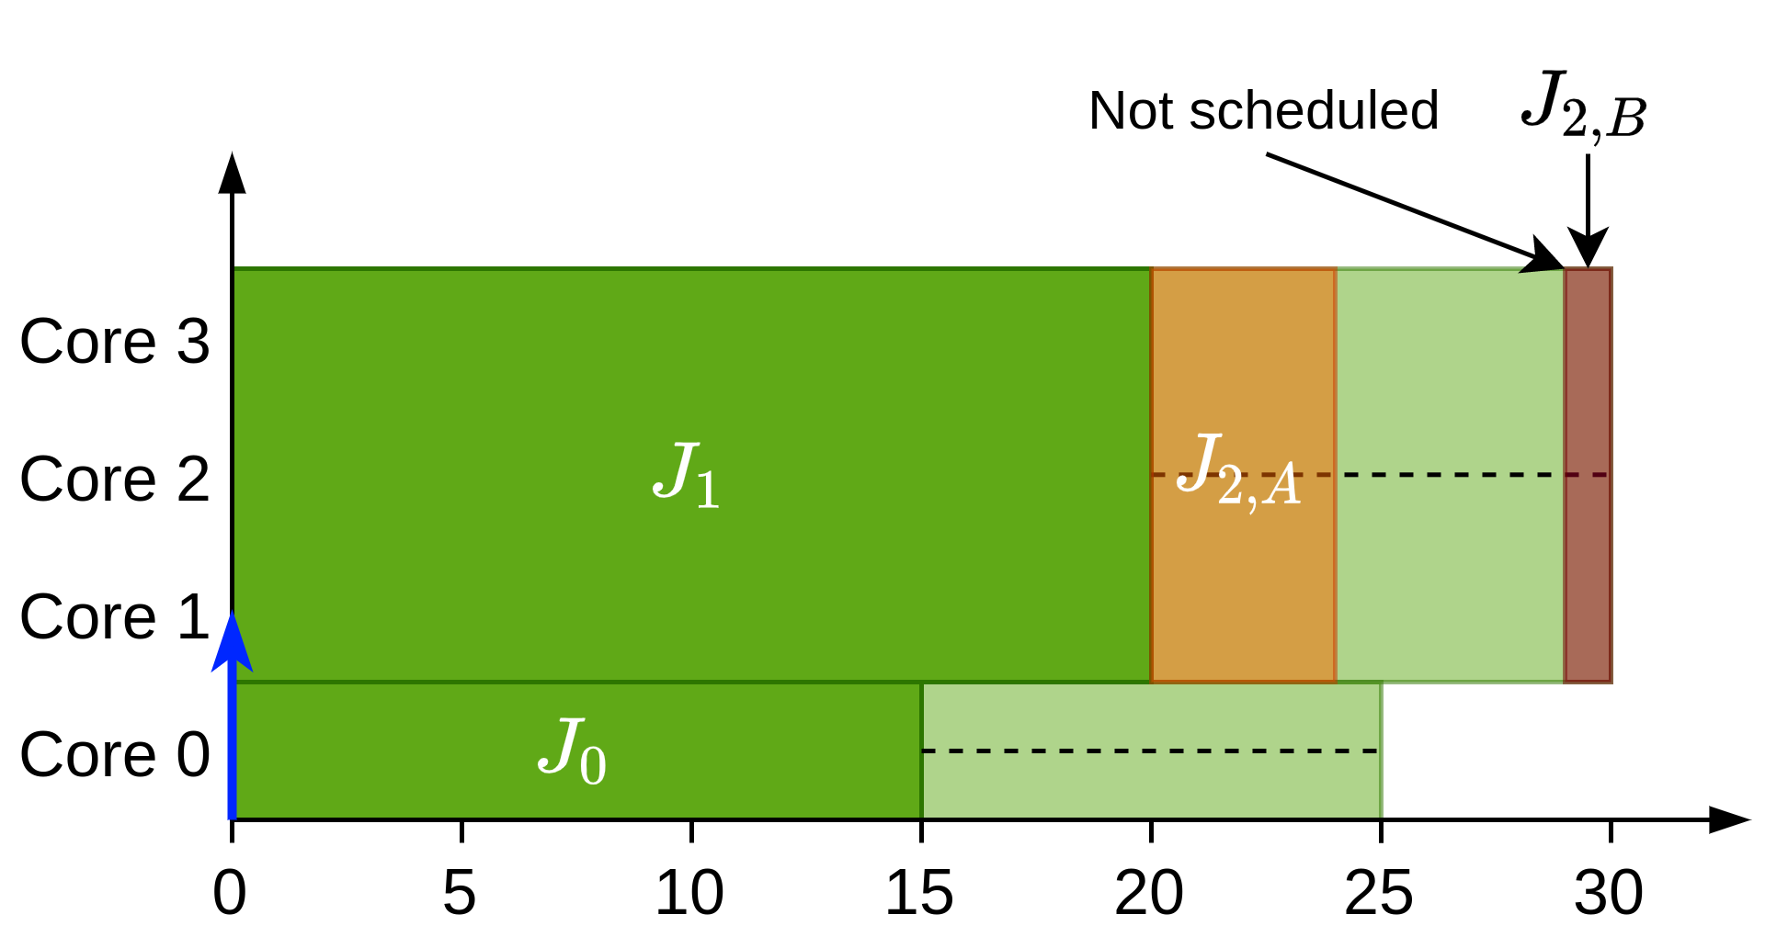
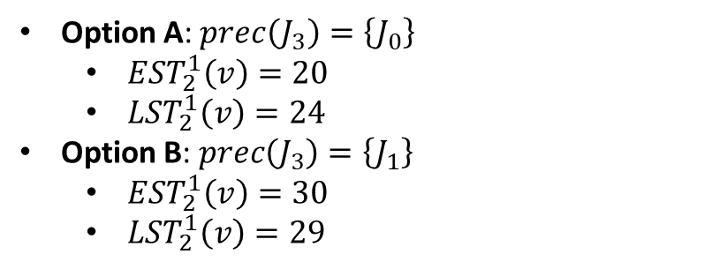
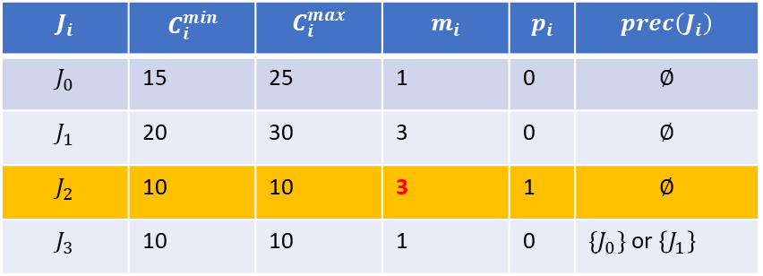
Illustration of the problem if LP is gang
$$J_{i}$$ | $$C_{i}^{min}$$ | $$C_{i}^{max}$$ | $$m_{i}$$ | $$p_{i}$$ | $$prec\left(J_{i}\right)$$
$$J_{0}$$ | 15 | 25 | 1 | 0 | $$∅$$
$$J_{1}$$ | 20 | 30 | 3 | 0 | $$∅$$
$$J_{2}$$ | 10 | 10 | 3 | 1 | $$∅$$
$$J_{3}$$ | 10 | 10 | 1 | 0 | $\{J_{0}\}$ or $\left\{J_{1}\right\}$
Option A: $prec\left(J_{3}\right)=\left\{J_{0}\right\}$
$EST_{2}^{1}\left(v\right)=20$
$LST_{2}^{1}\left(v\right)=24$
Option B: $prec\left(J_{3}\right)=\left\{J_{1}\right\}$
$EST_{2}^{1}\left(v\right)=30$
$LST_{2}^{1}\left(v\right)=29$

Slide 12
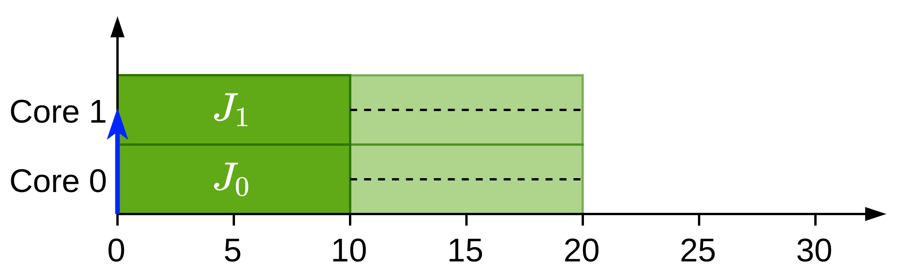
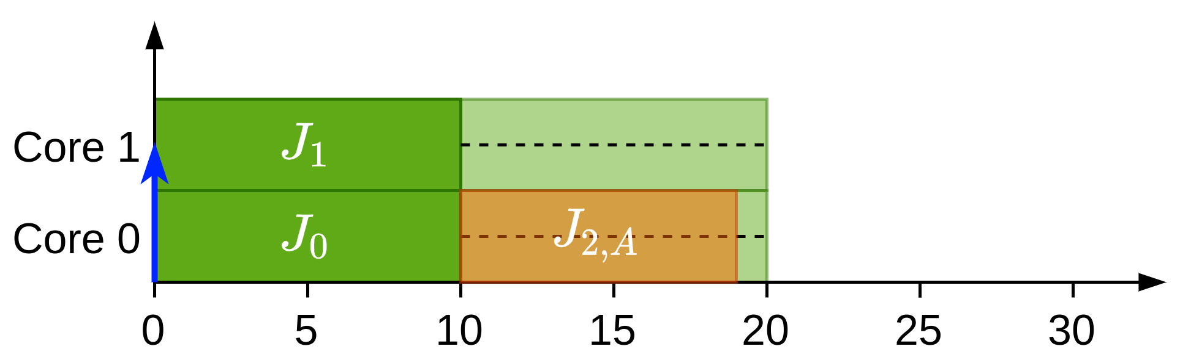
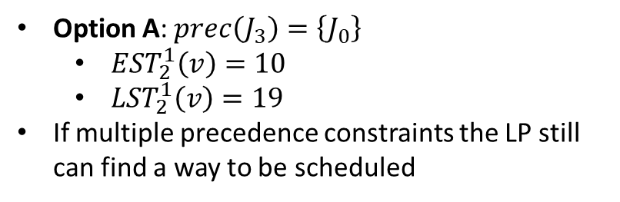
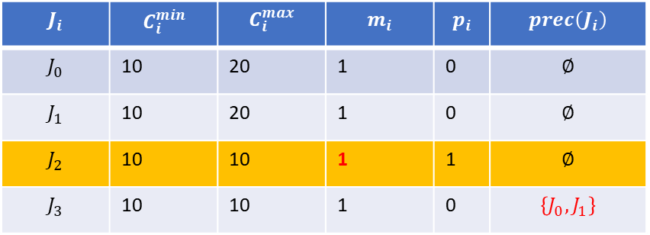
What happens with multiple PC?
$$J_{i}$$ | $$C_{i}^{min}$$ | $$C_{i}^{max}$$ | $$m_{i}$$ | $$p_{i}$$ | $$prec\left(J_{i}\right)$$
$$J_{0}$$ | 10 | 20 | 1 | 0 | $$∅$$
$$J_{1}$$ | 10 | 20 | 1 | 0 | $$∅$$
$$J_{2}$$ | 10 | 10 | 1 | 1 | $$∅$$
$$J_{3}$$ | 10 | 10 | 1 | 0 | $$\left\{J_{0}, J_{1}\right\}$$
Option A: $prec\left(J_{3}\right)=\left\{J_{0}\right\}$
$EST_{2}^{1}\left(v\right)=10$
$LST_{2}^{1}\left(v\right)=19$
If multiple precedence constraints the LP still can find a way to be scheduled

Slide 13
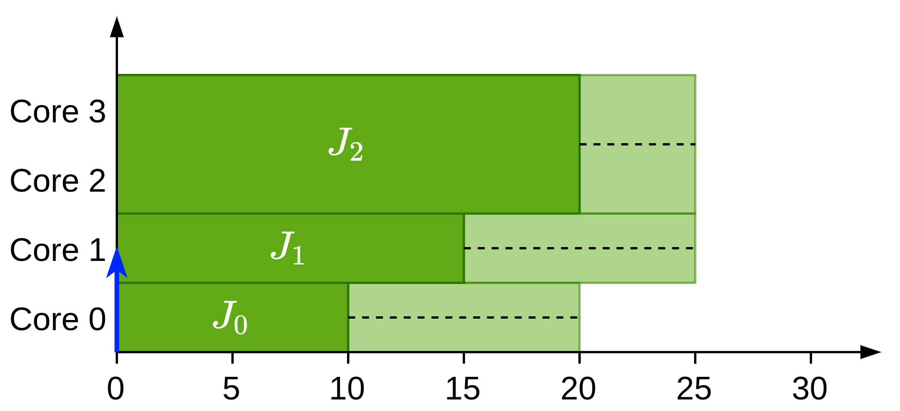
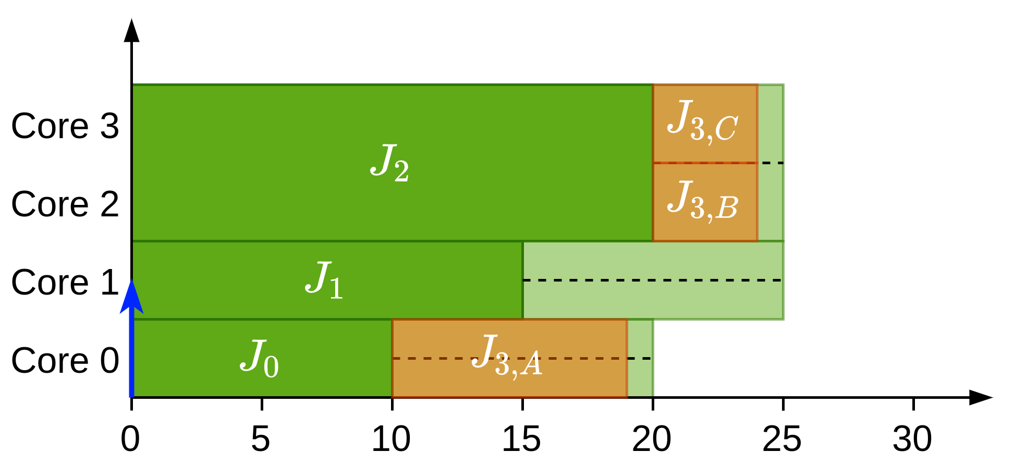

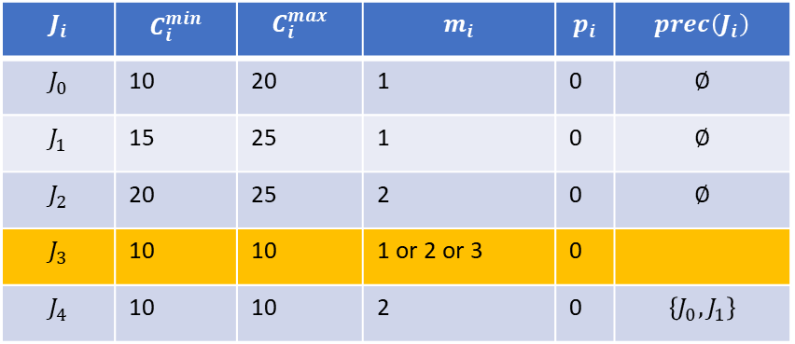
What happens with multiple PC?
$$J_{i}$$ | $$C_{i}^{min}$$ | $$C_{i}^{max}$$ | $$m_{i}$$ | $$p_{i}$$ | $$prec\left(J_{i}\right)$$
$$J_{0}$$ | 10 | 20 | 1 | 0 | $$∅$$
$$J_{1}$$ | 15 | 25 | 1 | 0 | $$∅$$
$$J_{2}$$ | 20 | 25 | 2 | 0 | $$∅$$
$$J_{3}$$ | 10 | 10 | 1 or 2 or 3 | 0
$$J_{4}$$ | 10 | 10 | 2 | 0 | $$\left\{J_{0}, J_{1}\right\}$$
Option A: $m_{3}=1$
$EST_{2}^{1}\left(v\right)=10$
$LST_{2}^{1}\left(v\right)=19$
Option B: $m_{3}=2$
$EST_{2}^{1}\left(v\right)=20$
$LST_{2}^{1}\left(v\right)=24$
Option C: $m_{3}=3$
$EST_{2}^{1}\left(v\right)=20$
$LST_{2}^{1}\left(v\right)=24$

Slide 14
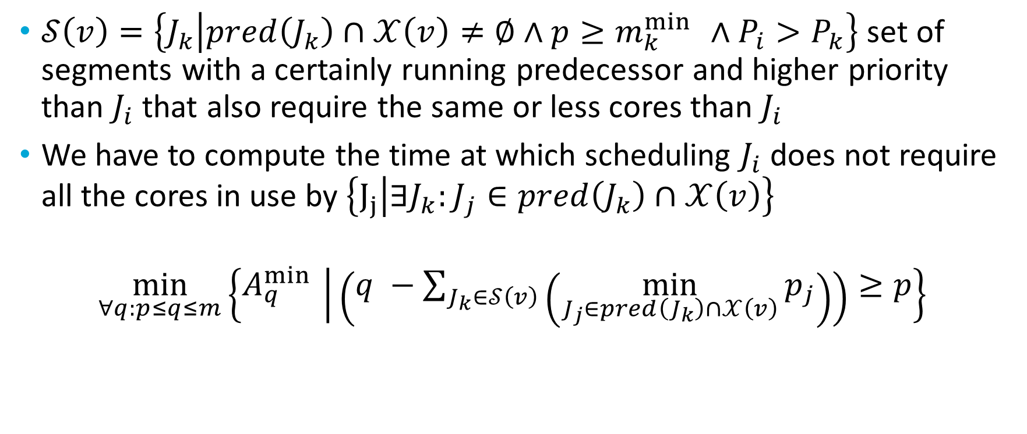
Basic rules
$𝒮\left(v\right)=\left\{J_{k} | pred\left(J_{k}\right)∩𝒳\left(v\right)≠∅∧p≥m_{k}^{\min{ }}∧P_{i}>P_{k}\right\}$ set of segments with a certainly running predecessor and higher priority than $J_{i}$ that also require the same or less cores than $J_{i}$
We have to compute the time at which scheduling $J_{i}$ does not require all the cores in use by $\left\{J_{j} | ∃J_{k}:J_{j}∈pred\left(J_{k}\right)∩𝒳\left(v\right)\right\}$
$$\min_{∀q:p≤q≤m}\left\{A_{q}^{\min{ }} | \left(q −\sum_{J_{k}∈𝒮\left(v\right)}{\left(\min_{J_{j}∈pred\left(J_{k}\right)∩𝒳\left(v\right)}{p_{j}}\right)}\right)≥p\right\}$$

Slide 15
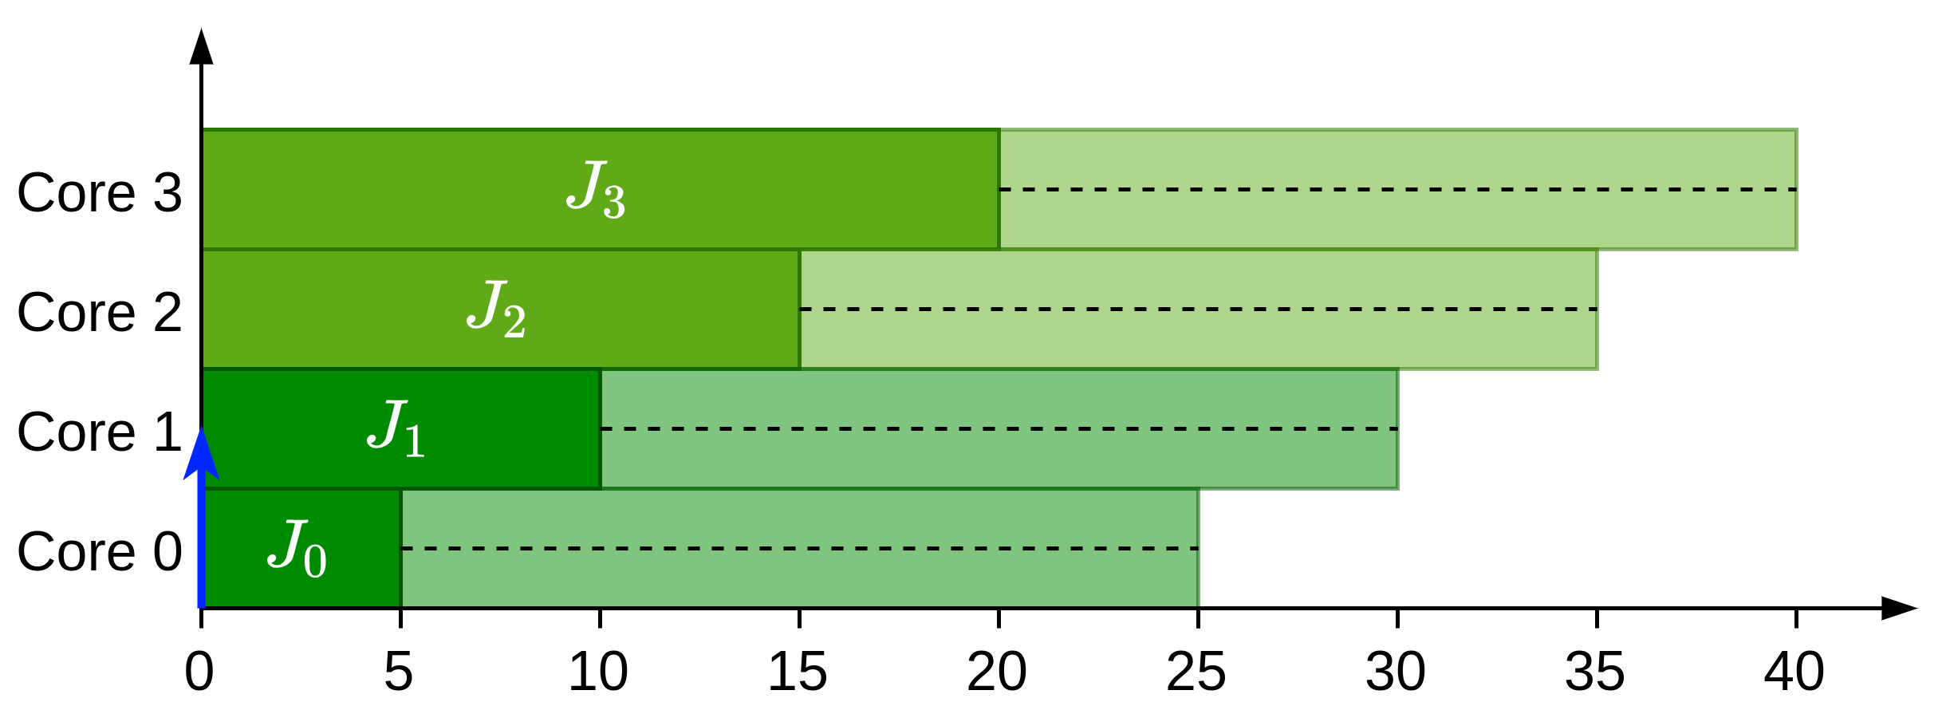



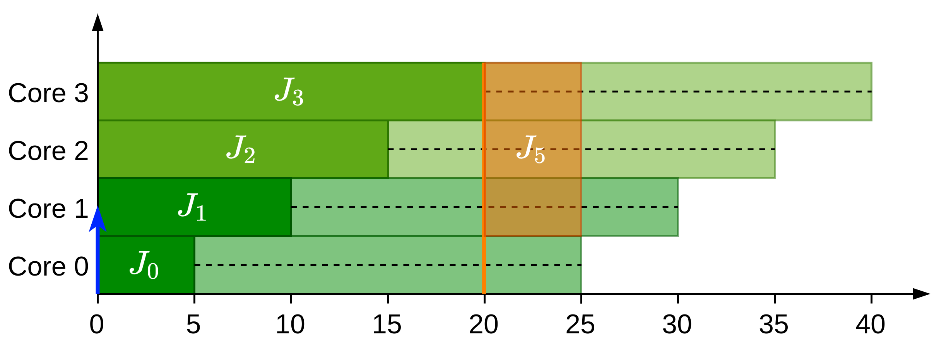

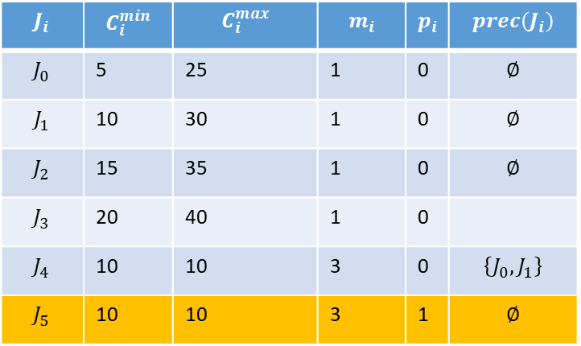
Example solution
$$J_{i}$$ | $$C_{i}^{min}$$ | $$C_{i}^{max}$$ | $$m_{i}$$ | $$p_{i}$$ | $$prec\left(J_{i}\right)$$
$$J_{0}$$ | 5 | 25 | 1 | 0 | $$∅$$
$$J_{1}$$ | 10 | 30 | 1 | 0 | $$∅$$
$$J_{2}$$ | 15 | 35 | 1 | 0 | $$∅$$
$$J_{3}$$ | 20 | 40 | 1 | 0
$$J_{4}$$ | 10 | 10 | 3 | 0 | $$\left\{J_{0}, J_{1}\right\}$$
$$J_{5}$$ | 10 | 10 | 3 | 1 | $$∅$$

