Slide 1

Scheduling and Analysis of Limited-Preemptive Moldable Gang Tasks Weekly Meeting
Joan Marcè i Igual
25th of March, 2020

Slide 2
To discuss today
Done
New tests
LPMGRS scheduler algorithm
Formalisation
Task generation formalisation
Results
Notation
To do
Tasks with precedence constraints generation
Notes:
First of all, let’s explain what gang scheduling is.
<click>
Let’s say that we have multiple threads that we want to schedule. If we want to convert them to a gang task we would put them together as a “gang” <click> and then we would schedule as a single task<click> so the execution would not start until there are enough free cores.

Slide 3
What has been done?
Analyse generated task sets
Make sure that we have proper utilization in all the discussed steps
Change period generation
Notes:
First of all, let’s explain what gang scheduling is.
<click>
Let’s say that we have multiple threads that we want to schedule. If we want to convert them to a gang task we would put them together as a “gang” <click> and then we would schedule as a single task<click> so the execution would not start until there are enough free cores.

Slide 4
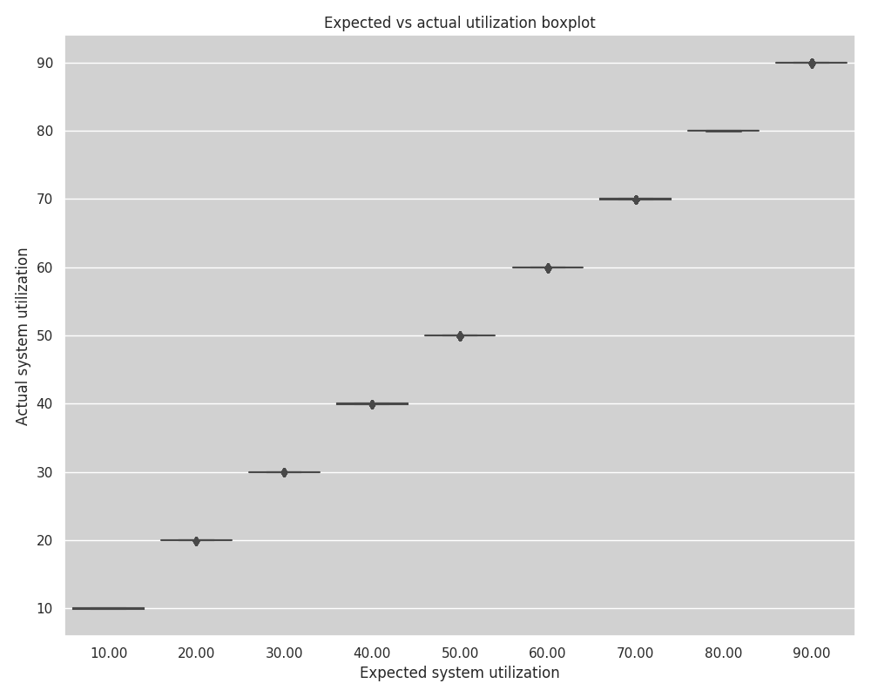

Slide 5
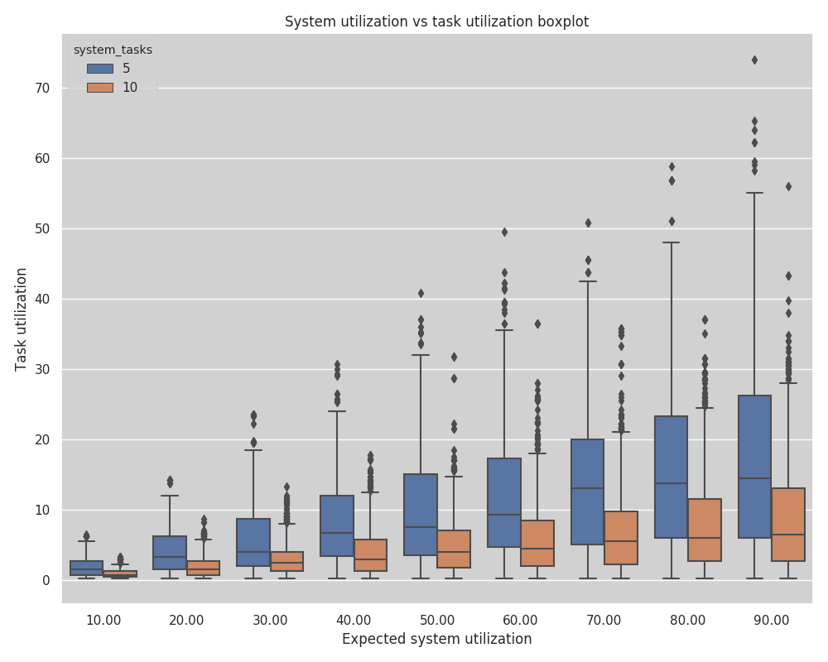

Slide 6
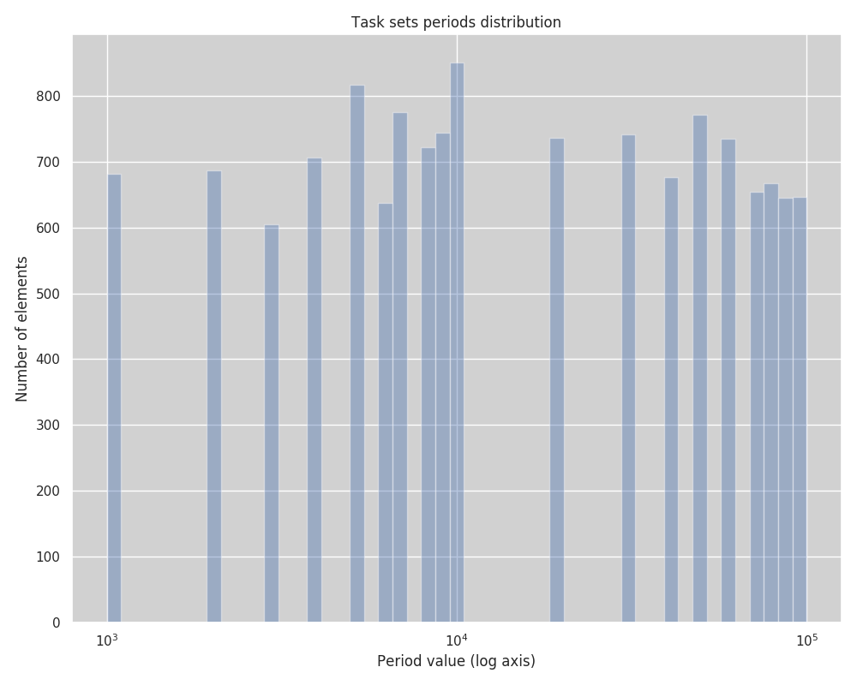

Slide 7
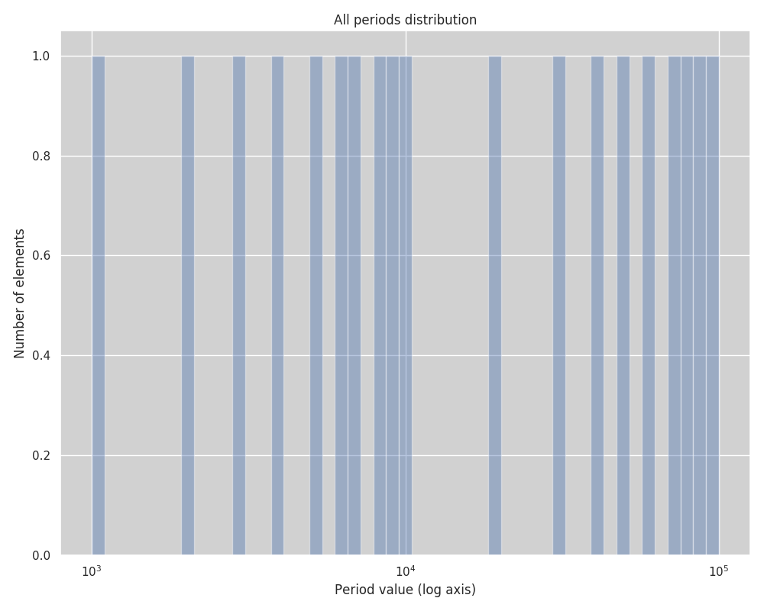

Slide 8
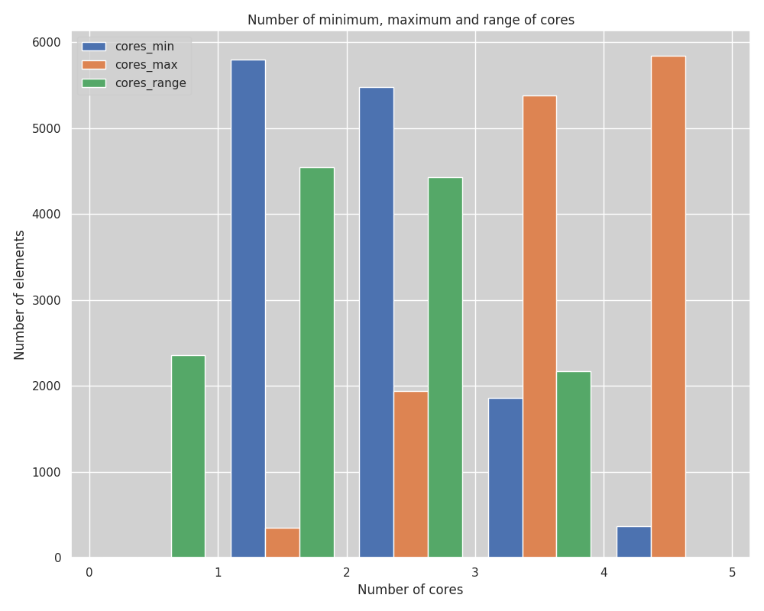

Slide 9
What has been done?
Analyse generated task sets
Make sure that we have proper utilization in all the discussed steps
Change period generation
Write petition for SURFSara
I mistakenly considered 48 hours per experiment while that was the time needed for the experiment without precedence constraints and without jitter
We need around 150 hours with precedence constraints
I am expecting thus ~1500 hours with jitter + precedence constraints
Generate tasks with precedence constraints
Notes:
First of all, let’s explain what gang scheduling is.
<click>
Let’s say that we have multiple threads that we want to schedule. If we want to convert them to a gang task we would put them together as a “gang” <click> and then we would schedule as a single task<click> so the execution would not start until there are enough free cores.

Slide 10
Tasks with precedence constraints
Generate in a linear way
Choose depth
Choose number of parallel jobs per node

Slide 11
What has been done?
Maybe we have too many task sets to evaluate, reduce some of the tests?
Implement task with precedence constraints into simulator (90%)
Test runs of tasks with precedence constraints into SAG
Some bugs were found
Certainly running jobs set is a bit imprecise
Notes:
First of all, let’s explain what gang scheduling is.
<click>
Let’s say that we have multiple threads that we want to schedule. If we want to convert them to a gang task we would put them together as a “gang” <click> and then we would schedule as a single task<click> so the execution would not start until there are enough free cores.

Slide 12
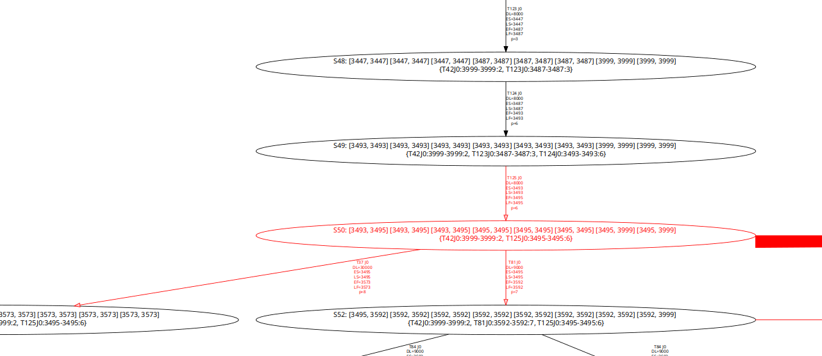
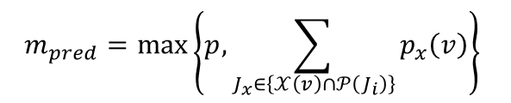
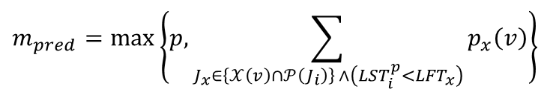
Certainly running jobs problems
$$m_{pred}=\max\left\{p, \sum_{J_{x}∈\left\{𝒳\left(v\right)∩𝒫\left(J_{i}\right)\right\}}{p_{x}\left(v\right)}\right\}$$
$$m_{pred}=\max\left\{p, \sum_{J_{x}∈\left\{𝒳\left(v\right)∩𝒫\left(J_{i}\right)\right\} ∧\left(LST_{i}^{p}<LFT_{x}\right)}{p_{x}\left(v\right)}\right\}$$

Slide 13
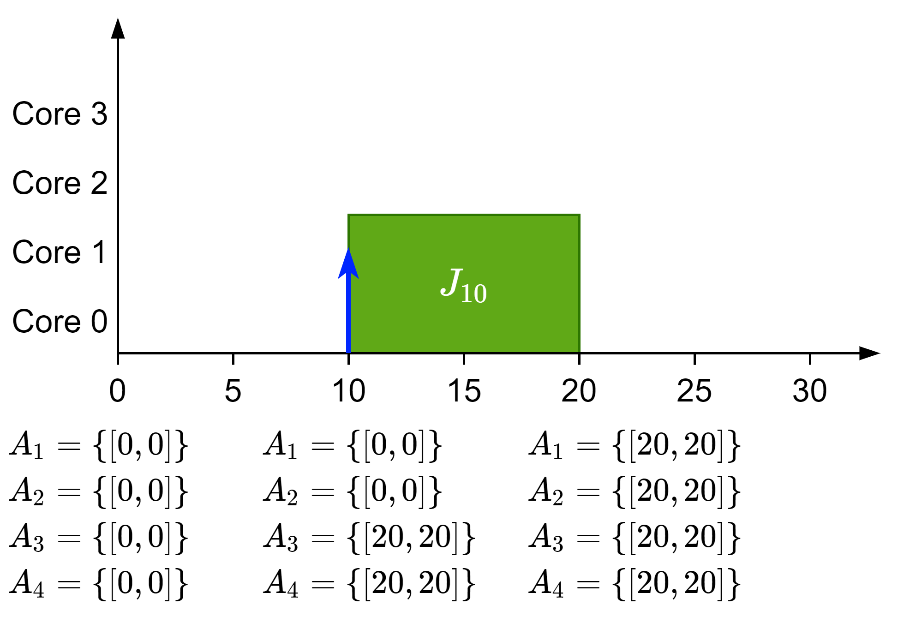
Discussion: PA

Slide 14
What’s next?
Optimize SAG for gang tasks
SAG for gang tasks is slower than with non gang tasks due to checking for jobs x cores
There are some cases that could speed up the next state generation a bit
Run schedulability analysis with precedence constraints
Small batches in order to test further for bugs
Once everything is clear run in cluster
Finish simulator precedence constraints and test against SAG
Create task sets with precedence constraints and jitter
Run them
Try to solve the mistake of asking for the wrong number of hours
I don’t really have my hopes high for that… I think I will need to find other ways
Notes:
First of all, let’s explain what gang scheduling is.
<click>
Let’s say that we have multiple threads that we want to schedule. If we want to convert them to a gang task we would put them together as a “gang” <click> and then we would schedule as a single task<click> so the execution would not start until there are enough free cores.

