Slide 1

Scheduling and Analysis of Limited-Preemptive Moldable Gang Tasks Weekly Meeting
Joan Marcè i Igual
25th of March, 2020

Slide 2
To discuss today
Done
New tests
LPMGRS scheduler algorithm
Formalisation
Task generation formalisation
Results
Notation
To do
Tasks with precedence constraints generation
Notes:
First of all, let’s explain what gang scheduling is.
<click>
Let’s say that we have multiple threads that we want to schedule. If we want to convert them to a gang task we would put them together as a “gang” <click> and then we would schedule as a single task<click> so the execution would not start until there are enough free cores.

Slide 3
What has been done?
Analyse generated task sets
Make sure that we have proper utilization in all the discussed steps
Change period generation
Notes:
First of all, let’s explain what gang scheduling is.
<click>
Let’s say that we have multiple threads that we want to schedule. If we want to convert them to a gang task we would put them together as a “gang” <click> and then we would schedule as a single task<click> so the execution would not start until there are enough free cores.

Slide 4
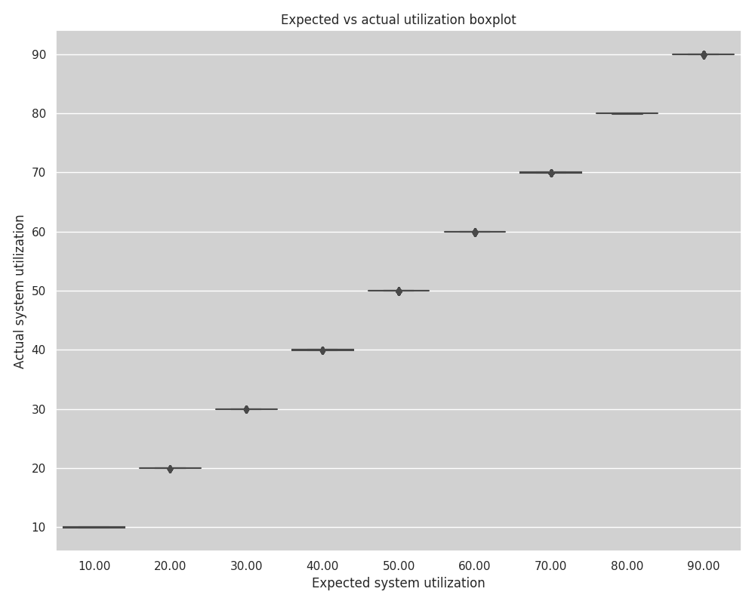

Slide 5
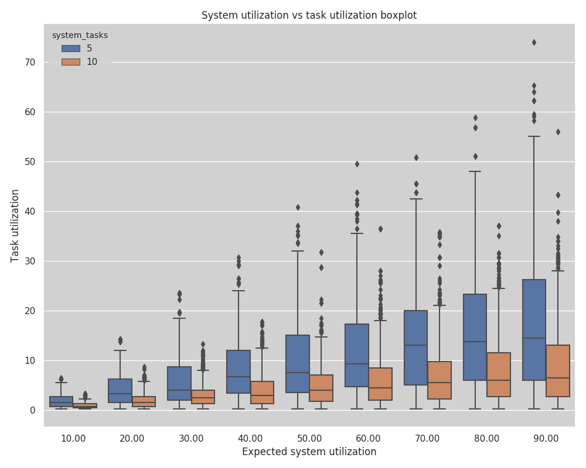

Slide 6
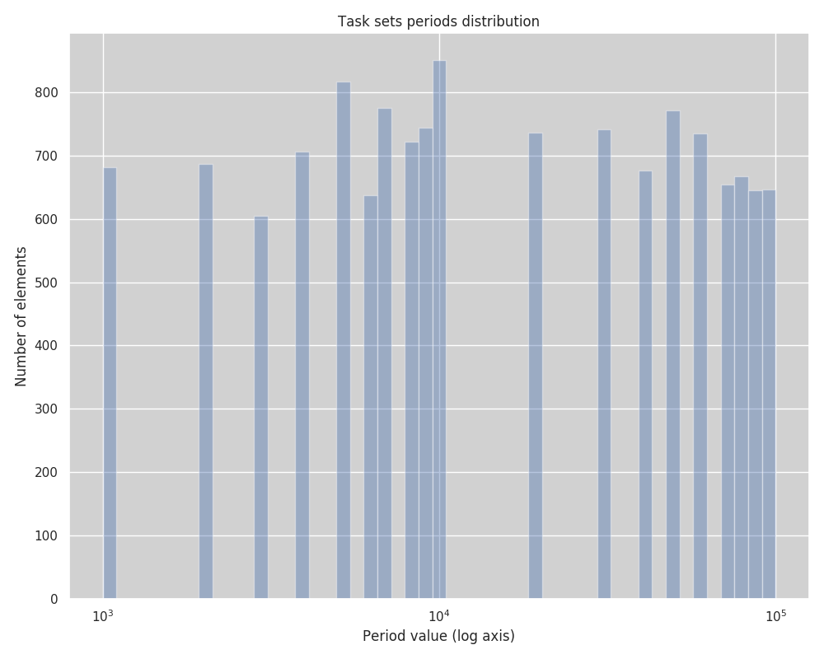

Slide 7
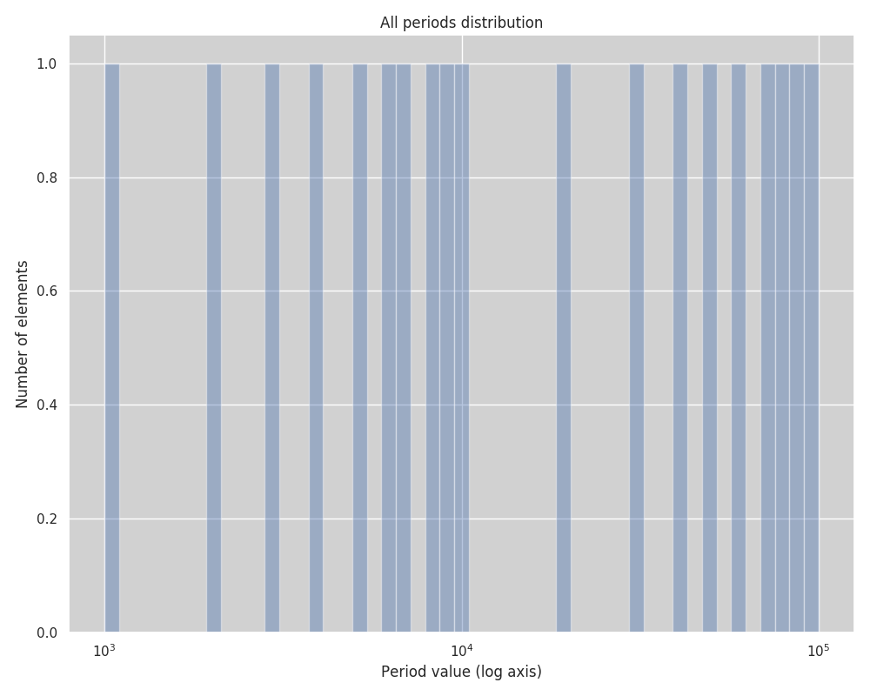

Slide 8
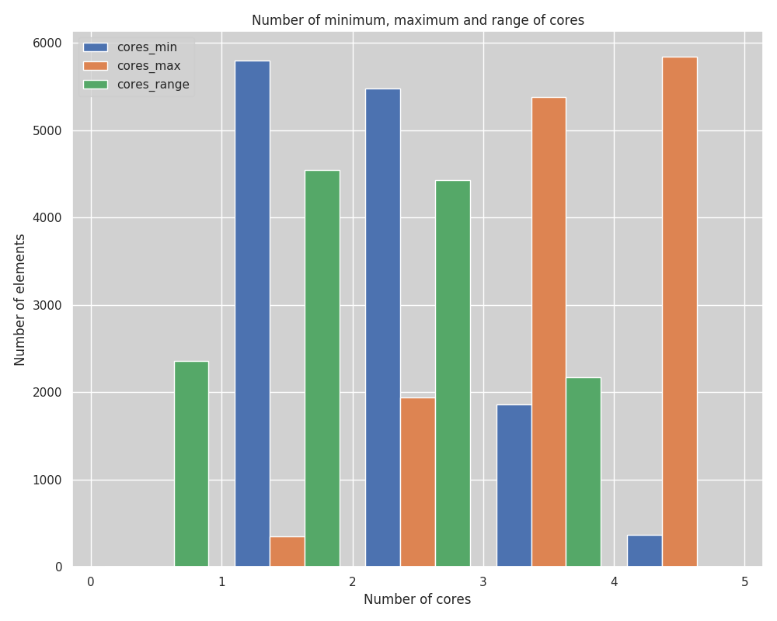

Slide 9
What has been done?
Analyse generated task sets
Make sure that we have proper utilization in all the discussed steps
Change period generation
Write petition for SURFSara
I mistakenly considered 48 hours per experiment while that was the time needed for the experiment without precedence constraints and without jitter
We need around 150 hours with precedence constraints
I am expecting thus ~1500 hours with jitter + precedence constraints
Generate tasks with precedence constraints
Maybe we have too many task sets to evaluate, reduce some of the tests?
Notes:
First of all, let’s explain what gang scheduling is.
<click>
Let’s say that we have multiple threads that we want to schedule. If we want to convert them to a gang task we would put them together as a “gang” <click> and then we would schedule as a single task<click> so the execution would not start until there are enough free cores.

Slide 10
Tasks with precedence constraints
Generate in a linear way
Choose depth
Choose number of parallel jobs per node

Slide 11
What’s next?
Run schedulability analysis with precedence constraints
Implement precedence constraints in simulator
Run simulator with precedence constraints
Create task sets with precedence constraints and jitter
Run them
Notes:
First of all, let’s explain what gang scheduling is.
<click>
Let’s say that we have multiple threads that we want to schedule. If we want to convert them to a gang task we would put them together as a “gang” <click> and then we would schedule as a single task<click> so the execution would not start until there are enough free cores.

