Slide 1



Scheduling and Analysis of Limited-Preemptive Moldable Gang Tasks Weekly Meeting
Joan Marcè i Igual
Geoffrey Nelissen
Mitra Nasri
Paris Panagiotou
1st of March, 2020

Slide 2
What has been done?
Finish presentation
Go to Brussels to present at CAPITAL
Recovering from being sick
Work a bit more on results
Obtain faster results
Notes:
First of all, let’s explain what gang scheduling is.
<click>
Let’s say that we have multiple threads that we want to schedule. If we want to convert them to a gang task we would put them together as a “gang” <click> and then we would schedule as a single task<click> so the execution would not start until there are enough free cores.

Slide 3
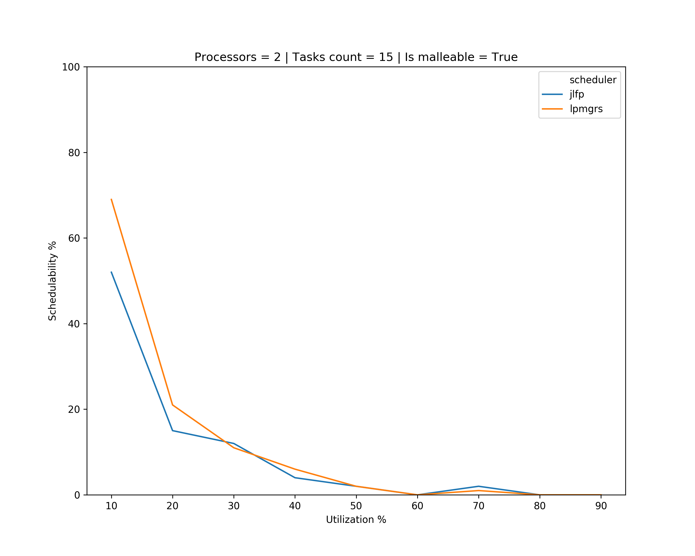
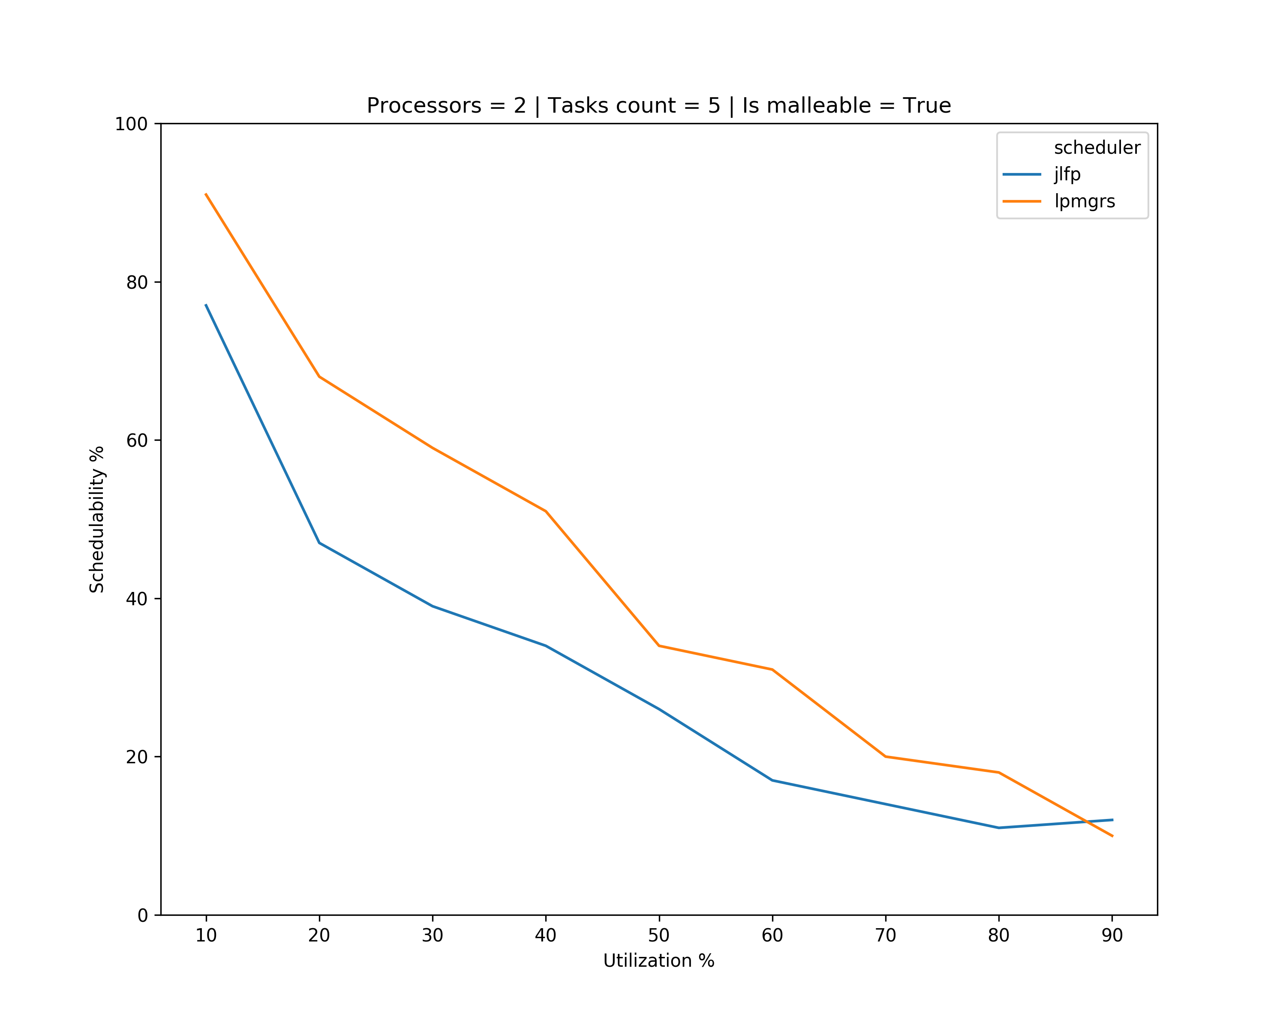
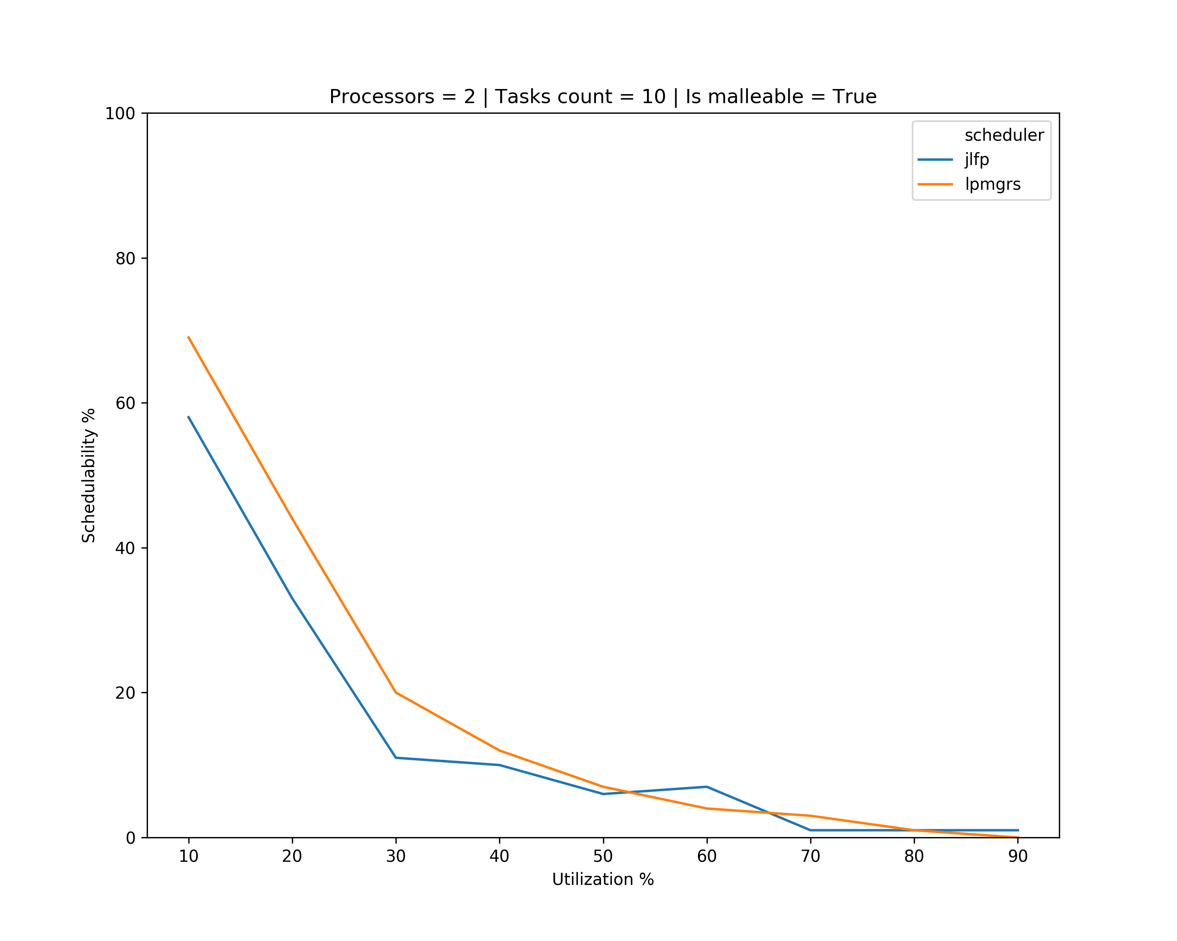
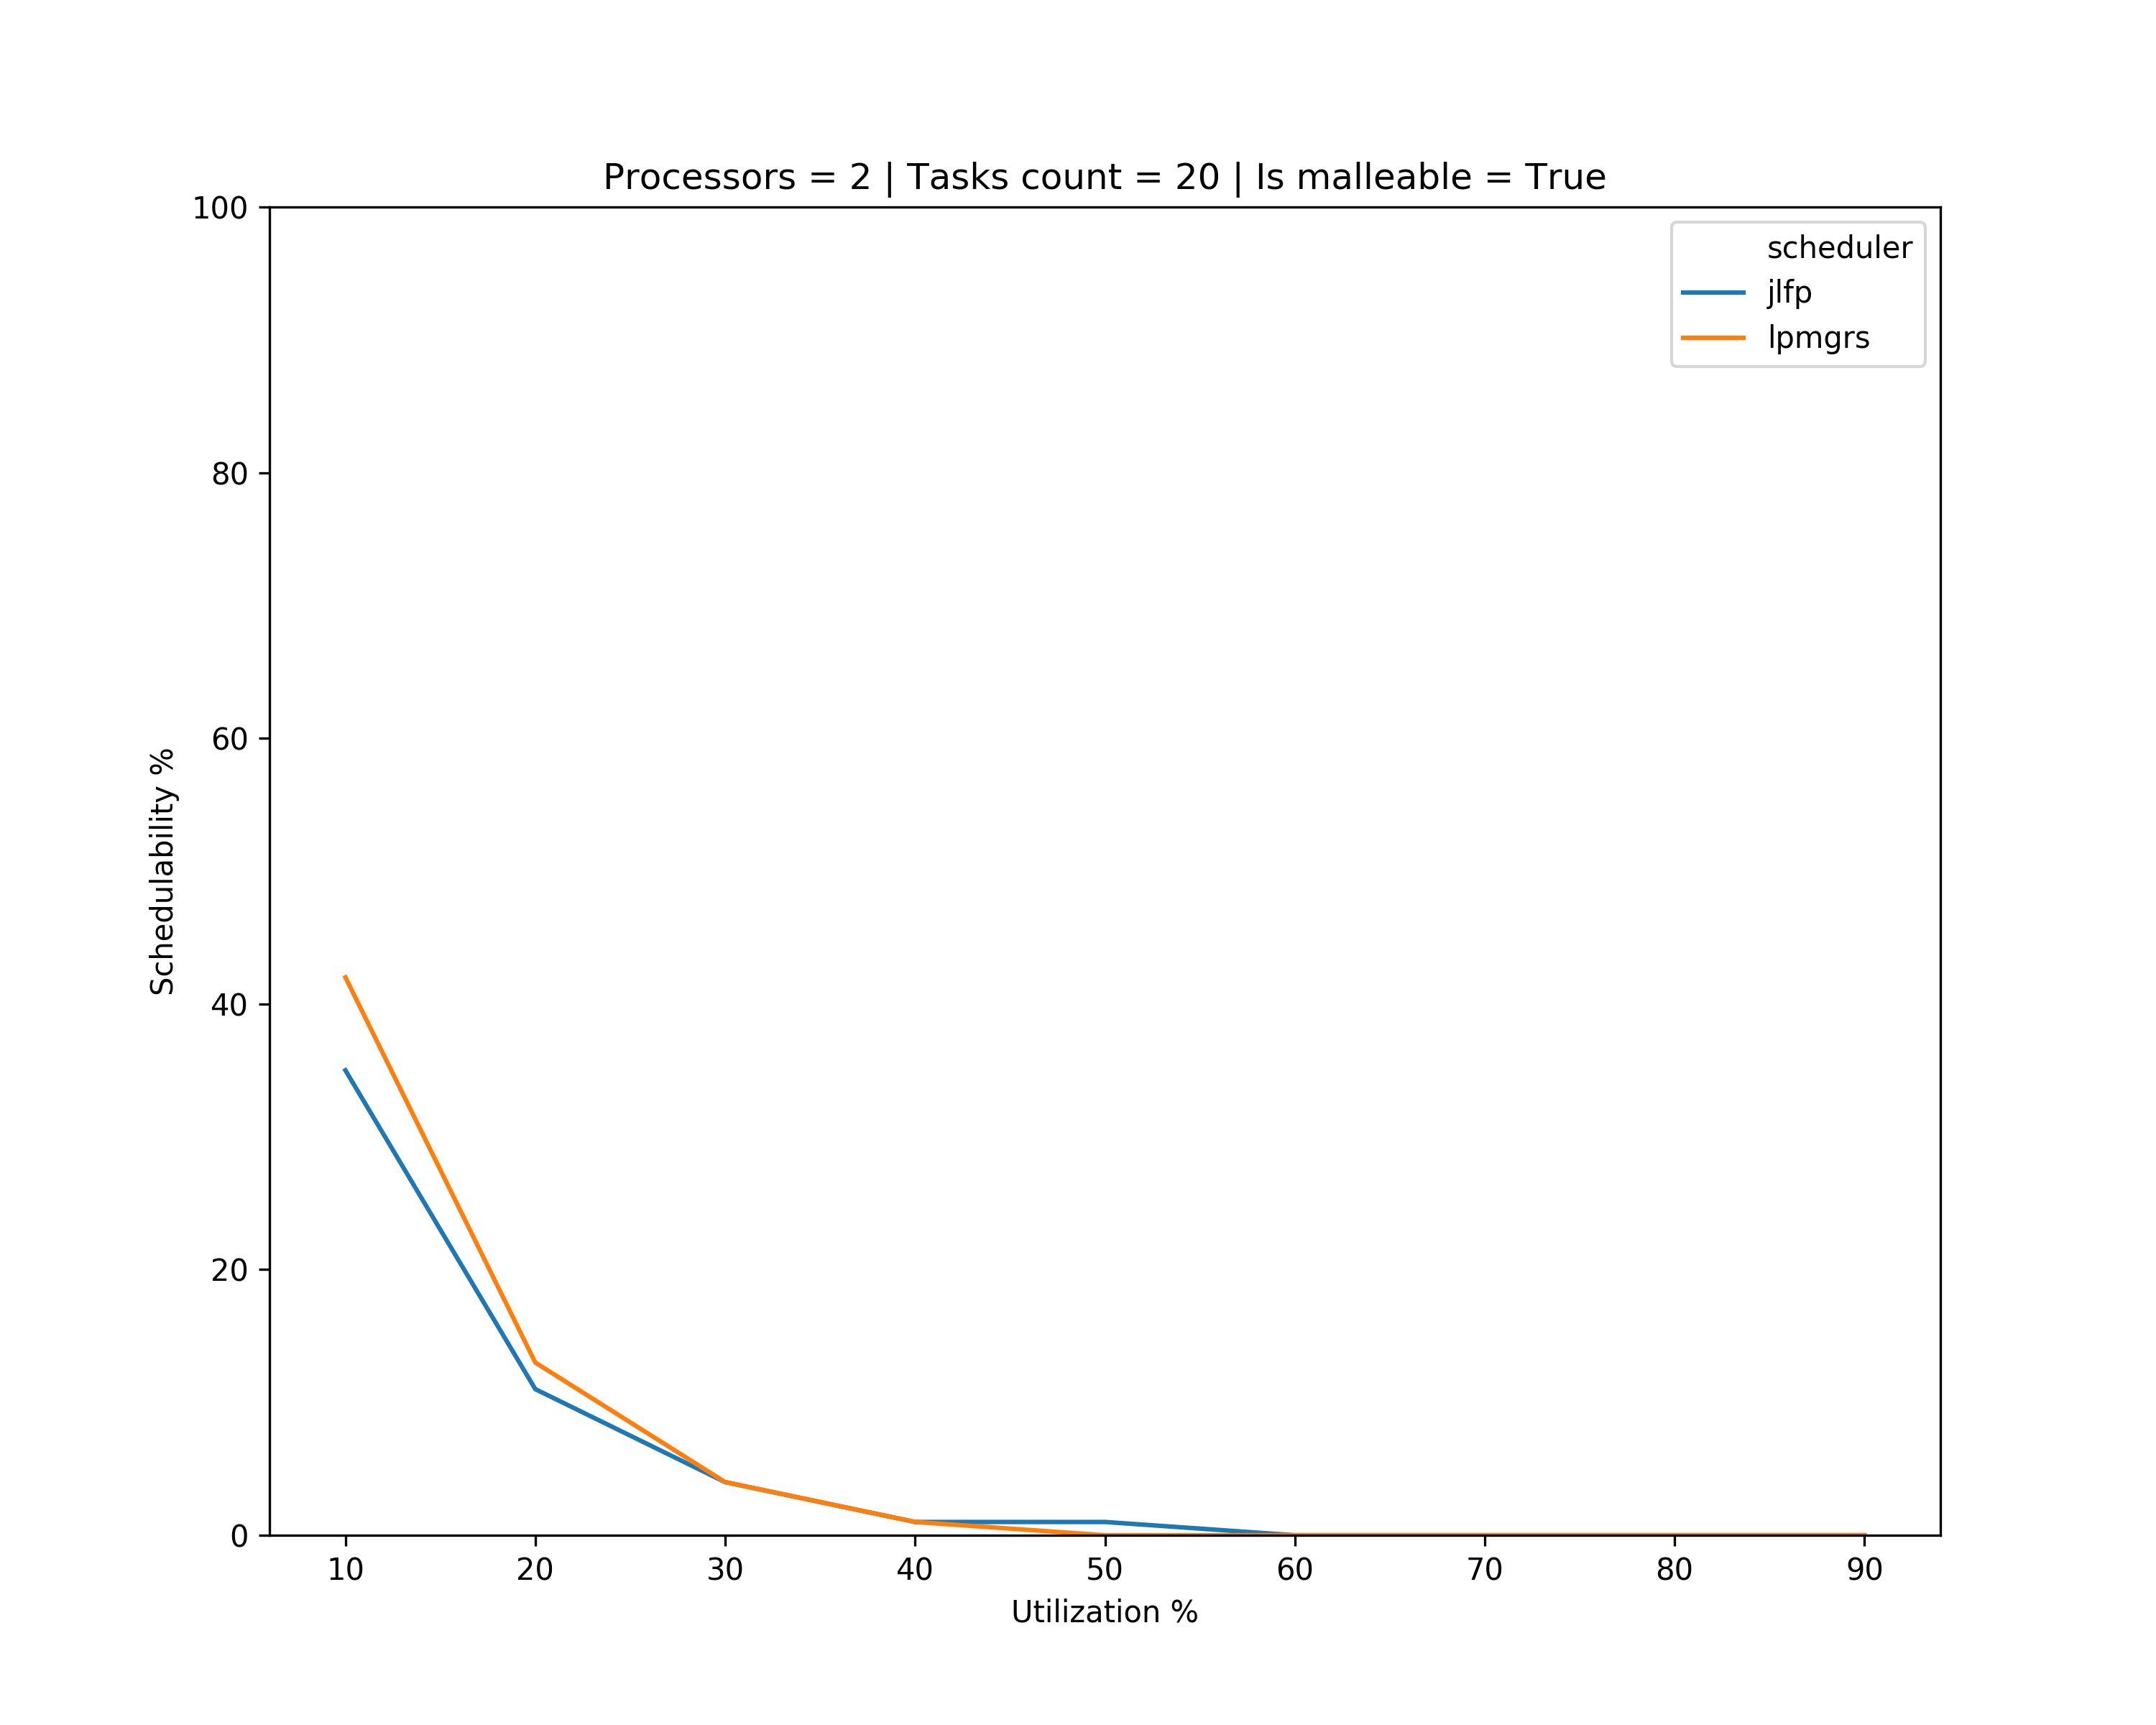
Results

Slide 4
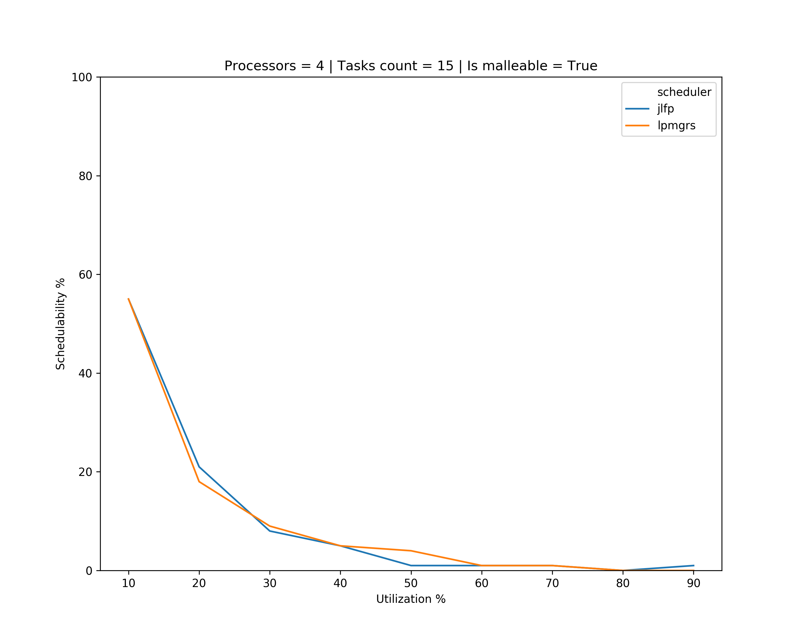
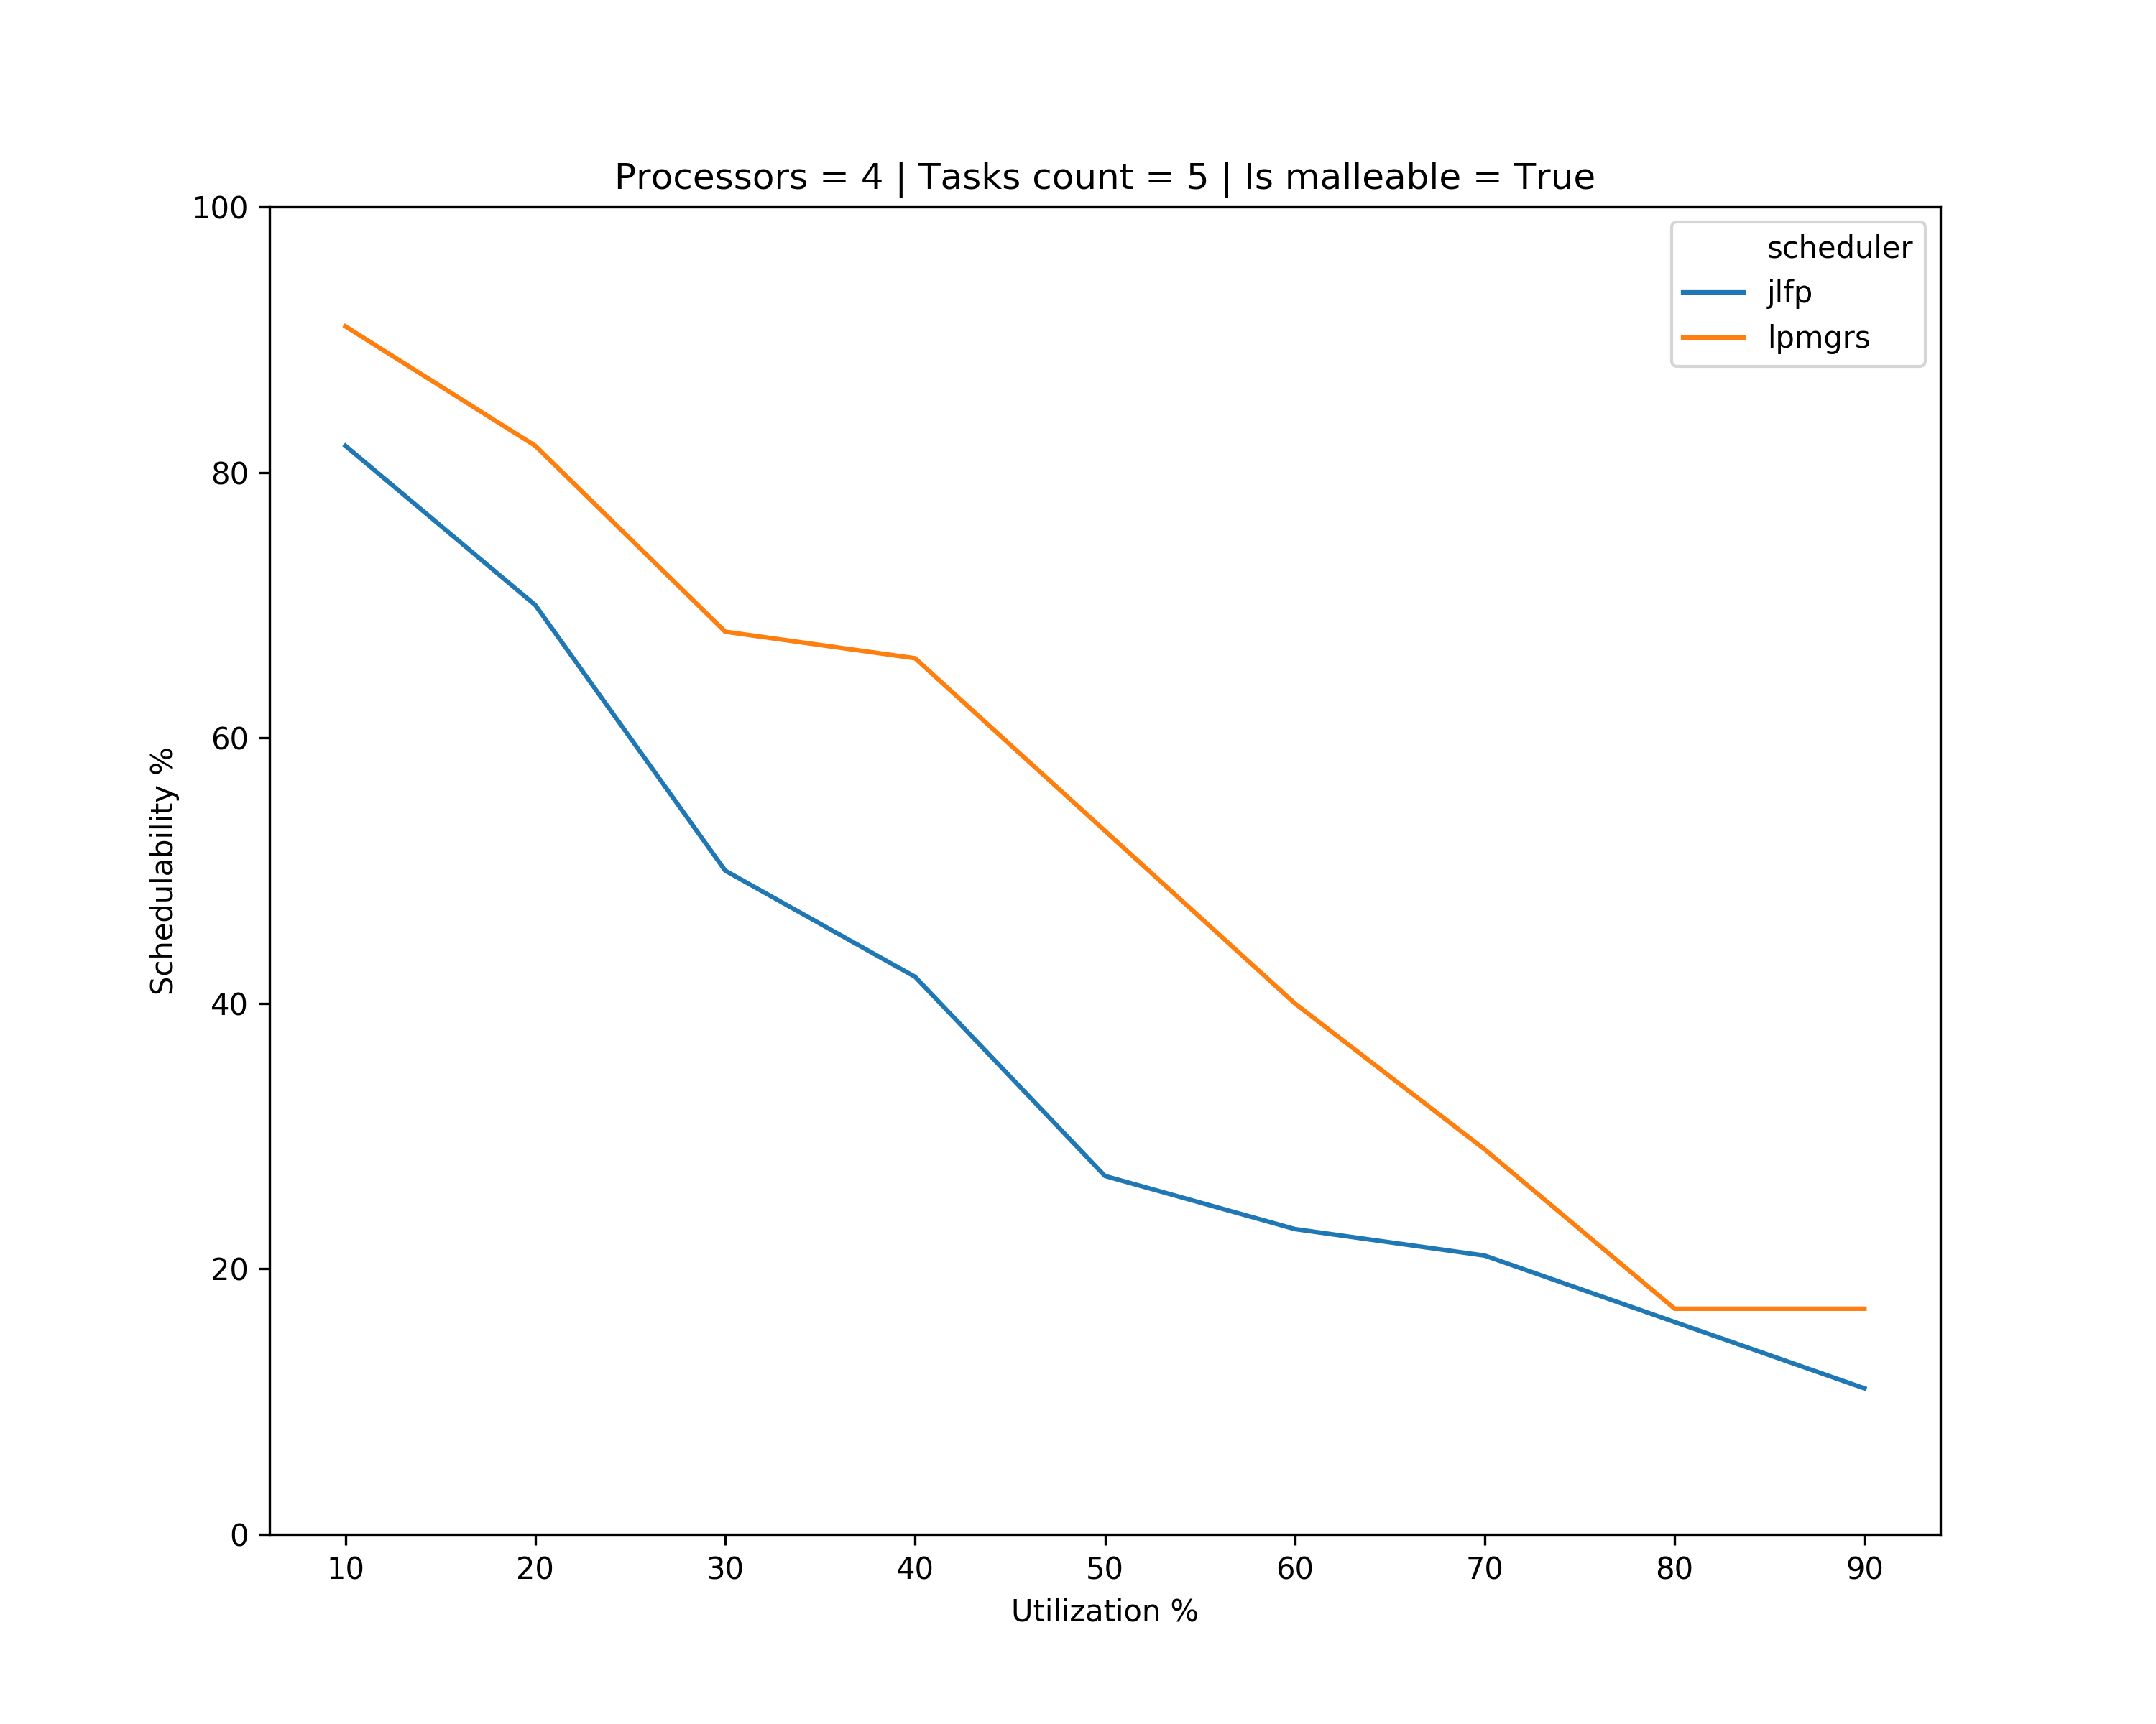
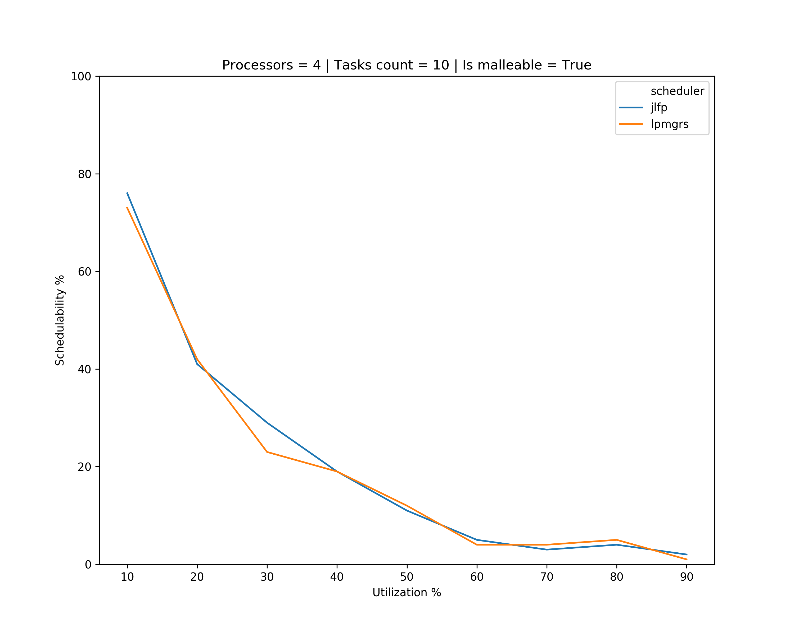
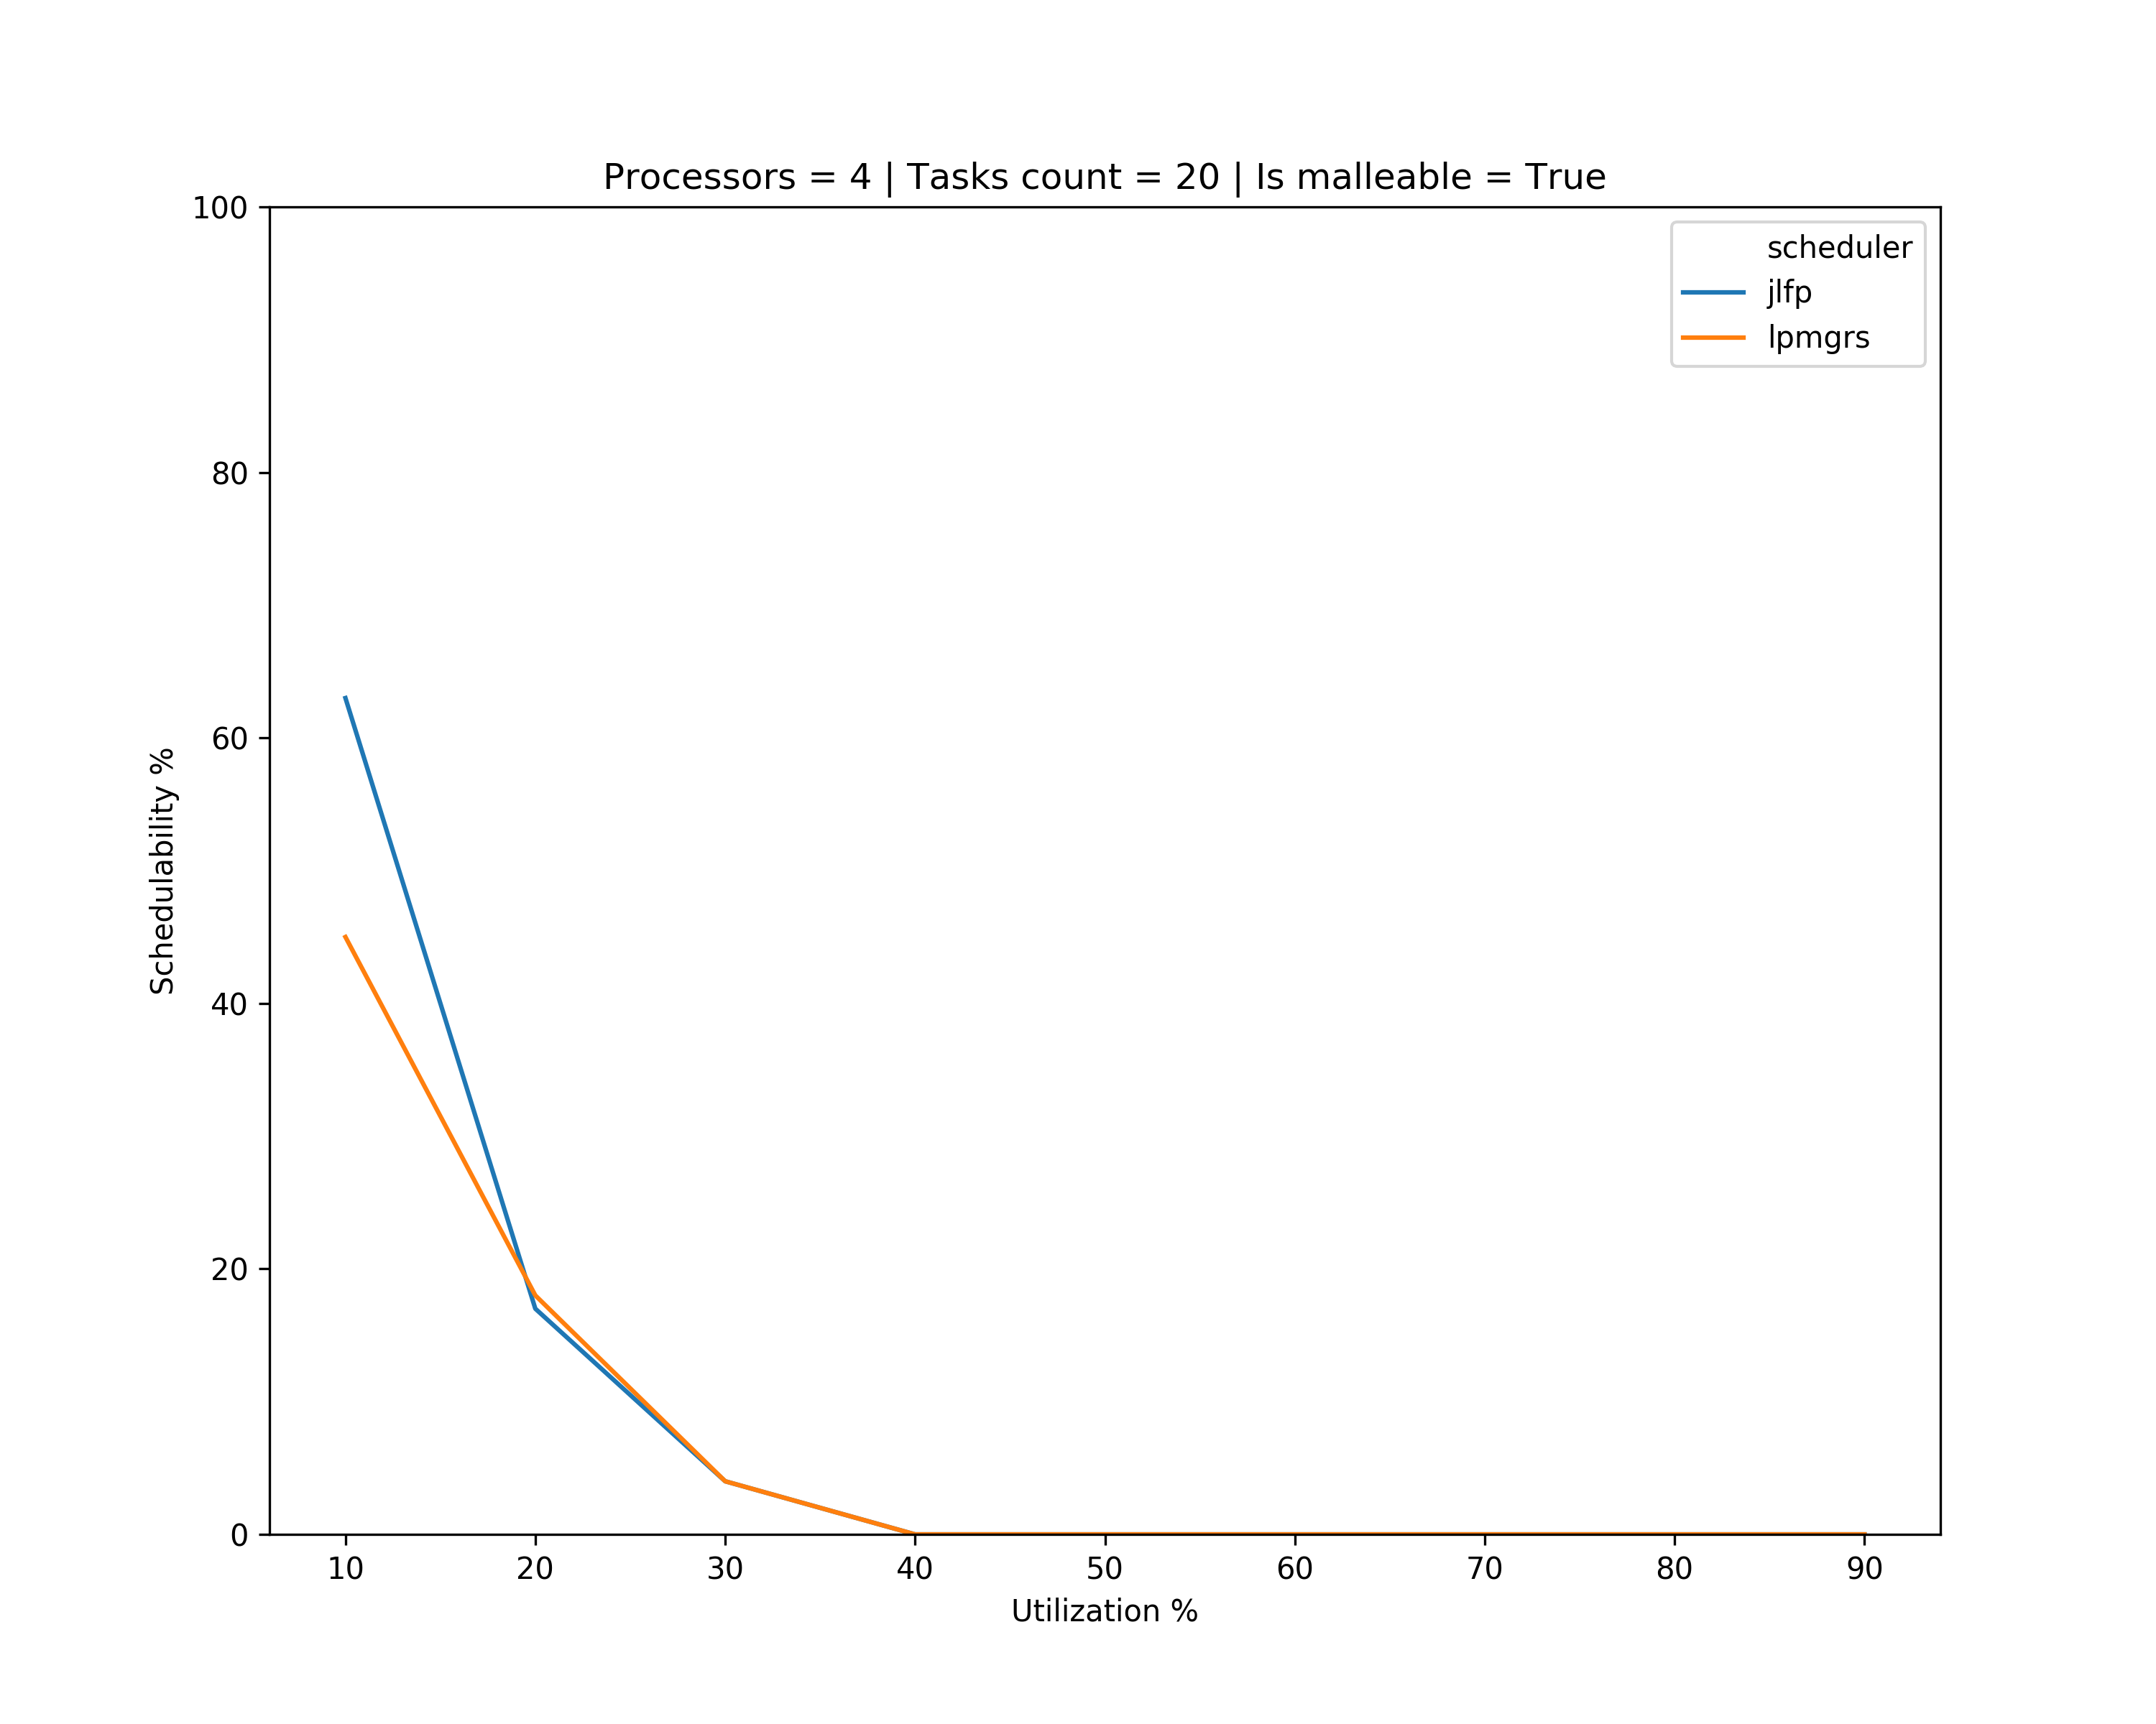
Results

Slide 5
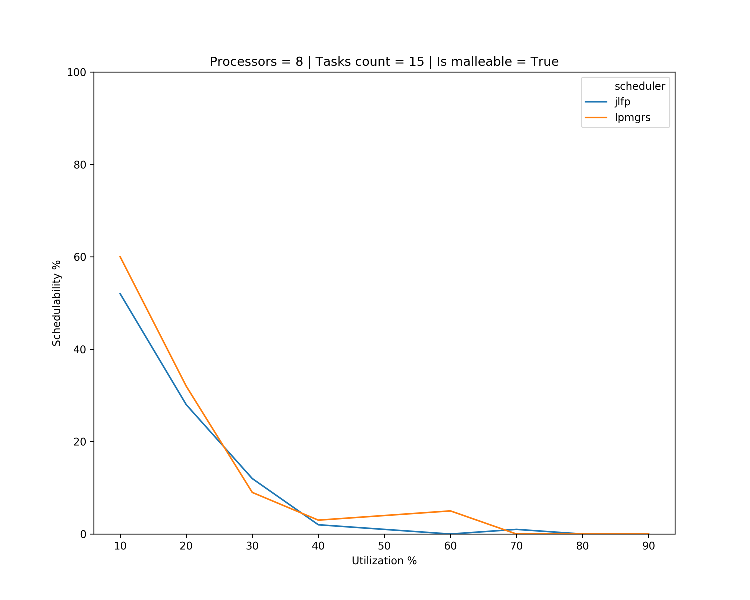
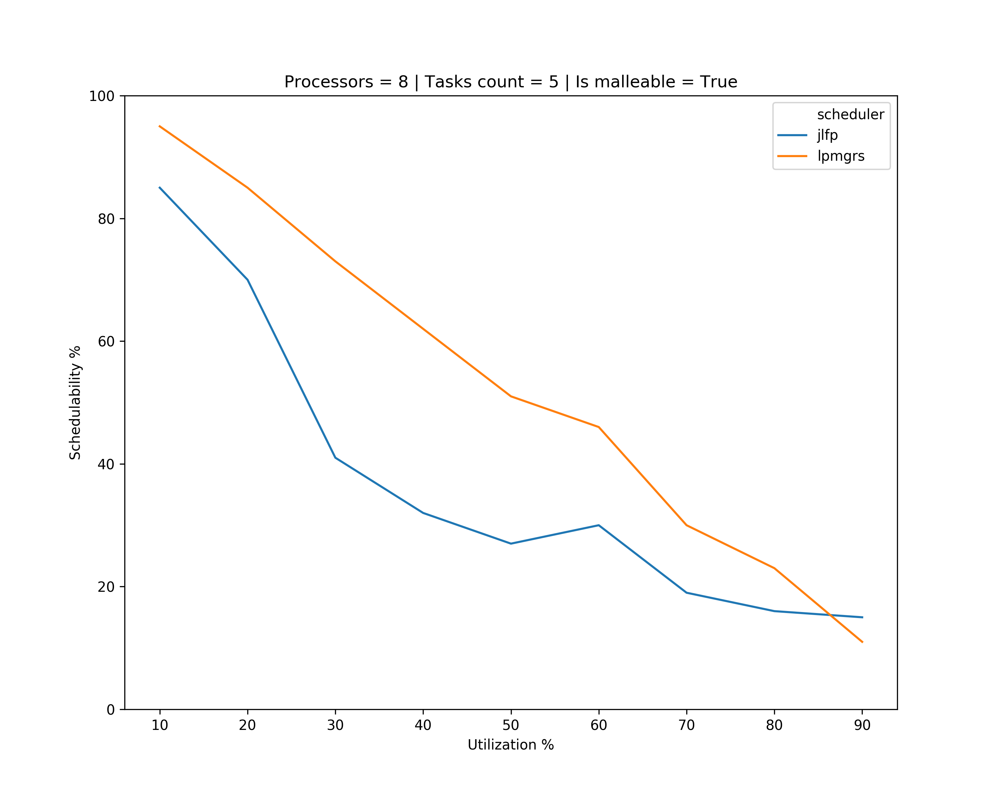
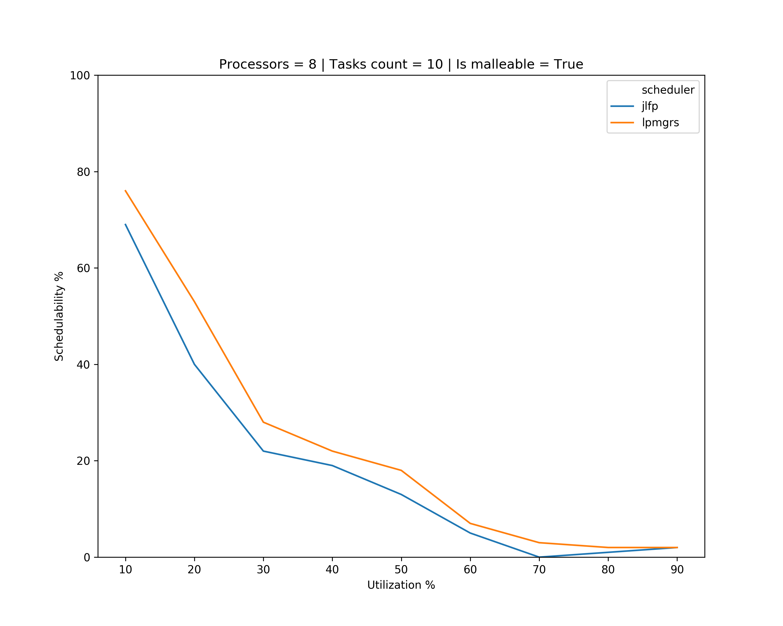
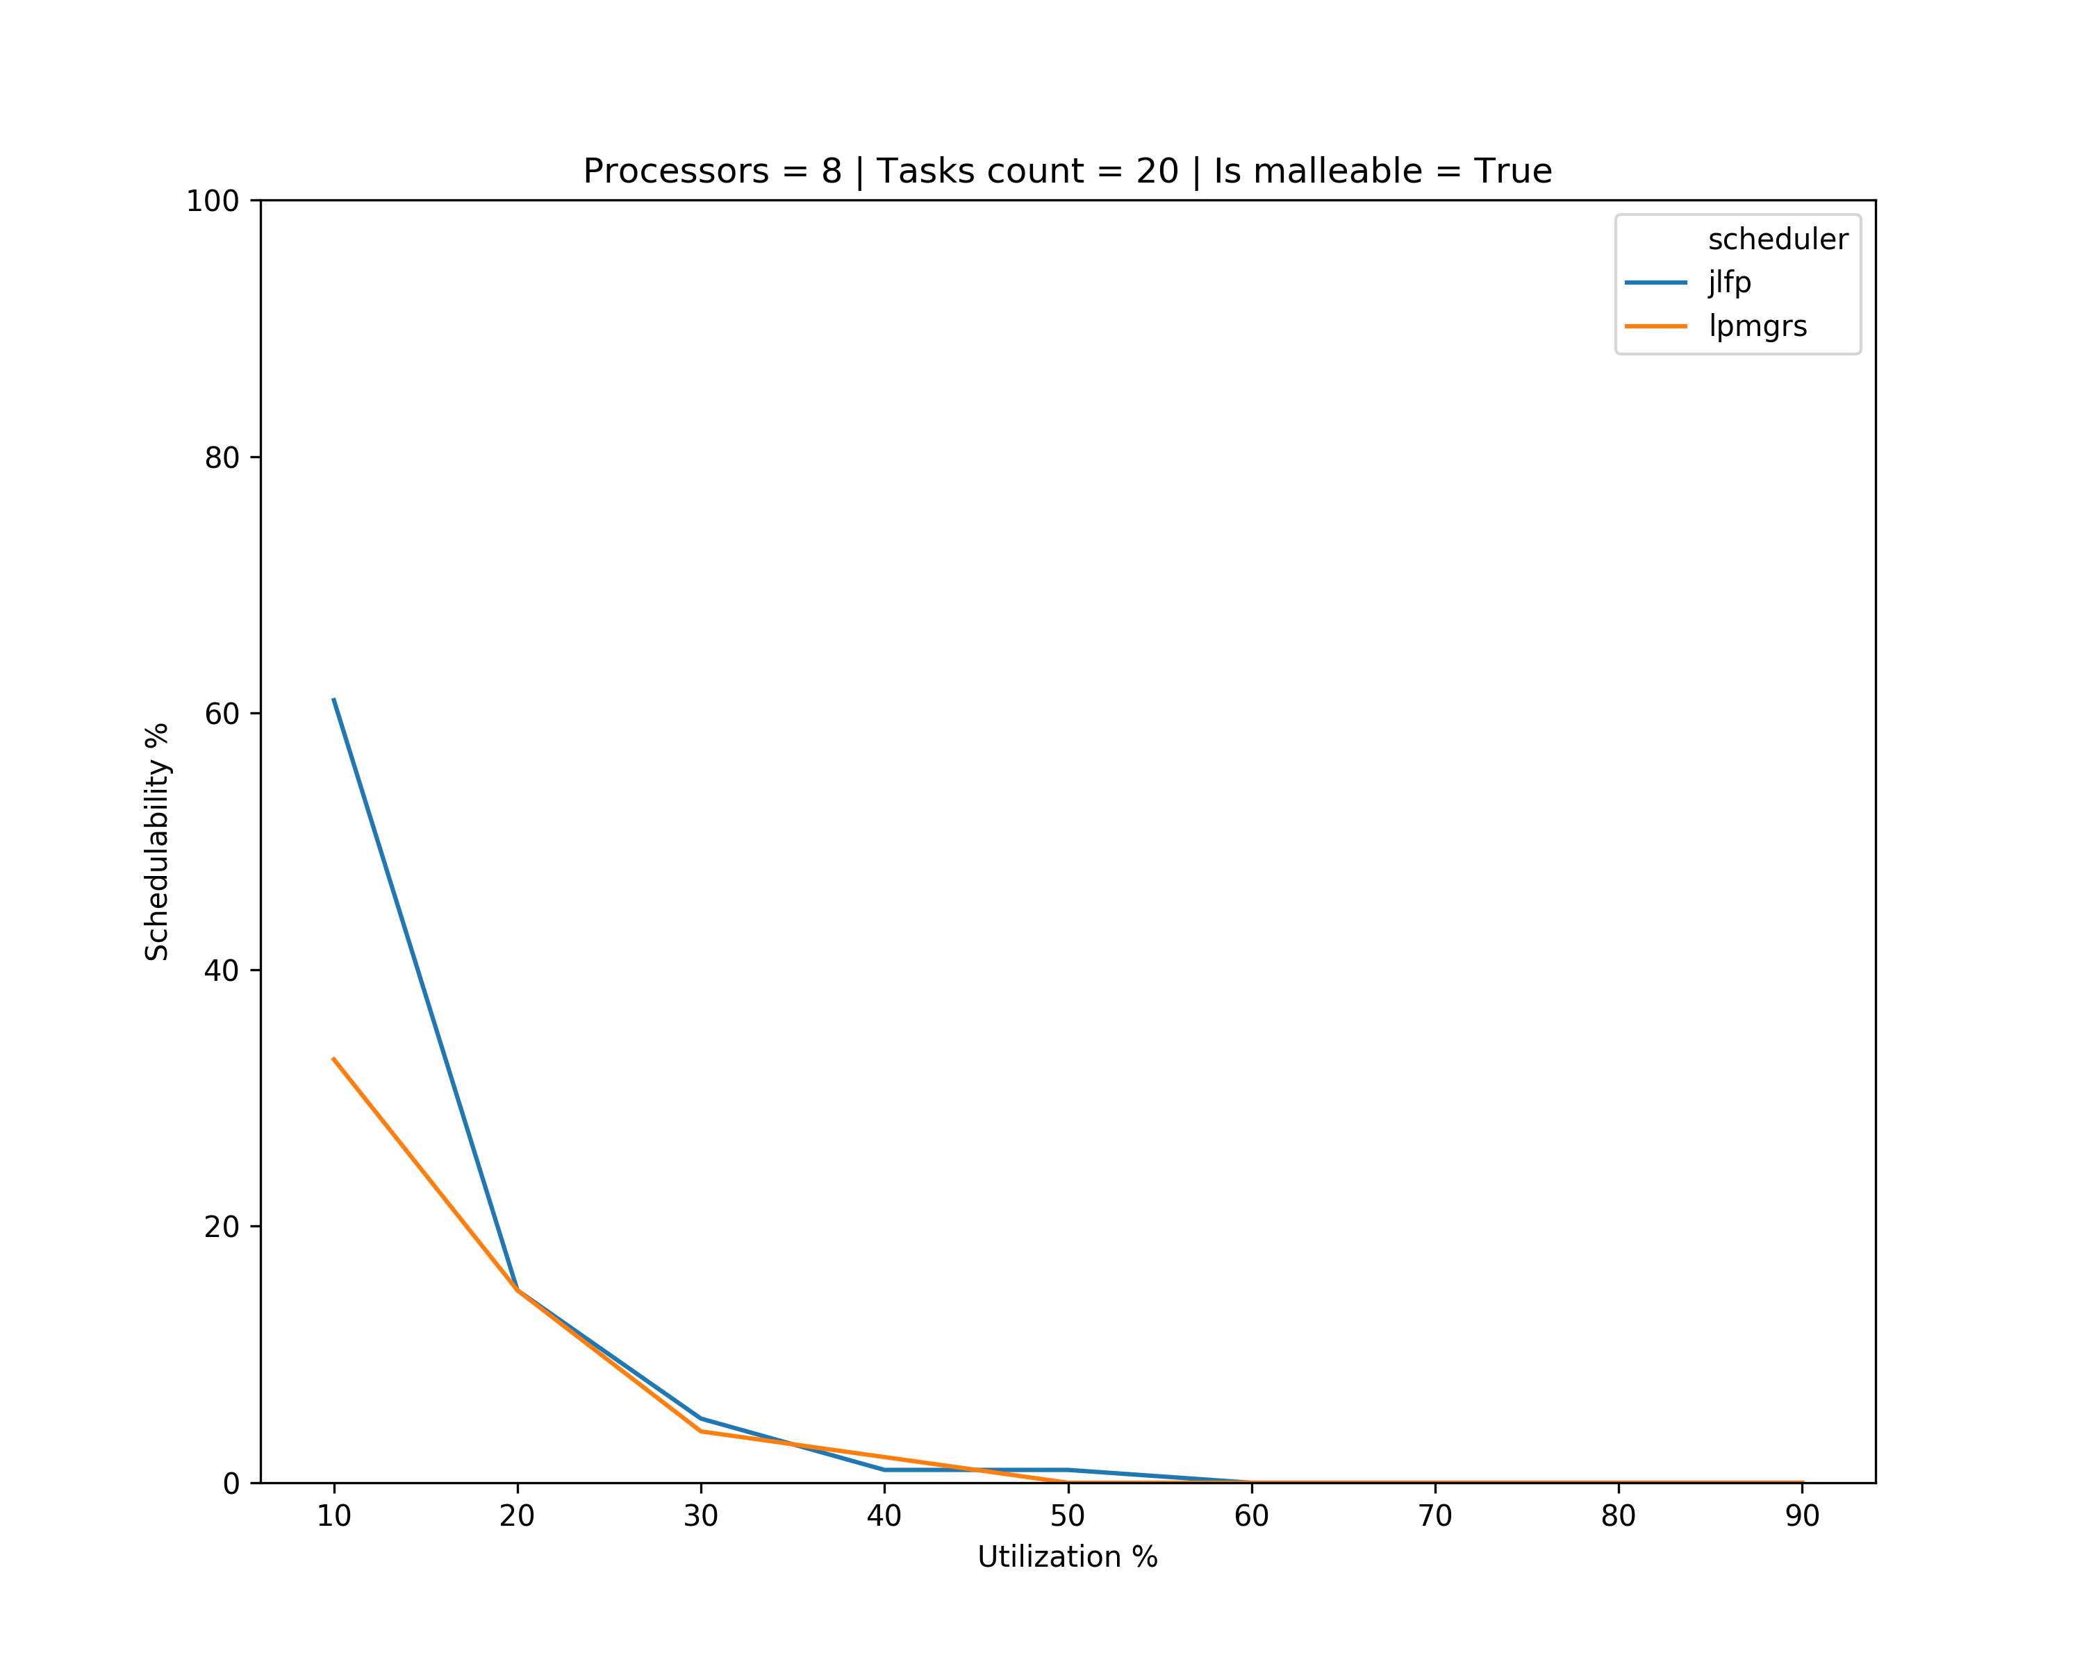
Results

Slide 6
What’s next?
Improve tasksets generation
The minimum number of cores should be determined by the utilization of the task
Find a way to increase schedulability
Find a way to analyse non-schedulable tasksets

