Slide 1
Scheduling and Analys of Limited-Preemptive Modable Gang Tasks
Joan Marcè i Igual
Geoffrey Nelissen
Mitra Nasri
Paris Panagiotou
24th of February, 2020

Slide 2
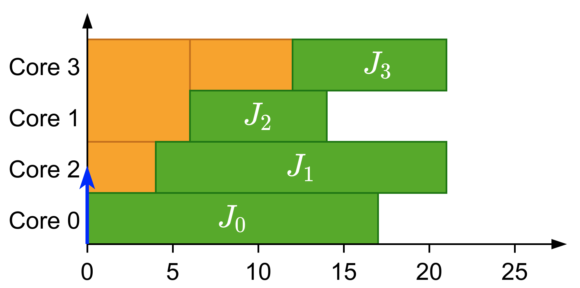
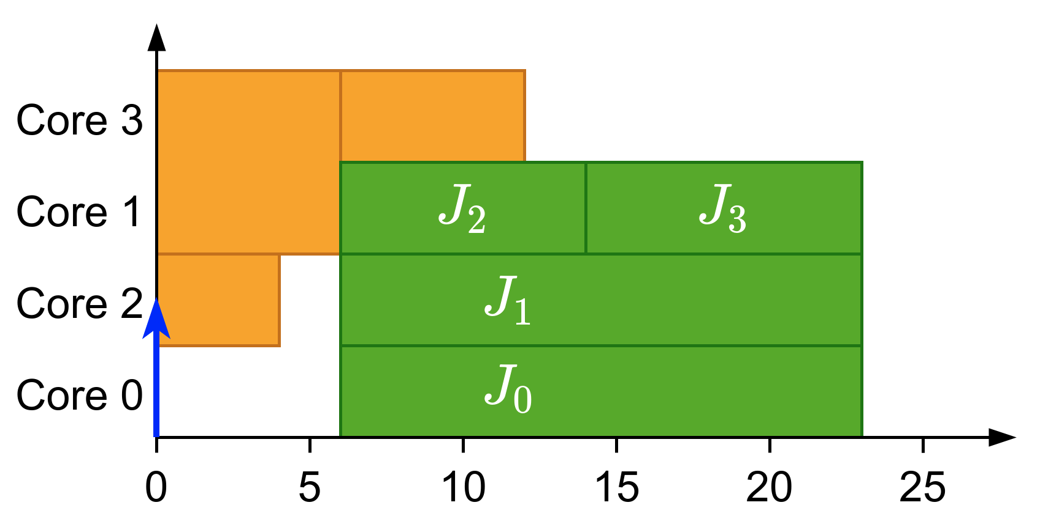
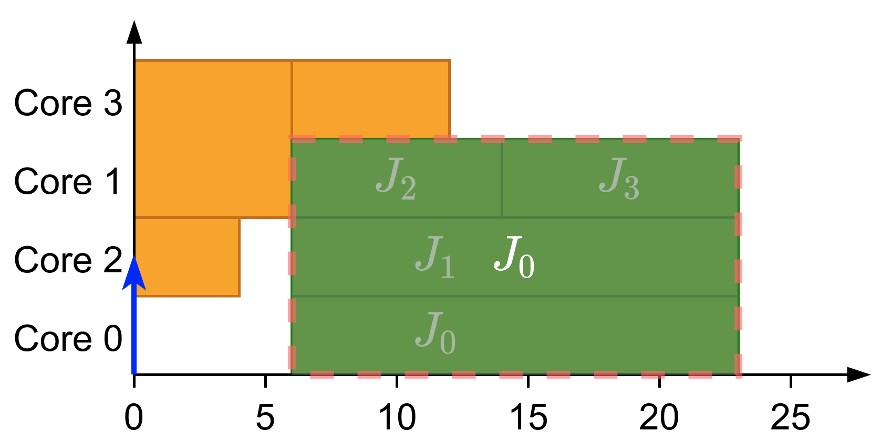
What is gang?
Parallel threads executed together as a “gang”
Execution does not start until there are enough free cores
Notes:
First of all, let’s explain what gang scheduling is.
It’s the execution of multiple parallel threads together as a “gang”. In these threads the execution does not start until there are enough cores to execute them together.
Let’s see an example:<click>
We have these jobs assigned to different cores.
If we release them as a gang job then we should pack them like a single task. Obtaining the following group. <click>
Then,<click> we have obtained the gang task result of merging the jobs

Slide 3
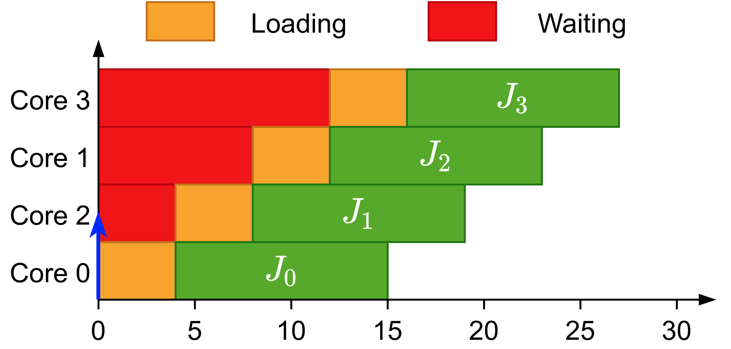
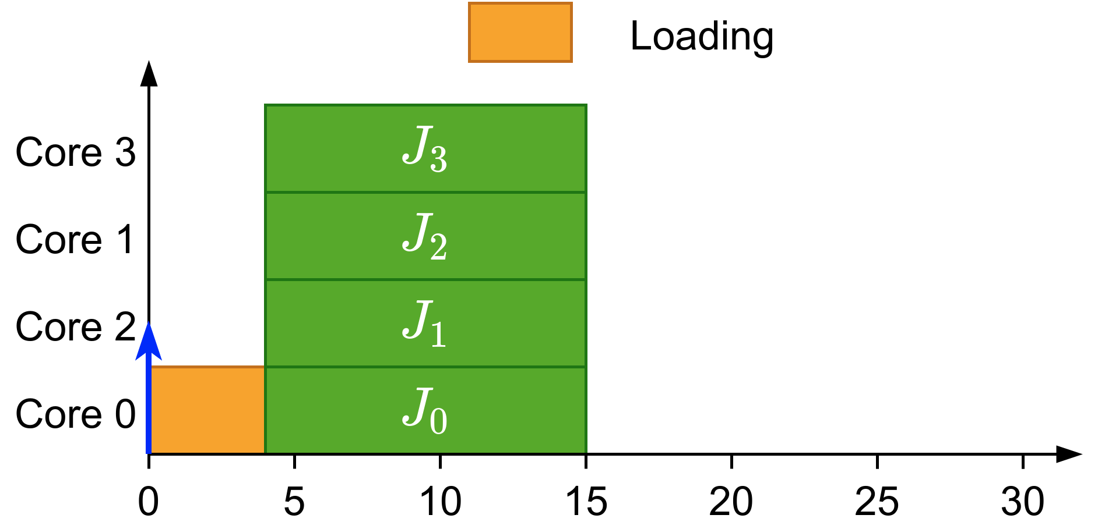
Why gang?
Avoids overhead when loading initial data
Notes:
So then, why do we need gang scheduling?
Well, it helps in reducing overhead when loading data initially.
<click>
In this example all these threads have been scheduled at the same time but have to wait until the previous one have finished loading.
On the contrary<click>, if we know that all these threads are starting at the same time we can load the data once for all the threads at the same time which is what we would do with gang scheduling.

Slide 4
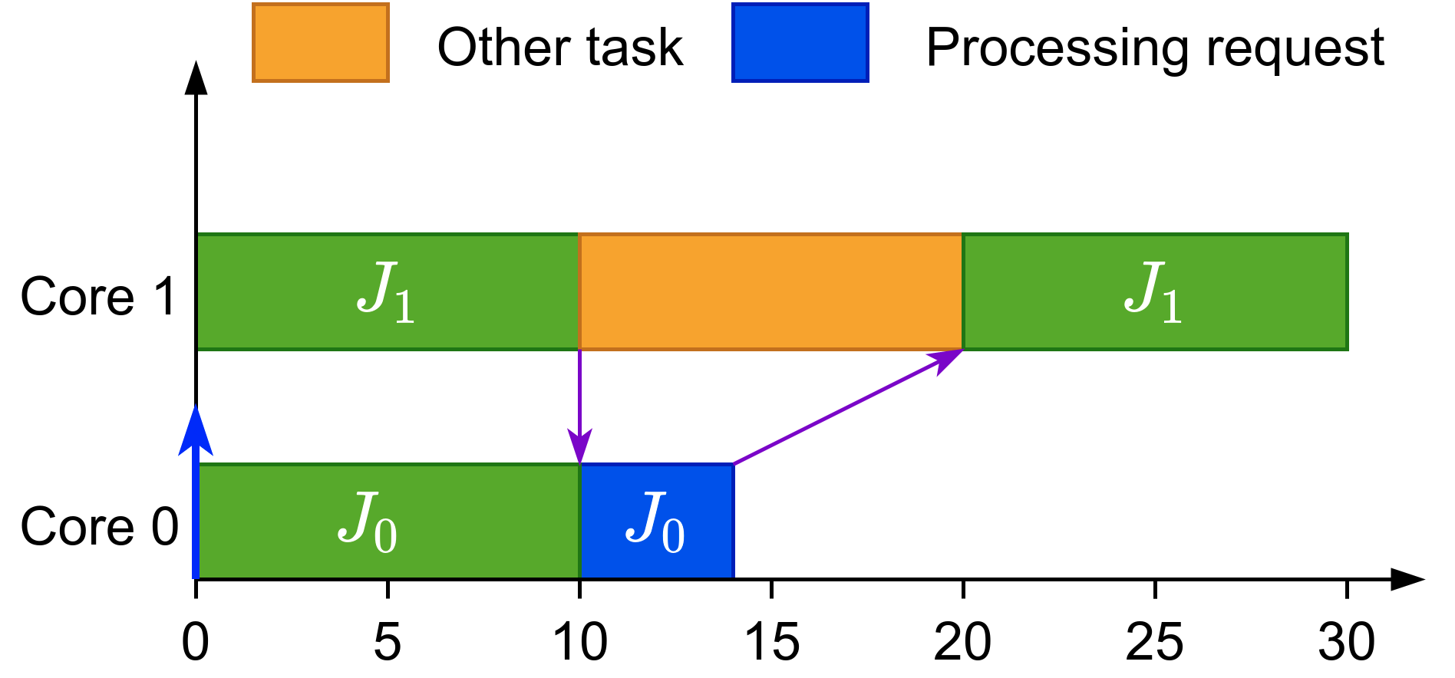
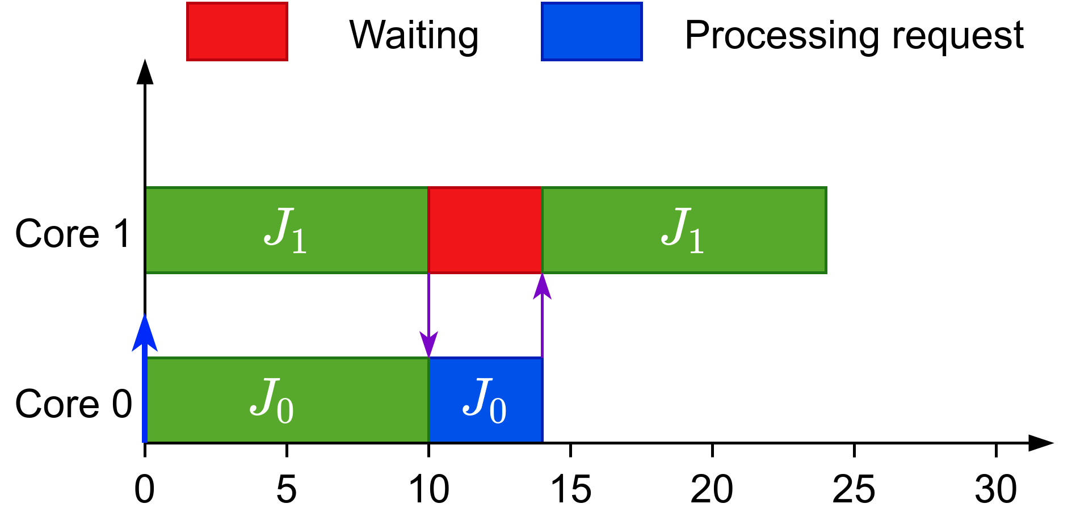
Why gang?
Avoids overhead when loading initial data
Allows synchronization
Notes:
Additionally it helps in synchronization situations, like in the following example<click>
Here there are two jobs and job 1 sends some data to job 0 that is processed and sent back. In this case another task has been scheduled after job 1 sent the data and after the other task finishes then job 1 can continue its execution
On the other hand if we use gang<click> the job would wait for job 0 to finish the processing part and return the results as no other task would be allowed to execute while job 1 is waiting.

Slide 5
Types of gang
Rigid: number of cores set by programmer
Moldable: number of cores assigned during scheduling
Malleable: number of cores can change during runtime
Notes:
When talking about gang scheduling, we can have three types:
<click>Rigid gang, where the number of cores is set by the programmer and fixed during execution
<click>Moldable gang, where the number of cores can be in a range of values and the actual chosen value is decided when scheduling the task
<click>Malleable gang, where the number of cores can vary during the execution of the job

Slide 6
Previous work
Introduced in the context of high-performance computing^{[1]}
In real-time:
  For rigid tasks:
    Job-Level Fixed Priority is not predictable^{[2]}
    An optimal scheduler (DP-Fair) exists for preemptive tasks^{[3]}
  For moldable tasks
    Global EDF has been adapted^{[4]}
    Scheduler that chooses cores to meet the deadline^{[5]}
^{[1]}Ousterhout, 1982
^{[3]}Goossens et al., 2016
^{[5]}Berten et al., 2011
^{[2]}Goossens et al., 2010
^{[4]}Kato et al.,2009

Slide 7
Previous work
In real-time:
  For malleable tasks:
    An optimal algorithm, in terms of processors, has been proposed^{[6]}
  Bundled task-model^{[7]}:
^{[6]}Collette et al., 2008
^{[7]}Wasly et al., 2017

Slide 8
Schedulability analysis

Slide 9
Our work

Slide 10
LPMRGS

