Slide 1


Scheduling Analysis of Limited-Preemptive Moldable Gang Tasks
Joan Marcè i Igual
Geoffrey Nelissen
Mitra Nasri
20th of May, 2020

Slide 2
Scheduling Analysis
Schedule Abstraction
Graph^{[1]}
Simulations
Scheduling tests
Exact
Slow
Pessimist
Fast
Accurate
Relatively fast
Explore space of possible schedules for a given job set
Models scheduler decisions
^{[1] Nasri et al., 2018}

Slide 3
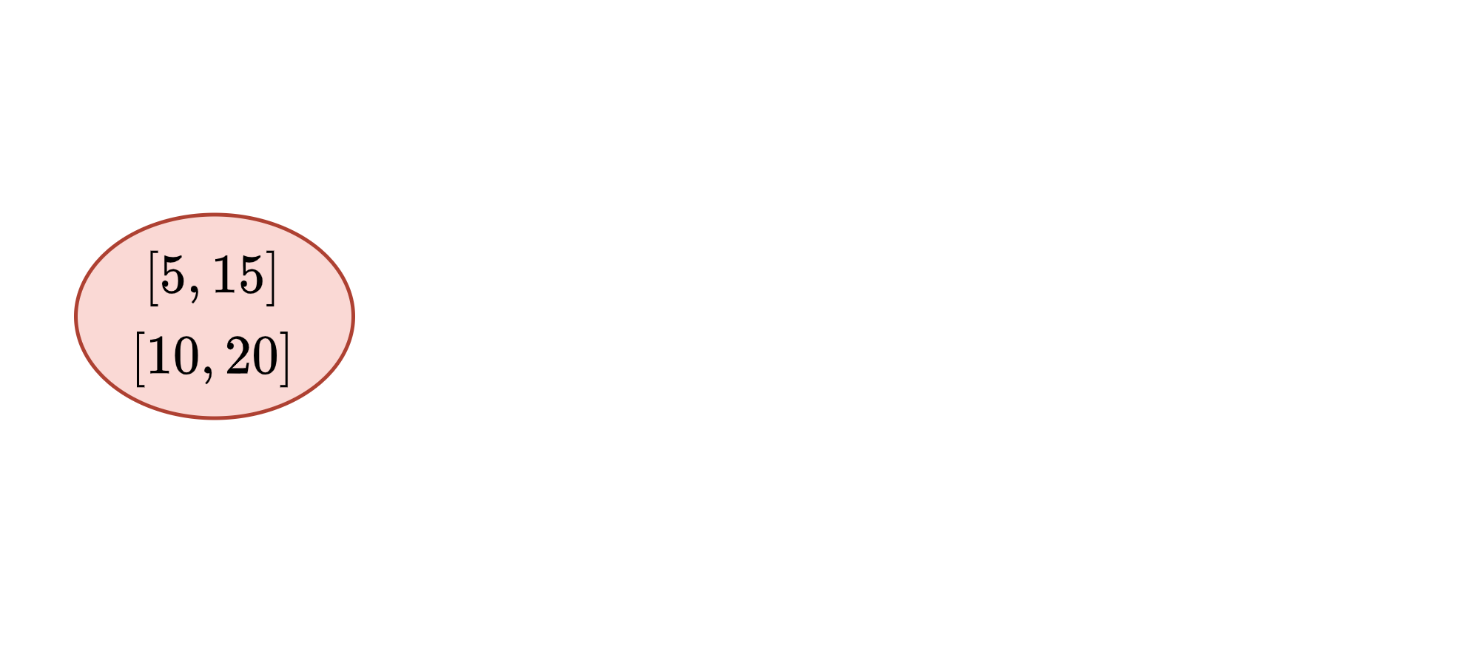
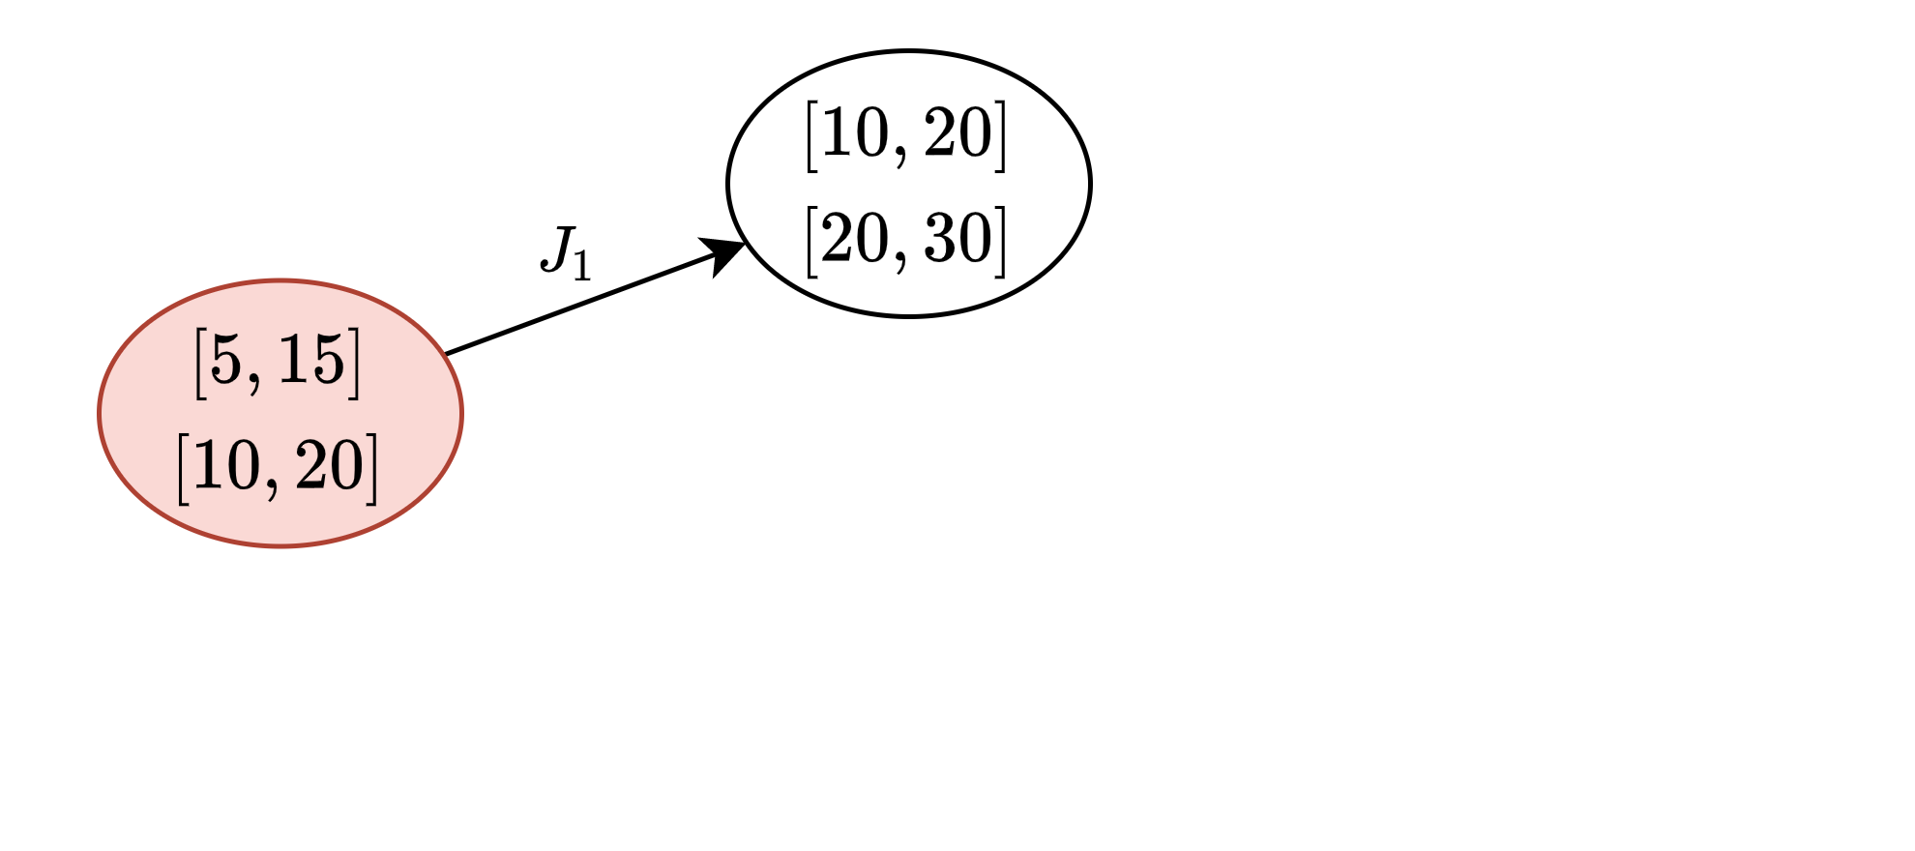
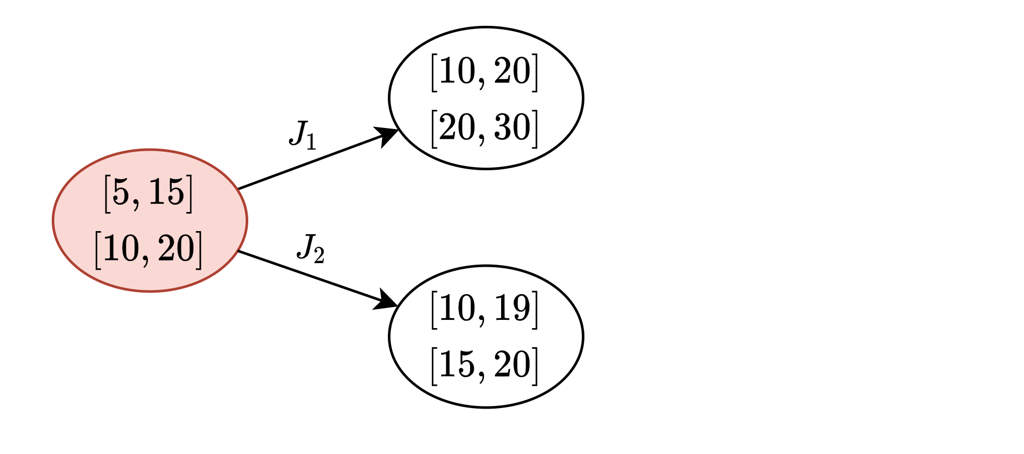
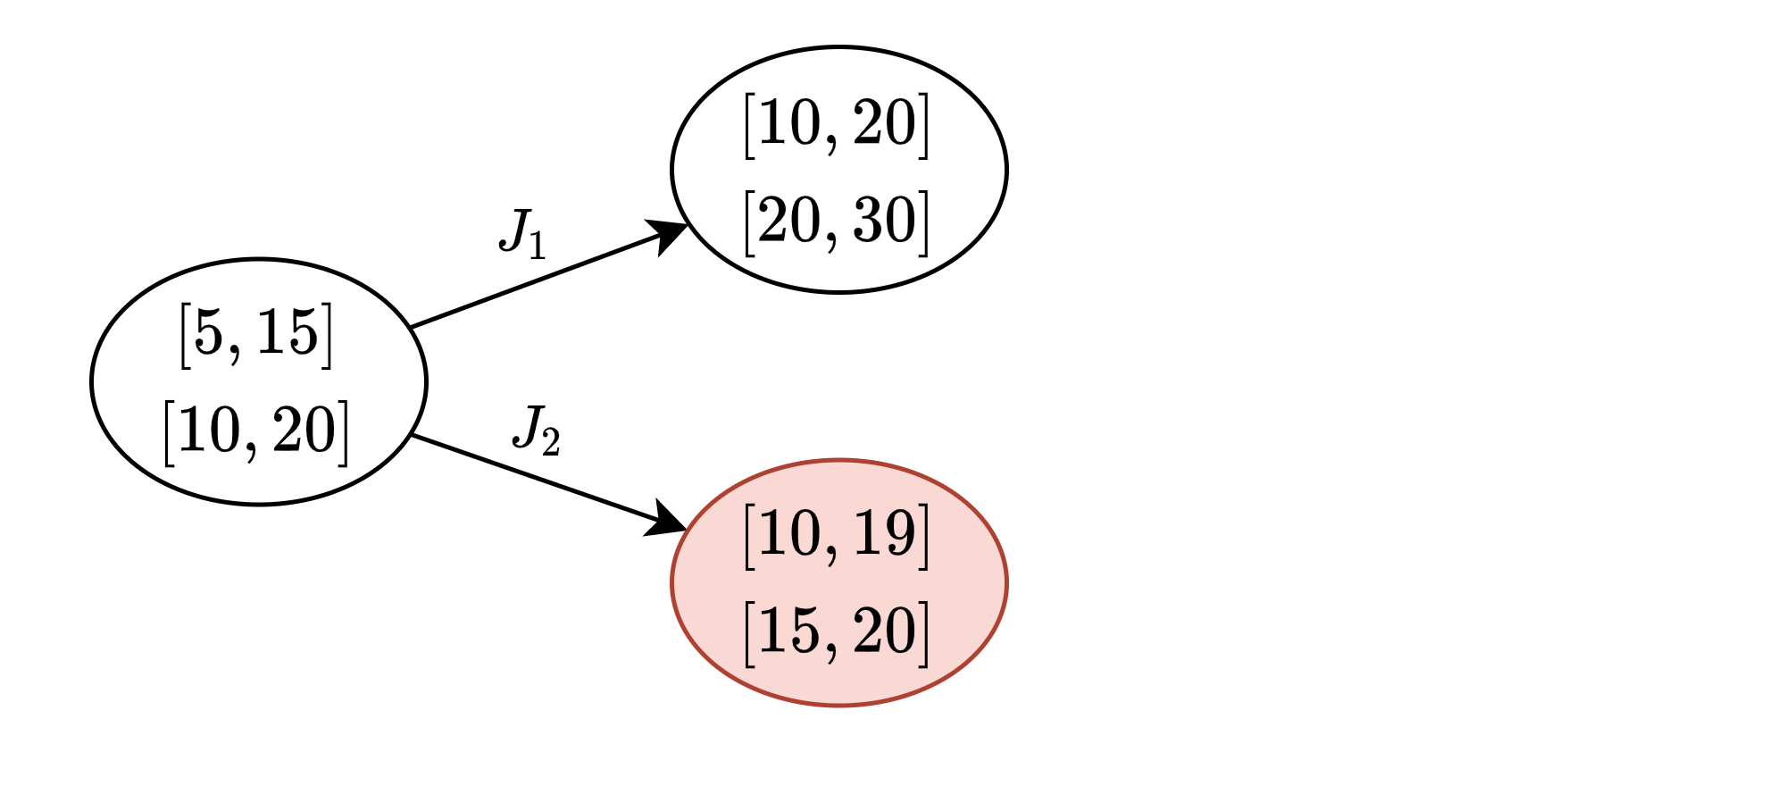
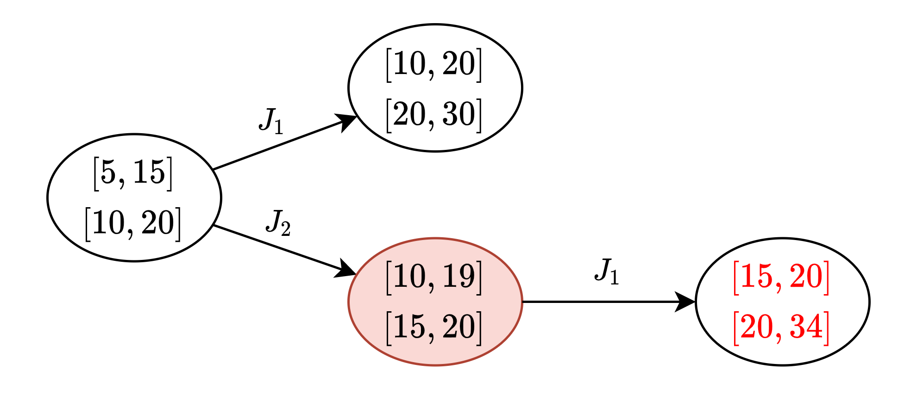
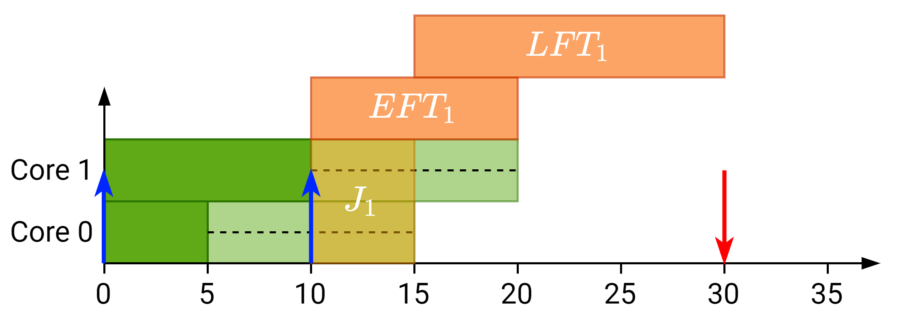
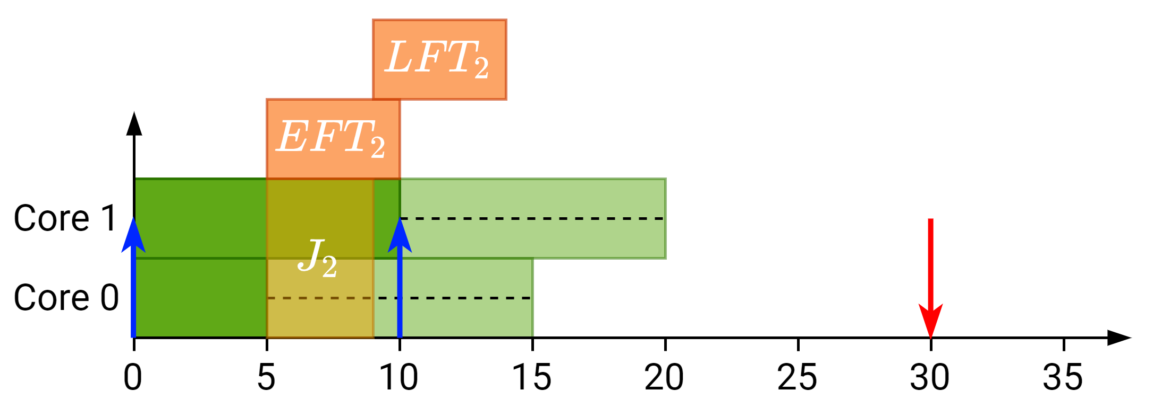
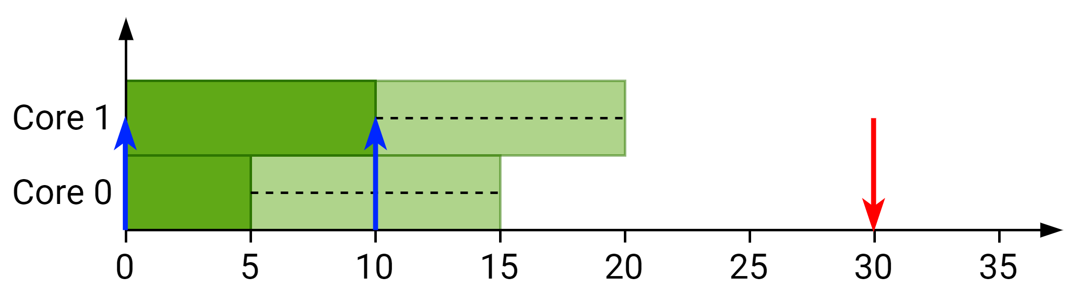
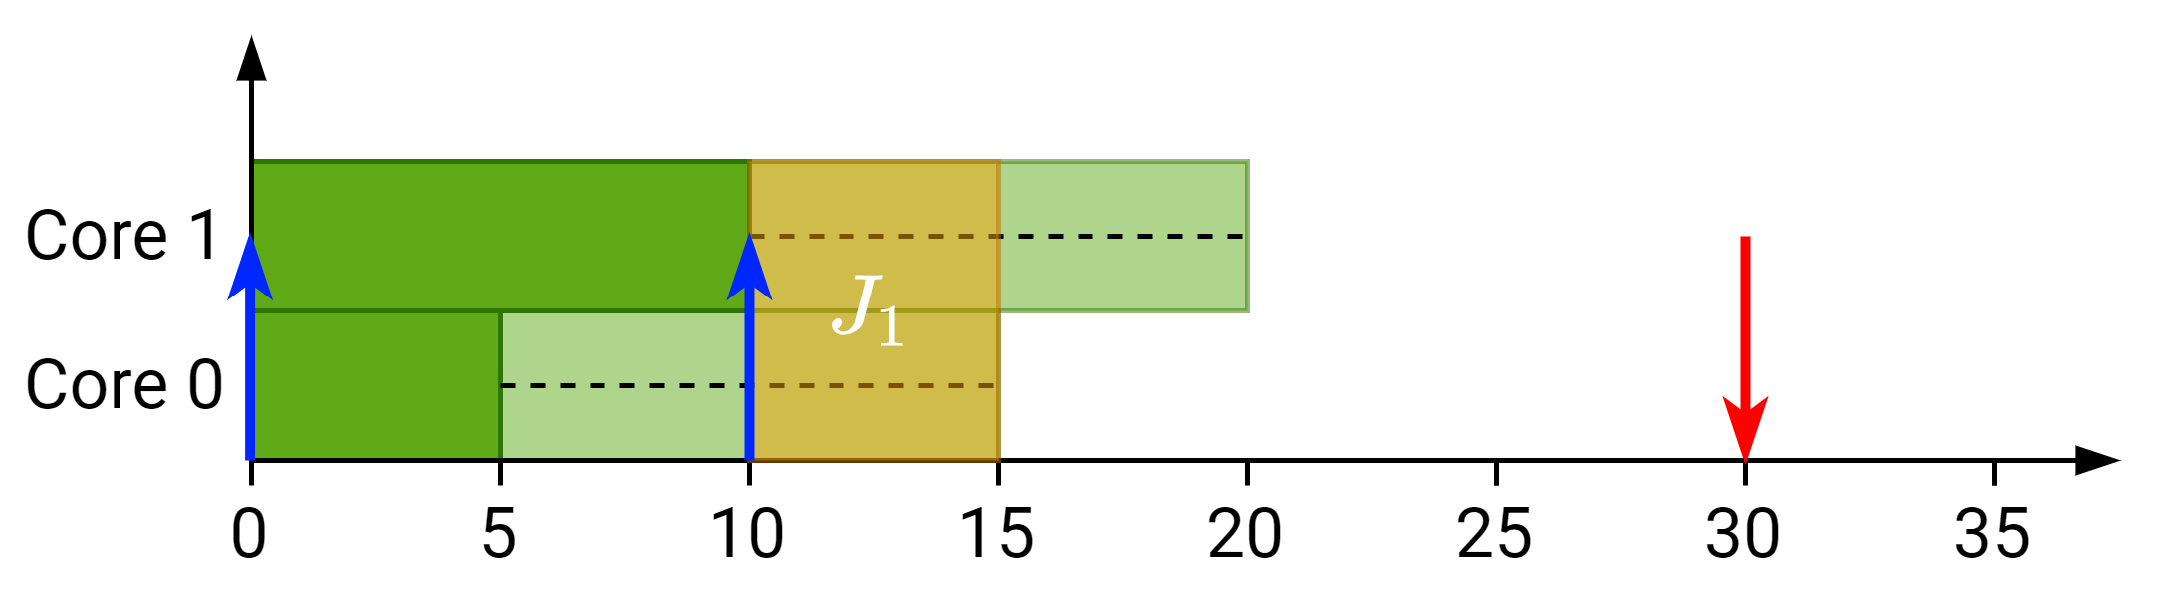
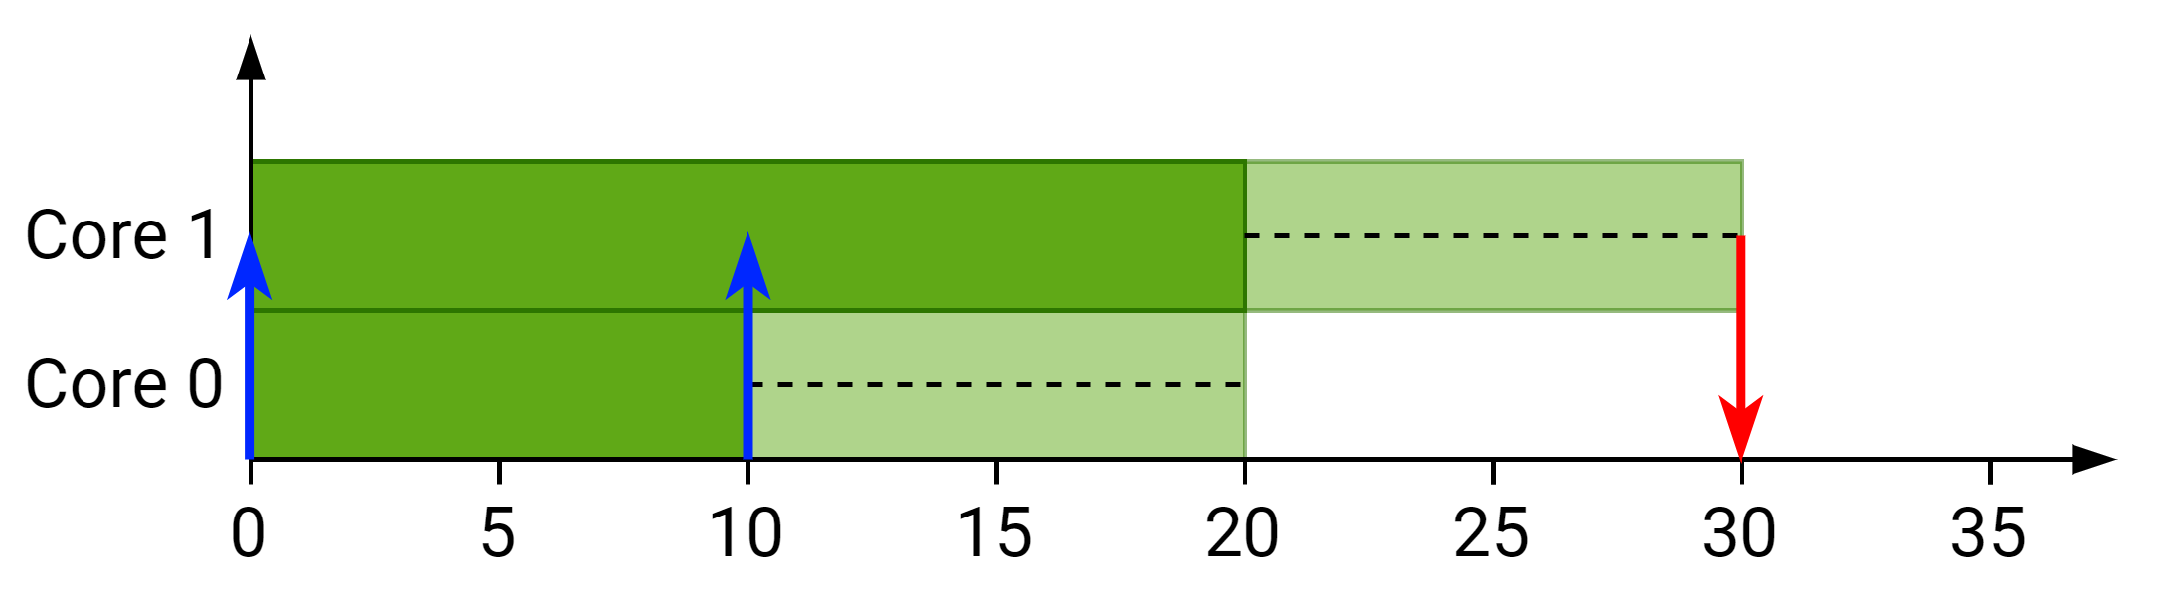
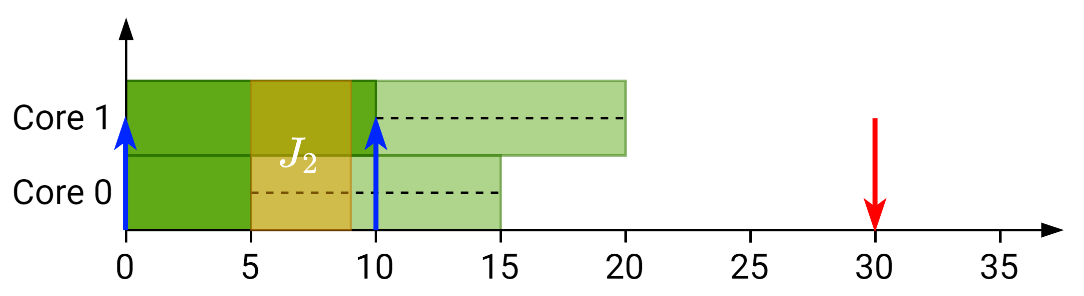
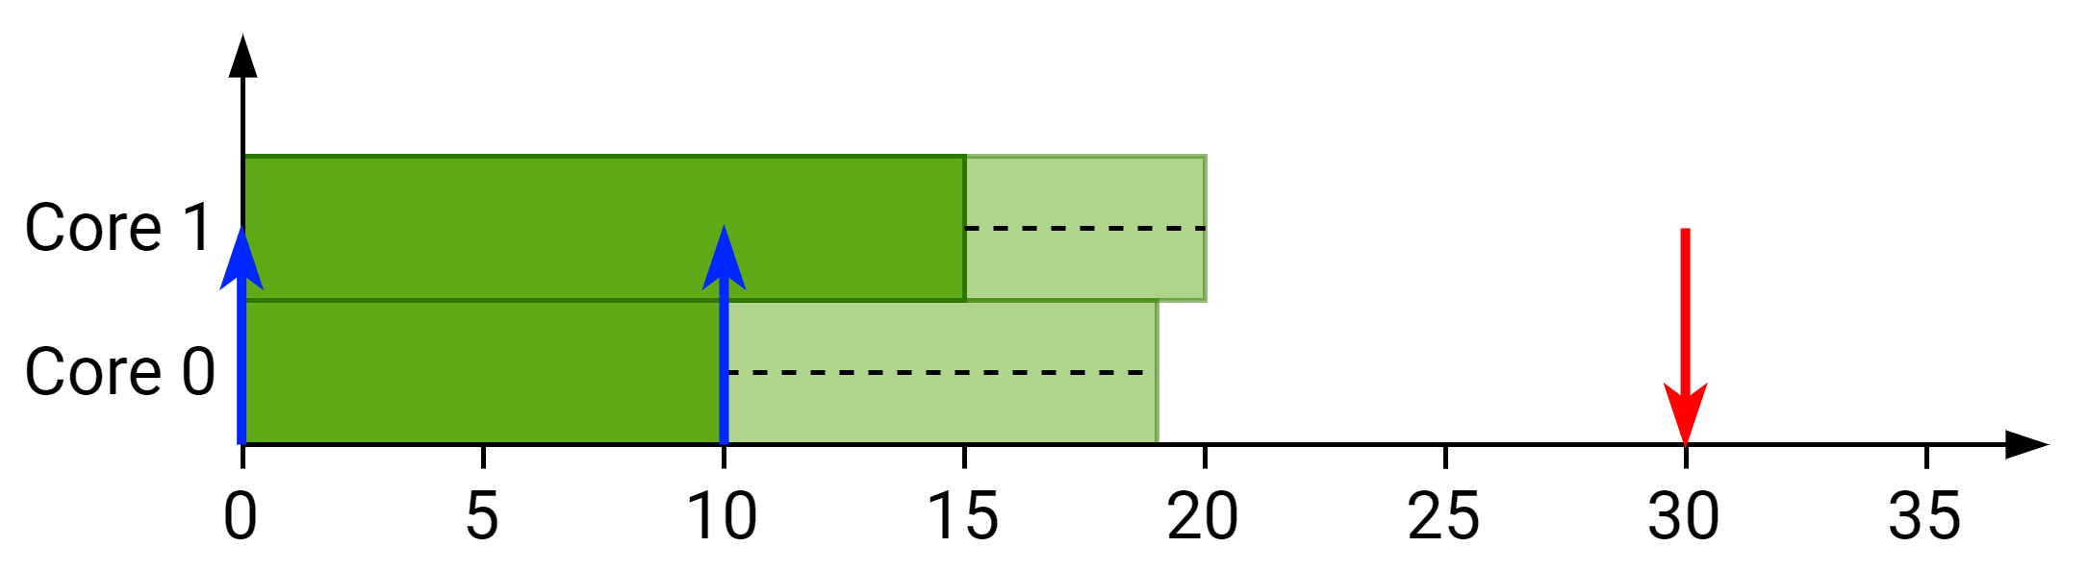
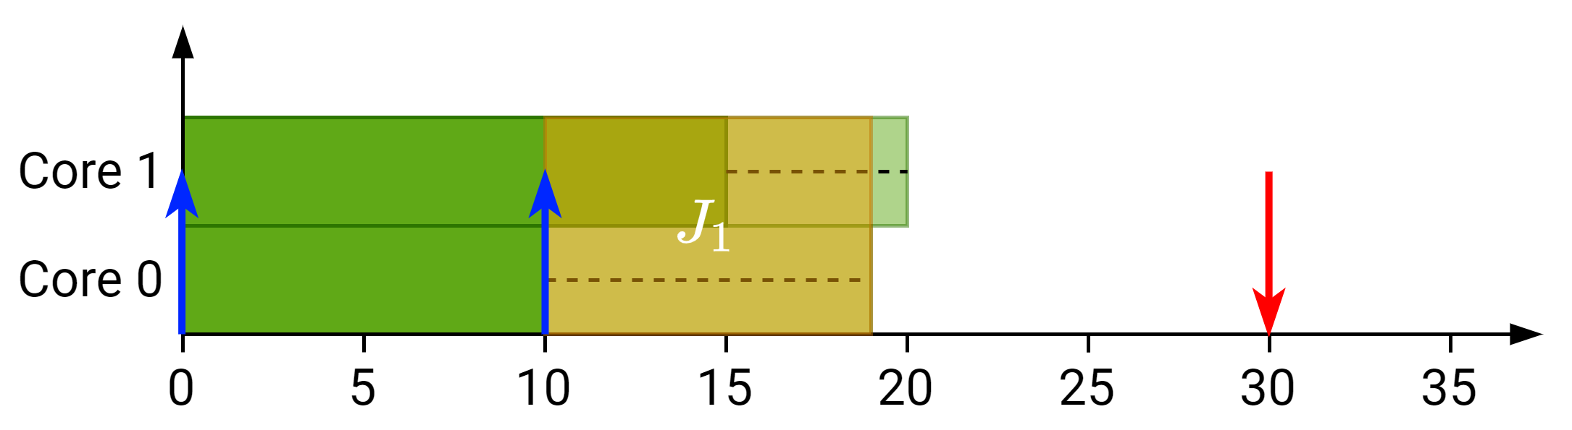
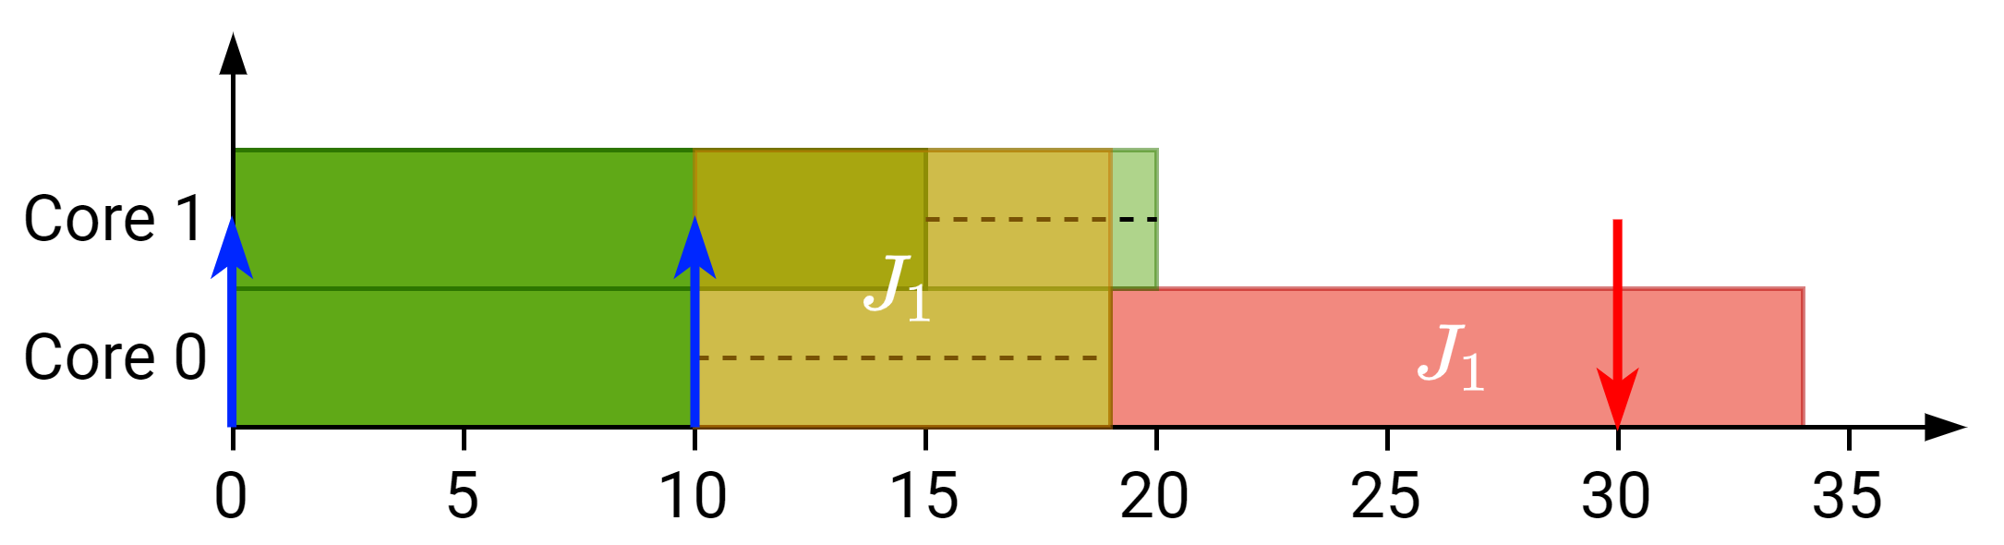
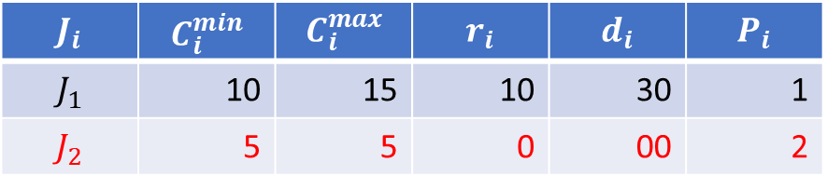
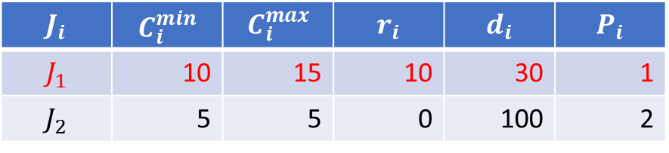
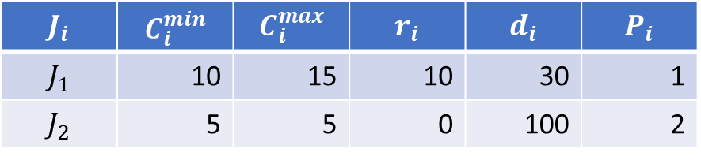
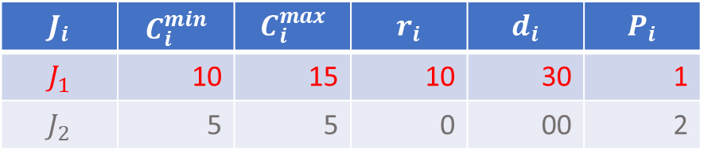
How does SAG work?
$$J_{i}$$ | $$C_{i}^{min}$$ | $$C_{i}^{max}$$ | $$r_{i}$$ | $$d_{i}$$ | $$P_{i}$$
$$J_{1}$$ | 10 | 15 | 10 | 30 | 1
$$J_{2}$$ | 5 | 5 | 0 | 100 | 2
$$J_{i}$$ | $$C_{i}^{min}$$ | $$C_{i}^{max}$$ | $$r_{i}$$ | $$d_{i}$$ | $$P_{i}$$
$$J_{1}$$ | 10 | 15 | 10 | 30 | 1
$$J_{2}$$ | 5 | 5 | 0 | 100 | 2
$$J_{i}$$ | $$C_{i}^{min}$$ | $$C_{i}^{max}$$ | $$r_{i}$$ | $$d_{i}$$ | $$P_{i}$$
$$J_{1}$$ | 10 | 15 | 10 | 30 | 1
$$J_{2}$$ | 5 | 5 | 0 | 00 | 2
$$J_{i}$$ | $$C_{i}^{min}$$ | $$C_{i}^{max}$$ | $$r_{i}$$ | $$d_{i}$$ | $$P_{i}$$
$$J_{1}$$ | 10 | 15 | 10 | 30 | 1
$$J_{2}$$ | 5 | 5 | 0 | 00 | 2

Slide 4
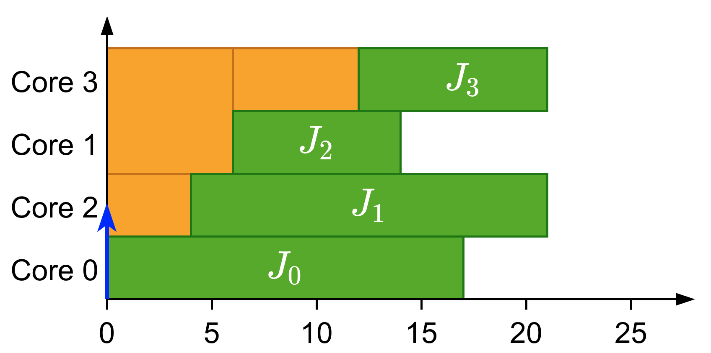
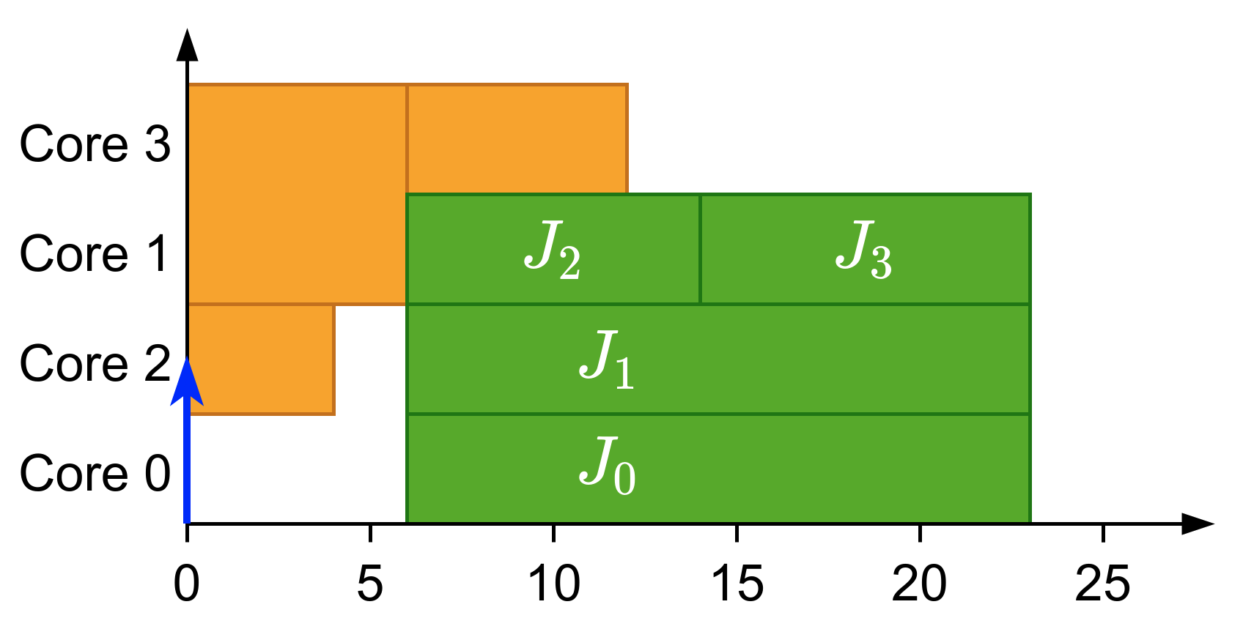
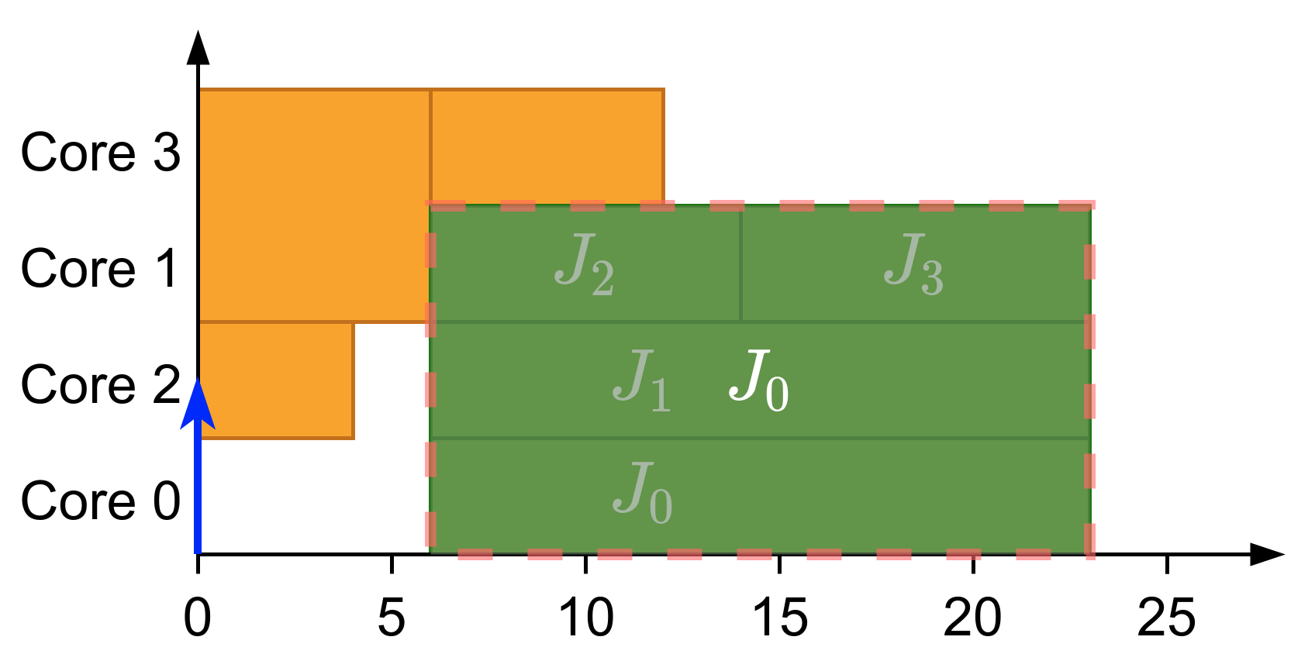
What is gang?
Parallel threads executed together as a “gang”
Execution does not start until there are enough free cores
Global scheduling
Gang Scheduling
Notes:
First of all, let’s explain what gang scheduling is.
<click>
Let’s say that we have multiple threads that we want to schedule. If we want to convert them to a gang task we would put them together as a “gang” <click> and then we would schedule as a single task<click> so the execution would not start until there are enough free cores.

Slide 5
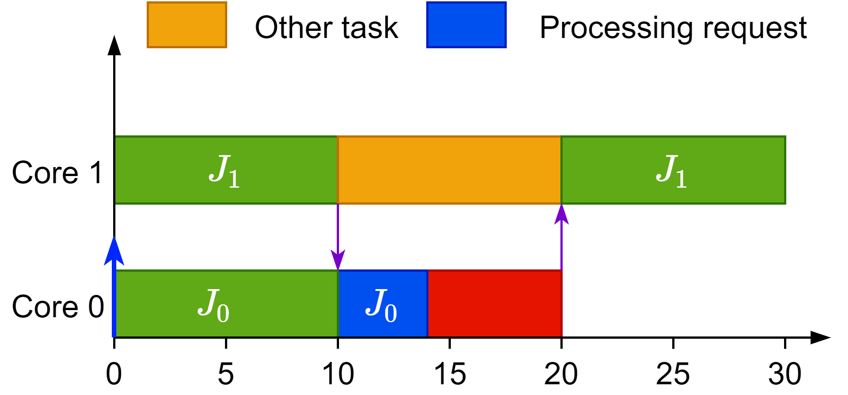
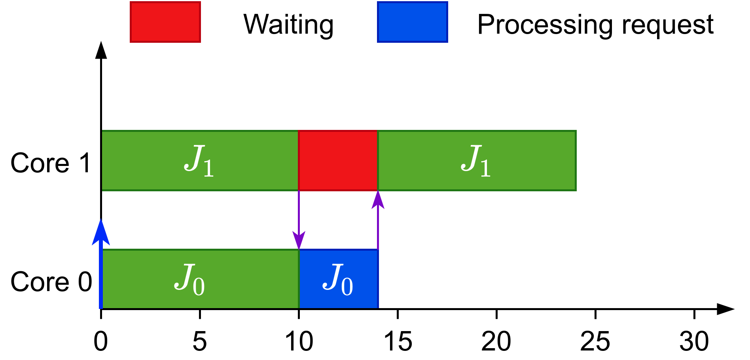
Why gang?
Efficient synchronization
Global scheduling
Gang Scheduling
Notes:
What advantages has gang over other models?
Here there are two jobs, scheduled under a global scheduling, that communicate. Job 1 has been preempted after sending the data and now job 0 has to wait in order to send the processed data back.
If we were to use gang scheduling <click> we could have a more efficient synchronization method and job 1 would busy wait for the data.

Slide 6
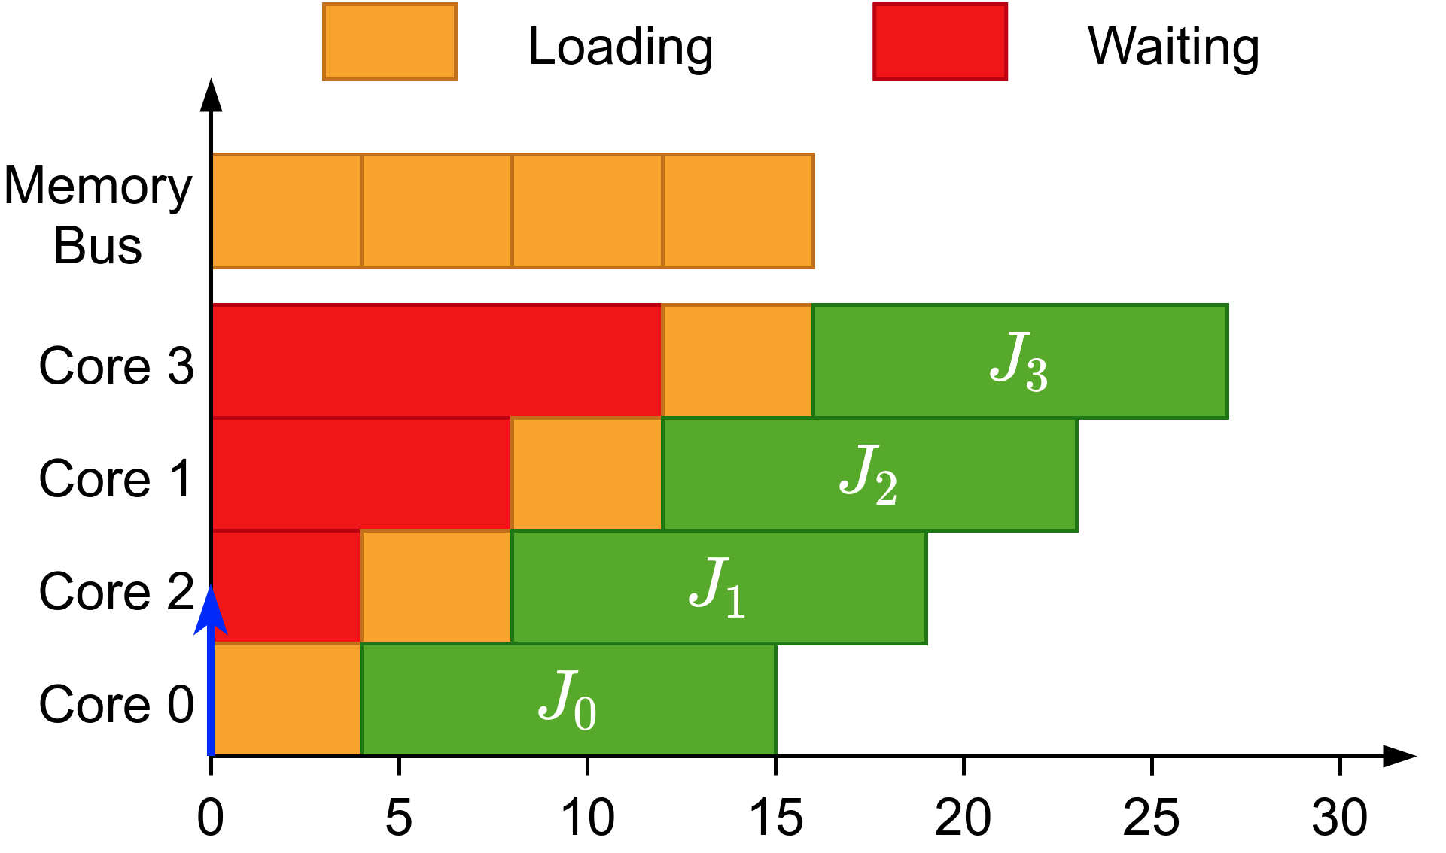
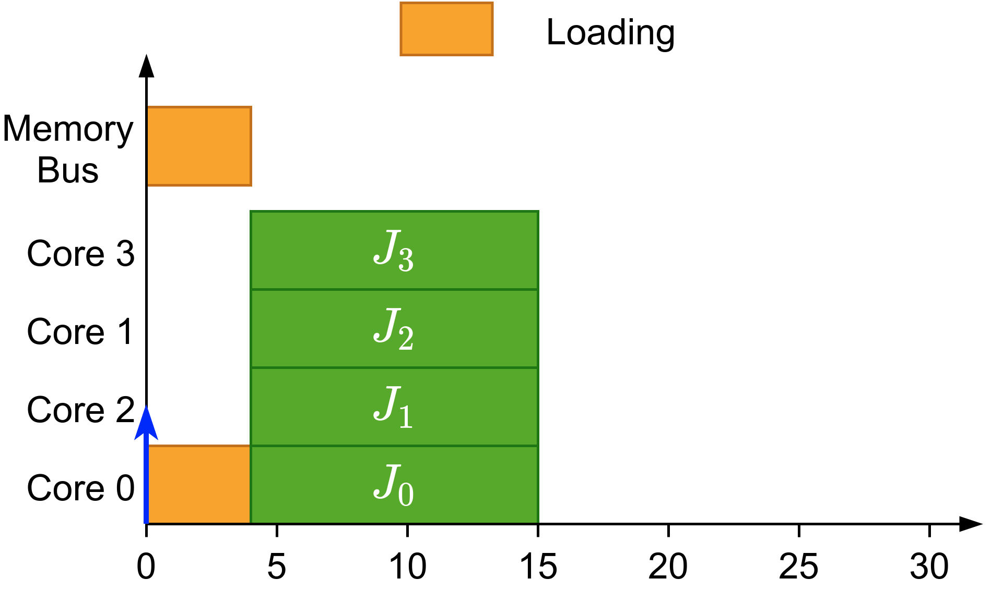
Why gang?
Efficient synchronization
Avoids overhead when loading initial data
Shows its full potential when executed non-preemptively
Global scheduling
Gang Scheduling
Notes:
Here we have some jobs that need to pre-load data before executing. All these jobs are independent but they preload the same data. However, they have to compete in for the access to the memory bus.
However<click>, if we use gang scheduling they can load the data once and avoid competing for resources.
These aspects of gang scheduling show their true potential if executed non-preemptively.

Slide 7
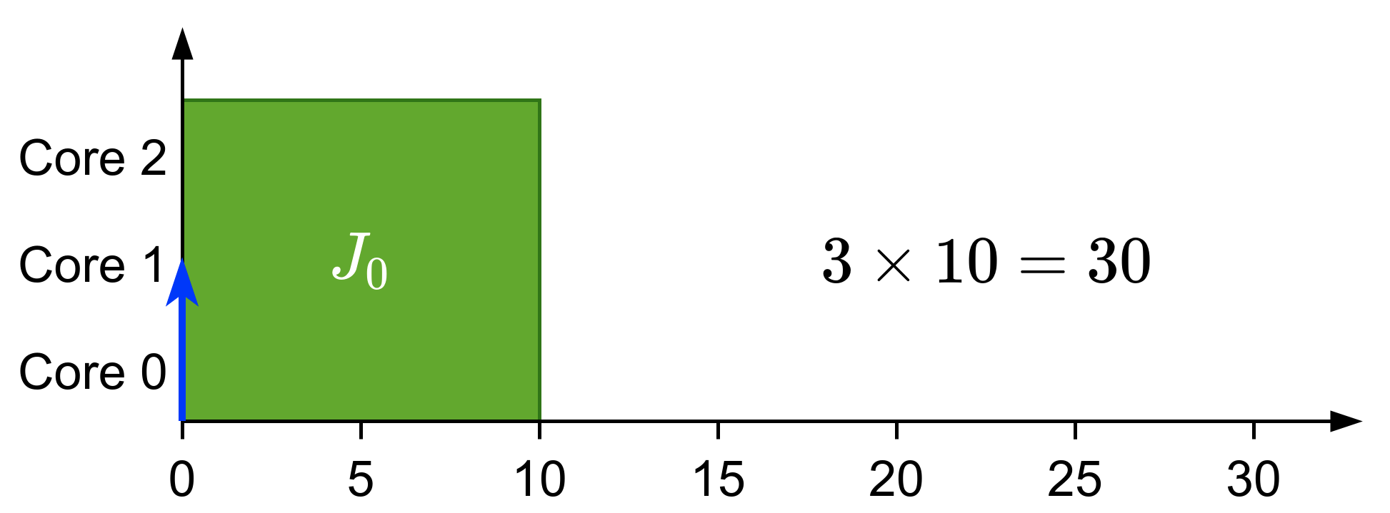
Types of gang
Rigid: number of cores set by programmer
Notes:
When talking about gang scheduling, we can have three types:
We can have a task where the number of cores is assigned by the programmer. For example three cores that execute for 10 time units each. <click>This is called rigid gang.

Slide 8
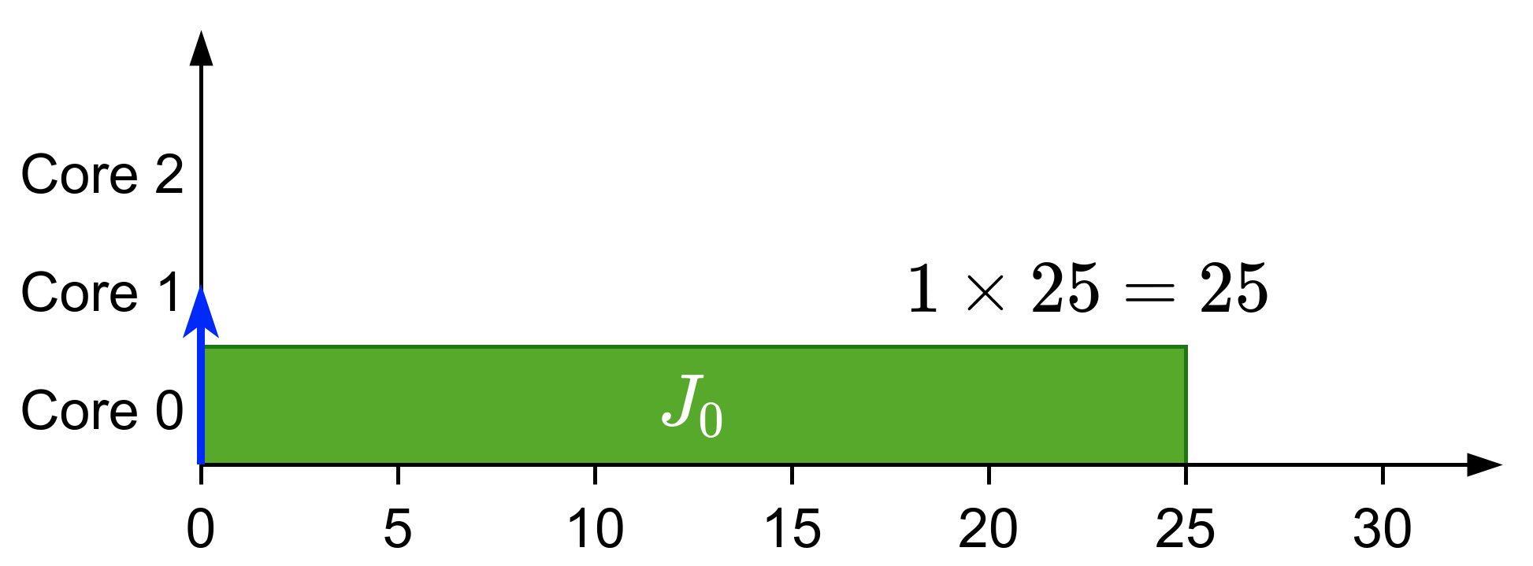
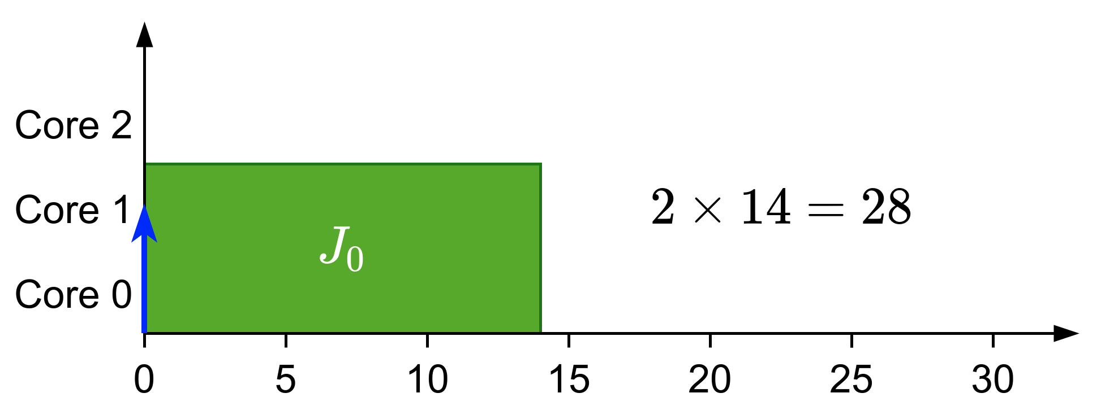
Types of gang
Rigid: number of cores set by programmer
Moldable: number of cores assigned during scheduling
Notes:
If the job has a variable number of cores <click>where usually the total workload diminishes <click> as the number of cores are reduced <click>it’s called moldable gang scheduling.

Slide 9
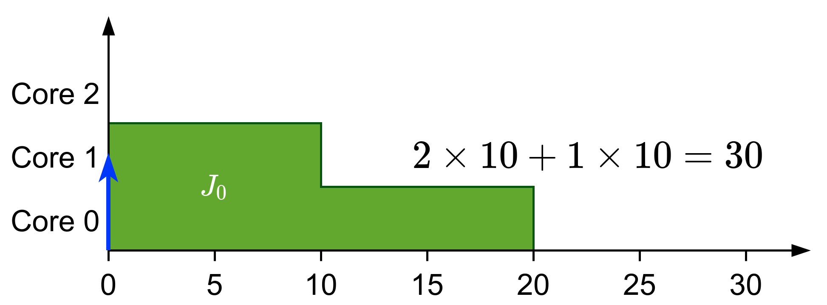
Types of gang
Rigid: number of cores set by programmer
Moldable: number of cores assigned during scheduling
Malleable: number of cores can change during runtime
Notes:
Finally if the number of cores are variable during execution, <click> it’s called malleable gang scheduling

Slide 10
Previous work
Introduced in the context of high-performance computing^{[1]}
In real-time:
We know that JLFP scheduler is not predictable/sustainable^{[2]}
Most of the work is focused in fully-preemptive solutions:
Optimal scheduler for rigid gang (DP-Fair)^{[3]}
Moldable scheduler^{[4]}
Bundled scheduling^{[5]}
Tasks with precedence constraints modelled as a succession of bundles
Our limited-preemptive definition comes from here
^{[1]}Ousterhout, 1982
[3]Goossens et al., 2016
^{[4]}Wasly et al., 2017
^{[2]}Goossens et al., 2010
^{[4]}Berten et al., 2011
Notes:
When looking at what has been done in gang scheduling we can see that<click> it was introduced in the context of high-performance computing.
<click>As for real-time we know <click> that the fixed-priority scheduler is not predictable or sustainable. Additionally, <click> most of the word is focused in fully-preemptive solutions like an optimal scheduler for rigid gang or a scheduler for moldable tasks.
Finally, there’s a special type of gang tasks called <click> bundled scheduling where the tasks with precedence constraints are modelled as a succession of bundles and that’s where our definition of limited-preemptive comes from.

Slide 11
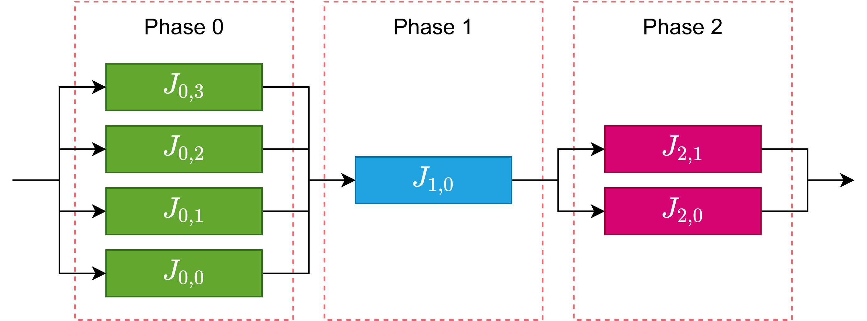
Summarizing

Slide 12
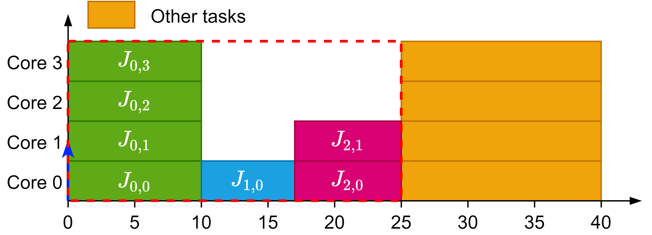
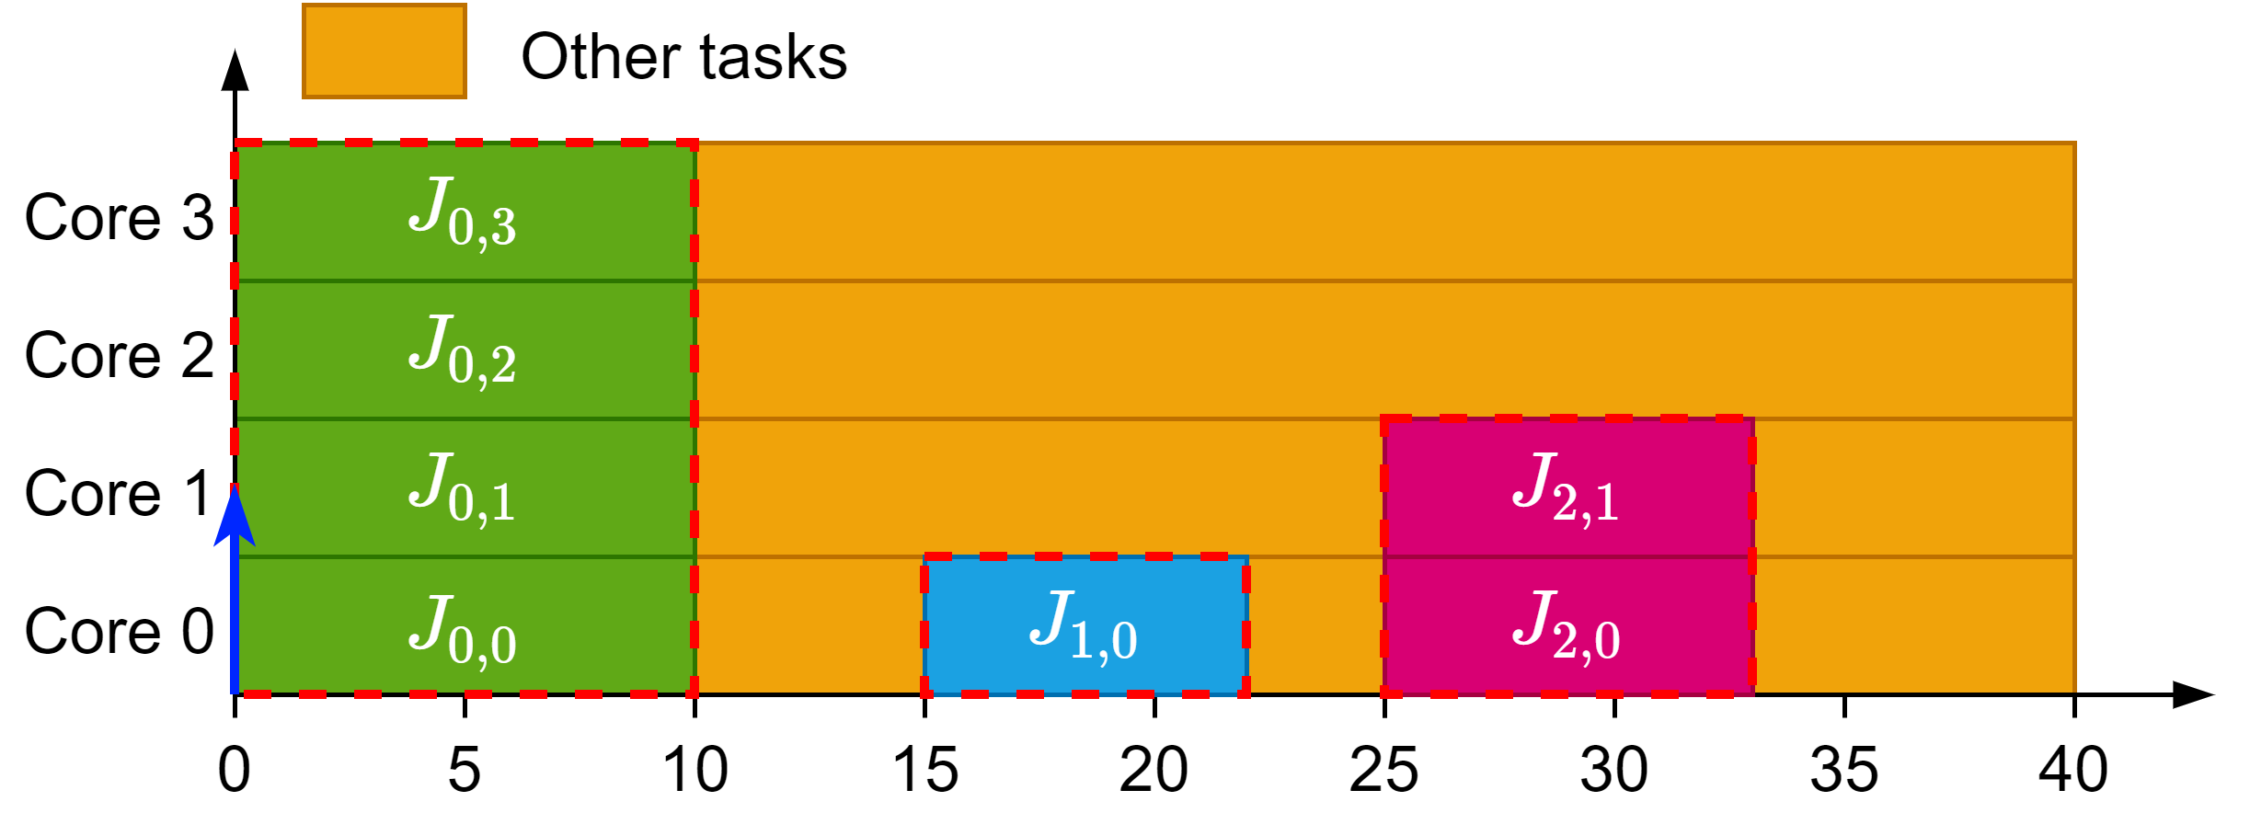
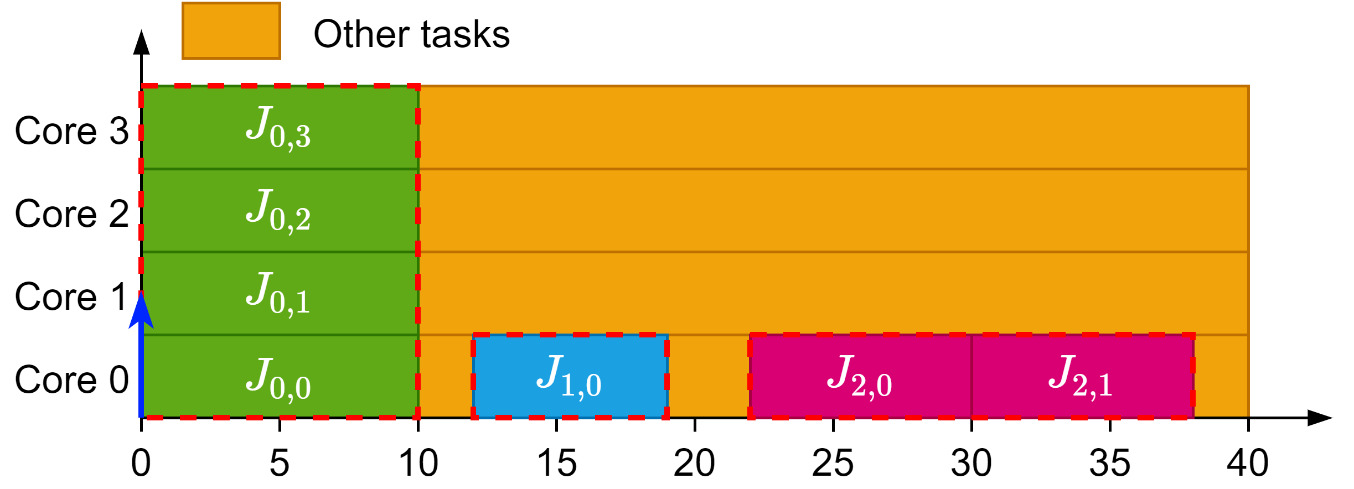
Summarizing
Rigid gang reserves the whole block
Bundled creates multiple rigid blocks with dependencies
Limited-Preemptive tries to schedule these blocks in a moldable way
Bundled model scheduling
Limited-Preemptive scheduling
Rigid gang scheduling

Slide 13
Our work

Slide 14
Project goals
Design an accurate schedulability analysis for limited-preemptive moldable gang tasks
Propose a new scheduling algorithm to improve the schedulability of limited-preemptive moldable gang tasks

Slide 15
Job-Level Fixed Priority Scheduler for Gang
Based on Global JLFP scheduler
Work conserving scheduler
Job with highest priority goes first
Assigns maximum cores available between $m_{i}^{\min{ }}$ and $m_{i}^{\max{ }}$

Slide 16
Difficulties related to SAG
We have to consider all scenarios.
The scheduler has to decide:
When to release a job
How many cores to assign to this job

Slide 17
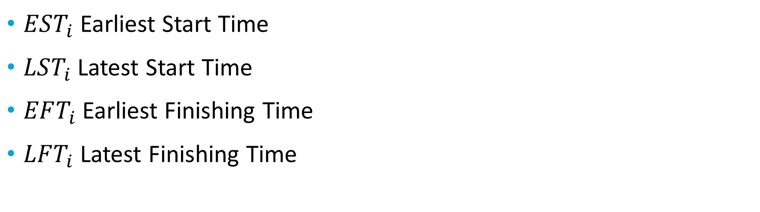
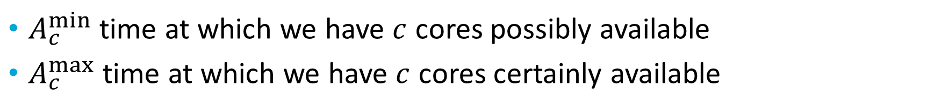
Analysis
$A_{c}^{min⁡}$ time at which we have $c$ cores possibly available
$A_{c}^{max⁡}$ time at which we have $c$ cores certainly available
$EST_{i}$ Earliest Start Time
$LST_{i}$ Latest Start Time
$EFT_{i}$ Earliest Finishing Time
$LFT_{i}$ Latest Finishing Time
Create next state if: $EST_{i}≤LST_{i}$

Slide 18
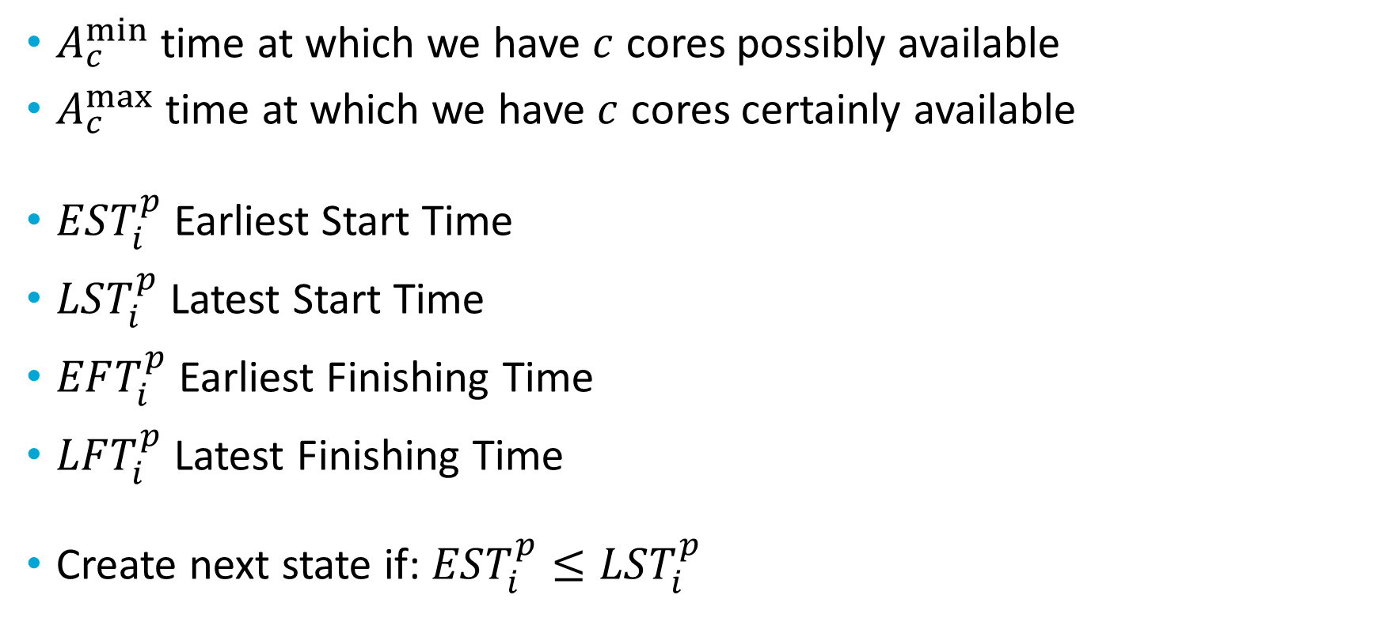
Analysis
$A_{c}^{min⁡}$ time at which we have $c$ cores possibly available
$A_{c}^{max⁡}$ time at which we have $c$ cores certainly available
$EST_{i}^{p}$ Earliest Start Time
$LST_{i}^{p}$ Latest Start Time
$EFT_{i}^{p}$ Earliest Finishing Time
$LFT_{i}^{p}$ Latest Finishing Time
Create next state if: $EST_{i}^{p}≤LST_{i}^{p}$

Slide 19
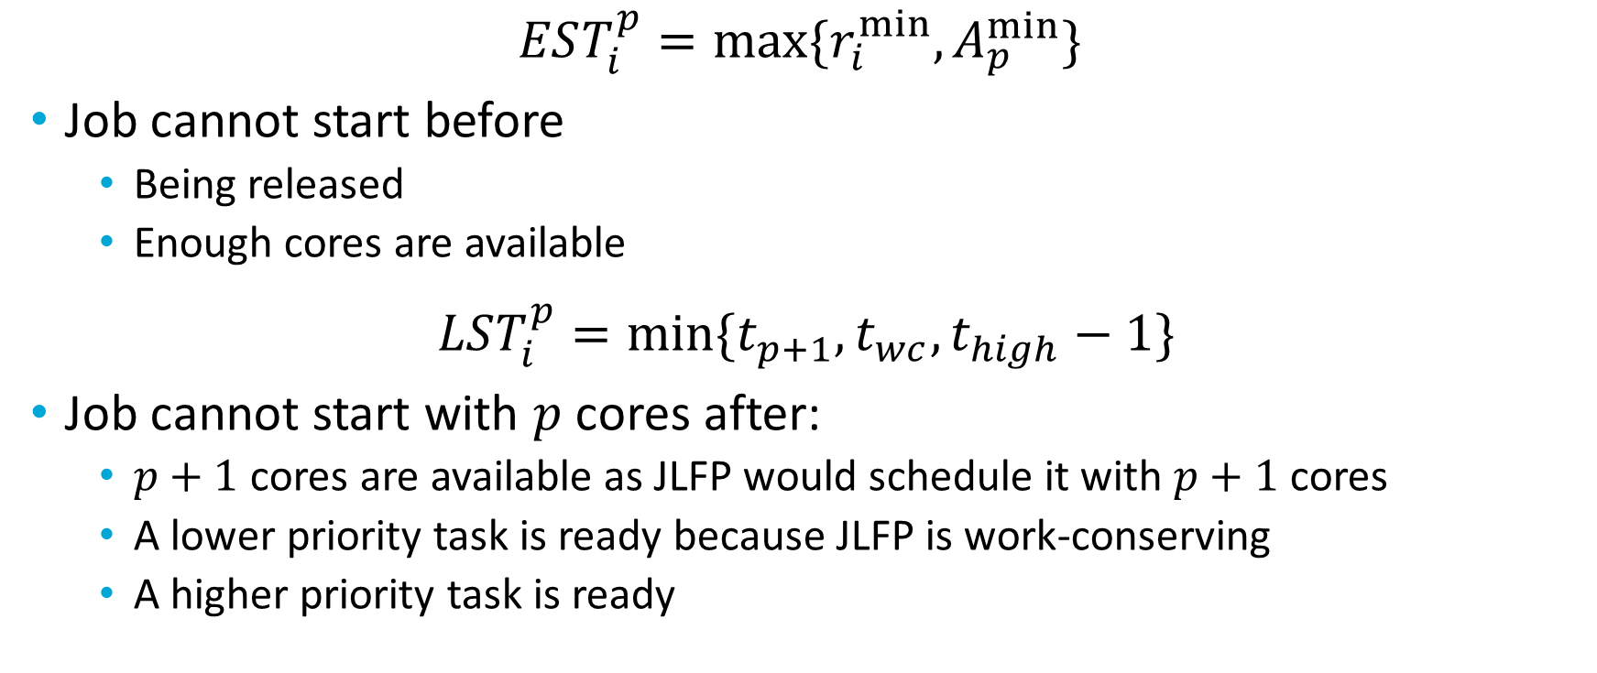
Analysis
$$EST_{i}^{p}=max⁡\{r_{i}^{min},A_{p}^{min}\}⁡$$
Job cannot start before
Being released
Enough cores are available
$$LST_{i}^{p}=\min{\{t_{p+1},t_{wc},t_{high}−1\}}$$
Job cannot start with $p$ cores after:
$p+1$ cores are available as JLFP would schedule it with $p+1$ cores
A lower priority task is ready because JLFP is work-conserving
A higher priority task is ready

Slide 20

Analysis
Obtain $EFT_{i}^{p}$ and $LFT_{i}^{p}$ from:
$$EFT_{i}^{p}=EST_{i}^{p}+c_{i}^{min}(p)$$
$$LFT_{i}^{p}=LST_{i}^{p}+c_{i}^{max⁡}\left(p\right)$$
And compute new $A_{c}^{min}$ and $A_{c}^{max}⁡⁡$

Slide 21
Temporary results

Slide 22
Pessimism identified

Slide 23
New scheduler

Slide 24
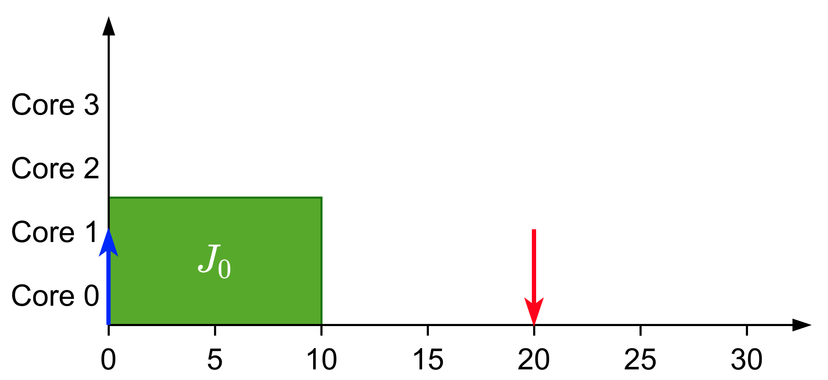
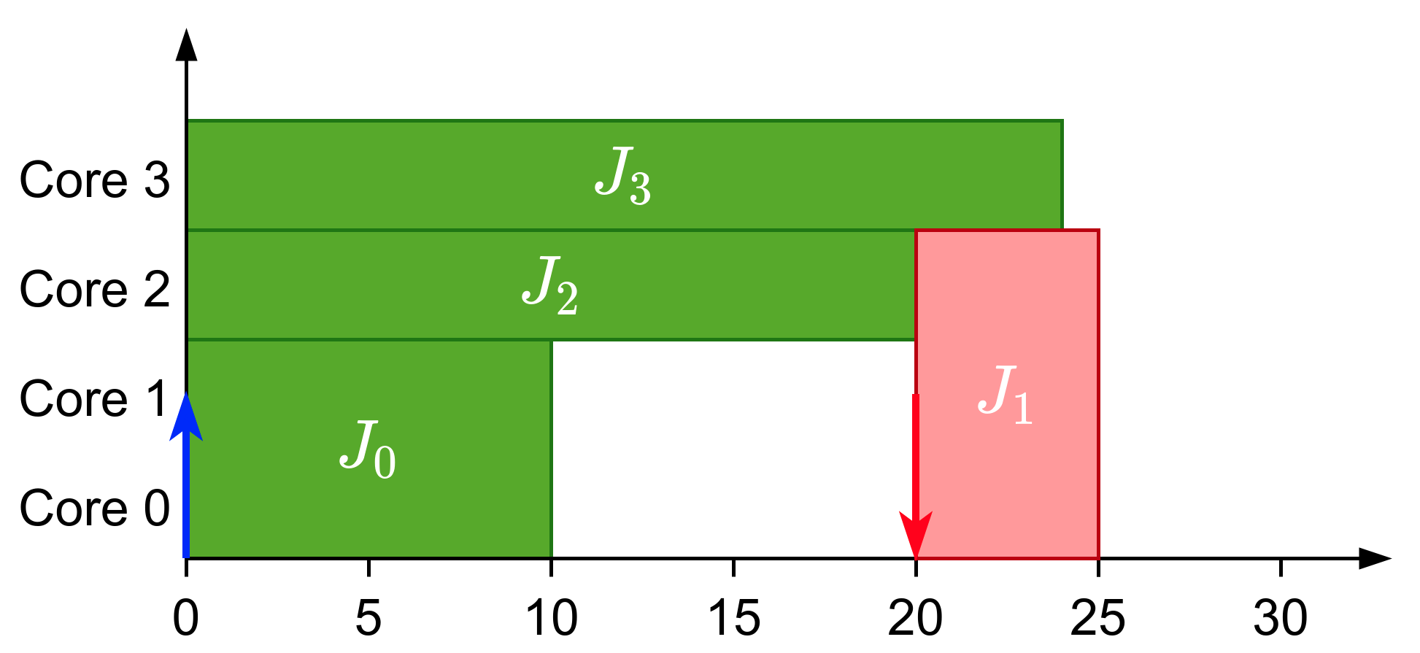
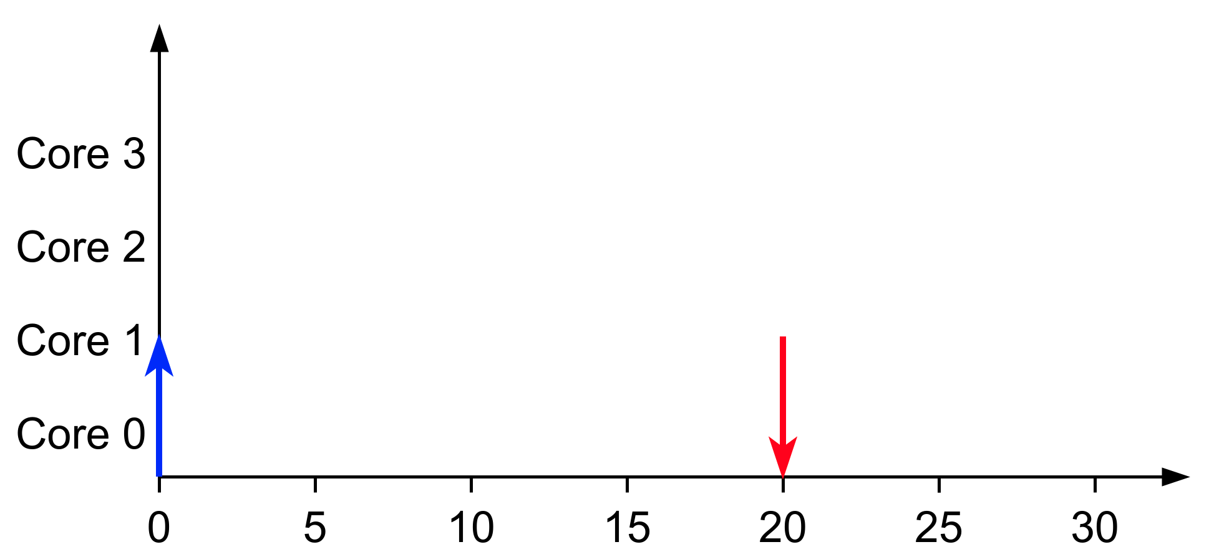
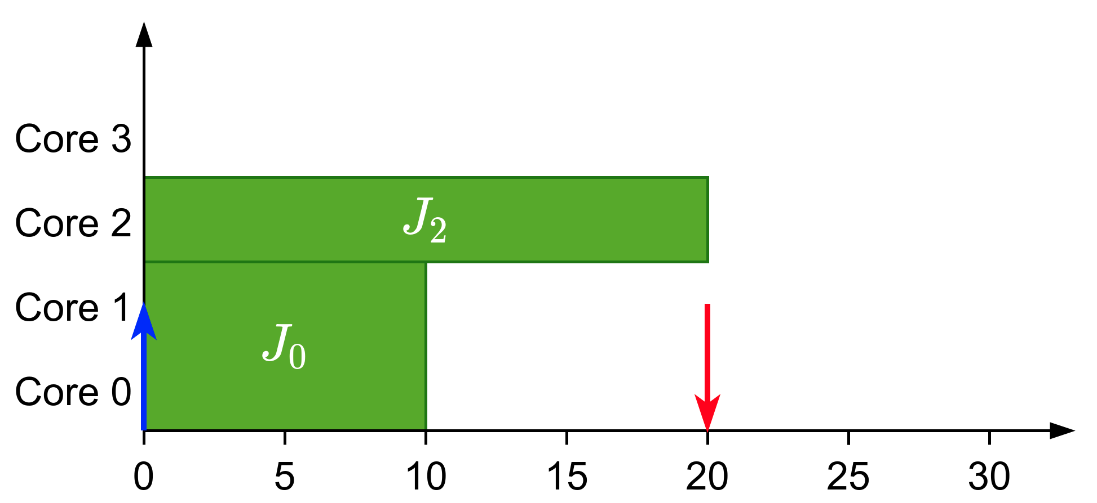
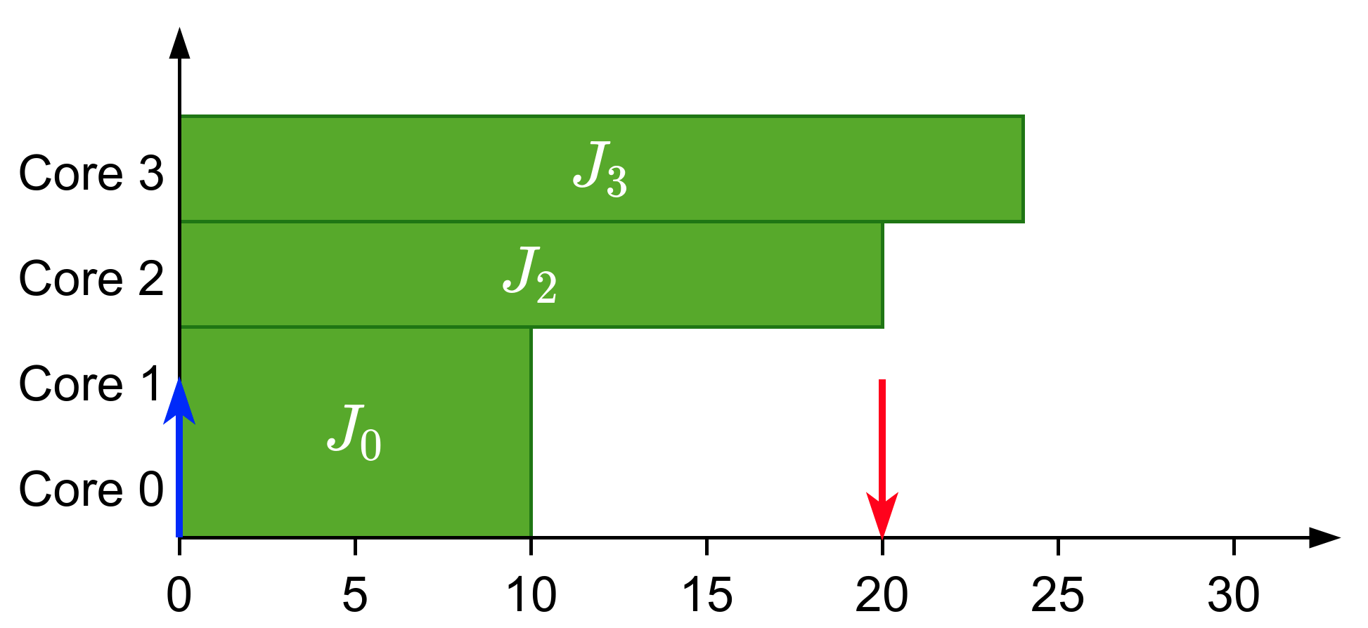
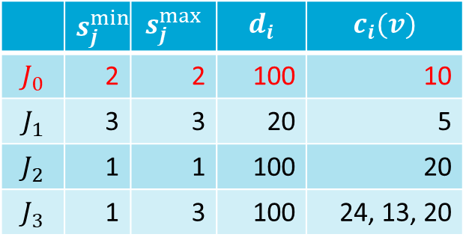
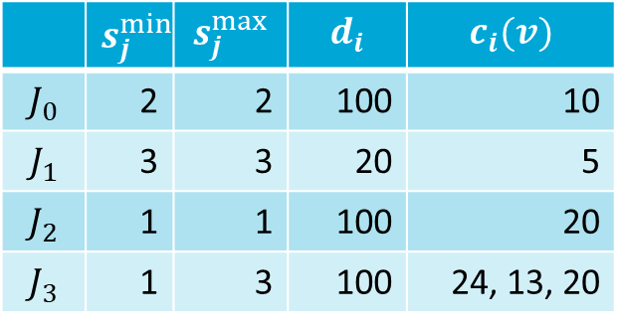

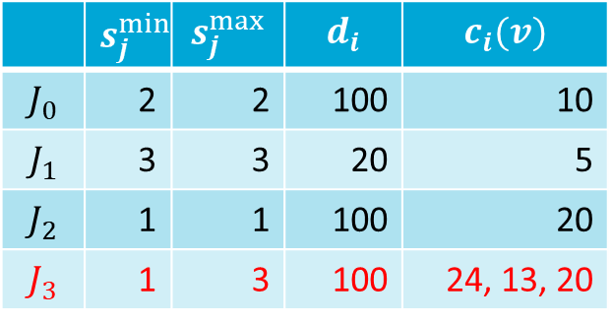

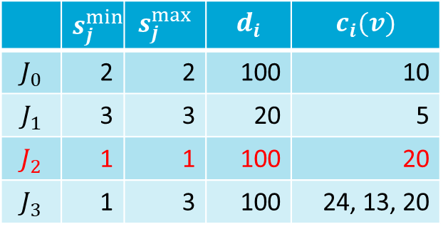


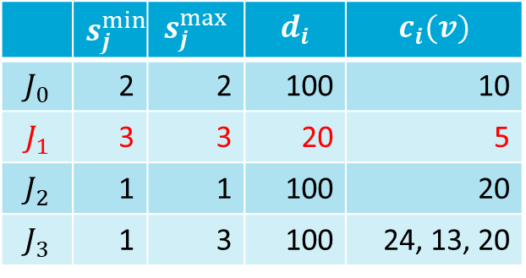
New Scheduler
Limited-Preemptive Moldable Reservation Gang Scheduler
Non-work conserving scheduler
Reserve cores of higher-priority tasks and distribute the remaining ones among lower priority tasks
JLFP scheduler
Scheduling: $J_{0}$
Scheduling: $J_{2}$
Scheduling: $J_{3}$
Scheduling: $J_{1}$
 | $$s_{j}^{min}$$ | $$s_{j}^{max}$$ | $$d_{i}$$ | $$c_{i}(v)$$
$$J_{0}$$ | 2 | 2 | 100 | 10
$$J_{1}$$ | 3 | 3 | 20 | 5
$$J_{2}$$ | 1 | 1 | 100 | 20
$$J_{3}$$ | 1 | 3 | 100 | 24, 13, 20
 | $$s_{j}^{min}$$ | $$s_{j}^{max}$$ | $$d_{i}$$ | $$c_{i}(v)$$
$$J_{0}$$ | 2 | 2 | 100 | 10
$$J_{1}$$ | 3 | 3 | 20 | 5
$$J_{2}$$ | 1 | 1 | 100 | 20
$$J_{3}$$ | 1 | 3 | 100 | 24, 13, 20
 | $$s_{j}^{min}$$ | $$s_{j}^{max}$$ | $$d_{i}$$ | $$c_{i}(v)$$
$$J_{0}$$ | 2 | 2 | 100 | 10
$$J_{1}$$ | 3 | 3 | 20 | 5
$$J_{2}$$ | 1 | 1 | 100 | 20
$$J_{3}$$ | 1 | 3 | 100 | 24, 13, 20
 | $$s_{j}^{min}$$ | $$s_{j}^{max}$$ | $$d_{i}$$ | $$c_{i}(v)$$
$$J_{0}$$ | 2 | 2 | 100 | 10
$$J_{1}$$ | 3 | 3 | 20 | 5
$$J_{2}$$ | 1 | 1 | 100 | 20
$$J_{3}$$ | 1 | 3 | 100 | 24, 13, 20
 | $$s_{j}^{min}$$ | $$s_{j}^{max}$$ | $$d_{i}$$ | $$c_{i}(v)$$
$$J_{0}$$ | 2 | 2 | 100 | 10
$$J_{1}$$ | 3 | 3 | 20 | 5
$$J_{2}$$ | 1 | 1 | 100 | 20
$$J_{3}$$ | 1 | 3 | 100 | 24, 13, 20

Slide 25

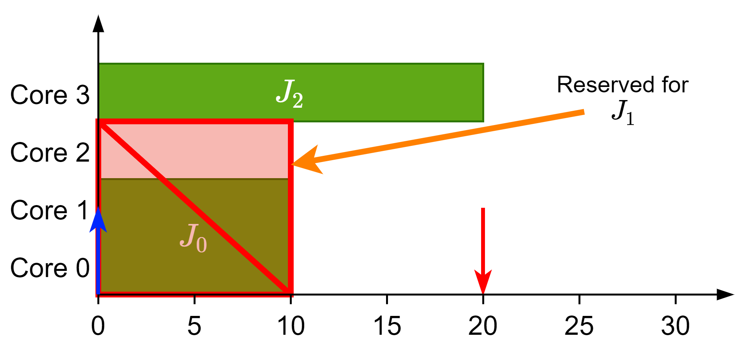
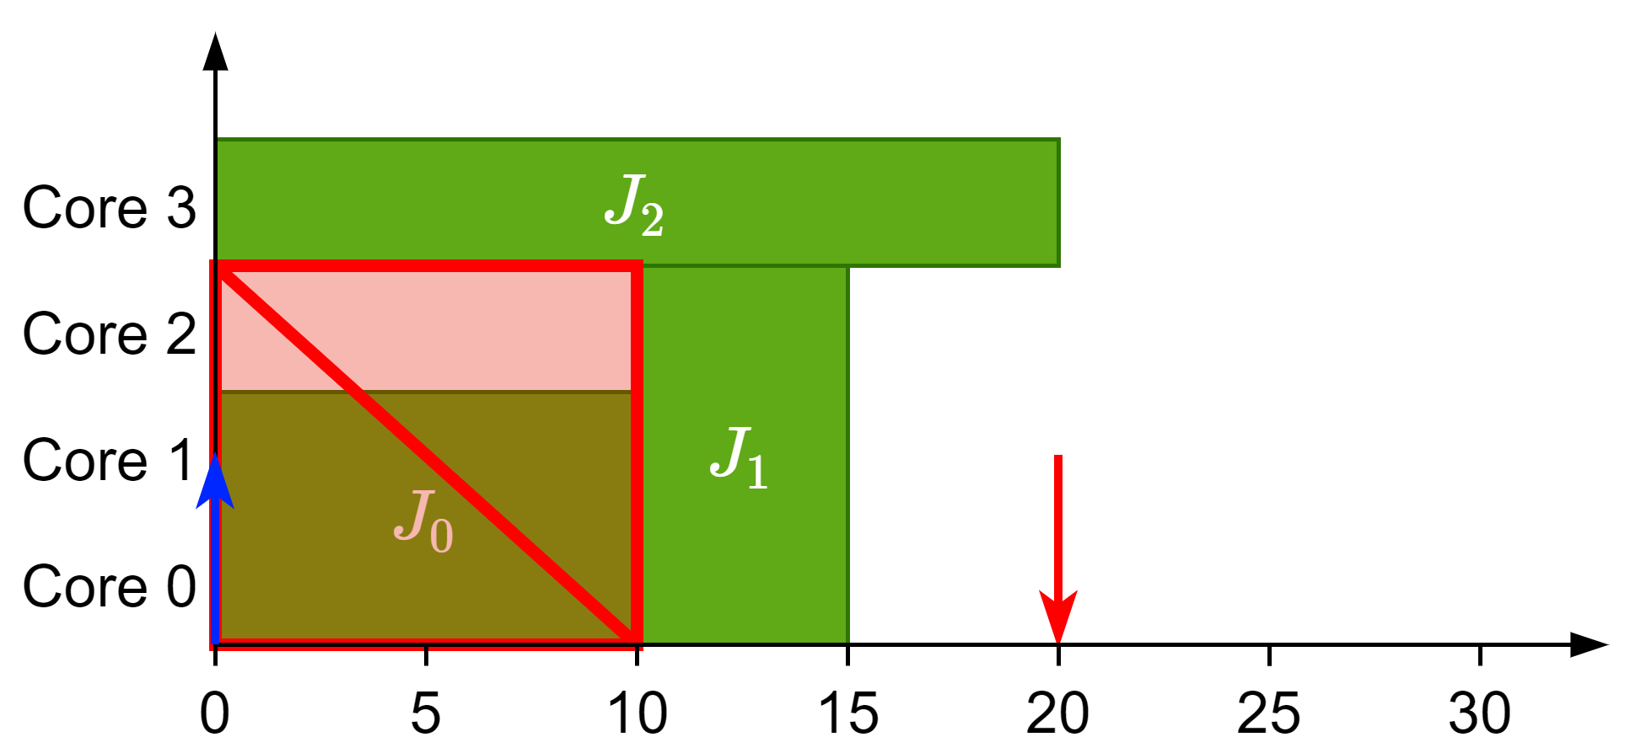






New Scheduler
Limited-Preemptive Moldable Reservation Gang Scheduler
Non-work conserving scheduler
Reserve cores of higher-priority tasks and distribute the remaining ones among lower priority tasks
LPMRGS scheduler
Scheduling: $J_{0}$
Scheduling: $J_{2}$
Scheduling: $J_{3}$
Scheduling: $J_{1}$
 | $$s_{j}^{min}$$ | $$s_{j}^{max}$$ | $$d_{i}$$ | $$c_{i}(v)$$
$$J_{0}$$ | 2 | 2 | 100 | 10
$$J_{1}$$ | 3 | 3 | 20 | 5
$$J_{2}$$ | 1 | 1 | 100 | 20
$$J_{3}$$ | 1 | 3 | 100 | 24, 13, 20
 | $$s_{j}^{min}$$ | $$s_{j}^{max}$$ | $$d_{i}$$ | $$c_{i}(v)$$
$$J_{0}$$ | 2 | 2 | 100 | 10
$$J_{1}$$ | 3 | 3 | 20 | 5
$$J_{2}$$ | 1 | 1 | 100 | 20
$$J_{3}$$ | 1 | 3 | 100 | 24, 13, 20
 | $$s_{j}^{min}$$ | $$s_{j}^{max}$$ | $$d_{i}$$ | $$c_{i}(v)$$
$$J_{0}$$ | 2 | 2 | 100 | 10
$$J_{1}$$ | 3 | 3 | 20 | 5
$$J_{2}$$ | 1 | 1 | 100 | 20
$$J_{3}$$ | 1 | 3 | 100 | 24, 13, 20
 | $$s_{j}^{min}$$ | $$s_{j}^{max}$$ | $$d_{i}$$ | $$c_{i}(v)$$
$$J_{0}$$ | 2 | 2 | 100 | 10
$$J_{1}$$ | 3 | 3 | 20 | 5
$$J_{2}$$ | 1 | 1 | 100 | 20
$$J_{3}$$ | 1 | 3 | 100 | 24, 13, 20
 | $$s_{j}^{min}$$ | $$s_{j}^{max}$$ | $$d_{i}$$ | $$c_{i}(v)$$
$$J_{0}$$ | 2 | 2 | 100 | 10
$$J_{1}$$ | 3 | 3 | 20 | 5
$$J_{2}$$ | 1 | 1 | 100 | 20
$$J_{3}$$ | 1 | 3 | 100 | 24, 13, 20

Slide 26



Results

Slide 27
Conclusions
Gang scheduling is an interesting problem with a lot that can be done
A faster and more accurate analysis can be defined with SAG
Its moldable properties can be used with the proper scheduler
Questions?

