Slide 1
Scheduling and Analys of Limited-Preemptive Modable Gang Tasks
Joan Marcè i Igual
Geoffrey Nelissen
Mitra Nasri
Paris Panagiotou
24th of February, 2020

Slide 2
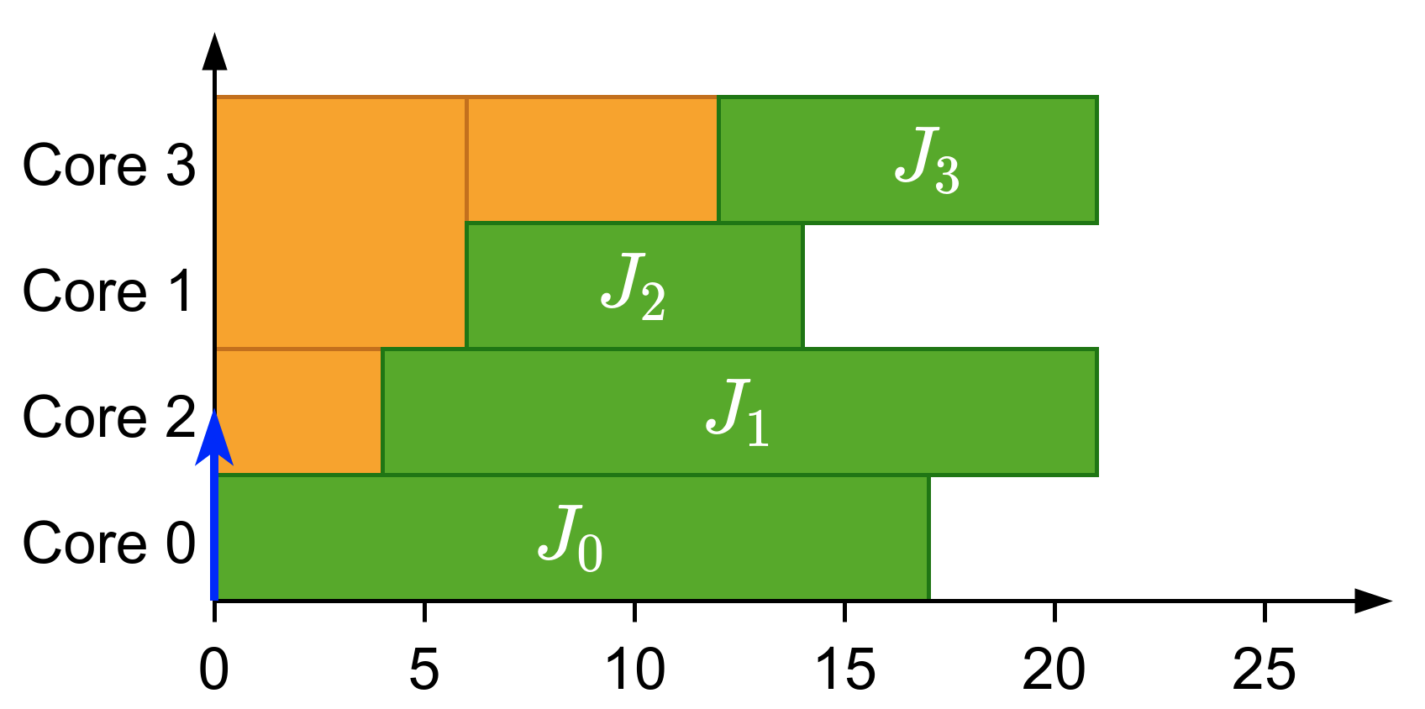
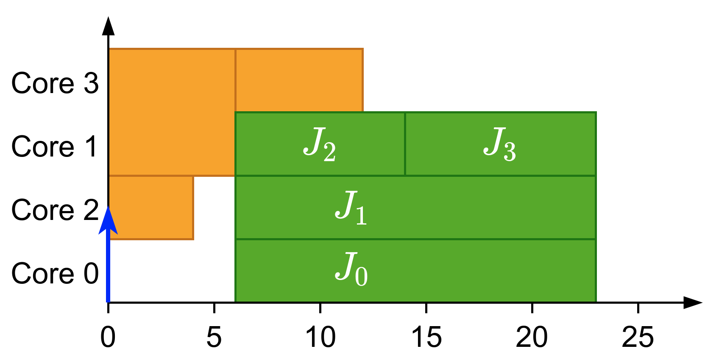
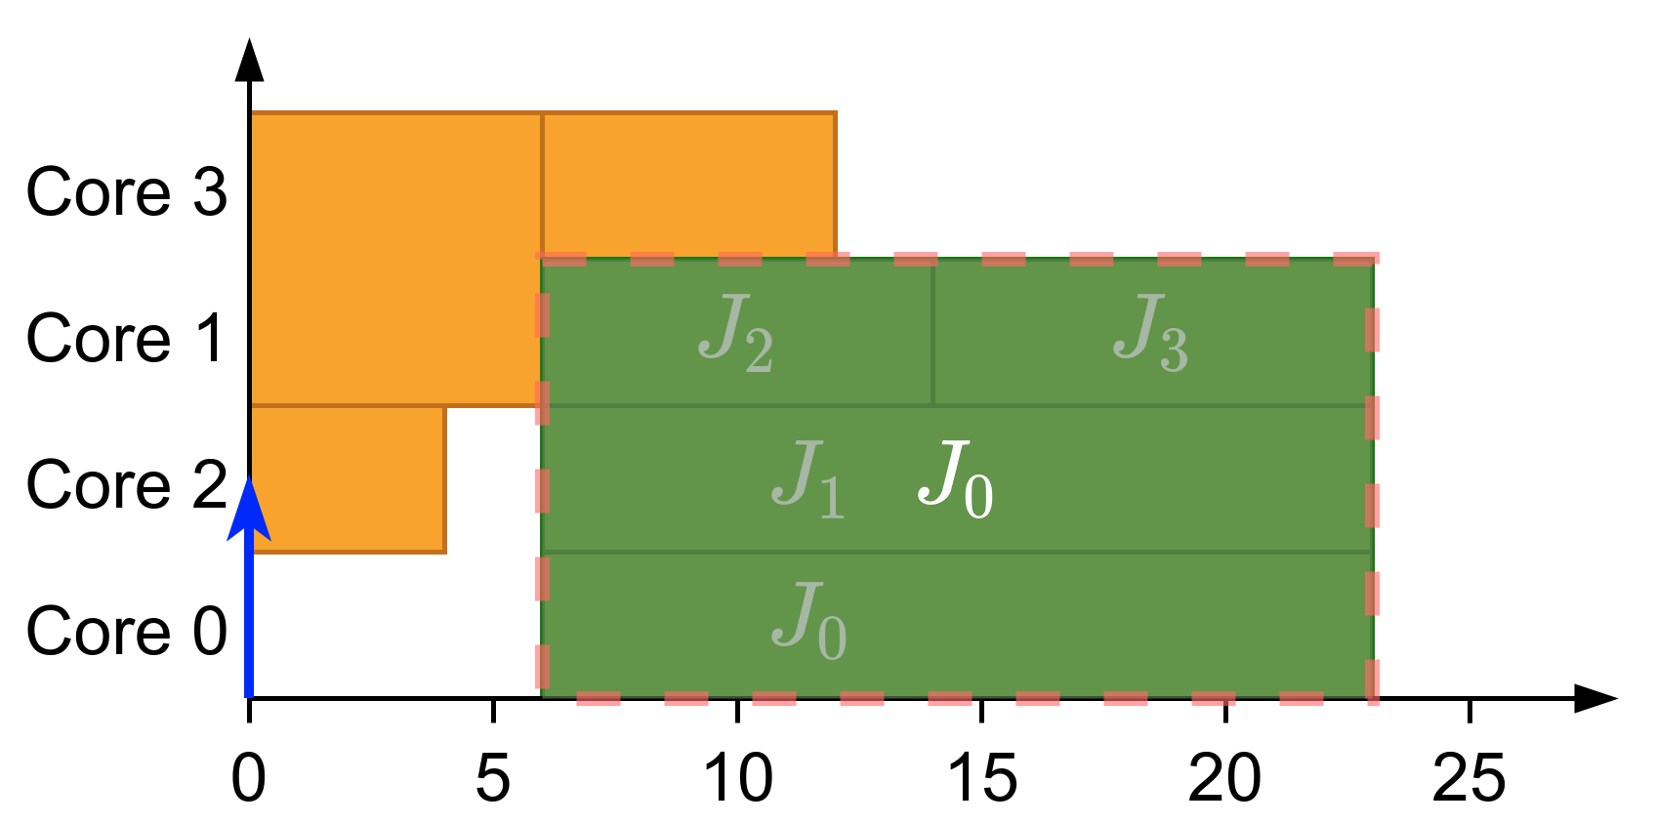
What is gang?
Parallel threads executed together as a “gang”
Execution does not start until there are enough free cores
Global scheduling
Gang scheduling
Notes:
First of all, let’s explain what gang scheduling is.
It’s the execution of multiple parallel threads together as a “gang”. In these threads the execution does not start until there are enough cores to execute them together.
Let’s see an example:<click>
We have these jobs assigned to different cores.
If we release them as a gang job then we should pack them like a single task. Obtaining the following group. <click>
Then,<click> we have obtained the gang task result of merging the jobs

Slide 3
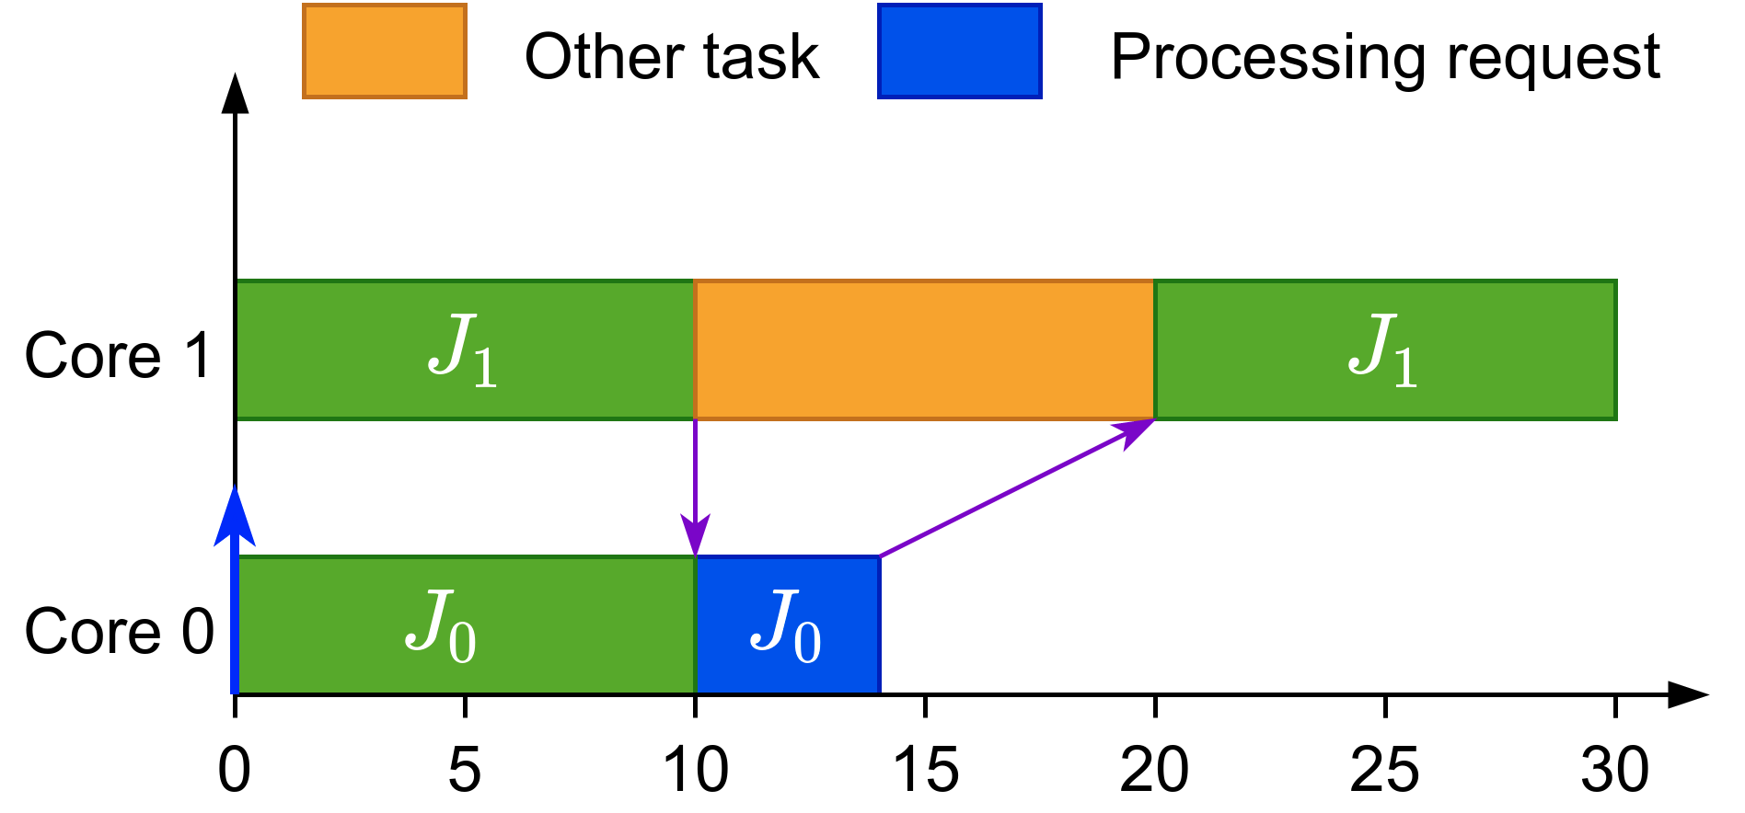
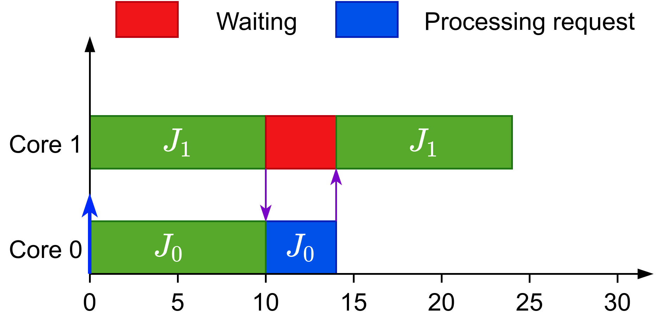
Why gang?
Efficient synchronization
Global scheduling
Gang scheduling
Notes:
Additionally it helps in synchronization situations, like in the following example<click>
Here there are two jobs and job 1 sends some data to job 0 that is processed and sent back. In this case another task has been scheduled after job 1 sent the data and after the other task finishes then job 1 can continue its execution
On the other hand if we use gang<click> the job would wait for job 0 to finish the processing part and return the results as no other task would be allowed to execute while job 1 is waiting.

Slide 4
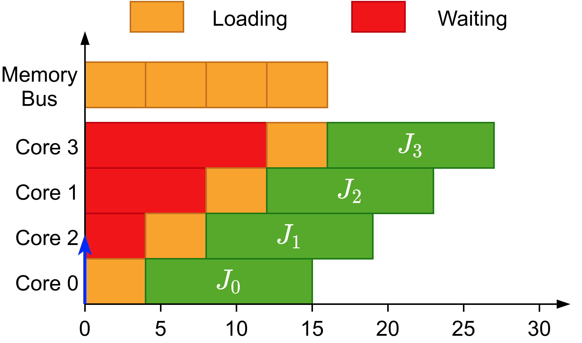
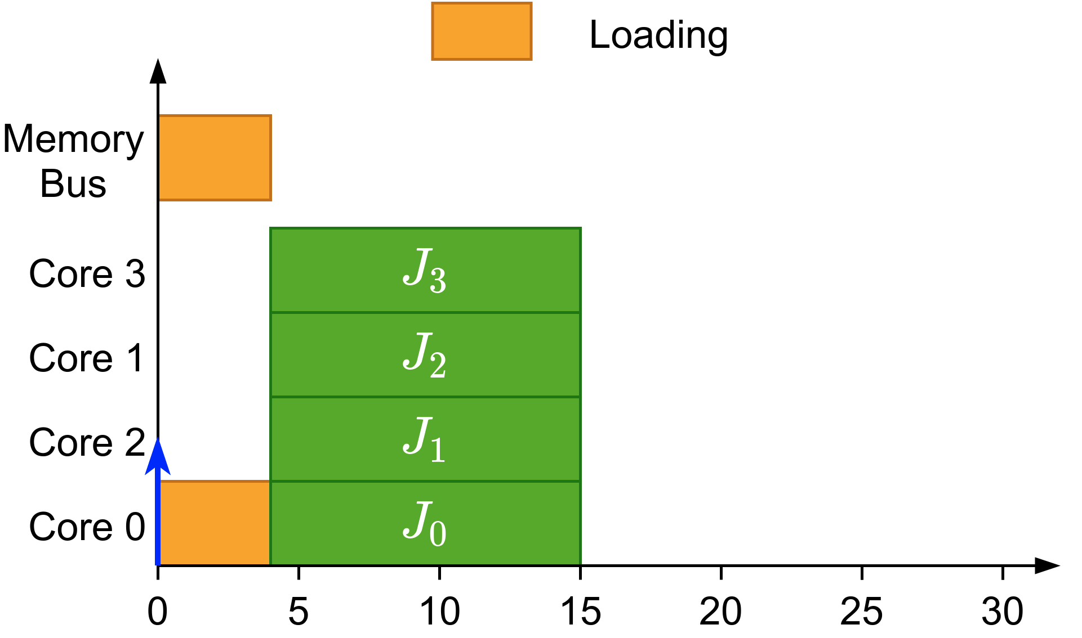

Why gang?
Efficient synchronization
Avoids overhead when loading initial data
Global scheduling
Gang scheduling
Notes:
Well, it helps in reducing overhead when loading data initially.
<click>
In this example all these threads have been scheduled at the same time but have to wait until the previous one have finished loading.
On the contrary<click>, if we know that all these threads are starting at the same time we can load the data once for all the threads at the same time which is what we would do with gang scheduling.
Finally, gang shows the full potential of these properties when executed non-preemptively

Slide 5
Why gang?
Efficient synchronization
Avoids overhead when loading initial data
Shows its full potential when executed non-preemptively
Notes:
Well, it helps in reducing overhead when loading data initially.
<click>
In this example all these threads have been scheduled at the same time but have to wait until the previous one have finished loading.
On the contrary<click>, if we know that all these threads are starting at the same time we can load the data once for all the threads at the same time which is what we would do with gang scheduling.
Finally, gang shows the full potential of these properties when executed non-preemptively

Slide 6
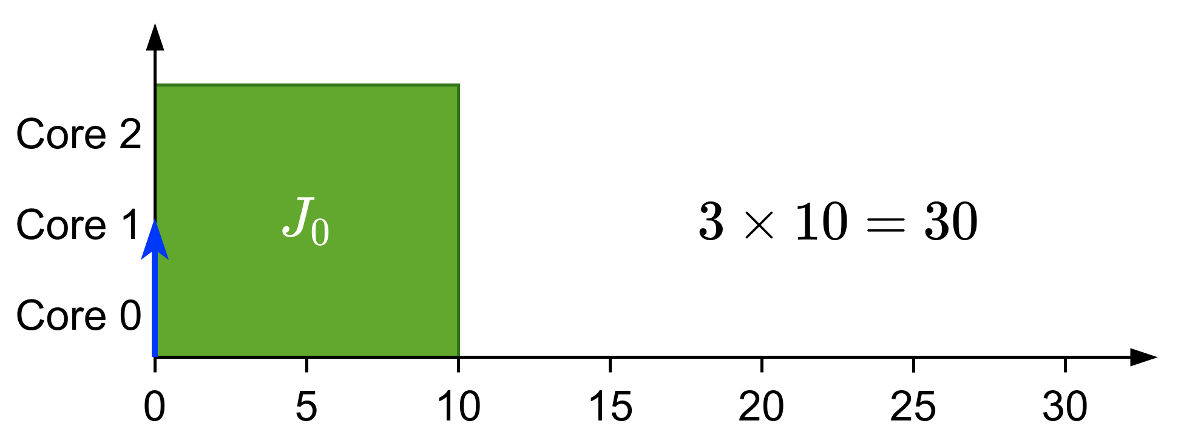
Types of gang
Rigid: number of cores set by programmer
Notes:
When talking about gang scheduling, we can have three types:
<click>Rigid gang, where the number of cores is set by the programmer and fixed during execution. In this example this job executes with 3 cores and requires 10 time units to compute

Slide 7
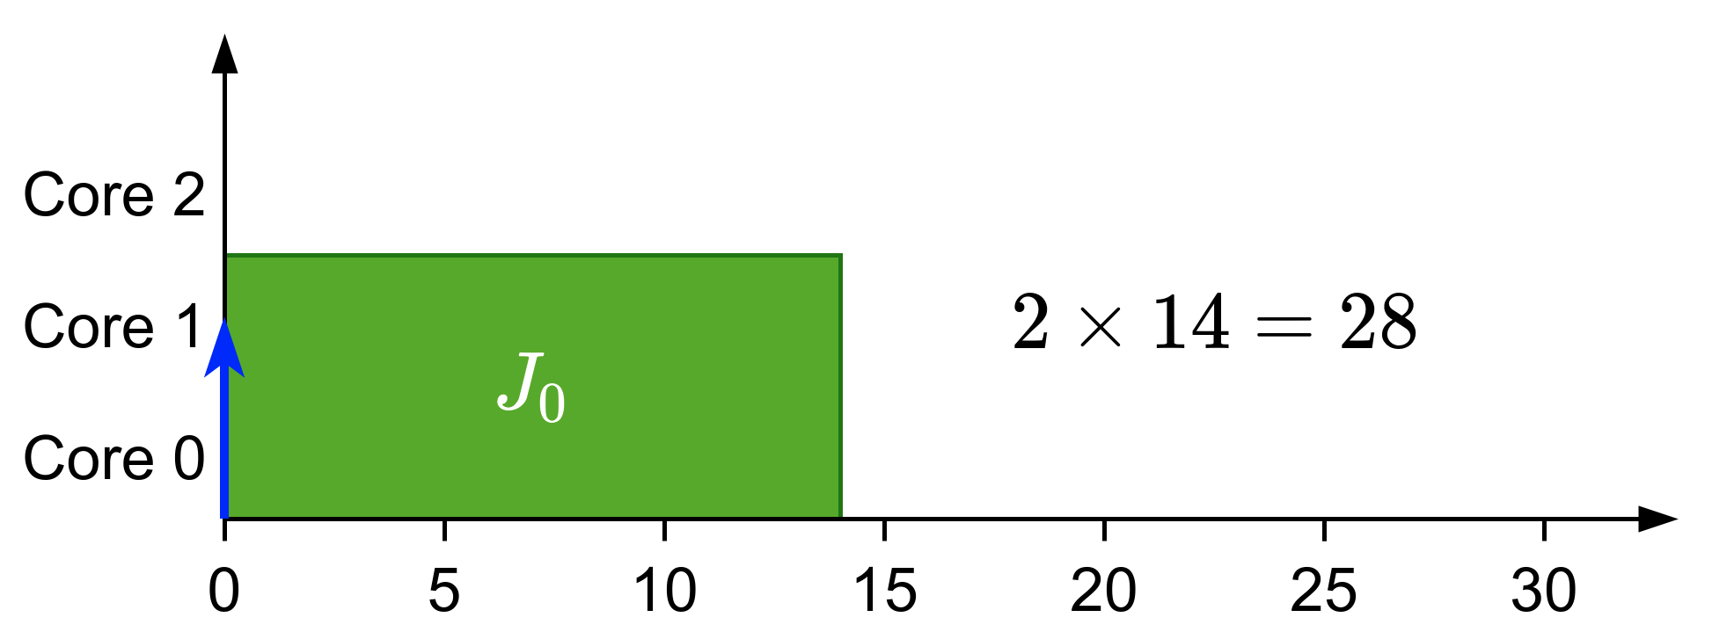
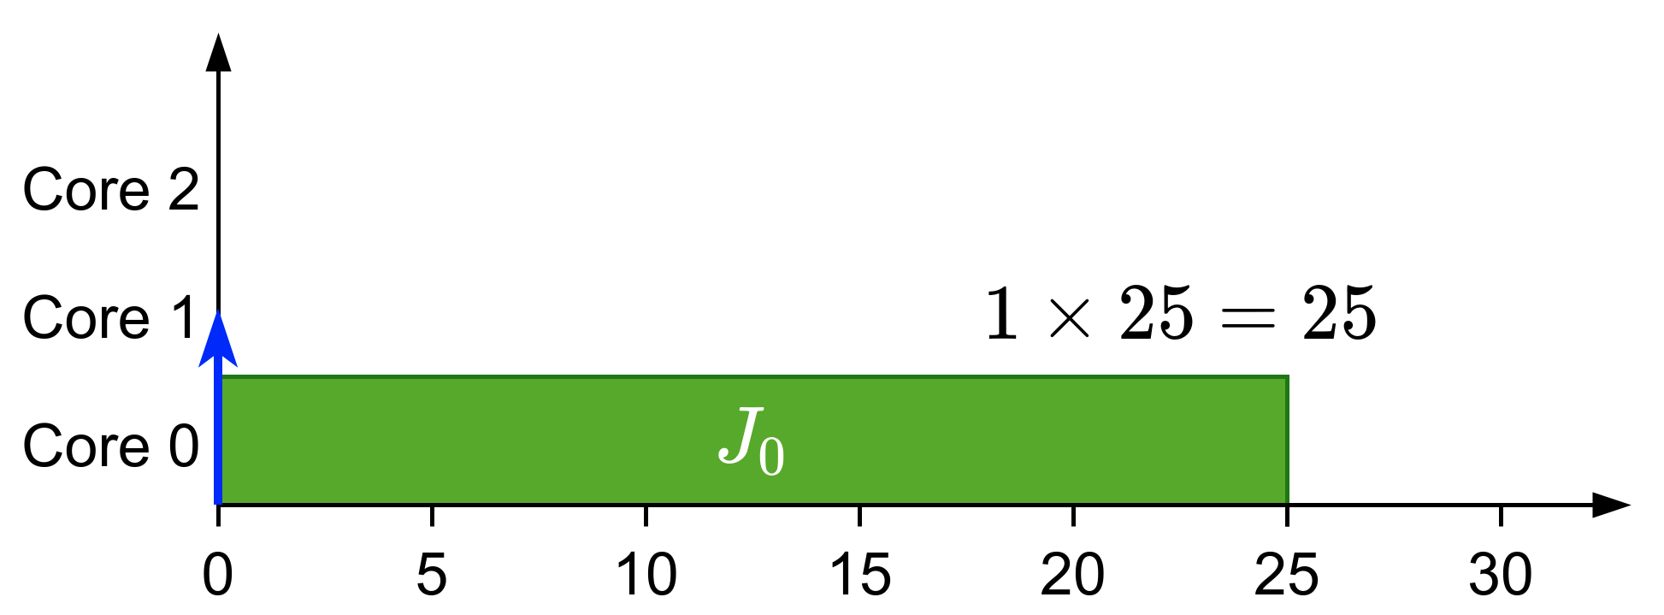
Types of gang
Rigid: number of cores set by programmer
Moldable: number of cores assigned during scheduling
Notes:
Moldable gang, where the number of cores can be in a range of values and the actual chosen value is decided when scheduling the task
In the example now the job can also execute <click> in two cores and <click> in one core. While also increasing the execution time.

Slide 8
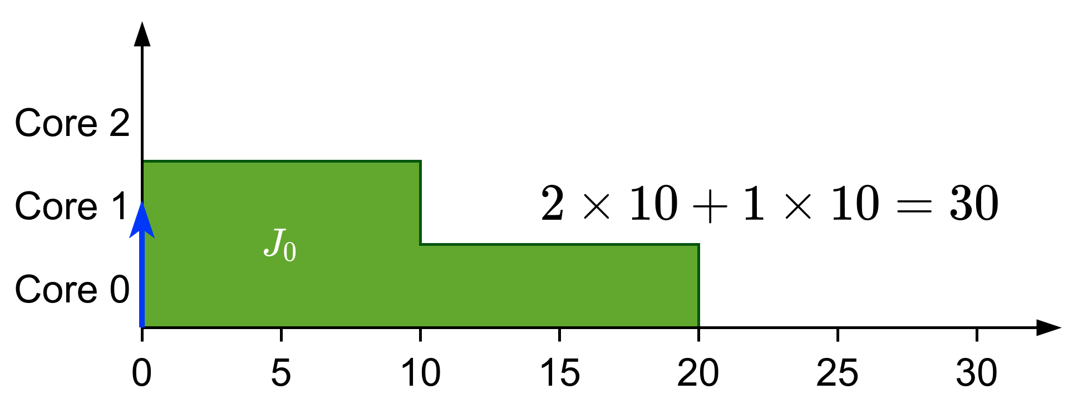
Types of gang
Rigid: number of cores set by programmer
Moldable: number of cores assigned during scheduling
Malleable: number of cores can change during runtime
Notes:
Finally there is malleable gang, where the number of cores can vary during the execution of the job and in the example the job starts executing with 2 cores and then at time 10 it switches to one core.
This work focuses on moldable gang

Slide 9
Previous work
Introduced in the context of high-performance computing^{[1]}
In real-time:
  For rigid tasks:
    An optimal scheduler (DP-Fair) exists for preemptive tasks^{[2]}
  For moldable tasks
    Preemptive scheduler that chooses cores to meet the deadline^{[3]}
^{[1]}Ousterhout, 1982
^{[3]}Berten et al., 2011
^{[2]}Goossens et al., 2016
Notes:
Alright, so what has been done previously in gang scheduling? <click>First, the gang task model was introduced in high-performance computing as a way to reduce synchronization overhead and optimize access to shared data
<click>From a real-time viewpoint the results are rather limited.
<click>For rigid gang taks it has been proven that the Job-Level Fixed-Priority scheduler is not predictable and an optimal scheduler was proposed, although it requires a high number of preemptions.
<click>For moldable gang tasks, the global EDF scheduler has been adapted and studied. Additionally a preemptive scheduler was proposed that tries to be smart and choose the appropiate cores in order to meet deadlines.

Slide 10
Previous work
Introduced in the context of high-performance computing^{[1]}
In real-time:
  Bundled task-model^{[4]}:
    Preemptive rigid gang tasks
    Tasks with precedence constraints modeled as a succession of “bundles”
    Our limited-preemptive definition comes from here
^{[4]}Wasly et al., 2017
Notes:
For malleable taks an optimal, in terms of processors, preemptive scheduler has been proposed. It was one of the first works of gang scheduling with real-time analysis
<click>Additionally there is the bundled task model that works with preemptive rigid gang tasks and models the tasks with precedence constraints as a succession of “bundles”. The limited-preemptive definition that we use for our work comes from this definition.

Slide 11
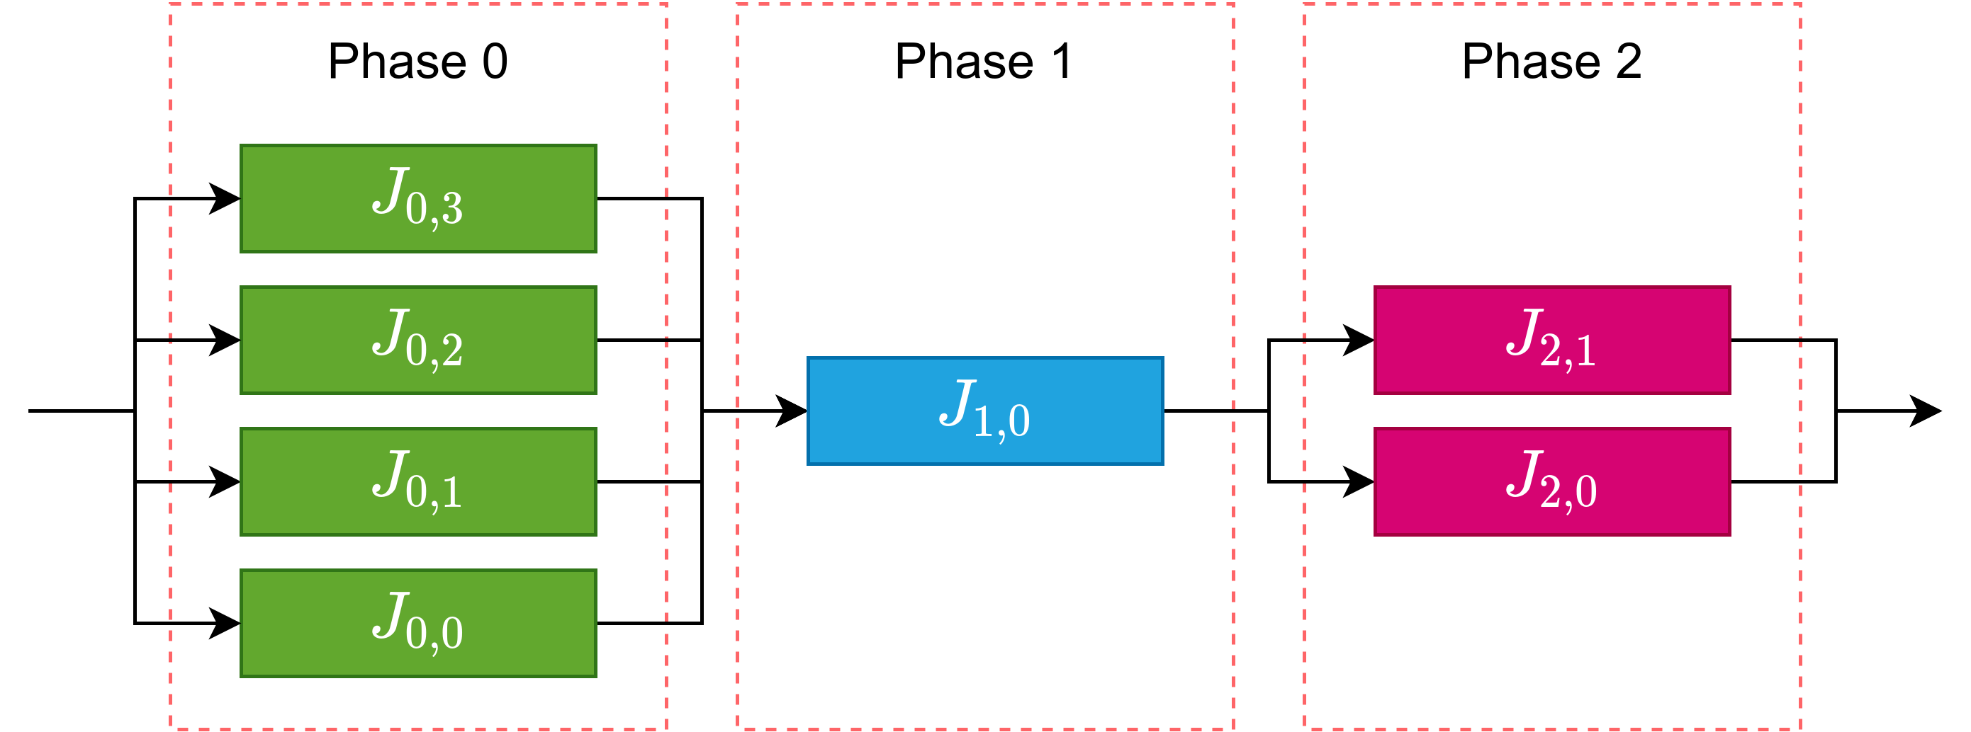
Limited-Preemptive
Notes:
Let’s see an example to understand the limited-preemptive definition. Here we have a job that is divided in three phases with dependencies between them.

Slide 12
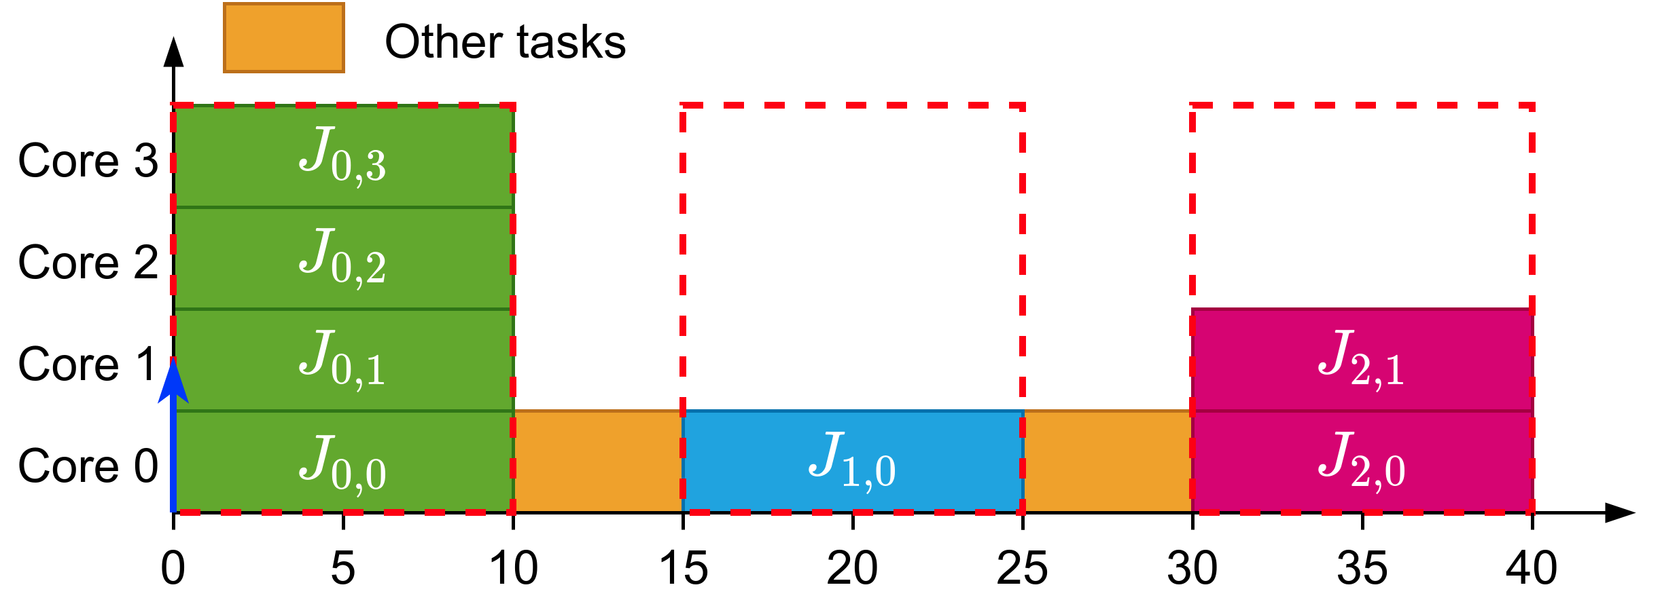
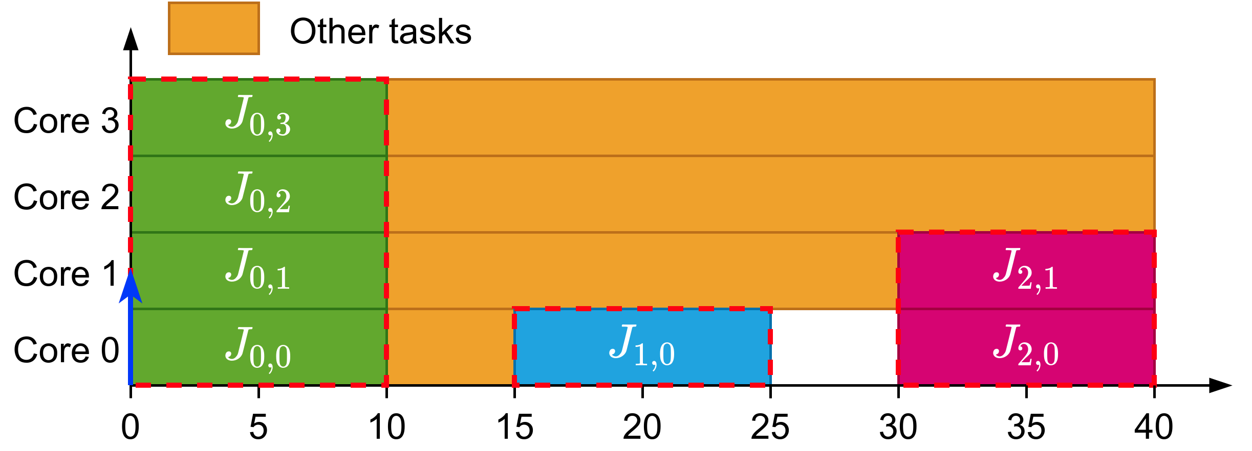
Limited-Preemptive
Rigid gang could ask for cores that does not use
Bundled^{[7]} asks only the required cores but preemptions can happen inside a bundle
LP only allows preemptions between bundles
^{[7]}Wasly et al., 2017
Notes:
If we try to schedule them with rigid gang we could obtain the following schedule were the gang task is taking cores that does not use.<click>
That’s why we have the bundled task model where each bundle only asks for the cores it requires but it allows preemptions to happen inside the bundle
<click>And here is where our limited-preemptive definition comes in where the preemptions are only allowed between bundles and not inside them.

Slide 13
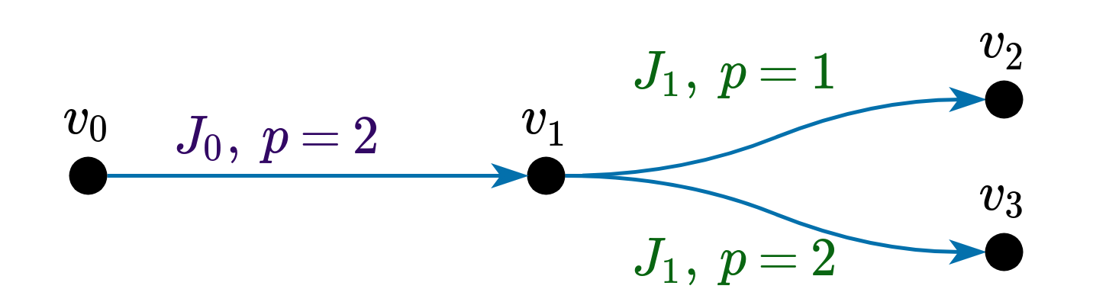
Schedulability analysis
Accurate and relatively fast analysis
Based on the notion of Schedule Abstraction Graph
Faster than an exact analysis
Not as pessimistic as closed-form analyses
Notes:
Now, to analyze gang tasks we use schedulability analysis. It is a technique that allows for accurate and relatively fast analysis as it is based o the notion of the Schedule Abstraction Graph.
It is faster than an exact analysis and not as pessimistic as closed-form analyses.
Here we can see the scheduling decisions that a scheduler has taken

Slide 14
Our work
We aim to extend schedulability analysis to moldable gang under the Job-Level Fixed Priority scheduler
  Many different scenarios
  Scheduler has to decide
    When to release a job
    How many cores to assign to this job
  This could lead to state-space explosion
Notes:
In our work we aim to extend the schedulability anylsis to incorporate the limited-preemptive moldable gang tasks.
However it has some difficulties as there are many different scenarios. In this case the scheduler has to decide when to release a job and how many cores it asssigns to the job.
This could lead to state-space explosion

Slide 15
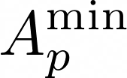






Analysis
Time at which we have p cores possibly available
Time at which we have p cores certainly available
Earliest Start Time of job i with p cores
Latest Start Time of job i with p cores
Earliest Finishing Time of job i with p cores
Latest Finishing Time of job i with p cores
Notes:
To do the analysis under the fixed priority scheduler we need at least the following terms.
A_min and A_max are the times at which we know that there are possibly for A_min and certainly for A_max p cores. This is the starting point to perform the analysis.
EST and LST are the earliest and latest start time of a job executed with p cores
EFT and LFT are the earliest and latest finishing time of a job executed with p cores
In order for a job to be eligible to be scheduled its earliest start time has to be lower or equal than the latest start time.

Slide 16
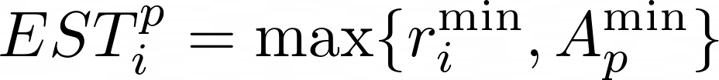
Analysis
Job cannot start before:
  Being released
  Enough cores are available
Job cannot start with p cores after:
  p+1 are avaible
  A lower priority task can start
  A higher priority task can start
Notes:
To get to the next step we compute the EST and LST of a job.
For the EST we know that a job cannot start before being released and if there are not enough cores to execute the job
<click>For the LST we know that if we want to execute it with p cores with the fixed-priority scheduler there cannot be p+1 cores as otherwise the job would execute with p+1 cores (unless the maximum number of cores is p). Additionally if this job is to be executed it has to be released before or at the same time of a lower priority task as otherwise the lower priority task would be executed. Finally the job has to be released before a higher priority task in order to be scheduled.

Slide 17

Analysis
Obtain and from job i
Which allows us to compute and
Notes:
Once we have the EST and the LST we can compute the earliest finishing time and latest finishing time just using the minimum and maximum execution time of the job.
Finally we can obtain new availability times for the cores and from here compute the state for other jobs. If there’s a deadline miss we would see it in this step

Slide 18
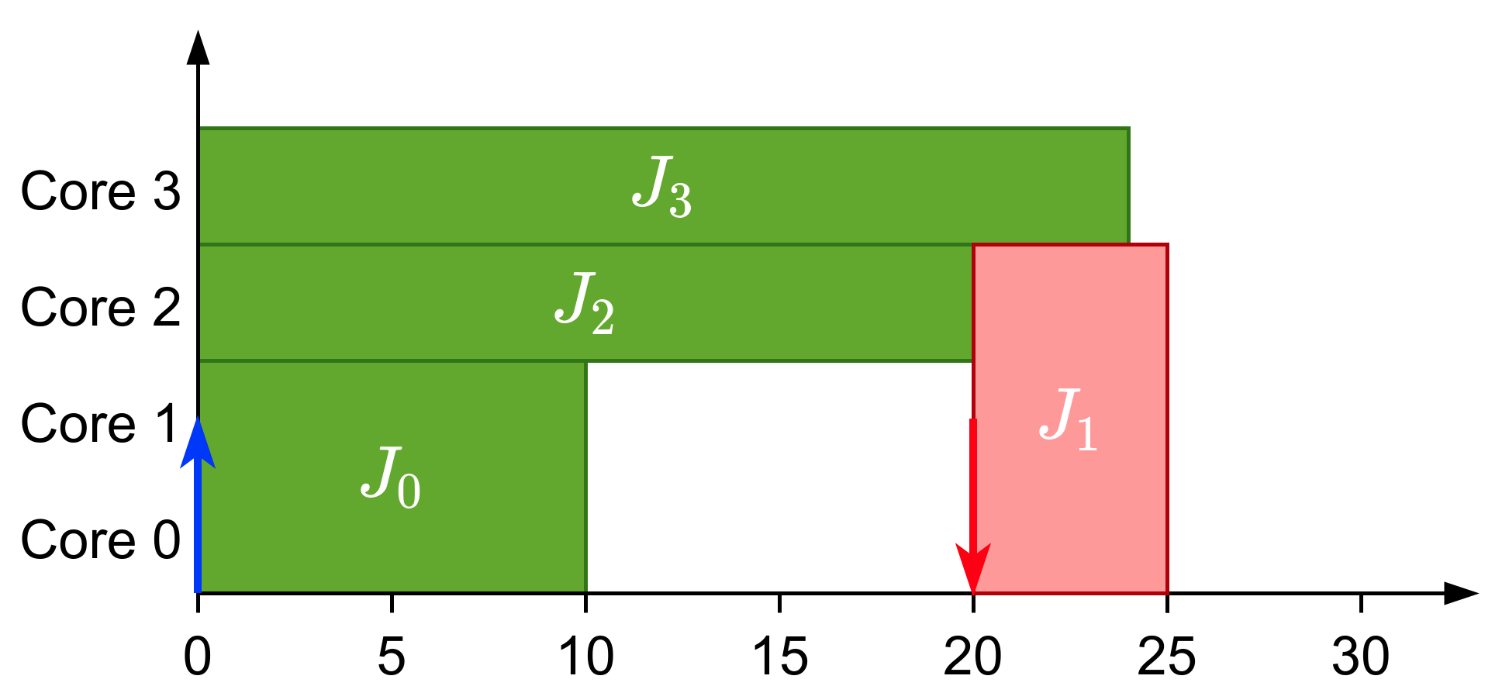
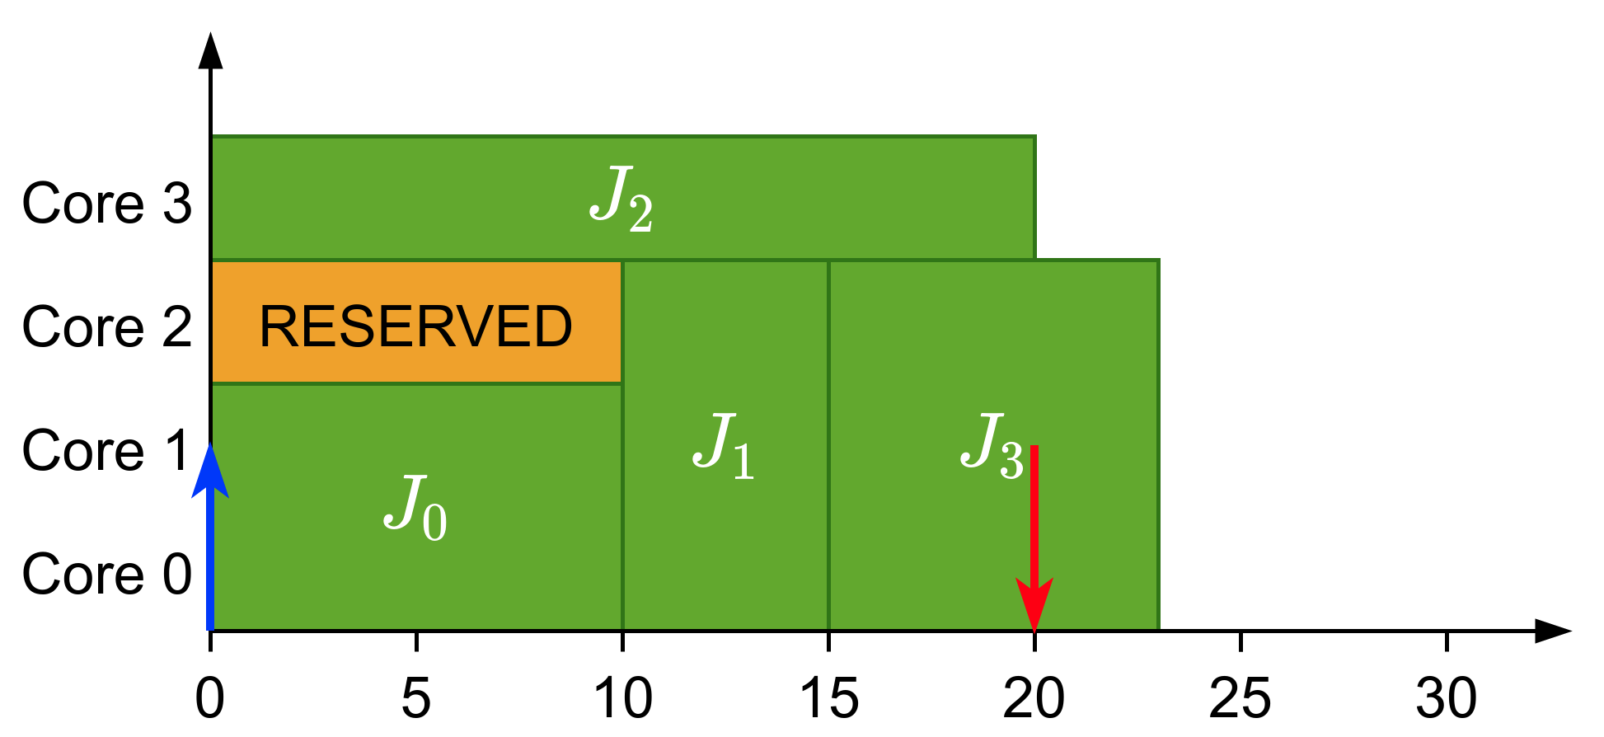
LPMRGS
Limited-Preemptive Malleable Reservation Gang Scheduler
Non-work conserving scheduler
Reserve cores of higher priority tasks and distribute the remaining ones among lower priority tasks
Notes:
Additionally we are working in a Limited-Preemptive Malleable Reservation Gang Scheduler which is a non-work conserving scheduler.
The idea behind is to reserve some cores for higher priority jobs and leave them idle.<click>
Let’s look at this example where the priorities are indicated by the job id and 0 is the highest priority. At time 0 Job 0 has been scheduled leaving 2 cores free but since Job 1 required 3 cores then it has not been scheduled an jobs 2 and 3 have been scheduled instead. Since we know that job 0 has to wait for job 1 to finish we could just leave one core idle reserved for job 1<click> which would allow job 1 to be scheduled immediately after job 0 finishes its execution

Slide 19
Questions?

