Slide 1



Scheduling and Analysis of Limited-Preemptive Moldable Gang Tasks Weekly Meeting
Joan Marcè i Igual
Geoffrey Nelissen
Mitra Nasri
Paris Panagiotou
1st of March, 2020

Slide 2
What has been done?
Work on results
Bugs found:
Priorities were not assigned properly
After solving JLFP was performing better than LPMGRS
Priorities were not used properly by LPMGRS
After solving LPMGRS performs better than JLFP
Core reservation by LPMGRS was not done properly in some cases where the cores were already busy
The reservation algorithm was changed slightly
Tested PlotSched from Pisa but it didn’t fill our requirements
Notes:
First of all, let’s explain what gang scheduling is.
<click>
Let’s say that we have multiple threads that we want to schedule. If we want to convert them to a gang task we would put them together as a “gang” <click> and then we would schedule as a single task<click> so the execution would not start until there are enough free cores.

Slide 3
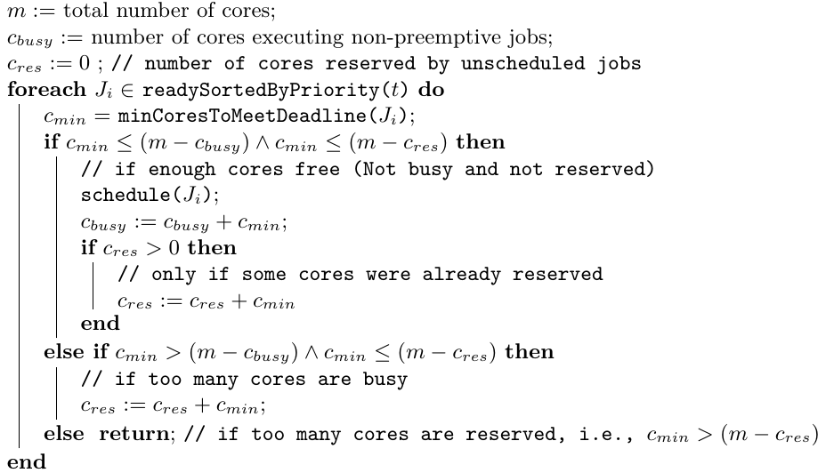
Algorithm change

Slide 4
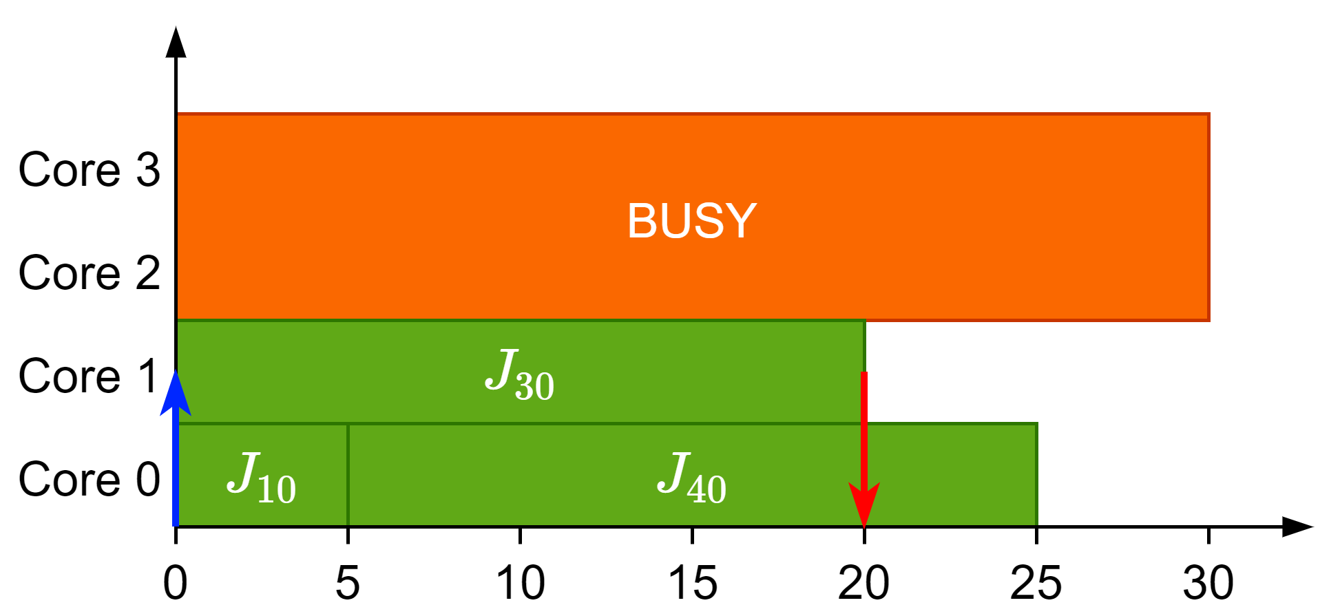
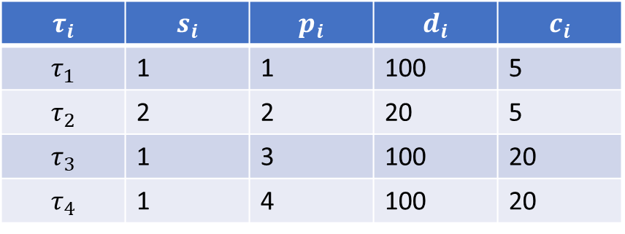
Bug with busy cores
$$τ_{i}$$ | $$s_{i}$$ | $$p_{i}$$ | $$d_{i}$$ | $$c_{i}$$
$$τ_{1}$$ | 1 | 1 | 100 | 5
$$τ_{2}$$ | 2 | 2 | 20 | 5
$$τ_{3}$$ | 1 | 3 | 100 | 20
$$τ_{4}$$ | 1 | 4 | 100 | 20

Slide 5
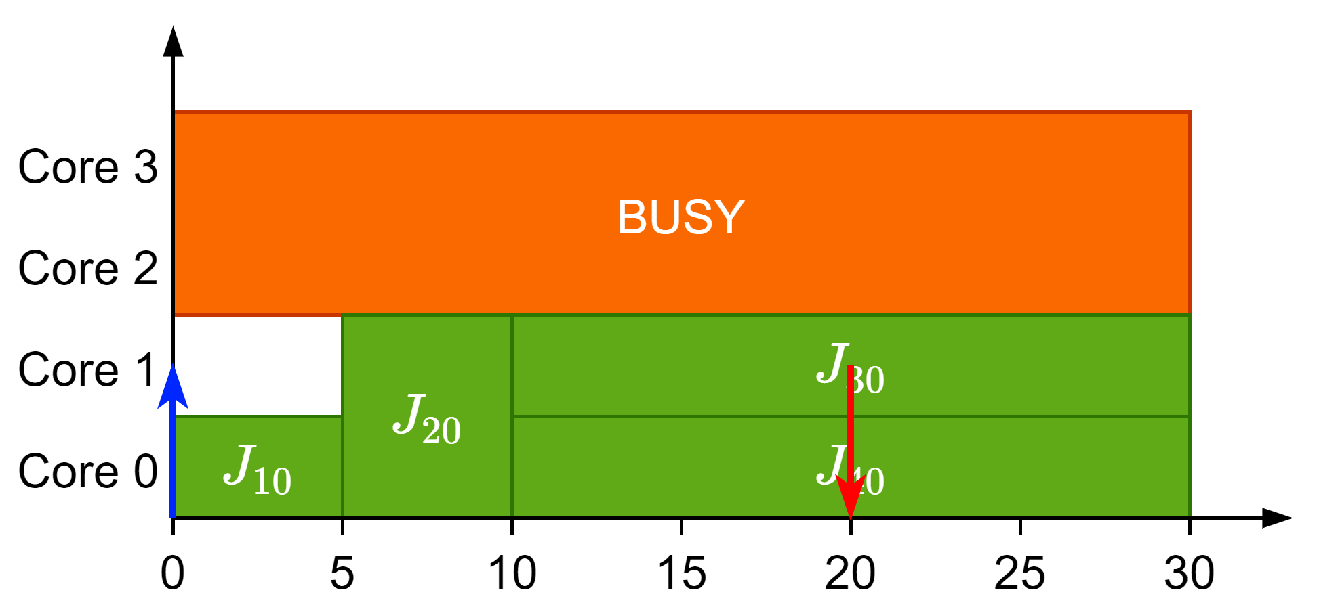
Bug with busy cores
$$τ_{i}$$ | $$s_{i}$$ | $$p_{i}$$ | $$d_{i}$$ | $$c_{i}$$
$$τ_{1}$$ | 1 | 1 | 100 | 5
$$τ_{2}$$ | 2 | 2 | 20 | 5
$$τ_{3}$$ | 1 | 3 | 100 | 20
$$τ_{4}$$ | 1 | 4 | 100 | 20

Slide 6
Algorithm change

Slide 7
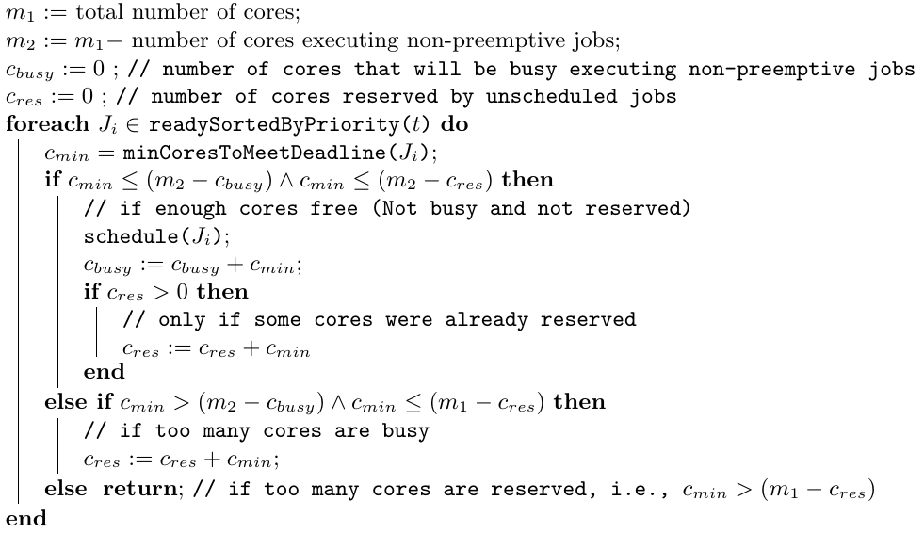
Algorithm change

Slide 8
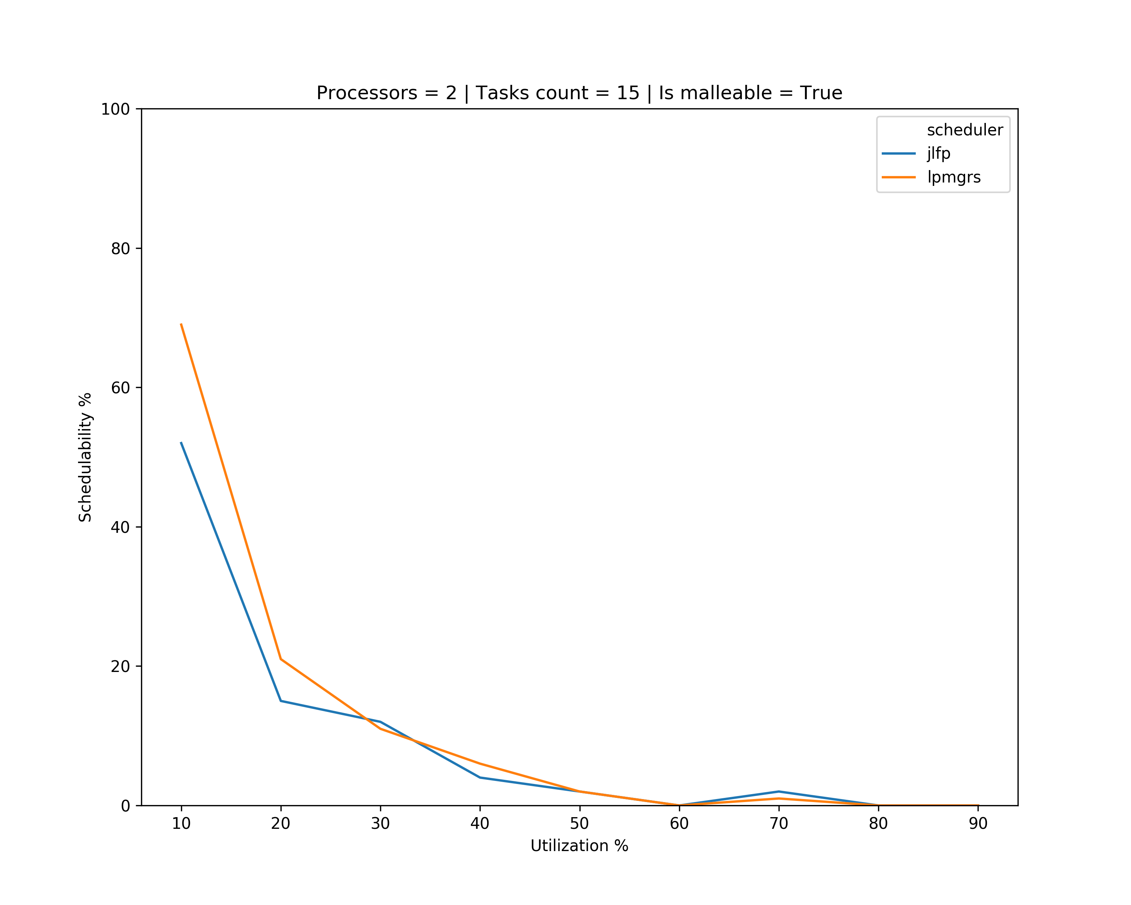
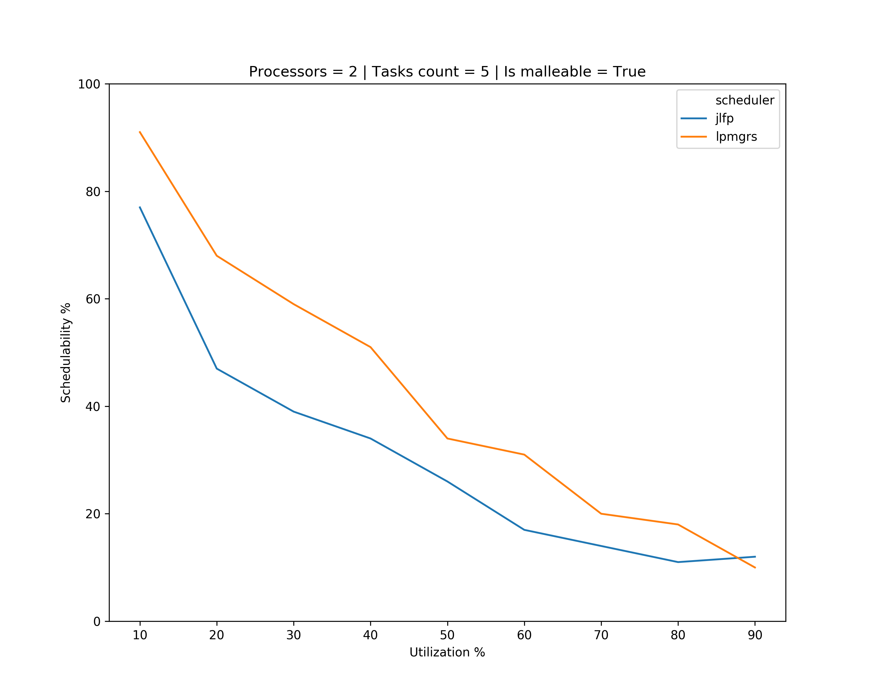
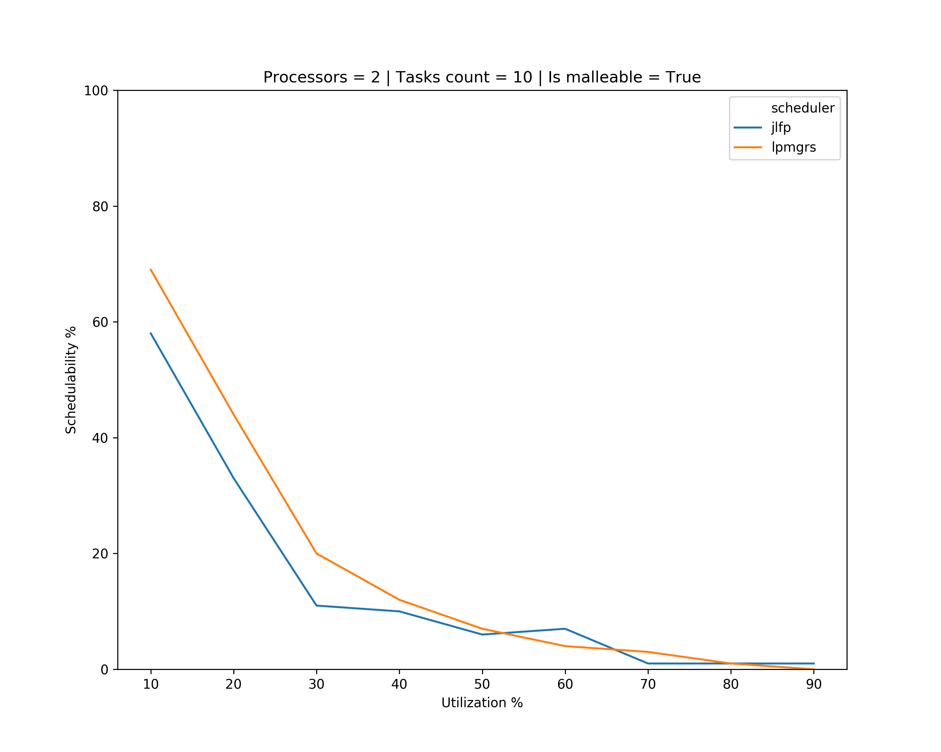
Old Results

Slide 9
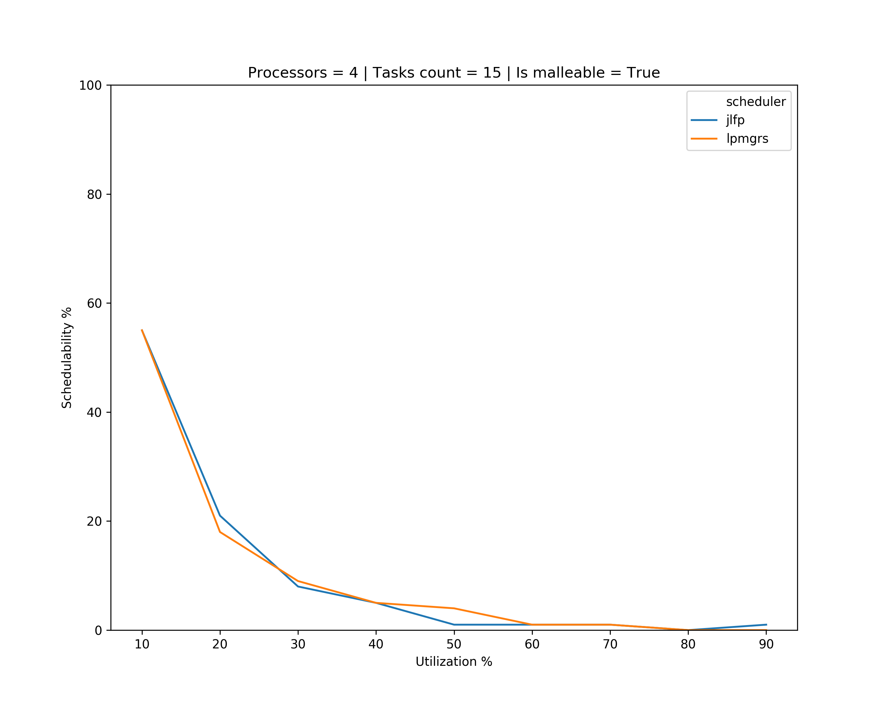
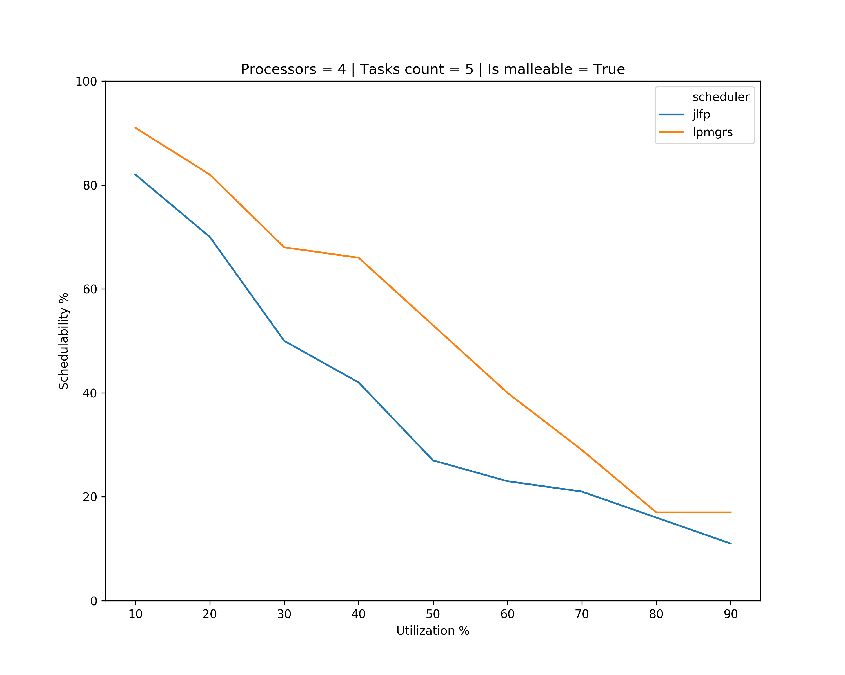
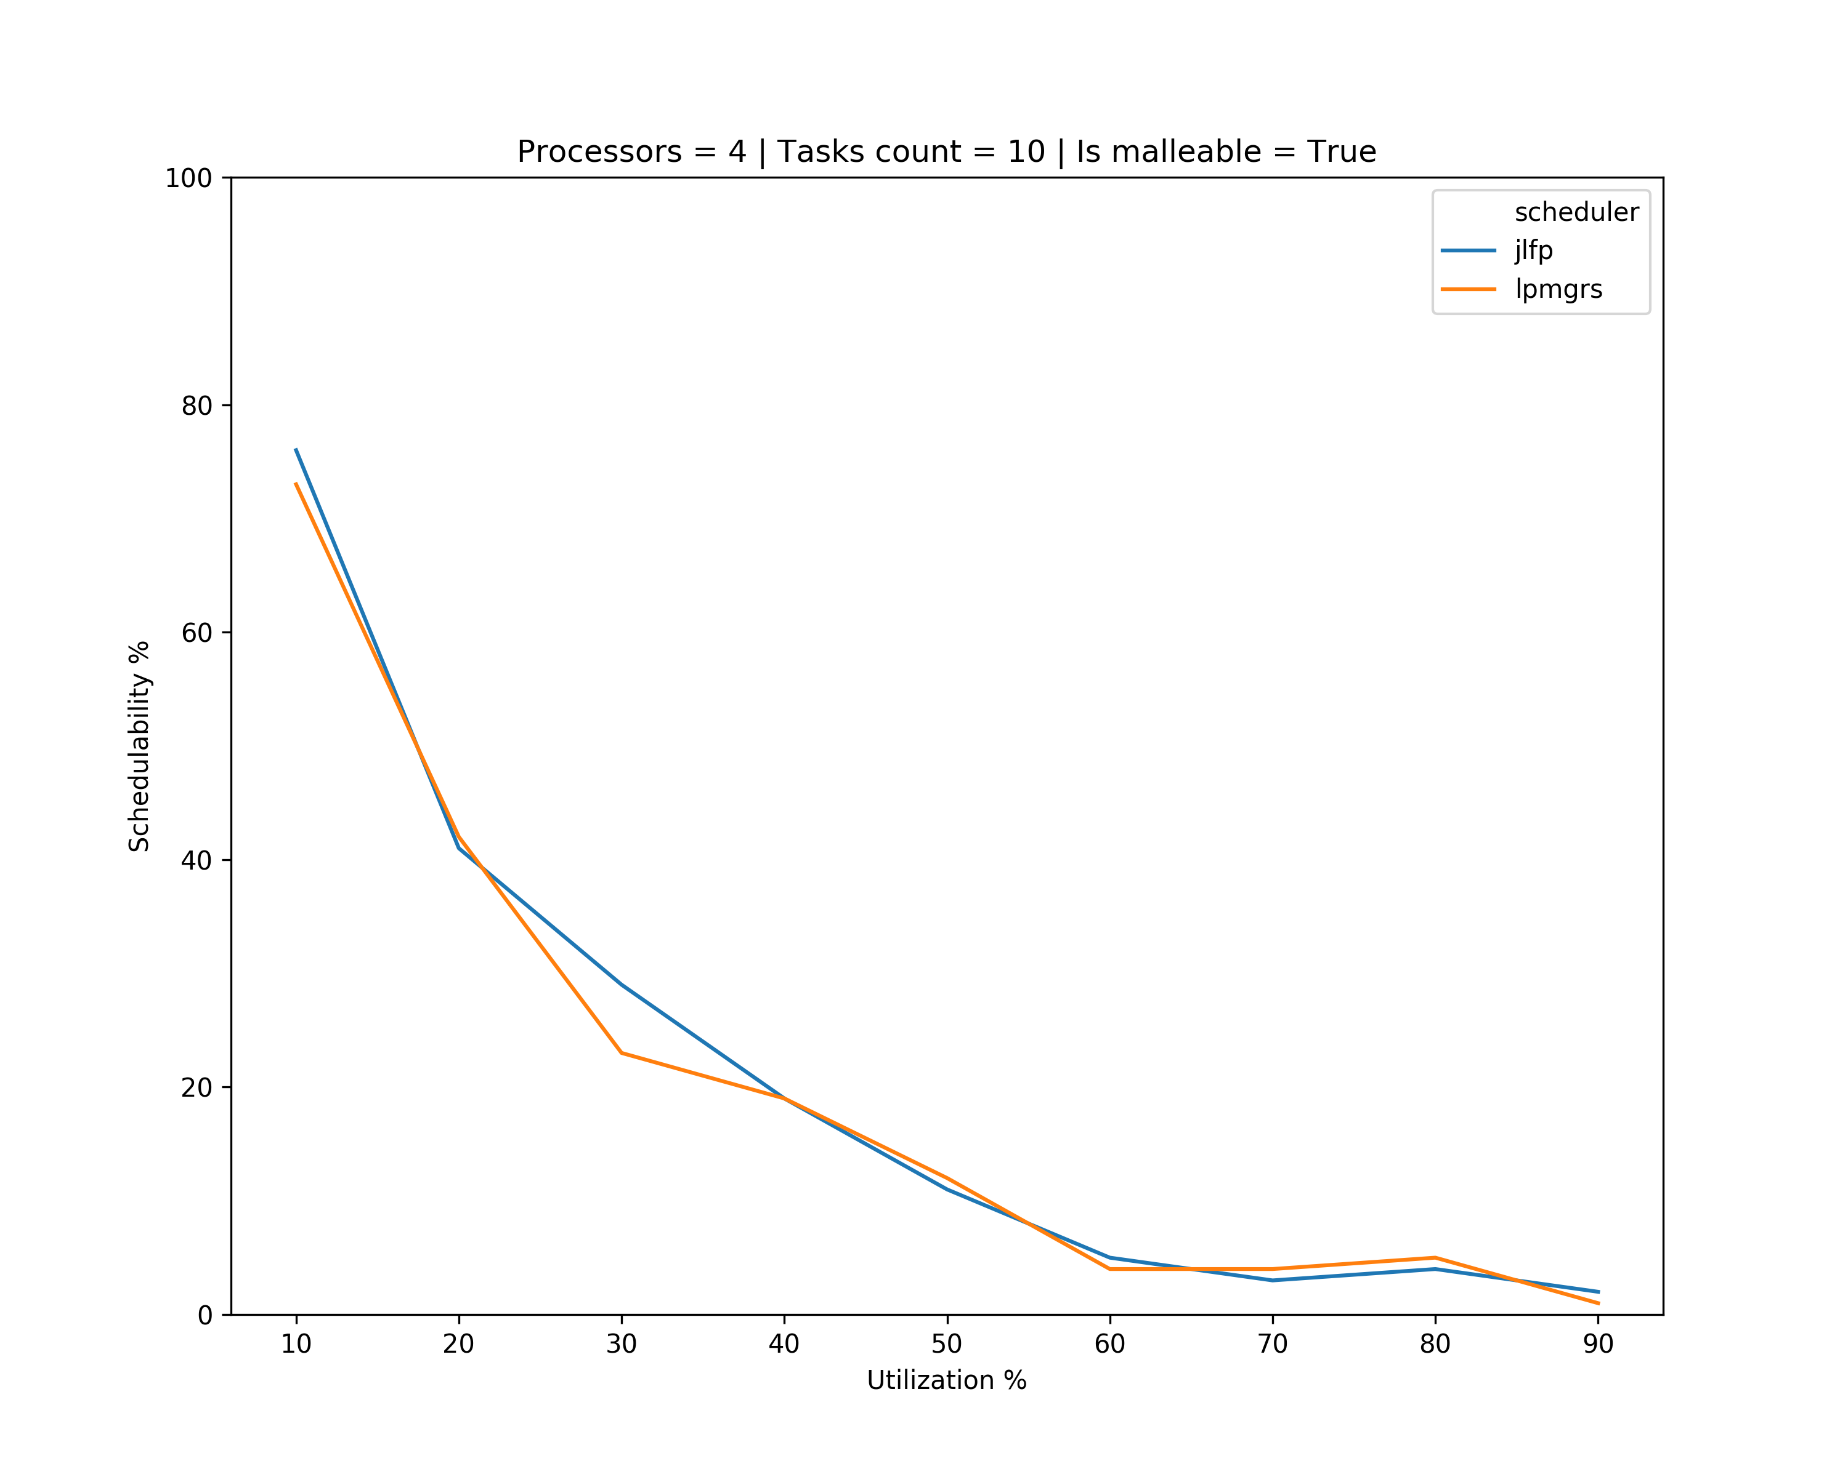
Old Results

Slide 10
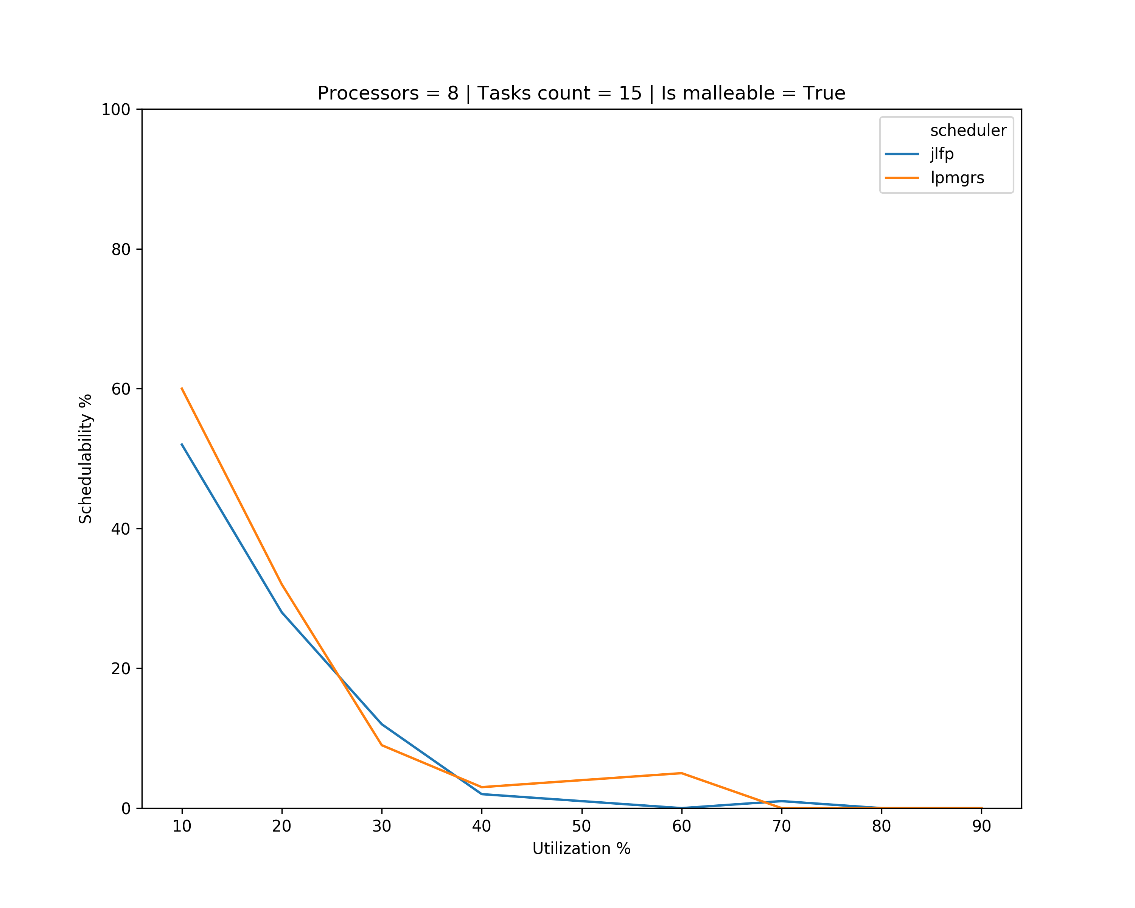
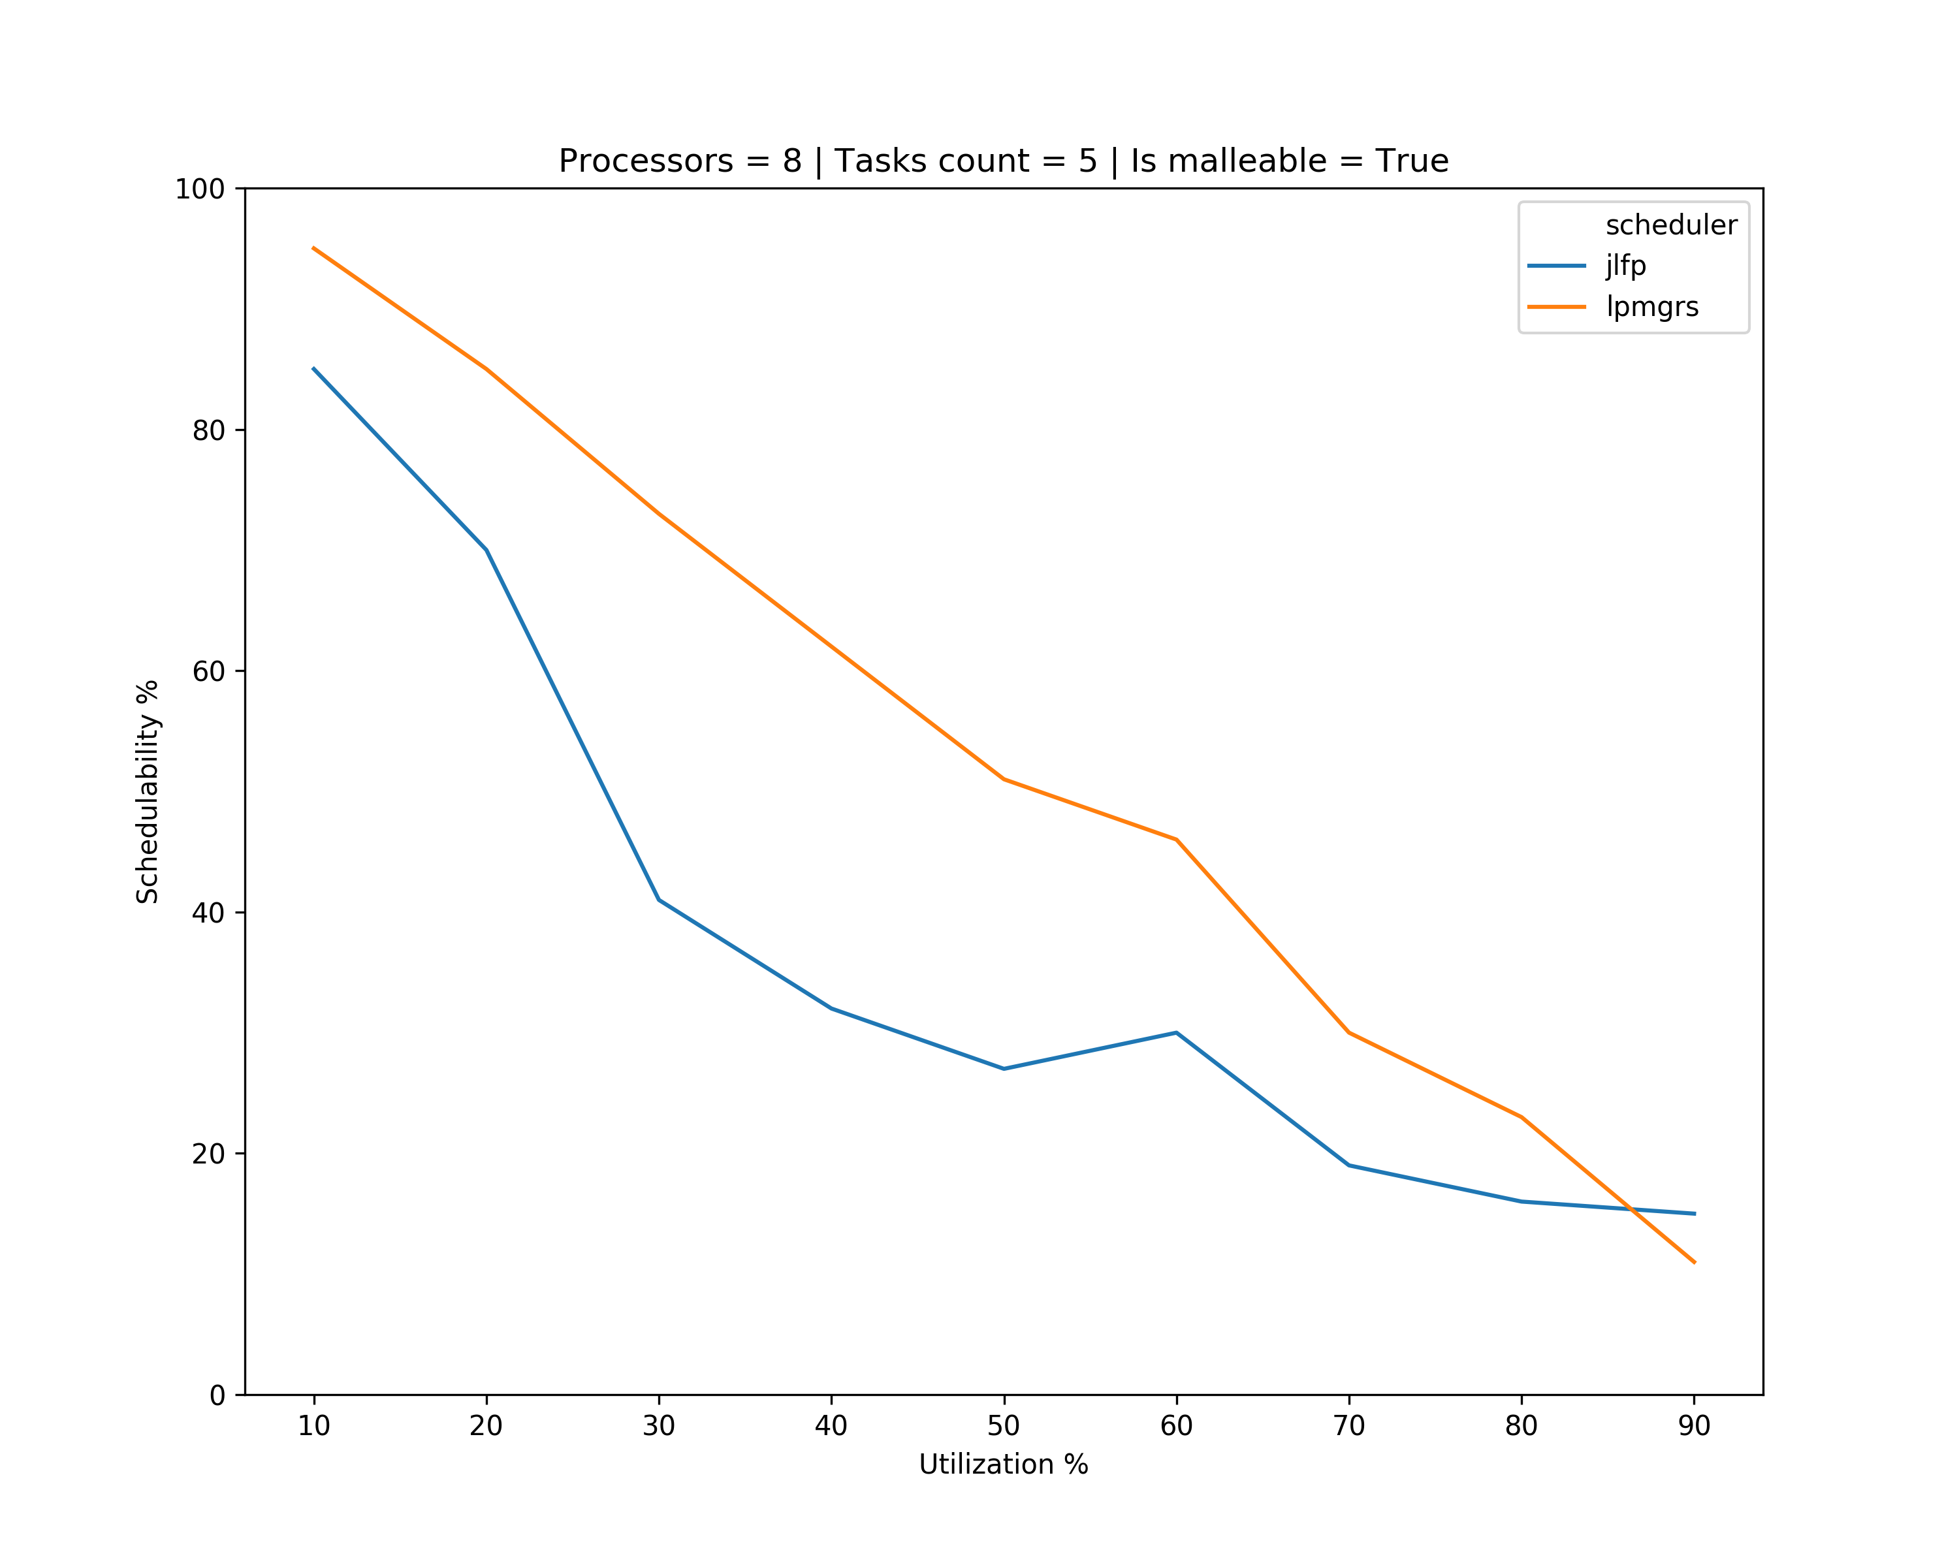
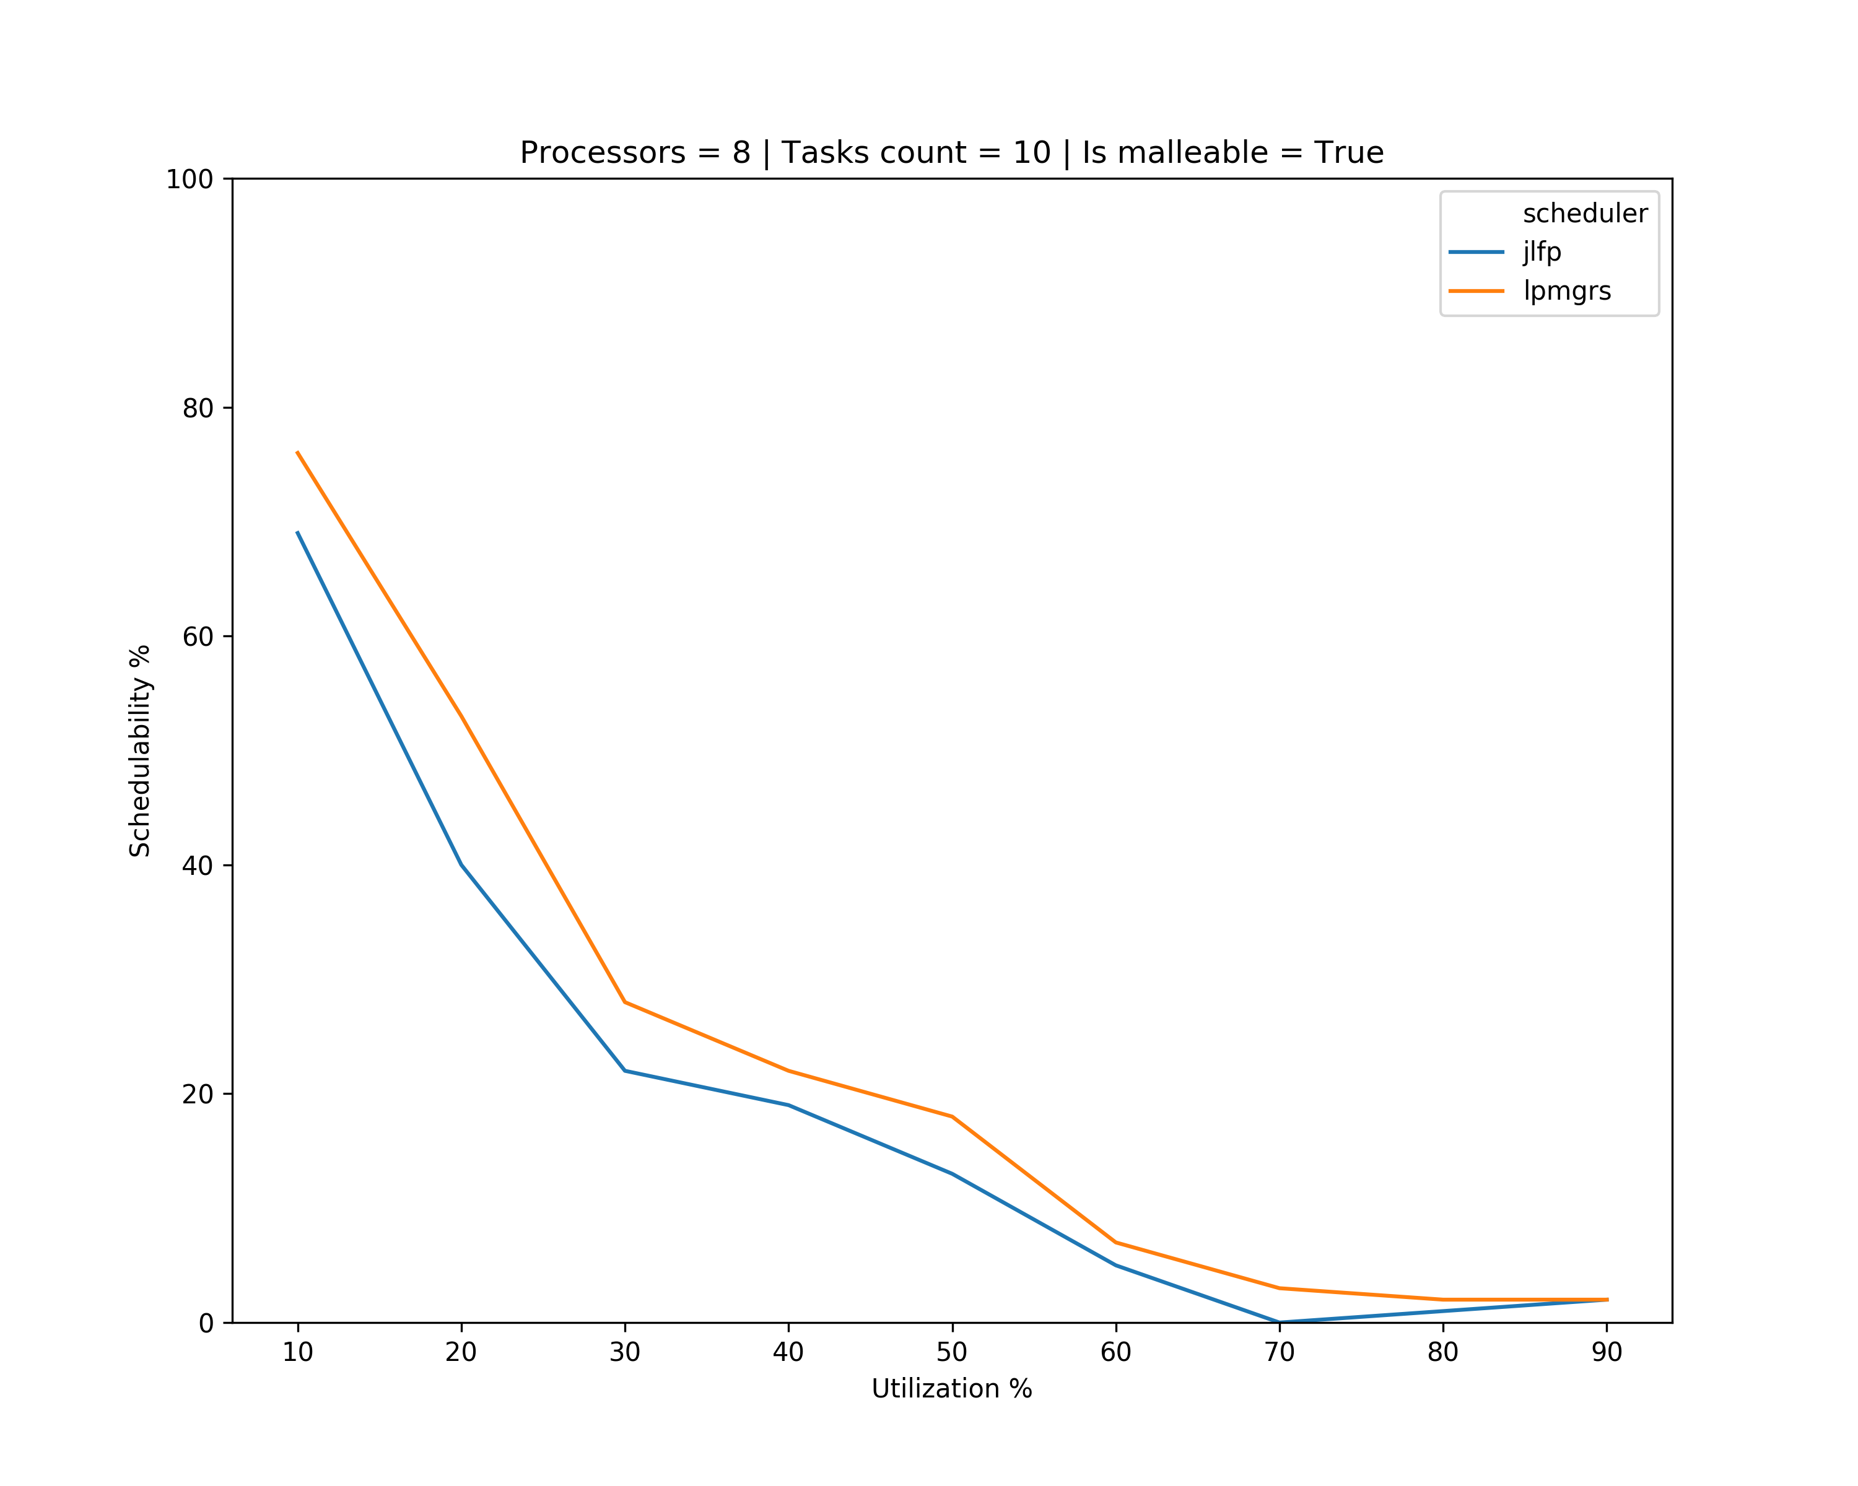
Old Results

Slide 11
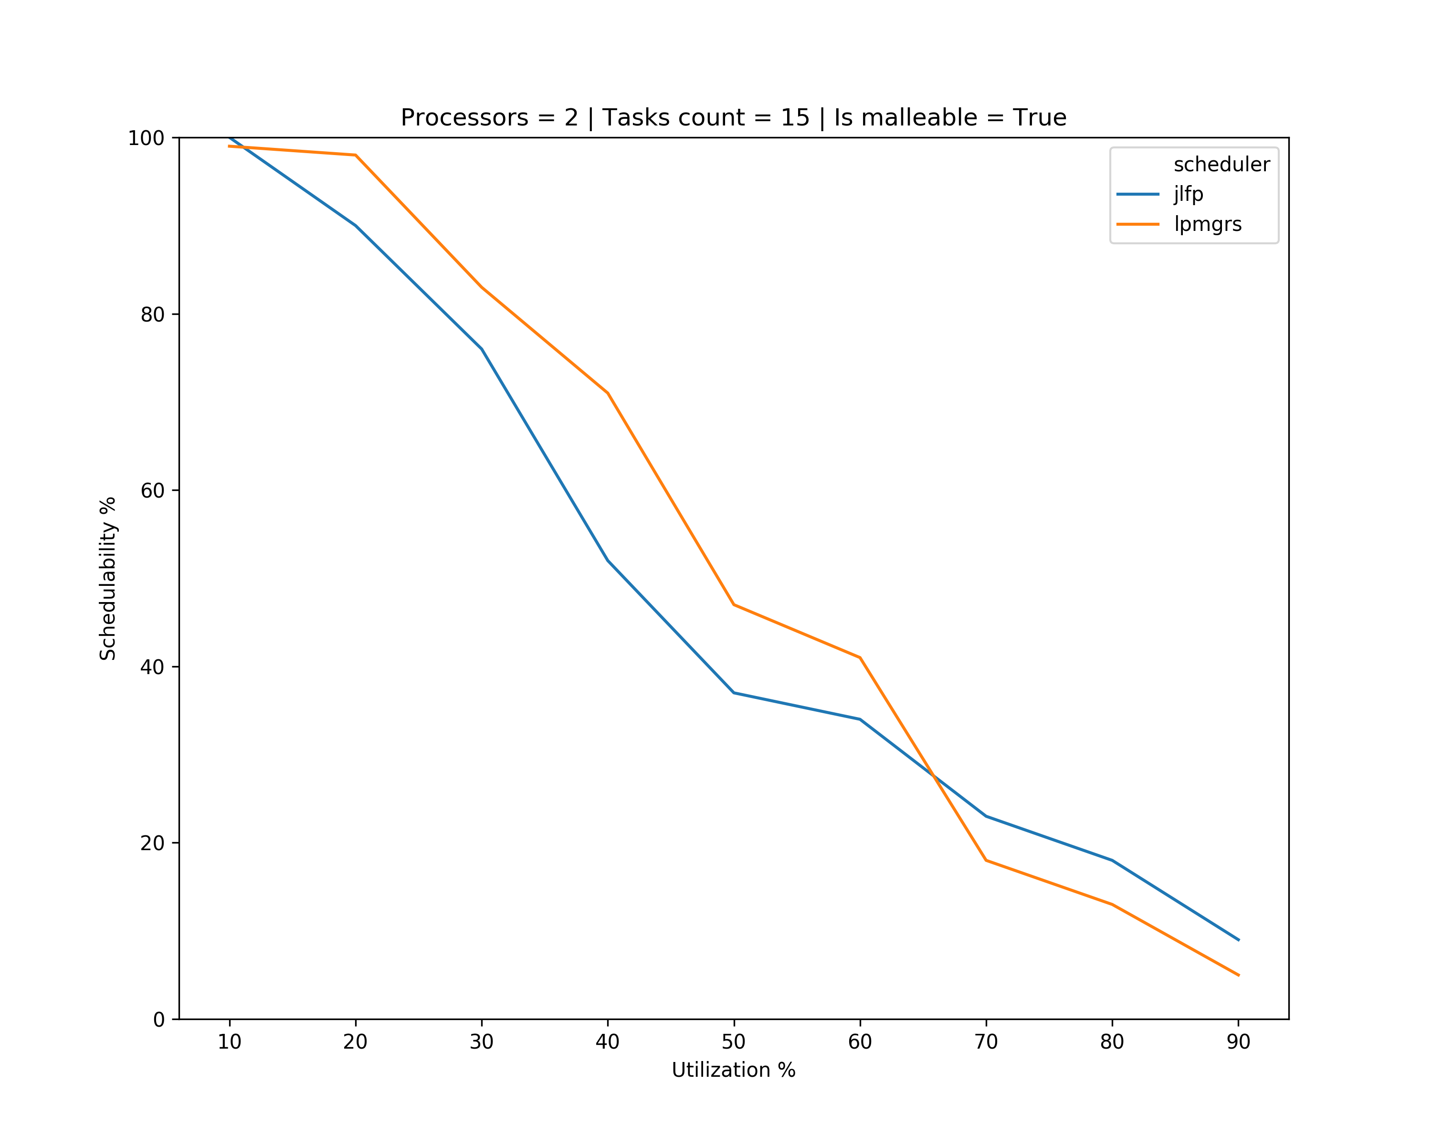
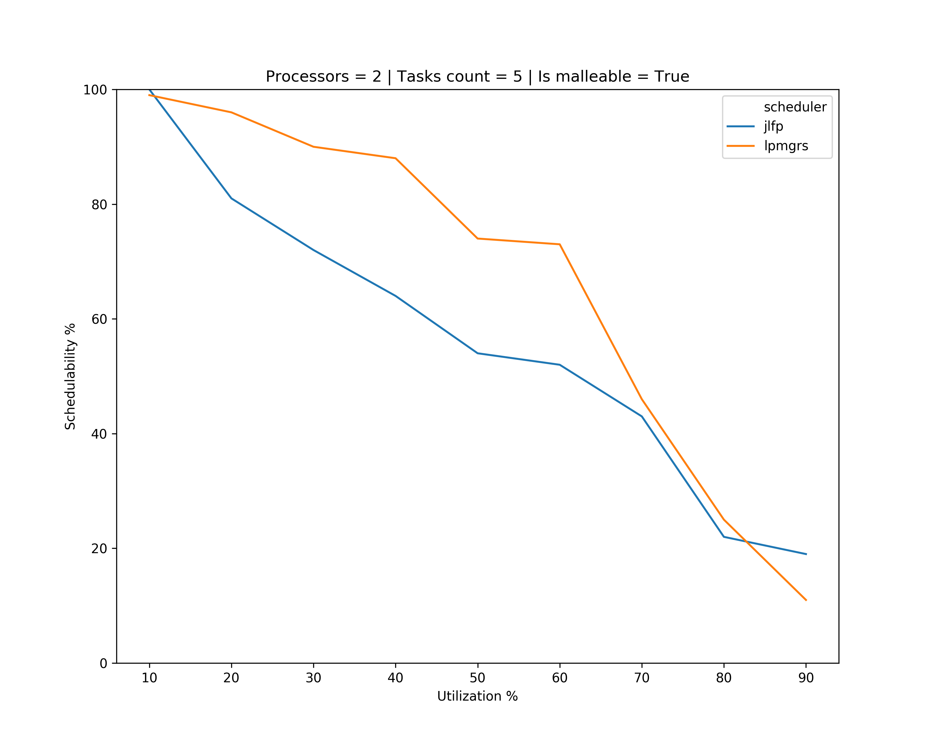
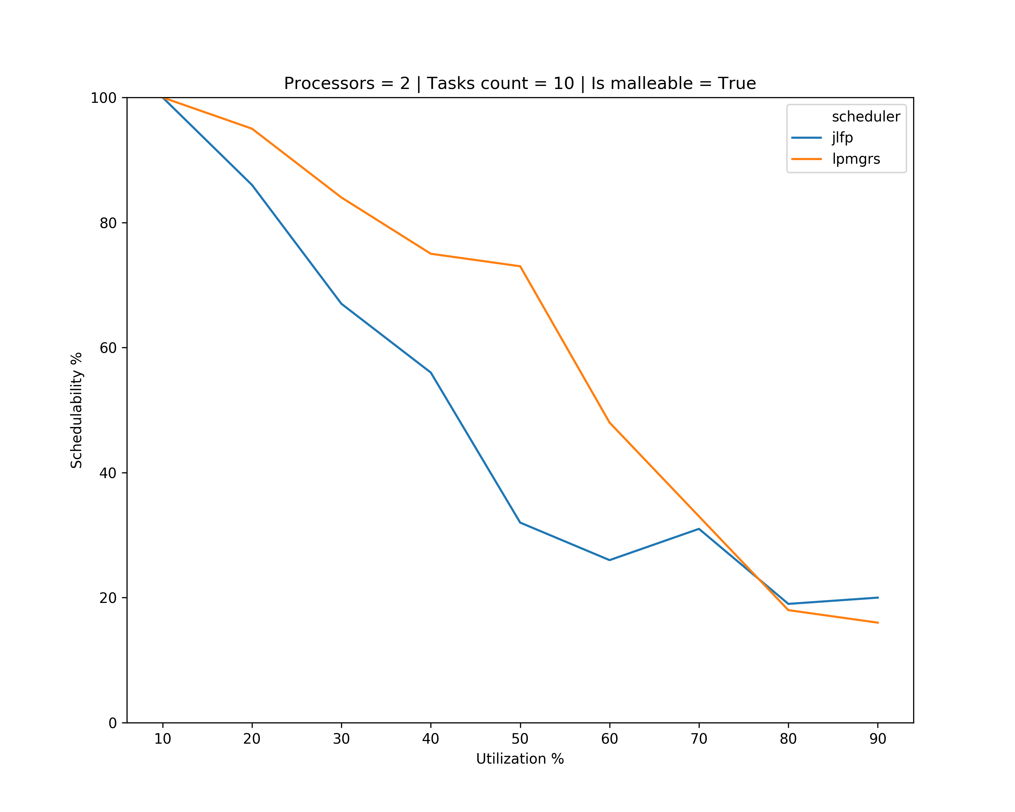
Results

Slide 12
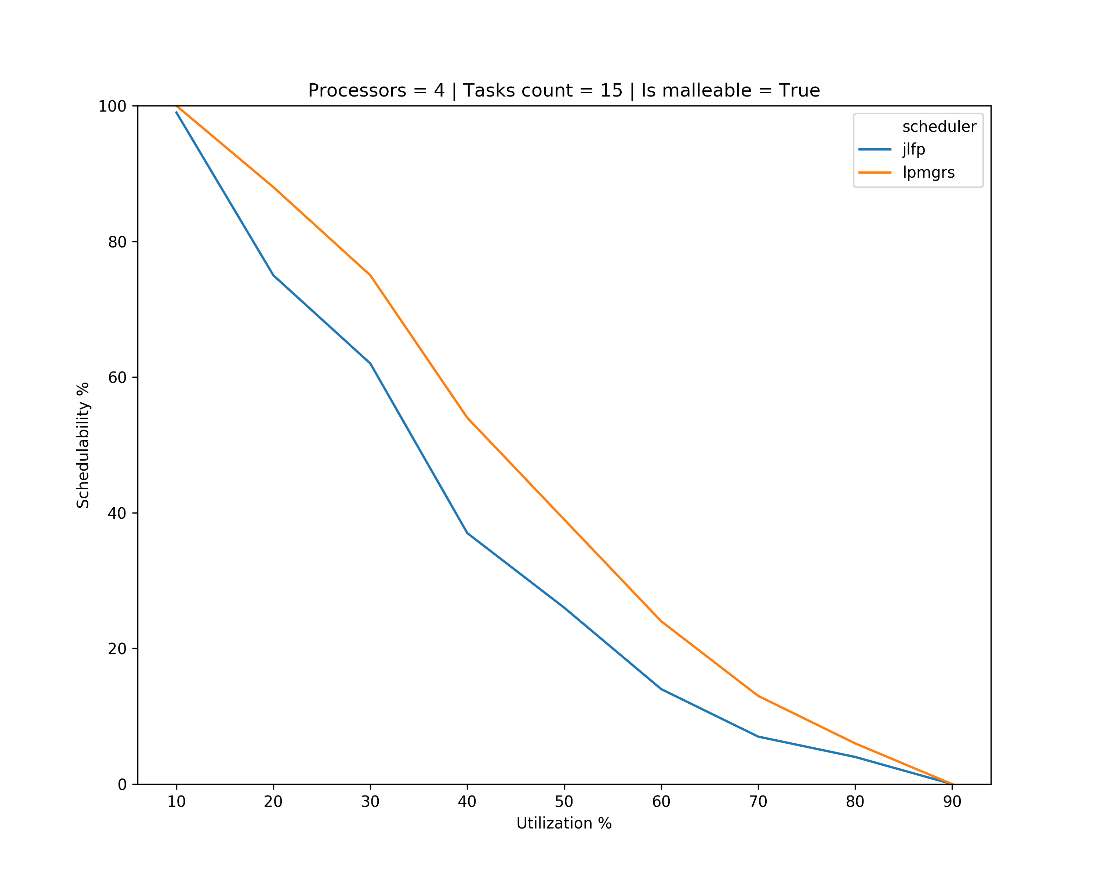
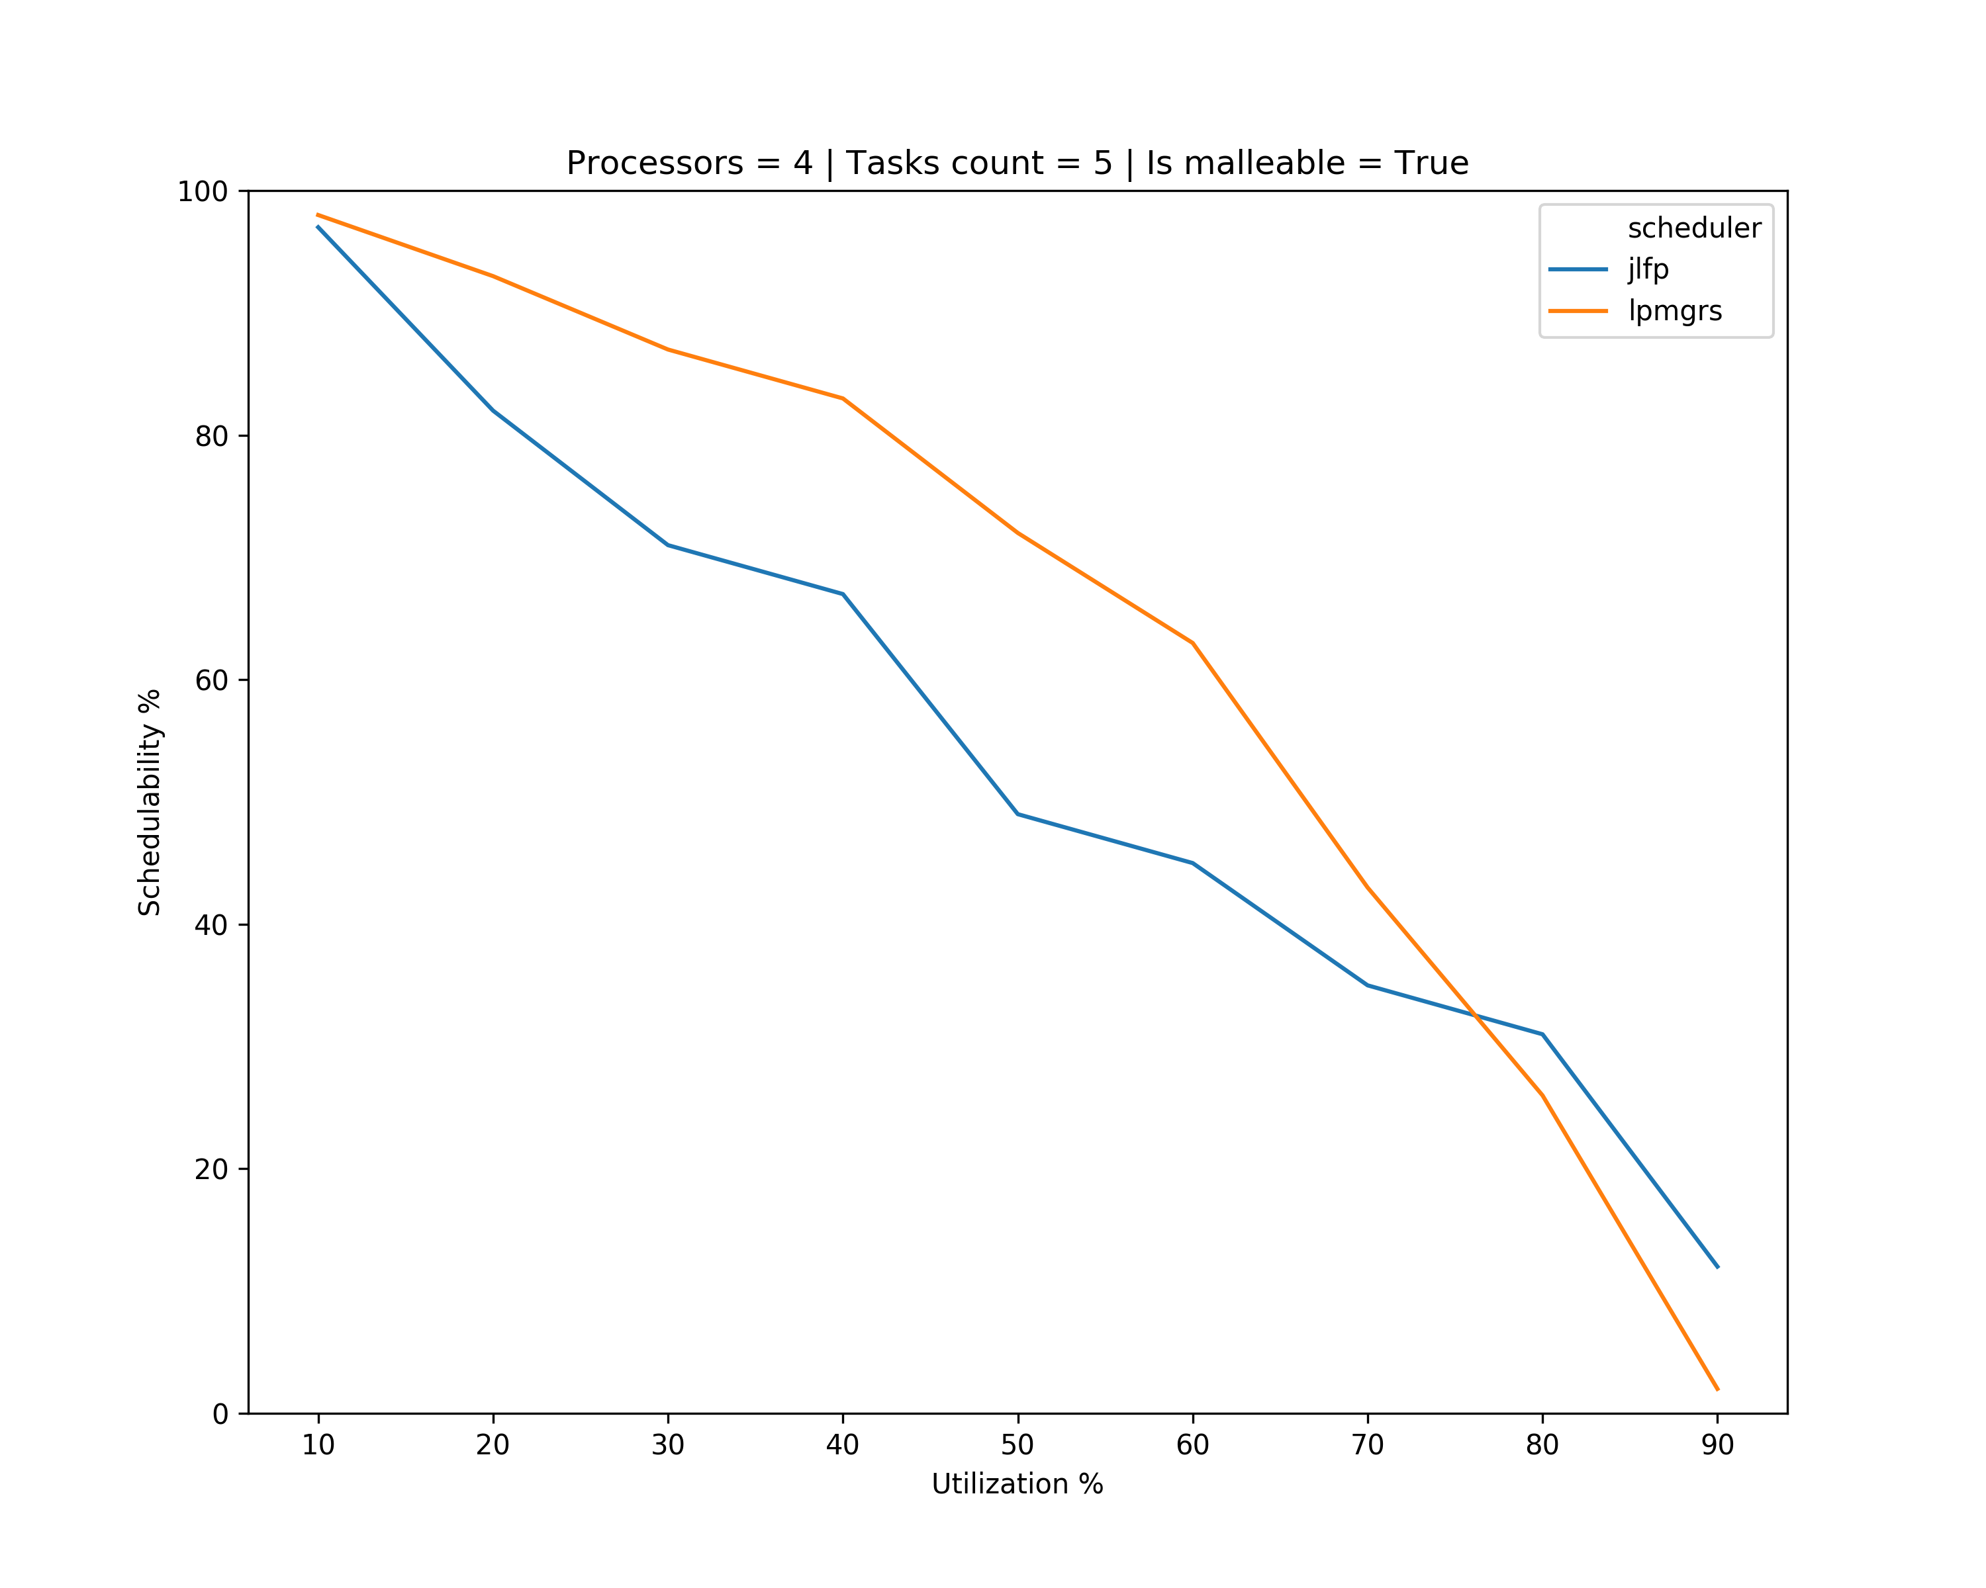
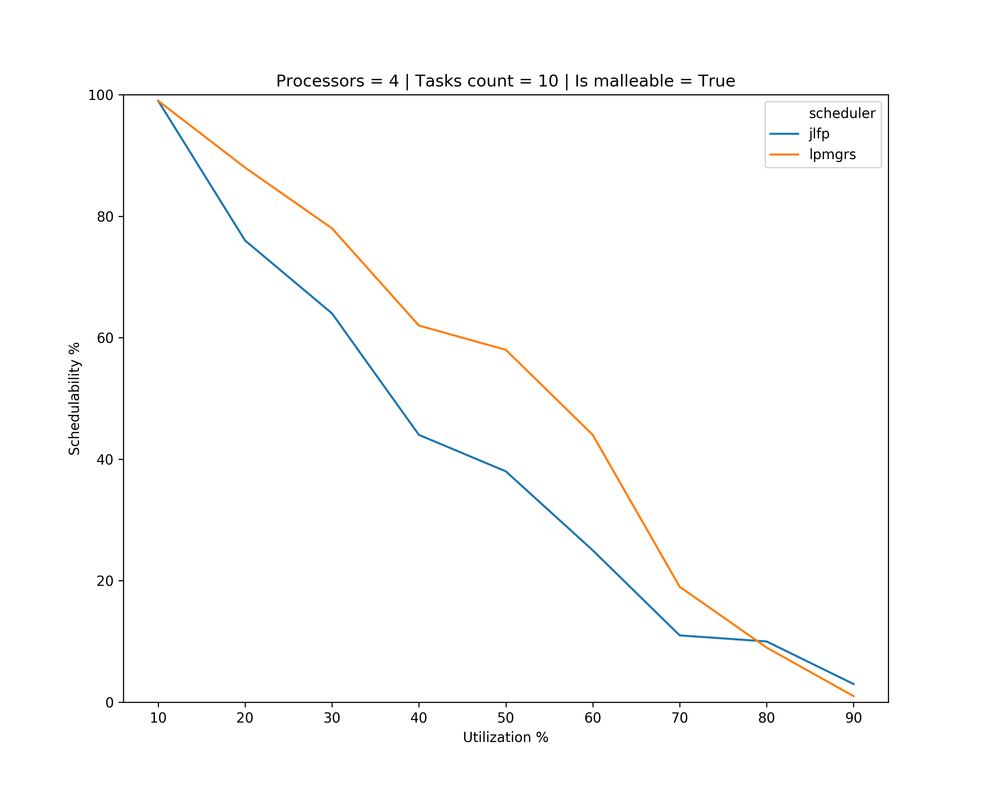
Results

Slide 13
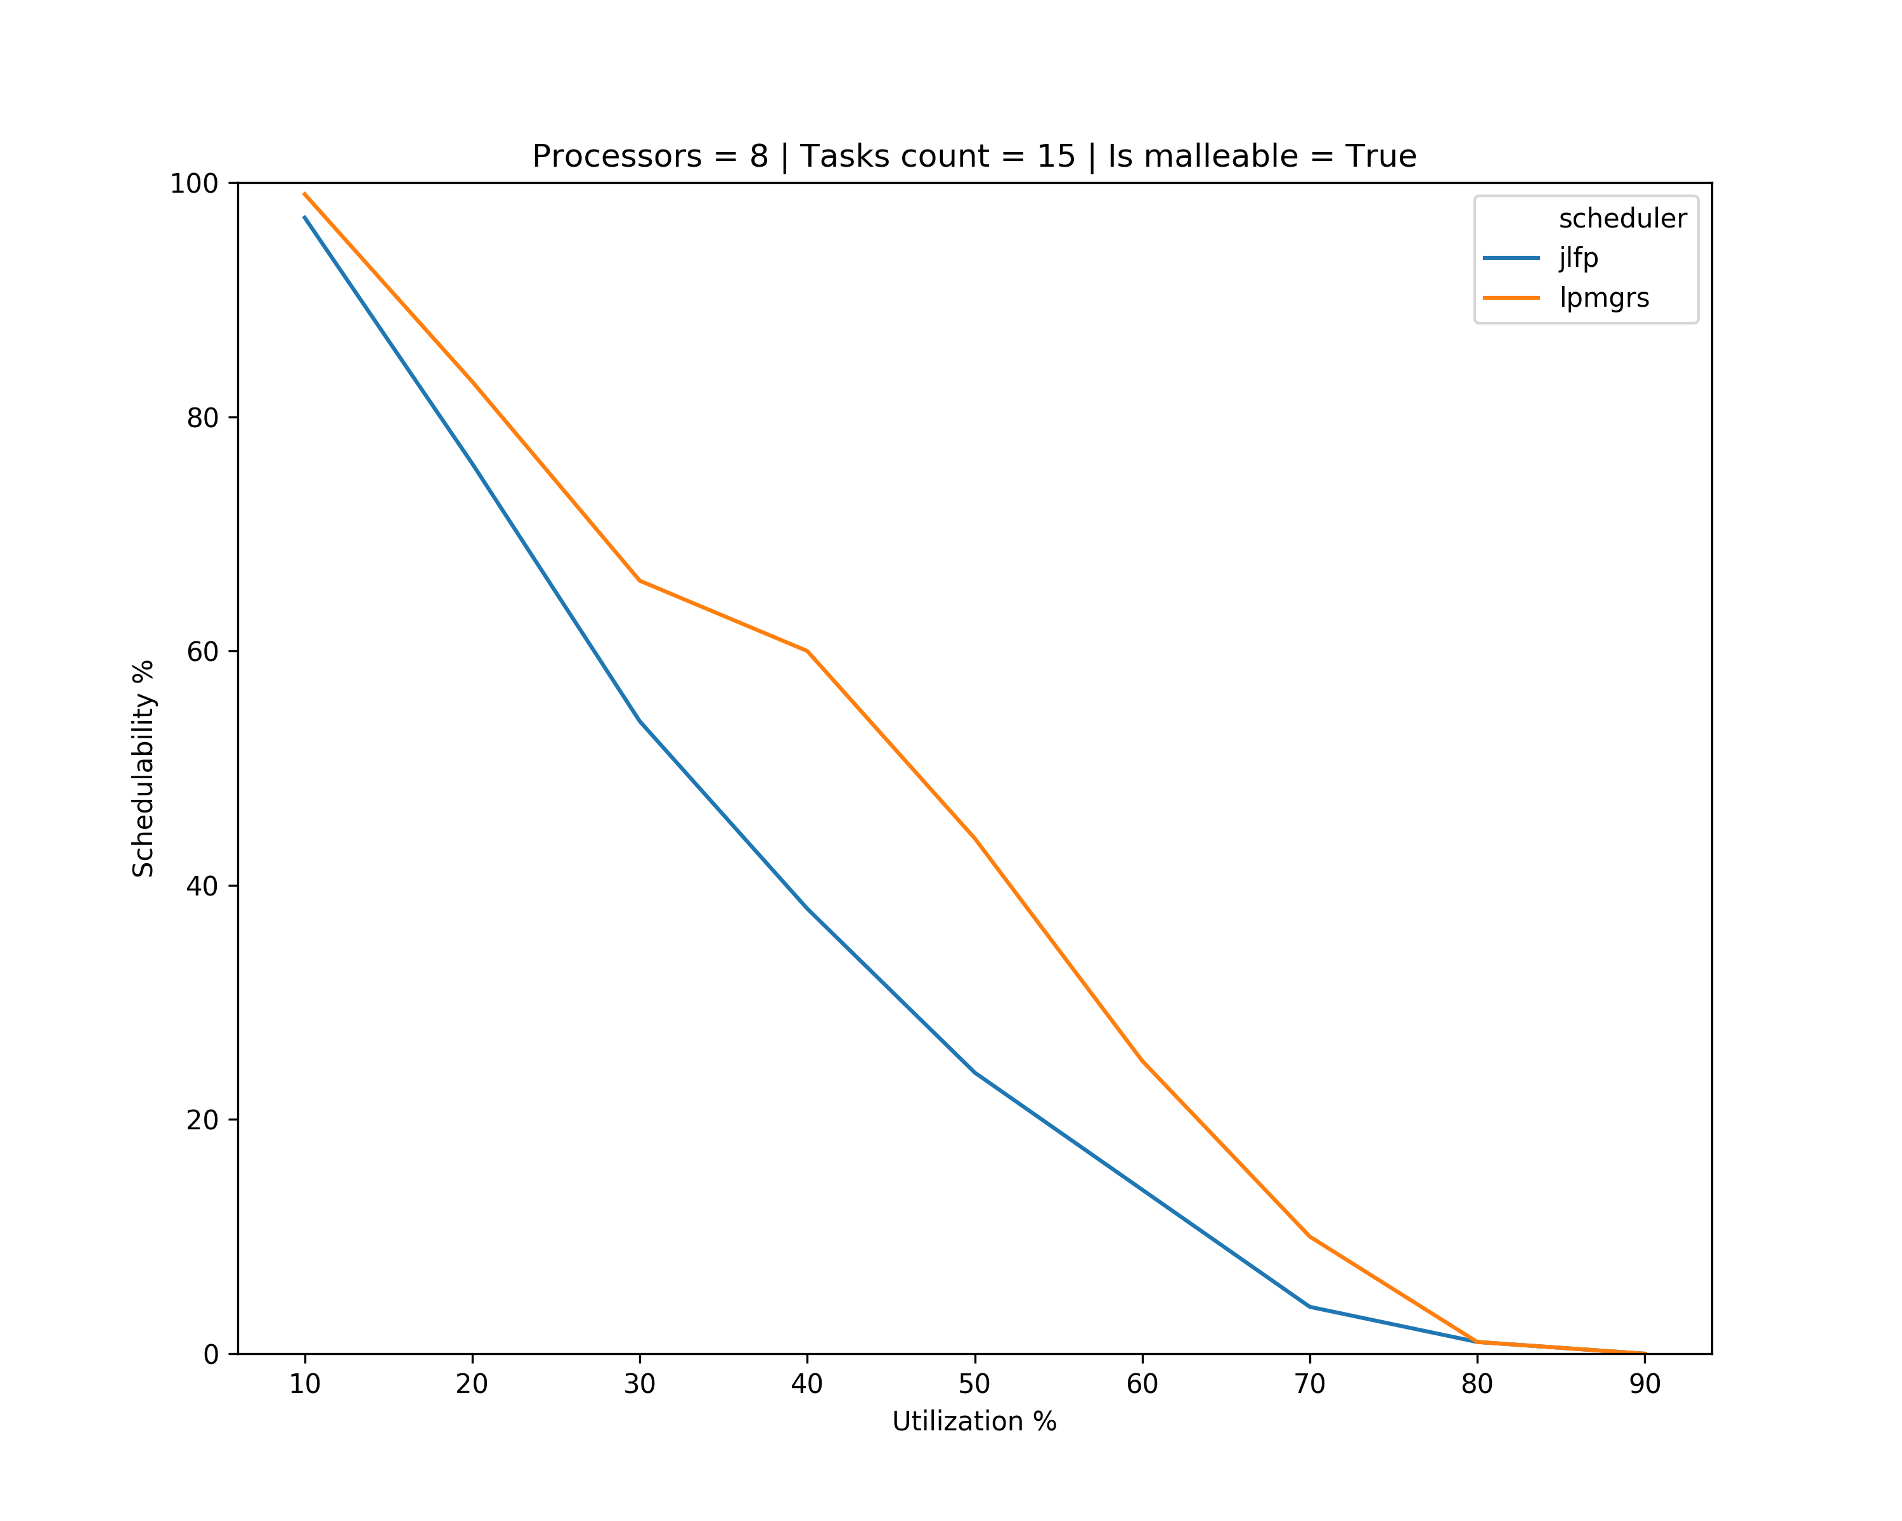
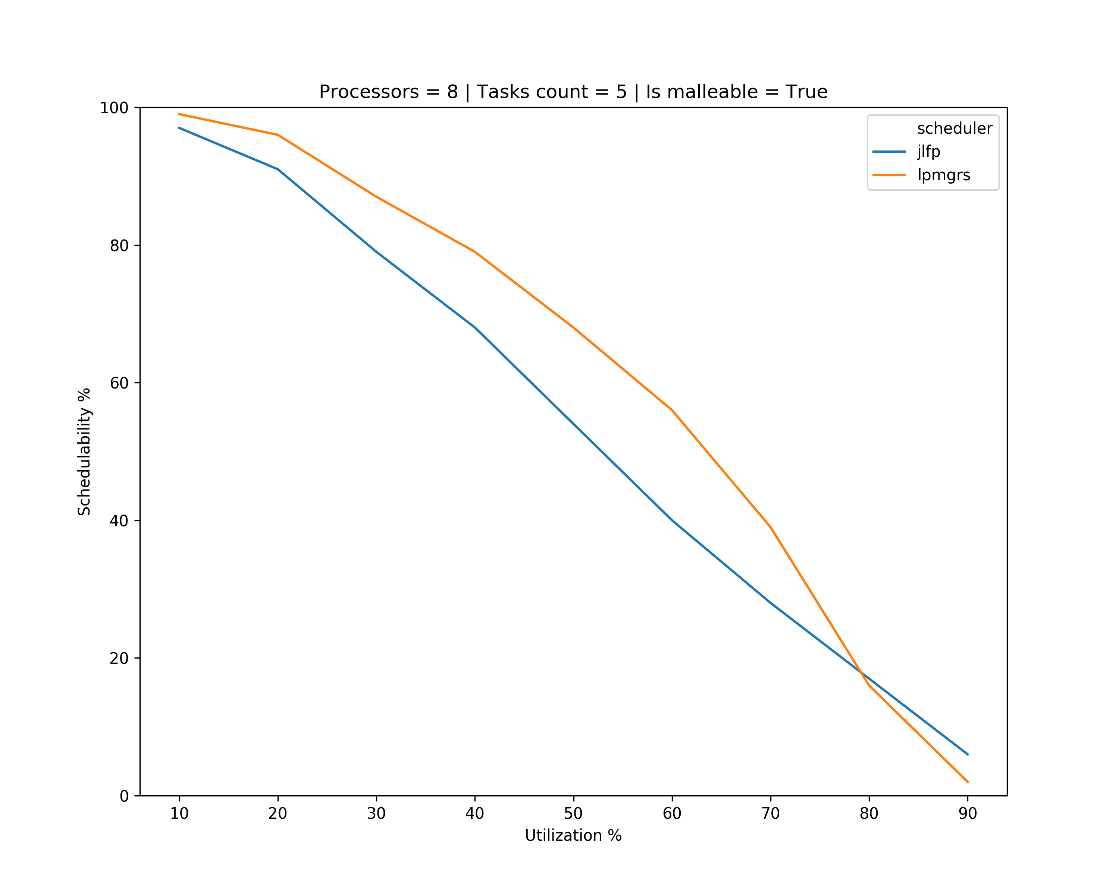
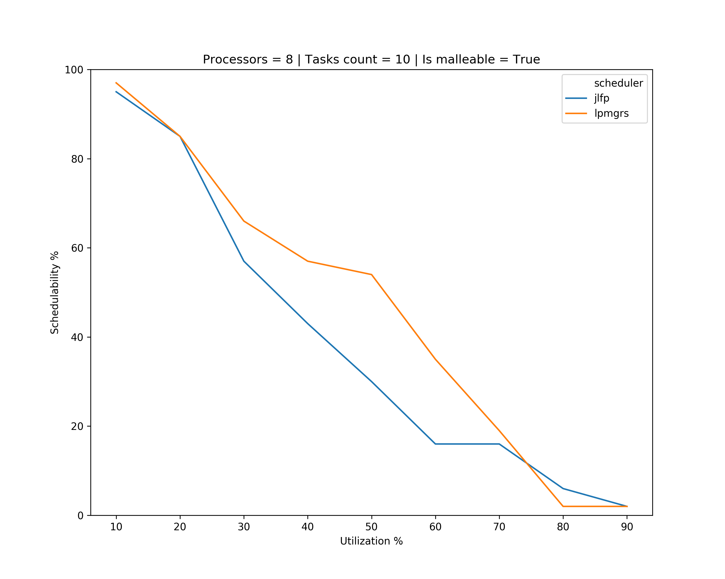
Results

Slide 14
What’s next?
Continue looking at cases for scheduling problems
Use the moldable property of the tasks
Get results with schedulability analysis tool and Paris’ code
Start finding the formulation of schedulability analysis for new algorithm

