Slide 1

Scaling Your App with NoSQL
Jeremy Mikola
jmikola.net

Slide 2

Company behind MongoDB
Provides support, training, and consulting
Actively involved in the community
  Mailing list, IRC, and StackOverflow
  Conferences and local user groups
Offices: NYC, Palo Alto, London, Dublin, Sidney
Hiring at 10gen.com/careers

Slide 3
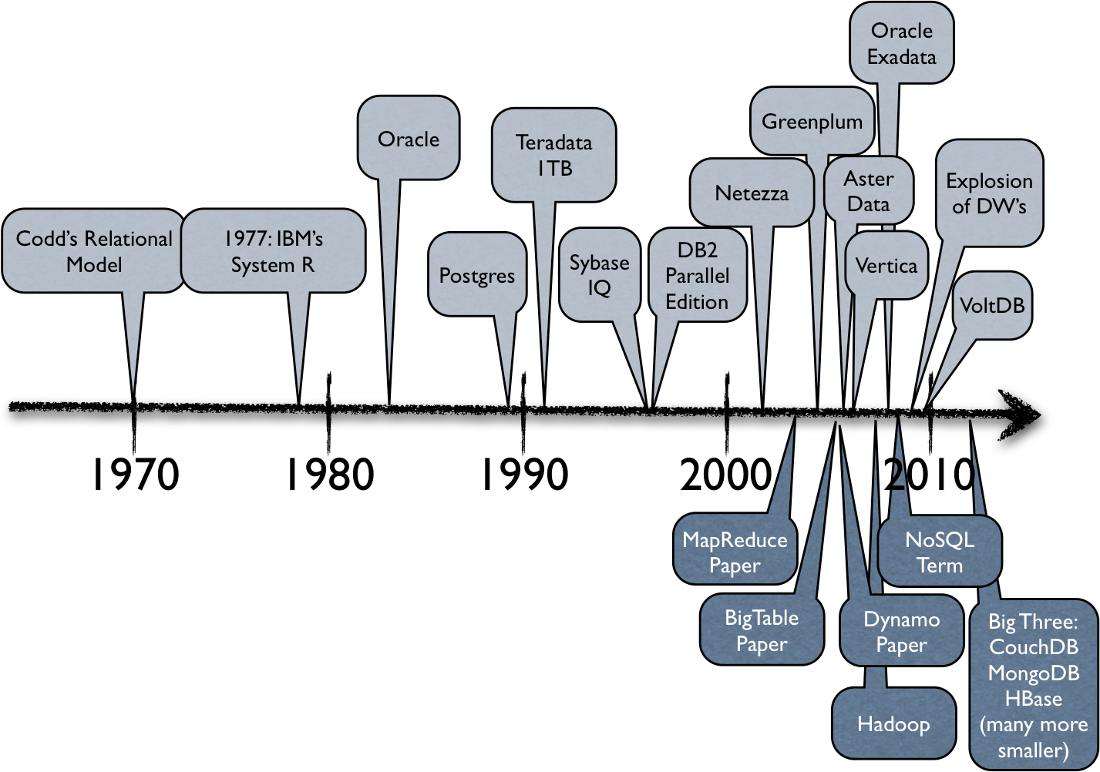
Some History
Ben Stopford, Thoughts on Big Data
http://www.benstopford.com/2012/06/30/thoughts-on-big-data-technologies-part-1/

Slide 4














What is NoSQL?
Key/Value
Key/Value
Key/Value
BigTable
Document
Graph

Slide 5
Key/Value Stores
Maps arbitrary keys to values
No knowledge of the value's format
Completely schema-less
Implementations
  Eventually consistent, hierarchal, ordered, in-RAM
Operations
  Get, set and delete values by key

Slide 6
BigTable
Sparse, distributed data storage
Multi-dimensional, sorted map
Indexed by row/column keys and timestamp
Data processing
  MapReduce
  Bloom filters

Slide 7
Graph Stores
Nodes are connected by edges
Index-free adjacency
Annotate nodes and edges with properties
Operations
  Create nodes and edges, assign properties
  Lookup nodes and edges by indexable properties
  Query by algorithmic graph traversals

Slide 8
Document Stores
Documents have a unique ID and some fields
Organized by collections, tags, metadata, etc.
Formats such as XML, JSON, BSON
Structure may vary by document (schema-less)
Operations
  Query by namespace, ID or field values
  Insert new documents or update existing fields

Slide 9
MongoDB Philosophy
Document data models good
Non-relational model allows horizontal scaling
Keep functionality whenever possible
Minimize the learning curve
  Easy to setup and deploy anywhere
  JavaScript and JSON are ubiquitous
  Automate sharding and replication

Slide 10
MongoDB Under the Hood
Server written in C++
Server-side code execution with JavaScript
Data storage and wire protocol use BSON
Reliance on memory-mapped files
B-tree and geospatial indexes

Slide 11
What are the challenges and trade-offs?

Slide 12
CAP Theorem
Consistency
Availability
Partition
Tolerance
CA
CP
AP

Slide 13
CAP Theorem
Consistency
Single-site RDBMS
Replicated RDBMS
MongoDB
HBase
Redis
Availability
Partition
Tolerance
CA
CP
AP
CouchDB
Cassandra
DynamoDB
Riak

Slide 14
“
In partitioned databases, trading some consistency for availability can lead to dramatic improvements in scalability.
Dan Pritchett, BASE: An ACID Alternative
http://queue.acm.org/detail.cfm?id=1394128

Slide 15
ACID vs. BASE
Atomicity
Consistency
Isolation
Durability
Basically Available
Soft state
Eventual consistency

Slide 16
Consistency Models
Eventual Consistency
Monotonic Read Consistency
MRC + RYOW
Read-your-own Writes
Immediate Consistency
Strong Consistency (single-entity)
Transactions (multi-entity)
http://blog.mongodb.org/post/475279604/on-distributed-consistency-part-1
Notes:
Eventual Consistency - eventual consistency as defined by Amazon in the Dynamo paper.
Monotonic read consistency - a stricter form of eventual consistency.
Read-your-own-writes consistency - a stricter form of eventual consistency.
MRC + RYOW - a system with both monotonic read plus read-your-own-writes properties. A master-master replication system, where a given client always interacts with a single master, would have these properties.
Immediate Consistency - a system which is immediately consistent but which does not support atomic operations. Strict quorum systems, where R+W>N, meet this criteria (and theoretically could do more, depending on the design).
Strong Consistency - a system which supports read/write atomic operations on single data entities. This is the default mode for MongoDB.
Full Transactions - Oracle!

Slide 17
Strong Consistency with MongoDB
Writes occur in order
Read-your-own writes
Replication via idempotent operations
Control replication per write if desired
Atomic operations within a single document
Durability with journaling

Slide 18
Replica Sets
Primary, secondary and arbiter
Optionally direct read queries to secondary
Automatic failover
mongod
Arbiter
Application
mongod
Primary
mongod
Secondary

Slide 19
Replica Sets
Primary with two secondaries
Arbiter unnecessary for odd number of nodes
MongoDB
Secondary
Application
MongoDB
Primary
MongoDB
Secondary

Slide 20
Sharding
mongod
Secondary
mongod
Secondary
mongod
Secondary
mongod
Primary
mongod
Primary
mongod
Primary
mongod
Secondary
mongod
Secondary
mongod
Secondary
mongos
mongos
mongod
Config₂
mongod
Config₁
Application
mongod
Config₃

Slide 21
Sharding
mongos processes
  Route queries to shards and merges results
  Coordinates balancing amongst shards
  Lightweight with no persistent state
Config servers
  Launched with mongod --configsvr
  Store cluster metadata (shard/chunk locations)
  Proprietary replication model

Slide 22
Sharding is the tool for scaling a system.
Replication is the tool for data safety, high availability, and disaster recovery.
http://www.mongodb.org/display/DOCS/Sharding+Introduction

Slide 23
It's not just about servers.

Slide 24
Scaling Development
Data format analogous to our domain model
  Embedded documents
  Arrays (of scalars, documents, other arrays)
Schema agility for ever-changing requirements
Useful features
  Aggregation framework
  Built-in MapReduce, Hadoop integration
  Geo, GridFS, capped and TTL collections

Slide 25
Working with Data
$ mongo
MongoDB shell version: 2.2.0-rc0
connecting to: test
> db.events.insert({name:"CloudCamp", tags: ["unconference", "tech"]})
> db.events.findOne()
{
"_id" : ObjectId("50199154647dc9a55063bd3f"),
"name" : "CloudCamp",
"tags" : [
"unconference",
"tech"
]
}
> db.events.update({name:"CloudCamp"}, {$set: {name: "CloudCamp Newark"}})
> db.events.findOne({tags: "unconference"}, {name: 1})
{
"_id" : ObjectId("50199154647dc9a55063bd3f"),
"name" : "CloudCamp Newark"
}

Slide 26
Case Study: Craigslist
1.5 million new classified ads posted per day
MySQL clusters
  100 million posts in live database
  2 billion posts in archive database
Schema changes
  Migrating the archive DB could take months
  Meanwhile, live DB fills with archive-ready data

Slide 27
Case Study: Craigslist
Utilize MongoDB for archive storage
Average document size is 2KB
Designed for 5 billion posts (10TB of data)
High scalability and availability
  New shards added without downtime
  Automatic failover with replica sets

Slide 28
“
We can put data into MongoDB faster than we can get it out of MySQL during the migration.
Jeremy Zawodny, software engineer at Craigslist and author of High Performance MySQL
http://blog.mongodb.org/post/5545198613/mongodb-live-at-craigslist

Slide 29
Case Study: Shutterfly
20TB of photo metadata in Oracle
Complex legacy infrastructure
  Vertically partitioned data by function
  Home-grown key/value store
High licensing and hardware costs

Slide 30
Case Study: Shutterfly
MongoDB offered a more natural data model
Performance improvement of 900%
Replica sets met demand for high uptime
Costs cut by 500% (commodity hardware)

Slide 31
Case Study: OpenSky
E-commerce app built atop Magento platform
Multiple verticals (clothing, food, home, etc.)
MySQL data model was highly normalized
Product attributes were not performant

Slide 32
Case Study: OpenSky
Integrated MongoDB alongside MySQL
Documents greatly simplified data modeling
  Product attributes
  Configurable products, bundles
  Customer address book
Purchases utilized MySQL transactions
Denormalized order history kept in MySQL

Slide 33






Additional Case Studies
10gen.com/customers

Slide 34
Try It Out
Binaries for Linux, OS X, Windows and Solaris
Supported drivers for over a dozen languages
Community-supported drivers for many more
Browser-based demo at mongodb.org

Slide 35
Questions?

