Slide 1

NoSQL Use Cases
Jeremy Mikola
@jmikola

Slide 2

Develops MongoDB and its drivers as OSS
Professional support, training, and consulting
Host and sponsor of conferences, user groups
Offices: NYC, Palo Alto, London, Dublin, Sidney

Slide 3
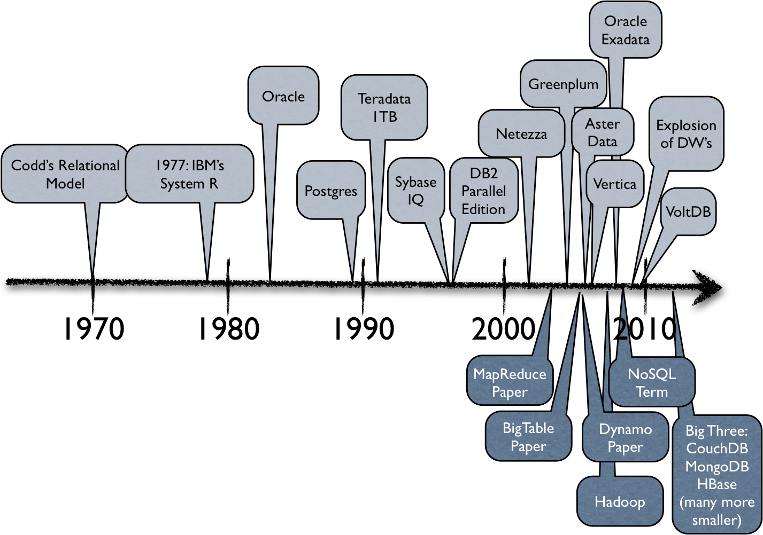
Some History
Ben Stopford, Thoughts on Big Data
http://www.benstopford.com/2012/06/30/thoughts-on-big-data-technologies-part-1/

Slide 4





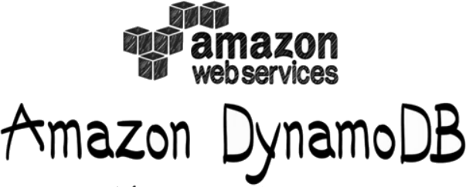







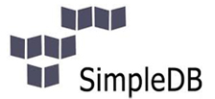
What is NoSQL?
Key/Value
Key/Value
Key/Value
BigTable
Document
Graph

Slide 5
Key/Value Stores
Maps arbitrary keys to values
No knowledge of the value's format
Completely schema-less
Implementations
  Eventually consistent, hierarchal, ordered, in-RAM
Operations
  Get, set and delete values by key

Slide 6
BigTable
Sparse, distributed data storage
Multi-dimensional, sorted map
Indexed by row/column keys and timestamp
Data processing
  MapReduce
  Bloom filters

Slide 7
Graph Stores
Nodes are connected by edges
Index-free adjacency
Annotate nodes and edges with properties
Operations
  Create nodes and edges, assign properties
  Lookup nodes and edges by indexable properties
  Query by algorithmic graph traversals

Slide 8
Document Stores
Documents have a unique ID and some fields
Organized by collections, tags, metadata, etc.
Formats such as XML, JSON, BSON
Structure may vary by document (schema-less)
Operations
  Query by namespace, ID or field values
  Insert new documents or update existing fields

Slide 9
What's the common thread?

Slide 10
What's the common thread?
All address some limitation(s) of relational DBs
Horizontal scalability, read/write performance, schema limitations, unconventional query patterns, parallel data processing, administration, etc.

Slide 11
What are we looking for?
Read/write availability and/or performance
Avoiding a single point of failure
Flexible schema and data types
Ease of maintenance, administration
Parallel computing (e.g. MapReduce)
Supporting large data sets with room to grow
Tunable for deployment size or functionality

Slide 12
Some specific needs
Storing large streams of non-transactional data
  e.g. log aggregation, ad impressions, web stats
Syncing on/offline data (CouchBase Mobile)
Caching results from slower data stores
  Provide faster in-app response times
  Denormalize results of expensive join queries
Real-time systems (games, financial data)

Slide 13
What are the challenges and trade-offs?

Slide 14
CAP Theorem
Consistency
Availability
Partition
Tolerance
CA
CP
AP

Slide 15
CAP Theorem
Consistency
Single-site RDBMS
Replicated RDBMS
MongoDB
HBase
Redis
Availability
Partition
Tolerance
CA
CP
AP
CouchDB
Cassandra
DynamoDB
Riak

Slide 16
“
In partitioned databases, trading some consistency for availability can lead to dramatic improvements in scalability.
Dan Pritchett, BASE: An ACID Alternative
http://queue.acm.org/detail.cfm?id=1394128

Slide 17
MongoDB Philosophy
Document data models are good
Non-relational model allows horizontal scaling
Provide functionality whenever possible
Strongly consistent, durable (data is important!)
Minimize the learning curve
  Easy to setup and deploy anywhere
  JavaScript and JSON are ubiquitous
  Automate sharding and replication

Slide 18

Case Study: Craigslist
1.5 million new classified ads posted per day
MySQL clusters
  100 million posts in live database
  2 billion posts in archive database
Schema changes
  Migrating the archive DB could take months
  Meanwhile, live DB fills with archive-ready data

Slide 19
Case Study: Craigslist
Utilize MongoDB for archive storage
Average document size is 2KB
Designed for 5 billion posts (10TB of data)
High scalability and availability
  New shards added without downtime
  Automatic failover with replica sets

Slide 20
“
We can put data into MongoDB faster than we can get it out of MySQL during the migration.
Jeremy Zawodny, software engineer at Craigslist and author of High Performance MySQL
http://blog.mongodb.org/post/5545198613/mongodb-live-at-craigslist

Slide 21

Case Study: Shutterfly
20TB of photo metadata in Oracle
Complex legacy infrastructure
  Vertically partitioned data by function
  Home-grown key/value store
High licensing and hardware costs

Slide 22
Case Study: Shutterfly
MongoDB offered a more natural data model
Performance improvement of 900%
Replica sets met demand for high uptime
Costs cut by 500% (commodity hardware)

Slide 23

Case Study: OpenSky
E-commerce app built atop Magento platform
Multiple verticals (clothing, food, home, etc.)
MySQL data model was highly normalized
Product attributes were not performant

Slide 24
Case Study: OpenSky
Integrated MongoDB alongside MySQL
Documents greatly simplified data modeling
  Product attributes
  Configurable products, bundles
  Customer address book
Purchases utilized MySQL transactions
Denormalized order history kept in MySQL

Slide 25

Case Study: Gauges
SaaS for real-time web analytics
Recording time-series data in documents
  Aggregate and display by hour, day, month, year
  Visits, screen size, geo location, search terms, etc.
MongoDB replica set for scalable storage
Kestrel distributed, message queue in front
  Highest availability, never misses a write operation

Slide 26



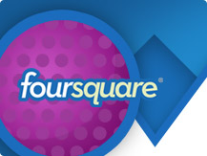


Additional Case Studies
10gen.com/customers

Slide 27

How Twitter Uses NoSQL
Facebook's Scribe for log aggregation
Hadoop for clustered data storage
  Yahoo's Pig scripting language for querying
Hbase for low-latency people searches
FlockDB for social graph queries
  Real-time, distributed, built upon MySQL
Cassandra for data-mining and analytics
http://readwrite.com/2011/01/02/how-twitter-uses-nosql

Slide 28

Using the Right Tool for the Job

Slide 29
Questions?

