Slide 1

Using MongoDB Responsibly
Jeremy Mikola
jmikola.net

Slide 2
Topics
Infrastructure
Concurrency
Indexing
Query Optimization
General Advice
Case Study
Map/Reduce
Aggregation Framework
Doctrine ODM
MMS

Slide 3
Infrastructure: Master/Slave
Deprecated in favor of replica sets
slaveOk allows queries to target slave
Manual failover process
Application
MongoDB
Master
MongoDB
Slave

Slide 4
Infrastructure: Replica Set
Primary, secondary and arbiter
slaveOk allows queries to target secondary
Automatic failover
MongoDB
Arbiter
Application
MongoDB
Primary
MongoDB
Secondary

Slide 5
Infrastructure: Replica Set
Primary with two secondaries
Arbiter unnecessary for odd number of nodes
MongoDB
Secondary
Application
MongoDB
Primary
MongoDB
Secondary

Slide 6
Infrastructure: Sharding
mongod
Secondary
mongod
Secondary
mongod
Secondary
mongod
Primary
mongod
Primary
mongod
Primary
mongod
Secondary
mongod
Secondary
mongod
Secondary
mongos
mongos
mongod
Config₂
mongod
Config₁
Application
mongod
Config₃

Slide 7
Infrastructure: Sharding
mongos processes
  Route queries to shards and merges results
  Lightweight with no persistent state
Config servers
  Launched with mongod --configsvr
  Store cluster metadata (shard/chunk locations)
  Proprietary replication model

Slide 8
Sharding vs. Replication
Sharding is the tool for scaling a system.
Replication is the tool for data safety, high availability, and disaster recovery.
Source: Sharding Introduction (MongoDB docs)

Slide 9
Concurrency: Locks
Read/write locks yielded periodically
  Long operations (queries, multi-document writes)
  Page faults (2.0+)
Write locks
  Greedy acquisition (priority over read locks)
  Global or database-level (2.2+)
  Collection-level forthcoming (SERVER-1240)

Slide 10
Concurrency: JavaScript
JavaScript executes in a single mongod thread
  $where queries
  db.eval() commands
  Map/reduce
SpiderMonkey JS interpreter
  Single-threaded
  Possible multi-threading with V8 (SERVER-4258)

Slide 11
Concurrency: JavaScript
db.eval() takes a write lock by default
  Cannot execute other blocking commands
  Can be used to perform atomic operations
    Swapping two collection names
    Complex find/modify
Executing JS without blocking the node
  {nolock: true} option with db.runCommand() (1.8+)
  Use mongo command-line client

Slide 12
Concurrency: Map/Reduce
JavaScript functions (lock yielded between calls)
Collection reads (lock yielded every 100 documents)
Write locks for incremental result storage
  Temporary collection used between map and reduce
  jsMode flag may bypass this for small datasets
Write lock for atomic output of final collection
  merge and reduce modes can take longer than replace
  Consider {nonAtomic: true} output option (2.2+)

Slide 13
Concurrency: Indexing
Foreground indexing
  Default for index creation
  Blocks all other database operations
Background indexing
  Use the {background: true} option with ensureIndex()
  Slower than foreground indexing, but doesn't block
  Watch db.currentOp() to track progress

Slide 14
Concurrency: Indexing
Replication uses foreground indexing (pre-2.2)
  Manually swap out members for indexing
  Documentation: Building Indexes with Replica Sets

Slide 15
Monitoring Foreground Indexing
> db.currentOp()
{
"inprog" : [
{
"opid" : 10000054,
"active" : true,
"lockType" : "write",
"waitingForLock" : false,
"secs_running" : 4,
"op" : "insert",
"ns" : "test.system.indexes",
"query" : {},
"client" : "127.0.0.1:52340",
"desc" : "conn",
"threadId" : "0x7f4ce7f50700",
"connectionId" : 1,
"msg" : "index: (1/3) external sort 3685454/10000000 36%",
"progress" : {
"done" : 3685457,
"total" : 10000000
},
"numYields" : 0
}
]
}

Slide 16
Monitoring Foreground Indexing
> db.currentOp()
{
"inprog" : [
{
"opid" : 10000054,
"active" : true,
"lockType" : "write",
"waitingForLock" : false,
"secs_running" : 15,
"op" : "insert",
"ns" : "test.system.indexes",
"query" : {},
"client" : "127.0.0.1:52340",
"desc" : "conn",
"threadId" : "0x7f4ce7f50700",
"connectionId" : 1,
"msg" : "index: (2/3) btree bottom up 1721606/10000000 17%",
"progress" : {
"done" : 1721606,
"total" : 10000000
},
"numYields" : 0
}
]
}

Slide 17
Monitoring Foreground Indexing
> db.currentOp()
{
"inprog" : [
{
"opid" : 10000054,
"active" : true,
"lockType" : "write",
"waitingForLock" : false,
"secs_running" : 25,
"op" : "insert",
"ns" : "test.system.indexes",
"query" : {},
"client" : "127.0.0.1:52340",
"desc" : "conn",
"threadId" : "0x7f4ce7f50700",
"connectionId" : 1,
"msg" : "index: (3/3) btree-middle",
"numYields" : 0
}
]
}

Slide 18
Monitoring Background Indexing
> db.currentOp()
{
"inprog" : [
{
"opid" : 10000075,
"active" : true,
"lockType" : "write",
"waitingForLock" : false,
"secs_running" : 12,
"op" : "insert",
"ns" : "test.system.indexes",
"query" : {},
"client" : "127.0.0.1:52340",
"desc" : "conn",
"threadId" : "0x7f4ce7f50700",
"connectionId" : 1,
"msg" : "bg index build 3258205/10000000 32%",
"progress" : {
"done" : 3258206,
"total" : 10000000
},
"numYields" : 53
}
]
}

Slide 19
Background Indexing: PHP
$mongo = new MongoDB();
$collection = $mongo->example->foo;
$collection->ensureIndex(
array('bar' => 1),
array('background' => true)
);
Not to be confused with the safe option, which blocks until the operation succeeds or fails

Slide 20
Background Indexing: PHP
> db.foo.count()
1000000
> db.foo.find()
{ "_id" : ObjectId("4fc5136b22f0e13f6f000000"), "x" : 1 }
{ "_id" : ObjectId("4fc5136b22f0e13f6f000001"), "x" : 2 }
{ "_id" : ObjectId("4fc5136b22f0e13f6f000002"), "x" : 3 }
{ "_id" : ObjectId("4fc5136b22f0e13f6f000003"), "x" : 4 }
$ php benchmark.php
Insertion took 17.095013 seconds
Indexing with [] took 0.000175 seconds
Indexing with {"background":true} took 0.000159 seconds
Indexing with {"safe":true} took 1.649953 seconds
Indexing with {"background":true,"safe":true} took 3.877397 seconds
Benchmarking single-field index generation with safe and background options (https://gist.github.com/2829859)

Slide 21
Background Indexing: ODM
<?php
use Doctrine\ODM\MongoDB\Mapping\Annotations as ODM;
/**
* @ODM\Document(collection="foo")
* @ODM\Indexes({
* @ODM\Index(keys={"x"="asc"}, options={"background"="true"})
* })
*/
class Foo
$ app/console doctrine:mongodb:schema:create --index
Created index for all classes
Doctrine ODM adds safe by default (since 06d8bb1)

Slide 22
Indexing: Advice
Kill 2+ birds queries with one stone index
Compound key and multi-key indexes
Avoid single-key indexes with low selectivity
Mind your read/write ratio
$exists, $ne and $nin can be inefficient
When in doubt, explain() your cursor

Slide 23
Indexing: Memory Usage
$ free -b
total used free shared buffers cached
Mem: 7307489280 6942613504 364875776 0 229281792 5872500736
-/+ buffers/cache: 840830976 6466658304
Swap: 0 0 0
$ mongo example --quiet
> var s = 0
0
> for each (var c in db.getCollectionNames()) {
... s += db[c].totalIndexSize();
... }
9784055680
7.3GB of RAM cannot hold 9.7GB of indexes, so expect intermittent page faults and disk access

Slide 24
Query Optimization with explain()
> for (i=0; i<1000000; i++) db.foo.insert({ x:i, y:Math.random() });
> db.foo.count()
1000000
> db.foo.find({x:5}).explain()
{
"cursor" : "BasicCursor",
"nscanned" : 1000000,
"nscannedObjects" : 1000000,
"n" : 1,
"millis" : 301,
"nYields" : 0,
"nChunkSkips" : 0,
"isMultiKey" : false,
"indexOnly" : false,
"indexBounds" : {},
"server" : "localhost:27017"
}

Slide 25
Query Optimization with explain()
> for (i=0; i<1000000; i++) db.foo.insert({ x:i, y:Math.random() });
> db.foo.count()
1000000
> db.foo.find({x:5}).explain()
{
"cursor" : "BasicCursor",
"nscanned" : 1000000,
"nscannedObjects" : 1000000,
"n" : 1,
"millis" : 301,
"nYields" : 0,
"nChunkSkips" : 0,
"isMultiKey" : false,
"indexOnly" : false,
"indexBounds" : {},
"server" : "localhost:27017"
}
Table scan or index-enabled?
Documents + index entries scanned
Documents scanned
Documents matched
Query time
Read lock yields
Docs skipped due to active chunk migrations
Was multi-key index used? (array values)
Was query covered by the index?
Key bounds used in index scanning

Slide 26
Query Optimization with explain()
> db.foo.ensureIndex({x:1, y:1})
> db.foo.find({x:5}).explain()
{
"cursor" : "BtreeCursor x_1_y_1",
"nscanned" : 1,
"nscannedObjects" : 1,
"n" : 1,
"millis" : 0,
"nYields" : 0,
"nChunkSkips" : 0,
"isMultiKey" : false,
"indexOnly" : false,
"indexBounds" : {
"x" : [ [5, 5] ],
"y" : [ [{"$minElement" : 1}, {"$maxElement" : 1}] ],
},
"server" : "localhost:27017"
}

Slide 27
Query Optimization with explain()
> db.foo.find({x:5, y:{$gt:0.5}}).sort({y:1}).explain()
{
"cursor" : "BtreeCursor x_1_y_1",
"nscanned" : 1,
"nscannedObjects" : 1,
"n" : 1,
"millis" : 0,
"nYields" : 0,
"nChunkSkips" : 0,
"isMultiKey" : false,
"indexOnly" : false,
"indexBounds" : {
"x" : [ [5, 5] ],
"y" : [ [0.5, 1.7976931348623157e+308] ],
},
"server" : "localhost:27017"
}

Slide 28
General Advice
Don't be afraid of denormalization
  Dedicated collection, embedded document, both?
  Make frequently needed data more accessible
Store computed data/fields for querying
  Count and length fields can be indexed and sorted
  Easily updated with $set and $inc

Slide 29
General Advice
Simple references (ObjectId only) over DBRefs
  Concise storage if referenced collection is constant
Use range queries over skip() for pagination
  skip() walks through documents or index values
  Range queries are limited to next/prev links
  http://stackoverflow.com/a/5052898/162228

Slide 30
General Advice
B-trees do not track counts for nodes/branches
  Filtered counts require walking the index (at best)
  Non-filtered collection counts are constant time
Use snapshot() for find-and-update loops
  Ensures documents are only returned once
  Avoids duplicate processing of updated documents
  No guarantee for inserted/deleted documents

Slide 31
DBRefs, Discriminators and mongo
> db.users.insert({
... name: "bob",
... address: {
... $ref: "addresses",
... $id: new ObjectId("4fcea14854298292394bd20a"),
... $db: "test",
... type: "shipping"
... }})
> db.users.findOne({name: "bob"}, {_id: 0, address: 1})
{ "address" : DBRef("addresses", ObjectId("4fcea14854298292394bd20a")) }
> db.users.findOne({name: "bob"}, {_id:0, "address.$db": 1})
{ "address" : { "$db" : "test" } }
> db.users.findOne({name: "bob"}, {_id:0, "address.type": 1})
{ "address" : { "type" : "shipping" } }

Slide 32
DBRefs, Discriminators and mongo
> db.users.findOne({name: "bob"}, {_id: 0, address: 1})
{ "address" : DBRef("addresses", ObjectId("4fcea14854298292394bd20a")) }
> db.users.findOne({name: "bob"}, {_id:0, "address.$db": 1})
{ "address" : { "$db" : "test" } }
> db.users.findOne({name: "bob"}, {_id:0, "address.type": 1})
{ "address" : { "type" : "shipping" } }
Although $db is a valid, optional field for DBRefs, the mongo shell hides it by default; likewise for ODM discriminators.
Be mindful of this if you ever need to write data migrations!

Slide 33
Refactoring OrnicarMessageBundle
User-to-user messaging (2+ participants)
Message and thread documents
Embedded metadata fields (hash type in ODM)
  message.isReadByParticipant
  thread.datesOfLastMessageWrittenByOtherParticipant
  thread.datesOfLastMessageWrittenByParticipant
  thread.isDeletedByParticipant

Slide 34
Refactoring OrnicarMessageBundle
function getNbUnreadMessageByParticipant($participant)
{
$fieldName = 'isReadByParticipant.' . $participant->getId();
return $this->repository->createQueryBuilder()
->field($fieldName)->equals(false)
->getQuery()
->count();
}
Counting the number of unread messages for a user entails scanning the entire collection from disk.

Slide 35
Refactoring OrnicarMessageBundle
> db.messages.findOne({}, {isReadByParticipant: 1})
{
"_id" : ObjectId("4fce28482516ed983884b158"),
"isReadByParticipant" : {
"4fce05e42516ed9838756f17" : false,
"4fce05e42516ed9838756f18" : true,
"4fce05e42516ed9838756f19" : true,
"4fce05e42516ed9838756f1a" : false,
"4fce05e42516ed9838756f1b" : false
}
}
Index isReadByParticipant? Entire object is indexed.
Index isReadByParticipant keys? We'd need 5+ indexes.

Slide 36
Refactoring OrnicarMessageBundle
> db.messages.findOne({}, {unreadForParticipants: 1})
{
"_id" : ObjectId("4fce28482516ed983884b158"),
"unreadForParticipants" : [
"4fce05e42516ed9838756f17",
"4fce05e42516ed9838756f1a",
"4fce05e42516ed9838756f1b"
]
}
Index unreadForParticipants? One multi-key index.

Slide 37
Refactoring OrnicarMessageBundle
function getNbUnreadMessageByParticipant($participant)
{
return $this->repository->createQueryBuilder()
->field('unreadForParticipants')->equals($participant->getId())
->getQuery()
->count();
}
Counting the number of unread messages for a user is now a single indexed query.

Slide 38
Map/Reduce
> db.articles.save({author: "bob", tags: ["business", "sports", "tech"]})
> db.articles.save({author: "jen", tags: ["politics", "tech"]})
> db.articles.save({author: "sue", tags: ["business"]})
> db.articles.save({author: "tom", tags: ["sports"]})
Generate a report with the set of authors that have written an article for each tag.

Slide 39
Map/Reduce
> db.articles.mapReduce(
... function() {
... for (var i = 0; i < this.tags.length; i++) {
... emit(this.tags[i], { authors: [this.author] });
... }
... },
... function(key, values) {
... var result = { authors: [] };
... values.forEach(function(value) {
... value.authors.forEach(function(author) {
... if (-1 == result.authors.indexOf(author)) {
... result.authors.push(author);
... }
... });
... });
... return result;
... },
... { out: { inline: 1 }}
... )

Slide 40
Map/Reduce
{
"results" : [
{ "_id" : "business", "value" : { "authors" : ["bob", "sue"] } },
{ "_id" : "politics", "value" : { "authors" : ["jen"] } },
{ "_id" : "sports", "value" : { "authors" : ["bob", "tom"] } },
{ "_id" : "tech", "value" : { "authors" : ["bob", "jen"] } }
],
"timeMillis" : 0,
"counts" : {
"input" : 4,
"emit" : 7,
"reduce" : 3,
"output" : 4
},
"ok" : 1,
}
Is there an easier way?

Slide 41
Aggregation Framework
Pipeline
  Operators process a stream of documents
  Transformations are applied in sequence
  Expressions calculate values from documents
  Defined in JSON (no JavaScript code)
Invoked on collections
  Use the $match operator for early filtering
  Compatible with sharding

Slide 42
Aggregation Framework
Operations
  Projection (altering)
  Match (filtering)
  Limit
  Skip
  Unwind (array values)
  Group
  Sort
Expressions
  Boolean
  Comparison
  Arithmetic
  String manipulation
  Date handling
  Accumulators
  Conditionals

Slide 43
Aggregation Framework
> db.articles.aggregate(
... { $project: { author: 1, tags: 1} },
... { $unwind: "$tags" },
... { $group: {
... _id: { tags : 1 },
... authors: { $addToSet : "$author" }
... }}
... )
{
"result" : [
{ "_id" : { "tags" : "politics" }, "authors" : ["jen"] },
{ "_id" : { "tags" : "tech" }, "authors" : ["jen", "bob"] },
{ "_id" : { "tags" : "sports" }, "authors" : ["tom", "bob"] },
{ "_id" : { "tags" : "business" }, "authors" : ["sue", "bob"] }
],
"ok" : 1
}

Slide 44
Benchmarking Doctrine ODM
Benchmark bulk document creation
  Persist and flush
  Query builder
  Collection (Doctrine class)
    Wraps driver class with event dispatching
  MongoCollection (driver class)
Track insertion time and memory usage

Slide 45
Benchmarking Doctrine ODM
$ ./benchmark-odm-flush.php 100000
Flushing 100000 documents took 47.423843 seconds and used 576978944 bytes
150732800 bytes still allocated after benchmarking
$ ./benchmark-odm-query.php 100000
Inserting 100000 documents took 15.918296 seconds and used 3670016 bytes
8126464 bytes still allocated after benchmarking
$ ./benchmark-odm-driver.php 100000
Inserting 100000 documents took 4.305500 seconds and used 524288 bytes
6029312 bytes still allocated after benchmarking
$ ./benchmark-driver.php 100000
Inserting 100000 documents took 1.120347 seconds and used 524288 bytes
6029312 bytes still allocated after benchmarking
Source: https://gist.github.com/2725976

Slide 46
Mongo Monitoring Service (MMS)
SaaS solution for monitoring MongoDB clusters
Speeds up diagnosis for support requests
MMS agent (lightweight Python script)
  Reports all sorts of database stats
  Additional hardware reporting with Munin
Free!

Slide 47
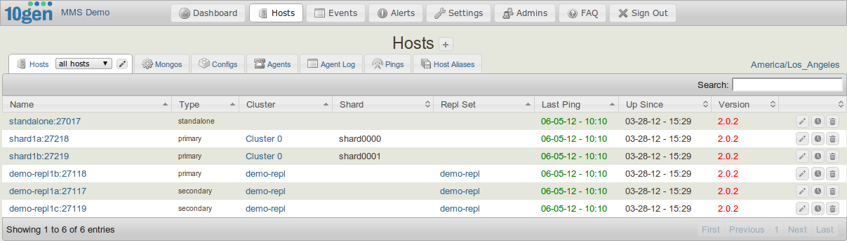
Mongo Monitoring Service (MMS)

Slide 48
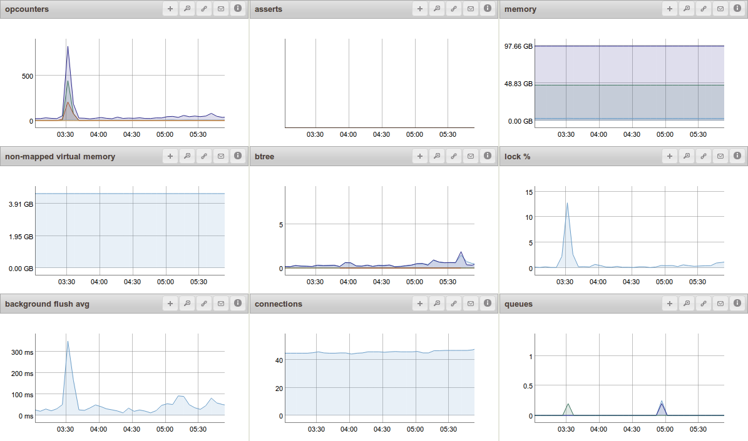
Mongo Monitoring Service (MMS)

Slide 49
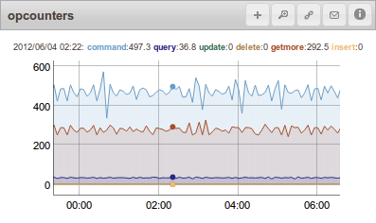
Mongo Monitoring Service (MMS)

