Slide 1
Processing the Danger Shield
Everything you wanted to know about Processing but were afraid to ask
By Ben Leduc-Mills

Slide 2
Processing?
Processing is a free, open source, cross-platform programming language and environment for people who want to create images, animations, and interactions.
Created in 2001 by Casey Reas and Ben Fry at the MIT Media Lab.
Downloads, updates, reference, forums, etc. at: http://processing.org

Slide 3
Installation
For Linux:
Download the .tar.gz file to your home directory, then open a terminal window and type:
Tar xvfz processing-xxxx.tgz
(replace xxxx with the rest of the file’s name, which is the version number)
This will create a folder named processing-1.5 or something similar. Then change to that directory:
cd processing-xxxx
and run processing:
./processing
For Mac:
Double-click the .dmg file and drag the Processing icon from inside this file to your applications folder, or any other location on your computer. Double click the Processing icon to start Processing.
For Windows:
Double-click the .zip file and drag the folder inside labeled Processing to a location on your hard drive. Double click the Processing icon to start Processing.
If you are stuck go to http://wiki.processing.org/index.php/Troubleshooting for help.

Slide 4
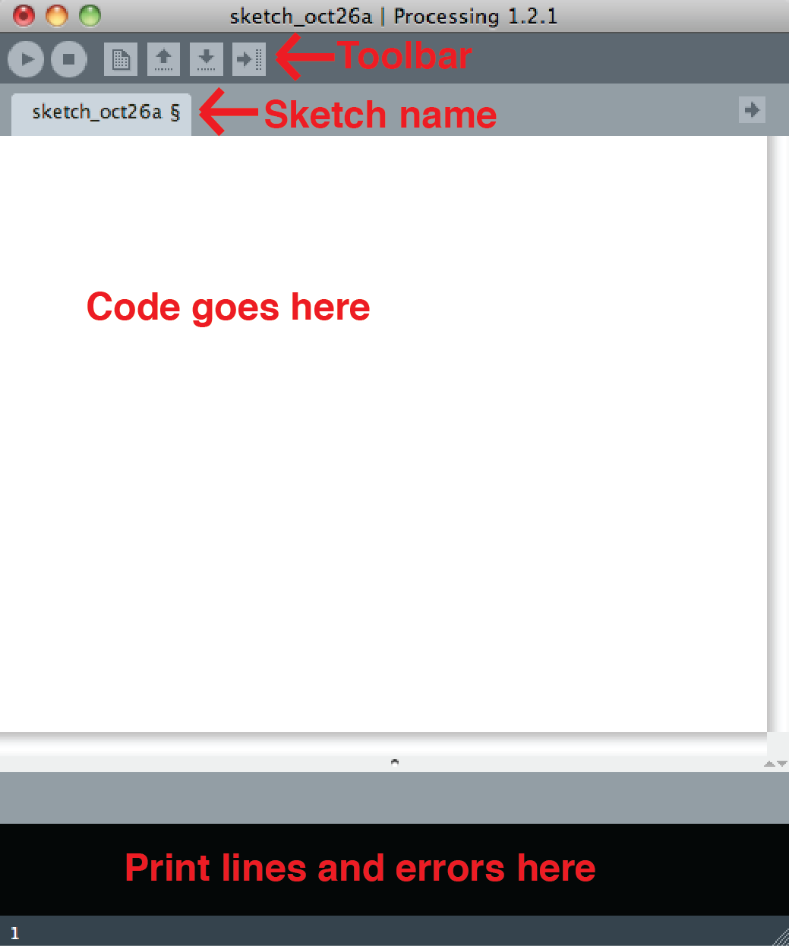
Anatomy of a sketch
A sketch is a file or project you create in Processing. When you first open up a new sketch it will be completely blank. Below is an example:

Slide 5
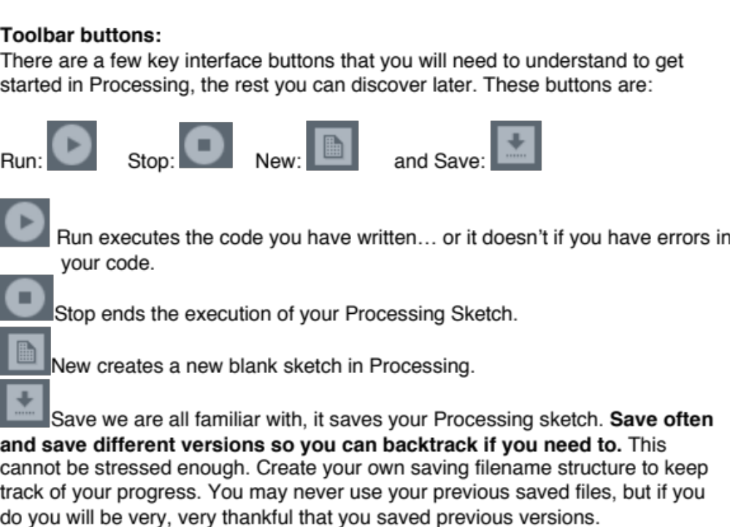

Slide 6
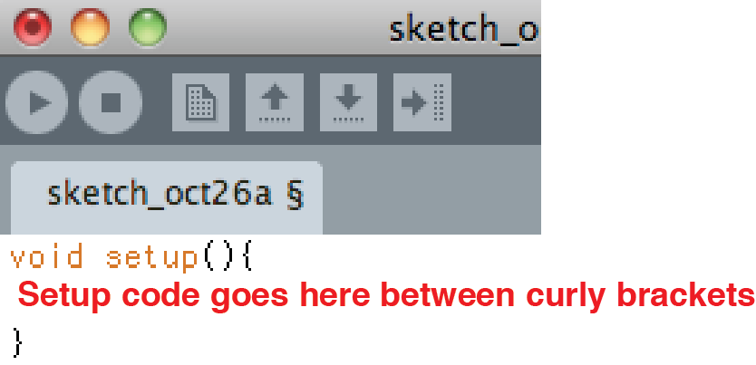
Setup()
This function runs once, at the very beginning of your sketch. You will use setup to set up certain aspects of your sketch, makes sense right?
Most importantly for this class you will begin Serial communication in the setup function. The setup function without anything in it looks like this:

Slide 7
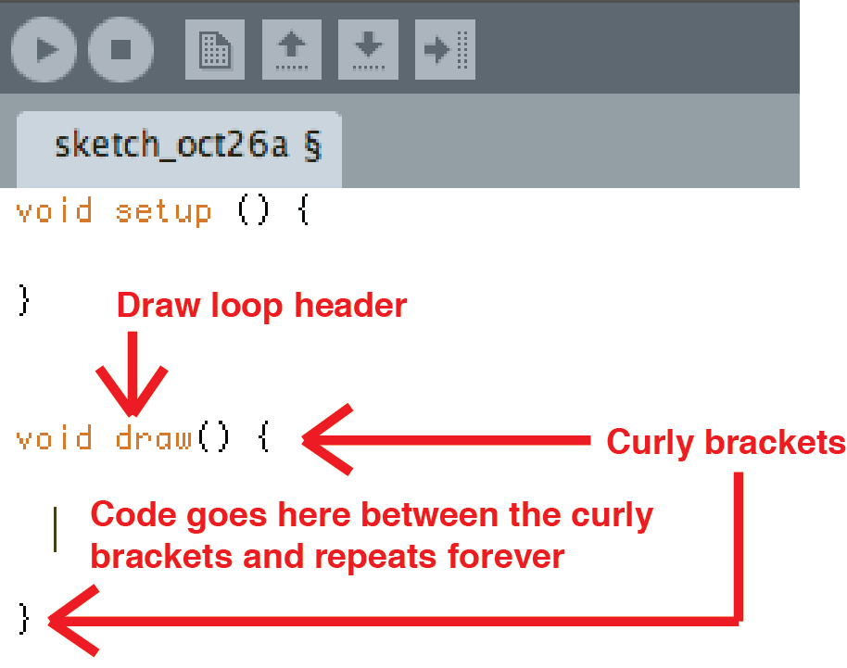
Draw()
This function is where everything happens in your sketch. The draw loop is the portion of code that keeps repeating while the Processing sketch is open. Any animation, interaction or changes to the images or variables in your sketch will need to be programmed inside of this loop. The draw loop looks like this:

Slide 8
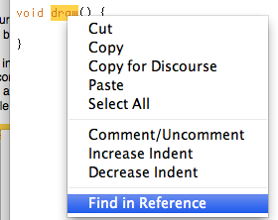
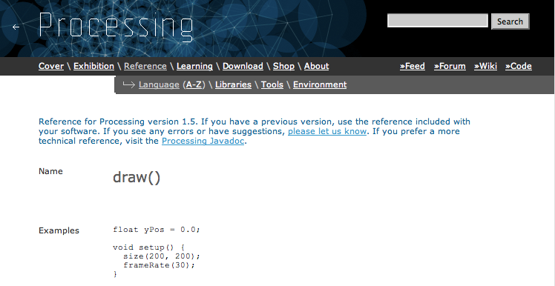
Reference
One very convenient way to access Processing’s Help Reference is to highlight a function or a word used in your code, right click and select Find in Reference (which brings you to the processing.org reference page):

Slide 9
Let’s get started!
Let’s draw a dot, a line and some shapes.
To do this first we will need a window to draw the dot in. Type the following code inside your setup function:
void setup (){
size (700, 500);
}
Notes:
Go ahead and press Run, you should get a window that is 700 pixels wide by 500 pixels tall. Don’t forget the parentheses or semicolon, everything is important in a Processing sketch. The parentheses indicate values inside of them and the semicolon tells the computer to execute the line. If you don’t type a line indicating size Processing will create a 100 X 100 window for you.

Slide 10
A dot.
Now let’s put a dot (one single pixel) in your window by typing the following inside of the draw loop, but replace x with a number smaller than 700 and y with a number smaller than 500.
void draw(){
point (x, y);
}

Slide 11
A line –
Next we are going to draw a single line in the window.
Delete (or comment out using // before the text) the line that created your dot. Replace it with the following line inside of the draw loop. (We left the draw loop syntax out from this point on, you’re a big kid now.)
line(x1, y1, x2, y2);
Replace x1 and y1 with the coordinates where your line will start and x2 and y2 with the coordinates where your line will end.

Slide 12
3 shapes:
triangle(x1, y1, x2, y2, x3, y3);
rect(x, y, width, height);
ellipse(x, y, width, height);
The order in which you write the code for the shapes will effect which shape is on top of the others with the first shape, in this case the triangle, being on the bottom, or behind all the other shapes.
Play around with different values for these shapes until you feel comfortable with them.
Notes:
Triangle is pretty straightforward and you should understand what x1, y2 and the rest are at this point. (The three different points of the triangle.)
Rectangle’s x and y coordinates specify the upper left corner of the rectangle, with width and height being the height and width of the rectangle. There are a lot of functions that use width and height. These values are measured in pixels, just like lines and windows, so to find out where the shape ends just add the starting position (x for width and y for height) to the width or height values.
Ellipse is almost the same as rectangle except the x and y coordinates indicate the center of the ellipse you are creating.
Should we discuss ellipseMode() ?

Slide 13
Stroke & Outline
Every shape in processing has a stroke (outline) and a fill (internal color)
strokeWeight(pixels);
noStroke();
fill(color);
noFill();
fill(red, blue, green);
stroke(red, blue, green);

Slide 14
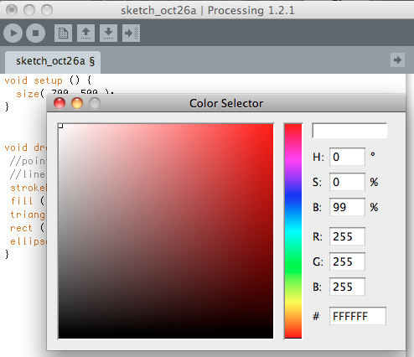
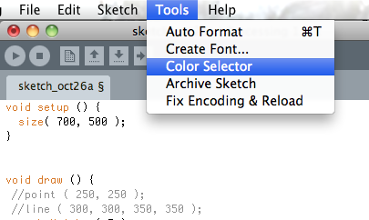
Colors!
Each of the variables, red, blue and green, are replaced with a number ranging from 0 to 255. The lower number the number the less of that color is present in the one color this line represents. For help figuring out the numbers you want, select Color Selector from the Tools menu.

Slide 15
Colors Continued…
So, for a bright purple:
fill(255, 255, 0);
There’s an optional 4th parameter for alpha:
fill(red, blue, green, transparency);
fill(#hexadecimalValue, transparency);

Slide 16
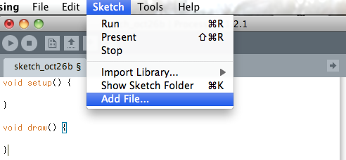
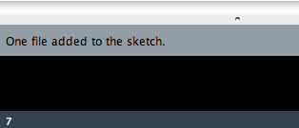
Using Images
To add a background image: First select Add File from the Sketch menu and find the file (.jpg, .png, .gif) you wish to add to your Sketch.

Slide 17
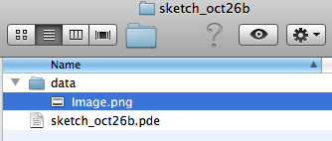
Images…
This means Processing has automatically created a folder called Data inside your Sketch folder with the image file inside of the Data folder

Slide 18
More Images
We need an instance of an object from the Pimage class to store our image in (above setup):
PImage img01;
Next, we have to assign our image to the Pimage object (in setup):
img01 = loadImage (“YourImageName.png”);
Finally, we draw the image on the screen (our image variable, the x and y coordinates of where we want to place it):
image (img01, x, y);
Notes:
Have them try it

Slide 19
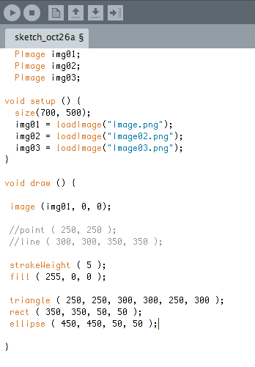
Images
Add two more image files to your sketch, until your code looks something like this:
You should have two more image declarations here ->
Notes:
Have them go through and change the image to each one

Slide 20
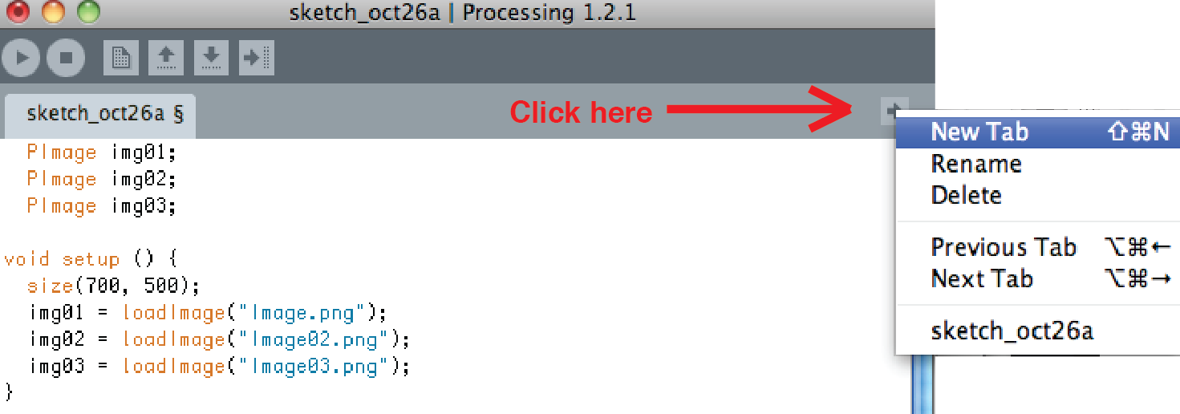
Creating a Function
A function is a way to package up a bunch of code into a single action that can be called in one line
First, create a new tab in your sketch like so:

Slide 21
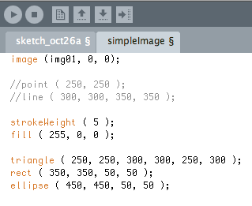
Creating a Function (part 2)
Now cut and paste all the code inside the brackets of your draw loop into the new tab. It should look something like this:

Slide 22
Creating a function part 3
Now we need a function header:
void functionName ( ) {
functionName is the name of your function
void simply means that the sketch isn’t expecting any information to be returned from the function
Don’t forget the closing bracket } at the end of your function

Slide 23
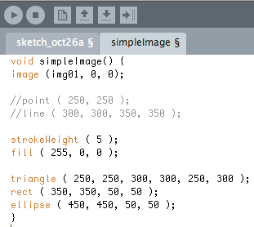
A finished function:

Slide 24
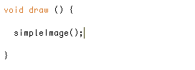
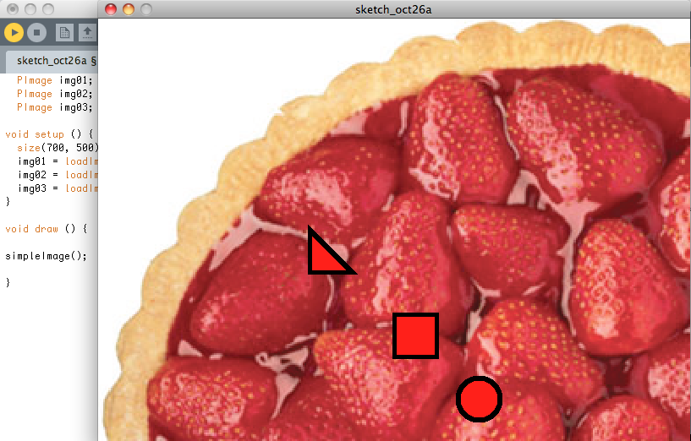
Now all we have to do to execute all that code is call our function:
Your sketch may look something like this:

Slide 25
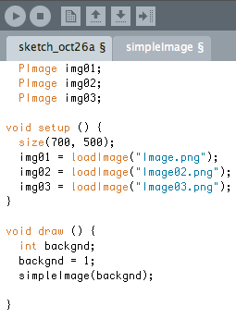
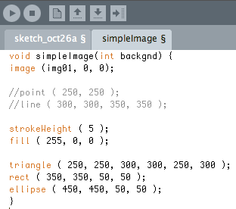
Function Arguments
To pass an argument to our function, we need an integer variable, as well as a change to our function call, like so:
You can affect how the function acts by passing in variables from other parts of your sketch
To do this, we need to first change our function header:
Notes:
By now you may be asking what the point of creating a Function was if the code acts exactly the same as it did before when it was inside the draw loop. One of the great things about creating Functions is that it makes your draw loop a lot less cluttered. Where you used to have lines and lines and lines of code, you now have one nice tidy line that acts the same as all the previous lines of code. Another great thing is that you can pass the Function “arguments” (this is a fancy way to say variable values and other pieces of code) from the draw loop that effect aspects of the Function

Slide 26
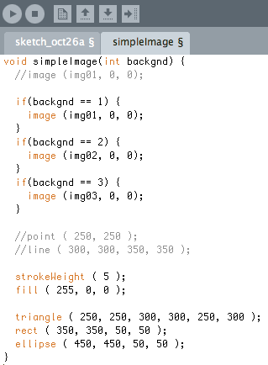
Function Arguments Con’t.
Before this will work, we need to do something with the incoming integer variable (like have it switch between our images).
Add these if statements to change our background image based on the value of the backgnd variable:
Feeling lucky? Try turning these if statements into a case / switch statement.
Now test it out!

Slide 27
Lunch!

Slide 28
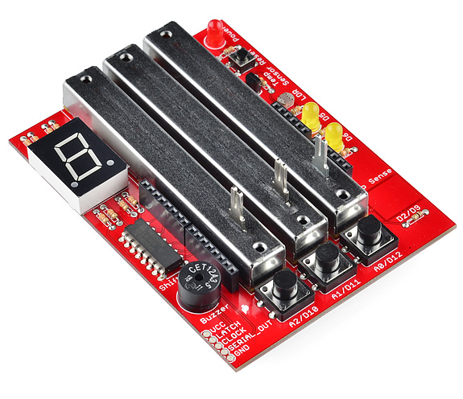
The Danger Shield:

Slide 29
Hooking into Processing
We can send values from the Danger Shield to Processing through an Arduino, and use these values to control things in Processing (!)
First step: Open a new Arduino sketch
Like Processing, we have a setup() function
In that function, we need to open Serial communication:
Serial.begin(9600);

Slide 30
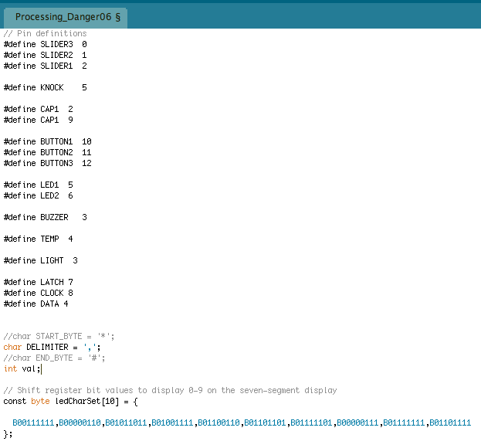
Hooking into Processing
Next we have to set up our pin definitions from the Danger Shield.
We also need a byte array to control our 7 segment display (it will tell us which picture we should be on).
Basically, these are byte values that the shift register will convert to the proper set of led segments for each number.

Slide 31
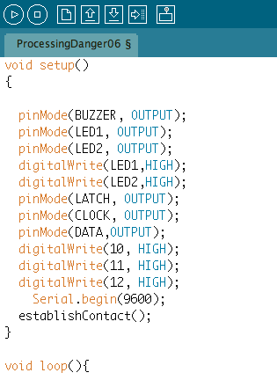
Hooking into Processing
We now have to set up all pins to the right pinMode, in our setup function.
We’ll get to the establishContact() function in a bit, but don’t forget to put it in now.

Slide 32
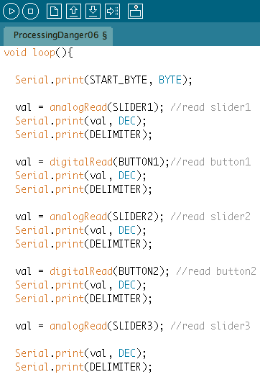
Hooking into Processing
In our loop() function, we need to read from all the sensors and send the values out the serial port by calling Serial.print
We used a start byte, end byte, and a delimiter to separate the sensor values so that the sensor values will be easier to distinguish when we get them into Processing.
loop() continued on next slide…

Slide 33
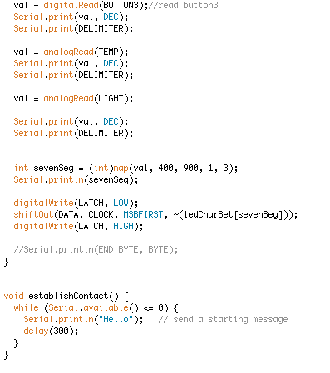
Hooking into Processing
Here are the rest of the loop() statements. Don’t forget the ln in the last Serial.println(sevenSeg); statement.
The last part of our loop deals with mapping the photocell values into a range that maps to the number of pictures in our processing sketch. We then send the mapped value to the seven segment display using the shiftOut command.
After you close the loop() function, add the establishContact() function. This function is called on startup and sends a ‘hello’ string over the serial port until it gets a response from Processing, which tells Arduino that it’s ok to start sending sensor data.

Slide 34
Receiving Data in Processing
import processing.serial.*;
Serial usbPort;
int [ ] sensors = null;
boolean firstContact = false;
void setup() {
usbPort = new Serial (this, Serial.list( ) [0], 9600);
usbPort.bufferUntil (‘\n’);
}
Now that we’re sending data from the Danger Shield, we need a way to receive it in Processing.
Luckily, there’s a library for that.
First, import the serial library.
We’ll also need a Serial object to define which serial port we’ll be using, as well as an integer array for our sensor data. We also have a boolean variable to keep track of whether we’ve heard from Arduino or not.
In your setup function, you need to initialize your Serial object, passing it the parent object (don’t worry about this) which port you want to use, and the baud rate.
Make sure you pick the same baud rate that you defined in the Arduino sketch.
The bufferUntil function just stores our incoming data in a buffer until we’re ready to do something with it.

Slide 35
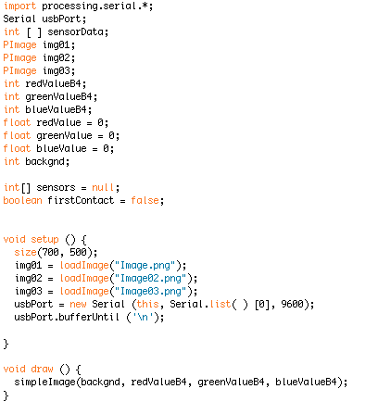
Receiving Data in Processing
Our next step is to define a SerialEvent function – this function automatically gets called every time the character in our bufferUntil() statement is read from the serial port.
We then read in a chunk of data into a String, trim it for whitespace, and split it using our delimiter character (told you it would be useful!) into our sensors[] integer array. This puts each sensor value into its own addressable place in the array.
There is a println that should be printing out the sensors values it sees – try running the sketch to make sure you’re getting values.

Slide 36
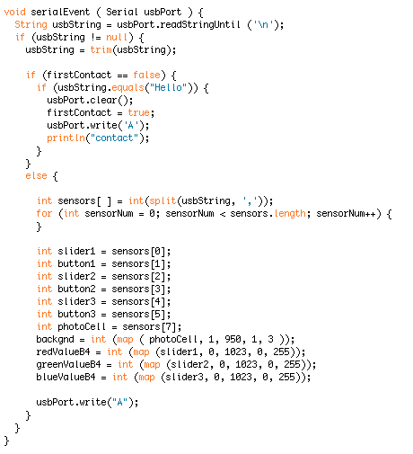
Receiving Data in Processing
There’s a lot going on here, so don’t worry if it doesn’t make sense at first.
Basically, we check for the ‘Hello’ from Arduino. If we get it, we ask for some sensor data.
We then check to make sure the data string is not empty.
If it’s got something, we split the string up by our delimiter character into an array. This lets us put each sensor value into its own variable.
We then map the slider values down into the range of RGB values our simpleImage function expects, and map the photoCell down to the number of images we have.
Then we can call the simpleImage function, with values gotten directly form our sensors!

